Slide 1
Sources for Ideation
- Creative Thinking
Lateral
Divergent
“Creative thinking is not a talent, it is a skill that can be learnt.”
Edward de Bono
SCAMPER (Tool)

Slide 2
SCAMPER
for Ideas
S = Substitute?
C = Combine?
A = Adapt?
M = Magnify? Modify? P = Put to other uses? E = Eliminate?
R = Rearrange? Reverse?

Slide 3
Can I substitute something?
Can I combine it with something else?
Can I adapt something to your subject?
Can I magnify or add to it?
Can I modify or change it in some fashion?
Can I put it to some other use?
Can I eliminate something from it?
Can I rearrange it?
What happens when I reverse it?

Slide 4
SCAMPER
Method - McDonald’s

Slide 5
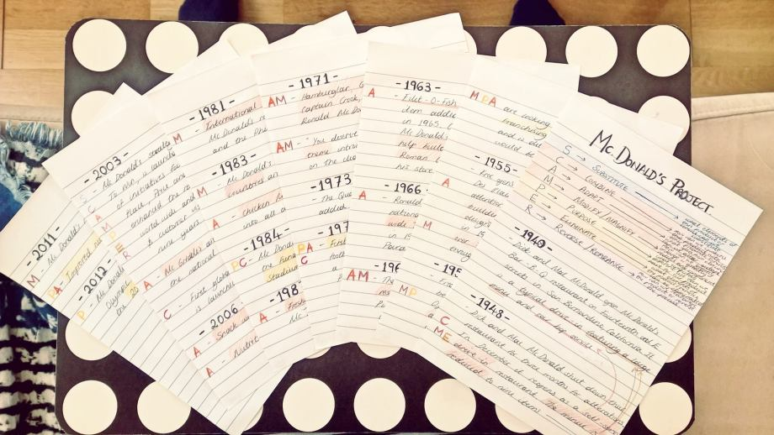

Slide 6
SCAMPER
S – SUBSTITUTE – What elements of this product/service can be substituted?
C – COMBINE – How can this product/service be combined with other products/services?
A – ADAPT – What idea from elsewhere can be altered or adapted?
M – MODIFY/MAGNIFY – Can any component be greatly enlarged or greatly reduced?
P – PURPOSE – What completely different purpose can the product/service have?
E – ELIMINATE – What elements of the product/service can be eliminated?
R – REVERSE/REARANGE – How can the product/service be rearranged / can the process be reversed?

Slide 7
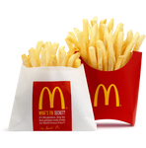
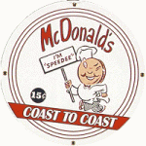
SUBSTITUTE
McDonald’s replaced the traditional (then) potato chips with the world famous French Fries.
In 1961, they substituted the then “Speedee” logo with the iconic Golden Arches logo – which was inspired by McDonald’s architecture at the time.

Slide 8
COMBINE
McDonald’s focus went from just burgers, to a whole new range of products and services.
Simple things like introducing the “Triple Thick Milkshakes”, “Big Mac”, and the “Hot Apple Pie”, are all good examples of this.
McDonald’s collaborated with Disney to get children to buy Happy Meals. Combining a free toy with the meal inside for the children.

Slide 9
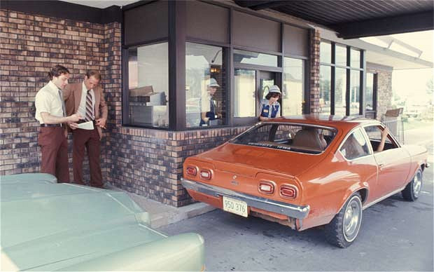
ADAPT
Their Drive Thru concept is based on the principles of a fast Formula 1 pit stop, where the racing car stops during a race for refueling, new tires, repairs.. etc.

Slide 10
MODIFY/MAGNIFY
A number of franchise owners wanted to expand the basic menu. The solution was to Magnify the burger and out came Big Mac.
In the middle east, they modified their sandwich to appeal to the Arabian culture, using Arabian flatbread bread instead of the traditional bun.
The McDonald’s brothers aspired to become a nationwide franchise, and in 1965 they reached 700 restaurants throughout the US. They then went international in 1967, opening restaurants in Canada and Puerto Rico. Today, they are in 119 countries around the world.

Slide 11
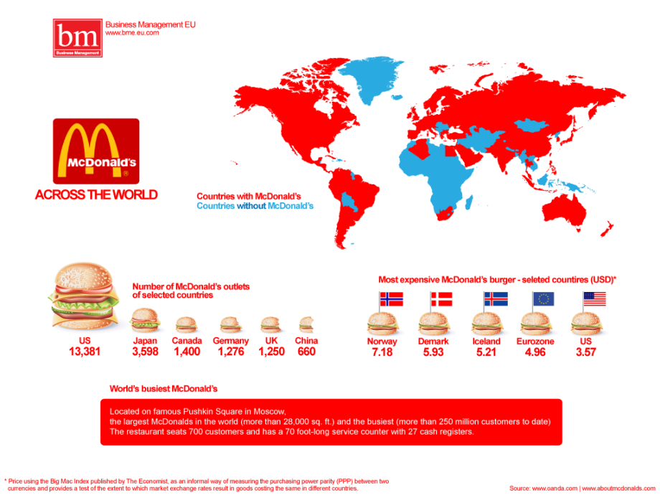

Slide 12
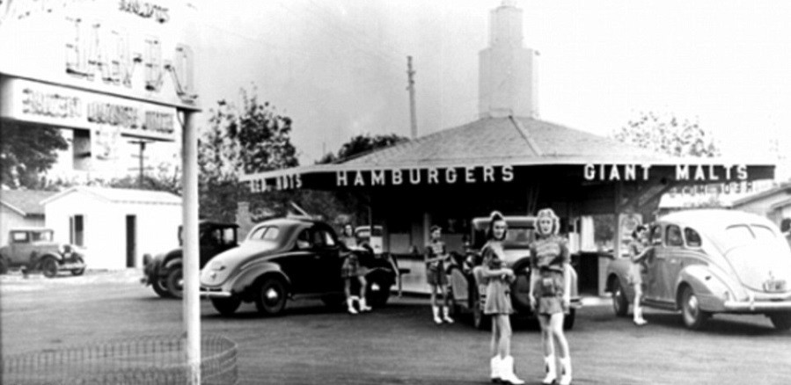
PUT TO OTHER USE
To develop other sources of income, McDonald’s invested in the real estate business. They would lease and develop a site, then release it to the franchisee, who would have to pay rent as well as franchise fees. Today, company’s highest revenue comes from real estate.
ELIMINATE
After the alterations in 1948, the restaurant went from a typical drive-in, with a car hop service, to a self-service drive-in.
REVERSE/REARANGE
McDonald’s introduced a new consumer experience by having them pay first then eat.

Slide 13
LET’S SEE HOW?

Slide 14
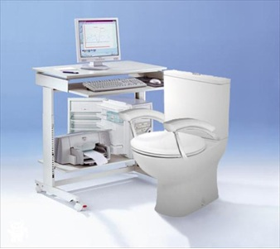

Slide 15
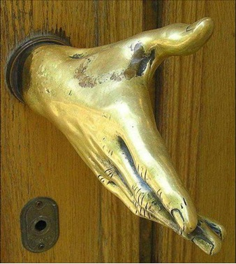

Slide 16
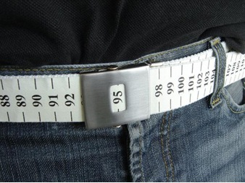

Slide 18
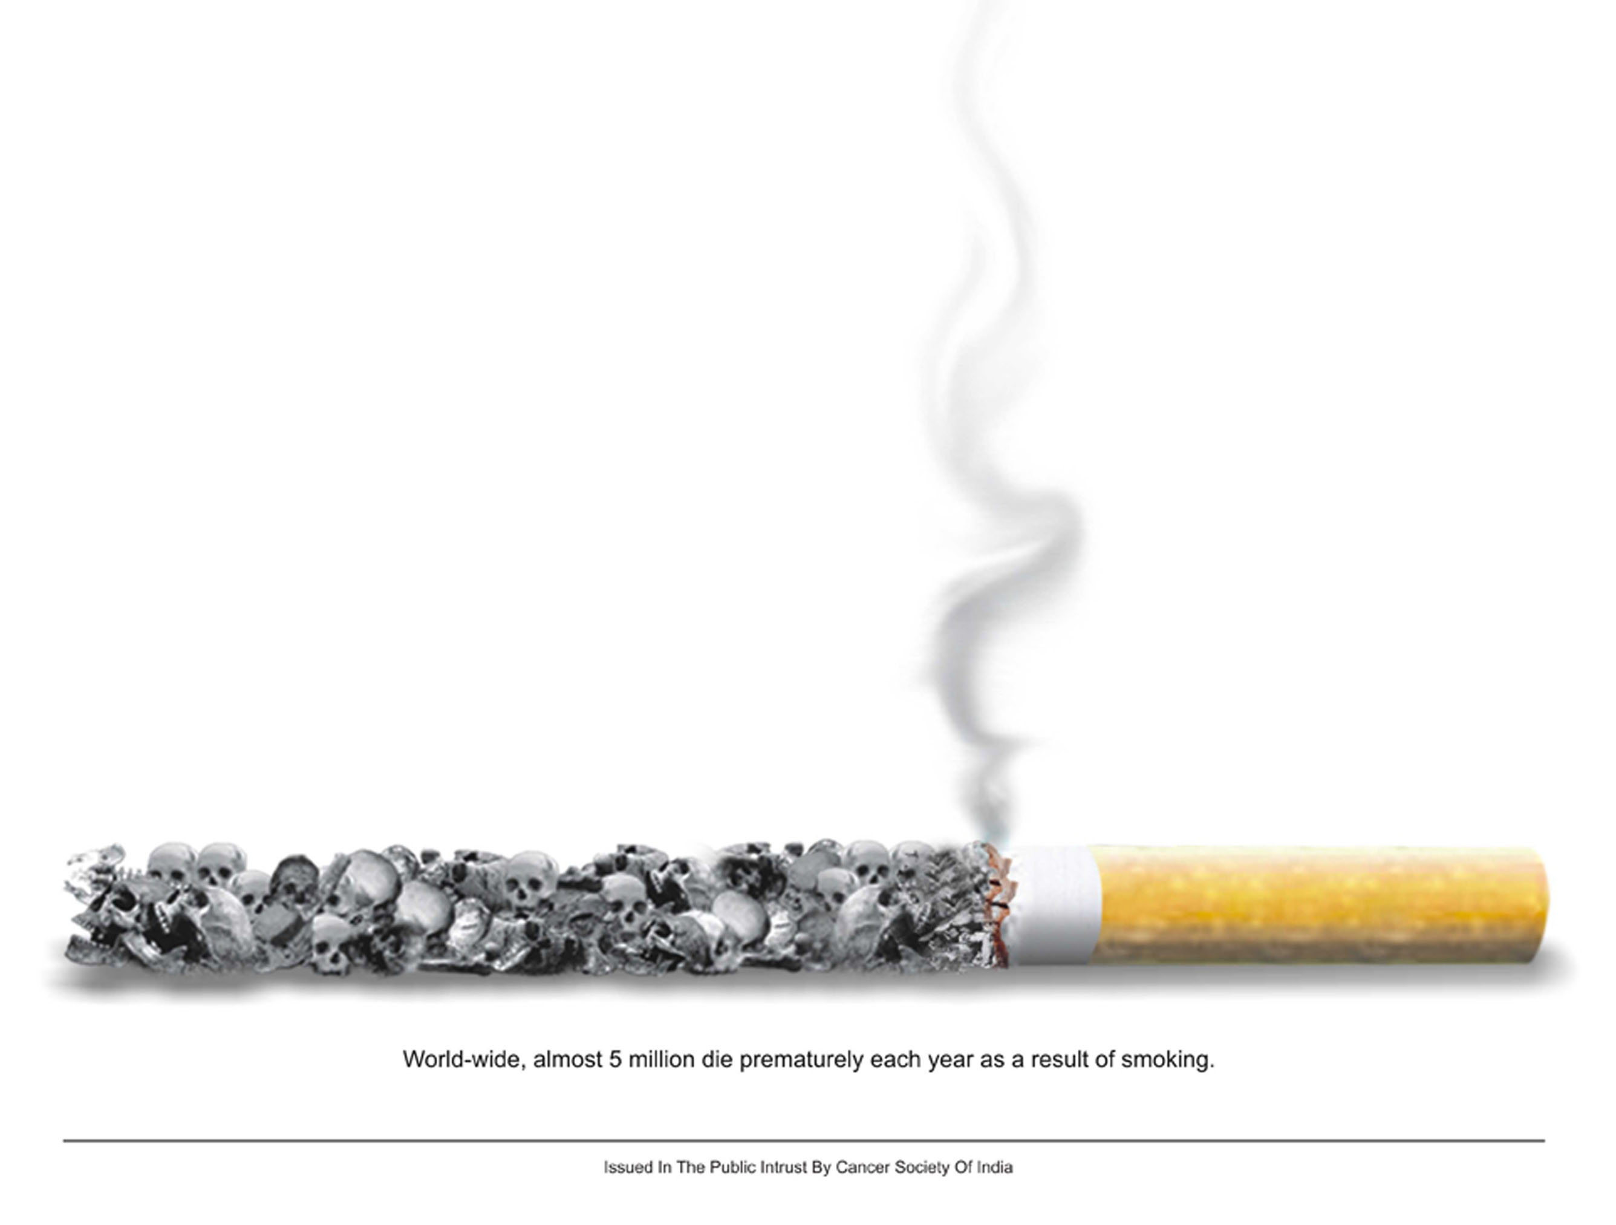

Slide 20
Vegetables have the same nutritional values as any other meat products
And also animal products promote more diseases than vegetable.
So learn to boorish your body without a non vegetarian meal.
Be Vegetarian

Slide 21
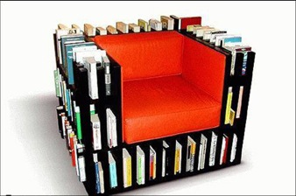

Slide 22
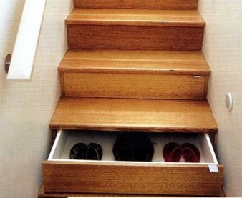

Slide 23
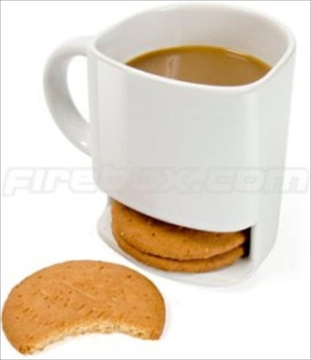

Slide 24
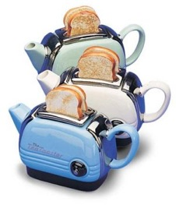

Slide 26
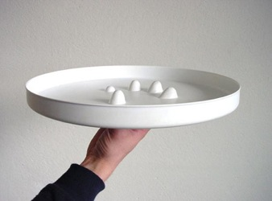

Slide 27
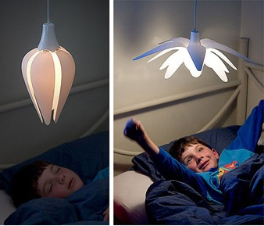

Slide 28
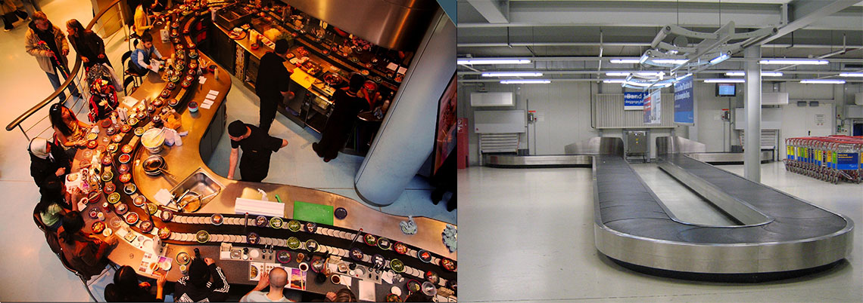

Slide 29
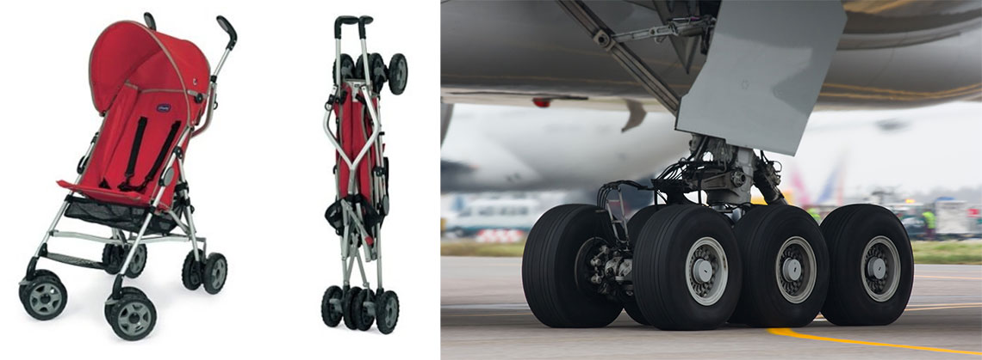

Slide 32
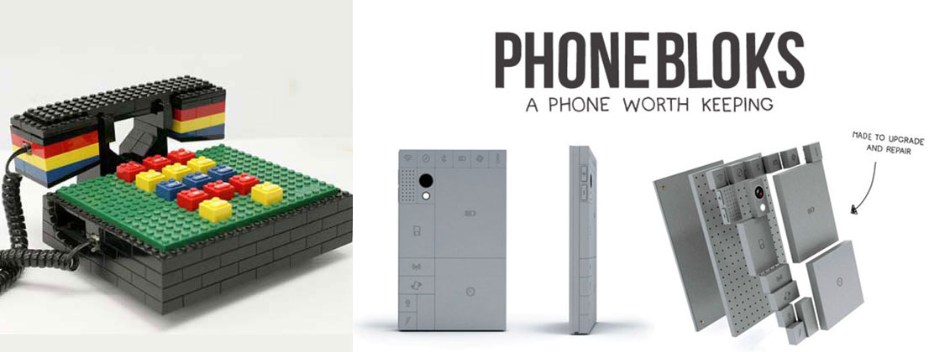

Slide 33
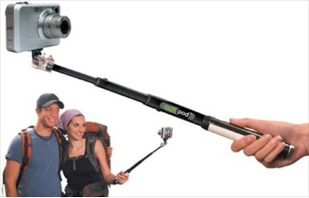

Slide 34
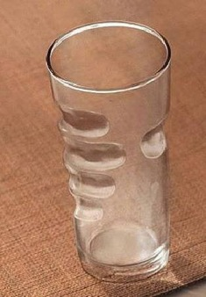

Slide 35
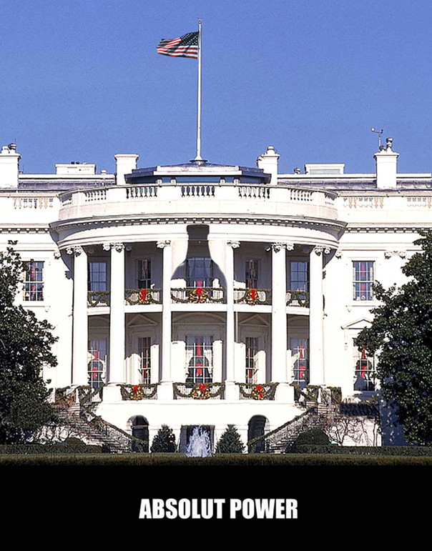

Slide 36
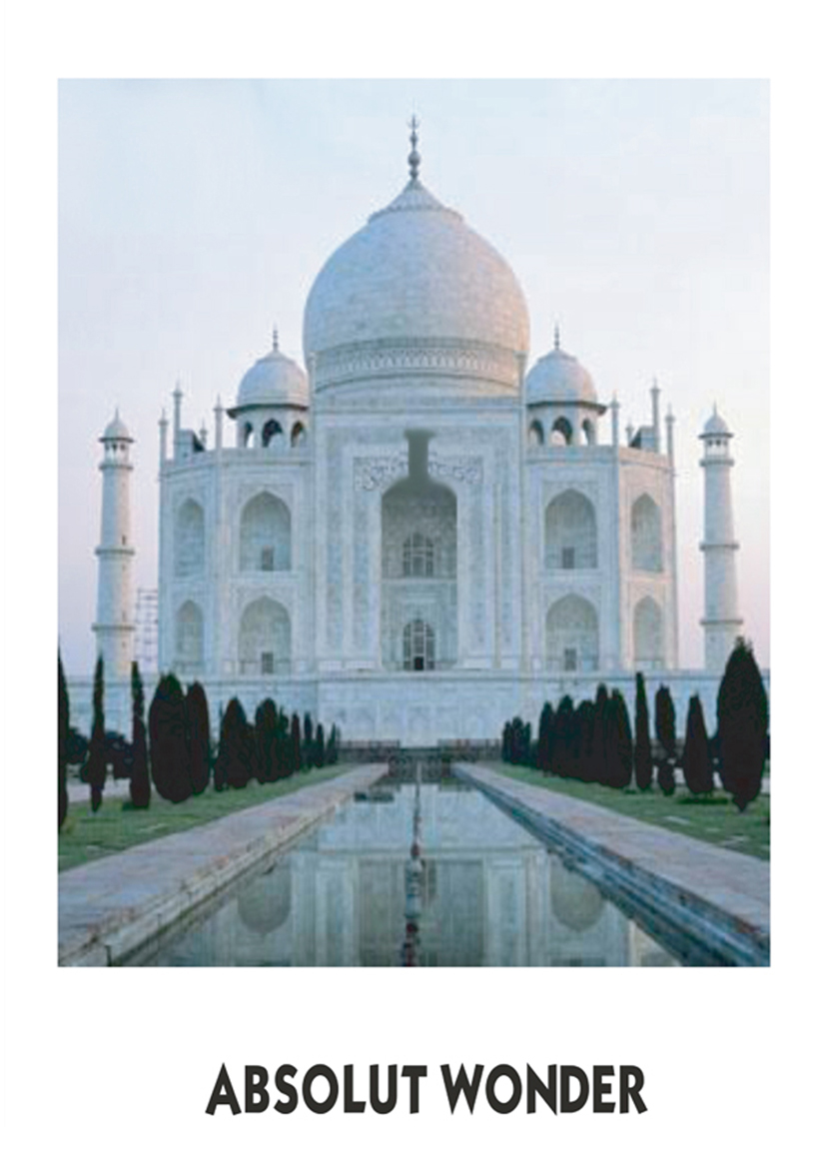

Slide 38
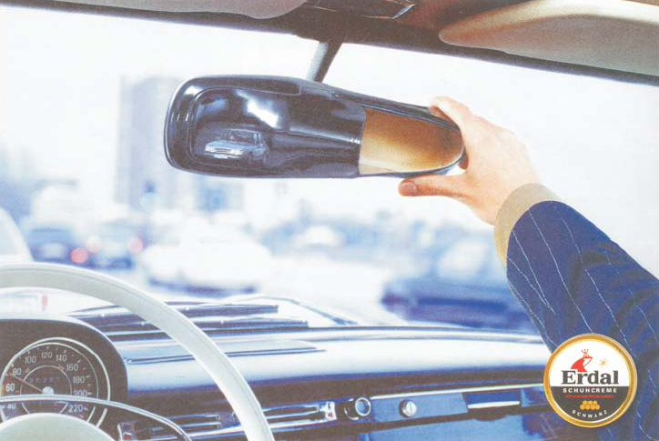

Slide 39
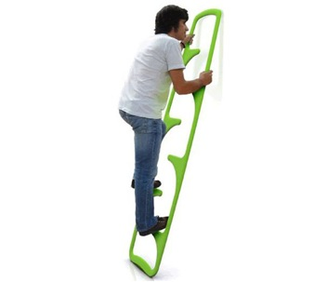

Slide 41
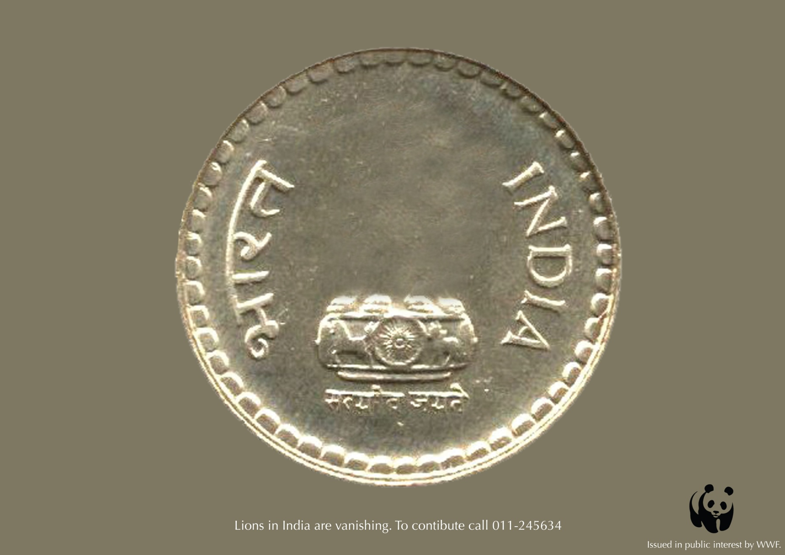

Slide 43
