Slide 1
Branding in Social Media & eCommerce Planning
Lauren Zaslansky Conner
Burbank, CA
LaurenZConner@gmail.com
323-422-1386

Slide 2
“Strategic” What is it?
LAUREN ZASLANSKY CONNER
MARKETING – BRAND - STRATEGIC MARKETING
LaurenZConner@gmail.com
323-422-1386
THOUGHTFUL

Slide 3
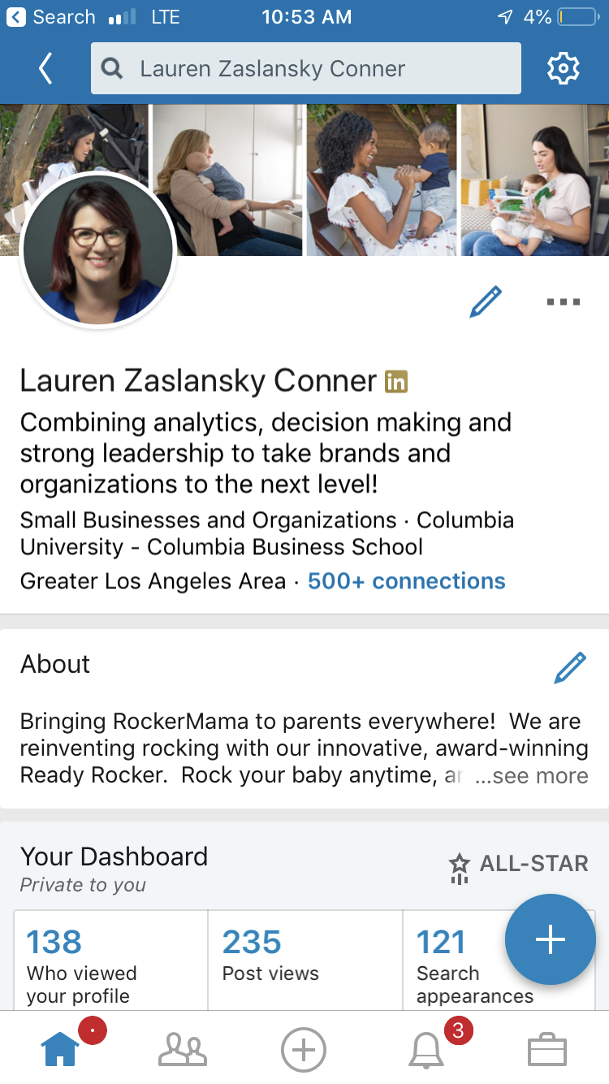
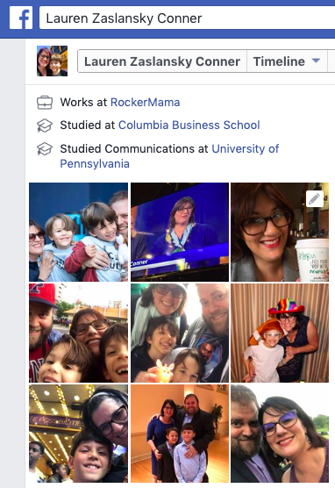
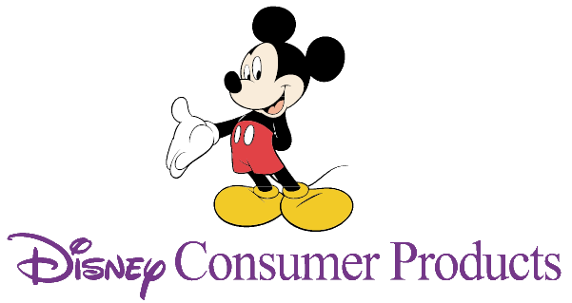
My BrandS
Notes:
Cross functional corporate veteran
Startup survivor
Over-educated
Mom/wife
Dog lover
Board member/leader

Slide 4
What we are going to talk about
Branding
Digital/Social Media
eCommerce
Math

Slide 5
Branding
Your brand, whether it’s a product or line of products, a service, or YOURSELF, extends to every point of contact

Slide 6
Why Branding Matters
Establishes what you stands for
Shortcut for audience
Increases awareness and customer loyalty
Not just a logo, overall feeling
Notes:
, includes colors, shapes and icons and the words or your
product, packaging and marketing.
Shortcut – means it is easier to get message across with a look/image/store

Slide 7
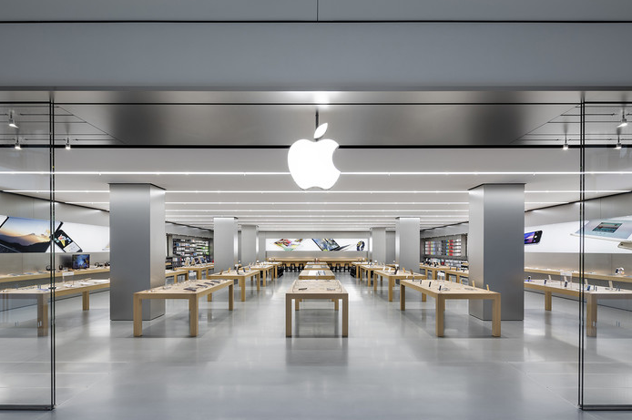
Branding is everywhere
Product
Store
Website
Package

Slide 8
What are you trying to say?
Logo
Color scheme
Language and voice
Images/Photography
Product
Customer Service
Notes:
Will people find and recognize your logo? Does your product match your materials? And most importantly, are customers receiving the message that you are attempting to send?

Slide 9
Does Your Communication tell Your story?
Companies often separate out departments and don’t share information.
Customers don’t care about your internal structure
Inconsistencies work against you
Notes:
To showcase your brand online, whether it’s your own webpage, on Amazon, or another site, you have images, text and videos at your disposal to convey your message. These should all follow the guidelines you’ve set for yourself, showing the logo and using the right product names. Review what your brand looks like online (including mobile!) – does it tell a story? Ask a neutral 3rd person to review your listing, do they get it? Sometimes the most powerful insight is just – “But WHAT is it? And WHY did we do that?” We’ve all seen examples when this goes wrong. When the beautiful ads give way to substandard online imagery experience -spelling errors, inconsistent capitalization or garbled punctuation ($#@!). Recently, I was reviewing a client’s website. The brand logo had the product name and beautiful coloring. Yet, it was impossible to see on a mobile device. Oops!
Avoid errors

Slide 10
Just Because something works for someone else, doesn’t mean it works for you!!!
It looked so great on the model!!
Notes:
Image of ill fitting dress
Nailed it

Slide 11
…But I Don’t have Apple’s Budget
Have everyone review your products, website, and all collateral
See how your brand is represented in the world?
Before hiring a branding agency, do some work?
Notes:
Review your products, website, and all collateral
Does is say what you want it to say?
Ask your friends/trusted advisors/random guy on the street? Can they tell?
See how your brand is represented at retail, online and in search engines?
Can your customers tell what you represent?
Are you making it easier for customers to understand your message?
Before hiring a branding agency, do some work?
What do you want your brand to mean?
Which stakeholders will be involved in the decision? Make sure you have a unified internal voice before you waste time and money
An agency will be only as good as the direction you give

Slide 12
No Seams!
Understanding of your customer
Branding decisions
Style Guide
Brand Voice
Flexibility – you are not your audience!
Creative Brief
Notes:
Focus on what you know
Have at least an understanding of what you want to do and who you are are talking to (remember
Ask what you don’t
Listen
Not all feedback is right, but only way you can hear is if your ears are open
Style Guide
Logos
Icons
Imagery
Color Scheme
Voice Guide
Formality
Audience
Tone
When a brand is executed well, we don’t see the seams.
Disney, every decision we made about the characters fit the brand image we were trying to project. With specific color schemes, brand voice, and imagery, it was difficult to stray too far off course. These guardrails were prescribed and practically required an act of Congress to change.

Slide 13
Digital & Social Marketing
What used to happen IRL, now can all happen online

Slide 14
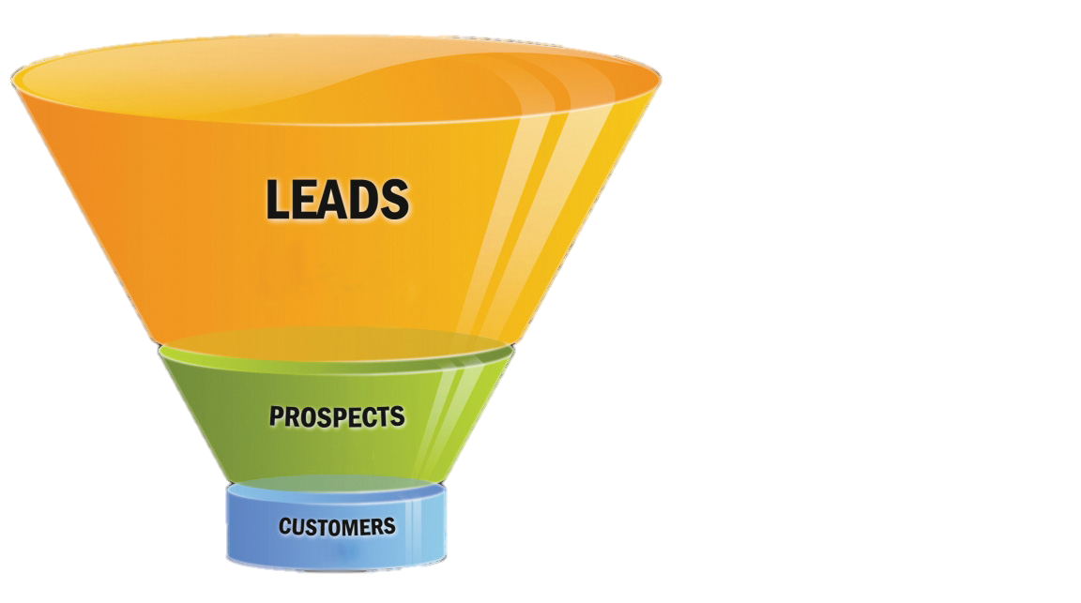
Funnel (Cake)

Slide 15
Prioritize your Purpose and Actions
Awareness: Tell people who you are
Engagement: Further your interaction
Purchase: Convert leads into sales
Post-Purchase: Solicit feedback
Remember what you want to say
Notes:
You’ll need all of these, but difficult to get
Thoughtful approach.
Can’t get to honest reviews before purchase, can’t get to purchase with engagement, can’t get to engagement without awareness.
Leaders often want to skip the funnel and ”optimize for conversion”
Time horizon and financial runway.
Once you can answer “Why” you can more effectively determine which networks to use, the types of messages, and frequency of your postings.

Slide 16
Social Media
A variety of website and applications that allow for user generated content
You can control your message, sort of…
Consider why you are posting
Only some of digital tactics to reach audience

Slide 17
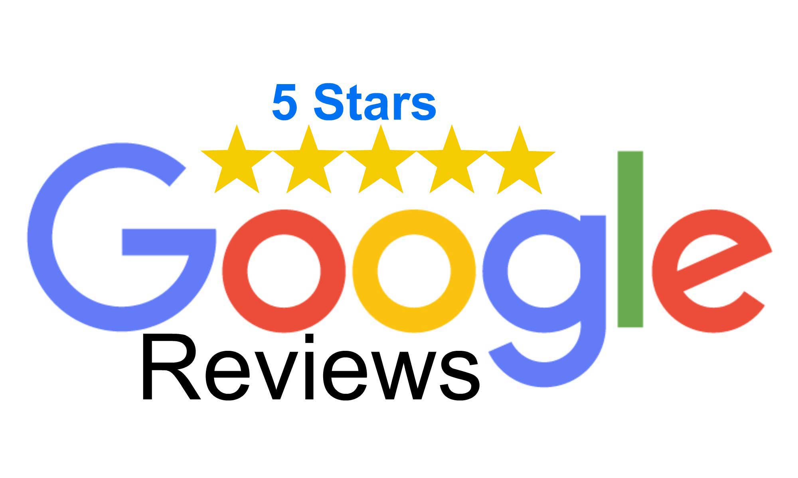
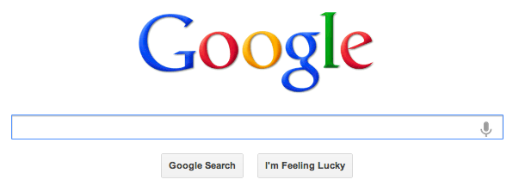
Evolves Over Time
Notes:
“we are spending so much on digital, why aren’t our eCommerce sales increasing?”
“Can’t we just find the 1000 people who need it!”

Slide 18
Close the Loop
Need to seed market with a few reviews
Without reviews, it’s difficult to get buyers
# of ratings/reviews required varies
Social Media and independent feedback supplements point of purchase reviews

Slide 19
All together Now
Brand X |  | Month 1 | Month 2 | Month 3 | Month 4 | Month 5
Key Message |  | Spring Cleaning |  |  | Memorial Day Sale
Website Hero |  | Kitchen | Garage | Yard | Sale1 | Sale 2
Retail Promo
Email |  | Celebrate | Cleaning Hacks |  | Backyard BBQ | Sale Last Year
Facebook |  | Recipes | Decorate
Instagram |  | Recipes
Events |  |  |  |  | Tailgate

Slide 20
To Sell or Not to Sell (Direct)
Direct to Customer (DTC) eCommerce vs. Retail

Slide 21
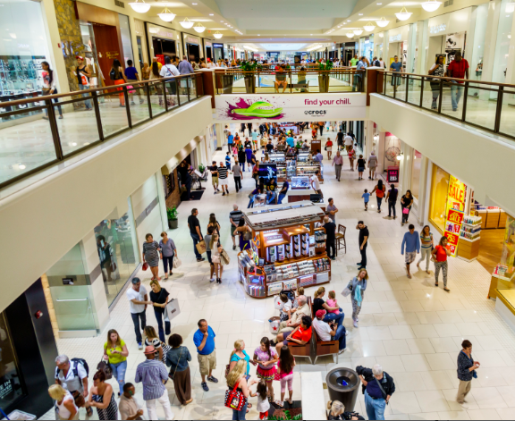
Where to Sell
Own Website
Retailers

Slide 22
Where to Sell
Own Website
Retailers
Higher Margin
Captivated audience
Own communication
Need to draw traffic
Pay commission
Browsing audience
Competitors
More eyeballs

Slide 23
Many Ways to Sell a Cat
Channel | Who sets price | Who fulfills | Seller of Record
Sell Direct | Manufacturer | Manufacturer | Manufacturer
Fulfill by Amazon | Manufacturer | Amazon | Manufacturer
3rd Party Seller | 3rd Party | 3rd Party | 3rd Party
Drop Ship | Amazon | Manufacturer | Amazon
Sell to Amazon | Amazon | Amazon | Amazon

Slide 24
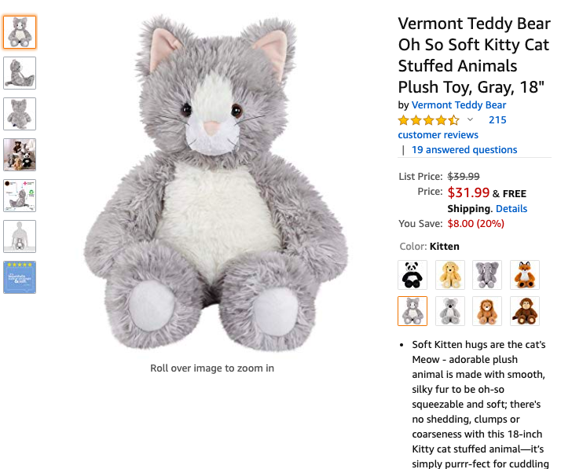
Optimize your Digital shelf Presence
Pictures
Words
Videos
Reviews
$$ Marketing
Notes:
Enhanced Brand Content

Slide 25
Don’t Fear the Math
Key Performance Indicators

Slide 26
This Photo by Unknown Author is licensed under CC BY

Slide 27
Two-way Communication
Online tools and social networks capture data
Companies use that data to learn
Social engagement doesn’t = sales
Notes:
Once you have locked down a brand, you’ll want your customers to find you. There are many social networks and search engines that you can use to drive customers and nurture your business. Social networks are designed for us all to show off our beautiful children, silly puppy antics, or that nutritious quinoa salad you shot to signal your healthy choices. Yet, the personal information we tell these sites, either directly or by our online actions, are available for advertisers to use.
Social networks, eCommerce retailers and search sites use proprietary algorithms to determine the order of results listings. In simpler terms, there’s a lot of forces out there making it harder for your business to appear on the first page of search results - really the only page that matters. Each company has a secret formula but here are a few things that influence results; how closely your content matches what the customer is looking for, how active your site (or product) has been, and the number and quality of reviews.

Slide 28
Secret Formulas AKA Algorithms
Relevance to search
Asset completeness
Recent and historical activity
Feedback and reviews
Conversion and sales $
PAID MARKETING/SPONSORSHIP
Notes:
Algorithms: digital shortcuts
aka
the secret formulas that make you always see your frenemy’s post before everything else!
Forces are making it harder for your business to appear in search results. Most of what you see if curated and sponsored. Each company has a secret formula but here are a few things that influence results;
Social networks, eCommerce retailers and search sites use proprietary algorithms to determine the order of results listings.
Relevance: how closely your content matches what the customer is looking for,
Asset Completeness
Activity: how active your site (or product) has been
Feedback: The number and quality of reviews
Conversion and Sales $:

Slide 29
Huffpost

Slide 30
You Get What You Measure!
Impressions
Traffic
Click Through Rate (CTR)
Bounce Rate
Time on Site
Likes
Views
Open Rate
ROAS
CPC
Revenue
Notes:
Must Prioritize!

Slide 31
Setup a Dashboard
An Impression is not always an impression
Start big and drill down
Require learning and testing
Management vs. tactical reports

Slide 32
Tying it all Together
Be thoughtful and consistent with your brand message
Remove the seams and plan accordingly
Remember data is your friend
Analyze and modify
Rinse and Repeat indefinitely
Notes:
What do you want to say?
Are you saying it?
Remember customers see one company, use that to your advantage.
Coordinate across tactics to leverage success in one area to benefit another. Website, retailers, live events and social.
Can geo-target if you have limited budget.
Track

Slide 33
Questions?
Lauren Zaslansky Conner
Burbank, CA
LaurenZConner@gmail.com
323-422-1386

