Slide 1
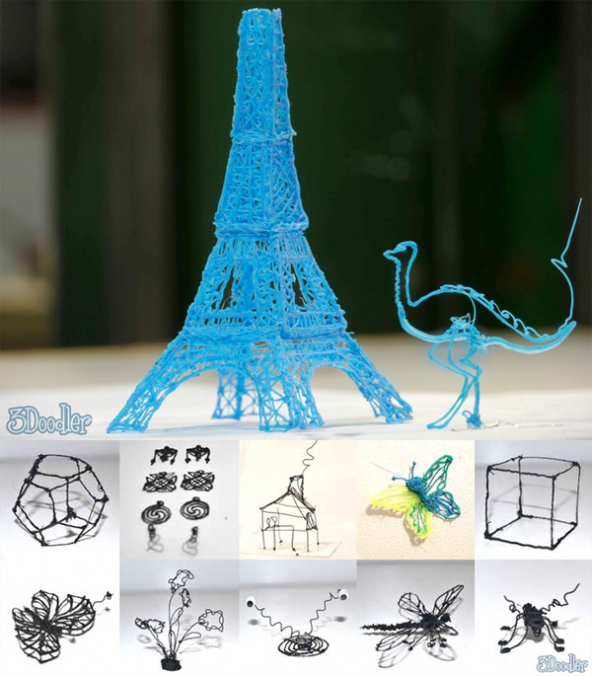

Slide 2
TESCO
* Eliminate * Put to Other Use * Adapt

