Slide 1
Building Mobile Apps
with FireMonkey
Fast Track to Mobile Development Training for Delphi & RAD Studio
Notes:
Mary still to complete: LiveBindings

Slide 2
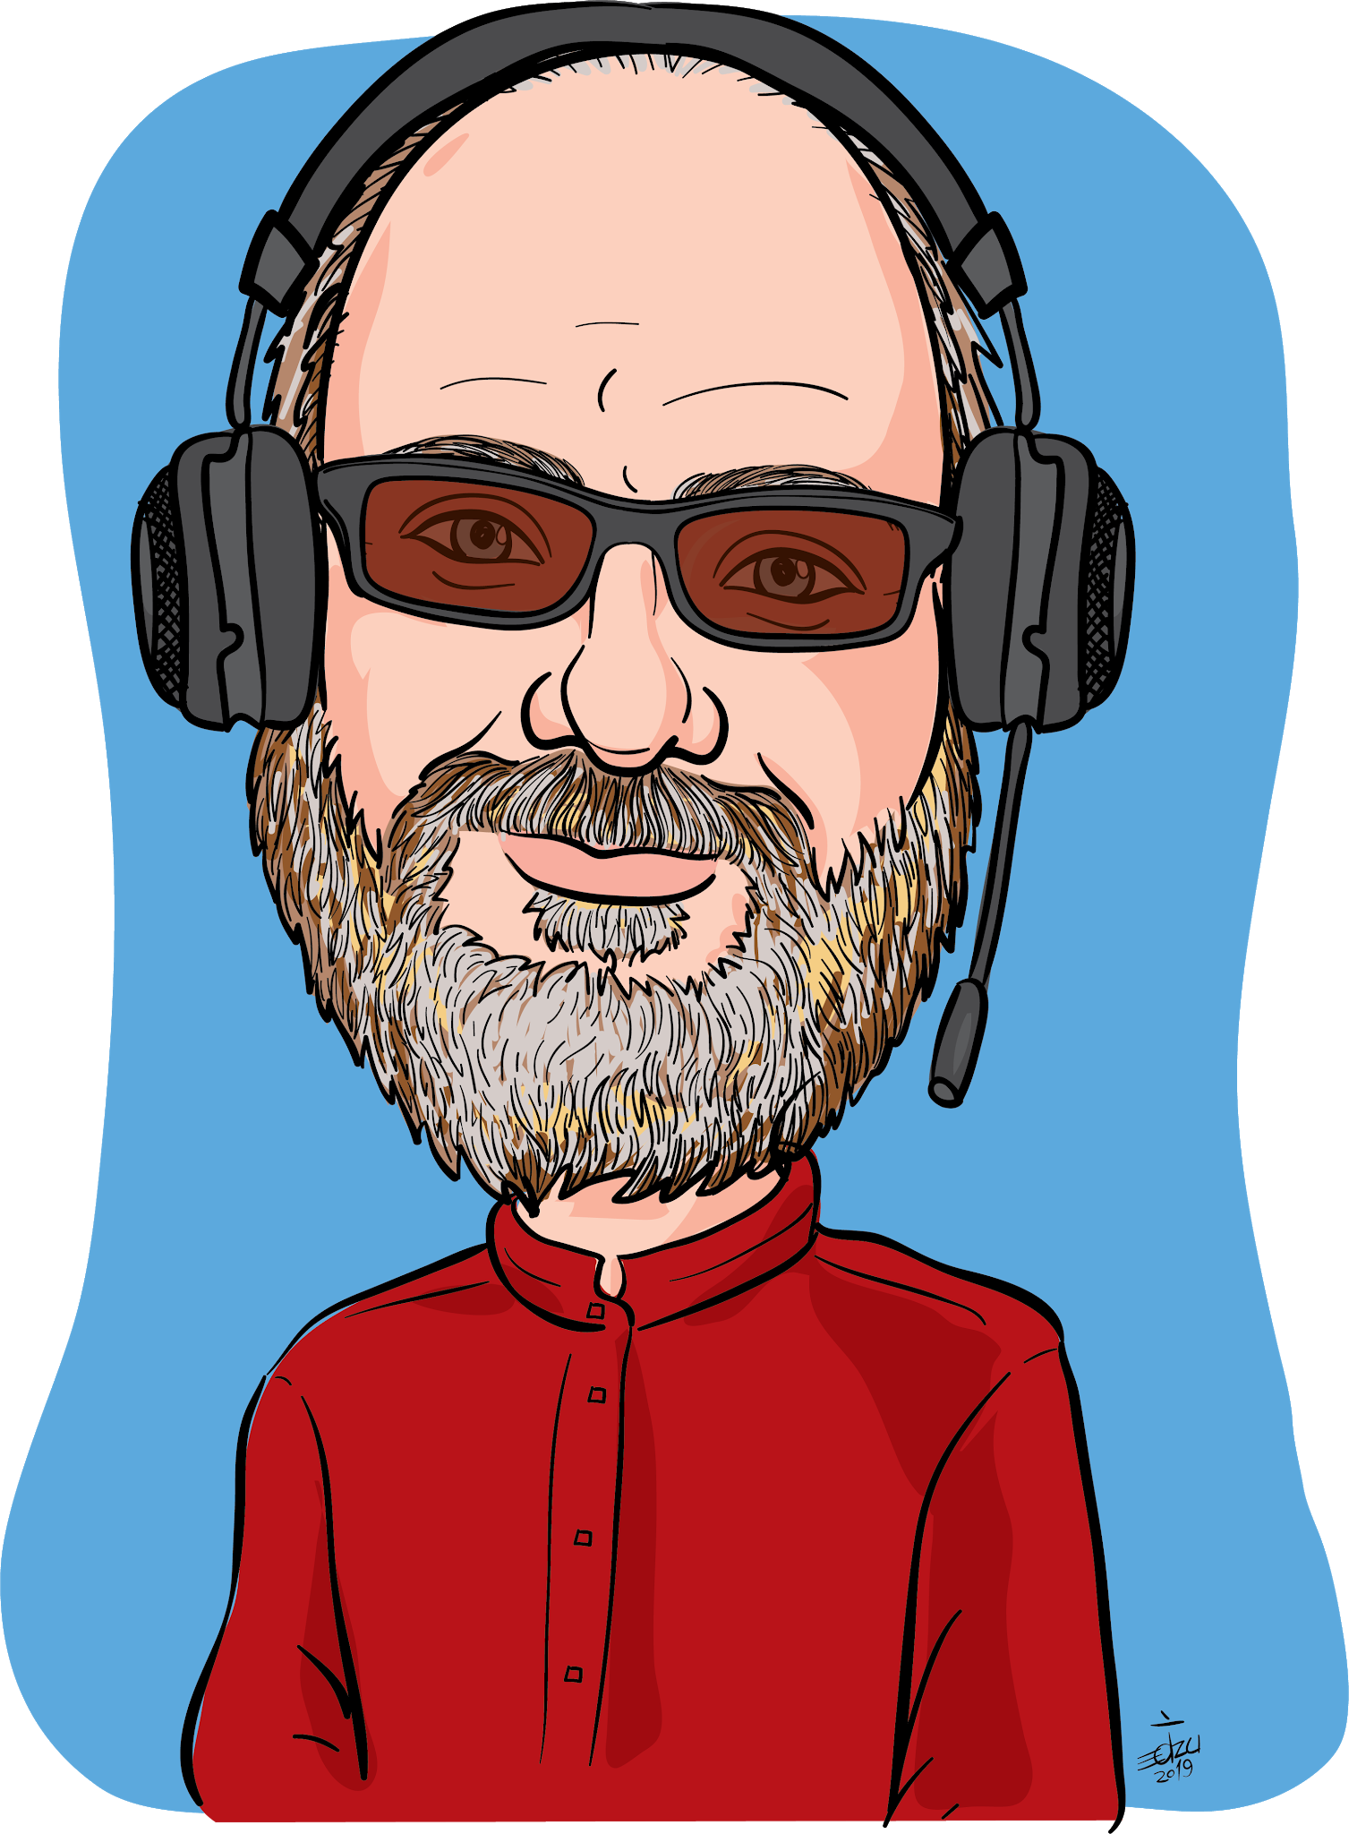
About Jim McKeeth
Embarcadero’s Chief Developer Advocate & Engineer
Long time software developer
Invented and patented pattern and swipe to unlock
US Patent # 8352745 & 6766456, etc.
Built thought controlled drone with Google Glass
Host of Podcast at Delphi.org
Lives near Boise, Idaho, USA with family & dogs
Improvisational ComedySportz performer
Contributor to Internet of Things and Data Analytics Handbook

Slide 3
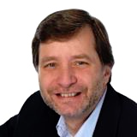
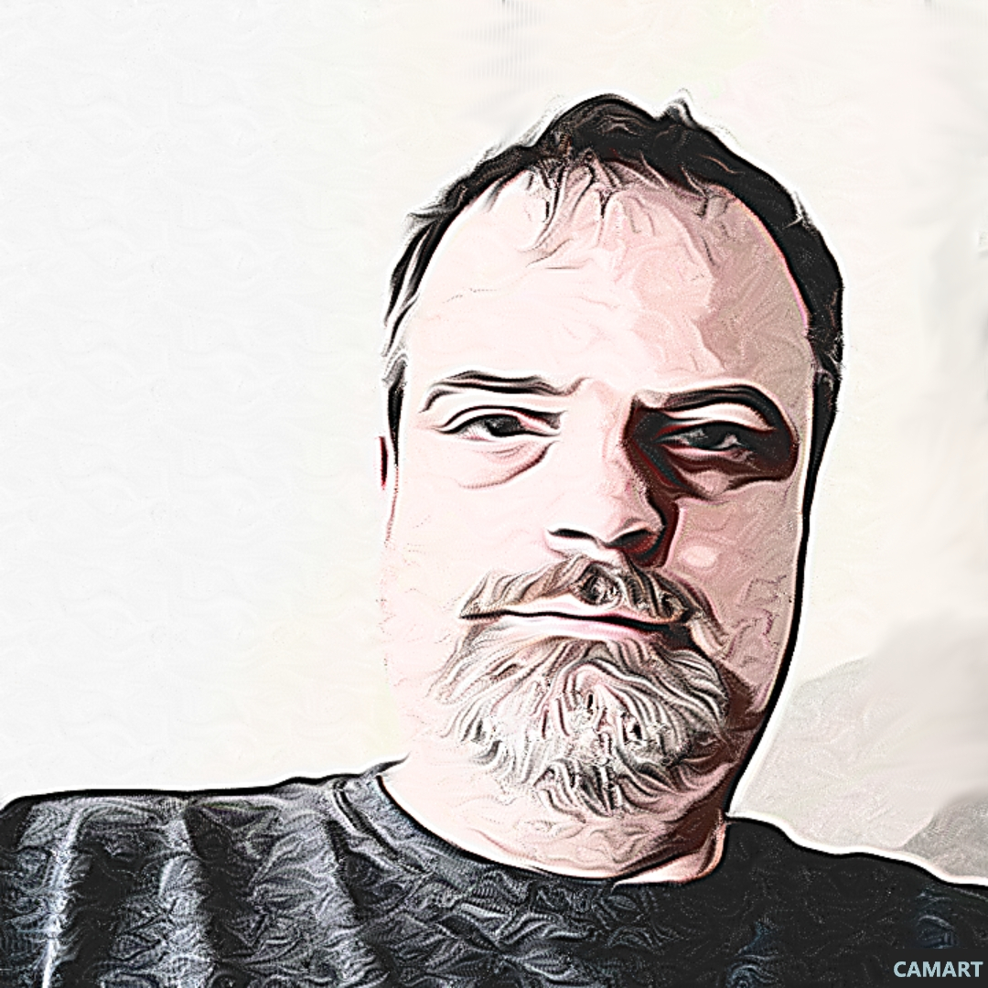
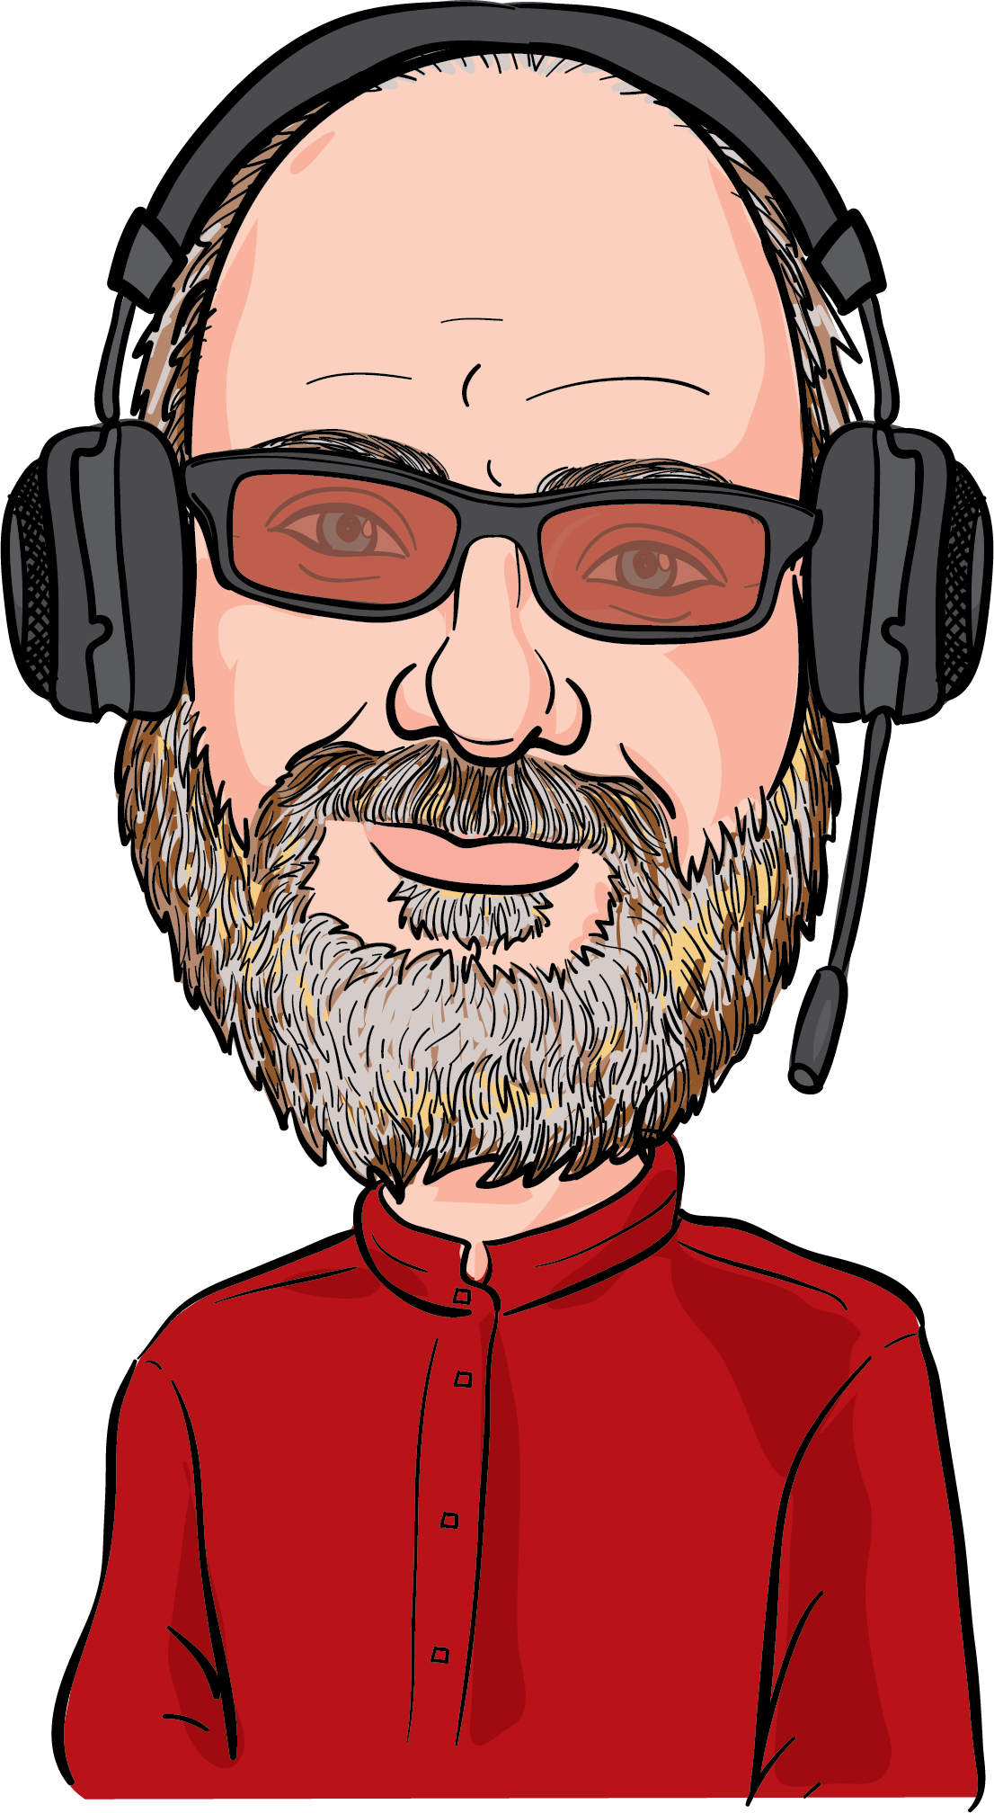
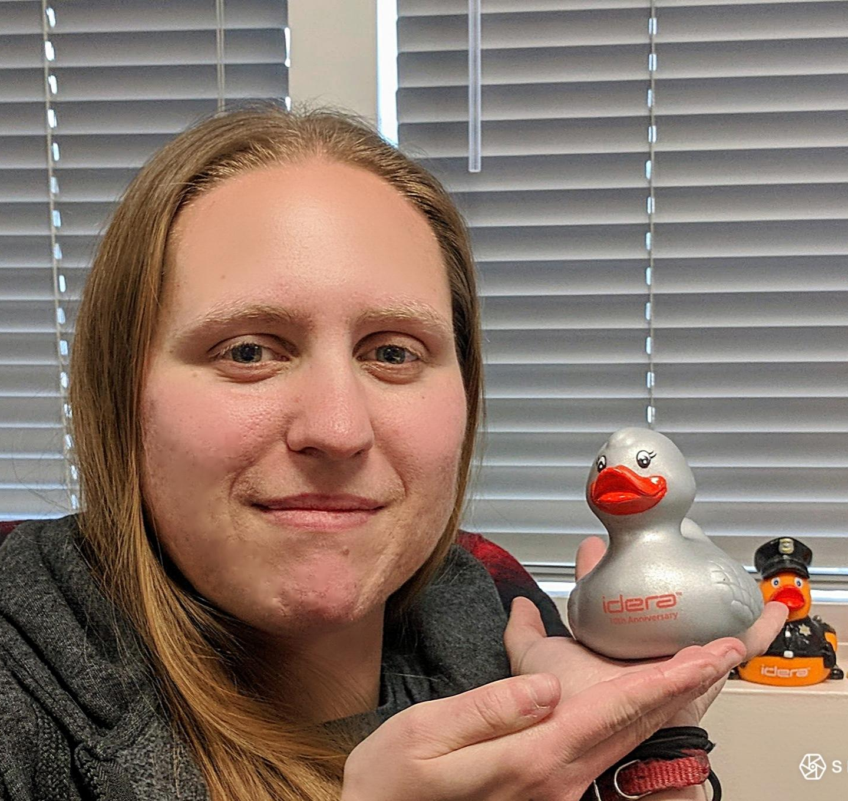
Rest of the Team
Al Mannarino
Principal Software Consultant
Al.Mannarino@embarcadero.com
Craig Chapman
Software Consultant
Craig.Chapman@embarcadero.com
Mary Kelly
Software Consultant
Mary.Kelly@embarcadero.com
Jim McKeeth
Chief Developer Advocate
and Engineer
Jim.McKeeth@embarcadero.com

Slide 4
Training Curriculum: Part A
Topic | Duration
Introduction to FMX | What is it? How it works? What are advantages? What are limitations? | 30 min.
Setup the Environment | Downloading SDKs Emulators Styles Basic architectures | 30 - 60 min.
Setup Users and Login Screen | Create the screens with users User authentication | 60 min.
Build Data Capture Form | Most apps that are commercial will have a function to collect data remotely and write to a DB or input into the main Delphi app | 120 min.

Slide 5
Training Curriculum: Part B
Topic | Duration
Refresh | What have we done so far | 30 min
Build Data Output Form - May Split In Sections... | Most apps will display data. For example, a simple functionality that we discussed in services app is to provide access to repository of documents locally (e.g. blueprints or manuals). | 120 min.
Architecture Considerations | Maybe discuss considerations for local DB / Interbase Rest API structures, etc. | 60 min.
Publishing | Submitting to App & Play Stores | 30 min

Slide 6
Training Overview

Slide 7
Training Overview
Goals for this training
Agenda and overview
Where to Git the Code
General Useful Information
Specs for the App

Slide 8
Goals
Help you get up to speed for mobile development with FireMonkey
This is a workshop - we are developing an app together
Expectations
Experienced with Delphi or C++Builder
Some experience with database development
Follow along with the exercises
We are showing Delphi, but you can also do it in C++Builder
Built with 10.3 Rio & should work with any edition
Including the free Community Edition

Slide 9
Agenda
The App Specs: What we are building
Introduction to FireMonkey
Setting Up for Mobile Development
Working with Embedded InterBase: IB ToGo & IBLite
Building the User Interface with Styles
LiveBinding: Connecting the UI to Data
Using Sensors: Hello World!
Reporting and Sharing: Will you be my friend?
Architecture Considerations: Android vs. iOS
Publishing and Sharing your App
Ad-Hoc as well as Google and Apple stores
Image by Tumisu https://pixabay.com/photo-1919292/

Slide 10
Git the Code
Available on GitHub
https://github.com/Embarcadero/FieldLogger-FMXTraining
Lab Docs in GitHub ⇨ /tree/master/Lab%20Exercises
Delphi, FMX, and SQL code
Includes the app at various stages
Also resources and libraries
These slides: https://embt.co/FmxMobileAppTraining
Master folder on Google Drive: https://drive.google.com/drive/u/0/folders/1pH-3UPc9x0I6jF1MWyw2aI1Mf2ewUkPX

Slide 11
Useful Information
There are many links to the DocWikis
To save space we’ll use shorthand
docwiki:RAD = docwiki.embarcadero.com/RADStudio/en/
docwiki:lib = docwiki.embarcadero.com/Libraries/en/
docwiki:code = docwiki.embarcadero.com/CodeExamples/en/
docwiki:ib = docwiki.embarcadero.com/InterBase/2017/en/
Example:
docwiki:RAD/FireMonkey_Platform_Services
http://docwiki.embarcadero.com/RADStudio/en/FireMonkey_Platform_Services
You have a copy of the slides and there are notes with more information and comments in the “speaker notes” section

Slide 12
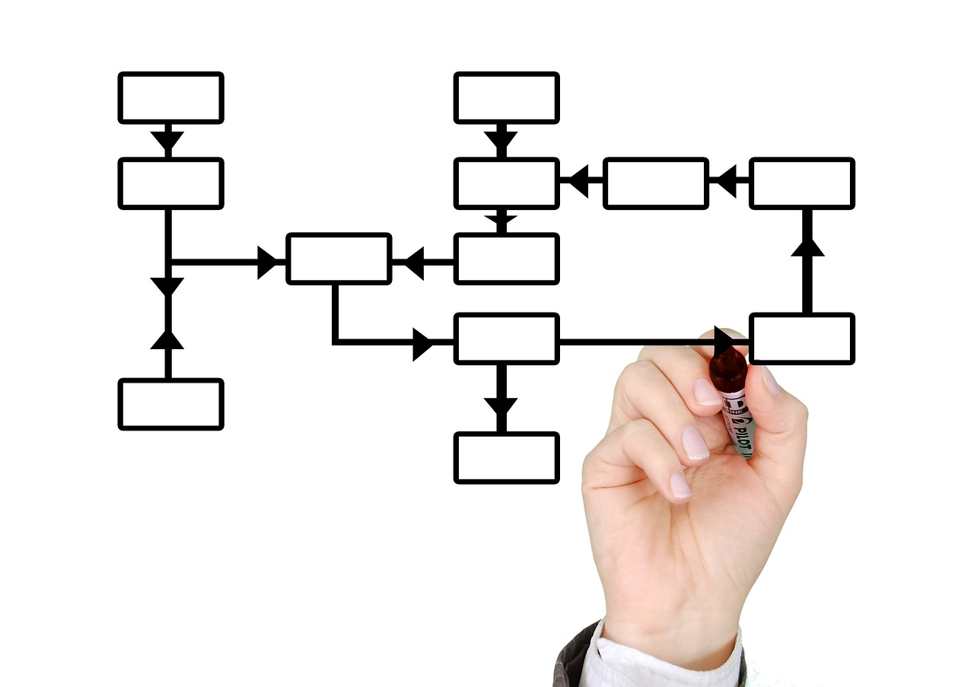
App Specs
Project log collection application
Uses Embedded InterBase ToGo (or the free IBLite)
Database has projects with child log entries
Log entries include:
DateTime, Picture, Geolocation, Orientation, Accelerometer, User notes
Screens
Edit project details
Add logs to project
Browse & edit projects & log entries
Reporting
Export project with log entries as JSON or HTML
Save to file or share via email, etc.
Image by Geralt
https://pixabay.com/photo-516279/

Slide 13
Training Overview
Goals for this training
Agenda and overview
Where to Git the Code
General Useful Information
Specs for the App

Slide 14
Up Next...
Introduction to FireMonkey
The cross platform application development framework!

