Slide 1
Clinical Services & Quality Management DBH Effective Documentation 2021
Behavioral Technicians, Counselors, & Milieu Support
Nursing
Clinical
Medical
ED, MH, SUD Divisions

Slide 2
TABLE OF CONTENTS & GUIDE
Instructions: Please locate your appropriate division and department and click on the link to access the relevant training
Part I
All Divisions
2. Documentation Do's & Don't
All Divisions
3. Group Notes
All Divisions
4. SUD Effective Documentation:
SUD Behavioral Health Technicians
SUD Nursing
SUD Medical
SUD Clinical
5. ED Effective Documentation:
ED Counselors & Milieu Managers
ED Nursing
ED Medical
ED Clinical
6. MH Effective Documentation:
MH Technicians
MH Nursing
MH Medical
MH Clinical
7. Part II
All Divisions

Slide 3
Part I: Effective Documentation for DBH ED, MH, SUD Divisions

Slide 4
Purpose and Objective of Annual Effective Documentation:
Reinforce the importance and role of Documentation and Medical Records
Provide you with clear instructions and resources to make your job easier and more efficient!
Provide a user-friendly resource for you to download and reference, as needed
Reduce confusion with documentation requirements
Provide examples of documentation requirements for each role
Improve clinical quality, which improves patient engagement¹
Increase understanding of expectations to improve staff engagement
¹ Stanhope, V., et al., (2013)

Slide 5
The Role and Importance of Documentation
Potential consequences of an incomplete medical record:
is used to support allegations of negligence
is used to support allegations of fraud
Can cause a provider to lose their license
cause lost revenue/reimbursement
result in poor patient care by other healthcare team members
result in inappropriate billing leading to charges of fraud
interfere with patient-related studies
compromise safe patient care
decrease reimbursement/gross revenue
"Good documentation is important to protect your patients. Good documentation promotes patient safety and quality of care. Complete and accurate medical recordkeeping can help ensure that your patients get the right care at the right time. At the end of the day, that's what really matters" (Taitsman, 2011).
Myth: Detailed documentation should be avoided because “lawyers can hang you with it.”
Rebuttal: Good care combined with high quality documentation is the surest way to avoid being a defendant in a malpractice action. Documentation is key when reviewing a potential case (Simpson, S., J.D, 2015).

Slide 6
Clinical Documentation and Medical Records
Medical/Clinical Records are:
Legal documents
Evidence of services provided by staff within the scope of practice of the individual delivering service
Substantiation of medical necessity and appropriate level of care
Data that relates to the clinical goals and/or links to Diagnosis/es and/or Patient Needs
Communication with outside readers (e.g., providers, payers, court of law, etc.)
Clinical documentation in behavioral health care tells a story. That story recounts the entire process of care, treatment, or services for an individual served, including any transfer or discharge. The story must be founded on timely, complete, accurate data continuously collected and analyzed. This enables appropriate assessment of needs and an individualized plan for care, treatment, or services that reflects the individual’s progress.

Slide 7
Documentation Do’s:
Document all attempts for Coordination of Care!
Give yourself credit for your hard work; include Contact or Communication Notes when reaching out to outside providers, family, social support, collateral, or requesting medical records
Document so that the record flows logically
Assume another person will be reviewing the record; follow the logic and flow of the Golden Thread Treatment Path
Collaborative with patient and document with them!
Include patient in the treatment planning or discharge planning process. View the training on Collaborative Documentation for more information on how to reduce clinician burnout and improve patient engagement!
“Verba volant, scripta manent”
(spoken words fly away, written words remain)
- Caius Titus

Slide 8
Documentation Do’s:
DO use abbreviations that are consistent with Discovery Behavioral Health’s Abbreviation Use and Elimination Policy (IM-002) Policy.
e.g.: “This writer spoke to patient’s boyfriend (bf) on the phone regarding her recent verbal altercation with
staff. Bf shared with writer an incident from weekend.”
DO include Job Title, Credentials, and License Number in EMR Signature/Title Line, (when applicable)
Staff without a license or discipline must include a job title:
(e.g., Sandy Stone, Behavioral Health Technician)
Staff must include a license or designation, when applicable:
(e.g., Peter Roberts, Licensed Clinical Social Worker #12345 (TX)
DO Sign your full name legibly!
Signatures that are illegible and ‘scribbled’ are unacceptable
Initials or incomplete names are unacceptable
DO utilize the Annotation feature, when necessary:
Use as an annotation to include an addendum when a form is closed (e.g., clarification, late entry, error).
e.g.: Shift note was performed and completed at time dated above. Signature late due to Technician error.
e.g..: Late entry for service provided on x/x/xx due to crisis in milieu that required writer’s attention..
Use as evidence of additional reviewer (e.g., Physician indicating they reviewed patient’s lab results. Physician can add annotation to document or upload stating, “Reviewed”.

Slide 9
Documentation Don’ts!
Don’t use judgmental or opinionated language e.g.: “It seems like she doesn’t know how to listen or follow program guidelines.”
Alternative: "Patient appears to be having a difficult time following program guidelines, as evidenced by......."
Don’t use jargon/subjective language/opinions of patient e.g.: “Patient looked irritated, is OCD about her clothes and seems rude to everyone.”
Alternative: "Patient was visibly upset, as evidenced by expressing feelings of discomfort related to her attire while interrupting peers during group."
Avoid labeling or identifying the patient that may negatively impact them if reviewing their chart. e.g.: “Patient is a cutter and a purger.”
Alternative: “Patient reported purging and engaging in self-injurious behavior.”
Don’t write “N/A” when it IS “A”!
‘N/A’ should be reserved for when the response is Not Applicable (e.g., “How old are your children?” If patient does not have any children, ‘N/A’ would be an appropriate response.
If a patient discharges against treatment advice (ATA), avoid using ‘N/A’ as a response in the aftercare appointment section of the Discharge Plan. Rather, indicate the circumstance (ATA) and give yourself credit; write out all attempts to make appointments and/or discuss aftercare with patient prior to them leaving ATA.

Slide 10
Documentation Don’ts!
Don’t copy and paste into patient’s record- Each note needs to be specific to the service provided
Don’t write another patient’s name in the chart
Don’t use stigmatizing language
Payors have identified this as “cloning” and are prepared to reject claims with cloned documentation
If another patient must be identified, use initials. Avoid names of family and friends, rather, refer to the relationship (e.g., mother, friend)
WORDS MATTER¹! Avoid words that can be stigmatizing. Instead of:
“Drunk” use “under the influence of alcohol”
Psychotic use “experiencing psychotic symptoms or psychosis”
¹In a study performed by Beach, M.D. MPH, research found that physicians-in-training who read stigmatizing patient chart notes were significantly more likely to have a negative attitude toward the patient than those who read the chart containing more neutral language (2018).

Slide 11
Part II ED Division MH Division SUD Division

Slide 12
SUD Behavioral Technicians SUD Nursing SUD Medical

Slide 13
Nursing and Medical Documentation: (1 of 3)
Face-to-Face Nursing Evaluation - The Face-to-Face Evaluation is considered a pre-admission document to determine level of care. This form must be signed by Nurse prior to patient’s admission date and time.
Nursing shift notes:
Be mindful that start and stop times do not overlap with other services (e.g., Group sessions, clinical sessions; the patient cannot be in two locations at once!)
Ensure appropriate follow through on patient reports (e.g., Pain, suicidality, chest pains, etc.) > document the plan of action and/or referral provided.
Pain Screen/Assessment - Included in the Face-to-Face Evaluation, evaluation for Pain begins as a Screen and expands to an Assessment, as necessary, based on responses. Please make sure there is appropriate follow through based on responses (e.g., documented pain reassessment in 72 hrs., referral to physician for further evaluation, and/or pain clinic, inclusion in clinical treatment plan on how pain will be co-managed¹, etc.)
¹ (TJC, 2018). Pain, especially chronic pain, frequently occurs together with mental and/or substance use disorders. These conditions must be co-managed to achieve progress in treatment for the affected individuals

Slide 14
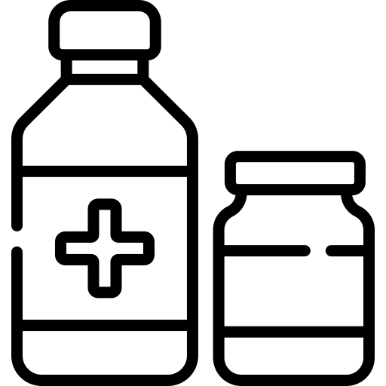
Nursing and Medical Documentation: (2 of 3)
COWS/CIWA - A score below 11 is considered stable on either scale. If a patient is stable CWS and/or CIWAS will be repeated every 4 hours for the duration of detoxification or per physician orders. [Policy: SUD 010 Detoxification Protocol in SUD Programs]
Medication Identification:
Individual medications brought into the facility will be identified and verified by a Nurse using the Epocrates pill identification service and documented in the patient's medical record. [Policy: MS 002 Medication Management]
Medication Destruction:
Medications > 14 days expired, discontinued, and/or unclaimed must be stored separately from active medications.
Ensure appropriate forms are completed and signatures (+ witness signatures) are captured (e.g., Medication Destruction Form. [Policy MS 003 Medication Destruction Policy]

Slide 15
Nursing and Medical Documentation: (3 of 3)
Controlled Med Counts:
Must be counted at each shift, until destroyed
Must be accurate
Must be double signed
Follow program policies to ensure compliance with state specific regulations
Physician’s orders:
Orders must have matching results (e.g., Labs, vitals, increased frequency of COWS/CIWAS, safety observations, etc.) If there is a physician’s order, please make sure there is documentation to back it up!
Verbal Orders
Must be documented in Physician’s Orders Tab by the staff recording the order
Must be read back for confirmation by the prescribing doctor
Document Read Back and Verified by choosing from the drop-down menu option in EMR
Physician orders must be signed by the prescribing doctor within 72 hours
Labs: Make sure labs/tests are appropriately uploaded into the patient record
Including urinalysis samples, any Lab panel, tests (EKG)
Vitals- Reach out to physician if vitals are out of range and document action steps

Slide 16
Shift Notes:
Record observations on patient behavior and interactions during shift.
Include mental and physical status, including:
Appearance (e.g., level of engagement with staff and peers, grooming, attitude: cooperative, uncooperative)
Behavior (e.g., eye contact: poor, good; psychomotor activity: handwringing; coping skills employed)
Presentation of mood (e.g., sad, angry, elated; self-report congruent or incongruent with observations)
Speech pattern (e.g., rate: increased/decreased, volume: loud, soft)
High-risk behavior (e.g., agitation, impulsivity, violence, self-injurious behaviors)
Include any safety concerns observed and action completed to ensure safety
For 1:1 observations, complete a one-to-one Safety Attestation Shift Note at the end of each 1:1 shift

Slide 17
Rounds:
Rounds:
Rounds are performed every 15-60 minutes
Rounds should be documented in real- time, (or as close to when the round was made as possible).
Vitals can be performed and recorded during rounds, (if ordered by physician)
Additional observations can be included in the Rounds feature
Rounds provide:
an environment of patient safety
accuracy of patient’s location
an opportunity to connect with patient and assess any needs
Rounds must be consistent with clinical and/or physician orders and documentation.

Slide 18
Suicide Prevention and Your Role
“Suicide is a shared problem of humanity”
– Dr. Kelly Posner, Founder and Director, The Columbia Lighthouse Project, 2021
Q: Who can perform the Suicide Assessment?
A: A clinician trained on the assessment, that can apply clinical judgment.
“Asking people about their thoughts and behaviors to assess their risk for suicide is the first, critical step in suicide prevention.”
The Columbia Lighthouse Project, 2020
Familiarize yourself with the Suicide Assessment Policy and flowchart
*Requirements (and best practices) are different at Outpatient versus Residential
Patients identified as moderate and high-risk level will require increased observations, suicide reassessment and safety planning
For patients identified as high risk, you will communicate with the entire team by creating and documenting an Urgent Issue in the EMR
When clinical staff are available, (e.g., onsite), you are the initial point of contact for staff. When clinical staff are unavailable, (e.g., offsite), reassure staff that they can seek direction and support from their supervisor and/or on-call clinician
Q: Who can perform the Suicide Reassessment?
A: Any level staff that has completed the C-SSRS training sent to all staff via the learning management system.

Slide 19
Suicide Prevention Protocols and Policy:
Responding to Suicidal Behavior: If a patient reports suicidal thinking or behavior or information is obtained through collateral sources (e.g., a family member), you will want to:
Complete a Suicide Reassessment with the patient and determine risk level based on patient’s answers and key provided in the Suicide Reassessment.
Complete a Safety Plan.
⋆ If the Suicide Assessment or Reassessment determines patient is a high-risk level, and/or you have concerns about the patient's safety, and patient refuses to formulate a safety plan, ensure patient is placed on one-to-one staff observation and contact your supervisor for further direction
Document, document, document!
* If patient stabilizes and remains in treatment, ensure their treatment plan is updated and accurate to reflect recent behavior

Slide 20
SUD Clinical

Slide 21
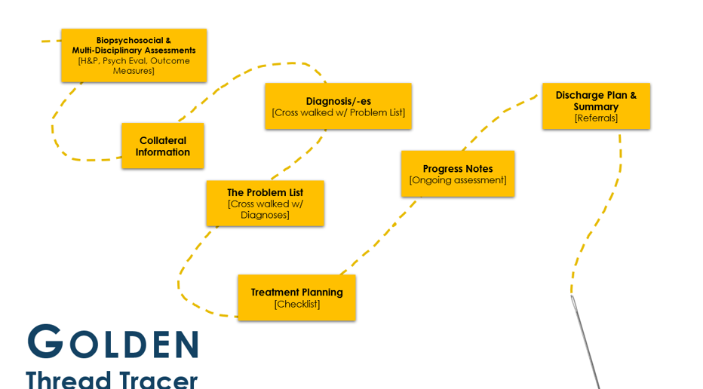
The Golden Thread
Q: Is Golden Thread synonymous with Treatment Plan?
A: No, it is not, it expands beyond the treatment plan! See below for clarification.
Golden Thread is a behavioral healthcare best practice of consistently and accurately aligning clinical information throughout the care continuum and related documentation. More specifically, the Golden Thread is a feature within the EMR that links (or threads) the patient’s episode of care from admission to discharge. Joint Commission’s individual Tracer refers to a similar process, whereby the patient’s care is traced. As part of the DBH Clinical Philosophy and Supervision Framework, this process is being internally referred to as The Golden Thread Tracer.

Slide 22
Group Notes: Documentation
Group Description: Include objective of group and evidence-based interventions performed (e.g., CBT, DBT). Group descriptions do not include patient specific information.
Individual Assessment/Intervention:
Must be individualized and demonstrate quality (e.g., not copied and pasted /cloned)
Individual goals are strongly encouraged (e.g.: “Patient's goal is to practice assertiveness in interpersonal relationship this weekend during visiting hours and report experience in next week's group.”)
Include patient reports (e.g., urges/cravings, rating of mood)
Brief observations of mental and physical status:
Appearance (e.g., level of engagement with staff and peers, grooming, attitude: cooperative, uncooperative)
Behavior (e.g., eye contact: poor, good; psychomotor activity: handwringing; coping skills employed)
Presentation of mood (e.g., sad, angry, elated; self-report congruent or incongruent with observations?)
Speech pattern (e.g., rate: increased/decreased, volume: loud, soft)
High-risk behavior (e.g., agitation, impulsivity, violence, self-injurious behaviors)
Every effort should be made to complete notes on the same day as the session! Refer to division specific policies for specific timeframes.

Slide 23
Group Notes: How to incorporate the Golden Thread
Golden Thread function:
Use the Golden Thread feature to identify which Problem, Objective, and intervention is being addressed in the group - (it can be one Problem, or it can be all Problems) - whichever is accurate. i.e., do not click all Problems, if only “Suicide Risk” and “Substance Misuse” were addressed in that specific group.

Slide 24
Group Notes: Content
Requires Improvement Individual Assessment is generic, does not include any subjective data on patient, does not reference Problem and/or Group Topic. Improper use of abbreviations.
Good Individual Assessment , provides brief mental status, observation of patient’s behavior, and how the patient responded to activity. Missing Problem that is being addressed and/or how it relates to Group Topic. Improper use of abbreviations.
Excellent Individual Assessment provides brief mental status, observation of patient’s behavior, quote, how patient responded to prompt and connects back to SUD Problem and Group Topic. No abbreviations used.

Slide 25
Identification of Problem List
Related assessments reviewed for data:
( e.g., H&P, psych eval,dietary assessment, outcome measures, collateral records, etc.)
Biopsychosocial
Assessment
The Problem List

Slide 26
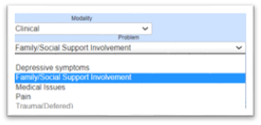
Identification of The Problem List
The Problem List
Defer
Not a current focus of treatment, a/o requires further assessment
(EMR will not generate a TP¹)
Refer
Out of scope, a/o requires specialist
Treat
Active Treatment Plan
The Problem List¹ may continue to develop as the patient moves through treatment
New problems may be added as conditions change
The Problem List must address all Diagnosis/es (but the Problem List may be more Comprehensive than the Diagnosis Form, as it also includes identified Problems that do not meet diagnostic criteria)²
Example: If a diagnosis for PTSD is present, then Trauma must be included on the Problem list
Alternatively, if a Problem is identified for Disordered Eating, then there should be an Eating Disorder diagnosis, OR a "Rule/Out” OR a "Provisional" diagnosis” for Eating Disorder. (It's not comprehensive to identify that an area is a Problem in a patient's life, yet not demonstrate how this will be managed diagnostically)
The Problem List includes information collected from all assessments and patient concerns (e.g., “Problems”) that have been identified.
The Problem list and treatment plan(s) should be developed based on a multidisciplinary assessment and “may include, diagnoses, medical conditions, functional limitations, living environment, and/or symptoms” (AHIMA, 2020).
2
1Problem List if often referred to as the patient's "Needs" List.

Slide 27
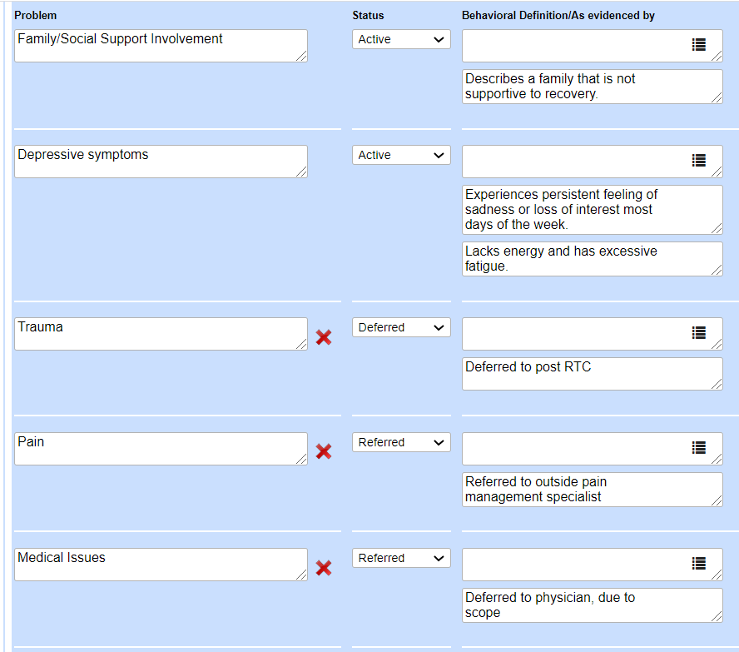
Problem List versus Treatment Plan
The Problem List must include any significant issues reported by the patient, even if they are not a focus of treatment:
The Treatment Plan(s) must include any significant issues reported by the patient that are a focus of treatment:
Not a Focus of Treatment BUT, identified in assessments as Problems
Focus of Treatment
=
1. Depression
2. Family Involvement
Notes:
Since you already know the requirements (e.g. family conflict for RTC and PHP, suicide risk/ideation for high risk), then it is recommended you obtain a goal in the patient’s words during the intake process.
It is important understand that the Problem List can be broader, as it identifies what the patient reports. A good example is Chronic Pain. This may be a problem that is included on the Problem List but has a status of Referred (to MD).

Slide 28
Treatment Planning: Snapshot of Requirements (1 of 3)
Signatures:
Signatures must be captured within 5 days of admission
(patient, therapist, clinical supervisor)
Needs Assessment:
Treatment plans MUST include language from the Needs, Strengths, Preferences, Goals (NSPG) section of Patient BPS (Recommended to include in Goals section)
Outcome Measures:
Treatment plans (TPs) MUST include a treatment Objective that focuses on outcome measures (PHQ-9) and how the score informs treatment planning.
I.e., including the score without any context of what the score means for the treatment plan is insufficient.
Is the PHQ-9 score increasing? Does that indicate that the current treatment plan needs to be revisited and likely requires an adjustment? Perhaps a referral to a Psych, and additional CBT assignments.
Is the PHQ-9 score decreasing and as a result, does this evidence that the current treatment plan is effective, and no changes are indicated at this time? Great! Write that!

Slide 29
Treatment Planning: Snapshot of Requirements (2 of 3)
Goals:
Include at least one goal stated in the patient’s words for each Problem
Highly recommend to also include the Clinical Interpretation of the goal
Statuses and Status Updates:
Initial Status must be added to each intervention when the Treatment Plan (TP) is created. This allows for you to enter a Target Date for each intervention
Patient can sign the initial TP & Statuses (as one signature) via The Golden List Thread View
Treatment Plan Reviews (e.g., Status Updates) are required (at a minimum) 14 days from admission date and every two weeks thereafter
Patient must sign at each Status Update.
Status Updates allow you to update the Target Date, enter commentary on patient’s progress, and change the Status from the drop-down menu (if applicable)
Clinically Relevant Treatment Plans:
Primary Diagnosis/Presenting Problem: e.g., Substance use Disorder/Substance Misuse Problem/TP
Secondary and Tertiary Diagnoses: e.g., PTSD, Mood Disorder (Trauma, Depressive symptoms, Problem/TP
Common clinically relevant focuses of treatment: Aftercare Planning/ Family Conflicts a/o Social Support Involvement
Suicide Risk a/o Safety Related TP:
RTC > High-risk level, requires a Problem & TP for Suicide Risk (Moderate risk - suicidal risk mitigation
strategies in another TP
PHP/IOP > Moderate AND High-risk level, requires a Problem & TP for Suicide Risk OP Care Plan

Slide 30
Treatment Planning: Personal check-off list (3 of 3)
Signatures | 𐄂 Patient 𐄂 Therapist 𐄂 Clinical Supervisor or 𐄂 N/A
Needs Assessment | 𐄂 Included language from the Needs, Strengths, Preferences, Goals (NSPG) section of Patient BPS
Outcome Measures | 𐄂 Included a treatment objective that focuses on outcome measures (PHQ-9) 𐄂 Included how the score informs treatment planning
Goals | 𐄂 Included at least one goal stated in the patient’s words for each Problem Highly recommended: include the Clinical Interpretation of the goal
Statuses and Status Updates | 𐄂 Initial Status added to each intervention when the Treatment Plan is created (w/ target date entered) 𐄂 Status Updates made 14 days from admission date and every two weeks thereafter 𐄂 Patient signature at each Status Update
Clinically Relevant Treatment Plans | 𐄂 Primary Diagnosis/Presenting Problem 𐄂 Secondary and Tertiary Diagnoses 𐄂 Family Conflicts/Social Support Involvement 𐄂 Suicide Risk a/o Safety Related Treatment Plans

Slide 31
How it looks: Initial Status
Create an initial status (and obtain the patient signature) for all interventions/plans with a Target date) for each intervention
Target dates can vary based on the intervention. You may have some Target Dates a week out and others 2 weeks out.
Adding the initial status is very important upon creation of the treatment plan and patients need to sign this initial status when signing the treatment plan (Can sign once for TP and statuses via Golden Thread List View).
You do not need to add a status for the objective, as it tends to be too broad
Comments can be left blank at the initial status because there hasn’t been any progress

Slide 32
Treatment Plan Updates
Sample updates
The Treatment Plan must be updated!
Statuses must be updated to reflect new target date and include comments on patient’s progress.
It is imperative to have the patient sign the statuses every time so that no changes can be made, and progress can be tracked. When a patient signs the statuses, the box turns gray, and no edits can be made.
Once you add the new status, you want to include a comment about patient’s progress, such as how the patient has/has not made progress on that intervention and what the therapist plans to do in order to meet the goal.
As you complete interventions and/or as new problems come up, you will want to add a new goal, objective and/or plan with something to be worked on over the subsequent weeks.
Each update must be re-signed by patient and guarantor (when applicable)
Example of how to update Outcome Measures intervention

Slide 33
Treatment Planning: Treatment Plan Statuses and Updates
TJC Finding: It was observed that the treatment plan of a 17-year-old female, admitted to the residential facility on 02/02/20, had not been reviewed/revised since her initial treatment plan was developed. The organization's policy required the treatment plan to have been reviewed/revised at 30 days.
Upon initiating a treatment plan and adding individualized Objectives and Interventions, you will ADD a STATUS to each intervention
Initial Status will typically be Open. This will also open a field for you to enter the Target Date (varies based on intervention)
Upon completion of the treatment plans, patient will sign for:
1) the overall treatment plans
2) the treatment plan statuses
When performing an initial Treatment Plan Update, clinician is to “ADD A STATUS” to each intervention indicating current status (e.g., extended, completed, etc.). Next, clinician will update target date.
Patient will sign evidencing they reviewed updated statuses. When applicable, Guarantors must show evidence of status review by signing either the treatment plan (again), or signing a Family Attestation Form

Slide 34
Progress Notes: (1 of 2)
Reminders!
Use the Golden Thread to identify which Problems, Objectives, and Interventions were addressed in a specific session (Remember, you only want to check off the ones that were addressed in the session!)
Make sure the times do not overlap with other sessions (patients can’t be two places at once)
For conjoint sessions, only one clinician should document a note. E.g., if a therapist and case manager hold a conjoint session with a mutual patient, only one clinician is to write a note and can document that the case manager was present. Duplicate notes can be viewed as “double billing”. Using this example, the case manager can write a “contact note”, indicating the conjoint session (non-billable) by emphasizing the coordination of care
Include any safety concerns observed and actions completed to ensure safety
If patient reports suicidality, the Suicide Reassessment (Frequent Screener) should be completed
If client is on a 1:1 observation, and accompanied by another staff member in session, please document that

Slide 35
Progress Notes: (2 of 2)
Tips for Telehealth!
Make sure to identify Telehealth sessions appropriately!
Here are a few scenarios to help:
Therapist and patient are physically present in therapist’s Discovery Behavioral Health company office and patient’s family “zoom in” for a session, due to being outside the geographic area of the treatment center = Family and/or Collateral session
Therapist is in their Discovery Behavioral Health company office and receives a call that her patient is feeling symptomatic and is unable to make it to session, but is requesting a virtual session (from home if outpatient, from room if residential) = Telehealth
Both Therapist and patient are in their respective homes, due to a “stay-at-home” order and are meeting virtually via Zoom = Telehealth

Slide 36
Discharge Plan and Discharge Summary: (1 of 2)
Discharge Plan
(For the patient)
Is for the patient (and for the clinical record)
Is completed throughout treatment and functions as an evolving document/process
Includes Safety Plan/Crisis Management Plan
Includes specifics of aftercare appointments (e.g., Full Name and Address of Provider, Date and time of initial appt.
Referrals provided
Discharge Plan must be signed by the patient, and staff member responsible (counselor, therapist, case manager, discharge planner, etc.) prior to the patient discharging! For unexpected discharges, send the patient the discharge summary via secure email or patient portal.
Discharge planning must be initiated within 24 hours of admit!
Discharge Summary
(For the clinical record)
Is for the clinical record
Is completed upon patient’s discharge containing all relevant clinical information
Discharge summary must be signed by the therapist and clinical supervisor, (if applicable).
Discharge summaries MUST include:
Reason patient sought treatment
Treatment Summary
Clinical recommendations
Condition upon discharge
Summary of Treatment goals
Prognosis
Accurate Discharge Type
Evidence of referrals
*NEW*: A Discharge Statement can now be completed in lieu of a Discharge Plan & Summary, WHEN: Patient discharges ATA within < 72 hrs. of admission, OR, for internal DBH transfers. [Refer to Policy: DC 001]

Slide 37
Discharge Plan, Summary and Referrals: (2 of 2)
Discharge Plan
A Discharge Plan and Referrals:
Must include specifics of appointments for Problems Addressed (e.g., Substance use disorder)
“TBD” is insufficient
Must include follow-up appointments for medication management; please ensure patient has sufficient medications to bridge the gap from discharge and their first follow-up appointment w/ psych a/o physician
Must include follow up appointment within 72 hrs. for patients determined to be high-risk level
Must include referral list for Problems not addressed (e.g., If Trauma was identified as a Problem, but “Deferred”, the discharge plan should include (3) referrals for a trauma-focused therapists
Discharge Summary
A Discharge Summary and Referrals:
Must include a summary of appointments arranged for: Problems Addressed (e.g., Substance use disorder), follow-up for relevant medication management and follow-up appointment within 72 hrs. for high-risk patients, and general referral list provided for Problems identified, but not addressed
Must include evidence referrals were provided:
Referrals include both aftercare appointments (within DBH and outside of DBH), as well as general referral lists
If you are unable to provide one of the above two mentioned options, you will want to document that referrals were not provided (due to patient refusal, ATA, etc.) You would then include action steps, (e.g., sent a referral list via secure email, snail mail, or patient portal)
If patient was in our care for a brief period and you are unable to sufficiently complete items on the DC summary, indicate that (e.g., “Patient left against treatment advice and as a result did not set up aftercare appointments. Referrals have been sent to patient via …” Remember, while YOU may know what the circumstances of patients admit and sudden discharge are, it needs to be clear to a reader six months after patient’s discharge!

Slide 38
ED Effective Documentation

Slide 39
ED Counselors & Milieu Managers

Slide 40
Documentation Support & the MM’s role:
The Medical Screening Exam (MSE)
The MSE is considered a pre-admission document and outlines requirements for admissions, including labs, EKG, and a brief physical. Support the team with ensuring all items are received and uploaded into the patient’s record!
Outpatient History & Physical (H&P) Screen
The H&P Screen is completed upon admission and determines if patient’s most recent H&P exam results are sufficient (<1 year), or if patient needs to be referred to have a new exam performed (within 30 days of admission). Support the team w/ requesting records, documenting action steps, such as a Contact Note, and ensuring H&P exam results are uploaded into the patient’s record.
Uploads
Make sure additional labs/tests are appropriately uploaded into the patient’s record including urinalysis samples, lab panels, tests (EKG), etc.

Slide 41
Shift Notes:
Record observations on patient behavior and interactions during shift.
Include mental and physical status, including:
Appearance (e.g., level of engagement with staff and peers, grooming, attitude: cooperative, uncooperative)
Behavior (e.g., eye contact: poor, good; psychomotor activity: handwringing; coping skills employed)
Presentation of mood (e.g., sad, angry, elated; self-report congruent or incongruent with observations)
Speech pattern (e.g., rate: increased/decreased, volume: loud, soft)
High-risk behavior (e.g., agitation, impulsivity, violence, self-injurious behaviors)
Include any safety concerns observed and action completed to ensure safety
For 1:1 observations, complete a one-to-one Safety Attestation Shift Note at the end of each 1:1 shift.

Slide 42
Rounds:
Rounds:
Rounds are performed every 15-30 minutes
Rounds should be documented in real- time, (or as close to when the round was made as possible).
Vitals can be performed and recorded during rounds, (if ordered by physician)
Additional observations can be included in the Rounds feature
Rounds provide:
an environment of patient safety
accuracy of patient’s location
an opportunity to connect with patient and assess any needs
Rounds must be consistent with clinical and/or physician orders and documentation.

Slide 43
Suicide Prevention and YOUR Role
Q: Who can perform the Suicide Assessment?
A: A clinician trained on the assessment and that can apply clinical judgment.
“Asking people about their thoughts and behaviors to assess their risk for suicide is the first, critical step in suicide prevention.”
(The Columbia Lighthouse Project, 2020)
Familiarize yourself with the Suicide Assessment Policy and flowchart
*Requirements (and best practices) are different at Outpatient versus Residential
Patients identified as moderate and high-risk level will require increased observations, suicide reassessment and safety planning
For patients identified as high risk, you will communicate with the entire team by creating and documenting an Urgent Issue in the EMR
When clinical staff are available, (e.g., onsite), you are the initial point of contact for staff. When clinical staff are unavailable, (e.g., offsite), reassure staff that they can seek direction and support from their supervisor and/or on-call clinician
Q: Who can perform the Suicide Reassessment?
A: Any level staff that has completed the C-SSRS sent to all staff.

Slide 44
Suicide Prevention Protocols and Policy:
Responding to Suicidal Behavior: If a patient reports suicidal thinking or behavior or information is obtained through collateral sources (e.g., a family member), you will want to:
Complete a Suicide Reassessment with the patient and determine risk level based on patient’s answers and key provided in the Suicide Reassessment.
Complete a Safety Plan.
⋆ If the Suicide Assessment or Reassessment determines patient is a high-risk level, and/or you have concerns about the patient's safety, and patient refuses to formulate a safety plan, ensure patient is placed on one-to-one staff observation and contact your supervisor for further direction
Document, document, document!
* If patient stabilizes and remains in treatment, ensure their treatment plan is updated and/or accurate to reflect recent behavior

Slide 45
ED Nurses

Slide 46
Nursing and Medical Documentation: (1 of 3)
ED Nursing Assessment -
Ensure patient’s date of last physical is consistent w/ records! Patient may respond that their last physical was six months ago, when Medical Screening Exam (MSE) indicates it was two weeks ago.
Follow up as necessary!
If patient reports withdrawal symptoms, open wound, etc., make sure documented medical intervention a/or referral is identified
If patient reports suicidality, self-injurious behavior, etc., make sure documented clinical intervention a/or referral is identified
Fall Risk Assessment - Ensure appropriate follow-up is documented!
Score of 25-50 = Low Risk - Create Nursing care plan for fall risk and make sure client and all staff are aware of fall risk status
Score 50+ = High Risk - Create Nursing care plan for fall risk, apply yellow fall risk bracelet to client risk, ensure client is accompanied by staff (within arm’s reach) and complete a Fall Risk re-screen weekly
Pain Assessment
Ensure appropriate follow-up based on responses (e.g., pain reassessment in 72 hrs, referral to physician, a/o pain clinic, etc.)
Nursing progress notes
Ensure session dates and times do not overlap with other services (e.g., Group sessions, clinical sessions)

Slide 47
Nursing and Medical Documentation: (2 of 3)
Medication Identification:
Individual medications brought into the facility will be identified and verified by a Nurse using the Epocrates pill identification service and documented in the patient's medical record.
Medication Destruction:
Medications > 14 days expired, discontinued, and/or unclaimed must be stored separately from active medications.
Follow all steps outlined in the Medication Destruction Policy (MS-003)
Ensure appropriate forms are completed and signatures (+ witness signatures) are captured (e.g., Medication Destruction Form)
Controlled Med Counts:
Must be counted at each shift, until destroyed
Must be accurate
Must be double signed
Follow program policies to ensure compliance with state specific regulations

Slide 48
Nursing and Medical Documentation: (3 of 3)
Physician’s orders:
Orders must have matching results (e.g., Labs, vitals, safety observations, etc.) If there is a physician’s order, please make sure there is documentation to back it up!
Verbal Orders
Must be documented in Physician’s Orders Tab by the staff recording the order
Must be read back for confirmation by the prescribing doctor
Document Read Back and Verified by choosing from the drop-down menu option in EMR
Physician orders must be signed by the prescribing doctor within 72 hours
Labs: Make sure labs/tests are appropriately uploaded into the patient record
Including urinalysis samples, any Lab panel, tests (EKG)
Vitals- Reach out to physician if vitals are out of range and document action steps

Slide 49
ED Medical

Slide 50
Medical Documentation: (Physician)
Medical Screening Exam and Medical Clearance Attestation:
Ensure patient’s preadmission physical and labs are reviewed and if patient is stable, then a Medical Clearance Attestation is completed.
If preadmission medical records are not available for review, arrange with the facility nurse for patient to have their labs and/or EKG performed. Physician will review results and if patient is stable, physician will complete a Medical Clearance Attestation.
History and Physical:
Follow up as necessary!
If patient reports concerning symptoms, open wound, etc., make sure it is documented, and medical intervention a/or referral is identified
If patient reports suicidality, self-injurious behavior, etc., make sure documented clinical intervention a/or referral is identified
*Any direction to staff should be documented via a Physician’s Action Order
Medical Progress Notes:
Ensure session dates and times do not overlap with other services (e.g., Group sessions, clinical sessions)
Ensure Telehealth sessions are accurately documented

Slide 51
Medical Documentation: (Psychiatrist)
Informed Consent for Psychotropic Medications:
Ensure patient has completed and signed informed consents for all psychotropic medications that are currently prescribed and taking. Located in the Psychiatry Forms Tab
Initial Psychiatric Evaluation:
Follow up as necessary!
If patient reports suicidality, self-injurious behavior, etc., make sure documented clinical intervention or direction to staff is clearly documented (e.g., Increased observation)
*Any direction to staff should be documented via a Physician’s Action Order
Psychiatric Progress Notes:
Ensure session dates and times do not overlap with other services (e.g., Group sessions, clinical sessions)
Ensure Telehealth sessions are accurately documented
Contact Note (Family/Support):
Utilize this note to document interactions with patient outside of session, changes in medication dosages and/or any form of contact with patient and/or family/support system

Slide 52
Clinical Documentation To Review:
Patient Biopsychosocial
Located in the Clinical Assessments Tab of the EMR, includes extensive ED Assessment, Family history, Pain Assessment, Patient Goals, Initial Treatment Plan, Diagnostic Summary
Suicide Assessment:
Along with patient’s Safety Plan are both located in the Clinical Assessments Tab of the EMR. Suicide Assessment will identify patient as Low, Moderate, or High Risk for Suicide
Nurse Assessment:
Located in the Medical Tab, this includes a Fall Risk Assessment
Fall Risk Assessment Guide: Score of 25-50 = Low Risk, Score 50+ = High
Dietary Assessment:
Located in the Dietary Tab, includes Food & Weight history, Current Dietary Intake , Dietary Goals and Diagnosis, and Meal Plan Recommendations
*Reminder: CA ED RTC Physicians must sign patient’s Meal Plans*
Diagnosis/es and Treatment Plans:
Diagnosis/es identified at the top of the chart, and Treatment Plans found in the Treatment Plan tab, ensure you and the clinician are on the same page and/or if consultation is needed!

Slide 53
Physician’s Orders:
Labs and tests must be ordered within 72 hours of patient’s admission date
Action Orders must have matching results (e.g., Labs, vitals, safety observations, etc.) If there is a physician’s order, please make sure there is documentation to back it up!
Verbal Orders
Must be documented in Physician’s Orders Tab by the staff recording the order
Must be read back for confirmation by the prescribing doctor
Document Read Back and Verified by choosing from the drop-down
menu option in EMR
Physician orders must be signed by the prescribing doctor within
72 hours

Slide 54
ED Clinical

Slide 55
Group Notes: (1 of 5)
Group Description: Include objective of group and interventions performed
Individual Assessment/Intervention:
Must be individualized and demonstrate quality (e.g., not copied and pasted /cloned)
Individual goals are strongly encouraged (e.g.: “Patient's goal is to practice assertiveness in interpersonal relationship this weekend during visiting hours and report experience in next week's group.”)
Include patient reports (e.g., urges/cravings, rating of mood)
Observations of mental and physical status:
Appearance (e.g., level of engagement with staff and peers, grooming, attitude: cooperative, uncooperative)
Behavior (e.g., eye contact: poor, good; psychomotor activity: handwringing; coping skills employed)
Presentation of mood (e.g., sad, angry, elated; self-report congruent or incongruent with observations)
Speech pattern (e.g., rate: increased/decreased, volume: loud, soft)
Behavior (e.g., agitation, impulsivity, violence, self-injurious behaviors)
Every effort should be made to complete notes on the same day as the session!
Refer to division specific policies for specific timeframes.

Slide 56
Group Notes: Details (2 of 5)
OP & RTC:
For patients that miss a group, during the course of a scheduled treatment day, please “uncheck” them from the group attendance.
Explain their absence and ensure there is documentation that matches.

Slide 57
Group Notes: Details (3 of 5)
Outpatient:
For patients that miss an entire treatment day, (excused or unexcused), or are not scheduled for the programming day, you will remove them from Group Roster, or you will not add them to the Roster. Unexcused absences can be explained via an Absence Note.
(This will allow for more accurate billing)
Absence Note

Slide 58
Group Notes: Details (4 of 5)
Golden Thread function:
Use the Golden Thread feature to identify which Problem, Objective, and intervention is being addressed in the group (it can be one Problem, it can be all) - whichever is accurate, i.e., do not click all Problems, if you only addressed the Problems for “Eating Disorder and Anger”.

Slide 59
Group Notes: Content (5 of 5)
Requires Improvement Individual Assessment is generic, does not include any subjective data on patient and does not reference Problem and/or Group Topic. Improper use of abbreviations.
Good Individual Assessment provides brief mental status, observation of patient’s behavior, and how the patient responded to activity and eventually stabilized.. Missing: Identification of Problem that is being addressed and/or how it relates to Group Topic. Improper use of abbreviations.
Excellent Individual Assessment provides brief mental status, observation of patient’s behavior, patient quote, and connects back to Eating Disorder Problem and/or Group Topic. Proper use of abbreviations.

Slide 60
Identification of Problem List
Related assessments reviewed for data:
( e.g., H&P, psych eval,dietary assessment, outcome measures, collateral records, etc.)
Biopsychosocial
Assessment
The Problem List

Slide 61
Identification of Problem List
The Problem List
Defer
Not a current focus of treatment, a/o requires further assessment
(EMR will not generate a TP¹)
Refer
Out of scope, a/o requires specialist
Treat
Active Treatment Plan
The Problem list may continue to develop as the patient moves through treatment
New problems may be added as conditions change
The Problem list must address all Diagnosis/es (but the Problem List may be more Comprehensive than the Diagnosis Form, as it also includes identified Problems that do not meet diagnostic criteria)
Example: If a diagnosis for PTSD is present, then Trauma must be included on the Problem list
Alternatively, if a Problem is identified for Disordered Eating, then there should be an Eating Disorder diagnosis, or a Rule/Out” or "Provisional" diagnosis” for Eating Disorder
The Problem list includes information collected from all assessments and patient concerns (e.g., “Problems”) that have been identified
The Problem list and treatment plan(s) should be developed based on a multidisciplinary assessment and “may include, diagnoses, medical conditions, functional limitations, living environment, and/or symptoms” (AHIMA, 2020).
1

Slide 62
Problem List versus Treatment Plan
The Problem List must include any significant issues reported by the patient, even if they are not a focus of treatment:
The Treatment Plan(s) must include any significant issues reported by the patient that are a focus of treatment:
Not a Focus of Treatment BUT, identified in assessments as Problems
Focus of Treatment
=
1. Depression
2. Family Involvement
Notes:
Since you already know the requirements (e.g. family conflict for RTC and PHP, suicide risk/ideation for high risk), then it is recommended you obtain a goal in the patient’s words during the intake process.
It is important understand that the Problem List can be broader, as it identifies what the patient reports. A good example is Chronic Pain. This may be a problem that is included on the Problem List but has a status of Referred (to MD).

Slide 63
Treatment Planning: Clinical Information Reviewed (1 of 2)
Clinical information reviewed to formulate treatment plan
Prior to checking off an item below, it is your responsibility to ensure the information is accurate!
Ideally, all available assessments and evaluations are reviewed prior to the creation of the Treatment Plan. However, all assessments and evaluations do not need to be incorporated into each Treatment Plan.
Examples:
Do not check off “History and Physical”, if there is no History and Physical in the chart.
The below example makes sense for an ANXIETY Treatment Plan but would not make much as much sense for an Education Treatment Plan.

Slide 64
Treatment Planning: Clinical Information Reviewed (2 of 2)
The below example makes sense for a MALNUTRITION Treatment Plan but would not make as much sense for a Family Conflicts/Social Support
Involvement Treatment Plan.
The below example makes sense for a DISORDERED EATING Treatment Plan but would not make much sense for a Substance Misuse Treatment Plan.

Slide 65
Progress Notes: (1 of 2)
Reminders!
Use the Golden Thread to identify which Problems, Objectives, and Interventions were addressed in a specific session (Remember, you only want to check off the ones that were addressed in the session!)
Make sure the times do not overlap with other sessions (patients can’t be two places at once)
For conjoint sessions, only one clinician should document a note. E.g., if a therapist and dietitian hold a conjoint session with a mutual patient, only one clinician is to write a note and can document that the dietitian was present, under “additional attendees”. Duplicate notes can be viewed as “double billing”. Using this example, the dietitian can write a “contact note”, indicating the conjoint session (non-billable) by emphasizing the coordination of care
Include any safety concerns observed and actions completed to ensure safety
If patient reports suicidality, the Suicide Reassessment (Frequent Screener) should be completed
If client is on a 1:1 observation, and accompanied by another staff member in session, please document that

Slide 66
Progress Notes: (2 of 2)
Tips for Telehealth!
Make sure to identify Telehealth sessions appropriately!
Here are a few scenarios to help:
Therapist and patient are physically present in therapist’s Discovery Behavioral Health company office and patient’s family “zooms in” for a session, due to being outside the geographic area of the treatment center = Family and/or Conjoint session
Therapist is in their Discovery Behavioral Health company office and receives a call that her patient is feeling symptomatic and is unable to make it to session, but is requesting a virtual session (from home if outpatient, from room if residential) = Telehealth
Both Therapist and patient are in their respective homes, due to a “stay-at-home” order and are meeting virtually via Zoom = Telehealth

Slide 67
Discharge Plan and Discharge Summary: (1 of 2)
Discharge Plan
(For the patient)
Is for the patient (and for the clinical record)
Is completed throughout treatment and functions as an evolving document/process
Includes Safety Plan/Crisis Management Plan
Includes specifics of aftercare appointments (e.g., Full Name and Address of Provider, Date and time of initial appt.
Referrals provided
Discharge Plan must be signed by the patient, and staff member responsible (counselor, therapist, case manager, discharge planner, etc.) prior to the patient discharging! For unexpected discharges, send the patient the discharge summary via secure email or patient portal.
Discharge planning must be initiated within 24 hours of admit!
Discharge Summary
(For the clinical record)
Is for the clinical record
Is completed upon patient’s discharge containing all relevant clinical information
Discharge summary must be signed by the therapist and clinical supervisor, (if applicable).
Discharge summaries MUST include:
Reason patient sought treatment
Treatment Summary
Clinical recommendations
Condition upon discharge
Summary of Treatment goals
Prognosis
Accurate Discharge Type
Evidence of referrals
*NEW*: A Discharge Statement can now be completed in lieu of a Discharge Plan & Summary, WHEN: Patient discharges ATA within < 72 hrs. of admission, OR, for internal DBH transfers. [Refer to Policy: DC 001]

Slide 68
Discharge Plan, Summary and Referrals
Discharge Plan
A Discharge Plan and Referrals:
Must include specifics of appointments for Problems Addressed (e.g., Substance use disorder)
“TBD” is insufficient
Must include follow-up appointments for medication management; please ensure patient has sufficient medications to bridge the gap from discharge and their first follow-up appointment w/ psych a/o physician
Must include follow up appointment within 72 hrs. for patients determined to be high-risk level
Must include referral list for Problems not addressed (e.g., If Trauma was identified as a Problem, but “Deferred”, the discharge plan should include (3) referrals for a trauma-focused therapists
Discharge Summary
A Discharge Summary and Referrals:
Must include a summary of appointments arranged for: Problems Addressed (e.g., Substance use disorder), follow-up for relevant medication management and follow-up appointment within 72 hrs. for high-risk patients, and general referral list provided for Problems identified, but not addressed
Must include evidence referrals were provided:
Referrals include both aftercare appointments (within DBH and outside of DBH), as well as general referral lists
If you are unable to provide one of the above two mentioned options, you will want to document that referrals were not provided (due to patient refusal, ATA, etc.) You would then include action steps, (e.g., sent a referral list via secure email, snail mail, or patient portal)
If patient was in our care for a brief period and you are unable to sufficiently complete items on the DC summary, indicate that (e.g., “Patient left against treatment advice and as a result did not set up aftercare appointments. Referrals have been sent to patient via …” Remember, while YOU may know what the circumstances of patients admit and sudden discharge are, it needs to be clear to a reader six months after patient’s discharge!

Slide 69
ED Dietitians

Slide 70
Identification of Problem List
Related assessments reviewed for data:
( e.g., H&P, psych eval,dietary assessment, outcome measures, collateral records, etc.)
Biopsychosocial
Assessment
The Problem List

Slide 71
Identification of Problem List
The Problem List
Defer
Not a current focus of treatment, a/o requires further assessment
(EMR will not generate a TP¹)
Refer
Out of scope, a/o requires specialist
Treat
Active Treatment Plan
The Problem list may continue to develop as the patient moves through treatment
New problems may be added as conditions change
The Problem list must address all Diagnosis/es (but the Problem List may be more Comprehensive than the Diagnosis Form, as it also includes identified Problems that do not meet diagnostic criteria)
Example: If a diagnosis for PTSD is present, then Trauma must be included on the Problem list
Alternatively, if a Problem is identified for Disordered Eating, then there should be an Eating Disorder diagnosis, or a Rule/Out” or "Provisional" diagnosis” for Eating Disorder
The Problem list includes information collected from all assessments and patient concerns (e.g., “Problems”) that have been identified
The Problem list and treatment plan(s) should be developed based on a multidisciplinary assessment and “may include, diagnoses, medical conditions, functional limitations, living environment, and/or symptoms” (AHIMA, 2020).
1

Slide 72
Problem List versus Treatment Plan
The Problem List must include any significant issues reported by the patient, even if they are not a focus of treatment:
The Treatment Plan(s) must include any significant issues reported by the patient that are a focus of treatment:
Not a Focus of Treatment BUT, identified in assessments as Problems
Focus of Treatment
=
1. Depression
2. Family Involvement
Notes:
Since you already know the requirements (e.g. family conflict for RTC and PHP, suicide risk/ideation for high risk), then it is recommended you obtain a goal in the patient’s words during the intake process.
It is important understand that the Problem List can be broader, as it identifies what the patient reports. A good example is Chronic Pain. This may be a problem that is included on the Problem List but has a status of Referred (to MD).

Slide 73
Treatment Planning: Requirements at a glance
Signatures:
Signatures must be captured within 72 hours of admission
(patient, guarantor (if minor), dietitian)
Signatures on Treatment Plans is best practice! (Reserve Attestations for when patients and/or guarantor are unavailable)
Needs Assessment:
Treatment plans must include language from the Needs, Strengths, Preferences, Goals (NSPG) section of Patient BPS (Check for dietary Goals and/or Needs)
Goals:
Include at least one goal stated in the patient’s words for each Problem
Highly recommend to also include the Clinical Interpretation of the goal
Statuses and Status Updates:
Initial Status must be added to each intervention when the Treatment Plan (TP) is created. This allows for you to enter a Target Date for each intervention
Patient can sign the TP and TP Statuses at the same time when the TP is created (Golden List Thread View)
Status Updates are required 30 days from admission date and every two weeks thereafter
Client must sign at each Status Update. Guarantors must show evidence of review by signing a Family Attestation Form
Status Updates allow you to update the Target Date, enter commentary on patient’s progress, and change the Status from the drop down menu (if applicable)

Slide 74
Treatment Planning: Clinical Information Reviewed (1 of 2)
Clinical information reviewed to formulate treatment plan
Prior to checking off an item below, it is your responsibility to ensure the information is accurate!
Ideally, all available assessments and evaluations are reviewed prior to the creation of the Treatment Plan. However, all assessments and evaluations do not need to be incorporated into each Treatment Plan.
Examples:
Do not check off “History and Physical”, if there is no History and Physical in the chart.
The below example makes sense for an ANXIETY Treatment Plan, but would not make much as much sense for a Malnutrition Treatment Plan.

Slide 75
Treatment Planning: Clinical Information Reviewed (2 of 2)
The below example makes sense for a MALNUTRITION Treatment Plan, but would not make as much sense for a Family Conflicts/Social Support
Involvement Treatment Plan.
The below example makes sense for a DISORDERED EATING Treatment Plan, but would not make much sense for a Substance Misuse Treatment Plan.

Slide 76
Progress Notes: (1 of 2)
Reminders!
Use the Golden Thread to identify which Problems, Objectives, and Interventions were addressed in a specific session (Remember, you only want to check off the ones that were addressed in the session!)
Make sure the times do not overlap with other sessions (patients can’t be two places at once).
For conjoint sessions, only one clinician should document a note. Eg., if a therapist and dietitian hold a conjoint session with a mutual patient, only one clinician is to write a note and can document that the dietitian was present, under “additional attendees”. Duplicate notes can be viewed as “double billing”. Using this example, the dietitian can write a “contact note”, indicating the conjoint session (non-billable) by emphasizing the coordination of care.
If patient is on a 1:1 observation, and accompanied by another staff member during session, please document that.

Slide 77
Progress Notes: (2 of 2)
Tips for Telehealth!
Make sure to identify Telehealth sessions appropriately!
Here are a few scenarios to help:
Dietitian and patient are physically present in dietitian’s Discovery Behavioral Health company office and patient’s family “zooms in” for a session, due to being outside the geographic area of the treatment center = Family Support System Dietary Session Progress Note
Dietitian is in their Discovery Behavioral Health company office and receives a call that their patient is feeling symptomatic and is unable to make it to session, but is requesting a virtual session (from home if outpatient, from room if residential) = Telehealth
Both Dietitian and patient are in their respective homes, due to a “stay-at-home” order and are meeting virtually via Zoom = Telehealth

Slide 78
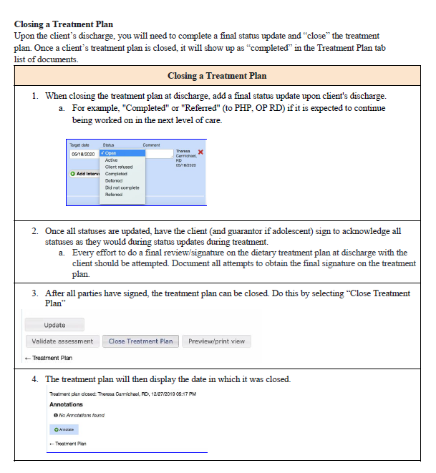
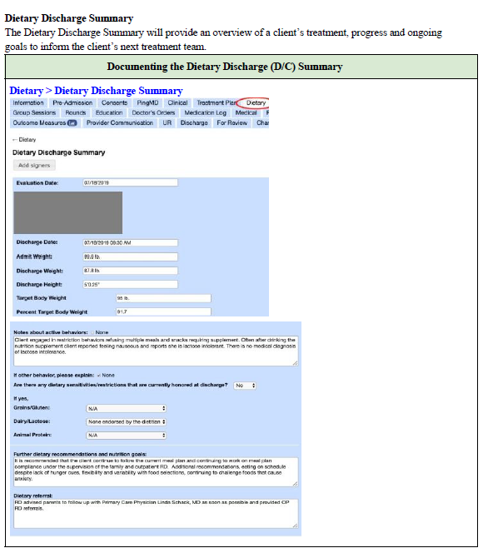
Discharge Planning:

Slide 79
MH Effective Documentation

Slide 80
MH Technicians

Slide 81
Treatment Plan Updates
Sample updates
The Treatment Plan must be updated!
Statuses must be updated to reflect new target date and include comments on patient’s progress.
It is imperative to have the patient sign the statuses every time so that no changes can be made, and progress can be tracked. When a patient signs the statuses, the box turns gray, and no edits can be made.
Once you add the new status, you want to include a comment about patient’s progress, such as how the patient has/has not made progress on that intervention and what the therapist plans to do in order to meet the goal.
As you complete interventions and/or as new problems come up, you will want to add a new goal, objective and/or plan with something to be worked on over the subsequent weeks.
Each update must be re-signed by patient and guarantor (when applicable)
Example of how to update Outcome Measures intervention

Slide 82
MH Nursing

Slide 83
MH Medical & Psychiatry

Slide 84
MH Clinical

Slide 85
Group Notes: Content (3 of 3)
Requires Improvement Individual Assessment is generic, does not include any subjective data on patient and does not reference any Problem(s) and/or Group Topic. Improper use of abbreviations.
Commitments Group
Pt
Good Individual Assessment provides patient quote, observation of patient’s behavior, how the patient responded to activity and interpersonal interactions. Missing: Brief mental status and/or clinical assessment.
Excellent Individual Assessment provides brief mental status, observation of patient’s behavior, quote, how patient responded to prompt and connects back to SUD Problem and Group Topic. No abbreviations used.

Slide 86
Identification of Problem List
Related assessments reviewed for data:
( e.g., H&P, psych eval,dietary assessment, outcome measures, collateral records, etc.)
Biopsychosocial
Assessment
The Problem List

Slide 87
Identification of Problem List
The Problem List
Defer
Not a current focus of treatment, a/o requires further assessment
(EMR will not generate a TP¹)
Refer
Out of scope, a/o requires specialist
Treat
Active Treatment Plan
The Problem list may continue to develop as the patient moves through treatment
New problems may be added as conditions change
The Problem list must address all Diagnosis/es (but the Problem List may be more Comprehensive than the Diagnosis Form, as it also includes identified Problems that do not meet diagnostic criteria)
Example: If a diagnosis for PTSD is present, then Trauma must be included on the Problem list
Alternatively, if a Problem is identified for Disordered Eating, then there should be an Eating Disorder diagnosis, or a Rule/Out” or "Provisional" diagnosis” for Eating Disorder
The Problem list includes information collected from all assessments and patient concerns (e.g., “Problems”) that have been identified
The Problem list and treatment plan(s) should be developed based on a multidisciplinary assessment and “may include, diagnoses, medical conditions, functional limitations, living environment, and/or symptoms” (AHIMA, 2020).
1

Slide 88
Problem List versus Treatment Plan
The Problem List must include any significant issues reported by the patient, even if they are not a focus of treatment:
The Treatment Plan(s) must include any significant issues reported by the patient that are a focus of treatment:
Not a Focus of Treatment BUT, identified in assessments as Problems
Focus of Treatment
=
1. Depression
2. Family Involvement
Notes:
Since you already know the requirements (e.g. family conflict for RTC and PHP, suicide risk/ideation for high risk), then it is recommended you obtain a goal in the patient’s words during the intake process.
It is important understand that the Problem List can be broader, as it identifies what the patient reports. A good example is Chronic Pain. This may be a problem that is included on the Problem List but has a status of Referred (to MD).

Slide 89
Treatment Planning: Requirements at a glance (1 of 3)
Signatures:
Signatures must be captured within 72 hours of admission
(patient, guarantor, therapist, clinical supervisor)
Therapist signatures must be on treatment plan (not Attestations)
Signatures on Treatment Plans is best practice! (Reserve Attestations for when patients and/or guarantor are unavailable)
Needs Assessment:
Treatment plans MUST include language from the Needs, Strengths, Preferences, Goals (NSPG) section of Patient BPS
Outcome Measures:
Treatment plans MUST include a treatment objective that focuses on outcome measures (DASS-21/RAS) and how the score informs treatment planning.
I.e., including the score without any context of what this means for the treatment plan is insufficient.
Is the RAS score increasing? Does that evidence the current treatment plan is effective and no changes are indicated at this time?
Is the RAS score decreasing and as a result, therapist will increase family therapy from 1x/wk. to 2x/wk. w/ the goal that by doing so, client’s engagement in recovery will improve (and RAS score will increase?)

Slide 90
Treatment Planning: Requirements at a glance (2 of 3)
Goals:
Include at least one goal stated in the patient’s words for each Problem
Highly recommend to also include the Clinical Interpretation of the goal
Statuses and Status Updates:
Initial Status must be added to each intervention when the Treatment Plan (TP) is created. This allows for you to enter a Target Date for each intervention
Patient can sign the TP and TP Statuses at the same time when the TP is created (Golden List Thread View)
Status Updates (which are Kipu’s form of TP “reviews”) are required 30 days from admission date and every two weeks thereafter
Client must sign for at each Status Update. Guarantors must show evidence of review by signing a Family Attestation Form
Status Updates allow you to update the Target Date, enter commentary on patient’s progress, and change the Status from the drop-down menu (if applicable)
Determination of Treatment Plans:
Primary Diagnosis/Presenting Problem: e.g., Mental health diagnosis
Secondary and Tertiary Diagnoses: e.g., PTSD, Substance Use Disorder (Trauma, Substance Abuse Problems)
Other clinically relevant focuses of treatment: Education and Family Conflicts a/o Social Support Involvement
Suicide Risk a/o Safety Related TP:
If patient is determined to be a HIGH-risk level, they must have a TP for Suicidal Ideation, or Suicide Risk (Suicide Risk OP Care Plan OP)
For MODERATE risk level, you can either include a SI or Suicide Risk TP, or you can include suicide risk mitigation strategies in another treatment plan (e.g. Depression).

Slide 91
Treatment Planning: Personal check-off list (3 of 3)
Signatures | 𐄂 Patient 𐄂 Guarantor or 𐄂 N/A 𐄂 Therapist 𐄂 Clinical Supervisor or 𐄂 N/A
Needs Assessment | 𐄂 Included language from the Needs, Strengths, Preferences, Goals (NSPG) section of Patient BPS
Outcome Measures | 𐄂 Included a treatment objective that focuses on outcome measures (DASS-21/RAS) 𐄂 Included how the score informs treatment planning
Goals | 𐄂 Included at least one goal stated in the patient’s words for each Problem Highly recommended: include the Clinical Interpretation of the goal
Statuses and Status Updates | 𐄂 Initial Status added to each intervention when the Treatment Plan is created (w/ target date entered) 𐄂 Status Updates made 30 days from admission date and every two weeks thereafter 𐄂 Client signature at each Status Update 𐄂 Guarantors show evidence of review by signing a Family Attestation Form
Determination of Treatment Plans | 𐄂 Primary Diagnosis/Presenting Problem 𐄂 Secondary and Tertiary Diagnoses 𐄂 Education a/o Family Conflicts/Social Support Involvement 𐄂 Suicide Risk a/o Safety Related Treatment Plans

Slide 92
Treatment Planning: Clinical Information Reviewed (1 of 2)
Clinical information reviewed to formulate treatment plan
Prior to checking off an item below, it is your responsibility to ensure the information is accurate!
Ideally, all available assessments and evaluations are reviewed prior to the creation of the Treatment Plan. However, all assessments and evaluations do not need to be incorporated into each Treatment Plan.
Examples:
Do not check off “History and Physical”, if there is no History and Physical in the chart.
The below example makes sense for an ANXIETY Treatment Plan but would not make much as much sense for an Education Treatment Plan.

Slide 93
Treatment Planning: Clinical Information Reviewed (2 of 2)
The below example makes sense for a MEDICATION MANAGEMENT Treatment Plan but would not make as much sense for a Family Conflicts/Social Support
Involvement Treatment Plan.
The below example makes sense for a DISORDERED EATING Treatment Plan but would not make much sense for a Substance Abuse Treatment Plan.

Slide 94
Progress Notes: (1 of 2)
Reminders!
Use the Golden Thread to identify which Problems, Objectives, and Interventions were addressed in a specific session (Remember, you only want to check off the ones that were addressed in the session!)
Make sure the times do not overlap with other sessions (patients can’t be two places at once)
For conjoint sessions, only one clinician should document a note. E.g., if a therapist and dietitian hold a conjoint session with a mutual patient, only one clinician is to write a note and can document that the dietitian was present, under “additional attendees”. Duplicate notes can be viewed as “double billing”. Using this example, the dietitian can write a “contact note”, indicating the conjoint session (non-billable) by emphasizing the coordination of care
Include any safety concerns observed and actions completed to ensure safety
If patient reports suicidality, the Suicide Reassessment (Frequent Screener) should be completed
If client is on a 1:1 observation, and accompanied by another staff member in session, please document that

Slide 95
Progress Notes: (2 of 2)
Tips for Telehealth!
Make sure to identify Telehealth sessions appropriately!
Here are a few scenarios to help:
Therapist and patient are physically present in therapist’s Discovery Behavioral Health company office and patient’s family “zooms in” for a session, due to being outside the geographic area of the treatment center = Family and/or Collateral session
Therapist is in their Discovery Behavioral Health company office and receives a call that her patient is feeling symptomatic and is unable to make it to session, but is requesting a virtual session (from home if outpatient, from room if residential) = Telehealth
Both Therapist and patient are in their respective homes, due to a “stay-at-home” order and are meeting virtually via Zoom = Telehealth

Slide 96
Discharge Plan and Discharge Summary: (1 of 2)
Discharge Plan
(For the patient)
Is for the patient (and for the clinical record)
Is completed throughout treatment and functions as an evolving document/process
Includes Safety Plan/Crisis Management Plan
Includes specifics of aftercare appointments (e.g., Full Name and Address of Provider, Date and time of initial appt.
Referrals provided
Discharge Plan must be signed by the patient, and staff member responsible (counselor, therapist, case manager, discharge planner, etc.) prior to the patient discharging! For unexpected discharges, send the patient the discharge summary via secure email or patient portal.
Discharge planning must be initiated within 24 hours of admit!
Discharge Summary
(For the clinical record)
Is for the clinical record
Is completed upon patient’s discharge containing all relevant clinical information
Discharge summary must be signed by the therapist and clinical supervisor, (if applicable).
Discharge summaries MUST include:
Reason patient sought treatment
Treatment Summary
Clinical recommendations
Condition upon discharge
Summary of Treatment goals
Prognosis
Accurate Discharge Type
Evidence of referrals
*NEW*: A Discharge Statement can now be completed in lieu of a Discharge Plan & Summary, WHEN: Patient discharges ATA within < 72 hrs. of admission, OR, for internal DBH transfers. [Refer to Policy: DC 001]

Slide 97
Discharge Plan, Summary and Referrals
Discharge Plan
A Discharge Plan and Referrals:
Must include specifics of appointments for Problems Addressed (e.g., Substance use disorder)
“TBD” is insufficient
Must include follow-up appointments for medication management; please ensure patient has sufficient medications to bridge the gap from discharge and their first follow-up appointment w/ psych a/o physician
Must include follow up appointment within 72 hrs. for patients determined to be high-risk level
Must include referral list for Problems not addressed (e.g., If Trauma was identified as a Problem, but “Deferred”, the discharge plan should include (3) referrals for a trauma-focused therapists
Discharge Summary
A Discharge Summary and Referrals:
Must include a summary of appointments arranged for: Problems Addressed (e.g., Substance use disorder), follow-up for relevant medication management and follow-up appointment within 72 hrs. for high-risk patients, and general referral list provided for Problems identified, but not addressed
Must include evidence referrals were provided:
Referrals include both aftercare appointments (within DBH and outside of DBH), as well as general referral lists
If you are unable to provide one of the above two mentioned options, you will want to document that referrals were not provided (due to patient refusal, ATA, etc.) You would then include action steps, (e.g., sent a referral list via secure email, snail mail, or patient portal)
If patient was in our care for a brief period and you are unable to sufficiently complete items on the DC summary, indicate that (e.g., “Patient left against treatment advice and as a result did not set up aftercare appointments. Referrals have been sent to patient via …” Remember, while YOU may know what the circumstances of patients admit and sudden discharge are, it needs to be clear to a reader six months after patient’s discharge!

Slide 98
Suicide Awareness and Prevention: References & Resources
DBH Policies related to Suicide Prevention and Awareness:
Suicide Risk Assessment for Residential
Suicide risk Assessment for Outpatient
Environmental Risk of Suicide Assessment
One to One Observation Protocol for Residential
Simpson, Skip, J.D., et al, ZERO SUICIDE: https://zerosuicide.edc.org/sites/default/files/Legal%20and%20Liability%20Issues%20in%20Suicide%20Care%205.27.16%20PPT%20Transcript.pdf
Anita Rothera-Delaney RN, BS
https://www.myfreece.com/Applet/Course/BrowseCourse2.aspx?SiteCourseId=9342&CourseScheduleId=%E2%80%8B
Julie Taitsman, Chief Medical Officer for the US Department of Health and Human Services
https://oig.hhs.gov/newsroom/podcasts/2011/heat/heat09-trans.asp
https://www.hopkinsmedicine.org/news/newsroom/news-releases/words-matter-stigmatizing-language-in-medical-records-may-affect-the-care-a-patient-receives
https://store.jcrinc.com/assets/1/14/ebbh18samplepages.pdf
Stanhope, V. (2013) The Impact Of Person Centered Planning and Collaborative Documentation on Treatent Adherence https://doi.org/10.1176/appi.ps.201100489
TJC (2018). R3: Pain assessment and management standards for behavioral health care , https://www.jointcommission.org/-/media/tjc/documents/standards/r3-reports/r3_20_pain_standards_bhc_12_21_18_final.pdf
References and Resources:
Text hello to 741741
Columbia Suicide Severity Rating Scale
Safety Planning Intervention: A Brief Intervention to Mitigate Suicide Risk
The Joint Commission Behavioral Health Care: 2020 National Patient Safety Goals
ZERO Suicide Model - A model for reducing suicide in United States behavioral healthcare
Disaster and Distress emergency resources for patients,families and employees
COVID-19 UPDATE: COMBATING SOCIAL ISOLATION WITH THE COLUMBIA PROTOCOL: A COMMUNITY RESOURCE TO MITIGATE COVID-19 RELATED MENTAL HEALTH SEQUELAE

