Slide 1
High-intensity electromagnetic technology (HIEMT) Electrical Muscle Stimulation (EMS)

Slide 2
LEGISLATION

Slide 3
LEGISLATION
It is a legal requirement for employers to display an approved health and safety poster or to supply employees with an equivalent leaflet or information and to provide training.
It is recommended that you get copies of the following from your local council:
Health and Safety in the Workplace
Trade Descriptions Act
Data Protection Act
Sales of Goods Act
COSSH Regulations and Risk Assessment (Control of Substances Hazardous to Health)
Local Government (Miscellaneous Provisions) Act 2002
The Management of Health and Safety at Work Regulations 1999
Workplace Regulations 1992
The Manual Handling Regulations 1992
The Personal Protective Equipment at Work Regulations 1992
Health and Safety (Display Screen Equipment) Regulations 1992
The Electricity at Work Regulations 1992
Health and Safety (First Aid) Regulations 2018
RIDDOR – The Reporting of Injuries, Diseases & Dangerous Occurrences Regulations 2013
Regulatory Reform (Fire Safety) Order 2005
Consumer Protection Act of 2015

Slide 4
All businesses are required by law to comply with the following health and safety acts, which are monitored and managed by The Health & Safety Executive (HSE) www.hse.gov.uk.
Health and Safety at Work Act 1974 and updated in 2015
This protects your rights either as an employer or employee. The law states that the employer must provide a safe working environment, provide health and safety training for staff, produce a written policy of the company’s health and safety policy, and ensure that anyone on their premises is not exposed to any health or safety risks.
Trade Descriptions Act 2011, including amendments 2021
This act is particularly relevant to stylists as it relates to how the goods or services are described in any kind of advertising or promotional material. The act makes it illegal to mislead the public in any way or make any false claims about what you are able to do.

Slide 5
Data Protection Act of 2018
This is only relevant if you are storing information about your clients on a computer. If so, you must register your business on the Data Protection register.
General Data Protection Regulation GDPR
If you are collecting and storing personal data as a therapist, then you will need to comply with GDPR. You will need to decide which of the six lawful bases on which you will collect and store personal data and inform your clients of how and why you will retain their data and for how long. The Independent Commissioners Office will provide you with all relevant information.
Sale of Goods Act 2015
This act protects your clients’ rights by insisting that any goods or services sold must be of a satisfactory standard, be suitable for the purpose described, accurately described, and provided in a reasonable time and for a reasonable price.

Slide 6
Control of Substances Hazardous to Health Act (COSHH) 2002
COSHH regulations cover the essential requirements for controlling exposure to hazardous substances, and for protecting people who may be affected by them. You should carry out a COSHH assessment to identify all chemicals, products or other substances which could cause harm.
A substance is considered to be hazardous if it can cause harm to the body. It poses a risk if it is inhaled, ingested, in contact with the skin, absorbed through the skin, injected into the body or introduced to the body through cuts.
Always check the ingredients and instructions of all products to see what they contain and ensure they are correctly stored. If the product could cause harm, it should be listed on your COSHH assessment, together with what the risk is and who is at risk from it.
Next, decide on the degree of risk and who to minimise that risk. If you can, try to replace high-risk products with lower risk ones. Never leave chemicals identified as hazardous in areas accessible to the general public. Do not forget, COSHH substances include both those used for treatments and cleaning.

Slide 7
Local Government (Miscellaneous Provisions) Act 1999
The local authority is responsible for registering and licensing any businesses where invasive treatments or hair treatments are taking place. They are able to implement their own local by-laws, and these can vary between different local councils. To find out your local bye-laws, you should contact your local council.
The Management of Health & Safety at Work Regulations 1999
This act outlines the responsibilities of the owner/manager of the business to protect the well-being of all who visit the premises, to keep a record of all checks they have made and also of any first aid treatments carried out on their premises.

Slide 8
The Workplace (Health, Safety and Welfare) Regulations 1992
These regulations govern the appearance of all parts of the Workplace, not just the salon. This would include suitable toilet facilities which are kept clean and tidy with adequate soap, towels, hot & cold running water etc. Proper ventilation, the areas are well lit, the area is at a comfortable temperature, is clear of all waste material (keep the walkways clear of clutter), has up to date fire fighting equipment, has drinking water available.
The Manual Handling Regulations 1999
This relates to the appropriate posture when lifting to reduce the risk of injury and to safely carry out manual tasks required in the Workplace.

Slide 9
The Personal Protective Equipment at Work Regulations 2002
This act requires you to provide the correct safety/protective equipment to carry out a particular task.
The Health & Safety (Display Screen Equipment) Regulations 1992
These regulations are relevant to anyone using a computer and require you to get regular eye tests, take regular breaks, and use the correct height adjusted chair.
The Electricity at Work Regulations 1992
This governs the use of electrical equipment in the Workplace and ensures that any equipment is checked at least once a year by a qualified electrician. Any faulty equipment is removed from service, and written records are kept should an inspector wish to see them.

Slide 10
Health and Safety (First Aid) Regulations 2018
No matter how small your business is, there must be first aid treatment available should an injury take place.
RIDDOR – The Reporting of Injuries, Diseases & Dangerous Occurrences Regulations 2013
This outlines the correct procedure to adopt if a workplace accident occurs. An accident book is a must.
Regulatory Reform (Fire Safety) Order 2005
All premises must have adequate means of dealing with a fire, and all members of staff should know where these are. This can include fire extinguishers and blankets; however, you should only operate a fire extinguisher if you have been properly trained to do so. All equipment should be checked and maintained regularly.
Fire Drill notices should be clearly displayed and should inform people of what to do in case of a fire. All staff should be trained in the location of alarms, exits and meeting points.

Slide 11
Consumer Protection Act 2015
This is designed to look after your clients’ interests and protect them from any product deemed unsafe.
The Provision and Use of Work Equipment Regulations 1998
This states the duties of any users of the equipment. It identifies the requirements in selecting and maintaining suitable equipment, as well as the training and safe use of it.
Cosmetic Products (Safety) Regulations 2008
These regulations require that cosmetics and toiletries are safe for their intended purpose and comply with labelling requirements.
Disability Discrimination Act 1996
You should ensure that clients are not discriminated against on the grounds of disability. You cannot use this as a reason to refuse to provide a service, provide a service to a lesser standard or fail to make reasonable adjustments. The premises must be able to facilitate access for disabled people.

Slide 12
The Equality Act 2010
gives disabled people important rights of access to everyday services. Service providers have an obligation to make reasonable adjustments to premises or to the way they provide a service. Sometimes it just takes minor changes to make a service accessible. What is considered a reasonable adjustment for a large business such as a bank, may be different from what is a reasonable adjustment for a small local salon. It is about what is practical in the service provider’s individual situation and what resources the business may have. They will not be required to make adjustments that are not reasonable because they are unaffordable or impractical.

Slide 13
Reporting Accidents
All accidents and near misses should be recorded in an Accident Report Book, which should be kept with a first aid kit on the premises.
The following information must be recorded:
Full name and address of the person(s) involved in the accident.
Circumstances of the accident.
Date and time of the accident.
All details of what may have contributed to the accident.
The type of injury that occurred and treatment provided on or off-site.
Details of any witnesses.

Slide 14
The Personal Protective Equipment at Work Regulations 1992
This act covers your requirements under the COSHH regulations. You are required to wear or provide to your employee's protective clothing or equipment (PPE) to ensure their health and safety when handling chemicals or coming into contact with bodily fluids.
What PPE will you need?
Powder-free non-latex Gloves that must be changed for each new client.
Disposable aprons.
Face Masks
Eyewear (optional)
Some therapists like to wear eye protection, although the risk is very low from spillages or splashes. However, a new apron, facemask and gloves should be worn before each new client.

Slide 15
Salon Hygiene, Health & Safety
The salon should be cleaned thoroughly every day.
The working area must be cleaned before and after every client.
Fresh towels and linen should be used for every new client that has been laundered at a minimum of 60°C.
Couch roll, disposable plastic sheeting or waterproof bed sheets need to be used to protect the couch and keep the area as clean as possible.
Products should be dispensed from purpose-specific pump or spray bottles. Creams can be removed from jars or bottles with clean spatulas.
Replace all lids on products securely after use.
All tools that are non-disposable should be sterilised prior to use.
Bins should be metal and have foot pedal operations and be emptied every day. Bins should be collected by an appropriate commercial waste disposal company.
All fire exits should be clearly marked and accessible at all times.
Read all labels and follow manufactures instructions.
Know the hazardous warning signs on products.
Store products safely and in accordance with safety data sheets.
Ensure equipment is placed on a sturdy surface and cannot fall off.
Check wires and plugs regularly on any electrical equipment. Ensure electrical equipment is PAT tested annually. Faulty equipment should not be used.
A first aid kit that complies with the Health and Safety (First Aid) Regulations 1981.

Slide 16
Appearance of the Therapist
A therapist should ensure that they look well presented at all times. Therapists will be working in close contact with a client, and it is important that a professional image is observed.
A therapist should:
Wear clean, freshly laundered and ironed uniform each day.
Wear clean, flat, closed-toe shoes.
Have short, clean, manicured nails.
Have a fresh breath.
Wear antiperspirant.
Apply modest makeup for a natural look.
Wear hair up and away from the face.
Wear minimal jewellery.

Slide 17
Professional Ethics and Standards of Practice
Therapists should:
Maintain the highest possible standards of professional conduct.
Always be courteous and show respect for clients, colleagues and other professionals.
Never gossip or criticise another therapist, salon or brand.
Never talk across a client to another member of staff.
Not to engage in conversations about politics, religion or race that may cause offence.
Maintain a good reputation by setting an example of good conduct in all your communication with clients, team members and visitors to the business.
Ensure to make the treatment or service special for every client.
Respect client confidentiality.
Explain the treatment to the client and answer any questions and queries prior to carrying out the treatment.
Treat all clients in a professional manner at all times regardless of their race, colour, religion, sexual orientation or ability.
Not to treat minors or clients with limited mental capacities, such as those with Alzheimer's or dementia without prior written consent from a parent or carer.

Slide 18
Practising good ethics is essential for the reputation of the therapist and the welfare of the clients. The following is an example of standards and ethics for therapists:
Conduct yourself in a professional, honest and ethical manner.
Promote professionalism
Establish a treatment plan with your client and evaluate the outcome at the end of every session.
Truthfully represent your credentials, qualifications and education, experience, training and competence relevant to practice.
Maintain the confidentiality of the client.
Take a full medical history of the client and ensure that they are suitable for treatment and the treatment is the best solution for their concerns.
Give full aftercare advice.

Slide 19
Precautions taken within the salon to prevent Contamination and Cross-Infection
Hands
Wash with soap/disinfectant and warm water before and after each client—dry hands with a paper towel or blower.
Surfaces
Wipe over with disinfectants, e.g. Alcohol, Surgical spirits.
Treatment of Wounds
If the skin bruises or bleeds after the insertion of a needle, a small pad of dry cotton wool should be used over the area to cover it and apply pressure until the bleeding stops. Apply aftercare solution to the area and work in a different area. The same applies to extractions or any other form of skin piercing. Use disinfectant to clean area.
Disposal
Sharp metal instruments, e.g. needles, lancets, should be placed in a sharps box after use. When the box is about 3/4 full, it may be disposed of by special arrangement. Usually collected by local health office and incinerated at a local hospital.
Metal Instruments
Sterilised before and after each client in Autoclave or in Glass bead steriliser, and wipe with Chlorhexidine Gluconate or Methylated spirits.

Slide 20
Skin Preparation
Do not use sharp or pointed instruments on or at least near areas of a client's skin that are obviously diseased, infected or inflamed. Except in facial treatments during the extracting phase (a tile with a lancet and cotton wool dampened with methylated spirits and an antiseptic solution containing Chlorhexidine Gluconate must be prepared, hands should be washed before and after extractions and finger cots or gloves must be used).
Cuts on your Hands
Cover existing wounds with a waterproof dressing, wash fresh cuts and encourage bleeding under running water and then cover with a waterproof dressing. Clean with an antiseptic. Always have a box of plasters/waterproof dressing available. No salon should be without a first aid kit.
Needles
Do not test needles on yourself. Test needles on a damp of cotton wool held with tweezers. Needles should only be used once, and needles must not be used on more than one client.
Creams
Tubes are better than jars. Always use a spatula to obtain creams from containers. Never use fingers and always close a container after use. Excess product must not be returned to containers.
Blood
Anything that has come into contact with blood must be disposed of in the correct manner. Pay attention to the following: Hands, lancets, tweezers, surface, disposal gloves, bin liners, cotton wool or gauze and needles)

Slide 21
Colds/Flu
Wear a surgical mask. Wash your hands regularly, especially after sneezing or blowing the nose. Also, wash hands in general after touching other surface areas. General advice - stay at home when feeling ill or send employees home if they develop cold/flu symptoms at work.
Waste Bins
Bin liners. Emptied regularly. Bins should have lids.
Gloves
Surgical gloves can be used, e.g. epilation or, to prevent contamination. Used always when performing any procedure that breaks the skin and any action that may come into touch with blood.
Instruments
Must be cleaned, sanitised and sterilised or where appropriate disposable tools should be used.

Slide 22
Sterilisation Methods

Slide 23
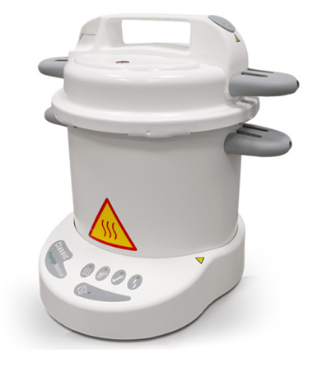
Autoclave
Works like a pressure cooker.
Consists of 2 chambers. Water in the lower chamber and instruments on the upper chamber.
The principle of sterilisation is moist heat.
The water boils in the lower chamber and steam is released towards the upper chamber. Instruments are left in the unit for 10 - 20 min. Afterwards, instruments must be placed in a sterile and clean container.
The moist heat autoclave operates at 121°C and is considered a very effective means of sterilisation.
Other types available, e.g., dry heat autoclave, vacuum autoclave, flash instrument autoclave.
The time and temperature of dry heat autoclave is 160°C (320°F) for 2 hours or 180°C (356°F) for one hour.
Consult manufacturer's instructions and local government laws and regulations on sterilisation times and temperatures.

Slide 24
Advantages of an Autoclave
Disadvantages of an Autoclave
Economical and very effective
Non-toxic on instruments
Easy to operate
Sharp instruments can become blunt.
Metal instruments might rust. Recommend use of stainless-steel instruments.
Expensive
Plastic instruments will be damaged.
Autoclaves will need to be kept clean.
Regular servicing and calibration are required of the device.

Slide 25
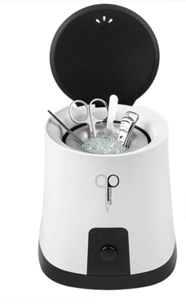
Glass Bead Steriliser
Operates at approximately 300°C.
Metal instruments will thus be completely sterilised within minutes.
Only the parts covered with beads will be sterilised.
The unit takes + 20 - 30 minutes to warm up before sterilisation can take place.
If more than one instrument is placed in the container, a longer time must be added for sterilisation.
Consult manufacturers` instructions and local government laws and regulations on sterilisation times and temperatures

Slide 26
Wet Sterilisation (Chemical)
Asepsis can be obtained by washing down all surfaces, walls, floors, treatment beds, tiles, trolleys, work surfaces, basins etc. after basic cleaning with an antiseptic solution. EG: Antiseptic solution concentrates, diluted according to manufacturers' instructions. Towels can also be disinfected in this method. If metal tools are sterilised by this method, the liquid must contain a rust inhibitor.

Slide 27
UV Cabinet
They are used for the maintenance of your sterilisation process.
Basically, used as a storage unit.
They are not used for sterilisation only for sanitation.
This cabinet will keep your item as clean as it was when you first inserted it.

Slide 28
Antiseptics and Disinfectants
Antiseptic
A diluted disinfectant that is safe to apply to the skin. Its' task is to slow down multiplication, growth and in some cases may destroy/kill micro-organisms if the strength of the solution is correct, e.g. some soaps (hands), alcohol and hydrogen peroxide etc.
Disinfectant
A chemical agent which destroys or kills all micro-organisms. Safe to apply on surfaces but too toxic to be applied directly onto the skin, e.g. Quaternary Ammonium compound/Quats, formalin, ethyl or grain alcohol.

Slide 29
Ergonomics
Posture is important, whether you are sitting or standing up to do a treatment. Try to find a working position that is comfortable for you and reduces the need to lean over to just one side.
Using height adjustable treatment couches and chairs. Choose a height that reduces your need for bending over the client. Ideally, your back should be at a 90-degree angle. Your chair should be comfortable to avoid pressure point sores or injury.
Try to avoid twisting the neck, keep your head upright and keep your shoulders relaxed.
Never ignore pain; look at ways to alleviate the symptoms. If you cannot take a break during treatment, then you can adopt gentle stretching techniques.
Repetitive strain injuries can be caused by using the same movements over and over again. Try to avoid repetitive flexing of the wrist and instead alternate by bending elbows or shoulders instead. Equipment should feel comfortable in your hand and have as minimal vibration as possible.

Slide 30
Storage
Make sure you receive a copy of Material Safety Data Sheets (MSDS) from your suppliers.
All staff must be trained on the use of products and equipment.
Training manuals and information leaflets should be accessible to all staff.
Store your products correctly by following the guidance on the MSDS.
Carry out a risk assessment on each product or COSHH report if required.
Keep products in original containers where possible and ensure any decanted products are fully labelled in smaller, purpose-built containers.
Keep all flammable products out of direct sunlight and at room temperature or below.
Mobile therapists must make suitable travel arrangements to avoid spillage and ensure safe working practice and be professional in appearance.

Slide 31
Insurance
There are several types of insurance that are potentially relevant to you as a therapist. The most important is the 'Professional Indemnity Insurance' and 'Public Liability Insurance'. Both of these are necessary in the unlikely event that a client decided to sue you.
Public Liability Insurance - This covers you if a member of the public, i.e. a client or passer-by is injured on your premises or if their personal property is damaged in any way.
Professional Indemnity Insurance - This protects you should a client decide to sue you claiming personal injury or damage as a result of treatments carried out by you.
Employer’s Liability Insurance - This is only necessary if you hire others to work for you. This type of insurance would cover you should a member of your staff have an injury on your premises.
Product Liability Insurance - This insurance is important if you plan to use, manufacture or sell products as part of your business. This will protect you in the event that a client is dissatisfied with the product or experiences a reaction to using the product.
Car Insurance - If a car is used for business purposes, ensure that this is covered by the policy and that theft of equipment is included.

Slide 32
Electricity
To use electricity correctly, we need to understand what is happening in electrical appliances and some of the electrical terms used.
Mains electricity is generated in power stations and can often travel a long distance from the places where we would use the energy, for example, where we live and work. By plugging appliances into the mains sockets, this energy is then available for us to use in various forms.
The below diagram shows a simple circuit which you would’ve seen at school. Energy is stored in a battery, and electrical current flows in the wires, energy is then carried by the current to the bulb, and the bulb uses the energy to get hot.
The following terms are used to describe what happens in an electrical circuit:
Current is the flow of electricity. We measure currents in amperes (usually shortened to amps or abbreviated to A). We can compare the current in a circuit to the flow of water in pipes.
Direct current (dc) means that the current always flows in the same direction. This is what happens in the circuit shown above, and also when we charge a mobile phone.
Alternating current (ac): the electricity from the mains is ac, meaning that the direction of the current is always reversing (alternating). In Europe, the frequency of the AC supply is 50 Hz (which means that the direction of the current is reversed 100 times a second).
Potential difference (or voltage): this can be thought of as the push that makes the current flow. It is usually called the voltage and is measured in volts. The voltage from the mains is about 230 volts. If we increase the potential difference across an appliance, the current will increase.
Resistance (ohms): all electrical circuits have resistance. This is a measure of how hard it is for the current to flow around the circuit; high resistances will mean small currents. Resistance is measured in ohms.
Power (watts): this is how we measure how much energy replace uses every second. We measure power in watts. As an example, a lightbulb may be labelled as 60 watts while the kettle may be labelled as 2200 watts (or 2.2 kilowatts – ‘kilo’ means ‘thousand’. The potential difference(voltage) Will be the same for the light bulb and the kettle at 230 volts. As we might expect, the kettle will require a larger current flowing through it (about 9.5 amps) than the bulb (about ¼ of an amp).

Slide 33
Ohms law and electrical circuits
A current that flows through a circuit will vary in direct proportion to the potential difference and in inverse proportion to the resistance; this is known as ohms law. And Therefore, is the potential difference increases, so does the current; was it the resistance increases, the current decreases.

Slide 34
Electrical safety
Electrical appliances, if not used correctly, can be dangerous and cause harm. Hazards include:
Electrocution: the main electricity supply (230 volts) Will deliver a large enough current through the body to injure or kill someone. A current as low as 0.1 amps can be fatal.
Electrical fires: overloaded sockets, extension leads or faulty appliances can lead to overheating and fires.
Explosions: in the event of a gas leak, a spark from an electrical switch is all that is needed to create an explosion.
Tripping: trailing wires or badly positioned appliances can be a tripping hazard.
Medical employers and employees have responsibilities on the electricity at work regulations (1989) to ensure that all electrical equipment is used safely. The following rules should be observed:
Equipment should be stored in the correct place when not in use and all the wires and attachments securely fixed.
Any equipment with twisted, frayed or worn wires or with cracked or loose plugs should not be used.
Plug sockets should not be overloaded by using multiple adapters.
Check that plugs have the correct fuse.
Whilst using electrical equipment, ensure that it is on a stable surface, come away from water and with the leads safely tucked away.
Do not operate electrical equipment with wet hands.
Always read and follow the manufactures instructions.

Slide 35
Safety features
All electrical equipment has a number of Safety features:

Slide 36
Fuses
A fuse is a deliberate weak spot in a circuit that is designed to ‘blow’ if the current flowing through it is too large. All three-pin plugs have fuses fitted, whilst some appliances may have fuses fitted to them.
Blown fuses should be replaced with a fuse of the correct rating. If fuses on the appliance or plug keep blowing, the appliance is faulty and should be checked by an electrician before further use. Fuses will not protect against electrocution but will offer protection from overheating.

Slide 37
Earthing
The largest pin on a three-pin plug is known as the earth pin. No current flows through this pin if the appliance is working correctly. It’s a fault occurs a current-flows through the earth pin and allows the fuse to blow. Since they give protection against electrocution, the earth pin and its connections are an important safety feature.
Metal water pipes must also be earthed. This is done by using wires with green and yellow striped plastic coating. This is designed to help prevent electrocution; if a live wire accidentally touches the pipe. If the pipe is connected to the earth, a current will flow to the earth through the wires, and the fuse will blow.

Slide 38
Double insulated appliances
As the name implies, this simply means that electrical mechanisms are protected by two layers of insulating material and are not earthed. Appliances such as hairdryers are double insulated. Double insulated appliances do not need anything. They usually have a plug with a rigid plastic pin rather than a metal one.

Slide 39
Residual current circuit breaker
Besides the earth pin on a three-pin plug, there are two smaller pins called the live pin and the neutral pin. When the appliance is working correctly, the current flowing in the two pins will be equal. Should a fault develop and the current starts to flow through you, less current Will be coming out of the appliance through the neutral pin that is going into the appliance through the live pin is (because some of this current is going out through you). A residual current circuit breaker is created to detect the currents flowing in the two pins and turn off the circuit if the flow is not equal before you are electrocuted.

Slide 40
Cost of electricity
Electricity is measured in kilowatt-hours (sometimes called units). When calculating the cost of running an appliance, multiply the power of the appliance (measured in kilowatts) by the length of time of use (Measured in hours). This will give you the number of units used. Multiply this figure by the cost of each unit to get the total cost. For example, if you run a 3 kilowatts wax pot for six hours, we will have used 3 x 6 = 12-kilowatt hours. If the cost of one unit is 8p, that this will cost 12 x 8 =96p.

Slide 41
Skin Anatomy
The skin makes up around 12% of an adult's body weight. The skin has several important functions which include:
Absorption of UV rays from the sun helps with the formation of Vitamin D, which is needed by the body for the formation of strong bones and good eyesight.
Skin is made up of 3 major layers known as the Epidermis, Dermis and the Subcutaneous.
S | Sensation | The main sensory organ for temperature control, pressure, touch and pain.
H | Heat Regulation | The skin helps to regulate the bodies temperature by sweating to cool the body down when it overheats and shivering when the body is cold.
A | Absorption | Some creams, essential oils and even much-needed water can be absorbed through the skin.
P | Protection | Overexposure to UV light may harm the skin; the skin protects itself by producing a pigment, called melanin, which we see when we tan. Bacteria and germs are also prevented from entering the skin by a protective barrier called the Acid Mantle. This barrier also helps to protect against moisture loss.
E | Excretion | Waste products and toxins are eliminated from the body through sweat glands.
S | Secretion | Sebum and sweat are secreted onto the skin's surface. The sebum keeps the skin lubricated and soft, and the sweat combines with the sebum to form the acid mantle.
V | Vitamin D Production | Absorption of UV rays from the sun helps with the formation of Vitamin D, which is needed by the body for the formation of strong bones and good eyesight.

Slide 42
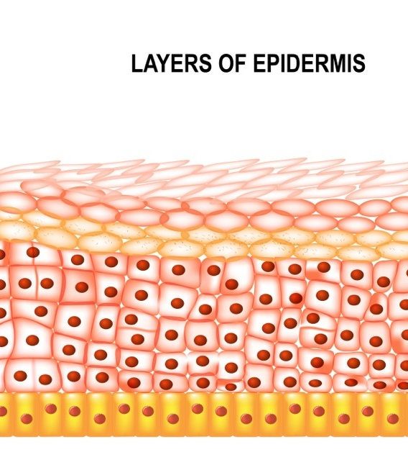
The Epidermis
This is the outermost layer of the skin. There are various layers of cells within the epidermis, the outermost of which is called the stratum corneum (or horny layer). The layers can be seen clearly in the diagram of the skin. The surface layer is composed of twenty-five to thirty sub-layers of flattened scale-like cells, that are continually being exfoliated off by friction and replaced by the cells beneath.
The surface layer is considered the real protective layer of the skin. Cells are called keratinised cells because the living matter within the cell (protoplasm) has changed to form a protein (keratin) which helps to give the skin its protective properties.
New skin cells are formed in the deepest layer of the epidermis. This layer is known as the stratum basale. New cells being to gradually move from this layer towards the stratum corneum to be shed. As they move towards the surface, the cells undergo a process of change from a round, living cell to a flat, hardened cell.
The layers of the epidermis from top to bottom are known as:
Stratum Corneum/Horny Layer
Stratum Lucidum/Clear Layer (only found in the palms on the hands and soles of the feet)
Stratum Granulosum/Granular Layer
Stratum Spinosum/Prickle Cell Layer
Stratum Basale/Basal or Germinative Layer

Slide 43
Dermis Layer
The dermis is a tough and elastic layer containing white fibrous tissue interlaced with yellow elastic fibres.
The dermis is an expanse layer and contains:
Blood vessels
Lymphatic capillaries and vessels
Sweat glands and their ducts
Sebaceous glands
Sensory nerve endings
The erector pili – which involuntary activates tiny muscles attached to the hair follicle in cold weather to trap heat.
Hair follicles, hair bulbs and hair roots

Slide 44
Subcutaneous Layer
This is the deepest layer of the skin and located beneath the dermis. It connects the dermis to the underlying organs. The subcutaneous layer is mainly composed of loose fibrous connective tissue and fat (adipose) cells interlaced with blood vessels. This layer is generally around 8% thicker in females than in males. The functions of this layer include insulation, storage of lipids, cushioning of the body and temperature regulation.

Slide 45
The Cardiovascular System
All body systems are linked by the cardiovascular system, a transport network that affects every part of the body. To maintain homeostasis, the cardiovascular system must provide for the rapid transport of water, nutrients, electrolytes, hormones, enzymes, antibodies, cells, and gases to all cells. In addition, it contributes to body defences and the coagulation process and controls body temperature. The term cardiovascular refers to the cardiac (heart) muscle, the vascular system (a network of blood vessels that includes veins, arteries, and capillaries), and the circulating blood. Thus, the three primary components of the cardiovascular system are:
Heart
Circulating blood
Blood vessels (the circulatory system)

Slide 46
Organ/Structure | Primary Functions
Heart | Muscular organ about the size of an adult's closed first Contractions push blood throughout the body The average heart beats 60 to 80 times per minute
Arteries | Transport blood from the right and left chambers of the heart to the entire body Large arteries branch into arterioles the farther they are from the heart Carry oxygenated blood that is bright red in colour Have thicker elastic walls than veins do Have a pulse Are located deep in muscles/tissues
Veins | Blood is transported from peripheral tissues back to the heart and lungs Large veins branch into venules in the peripheral tissues Deoxygenated blood is carried back to the lungs to release carbon dioxide Carry blood that is normally dark red in colour Have thinner walls than arteries; walls appear bluish Valves prevent the backflow of blood Are located both deep and superficially (close to the surface of the skin)
Capillaries | Connect arterioles with venules via microscopic vessels Oxygen and carbon dioxide, nutrients, and fluids in tissue capillaries are exchanged Waste products from tissue cells are passed into capillary blood, then onto removal from the body Carry blood that is a mixture of arterial blood and venous blood
Circulating Blood | Oxygen and carbon dioxide, nutrients, and fluids are transported by circulating blood Waste products are removed Nutrients are disbursed Regulates body temperature and electrolytes Regulates the blood-clotting system

Slide 47
The Heart
The human heart is a muscular organ about the size of a man's closed fist. The heart contains four chambers and is located slightly left of the midline in the thoracic cavity. The two atria are separated by the interatrial septum (wall), and the interventricular septum divides the two ventricles. Heart valves are positioned between each atrium and ventricle so that blood can flow in one direction only, thereby preventing backflow. The right atrium of the heart receives o2-poor blood from two large veins: the superior vena cava and the inferior vena cava. The superior vena cava brings blood from the head, neck, arms, and chest; the inferior vena cava carries blood from the rest of the trunk and the legs. Once the blood enters the right atrium, it passes through the heart valve (right atrioventricular, or tricuspid, valve) into the right ventricle. When blood exits the right ventricle, it begins the pulmonary circuit—it enters the right and left pulmonary arteries. Arteries of the pulmonary circuit differ from those of the systemic circuit because they carry deoxygenated blood.
Like veins, they are usually shown in blue on colour-coded charts. These vessels branch into smaller arterioles and capillaries within the lungs, where gaseous exchange occurs (o2 is picked up, and Co2 is released). From the respiratory capillaries, blood flows into the left and right pulmonary veins and then into the left atrium. The left atrium also has a valve (left atrioventricular, bicuspid, or mitral valve). Blood flows through the mitral valve into the left ventricle. When blood exits the left ventricle, it passes through the aortic semilunar valve and into the systemic circuit by means of the ascending aorta. The systemic circuit carries blood to the tissues of the body. If a valve malfunctions, blood flows backwards and a heart murmur results. The right side of the heart pumps o2 poor blood to the lungs to pick up more o2; the left side pumps o2-rich blood toward the legs, head, and organs. The heart's function is to pump sufficient amounts of blood to all cells of the body by contraction (systole) and relaxation (diastole). Because the lungs are close to the heart, and the pulmonary arteries and veins are short and wide, the right ventricle does not need to pump very hard to propel blood through the pulmonary circuit. Thus, the heart wall of the right ventricle is relatively thin. On the other hand, the left ventricle must push blood around the systemic circuit, which covers the entire body. As a result, the left ventricle has a thick, muscular wall and a powerful contraction.
Blood pressure increases during ventricular systole and decreases during ventricular diastole. Blood pressure not only forces blood through vessels but also pushes it against the walls of the vessels like air in a balloon. Therefore, it can be measured by how forcefully it presses against vascular walls.
The average heart beats 60 to 80 times per minute. Children have faster heart rates than adults, and athletes have slower rates because more blood can be pumped with each beat. During exercise, the heart beats faster to supply muscles with more blood. During and after meals, it also beats faster to pump blood to the digestive system. During a fever, the heart pumps more blood to the skin surface to release heat. Remember that all responses are designed to maintain homeostasis. The heart rate (pulse rate) is measured by feeling for a pulse and counting the pulses per minute.

Slide 48
The Vessels and Circulation
Three kinds of blood vessels exist in the human body:
Arteries
Veins
Capillaries
This intricate system travels to every inch of the human body through repeatedly branching vessels that get smaller and smaller as they move away from the heart (arteries) and then get larger again as they return toward the heart (veins). The largest artery (aorta) and veins (venae cavae) are approximately 1 inch wide.

Slide 49
Arteries
Arteries are highly oxygenated vessels that carry blood away from the heart (efferent vessels). They branch into smaller vessels, called arterioles, and into capillaries. Arteries appear brighter red in colour, have thicker elastic walls than veins do, and have a pulse.

Slide 50
Veins
Blood is carried toward the heart by the veins (afferent vessels). It is remarkable that the blood in veins flows against gravity in many areas of the body; these vessels have one-way valves and rely on weak muscular action to move blood cells. The one-way valves prevent the backflow of blood. All veins (except the pulmonary veins) contain deoxygenated blood. Veins appear bluish in colour under the skin and have thinner walls than arteries. You should become familiar with the principal veins of the arms and legs. The antecubital area of the forearm is most commonly and generally the largest and best-anchored vein. Others in the antecubital area that are acceptable are the basilic vein and the cephalic vein.

Slide 51
Capillaries
Capillaries are tiny microscopic vessels that connect or link arteries (arterioles) and veins (venules) and may be so small in diameter as to allow only one blood cell to pass through at any given time. They are the only vessels that permit the exchange of gases (o2 and Co2) and other molecules between blood and surrounding tissues.
Capillaries do not work independently but are a part of an interconnected network. Each arteriole ends in dozens of capillaries (capillary bed) that eventually feed-back into a venule (when gas/ the nutrient exchange has been completed). Blood in the capillary bed is a mixture of arterial and venous blood.

Slide 52
The Blood
Circulating blood provides nutrients, oxygen, chemical substances, and waste removal for each of the billions of individual cells in the body and is essential to homeostasis and to sustaining life. Any region of the body that is deprived of blood and 02 soon becomes oxygen-deficient, and the tissues may die within minutes. This condition is called hypoxia.
Human bodies contain approximately 4.73 litres of whole blood, which is composed of water, solutes (dissolved substances), and cells. The volume of blood in an individual varies according to body weight; for instance, adult men usually have 5 to 6 litres of whole blood, whereas adult women usually have 4 to 5 litres.
Abnormally low or high blood volumes can seriously affect other parts of the cardiovascular system. Whole blood is normally composed of approximately 2.84 litres, or about 55 to 60 percent, of plasma and 1.89 litres, or about 40 to 45 percent, of cells. Thus, if a blood specimen is withdrawn into a test tube from a vein and centrifuged, about 55 percent will be plasma, and 45 percent will be formed elements (cells). The plasma portion contains approximately 92 percent water and 8 percent solutes. Solutes include proteins, such as albumin (maintains water balance in the blood); fibrinogen (for blood clotting); metabolites, such as lipids; glucose; nitrogen wastes; amino acids; and ions, such as sodium (Na), potassium (K), calcium (Ca), magnesium (Mg), and chloride (Cl).

Slide 53
The Lymphatic System
The lymph system is a collection of thin tubes that carries colourless liquid called lymph. As discovered in the circulatory system, blood travels around the body and delivers oxygen and other nutrients. On its journey, fluid leaks into the bodies tissues, and it is this fluid that makes the lymph, along with substances such as fibrinogen, water and lymphocytes. It travels around the tissues of the body and carries white blood cells. After travelling around the body, lymph enters one of the major lymphatic vessels, the thoracic duct, which begins near the lower part of the spine and collects lymph from the pelvis, abdomen, and lower chest. This duct runs up through the chest and empties into the blood through a large vein near the left side of the neck. The right lymphatic duct is the other major lymphatic vessel and collects lymph from the right side of the neck, chest, and arm and empties into a large vein near the right side of the neck. This means that lymph is continuously emptied into the blood, where it mixes with the plasma. The system has no heart or arteries but capillaries that extend into most tissues, which run parallel to the blood capillaries. In conclusion, lymph is formed when plasma seeps from the blood into the surrounding tissues and becomes tissue fluid, where it is collected by the lymph vessels. The main function of the lymphatic system is to fight infection, distribute excess fluid and transport fats around the body

Slide 54
Nodes
Throughout the miles of lymph vessels, there are small round nodes or glands, which are bean-shaped structures covered in a capsule of connective tissue. They are packed full of lymphocytes which are used to filter the lymph. These structures are made of lymphatic tissue, and here the white blood cells fight infection; that is why sometimes these glands can be felt, for example, in the armpits, in the groin and neck, as the lymph nodes trap bacteria or viruses that they cannot destroy immediately. The lymph node may swell and become painful and sore. Some nodes cannot be felt, for example, those in the abdomen, chest and pelvis. Occasionally the lymph nodes can trap cancer cells that they cannot destroy. The nodes then become swollen but not necessarily painful. This is why it is so important to check any swollen lymph node as cancers can develop in the lymph system.

Slide 55
Lymph
As lymph flows through the node, lymphocytes (white blood cells) are added, which leaves the lymph cleaner due to breaking down bacteria. Lymph drains through around 8 – 10 nodes before returning to the blood. Most lymph nodes are solitary, but some can be found in clusters. For example, a cluster is found in the ileum of the small intestine. These large masses of lymph nodules are known as Peyer's patches.

Slide 56
Lymph Vessels – carry lymph.
These are microscopic, thin-walled tubes that branch, interconnect and extend into almost all tissues of the body. They look like blood capillaries, but they contain a larger inner space and also have a closed-end. Lymph capillary walls are made up of overlapping cells that swing slightly inward when fluid outside the capillary pushes against them. This allows the milky fluid to enter the capillary and is now referred to as lymph. Small amounts of diffuse lymphatic tissue are found in virtually every organ of the body.
Lymph capillaries join to form larger vessels called lymphatic's or sometimes called lymph veins. Lymphatics are found in the subcutaneous tissue of the skin, following the same path as veins. Lymph vessels contain valves to prevent the backflow of lymph, and they allow lymph to travel through lymphatic nodes.

Slide 57
Lymphatic Ducts – collects lymph.
The thoracic duct is the principal vessel of the lymphatic system and carries lymph as well as a substance called chyle, which is a milky fluid that contains lymph and emulsified fats. It begins in the abdomen and runs to the neck, where it empties into the venous bloodstream at the left subclavian vein. This duct receives the lymph from smaller vessels of the lower limbs and the upper left side of the head and neck.
The right lymphatic duct is a vessel that collects lymph from the right upper side of the body and drains it into the right subclavian vein.
Cisterna Chyli vessels drain lymph from the intestines, which is laden with digested fats.

Slide 58
Bone Marrow
Bone marrow is found in the hollow of bones and is a spongy material that makes red and white blood cells and plasma. Once mature enough, two types of white blood cells, lymphocytes and myeloid cells made by the bone marrow, enter the bloodstream and circulate around the body. The lymphocytes also circulate in the lymph system. These cells only live for a few days, so it is essential that the bone marrow constantly renews the old ones.
There are four main organs that are involved with the lymphatic system. They are the spleen, thymus, tonsils and adenoids.

Slide 59
The Spleen
This organ is found in the upper left abdominal cavity and is the largest lymphatic organ in the body. The spleen consists of two types of tissue called white and red pulp. The white pulp consists mainly of lymphocytes, and the red pulp consists of venous sinuses, which are filled with blood and cords of lymphatic cells.
The function of the spleen is to filter blood, similar to the way lymph nodes filter lymph, but it also breaks down and destroys old red blood cells, which have a life span of around 120 days. The spleen holds extra blood that can be released into the circulatory system if needed.

Slide 60
The Thymus
As already discovered, the thymus is an endocrine gland, but it also helps to produce white blood cells, so that puts it in the lymphatic system as well.

Slide 61
The Tonsils
The tonsils are two glands in the back of your throat, and they help to protect the entrance of the digestive system by preventing bacteria from entering. When the tonsils become infected, a condition called tonsillitis occurs. The lymphoid tissues in the back of the mouth at the top of the throat normally help to filter out bacteria.

Slide 62
The Adenoids
The adenoids are lumps of tissue found at the back of the nose above the tonsils but are only present in children as they begin to shrink by the age of 7. The appendix also needs to be mentioned as, although its function is unclear, it has a rich supply of lymph tissue.

Slide 63
Pathologies of the Lymphatic System
Disease | Meaning
Oedema | Soft tissue swelling – fluid retention.
Hodgkin’s | Cancer of the lymphatic system.
Non-Hodgkin’s lymphoma | Cancer of the lymphoid tissue.
Glandular fever | Viral infection causing sore throat and temperature.
Lymphadenitis | An infection of the lymph nodes.
Lupus | An autoimmune disease where the body starts to attack healthy cells, tissues and organs.
The lymphatic system is a system of thin tubes and lymph nodes that are found throughout the body and works alongside the circulatory system. The lymph system is an important part of the immune system and plays a major role in fighting bacteria and other infections and destroying old or abnormal cells, such as cancer cells. It distributes fluid in the body and transports fats.
In terms of cryolipolysis the lymphatic system also acts as a ‘waste disposal’ system helping rid the body of the dead fat cells by filtering them from the blood and sending them to the spleen to be destroyed.

Slide 64
Nervous System

Slide 65
Structure and Function
The nervous system provides communication in the body, sensations, thoughts, emotions, and memories. Nerve impulses and chemical substances regulate, control, integrate, and organise body functions. The nervous system consists of:
Neurons (specialised nerve cells)
Brain
Spinal cord
Brain and spinal cord coverings (meninges)
Cerebrospinal fluid (CSF)
An estimated 10 billion neurons or more reside in the human body, most of which are in the brain. The nervous system can be thought of as two systems: The central nervous system (CNS) is made up of the brain and spinal cord, and the peripheral nervous system (PNS) is everything outside of the brain and spinal cord. Sensory neurons transmit nerve impulses to the spinal cord or the brain from muscle tissues. Motor neurons transmit impulses to muscles from the spinal cord or the brain. Both the brain and the spinal cord are covered by protective membranes (meninges). Between these protective membrane layers are spaces filled with cerebrospinal fluid (CSF) that provides a cushion for the brain and the spinal cord. Furthermore, the brain and spinal cord are protected by the skull and vertebral column, respectively. The bony segments of the vertebral canal are divided into regions (cervical, thoracic, and lumbar vertebrae). There are seven cervical vertebrae (C1-C7) that extend from the head to the thorax, 12 thoracic vertebrae (T1 T12) that extend from the chest to the back, and five lumbar vertebrae (L1-L5) that extend to the lower back. At the lower end of the vertebral column, the sacrum (S1-S5) and coccyx are fused elements of the sacral and coccygeal vertebrae.

Slide 66
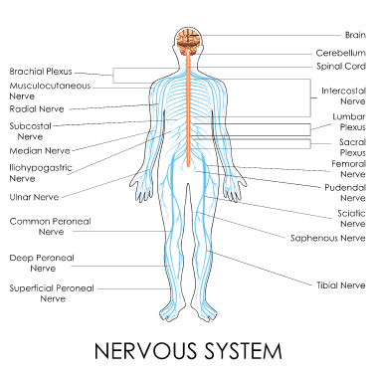
The brain, along with the cranial nerves, functions in all mental processes and many essential motor, sensory, and visceral responses. The spinal cord and the spinal nerves control sensory (touch), motor (voluntary movement), and reflex (knee-jerk) functions. Reflexes are responses to stimuli that do not require communication with the brain. A simple reflex, such as moving a finger from something hot, occurs even before the brain realises the pain. Specific cranial and spinal nerves control all complex or simple action processes in the body. There are 31 pairs of spinal nerves (nerves that branch off the spinal cord), each of which is identified by its location to the nearest vertebrae. Nerves that branch from the spinal cord (C5 through Tl) and extend into the arm region (the brachial plexus) are the axillary, radial, musculocutaneous, median, and ulnar nerves.
These nerves control all muscle movement of the shoulder, arm, and hand and also control sensations of the skin of the entire shoulder, arm, and hand. In summary, the nervous system is the primary communication and regulatory system in the body. The autonomic nervous system entails the functions that work without voluntary control of an individual, such as heartbeat, rate of breathing, tear and saliva production, and bladder constrictions.

Slide 67
Disorders of the Nervous System
Infectious conditions (viral or bacterial) such as encephalitis (inflammation of the brain), meningitis (inflammation of the linings of the brain and spinal cord), tetanus, herpes, and poliomyelitis.
Conditions such as ALS, MS, Parkinson's disease (a degenerative disorder characterised by hand tremors, loss of facial expression, shuffling walk), cerebral palsy (CP; brain damage at birth that typically causes lack of muscle control) (FIGURE 6-21)
Epilepsy (episodes of abnormal electrical discharges in the brain that may cause convulsions or loss of consciousness), hydrocephaly (excessive amounts of CSF in the brain that can lead to intracranial pressure and other complications), neuralgia (pain along a nerve), strokes, and headaches
Injuries that can also result in paralysis or partial paralysis
As a special note to those performing blood collection, nerve damage, including partial paralysis, can also occur as a result of accidental injury during phlebotomy procedures. Injury may be the result of excessive probing with the needle, sticking the needle in a poor site for venipuncture, deep needle penetration all the way into the nerve, and/or if the patient suddenly jerks his or her arm during the venipuncture procedure, causing the needle to puncture a nerve. Choose venipuncture sites that are stabilised as much as possible. Under no circumstances should you use the anterior or palmar side of the wrist to collect a blood specimen because the risk of hitting a nerve is high due to nerve locations close to the skin's surface.

Slide 68
Divisions of the Skeleton:
The human skeleton is divided into two distinct parts:
The axial skeleton consists of bones that form the axis of the body and support and protect the organs of the head, neck, and trunk:
Skull
Sternum
Ribs
Vertebral Column.
The appendicular skeleton is composed of bones that anchor the appendages to the axial skeleton:
Upper Extremities
Lower Extremities
Shoulder Girdle
Pelvic Girdle.
(The sacrum and coccyx are considered part of the vertebral column)

Slide 69
Types of Bone
The bones of the body fall into four general categories: long bones, short bones, flat bones, and irregular bones.
Long bones are longer than they are wide and work like levers. The bones of the upper and lower extremities (e.g. humerus, tibia, femur, ulna, metacarpals, etc.) are of this type.
Short bones are short, cube-shaped, and found in the wrists and ankles. Flat bones have broad surfaces for the protection of organs and attachment of muscles (e.g. ribs, cranial bones, bones of shoulder girdle).
Irregular bones are all others that do not fall into the previous categories. They have varied shapes, sizes, and surface features and include the bones of the vertebrae and a few in the skull.

Slide 70
Bone Composition:
Bones are composed of tissue that may take one of two forms—compact or dense bone, spongy or cancellous bone. Most bones contain both types.
Compact bone is dense, hard and forms the protective exterior portion of all bones.
Spongy bone is inside the compact bone and is very porous (full of tiny holes). Spongy bone occurs in most bones.
The charts on the following pages show the main bones that you will need to have good knowledge of.

Slide 71
Muscles

Slide 72
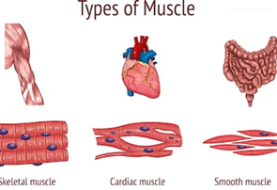
Muscles are classified into three different types, which are skeletal, smooth and cardiac.
Skeletal muscles, also known as striated due to its appearance or voluntary due to its action, are attached to bones and deal with movement. These muscles are made up of fine, thread-like fibres of muscles containing light and dark bands. Skeletal muscles can be made to contract and relax by voluntary will. They have striations due to the actin and myosin fibres and create movement when contracted.
Image result for smooth muscle diagramThis system gives individuals the ability to move using muscles and the skeleton. It consists of the body's bones, muscles, tendons, ligaments, joints, cartilage, and other connective tissue.
Smooth muscles, also called unstriated or involuntary, tend to be found within hollow organs such as blood vessels, the intestines and the respiratory tract. This muscle works automatically with no participant control. This type of muscle does not tire easily, and the contractions are slow, rhythmic and automatic.

Slide 73
Cardiac muscle is what the heart is made up of and only exists in your heart. It is similar in appearance to skeletal muscle in that it is striated. This type of muscle never tires and contracts and relaxes with no participant control. It is made up of short, cylindrical fibres and is purely controlled by the nervous system.
There are over 650 different types of muscles in the human body, making up nearly half of the body weight. The main function is to move joints, to which they are joined, by shortening and pulling one end of the muscle closer to the other end. Each muscle is made up of muscle fibres that are controlled by the brain, sending an impulse to the fibres via the nerves.
When a muscle is damaged, fibres become torn, and the connective tissue around the muscle is also damaged. The fibres are damaged, and fluid seeps out of torn fibres, which causes localised swelling. This fluid tends to stick the fibres together, which causes pain as the muscle is irritated by the slightest contraction. Stretching exercises will increase the length, flexibility and tone of muscles which allows the joint to move further than before.

Slide 74
Muscle Shapes
The bundles of fibres within muscles will determine the shape of the muscle. The commonest muscle fibre arrangements are:
Parallel fibres – these muscles have fibres that run parallel to each other in length and can sometimes be called strap muscles. These muscles have great endurance but may not be that strong due to their length. An example would be the Sternocleidomastoid (SCM).
Circular muscles – these muscles are usually circular in shape, and an example would be the muscles surrounding the mouth and eye.
Convergent – this is where the muscle fibres converge to an attachment to a bone. The fibres are arranged to allow maximum force and can sometimes cross joints with a large range of movement, such as the Pectoralis Major.
Pennate – these are made up of short fibres, so the pull is short and strong, though the muscle tires easily.
Fusiform – these are sometimes included within the parallel muscle group and are made up of spindle-shaped fibres. A good example is the Biceps Brachii, as the belly is wider than the origin and the insertion.

Slide 75
Muscle Movement
Muscles are only every able to contract or pull. This means they have to work in groups and, even when carrying out an action, do not work alone. A joint, therefore, has to have two or more muscles working together.
As muscle contracts, the second muscle relaxes, and as this second muscle contracts, the first muscle relaxes. This is called Antagonistic action as they are pulling in the opposite direction to each other but without working against each other. One end of the muscle needs to be fixed, which is known as the origin, and as that muscle contracts, the other end of the muscle moves towards the origin. The name given to the end of the muscle that moves towards the origin is called the insertion.

Slide 76
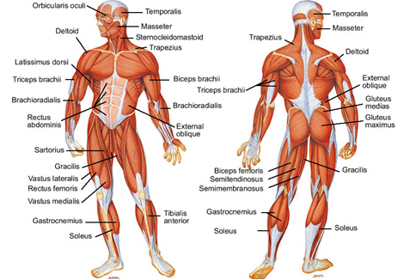
Muscles of the body

Slide 77
Muscles of the Chest and Upper Arm
Name | Position | Action
Pectoralis major | Across upper chest | Used in throwing and climbing; adducts arms
Pectoralis minor | Underneath pectoralis major | Draws shoulders downwards and forwards
Deltoids | Surrounds shoulders | Lifts arms sideways, forwards and backwards
Biceps | Front of upper arm | Flexes elbow; supinates the forearm and hand
Triceps | Back of upper arm | Extends the elbow
Brachialis | Under the biceps | Flexes the elbow

Slide 78
Muscles of the Hand and Forearm
Name | Position | Action
Brachio radialis | On the thumb-side of the forearm | Flexes the elbow
Flexors | Middle of the forearm | Flexes and bends the wrist drawing it towards the forearm
Extensors | Little finger side of the forearm | Extends and straightens the wrist and hand
Thenar muscle | Palm of the hand below the thumb | Flexes the thumb and moves it outwards and inwards
Hypothenar muscle | Palm of hand below little finger | Flexes little finger and moves it outwards and inwards

Slide 79
Muscles of the Abdomen
Name | Position | Action
Rectus abdominis | Front of abdomen from the pelvis to the sternum | Flexes the spine; compresses the abdomen; tilts the pelvis
Oblique’s | Internal – either side of the rectus abdominis External – lies on top of the internal oblique’s | Both compress the abdomen and twist the trunk

Slide 80
Muscles of the Back
Name | Position | Action
Trapezius | The back of the neck and collar-bones | Moves scapula up, down and back; raises the clavicle
Latissimus dorsi | Across the back | Used in rowing and climbing; adducts the shoulder downwards and pulls it backwards
Erector spinae | Three groups of muscles which lie either side of the spine from the neck to the pelvis | Extends the spine; keeps body in an upright position
Rhomboids | Between the shoulders | Braces the shoulders; rotates the scapula

Slide 81
Muscles of the Leg and Buttocks
Name | Position | Action
Gluteals | In the buttocks | Abducts and rotates the femur; used in walking and running
Hamstrings | Back of the thigh | Flexes the knee; extends the knee
Gastrocnemius | Calf of the leg | Flexes the knee; plantar-flexes the foot
Soleus | Calf of leg, below the Gastrocnemius | Plantar-flexes the foot
Quadriceps extensor | Front of the thigh: group of four muscles | Extends the knee; used in kicking
Sartorius | Crosses the front of the thigh | Flexes the knee and hip; abducts and rotates the femur
Adductors | Inner thigh | Adducts the hip; flexes and rotates the femur
Tibialis anterior | Front of the lower leg | Inverts the foot; dorsi-flexes the foot; rotates the foot outwards

Slide 82
Growth and Repair of the Muscles
Muscle hypertrophy is the term used for when a muscle cell grows in size, and the commonest reason for this is due to exercise, where there will be an increase in muscle fibre. When a muscle is damaged (torn), the body has to repair it and do this using satellite cells that fuse with the ends of the damaged fibre. If the damage is constant, then the process will repeat itself so that more satellite cells are used, which will create growth of the muscle.

Slide 83
Muscle Tone
Muscle tone refers to the amount of tension or resistance to movement in a muscle. Muscle tone is what enables us to keep our bodies in a certain position or posture. A change in muscle tone is what enables us to move. For example, to bend your arm to brush your teeth, you must shorten (increase the tone of) the bicep brachii muscles on the front of your arm at the same time you are lengthening (reducing the tone of) the tricep brachii muscles on the back of your arm. To complete a movement smoothly, the tone in all muscle groups involved must be balanced. The brain must send messages to each muscle group to actively change its resistance.

Slide 84
Tendons and Ligaments
Tendons and ligaments are made up of collagenous tissue, with ligaments attaching bone to bone and tendons attaching muscle to bone. The place where a muscle attaches to a bone but does not move is known as the origin. To make movement occur, the muscles contract, which will pull on the tendons; this then pulls on the muscles.
Tendons are tough yet flexible bands of fibrous tissue, which allows movement. Ligaments are the stretchy connective tissue that helps to stabilise the joints. They control the range of movements of a joint to prevent them from bending the wrong way. Injuries to both tendons and ligaments are very common, caused mainly by sporting injuries. It is fairly common for tendons to be stretched or torn, which can be extremely painful. If ligaments are stretched, caused by injury or excess strain, the joint will become weaker, as the ligaments cannot support it.
As discussed, the muscles within our body act when they receive impulses. The nervous system is how the body co-ordinates bodily systems and informs the body about any changes in the environment.
The nerves carry brief electrochemical messages that trigger appropriate responses in the various parts of the body. The messages (impulses) react and will do certain tasks such as making the muscles contract, the glands secrete, and the blood vessels widen or narrow.

Slide 85
Fat Distribution
Too much body fat could be bad for the health. Clients probably focus on how much they have; however, attention should be paid to fat distribution or where they have it.
There are certain places where having excess fat could be problematic. And there are other places where it might not be that big of a deal.
Most people tend to accumulate fat either in their midsection or in their hips and thighs. But genes, sex, age, and hormones can affect how much fat there is and where it goes.

Slide 86
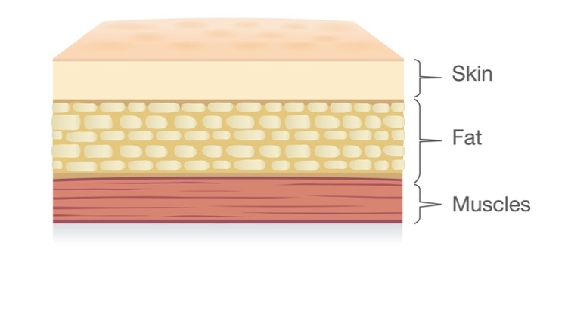

Slide 87
What determines fat allocation?
Genes. Nearly 50 percent of fat distribution may be determined by genetics. If most of the people in your family have rounder bellies or fuller hips, there’s a good chance you’ll follow suit.
Sex. Healthy body fat levels for males range from 6 to 24 percent, but for females, it’s between 14 and 31 percent. Men tend to accumulate more fat around the midsection, while women gain it more in the hips and buttocks.
Age. Older adults tend to have higher levels of body fat overall, thanks to factors like a slowing metabolism and gradual loss of muscle tissue. And the extra fat is more likely to be visceral instead of subcutaneous.
Hormone levels. Weight and hormones are commonly linked, even more so in the 40s. This is due to the natural decline of hormones like testosterone (in men) and oestrogen (in women).
Body fat distribution is a better predictor of the health hazards of obesity than is the absolute amount of body fat. Individuals with an upper body fat pattern, reflecting an excess of intra-abdominal or visceral fat, have significantly greater risk for diabetes, hypertension, hypertriglyceridemia, ischemic heart disease, some cancers, and death from all causes. The effect of intra-abdominal fat appears to be separate from that of total body fat per se. Waist circumference is a practical method for assessing body fat pattern.

Slide 88
Different types of Body Fat
Adipose tissue, or fat, is a loose connective tissue that serves many purposes, both structural and functional, in the body. It is primarily composed of adipocytes, or fat-containing cells, as well as leukocytes, macrophages, blood vessels, and fibroblastic cells, which are all held together in an array of collagen fibres.
There are two forms of adipose tissue in mammals: white adipose tissue, which forms most adult adipose tissue, and brown adipose tissue. Although adipose tissue is mainly involved in lipid anabolism, storage, and catabolism, it has also been implicated in a number of physiological and endocrine processes. Structurally, fat insulates and cushions organs to protect them from mechanical forces. Functionally, it regulates energy metabolism through lipogenesis and lipolysis, produces hormones and cytokines often referred to as adipokines such as leptin, resistin, and TNF-a, and mediates insulin regulation, inflammation, and cancer.
Understanding adipogenesis, the formation of adipose tissue at the molecular and cellular level, will eventually provide the key to future antiobesity therapy and is already forming the foundation for advances within the dermatologic, medical, surgical, and cosmetic fields.

Slide 89
Originally, adipocytes were viewed as passive structures. Their main role in lipid homeostasis was presumed to be in the storage of energy in the form of triacylglycerol and in its release in the form of free fatty acids and glycerol. This view has evolved to one of an active, multifunctional organ. Adipose tissue is involved in the regulation of insulin resistance, vascular disease, immunological responses, and energy balance. Adipocytes are also involved in endocrine and paracrine functions. An example of this function is leptin. Leptin is produced by adipocytes and is then secreted into the bloodstream. It targets the hypothalamus, where it suppresses appetite and increases energy use. In a paracrine fashion, leptin also acts locally to regulate metabolism and other cellular functions. In addition, multiple other factors produced by fat cells are involved in energy regulation and homeostasis.
In the past, scientists believed that humans were born with a certain number of adipocytes or that these cells developed early on after birth and did not change throughout life. This erroneous notion was called the “fixed adipocyte number” and determined whether someone was lean or obese. Instead, we now know that adipocytes undergo hypertrophy and hyperplasia and that these processes continue throughout life. During adipogenesis, preadipocytes proliferate and differentiate into mature adipocytes. This process is mainly activated when there is a net increase in calories. This current view of adipogenesis has revolutionised our view of adipocyte tissue as one that is a dynamic structure, with the preadipocyte being central to its growth, function, and distribution.

Slide 90
Histology of Adipose Tissue
Adipose tissue is composed of many cell types including adipocytes, preadipocytes, fibroblasts, endothelial cells, macrophages, and multipotent stem cells. Mature adipocytes comprise approximately one-third of fat tissue, whereas the remaining two-thirds are composed of small blood vessels, nerves, preadipocytes, and fibroblasts.
There are two types of adipose tissue, white and brown.

Slide 91
White Adipose Tissue
Grossly, adipose tissue is a yellow, homogenous structure with finely divided septae and a glistening surface.
Microscopically, white adipocytes contain one large droplet of triglycerides, which comprises 85% of the cell volume. The small nucleus and cytoplasm constitute the remaining 15% of cell volume. Thus, white adipose tissue is characteristically unilocular, with signet-ring shaped cells ranging from 25 to 200 mm in size.
Ultra-structurally, adipocytes differ depending on the stage of maturation of each fat cell. Preadipocytes, or developing adipocytes, are typically spindle shaped and have a high content of endoplasmic reticulum and small mitochondria.
During maturation, lipid accumulates as small perinuclear inclusions, which coalesce to form larger lipid droplets, the mitochondria become filamentous, and the endoplasmic reticulum becomes less prominent. Once mature, the lipid droplet occupies nearly the entirety of the cell, flattening the nucleus against the cytoplasmic membrane. Adjacent to the cell membrane are foci of basement membrane, which are closely opposed to capillaries. Although white adipose tissue is not heavily vascularised, each adipocyte is supplied by at least one
capillary for support of its active metabolism. Rarely, nerves may run along the collagenous septae.
Historically, the function of white adipose tissue was thought to be for energy storage. However, its role as an endocrine organ has recently come to light. White adipocytes secrete many hormones, called adipokines, which are involved in metabolism, inflammation, and insulin regulation.

Slide 93
Brown Adipose Tissue
Brown adipose tissue is predominant in new-borns and hibernating animals.
Grossly, it appears brown because of its high content of mitochondria and rich vascularisation. Structurally, brown fat cells differ from white fat cells in that they are multilocular. Thus, instead of one large lipid droplet, they contain several smaller droplets, which accounts for the generally smaller size of brown adipocytes approximately 60 mm in diameter.
Brown adipocytes are rich in mitochondria, whose main function in this tissue is the generation of heat, or thermogenesis. In the process, fat molecules are first broken down into fatty acids and then metabolised in the mitochondria. With the help of an uncoupling protein, thermogenin, the energy is released directly as heat.

Slide 95
Body Fat Distribution
Body fat distribution is multifactorial. Genetics account for roughly 30% to 50% of variability in body fat. Age, gender, physical activity, and nutritional habits are additional factors. More specifically, differences in regional fat distribution between men and women are related to hormone activity. The gynoid habitus or “pear distribution” is classically associated with the female shape and it is characterised by the presence of subcutaneous fat mostly in the trochanteric area.
Its regional distribution is influenced by oestrogen and progesterone, which stimulate accumulation of fat subcutaneously and decrease fat viscerally. Subcutaneous fat also has more oestrogen receptors than testosterone receptors.
By contrast, the “android” shape of men is described as fat primarily distributed viscerally or intra-abdominally. This type of adipose tissue has higher expression of androgen receptors (25). This difference in fat distribution may be because of lipoprotein lipase (LPL) activity. This enzyme regulates the uptake of fatty acids and fat accumulation. Higher activity of LPL has been found in men and is associated with the development of intra- abdominal fat. Visceral adiposity has been shown to be an independent risk factor for cardiovascular disease.
Subcutaneous fat, on the other hand, does not have as high levels of LPL as visceral fat, and therefore less visceral obesity is seen in women.

Slide 96
Body fat distribution, rather than total body fat, has been associated with metabolic and cardiovascular disorders, specifically the metabolic syndrome. The android body type, where fat is mostly stored centrally and viscerally, is associated with cardiovascular disease, as opposed to the gynoid habitus, which has a lower prevalence of such diseases. This may be because of the fact that visceral adipose tissue is known to secrete interleukins, vascular endothelial growth factor (VEGF), and plasminogen activator inhibitor-1, which have all been implicated in heart disease.
Aside from body fat distribution, the percentage of body fat also differs between men and women. Overall, women have a higher percentage of body fat than men, and they mostly gain fat during puberty. In contrast, the body fat content of men peaks in early adolescence. During the aging process, body fat is redistributed, and the percentage of body fat increases while muscle mass declines.

Slide 98
Cellulite
The bodies silhouette is characterised by a particular localisation of the subcutaneous adipose tissue over the osteomuscular structure.
The human body is characterised by the presence of rigid fasciae and especially deep muscular fasciae that start from the base of the cranium and continue to the ankles and metatarsus promoting various physiological functions: vascular, neurophysiologic, and orthopaedic.
Cellulite is a degenerative and evolutional effect on subcutaneous tissue. Cellulite is considered as a series of events characterised by interstitial oedema, secondary connective tissue fibrosis, and consequent sclerotic evolution. Such pathologies are mainly observed on the gluteal muscle and on the lower limbs of women.
Cellulite is a very common topographical alteration in the skin in which the skin acquires an orange peel, mattress or cottage cheese appearance. There are many theorise to explain the physiopathology of this condition. The majority of theories involve modifications that occur to the adipose tissue and microcirculation, resulting from blood and lymphatic disturbances, causing fibrosclerosis of the connective tissue. It is generally considered a non- inflammatory, degenerative phenomenon that provokes alterations to the hypodermis producing irregular undulations on the overlying skin.

Slide 99
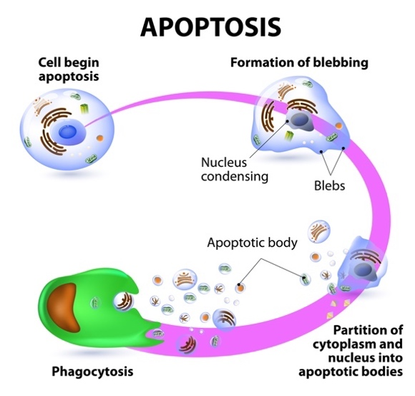

Slide 100
Cellulite results from many complex events that involve the epidermis, dermis and subcutaneous tissue. Cellulite can be divided into four stages:
Alteration to the pericapillary and interadipositary transudation, leading to oedema.
Oedema, provoking metabolic changes that result in hyperplasia and hypertrophy of the reticular network, leading to the formation of pericapillary and interadiposity transudation, leading to oedema.
Organisation of collagen fibres around groups of adipocytes forming micronodules and;
Union of the micronodules to form the macro nodules that cause sclerosis.
Anatomically, the cutaneous alterations found in cellulite are largely due to fibrosis of the connective tissues present in the dermis and/or in the subcutaneous tissue. The connective tissue of the reticular dermis is connected to the deep fascia (SMAS), by means of the interlobular trabeculas (fibrous septa).
Subcutaneous fat lobes are separated from one to another by these thin, usually rigid strands of connective tissue, which cross the fatty layers and connect the dermis to the underlying fascia. These septa stabilise the subcutis and divide the fat. The shortening of these septum due to fibrosis provokes retraction at the insertion points of the trabeculas, causing the depressions that are the characteristics of cellulite.
The anatomical basis of the characteristic mattress aspect of cellulite and has important differences in the organisation of the subcutaneous between genders. In women the fibrous septa are usually orientated perpendicularly in relation to cutaneous surface, while in men they have a crisscross pattern. Several studies have shown that the fat is divided into lobes, and in women these are larger and more rectangular when compared with those in men.

Slide 102
Cellulite is different from obesity and is seen in women with any body mass index (BMI). Cellulite is a result of various factors such as:
Gender - cellulite predominantly effects women.
Ethnicity – Asian women are less likely to suffer from cellulite than European women.
Diet –a high carbohydrate diet causes hyperinsulinemia and promotes lipogenesis that can lead to an increase in total body fat and enhance the appearance of cellulite.
Sedentary lifestyle – prolonged periods of sitting or standing inhibits blood flow leading to a lack of microcirculation in the areas prone to cellulite.
Pregnancy – hormones and increased water retention lead to promote cellulite lipogenesis.
Cellulite is characterized by the presence of fatty protrusions through the dermo hypodermal junction. Cellulite can be separated into three main grades based on its severity.

Slide 103
GRADE 1 cellulite is characterized by smooth skin with no visible signs of dimpling when lying down or standing up. The skin however, when pinched, shows a mattress type configuration.
GRADE 2 cellulite is a dimpled appearance present upon standing but will disappear when the client is lying down.
GRADE 3 cellulite can be seen in clients who show visible signs of dimpling when both standing up or lying down.
Cellulite can often be treated as ‘cellulite’ to reduce or shrink swelling in the area or fat cell. Skin laxity and underlying extra cellular matrix also plays a role in the appearance of cellulite and should be taken into consideration when devising a treatment plan.
When treating cellulite, a detailed client consultation should take place to determine:
history of bleeding disorders
vascular or lymphatic insufficiency
prior treatments for cellulite such as skin tightening, lipolysis or liposuction
Medication and medical history should be taken and noted on the consultation form
A physical exam should be undertaken with the client standing upright wearing comfortable clothing. A note should be made of any scars, cellulite grading and texture of skin. Photographs should be taken with the client in the same position – in the same light and the same underwear to try to ensure photographic consistency.

Slide 104
The Process of Fat Excretion
The body stores fat in adipocytes, or fat cells, in a form known as triglycerides. This form can't be used directly for energy. When the body senses a calorie deficit, it breaks them down into glycerol and fatty acids that get released into the bloodstream.
As a result, the fat cells shrink, but never disappear. The glycerol and fatty acids are then used to create fuel for energy to support basic body functions, chores and exercise.
Fat consists of three elements: carbon, hydrogen and oxygen. When the triglycerides break down, it unlocks the carbon stored in the fat cells in a process that results in the creation of carbon dioxide and water.
The chemical reaction creates heat as a by-product, but that isn't how the fat leaves the body. The fat actually excretes as about 85 percent carbon dioxide through the lungs and 15 percent water through urine, faeces, sweat and tears.

Slide 105
What is HIEMT?
High-intensity electromagnetic technology (HIEMT) is an acronym for high-intensity electromagnetic technology.
HIEMT contracts muscles in a specific location with a powerful but safe form of electromagnetic stimulation.
These magnetic fields generate electrical currents, which are then transferred to the muscles, where they contract often enough to develop muscle and burn fat.
Final results, which can be as dramatic as looking to be equal to six months of dieting and workouts, are typically noticeable four weeks after the treatment plan is completed, or about six weeks after the first session.

Slide 106
How Does HIEMT Burn Fat?
This treatment is at the forefront of body shaping innovation. It generates supramaximal muscular contractions in specific muscle areas by applying focused high-intensity electromagnetic energy routed through huge paddles.
These contractions are involuntary and occur at a pace of 20,000 pulses every 30 minutes, which is equivalent to doing 20,000 crunches or squats in half an hour!
You can target local fat deposits in the treated tissue location and see the fat melt away by instructing the muscles to consume more energy. The end outcome is an average of 15% fat loss and a 16% increase in muscle mass.
A chain reaction occurs in your muscles as a result of the fast, repetitive contractions in the targeted muscle groups:
The muscles release a hormone that tells local fat cells to break down.
Lipolysis, or fat cell destruction, is a metabolic process that metabolises local fat cells.
The fat cells are eventually broken down and ejected as waste by your body.
During this technique, the body’s process of metabolising fat cells is optimised at roughly 5x the typical pace thanks to the pulsating electromagnetic energy.

Slide 107
How does HIEMT Build Muscles
The fat-burning characteristic of these treatments is a side effect of the targeted muscle group’s hyper-contraction.
The targeted muscle region undergoes a transformation as the body burns fat to supply energy to the contracting muscles. Supramaximal contractions cause muscle fibres to constrict, forcing muscles to totally reconstruct their original structure at a cellular level, resulting in a firmer, more toned appearance.
Muscles will contract nearly 20,000 times over the course of numerous sessions, and your client will see an improvement in muscle tone and definition as soon as the first session.

Slide 108
How many treatments are recommended to see results?
In most cases, clients will require two to four treatments per area to achieve obvious benefits. Some clients, on the other hand, may observe effects after just one session.
It is recommended that customers exercise thoroughly and consistently and incorporate healthy food into their living routines in order for the treatment to be most effective.

Slide 109
Electrical Muscle Stimulation (EMS)
EMS 1 Most of the energy of the current is concentrated in the surface layer, only a small part can reach the muscle. • 2 Feeling a slight tingling or contraction. 1 It takes 40 treatments to produce a visible change, 2 The intensity of treatment cannot be increased due to the risk of pain and burns.

Slide 110
What Areas Can be Treated?
HIEMT/EMS is appropriate for big muscle groups and can be used to treat the following areas:
Areas that can be treated include:
Arms
Stomach
Flanks
Back
Bottom
Legs

Slide 111
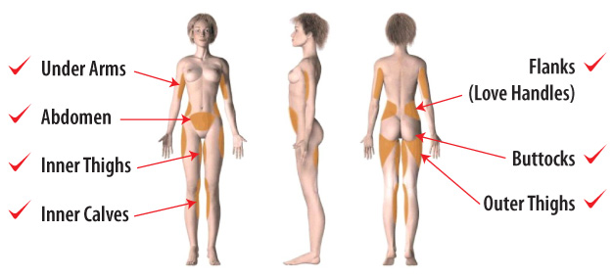

Slide 112
High-Intensity Focused Electromagnetic Field (HIFEM) is a non-invasive medical technology that is used for strengthening and re-education of muscles via interaction of the magnetic field with the tissue of the client. In aesthetic medicine it is used for non-invasive reduction of abdominal fat. HIFEM or HIEMT is the label of the technology that is used in aesthetic medicine, urology, and gynaecology. It uses focused electromagnetic field with intensity measured in Tesla and is based on Faraday’s principle of electromagnetic induction. Electromagnetic field passes non-invasively through the body and interacts with motor neurons which subsequently trigger supramaximal muscle contractions due to the action potential. The exposure of muscles to these contractions leads to muscle strengthening.
In aesthetic medicine, HIFEM/HIEMT is used as a non-invasive body contouring treatment for abdomen and buttocks. The same technology is used in urology and gynaecology to treat urinary incontinence through strengthening of the pelvic floor muscles.
Current non-invasive body-shaping devices are based on heating or cooling of subcutaneous fat tissue to levels that fat cells can no longer tolerate, consequently triggering programmed cell death—apoptosis. The heating modalities of these radiofrequency devices are based on emitting electromagnetic waves of high frequencies (0.5-50 MHz) which are predominantly absorbed in the subcutaneous fat tissue, where the energy of the waves is transformed into heat. HIFEM/HIEMT technology, on the other hand, does not deliver any heating through electromagnetic radiation, as it utilises magnetic waves of very low frequencies (3-5 kHz) which propagate through the tissue without being absorbed. In this case, an interaction between the wave and human tissue occurs according to the principles of electromagnetic induction, first described by Michael Faraday in 1831.
The law of electromagnetic induction says that any change in a magnetic field induces an electric current and vice versa. The HIFEM/HIEMT device comprises a circular coil located in the applicator, which is placed over the treatment area. During the treatment, an alternating electric current is sent into the circular coil. The alternations in the electric current induce rapidly changing magnetic waves which propagate into the underlying tissue, where they induce a secondary electric current. These electric currents within the tissue depolarise the muscle-innervating motor neurons and induce muscle contractions.

Slide 113
Mechanism of action
A pulse of electric current flowing through a wire coil generates a rapidly changing magnetic field. The changing magnetic field induces a secondary electric current in the nearby tissue.
When applied on a peripheral level the secondary electrical current depolarises neural membranes of underlying neurons. Motor neurons are predominantly depolarised due to their large diameter in comparison to other types of neurons. Other neurons or tissues are much less responsive to the electric current, and therefore stay unaffected. Induced action potential is transmitted to neural endings innervating the muscle. Consequently, the muscle contracts independently of the brain activity. When the stimulation induces action potentials at very high rates the muscle contraction becomes supramaximal as the muscle doesn't have time to relax between two consecutive stimuli.
Unlike electrical stimulation, HIFEM/HIEMT penetrates deep into the tissue, and thus affects deeper motor neurons. Electrical stimulation works on the basis of the flowing electric charge between the electrodes, and as such the current remains on the surface and innervates only superficial motor neurons. Also, intensity of electrical stimulation is limited due to pain and risk of burns.

Slide 114
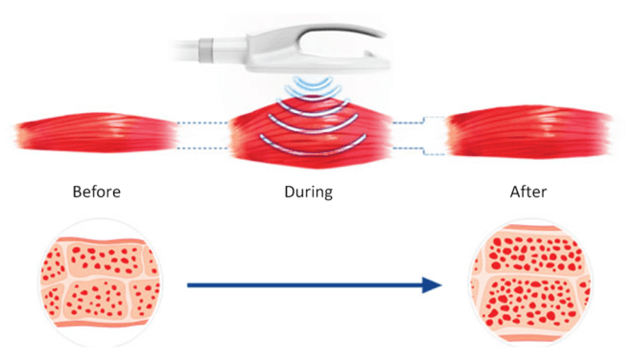

Slide 115
What is EMF?
Electricity and magnetism are two closely related fundamental forces of the universe which have existed since the beginning of time. Early civilizations were aware of their existence and used the earth's natural magnetic field for navigational purposes. The use of compasses made with naturally occurring magnetic ores is older than written historical records. Until about 100 years ago, human exposure to electric and magnetic fields was limited to naturally occurring fields. With the introduction of electricity into homes and businesses, the potential for Electromagnetic Field (EMF) exposure has significantly increased. EMFs are created anywhere electricity is generated, transmitted or used.

Slide 116
Characteristics of Electromagnetic Fields
EMF is a combination of electrical and magnetic fields. The strength of an EMF is directly related to the amount of electricity in use (the current) and to the electrical potential (the voltage) in the electric circuit. That means the more current or the higher the voltage, the greater the EMF which could be generated.
Electric fields are measured in volts per meter (V/m). A one-volt electrical potential one meter away will have an electric field of 1 V/m. This is a very small field, so it is common to see measurements which are thousands of volts per meter (kV/m).
The standard unit of magnetic field strength is called the tesla (T). The tesla is a very large unit, so measured magnetic fields are often only a few millionths of a tesla, called a microtesla (µT). An older, nonstandard unit of magnetic field is the gauss (G). 10,000 gauss = 1 tesla.
An important characteristic of an EMF is the frequency of the electrical source. Frequency is the change in the flow of electric current over time. It can range from zero for a direct current (DC) to several millions of cycles per second. The unit of frequency is the hertz (Hz), which is equal to one electrical cycle per second.

Slide 117
Effect on muscles
Contrary to voluntary muscle contractions, the supramaximal contractions are independent of brain function. The HIFEM/HIEMT uses a specific range of frequencies that does not allow muscle relaxation between two consecutive stimuli. The muscle is forced to remain in a contracted state for multiple seconds. When repeatedly exposed to these high load conditions the muscle tissue is stressed and is forced to adapt. Recent studies reported that on average 15% - 16% increase in abdominal muscle thickness was observed in treated clients one to two months after HIFEM/HIEMT treatments. The same studies also reported on average 10% - 11% reduction in abdominal separation. The increased volume of the treated muscles corresponds with previous research, concluding that intensive muscle contractions induce muscle hypertrophy and hyperplasia. This muscle strengthening effect is used in aesthetic medicine to non-invasively contour the abdomen and the gluteal region of a person, and in urology and gynaecology to re-educate the pelvic floor muscles which affect urinary incontinence.

Slide 118
The Science Behind Muscle Growth
Along with weight loss and general fitness goals, one of the most popular reasons people exercise is to gain muscle mass. Those who exercise frequently expect to lose weight and increase muscle.

Slide 119
Building Muscle
When we talk about muscle building, we’re talking about the skeletal muscles in the body. Muscle fibres, which are made up of myofibrils (muscle protein strands) and sarcomeres, make up skeletal muscles. In the human body, there are 650 skeletal muscles that contract when signals from motor neurones are received. The muscles are instructed to contract by these motor neurones, and as the effectiveness of these signals improves, the muscles become stronger. This is clear when we look at people who don’t appear to be particularly muscular but can carry huge weights.

Slide 120
Replace and Repair
After the muscle has been exercised, the body will begin to replace and repair any muscle fibres that have been injured. This is accomplished through a biological process in which muscle fibres are fused together, resulting in the formation of new myofibril strands. The muscle growth will be caused by these new myofibrils, which will be thicker and larger. When the rate of muscle protein synthesis exceeds the rate of muscle protein breakdown, this muscle growth occurs. Many people believe this happens while working the muscles, but it actually happens during the recovery period afterwards.
When the body isn’t given enough time to recover between workouts, then this really slows down muscular growth. The anabolic process can be reversed if the client doesn’t get enough sleep. Always leave at least 72 hours between treatments.

Slide 121
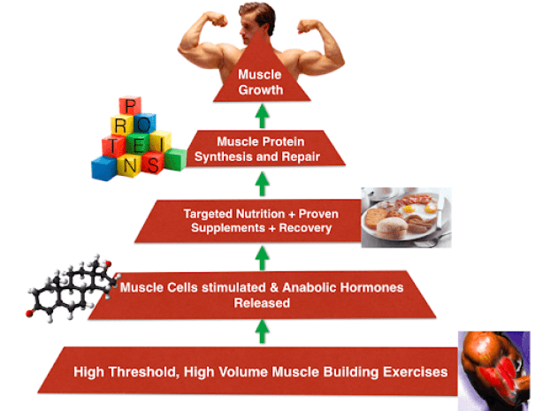

Slide 122
Testosterone and Muscle Gain
Men and women are different in a variety of ways, and the way they gain muscle is no exception. Even if women lift weights on a regular basis, they are unlikely to build significant muscle mass. This is due to the fact that hormones play a crucial part in muscle building. The presence of the male hormone testosterone stimulates protein synthesis while inhibiting protein breakdown in the body. Satellite cells are activated by testosterone, and other anabolic hormones are stimulated by it. Satellite cells deliver extra myonuclei to muscle fibres, which aids in the growth process. Strength training has been found in studies to help the body release more testosterone while also promoting muscle cell receptors to become more receptive to the hormone. Because women have very low levels of testosterone in their bodies, they do not react in the same way as males and so do not naturally acquire muscle mass.

Slide 123
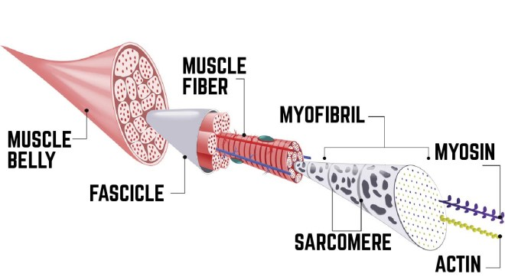

Slide 124
The Process of Muscle Growth
Muscle growth can be accomplished in a variety of ways. The essence of this method is to put tension on existing muscles. This stress should be more than what the body is used to in order to create muscle. This is why weightlifters keep increasing the amount of weight they lift and the number of repetitions they perform with each weight. Progress will not stall if you gradually increase both the weight and the number of reps.
This is why the intensity is increased with each treatment of HIEMT/HIFEM.

Slide 125
Effect on fat
Several recent studies using CT, MRI and ultrasound evaluations have reported approximately 19% reduction in subcutaneous fat layer in patients treated by HIFEM/HIEMT based device on their abdomen. In a histology study, Weiss et al. reported a 92% increase in the apoptotic index of adipocytes in the abdomen eight hours after applying HIFEM/HIEMT to pigs. The same study also reported an increase in pro-apoptotic RNA markers measured by molecular biochemistry and increased concentrations of free fatty acids in post-application blood tests.
The principle of cell apoptosis induced by increased concentrations of free fatty acids has been previously observed and demonstrated in numerous research studies. Yet the exact mechanism of the effects of HIFEM on fat tissue is not well understood and requires further research. Opposed to that, no change in adipose tissue has been reported after application of HIFEM on buttocks and the pelvic floor. It was suggested that this is primarily caused by different metabolic nature of adipocytes in different human body areas, however such claim requires further investigation.

Slide 126
What Does HIEMT Feel Like?
20,000 involuntary muscle contractions in a short amount of time is not a common occurrence, and it’s likely unlike anything your client has ever felt. It’s best described as feeling like you’ve just finished a vigorous workout session without putting in any effort; once done, your client will probably feel the same amount of muscle soreness as they would after a challenging Pilates workout, but they will also feel stronger and more confident once they notice their changing body.
The treatment is usually divided into several stages. The first phase consists of a muscle warm-up. This initial sensation will feel like the muscles are ticking. Then the treatment enters a more focused pulse chase, which will result in extremely rapid muscular contractions. This is the phase that will yield the most results. The third phase is characterised by a more dispersed pulse. This phase is in charge of releasing lactic acid from the muscles, reducing the likelihood of soreness the next day as a result of exercise.

Slide 127
During the Session
The electromagnetic energy is delivered in phases during a session to ensure that the muscles are stimulated safely. The session starts softly, builds in intensity for the duration of the session, and ends with a lower-intensity “cool-down” to ensure that fat cells and any lactic acid built up during muscular contractions are appropriately drained out of the muscles.
HIEMT/HIFEM uses non-invasive technology to release electromagnetic vibration energy through large treatment handles to penetrate to a depth of 8cm. This induces a continuous expansion and contraction of muscles to achieve high-frequency extreme training which increases the growth of myofibrils (muscle enlargement). It also produces new collagen chains and muscle fibres (muscle hyperplasia) thereby training the muscle as well as increasing muscle density and volume. This technology can trigger lipolysis, the greater the percentage of contraction the more lipolysis. Fatty acids are broken down and excreted from the body by normal metabolism within a few weeks.

Slide 128
Does the treatment replace exercise?
HIEMT/HIFEM is a wonderful tool for using as part of an aggressive muscle-building programme, but it cannot replace regular exercise.
If a client is unable to exercise owing to joint issues, HIEMT/HIFEM is a terrific way to help them overcome that obstacle.
Furthermore, research have demonstrated that HIEMT treatments not only improved looks but also boosted their confidence and contentment.
Clients have the option of returning for maintenance visits if they are unable to stick to a training plan or if they feel the need to improve their results after a period of time. To ensure and maintain the ideal image, these sessions can be scheduled monthly, yearly, or at any time in between.
Because fat burning is a side effect of this treatment, your client should maintain a healthy overall fitness routine and diet to limit the likelihood of fat build-up in the targeted location. Although maintenance treatments can help to some extent, the best method to maintain the new thin shape is to maintain a healthy weight and level of activity.

Slide 129
Do the results last?
Your client should be able to witness the ultimate outcome of the HIEMT/HIFEM session around four weeks after the completion of the client’s treatment.
Because this treatment tones muscle areas, it’s feasible to keep some definition by doing specific exercises that target the treated area. Depending on the targeted muscle area, this could involve core exercises, squats and lunges, side planks, and more.
It is proposed that clients maintain their weight with the help of a healthy diet and frequent exercise for optimal and long-term benefits.
It’s vital to remember that HIEMT/HIFEM isn’t a replacement for weight loss.
This procedure is most effective for men and women who are close to their desired weight but want to be more toned.

Slide 130
Booking in your client
Using the HIEMT/HIFEM machine is a simple but highly effective method that can give your client great results.
When body shaping procedures are performed appropriately, they are considered safe. However, there are some treatment-related dangers that you should be aware of, which we will discuss during your training.
You may think this is a minor module, but it is vital to avoiding risks and ensuring that your client is appropriately prepared for their treatment.

Slide 131
Contra-indications
A contraindication is the presence of a condition which may make the client unsuitable for the treatment. The treatment may not be able to take place, or the treatment will need to be adapted.
When treating a client, if they show any signs of contra-indications, you should tactfully refer them to their GP for treatment or advice. You should never make a diagnosis even if you are certain of the condition as you may be wrong.
If you are unsure about any contra-indications, then do not treat the client and refer them to their GP.
Be careful if you deal with a contra-indication, and they can often be contagious. Make sure you clean the work area and any implements between clients to prevent cross-infection.

Slide 132
Diabetes | Diabetes is a lifelong condition that causes a person's blood sugar level to become too high. There are two main types of diabetes: type 1 diabetes – where the body's immune system attacks and destroys the cells that produce insulin type 2 diabetes – where the body does not produce enough insulin or the body's cells do not react to insulin. Type 2 diabetes is far more common than type 1. In the UK, around 90% of all adults with diabetes have type 2. The amount of sugar in the blood is controlled by a hormone called insulin, which is produced by the pancreas (a gland behind the stomach). When food is digested and enters the bloodstream, insulin moves glucose out of the blood and into cells, where it's broken down to produce energy. However, with diabetes, the body is unable to break down glucose into energy. This is because there's either not enough insulin to move the glucose, or the insulin produced does not work properly. | Can often be treated if the client is managing their diabetes well. Check with your insurer as their criteria may not allow treatment. A GP note may be required. Treatments that cause injury to the skin can increase the risk of infection. Those with diabetes will need to understand wound management and treatments should be done under extreme caution as to not injure the skin if necessary. Diabetics have a slower wound healing response and have a higher risk of infection. All products used must be sterile, and care should be taken not to injure the skin.

Slide 133
Epilepsy | Epilepsy is diagnosed when a person has had more than one epileptic seizure and could have more in the future. Electrical activity is happening in our brain all the time. A seizure happens when there is a sudden burst of intense electrical activity. This is often referred to as epileptic activity. This intense electrical activity causes a temporary disruption to the way the brain normally works, meaning that the brain’s messages become mixed up. The result is an epileptic seizure. There are many different types of seizure, and each person will experience epilepsy in a way that is unique to them. Some things make seizures more likely for some people with epilepsy. These are often referred to as ‘triggers. Triggers are things like stress, not sleeping well and drinking too much alcohol. Some people say they have more seizures if they miss meals. Not taking epilepsy medicine is another common trigger. A very small number of people with epilepsy have seizures triggered by lights that flash or flicker. Avoiding triggers can stop them from having seizures. | If well-managed treatments may be able to be undertaken. It is worth assessing the client and finding out what triggers a fit and when as well as how it is managed and their last episode. You may also need to check your insurer's terms and refer the client to a GP for a letter of approval.

Slide 134
Heart conditions | Heart disease describes a range of conditions that affect the heart. Heart diseases include: Blood vessel disease, such as coronary artery disease Heart rhythm problems (arrhythmias) Heart defects you're born with (congenital heart defects) Heart valve disease Disease of the heart muscle Heart infection Risk of fainting, risk of slow healing or chances that the client may be medicated to keep their condition under control are some risks you will need to be aware of when treating the client. Clients may also have a heart catheter or a pacemaker. | Treatments that do not involve electrical currents being passed through the body are usually safe. Heart conditions should be well managed. You will need to check the terms of your insurance policy. A referral to a GP may be required.

Slide 135
Deficient Immune System | Immunodeficiency disorders prevent the body from fighting infections and diseases. This type of disorder makes it easier to catch viruses and bacterial infections. Immunodeficiency disorders are either congenital or acquired. A congenital, or primary disorder is one you were born with. Acquired, or secondary, disorders you get later in life. Acquired disorders are more common than congenital disorders. Your immune system includes the following organs: spleen tonsils bone marrow lymph nodes These organs make and release lymphocytes. These are white blood cells that fight invaders cells called antigens. Cells release antibodies specific to the disease the body detects. White blood cells destroy foreign or abnormal cells. Examples of antigens that white cells might need to fight off include: bacteria viruses cancer cells parasites An immunodeficiency disorder disrupts your body’s ability to defend itself against these antigens. | A deficient immune system can increase the risk of infection. Treatments that break the skin may increase the risk of infection. Clients may need a GP referral and understand wound management.

Slide 136
Pregnancy | Pregnancy is a period of considerable changes in a woman's body. These changes, affecting virtually every part of the body, are all geared towards growing and delivering a healthy baby, without harming the mother. Changes begin within days of conception when the fertilised egg implants itself in the wall of the uterus. The first changes are subtle, and most women will not notice them. Pregnancy lasts an average of 266 days (38 weeks) from the date of conception or 40 weeks from the first day of the last menstrual period. Pregnancy is divided into three periods of three months each. These periods are known as the first, second and third trimesters. Each trimester brings with its own unique set of experiences. Risks of pregnancy include: Miscarriage Increased/decreased blood flow Risk of fainting Oedema Pigmentation/Chloasma/mask of pregnancy Pelvic trauma | Nearly all treatments are contraindicated in the first trimester. Treatments that cause friction may have a side effect of PIH and should not be performed. Electrical treatments must not be performed at any point.

Slide 137
Breastfeeding | Anything the mother consumes or applies to her skin could be absorbed into the bloodstream and through into the milk ducts, where this can pass to the baby. Great care should be taken with what is being applied to the skin as well as avoiding treatments that could cause open wounds. An open wound is susceptible to infection, and this can cause infection or septicaemia. During breastfeeding, hormones are still active within the body, and these can have an overall effect on the skin. This may lead to dehydrated skin (if the mother is not ingesting enough water) and also lead to a high risk of pigmentation. Invasive procedures should be avoided until a few months after the mother has stopped producing milk. | Treatments that break the skin are strictly contraindicated. The client also has a high amount of hormone imbalance still and may be susceptible to PIH on certain treatments.

Slide 138
Electrical implants or pacemakers | A small battery-operated device called a pacemaker is placed into the chest. It sends regular electrical impulses, which help keep the heart beating regularly. The pacemaker is a small metal box weighing 20–50g. It is attached to one or more wires, known as pacing leads, that run to the heart. If the pacemaker senses that the heart has missed a beat or is beating too slowly, it sends signals at a steady rate. If it senses that the heart is beating normally by itself, it does not send out any signals. Most pacemakers have a special sensor that recognises body movement or the breathing rate. This allows them to speed up the discharge rate when active. An implantable cardioverter-defibrillator (ICD) is a device similar to a pacemaker. An ICD delivers an electrical shock to the heart during a life-threatening heart rhythm. The aim is to 'reboot' the heart to get it back into a normal rhythm again. Some modern devices contain both a pacemaker and an ICD. | Electrical implants contra-indicate any treatment that involves an electrical current. Other treatments that may affect blood pressure may also contra-indicate a procedure. Check your insurer's terms and refer the client to GP for a letter of approval.

Slide 139
Anticoagulant medicines such as warfarin or aspirin | Anticoagulants are medicines that help prevent blood clots. They're given to people at a high risk of getting clots, to reduce their chances of developing serious conditions such as strokes and heart attacks. A blood clot is a seal created by the blood to stop bleeding from wounds. While they're useful in stopping bleeding, they can block blood vessels and stop blood flowing to organs such as the brain, heart or lungs if they form in the wrong place. Anticoagulants work by interrupting the process involved in the formation of blood clots. They're sometimes called "blood-thinning" medicines, although they don't actually make the blood thinner. Although they're used for similar purposes, anticoagulants are different from antiplatelet medicines, such as low-dose aspirin and clopidogrel. | Anticoagulants prevent the blood from clotting and can affect the healing process of the skin. The client will be at higher risk of bruising also. Treatments that injure the skin or cause trauma will need to be avoided. A GP letter may be required for some services.

Slide 140
Steroids, antidepressants, antibiotics and other medications | Many drugs can affect the skin. For example, prescription antidepressants, especially the popular class of medications called selective serotonin reuptake inhibitors (SSRIs), can cause a wide variety of adverse skin reactions, including bruising. Acne medications and certain antibiotics may make the skin more sensitive to sunlight and light or heat-based procedures. It is vital that we find out the medications both prescription and over the counter drugs that the client is taking. The internet is a great source of information to establish the risks the medication may have on the skin during a procedure. | Medications can have numerous effects on the skin. If you are unsure, you should ascertain how the treatment affects the skin and the effects of the medication that is being taken. A patch test may be required or a letter from the clients GP. Where the side effects may be photosensitivity or thinning of the skin, then treatments should be avoided until the client has come off their medication for three months at their GPs request.

Slide 141
Recent surgery | Clients will have surgery for a variety of reasons and on any area of the body. Surgery puts the body under extreme pressure. The client may be on pain medication which could affect their susceptibility to feeling pain during treatment. Surgery wounds can take many months to fully heal. Post-surgery complications can also arise a few months after the procedure. This can include, infection or necrosis of the wound, infection of the blood, blood clots, internal bleeding, or fever. | If the client has had recent surgery, you will need to weigh up the risk of the procedure, the length of time between the surgery and treatment as well as where the surgery was. In most cases, it is advised to wait six months post-surgery before undertaking any procedures, especially where these may involve invasive techniques, massage or electrical machines.

Slide 142
Metal plates or pins | If you break a bone, it will need to be held in place while it heals. This can be done using a splint, sling, brace or cast. But sometimes a broken bone will need to be fixed with surgery, using metal plates, rods, wires, screws or pins. Implanted metal can help broken bones heal in proper alignment. While these implants do not help the bone heal faster, they can help to hold bones in the proper position while healing takes place. Implants may include metal plates and screws, pins, and intramedullary rods inserted into the cavity of a bone. | Electrical treatments are almost always contraindicated for clients with metal implants in their body. However, this can vary depending on the area of the implant vs the area of treatment. Care may also need to be taken when massaging over the area or any pressure is applied.

Slide 143
Chemotherapy/ radiotherapy | Chemotherapy is a form of cancer treatment where a patient is given drugs designed to kill cancer cells. Radiation is a type of cancer treatment where high doses of radiation are delivered to cancerous tumours in the body. Both procedures can affect the sensitivity of the skin, and the skin texture may change. A waxy appearance to the skin can alter the effects of treatments and treatments may not be suitable. Clients may also be at risk of pigmentation. | Clients undergoing treatment for cancer may benefit from a number of procedures in a salon for the purpose of relaxation and pain management as well as to make them feel good. Some treatments may be too much for the client to handle and cause unwanted side-effects. It is worth discussing the treatment with the client and working out alternatives where suitable. If unsure, you may wish to ask for a letter from the client's oncologist.

Slide 144
Broken bones | When a bone has an outside force exerted upon it, like a blow or a fall, there is potential that it cannot withstand the amount of force and it breaks. That loss of integrity results in a fracture. It is important to remember that a fracture, break, or crack all describe the same situation, an injury to the bone where it has been damaged. One term is not more serious than another. Fracture break and crack all mean the same thing. | Clients with a suspected or recent fracture should be treated with caution. If working over the area of a recent break, then the time between the break and the treatment should be at least six months. If working on other areas of the body, it is best to wait for 6-8 weeks post-injury as the client may be more susceptible to an embolism.

Slide 145
Previous or recent treatments in the area | When providing a service to the client, it is important to establish what previous treatments they have had, not only at clinics but at home. You should look to enquire over the products they use regularly that may affect the skin and the treatment outcome. | Some treatments can affect the skin by either removing out layers of the stratum corneum or stimulating a healing response. You will need to identify if the client has had any recent procedures in the treatment area you will be working on.

Slide 146
Contra-indications
A contraindication is the presence of a condition which may make the client unsuitable for the treatment. The treatment may not be able to take place, or the treatment will need to be adapted.
When treating a client, if they show any signs of contra-indications, you should tactfully refer them to their GP for treatment or advice. You should never make a diagnosis even if you are sure of the condition as you may be wrong.
If you are unsure about any contra-indications, then do not treat the client and refer them to their GP.
Be careful if you deal with a contra-indication, and they can often be contagious. Make sure you clean the work area and any implements between clients to prevent cross-infection.

Slide 147
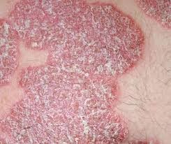
PSORIASIS
Scaling and inflammation of the skin.
Cause unknown but thought to be related to the nervous system
Treat with caution; avoid the affected area.
Do not treat if the skin is weeping.

Slide 148
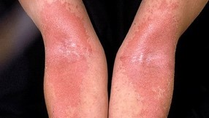
ECZEMA
Atopic eczema is a common skin condition that causes patches of skin that are itchy, cracked and sore.
Treat with caution: avoid the affected area.

Slide 149
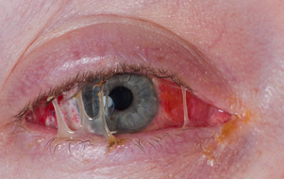
CONJUNCTIVITIS
A transparent and sticky substance covers the white of the eye and lids.
It is caused by a bacterial infection.
This is highly infections; do not treat; the client should be referred to their GP for correct diagnosis and treatment.

Slide 150
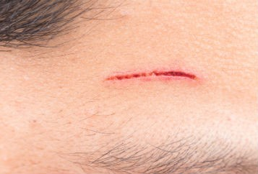
CUTS & ABRASIONS
Broken skin caused by an injury.
Avoid treatment in the affected area.
A transparent and sticky substance covers the white of the eye and lids.
It is caused by a bacterial infection.
This is highly infections; do not treat; the client should be referred to their GP for correct diagnosis and treatment.

Slide 151
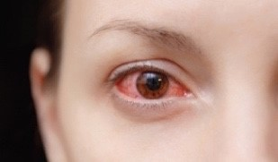
BACTERIAL KERATITIS
A severe disorder which can result in partial or total loss of vision.
It is caused by a bacterial infection.
Do not treat; refer clients to their GP for correct diagnosis and treatment.

Slide 152
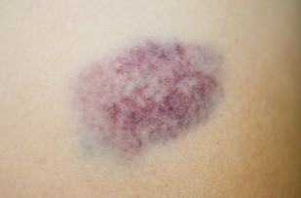
BRUISING
Black, green. Yellow or red marks appear on the skin.
They are generally caused by an injury.
Avoid the area if possible.

Slide 153
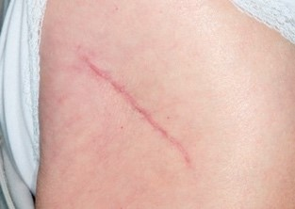
RECENT OPERATIONS (SCARS)
Scar tissue raised or flat undergoing the healing process.
Scar tissue is very sensitive.
Avoid treatment if the scar is less than six months old.

Slide 154
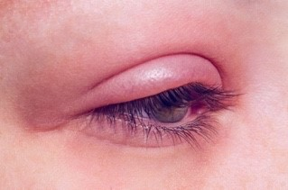
BLEPHARITIS
Inflammation of the eyelids; the inflammation is like eczema of the skin with red, scaly eyelids; you may notice tired or gritty eyes, which may be uncomfortable in sunlight or smoky atmospheres; they may be red and swollen and feel as though there is something in them.
The exact cause is unknown, but people who have dandruff or dry skin conditions may be more prone to blepharitis.
Avoid the area; refer the client to GP for correct diagnosis and treatment.

Slide 155
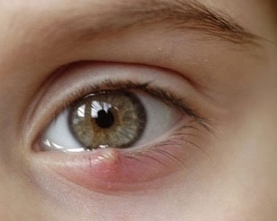
STYE
Infection in the root of an eyelash.
They are caused by a bacterial infection.
Avoid the area; no treatment until the infection has gone.

Slide 156
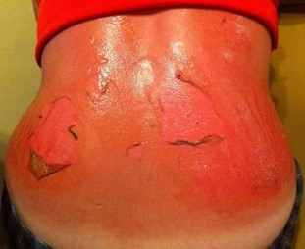
SUNBURN
Sunburn is a red, painful skin that feels hot to the touch. It usually appears within a few hours after too much exposure to ultraviolet (UV) light from sunshine or artificial sources, such as sunbeds.
No treatment should be provided until the skin has healed.
48 hours should be left from sun exposure/sunbed use before a treatment.

Slide 157
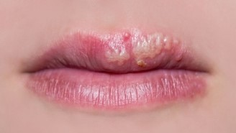
COLD SORES
Cold sores are painful lumps or blisters on the face. They're caused by a virus and are very contagious.
Treatment should not be provided on the face until the skin has healed.
Precautions should be taken when treating other areas to avoid cross-contamination.

Slide 158
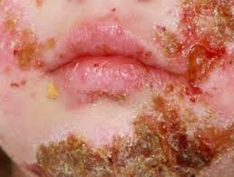
IMPETIGO
Impetigo is a highly contagious skin infection that often starts with red sores on the face or hands.
It causes red sores or blisters that burst and leave crusty, golden-brown patches.
Treatment should not be provided on the face until the skin has healed.
Precautions should be taken when treating other areas to avoid cross-contamination.

Slide 159
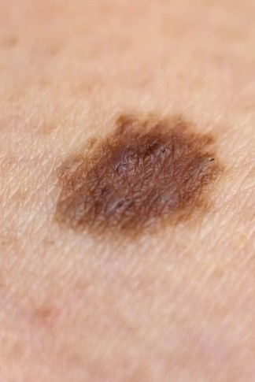
MOLES
Moles are small, coloured spots on the skin. Most people have them, and they're usually nothing to worry about unless they change size, shape or colour.
Avoid treating over a mole. Irritation or damage to the area may cause the mole to change.

Slide 160
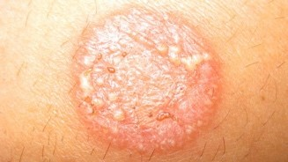
RINGWORM
Ringworm is a fungal infection on the skin. It causes a rash that is often ring-shaped.
Treatment should not be provided to the client until the condition has been treated.

Slide 161
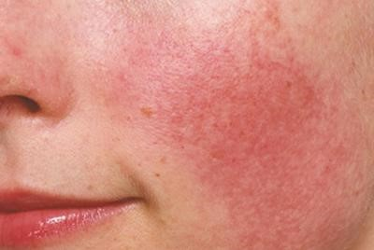
SENSITIVE SKIN
Sensitive skin is a common issue but not a medical diagnosis in itself. The term generally refers to skin that is more prone to inflammation or adverse reactions. People with sensitive skin may have strong reactions to chemicals, dyes, and fragrances present in products that come into contact with the skin.
Treatments should be applied with caution. Patch tests may be required before undertaking a full procedure.

Slide 162
Female clients may not have a treatment, if they are:
Menstruating
Pregnant
Lactating

Slide 163
Any client with one or more of the following conditions cannot receive treatment:
Heart disease
Thyroid conditions
Hypertension
Renal failure
Malignant tumour
Epilepsy
Open wounds or lesions on the treatment area
An active systemic or local skin disease that may alter wound healing
Autoimmune disease
Diabetes
Bell’s palsy
Under 18s’

Slide 164
Any client with one or more of the following conditions should be treated cautiously:
Muscle strain
Cerebrovascular disease (stroke victims)
Thrombophlebitis
Brain injury or post brain surgery

Slide 165
Metal implants or electronic implants such as:
Metal contraceptive ring
Cardiac pacemaker
Cardiac defibrillator
Stent
Drug pump
Nerve stimulator
Copper Coil/IUD

Slide 166
Client Consultation
A client consultation is a one to one talk with your client. During this time, you will find out very important and confidential information that will allow you to advise and provide the best treatment for the client.
It is important to always introduce yourself to the client as this removes any barriers and relaxes them. Consultations should always be undertaken in a private room or area where you cannot be overheard by others.
A client should first fill out a client consultation which helps identify any contra-indications that may mean you have to alter the treatment or be unable to treat them at all. If their form shows no reason why they cannot proceed with the treatment, then you can move onto verbal questioning.
Verbal questions would be to establish why the client has visited the salon and what their expectations and outcome of the treatment may be. Asking what they want ensures you can provide customer satisfaction as the client should be pleased with the outcome of their treatment. It is good practice to speak to the client in front of a mirror and explain the treatment to them and see if that meets their requirements.
Once you have established what the client is after, then a physical examination should be undertaken. This allows you to further check for any undeclared contra-indications and get a better overview of any issues that you may face during the procedure.
Allow around 15 minutes for the client's first salon visit. Ideally, you should sit face to face or next to the client to create an open atmosphere. Avoid barriers such as a couch or table between you.
Use open questions to tactfully encourage the client to give you information that you may need rather than using interrogating questioning techniques. Use the consultation form to work from and record anything you may discuss.

Slide 167
Record Keeping
Records must be maintained and updated for a number of reasons.
They provide contact details in case you need to alter or cancel an upcoming appointment.
So that you can track client’s progression.
To record the products used and timings so you can use these at further visits and adjust the treatment plan if required.
Tracks any aftercare you provide the client.
Records patch test history.
As a backup in case, the client has an adverse reaction to treatment.
For legal reasons if the client brings a claim against you.
Client records can be stored electronically or filed away manually and should be updated at every visit. If consultation forms are not updated and do not contain a history of services and dates, then you may find your insurance invalid.
Forms should be kept for the timeframe suggested by your insurance company. This may be for up to six years. If a client is under 21 at the time of service, then it is recommended to keep the forms for six years past their 21st birthday.

Slide 168
Client confidentiality must be protected at all times. Forms need to be locked away in a secure cabinet, and electronic records should be held on a password-protected computer. You may also need to register with the ICO as a data controller.
All information must be accurate and necessary for the service or treatment being performed.
Individual client records must be available for the clients to view if requested.
Data should not be passed on or sold without the client’s prior written permission.

Slide 169
The following details should be recorded on the client consultation form:
Personal details – name, address, contact details
Results of any patch tests
Contra-indications
Contra-actions
Reasons for the treatment
Any reactions to treatments/previous treatments
Home care advice/suggested retail items.
Any sales
Treatment timings/products used etc.
Next appointment or recommendations
Any contra-indications and possible contra-actions should be identified and discussed prior to the treatment. In the case of a medical referral, the therapist should keep a copy of the GP's letter with the client's record card.
Consultation forms must be signed and dated to prove that you have covered everything and given the correct advice and treatment plan.

Slide 170
Contra-actions to Treatment
A contra-action is a possible risk or side effect of treatment that occurs during or after treatment has been carried out.

Slide 171
Common contra-actions include:
Increase in the need to urinate. This is due to the extra water intake and the process of eradication of fat from the body.
Discomfort during treatment. It is normal to experience a little discomfort as we do apply pressure during treatment; however, if it is too much, advise your client to let you know so you can reduce the energy level.
Redness on the surface of the skin. This is heat-related erythema and will usually vanish within a couple of hours after treatment.
Clients’ circumference increases after treatment. This is temporary swelling due to trauma to the subcutaneous fat and will usually subside within 24 hours.
Mild Bruising. Although rare, it is worth mentioning as it can occur.

Slide 172
Measuring the client
Weigh the client - Whilst this is not a weight loss treatment it will help you to monitor future success of treatments if the client is on a course.
Ensure a proper measurement stance - This ensures all measurements are fair. Ask the client to stand straight – legs together and hands interlocked behind their head with elbows out to the side. Take measurements in inches and remember an inch is divided into 8 parts.
Keep fingers away - Ensure your fingers are not behind the tape when measuring the client.
Keep the tension on your tape the same at all times. Pulling the tape too tight or leaving it too loose will alter measurement results. Clients will notice this when you measure them so try to remain consistent.

Slide 173
How to read a tape measure
We will work in eighths. There are 8 eights to one inch.
If a client’s waist measures 31 and half inches, we would mark that down as 31.4
If the measurement is 31 and five eights this would be marked down as 31.5.
When re-measuring you must remember that you are working in eights of an inch, simply count the lines in the tape measure.
Using 31.5 as a ‘before’ measurement:
If the after measurement was 30.6 the total loss is 31.5 less 30.6 = 7 eights
If the after measurement was 30.1 the total inch loss is 31.5 less 30.1= 12 eights
We recommend you work your total loss out in eights and then divide by 8 for a total inch loss.

Slide 174
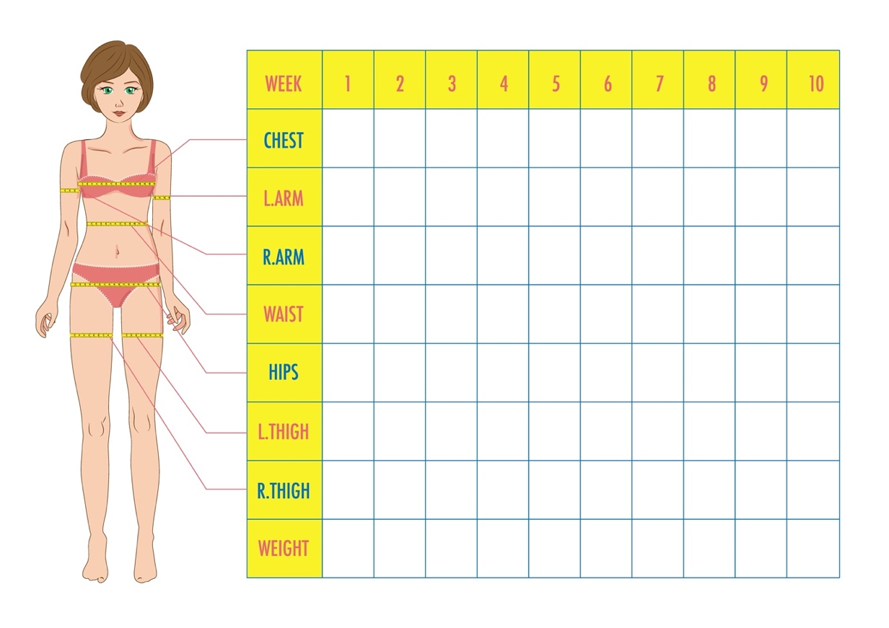

Slide 175
Generic instructions for clients
The client should not have any metal objects in the treatment area during treatment. This includes: Body piercings, clothes with metal attachments or studs.
A treatment should be at least 1 hour after meals.
The total treatment time in a day should not exceed 1 and a half hours and one treatment area should not exceed 1 hour a day.
Do not eat or drink during treatment.
Try to leave at least one hour between the end of a treatment and eating.
During the course of treatments, drink more water and eat food with a high protein content.
We also recommend treatment for clients over the age of 18, this being when they are considered an adult.

Slide 176
Managing client expectations
We like to make sure all our clients have the right expectation about HIEMT/HIFEM so you can pass this on to your clients. Our clients get the best results possible with this treatment; however, it is important to remember results are very subjective as each individual is different. While most clients are thrilled with the results some have unrealistic expectations due to edited results on social media or other advertising. Body sculpting will not always be able to produce perfect bodies like we see on celebrities. This is usually the result of fabulous genetics combined with specifically designed exercise programs and highly structured diets. Some celebrities even achieve their look with surgery.
Some of your clients will be lucky and have a good body shape and a lower percentage of body fat naturally. These clients will generally see results faster as the newly developed muscle will be more visible as it is under less fat. Those with a thicker layer of fat in the treatment area will need more treatments for the results to be significantly visible. Also, some people naturally build muscle and burn fat faster than others so will get a better outcome. Basically, the clients have a varying range of results depending on their body shape, genetics, and composition.

Slide 177
What results can the client expect?
Muscles account for about 35% of body mass and most body sculpting devices on the market focus on fat reduction and not muscle toning. In contrast, research shows that this type of treatment can achieve fantastic results with increased muscle by up to 16 percent, and reduced fat by up to 19 percent. This can be achieved on targeted areas on the body with major muscle groups like the abdomen and where the layer of body fat is not too deep.

Slide 178
Benefits of Building Muscle
Typical benefits of building muscle are seen as:
Improving the efficiency of weight loss
Building a strong body
Preventing ageing and maintaining physical youth
Reducing chronic pain of muscles and joints
Helping blood circulation
Protecting the safety of internal organs
Improving and preventing diabetes
Reducing high blood pressure
Preventing heart disease
Enhancing memory and preventing dementia

Slide 179
Signing the client consent form
It is important that your client reads and signs the client consent form. This will work with your insurance to protect you in the unlikely event there is a complication.
There are some clients who should avoid this type of treatment due to increased risk which is outlined in the consent form.

Slide 180
Record Keeping
Because your clients will typically have a course of treatments, it is highly recommended that you use the client setting and progress tracker to keep a track of:
Your client details
Treatment area required
Treatment area treated
The machine settings used for each treatment area per treatment
Clients progress measurements

Slide 181
How many sessions are required?
HIEMT/HIFEM body sculpting requires a minimum of four treatments, but most people require eight treatments every three days for optimal results. So, for the best results with HIEMT/HIFEM body sculpting, make sure your client has devoted time set out over a few weeks.

Slide 182
Precautions and Contraindications
Do not operate on the:
Head
Neck
Carotid artery
Near the spinal column
Do not allow the two handles to come into contact with each other.
Neither the operator nor the client should carry any metal objects during treatment.
Treatment should be at least 1 hour after meals.
The treatment site and handle should be dry when operating.
The operating energy varies from person to person so increase gradually from a low intensity.
The total operating time in a day should not exceed 1.5 hours and one treatment site should not exceed 1 hour a day.
Do not put any electronic products or metal objects on the instrument during operation.
Do not eat or drink during treatment.
Try to leave at least one hour between the end of a treatment and eating.
During the course of treatments, drink more water and eat food with a high protein content.

Slide 183
Treatment Steps
The paddles are placed on your client in the desired spot and secured with the accompanying straps.
The treatment area, your client’s age, and gender are then picked on the machine’s screen.
Choose the handles you’ll be using and the length of time you’ll be treating them.
Choose a treatment option based on the client’s situation.
Machines may have set training modes. Choose the mode best suited to your client in accordance with the manufacturer’s instructions.
For a first-time customer, start with a modest intensity.
Check with your client after the second phase pulses have been continuing for 1 or 2 minutes to determine whether they want to increase the therapy intensity.
You can leave your client to rest and enjoy their therapy once they are comfortable.
Release the straps and turn the machine off at the end of the treatment.

Slide 184
After the Session
After the session, your client will be free to resume their normal routine with no interruptions. Furthermore, no one will be able to tell that they had a body contouring treatment performed; aside from the slimming and toning results, an HIEMT/HIFEM burn fat therapy leaves no visible indications.

Slide 185
Aftercare Advice

Slide 186
Generic instructions for clients
The client should not have any metal objects in the treatment area during treatment. This includes: Body piercings, clothes with metal attachments or studs.
A treatment should be at least 1 hour after meals.
The total treatment time in a day should not exceed 1 and a half hours and one treatment area should not exceed 1 hour a day.
Do not eat or drink during treatment.
Try to leave at least one hour between the end of a treatment and eating.
During the course of treatments, drink more water and eat food with a high protein content.
We also recommend treatment for clients over the age of 18, this being when they are considered an adult.

Slide 187
Aftercare
As with any treatment, for the best results it is important to give the treatment the best opportunity to succeed. Whilst the aftercare with this treatment is minimal, it is recommended that:
The client leaves at least one hour between the end of a treatment and eating.
During the course of treatments, drink more water and eat food with a high protein content.
Avoid exercise for 24 hours to avoid overworking the muscle.
Keep up with the course of treatments for best results.

