Slide 1
ANATOMY OF COMPELLING visual design

Slide 2
You Want People to Instantly Recognize Your Brand
Color and fonts

Slide 3
You Want People to Instantly Recognize Your Brand
Color and fonts
Images, backgrounds and overlays

Slide 4
You Want People to Instantly Recognize Your Brand
Color and fonts
Images, backgrounds and overlays
Branding

Slide 5
You Want People to Instantly Recognize Your Brand
Color and fonts
Images, backgrounds and overlays
Branding
Different types of promotions and posts

Slide 6
Colors

Slide 7
Choose a color palette…then stick with it.
Joyful and happy
Subdued and serene
Grounded and secure
Depressed and despondent

Slide 8
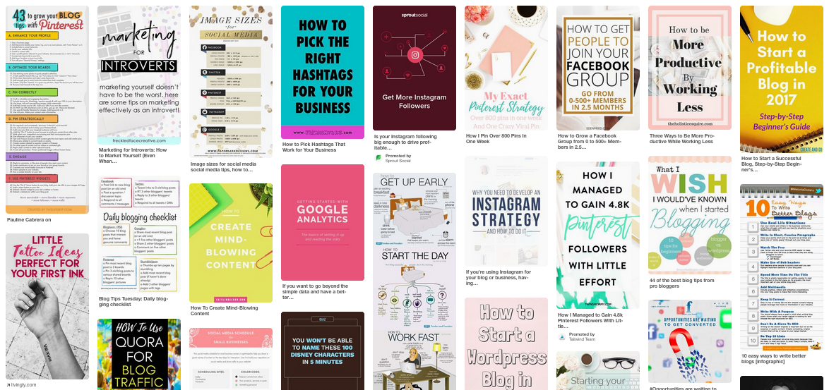
Reds and oranges stand out and get more clicks.

Slide 9
Reds and oranges stand out and get more clicks.

Slide 10
Color Scheme Generators
Kuler – Use the Kuler color wheel and select a rule (complimentary, shades, compound) to create different color schemes. It will give you the Hex code and RGB values for each color.

Slide 11
Color Scheme Generators
Kuler – Use the Kuler color wheel and select a rule (complimentary, shades, compound) to create different color schemes. It will give you the Hex code and RGB values for each color.
COLOURlovers – A community of creatives from around the world who share their color palettes.

Slide 12
Color Scheme Generators
Kuler – Use the Kuler color wheel and select a rule (complimentary, shades, compound) to create different color schemes. It will give you the Hex code and RGB values for each color.
COLOURlovers – A community of creatives from around the world who share their color palettes.
Coolors – This one is probably my favorite. It’s a color scheme generator that gives you an entirely new set of colors every time you press the space bar.

Slide 13
Color Scheme Generators
Kuler – Use the Kuler color wheel and select a rule (complimentary, shades, compound) to create different color schemes. It will give you the Hex code and RGB values for each color.
COLOURlovers – A community of creatives from around the world who share their color palettes.
Coolors – This one is probably my favorite. It’s a color scheme generator that gives you an entirely new set of colors every time you press the space bar.
Pictaculous –Upload a photo and create a custom color scheme from it.

Slide 14
How do you apply colors to your brand?

Slide 15
Use 2 to 4 colors for your brand…

Slide 16
Use 2 to 4 colors for your brand…
A primary color (aka: action color). Use for links, buttons, and social media images.

Slide 17
Use 2 to 4 colors for your brand…
A primary color (aka: action color). Use for links, buttons, and social media images.
A light neutral color. This will be a secondary color you can use for backgrounds and accent.

Slide 18
Use 2 to 4 colors for your brand…
A primary color (aka: action color). Use for links, buttons, and social media images.
A light neutral color. This will be a secondary color you can use for backgrounds and accent.
A dark neutral color. Another secondary color to use for backgrounds, text, and headings.

Slide 19
Use 2 to 4 colors for your brand…
A primary color (aka: action color). Use for links, buttons, and social media images.
A light neutral color. This will be a secondary color you can use for backgrounds and accent.
A dark neutral color. Another secondary color to use for backgrounds, text, and headings.
A contrast color.

Slide 20
I want people to feel happy and energized when they experience my brand…
Color Palette
Links, Buttons
Backgrounds
Headings, text
Accent color
Secondary colors

Slide 21
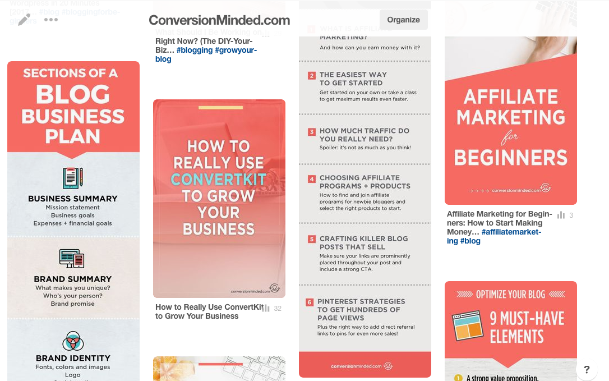
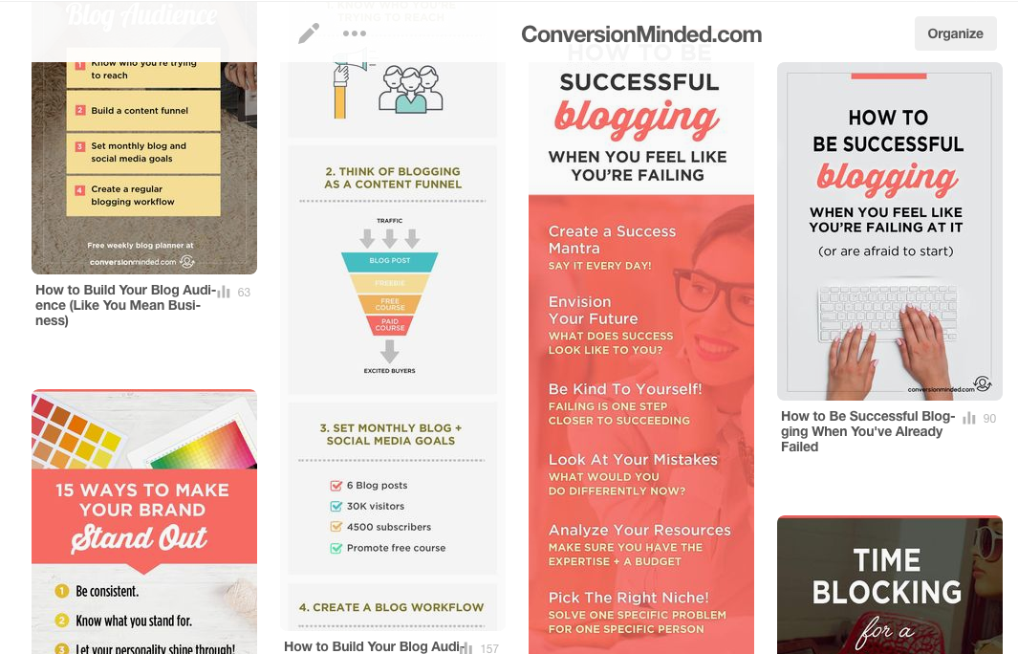
Applying colors to social media…

Slide 22
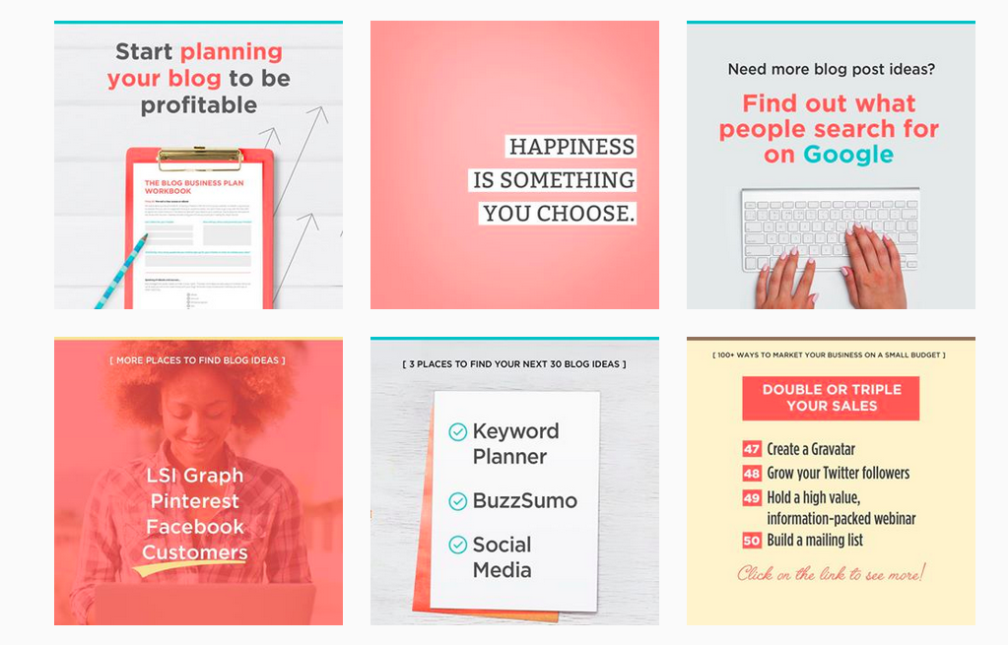
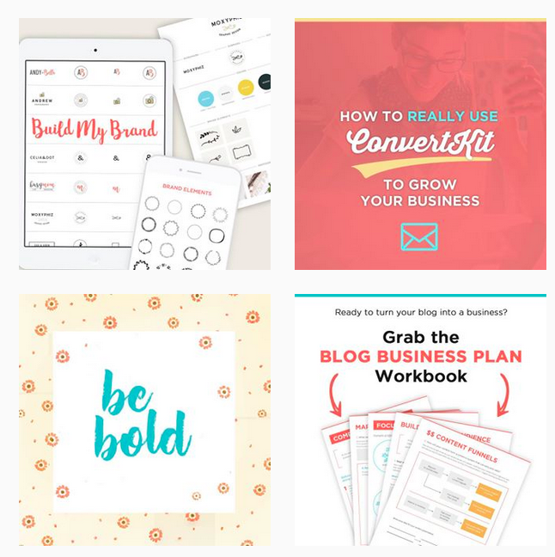
Applying colors to social media…

Slide 23
Fonts

Slide 24
Choose two or three fonts…then stick with them.
Bold, sans-serif stand out more than serif fonts.
Choose a contrast font that’s easy to read.

Slide 25
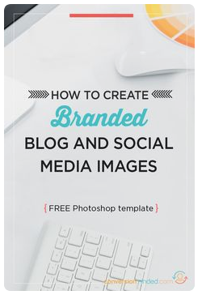
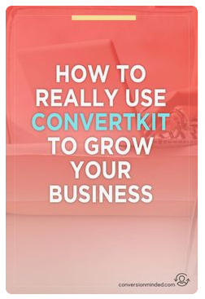
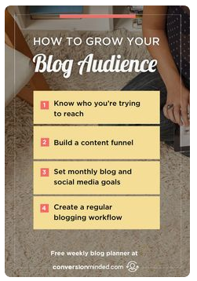
Aim for consistency + brand recognition.

Slide 26
There should be a clear contrast between your text and the background image.
Make it easy for people to read your text right away.
Use a white font on a dark background or a dark font on a light background.

Slide 27
Be strategic about how you use fonts
Don’t:
Use different fonts and sizes for all your text.
Have no purpose or reason for changing it.
Break up phrases with different sizes and fonts.

Slide 28
Be strategic about how you use fonts
Don’t:
Use different fonts and sizes for all your text.
Have no purpose or reason for changing it.
Break up phrases with different sizes and fonts.
Do:
Emphasize a key word/phrase by giving it a different font or color.
Use scripts or contrast fonts to emphasize a word.
Leave all the other fonts the same.
Change everything about the key phrase.

Slide 29
Be strategic about how you use fonts
vs

Slide 30
Images, Backgrounds, and Overlays

Slide 31
Images should reflect your audience, brand, and content.
Look for images that compliment your brand.

Slide 32
Images should reflect your audience, brand, and content.
Look for images that compliment your brand.
Flatlay images give you lots of room for text.
THIS IS A
FLATLAY

Slide 33
Images should reflect your audience, brand, and content.
Look for images that compliment your brand.
Flatlay images give you lots of room for text.
Dark image + light text or Light image + dark text
WHITE TEXT ON DARK
THIS IS A
FLATLAY

Slide 34
Images should reflect your audience, brand, and content.
Look for images that compliment your brand.
Flatlay images give you lots of room for text.
Dark image + light text or Light image + dark text
Customize stock images to suit your content.
WHITE TEXT ON DARK
THIS IS A
FLATLAY

Slide 35
Images should reflect your audience, brand, and content.
Look for images that compliment your brand.
Flatlay images give you lots of room for text.
Dark image + light text or Light image + dark text
Customize stock images to suit your content.
If you can, use your own photos or create custom images.
WHITE TEXT ON DARK
THIS IS A
FLATLAY

Slide 36
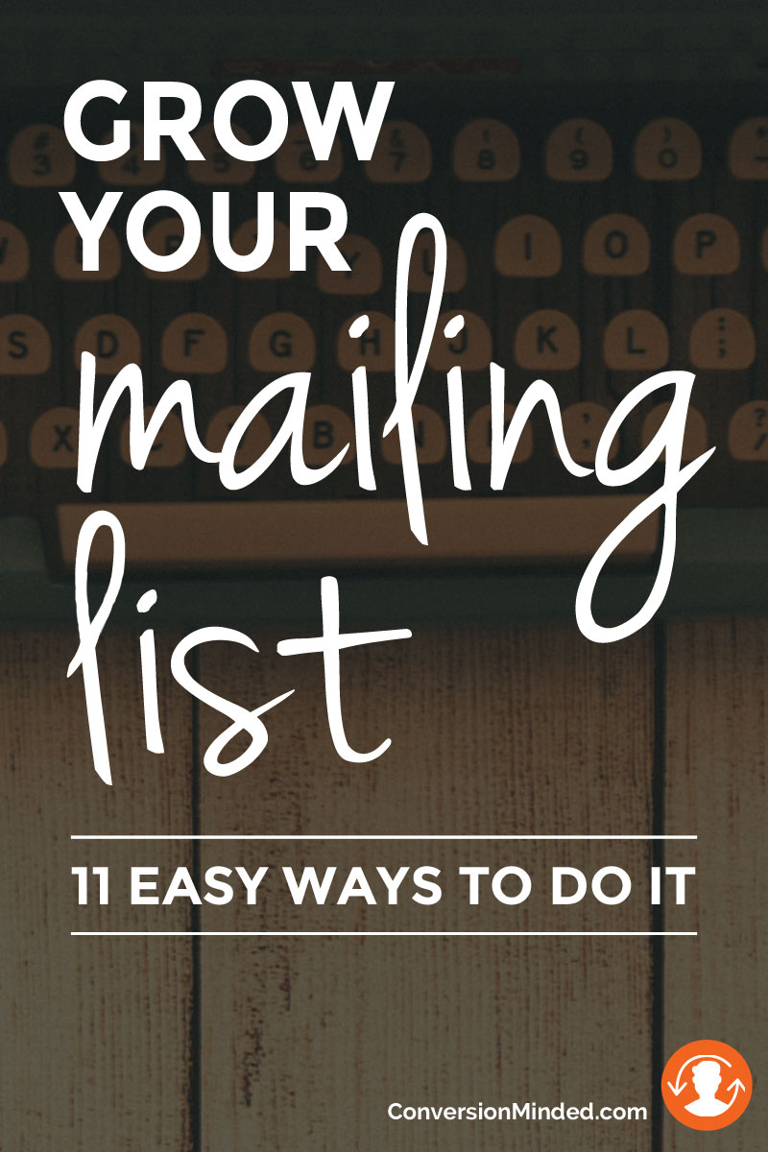
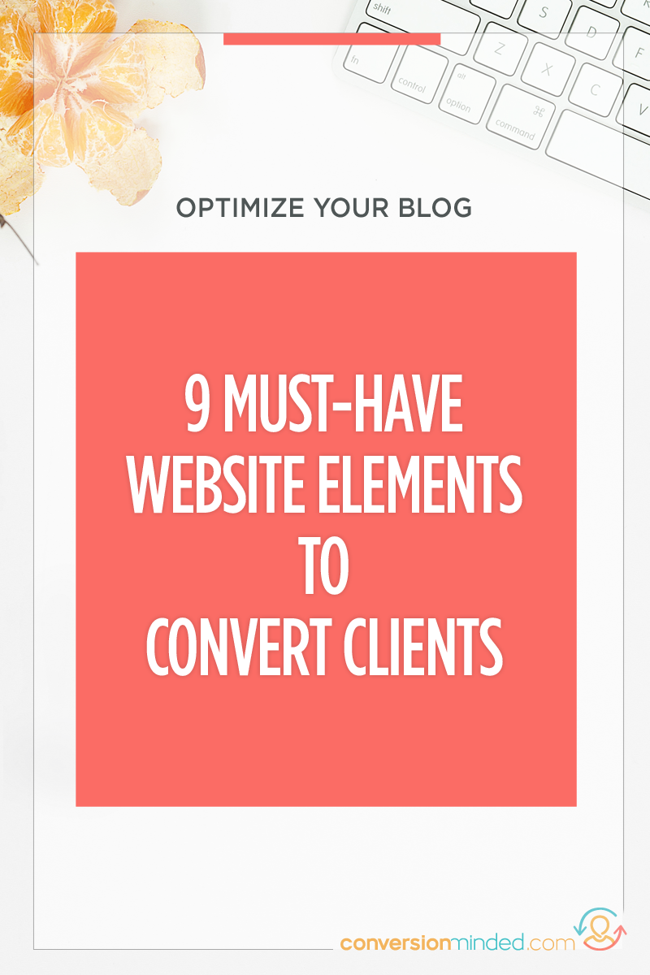
Make use of white space.
vs

Slide 37
Make your text pop by using overlays.

Slide 38
Make Sure Your Brand Is Consistent

Slide 39
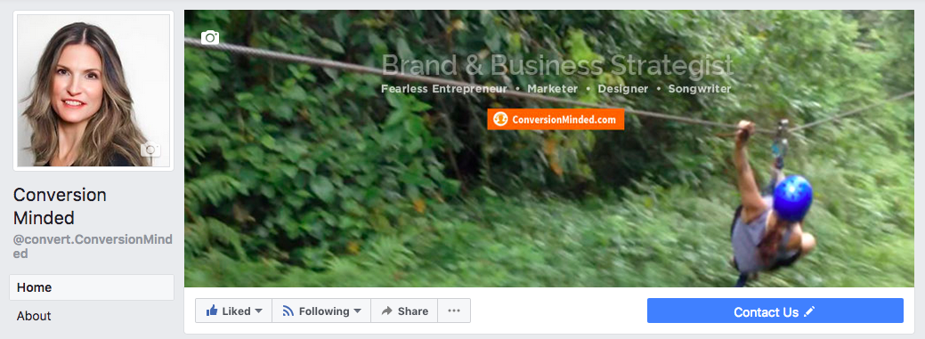
Use the same (or complimentary) images for your profile and cover photo.
Profile images should look professional
Consider developing monthly themes

Slide 40
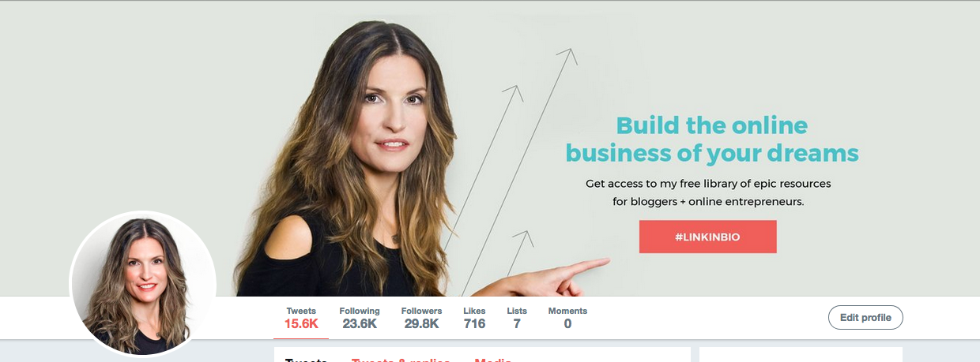
Use the same (or complimentary) images for your profile and cover photo.
If you have a product, service, or free offer to promote, feature it in your cover photo.

Slide 41
Profile Images Sizes
Profile pics:
500 x 500px
You can edit, crop and resize inside each platform.
Cover photos + backgrounds:
Facebook: 828 x 315px desktop 828 x 462px mobile
Twitter: 1500 x 500px
LinkedIn: 1400 x 425px
Google+ 1080 x 608px

Slide 42
Profile Images Sizes
Profile pics:
500 x 500px
You can edit, crop and resize inside each platform.
Cover photos + backgrounds:
Facebook: 828 x 315px desktop 828 x 462px mobile
Twitter: 1500 x 500px
LinkedIn: 1400 x 425px
Google+ 1080 x 608px
Share images:
1080px square for Instagram
1000 x 500px for Facebook, Twitter + LinkedIn (2:1 aspect ratio).
735 x 1106px (up to 2061) for Pinterest (use for Google+)

Slide 43
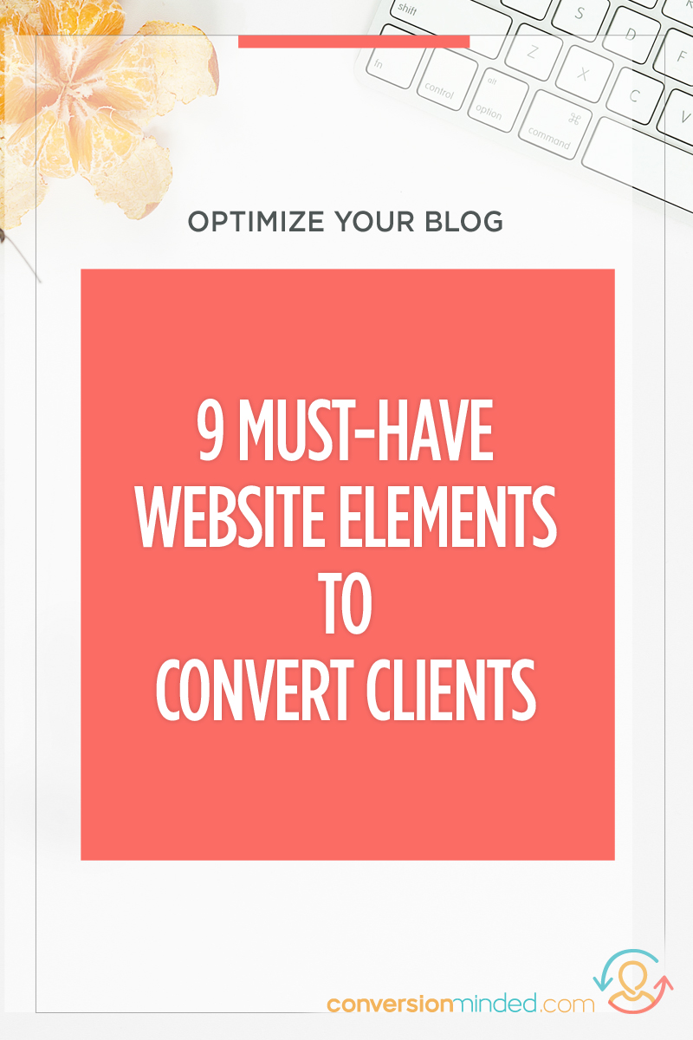
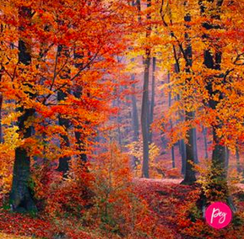
Watermark Your Share Images
(Use the submark version of your logo if possible.)

Slide 44
Templates will save you time and help your brand look harmonious.
Create templates for each social media site.

Slide 45
Templates will save you time and help your brand look harmonious.
Create templates for each social media site.
Include variations for the types of content you will share.
CREATE TEMPLATES FOR:
Products + services
Blog posts
Announcements
Specials + discounts
Helpful tips
Quotes + inspiration

Slide 46
Templates will save you time and help your brand look harmonious.
Create templates for each social media site.
Include variations for the types of content you will share.
Include styles and placement for images, your logo, colors, and fonts.
CREATE TEMPLATES FOR:
Products + services
Blog posts
Announcements
Specials + discounts
Helpful tips
Quotes + inspiration

Slide 47
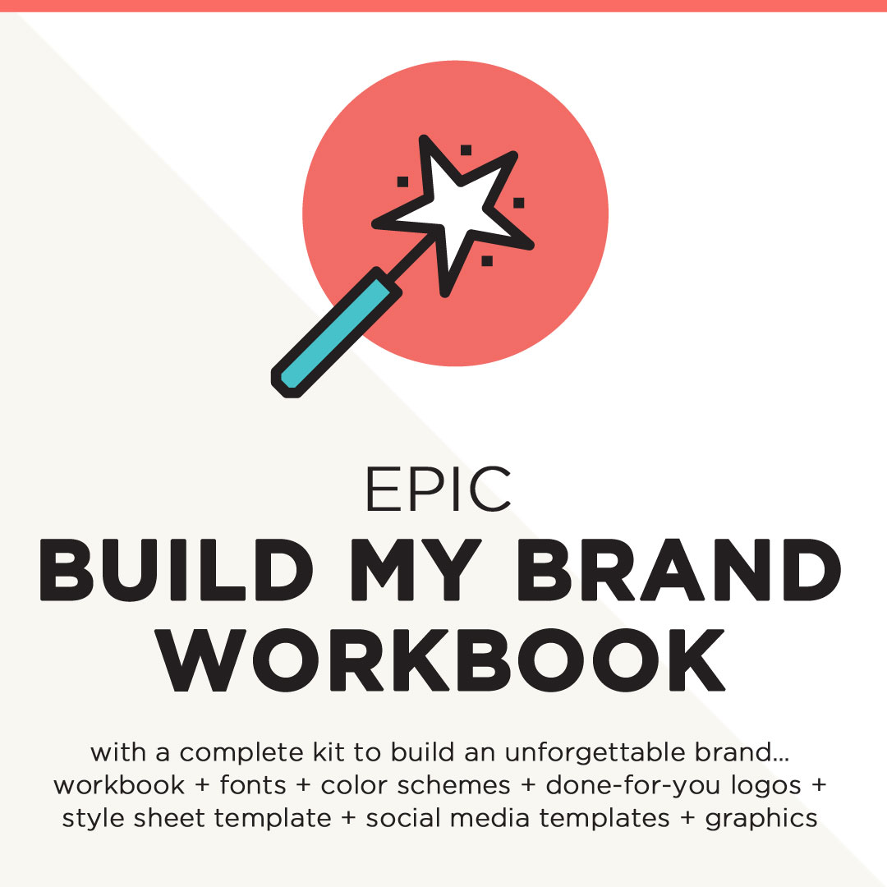
Some examples of templates…
Blog post templates
Product templates
Quote template

Slide 48
Some examples of templates…

Slide 49
Standard Sizes for Share Images
For shared + link images:
1080px square for Instagram 1200 x 600 for Facebook, Twitter + LinkedIn 736 x 1102 (up to 2061) for Pinterest (use for Google+)
Use a 2:1 aspect ratio for Twitter and Facebook.

