Slide 1
Embedded Multiplication Making Disciples Who Multiply Churches
ralphmoore.net

Slide 2
Hope Chapel Story In A Nutshell
Started by accident

Slide 3
Hope Chapel Story In A Nutshell
Started by accident
Became opportunistic

Slide 4
Hope Chapel Story In A Nutshell
Started by accident
Became opportunistic
Grew in fits & starts, no smooth curve

Slide 5
Hope Chapel Story In A Nutshell
Started by accident
Became opportunistic
Grew in fits & starts, no smooth curve
Never built a brand

Slide 6
Hope Chapel Story In A Nutshell
Started by accident
Became opportunistic
Grew in fits & starts, no smooth curve
Never built a brand
2,300+ churches on every continent since 1971

Slide 7
Four Keys To Our Multiplication
An easily reproducible model

Slide 8
Four Keys To Our Multiplication
An easily reproducible model
Hands on training

Slide 9
Four Keys To Our Multiplication
An easily reproducible model
Hands on training
A continuing example

Slide 10
Four Keys To Our Multiplication
An easily reproducible model
Hands on training
A continuing example
Championing vision and results through events, books, email and white papers.

Slide 11
1. Lay a foundation through teaching more than preaching

Slide 12
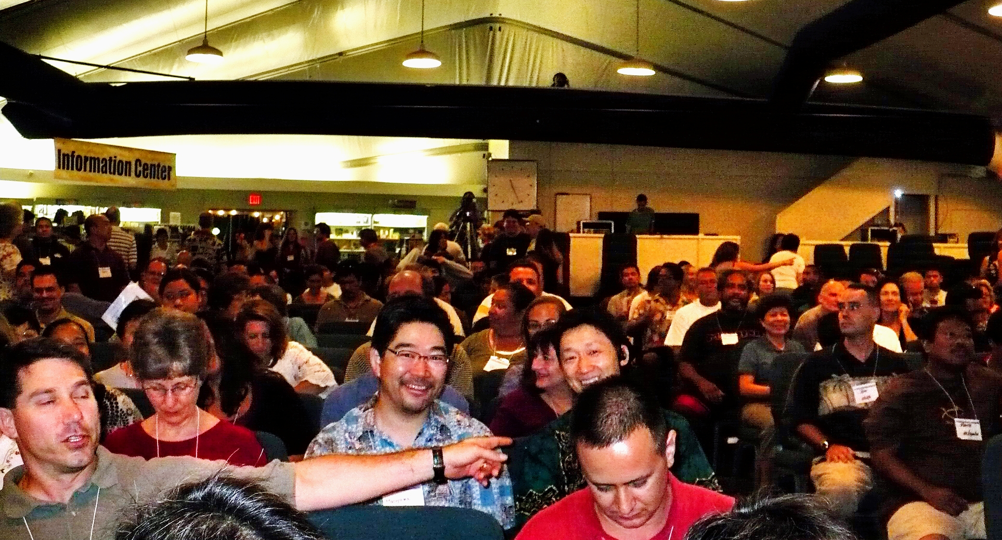
Looks much like any other church…

Slide 13
1. Lay a foundation through teaching more than preaching
2. Disciple members around sermon
A. Food & Fellowship
B. What did you hear from the Holy Spirit?
C. What will you do because of it?
D. How can we help, or pray for you?
E. Prayer

Slide 14
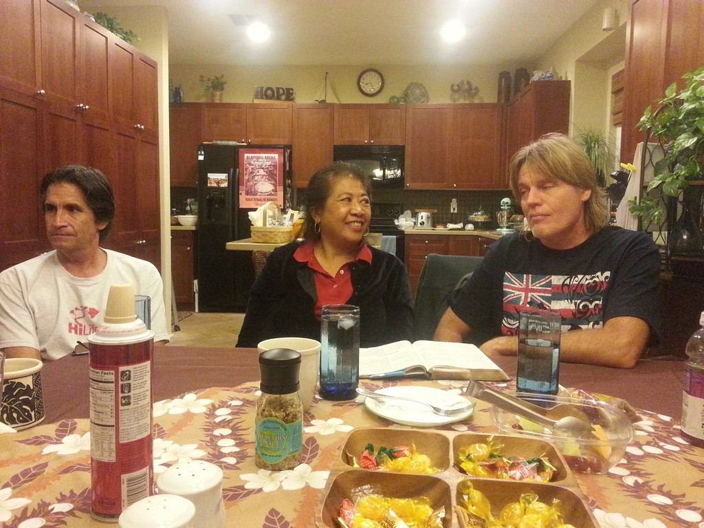
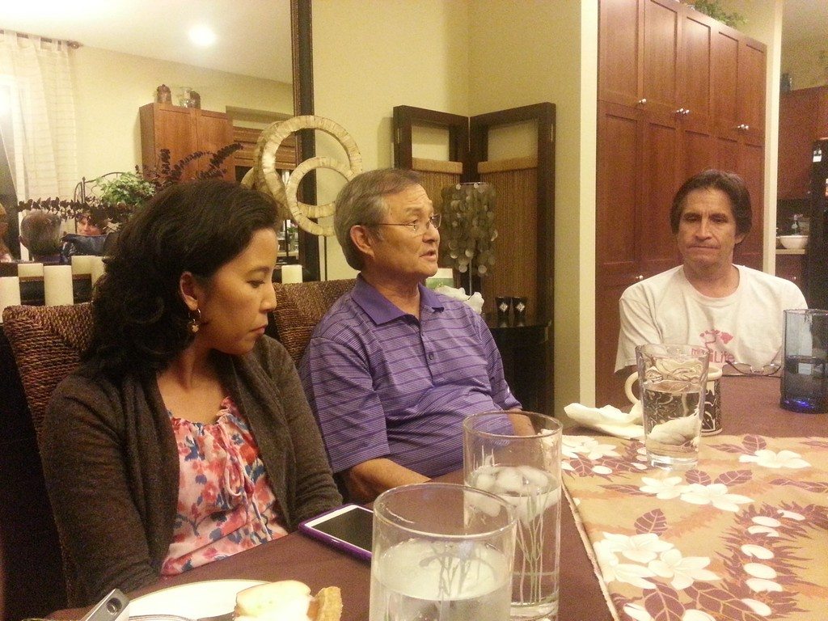
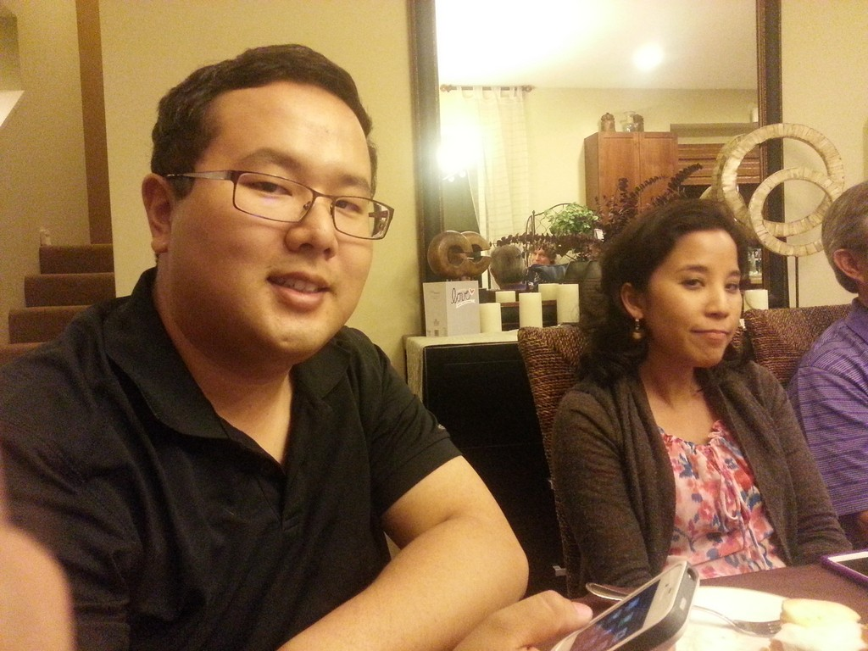
But, functions differently…

Slide 15
1. Lay a foundation through teaching more than preaching
2. Disciple members around sermon
A. Food & Fellowship
B. What did you hear from the Holy Spirit?
C. What will you do because of it?
D. How can we help, or pray for you?
E. Prayer
3. Disciple leaders around books and experience
A. What did you hear from the Holy Spirit?
B. How will that impact your ministry?
C. What are you doing in ministry?

Slide 16
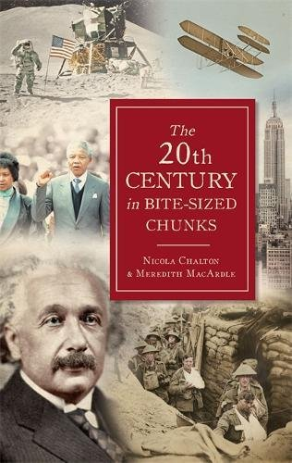
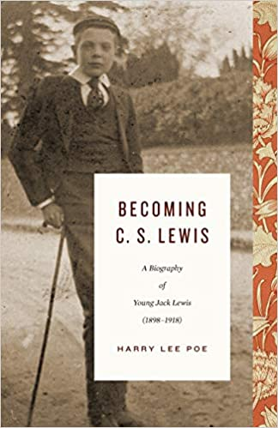
We read together

Slide 17
1. Lay a foundation through teaching more than preaching
2. Disciple members around sermon
A. Food & Fellowship
B. What did you hear from the Holy Spirit?
C. What will you do because of it?
D. How can we help, or pray for you?
E. Prayer
3. Disciple leaders around books and experience
A. What did you hear from the Holy Spirit?
B. How will that impact your ministry?
C. What are you doing in ministry?
4. Lead pastor and elders send and coach reproducing leader as church planters

Slide 18
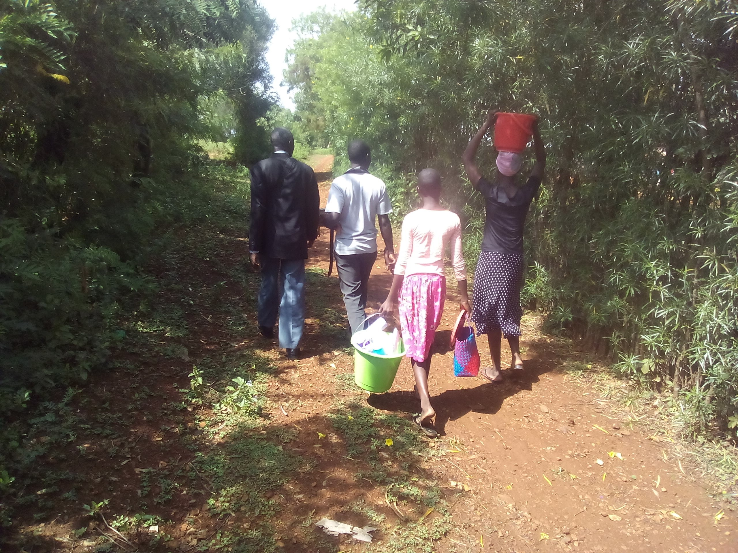
We send, they send!

Slide 19
Three Simple Questions
1. What did the Holy Spirit speak to you while the pastor was talking (as you were reading the assigned book)?
2.
3.

Slide 20
Three Simple Questions
1. What did the Holy Spirit speak to you while the pastor was talking (as you were reading the assigned book)?
2. What will you do because of what He said to you?
3.

Slide 21
Three Simple Questions
1. What did the Holy Spirit speak to you while the pastor was talking (as you were reading the assigned book)?
2. What will you do because of what He said to you?
3. How can we help, or pray for you?

Slide 22
Multiplication Levers
Low threshold into leadership
Biblical standards (no formal education required)
A leader must already have followers

Slide 23
Multiplication Levers
Low threshold into leadership
Biblical standards (no formal education required)
A leader must already have followers
No central government
Slows the mother church
Impedes innovation & cultural accommodation

Slide 24
Multiplication Levers
Low threshold into leadership
Biblical standards (no formal education required)
A leader must already have followers
No central government
Slows the mother church
Impedes innovation & cultural accommodation
Acceptance of diversity
Church names are unimportant
The model is flexible
A place where nobody knows my name…

