Slide 1
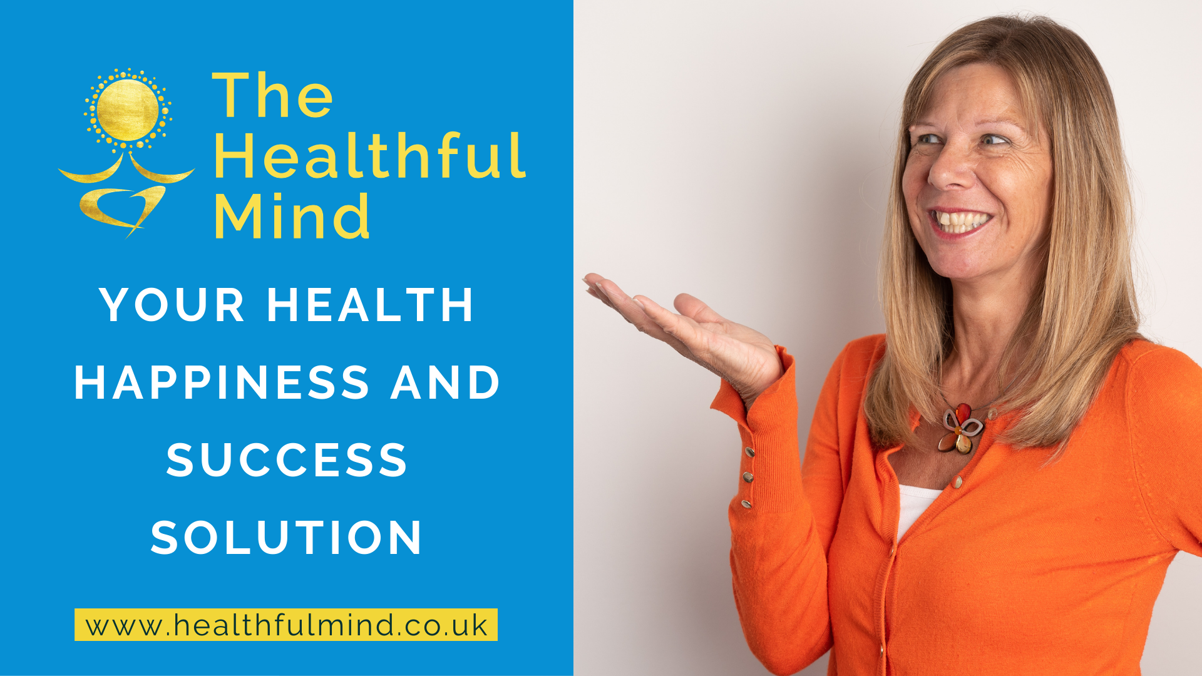

Slide 2
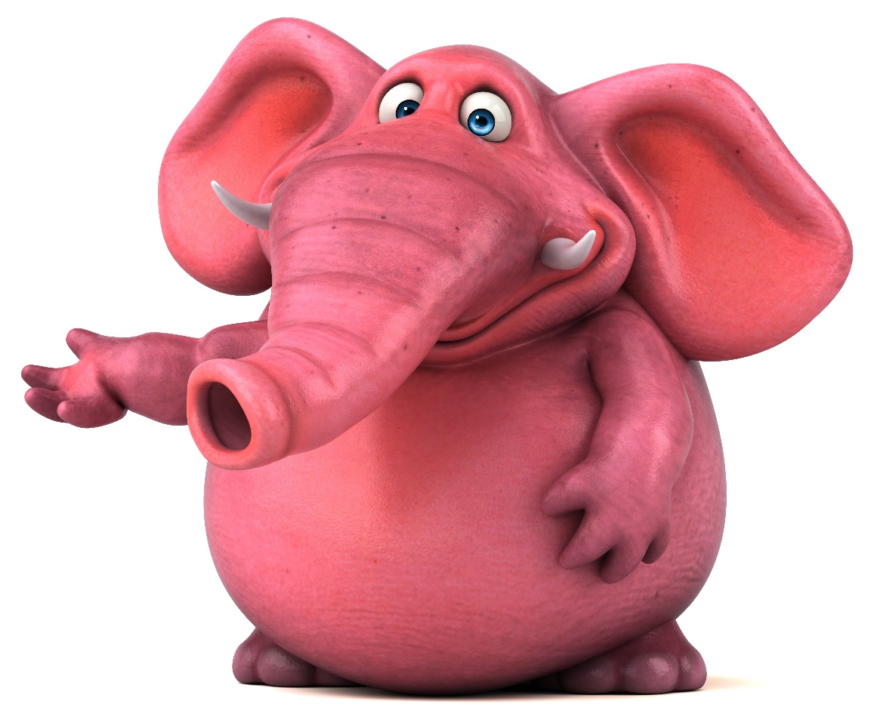
Pink Elephants! Before we start if you haven’t already done so, please watch the training video in the introductory section so the next part makes more sense.

Slide 3
The Healthful Mind Mission
To empower you to take back control of your health and happiness
To make the journey enjoyable, inspirational and achievable.
To ensure you have all you need to reach your health, happiness and success potential, whatever that may mean to you.
To provide you with personal support and guidance that will enable you to address your individual issues.
To address your fears and doubts, bring peace to your past and optimism to your future.
To create a blueprint of how to navigate your future from a healthful perspective.

Slide 4
The Healthful Mind.

Slide 5
So what is a healthful mind: Sees things from the perspective of health. Knows how to thrive rather than just survive. Notices and focusses on what is right in your body or your life rather than what is or could be wrong. Works with you not against you. Creates a body full of health.

Slide 6
A few of the benefits others have experienced:
Being back in control of your body, mind and life.
Freedom
Confidence
Calm
Success
A good night’s sleep
Waking in the morning refreshed
Optimism for the future
Enjoying old and new activities
Peace of mind

Slide 7
KISS: Keep It Super Simple - It is all about the doing.

Slide 8
Rebalance: week 1 – 4 and for life!
Learning to feel how you want to feel, emotionally and physically.
Rebalancing the nervous systems: Thriving instead of surviving.
Building a solid foundation to grow and develop from.
Harnessing the bodies own healing processes.
Creating an internal environment that will readily accept change in preparation for the resolve stage.

Slide 9
Resolve: week 5 - 8
Gain deeper understanding of what caused your issues (we don’t start here as without the changes made in rebalance this would have just triggered you further)
Use powerful yet gentle techniques to remove and desensitise you from your triggers and the causes of your problems.
Building a greater sense of calm, confidence and control.
All the while gently steering you along a positive pathway, moving you closer to all that you desire.

Slide 10
Reboot: Making your healthy happy future
What else do you need: support for some of your more specific areas, diet, lifestyle, healthful habits etc.
Mastering your magnificence
Making this last.
Completing your toolbox
Future goals
Blueprinting your healthful life.

Slide 11
Be patient and trust in the process, I know the way!

Slide 12
Week 1 Sowing the seeds of change; Understanding and creating a thriving internal environment.

Slide 13
Change one thing and everything changes, you just need to know what to change and when to get what you want.

Slide 14
The rebalance model

Slide 15
Ruminating on the past = SNS Fearing the future = SNS Being in the present = PNS SNS = Sympathetic nervous system: Fight or flight PNS = Parasympathetic nervous system: Rest and digest or safe and socialise. Positive change happens in the PNS.

Slide 16
Taking control of what we can: the present, as the past has gone and the future hasn’t yet happened.
In these first weeks are aim is to nurture what we already have enabling us to feel comfortable in the present, to keep our focus on what we can do now in this moment, harnessing our bodies own processes to trigger our PNS.
When in our problems the negative past and the catastrophic future nearly always trigger the SNS, so you will learn to gently bring yourself back to the PNS.

Slide 17
We are all unique but what is going on underneath the surface is not:
The causes and impact of your emotional or physical symptoms are unique to you, but they are all made by the same systems in our bodies in response to your unique experiences, because we are all wired to survive.
When you are experiencing an excess of fear, anxiety, pain, illness, fatigue or emotional overwhelm, then these are all signs that your defence mechanism is working on overdrive.
You are surviving not thriving.

Slide 18
In survival mode life feels like a constant fight or battle.

Slide 19
How did you come to feel this way?
There maybe many reasons or just a few that lead you to where you are now.
There is no blame, even if bad things have happened.
Adverse childhood experiences (ACE’S), genetics, one off trauma, life, can trigger your body into ill health.
Remaining in that state is not about what happened but how we dealt with it and the cycles we got stuck in.

Slide 20
In future weeks we will delve much deeper into what has been going on within you and around you, but the whole point of the Rebalance section is to bring you to where you want to be, into a healing healthful state. In this first week we are therefore taking the advice of Tony Robbins: “Focus on where you want to go, not on what you fear.”

Slide 23
You want to be healthy and happy, so let’s start with harnessing your health and your happiness.

Slide 24
This weeks exercises for accessing a healthful state.
Opening up to health and happiness:
In this exercise you will be using both your body and mind to access the feeling of health and happiness.
There is a statement you can print as well as a short meditation to help you feel it, so you believe it.
2. Using a powerful NLP anchoring exercise I will guide you through creating a switch to a healthy happy state.
All the instructions, a hypnosis recording and how to stack it up mindfully throughout the day then add to your journal, are in this weeks lesson materials.

