Slide 1
Routing Internet Protocol
RIP

Slide 2
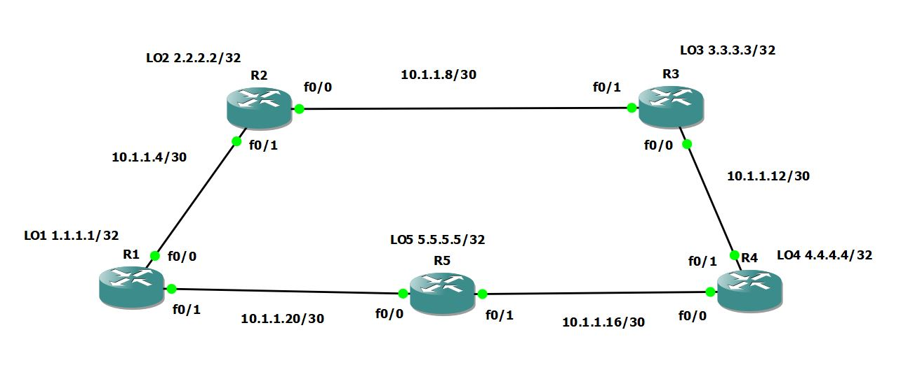
The Topology we will be using

Slide 3
The RIP Routing Protocol
RIP is a Distance Vector routing protocol
  Concerned only shortest distance and direction to destination
  Sends its full routing table to its neighbor every 30sec by default
  Maximum number of hops is 15 routers
  By default, it summarizes networks to there class-full boundary
  It has an administrative distance of 120 by default
  Multicast Address of 224.0.0.9
Versions of RIP
  Version 1
  Version 2
  Next Generation (RIPng) for IPv6

Slide 4
The RIP Routing Protocol
Feature | Description
Version | This will tell the router which version of the routing protocols you will be using. Version 1 (not used), Version 2 used for IPv4 Class-less support, RIPng for IPv6. IP rip send version 1 or IP rip receive version 1
Network | You are advertising the networks, you are connected to directly. You will use the class full boundary of the class of address.
Default-information | To generate a default route into RIP, you would used this feature.
Maximum path | RIP will load balance on all paths with same metric, the default setting (depending on your Cisco IOS version) is 4. The minimum is 1, which disables load balancing.
Passive Interface | Passive-interface command is used in all routing protocols to disable sending updates out from a specific interface. command behavior varies from one protocol to another. ... The command suppresses hello packets and hence neighbor relationships.

Slide 5
The RIP Routing Protocol
Feature | Description
No Auto-Summary | This command will disable summarizing the networks to there class-full boundaries when sending out updates and sends the exact subnet mask out on the updates.
Timers | Update: this is how often we send routing updates, the default is 30 seconds. Invalid: the number of seconds since we received the last valid update, once this timer expires the route goes into holddown, the default is 180 seconds. Holddown: the number of seconds that we wait before we accept any new updates for the route that is in holddown, the default is 180 seconds, Flush: how many seconds since we received the last valid update until we throw the route away, the default is 240 seconds.
Distance | This feature will allow you to change the Administrative Distance of RIP

Slide 6
The RIP Routing Protocol
Need to know features for CCENT or CCNA certification
  Version
  Network
  No auto-summary
  Distance
  Timers
  Passive interface
  Maximum Paths
  Default-information

