Slide 1
Introduction to QuantZilla
Quant Trading Basics
www.quantzilla.in

Slide 2
Rajandran – Your Mentor
Founder – Marketcalls & Co-Creator - Algomojo
TRADING
SOFTWARES
Trade mostly index/stock futures/option instruments. Trading/Investing since 2006. Wrote 3200+ articles since 2007 about various technical analysis topics
Use Ninjatrader 8 (Bell TPO) for Orderflow & Market Profile studies and Amibroker for Trading Systems
EXPERTISE
COMMUNICATION
Market Profile, Order flow analytics, Trading System/Indicator Development, Automated Trading
Twitter : @marketcalls_
Telegram : @marketcalls_in
TRAINER
NATURE OF TRADING
Trained more than 1000+ Professional traders on Market Profile, Orderflow & Amibroker Trading System Development and Automation
Derivative Trader. Mostly Index Futures & Option Trades ranging from Scalping/ Intraday / Short term Trades. Hedged Stock Futures trades (Positional Trading)

Slide 3
What is QuantZilla?
Immersive Program on Building Trading Models.
Acquiring Deep knowledge about Amibroker AFL Programming.
Building Trading Execution capabilities for your trading system.
Fine tuning Trading System and Validating Trading System models properly.
Building a complete end to end trading system independently.

Slide 4
What is Quant Trading?
Building Models to Predict the Stock Market
Applying Machine Learning Principles to forecast the market
Systematic Trading Based on Trading Rules
Automated Trading

Slide 5
Different Types of Algorithmic Trading
Momentum Trading
Mean Reversion Trading
Trend Following
Statistical Arbitrage
Trading the Market Sentiment
Market Making

Slide 7
Qualities of a Quant Trader
Quantative Analysis
Programming Skills
Market Understanding

Slide 8
QuantZilla Basics Starts on August 03,2020 | 06.00 - 09.00 PM

Slide 9
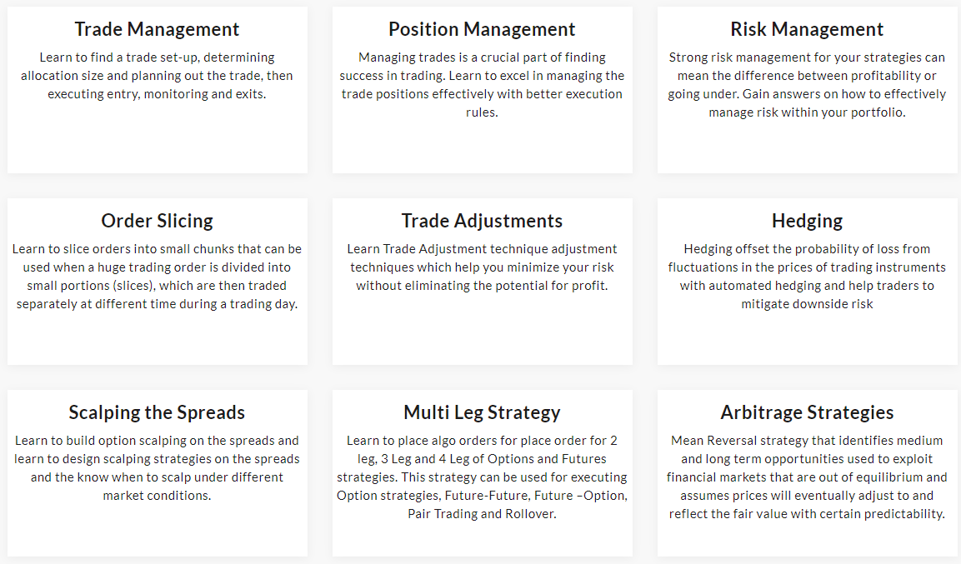
QuantZilla Advanced www.quantzilla.in

Slide 10
Choosing the Trading Platforms
Platform | Programming Language
Amibroker | Amibroker Formula Language (AFL)
Metatrader | MetaQuotes Language (C++)
Ninjatrader | Ninjascript ( C#)
TradeStation, Multicharts | Easy Language
Multicharts .Net | C#
Matlab | Matlab
Tradingview | Pinescript
Esignal | Esignal Formula Script (EFS) – (Javascript)
Custom Trading Platforms | R, Python, Java, Julia, C++, C#

Slide 11
How to Setup Algorithmic Trading Desk? Amibroker or Python Which one I should use?

Slide 12
Questions?

Slide 13
Thanks!

