Slide 1

Introduction to Mental Health and Wellbeing
What is mental health and why does it matter?

Slide 2
Objectives for this lesson
1. Define the concept mental health
2. Consider the ways in which mental health matters

Slide 3
Our mental health is part of our overall health
Mental health forms part of our emotional, psychological, and social well-being which can have an impact on how we think, feel, and behave.
Our mental health helps to determine how we handle stress, relate to others, and make healthy choices.
Across the lifespan, from early years to later adulthood our mental health is important; as important as our physical health.
Since many individuals can struggle with poor mental health which is usually derived from some form of distress, it could be argued that taking care of our mental health is as important as our physical.

Slide 4
Why is Mental Health Important?
Mental health is essential to our overall well-being, greatly influencing how we think, act, and interact in our daily lives.
Good mental health enables us to face life’s challenges with resilience and strengthens our ability to create meaningful relationships, and make decisions that shape a positive future for ourselves and our communities.
When we are aware of the importance good mental health can bring to societies, it can lay the foundation for individual resilience and collective well-being.

Slide 5
Mental Health Trajectory
By 2030
It is projected that by 2030 mental health problems (particularly depression) will be the leading cause of mortality (death) and morbidity (sickness) globally.
The primary drivers of disability globally include depression, anxiety and substance misuse.
Major depression is thought to be the second leading cause of disability worldwide and a major contributor to the burden of suicide and heart disease
Ref: mentalhealth.org.uk

Slide 6
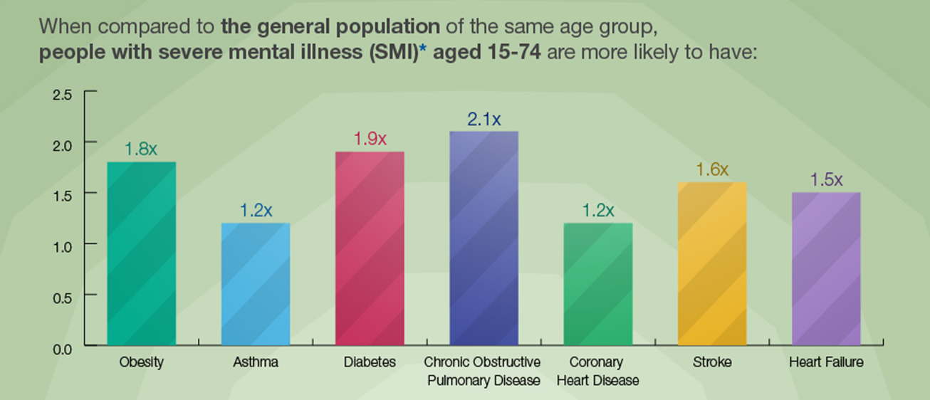
Why mental health matters:

Slide 7
How do we define mental health?
The World Mental Health Organisation (WHO) defines mental health as not just in terms of the absence of mental disorder, but as a state of wellbeing in which every individual realises their own potential, can cope with the normal stresses of life, can work productively and fruitfully, and is able to make a contribution to their community.
Good mental health is thought to be characterised by a person’s ability to fulfil a number of key functions and activities, including:
The ability to learn
The ability to feel, express and manage a range of positive and negative emotions
The ability to form and maintain good relationships with others
The ability to cope with and manage change and uncertainty
Ref: imperial.ac.uk

Slide 8
How do we define mental health?
John Cromby (2013) is a senior psychologist at Loughborough University and has conducted research in intellectual disability, mental health and drug addiction settings.
Cromby encourages individuals to consider mental illness as a subjective experience, that is expressed according to the individual life events of the sufferer rather than the rigidity of diagnostic categories; it is for this reason Cromby suggests we use the term “mental health distress” instead since poor mental health is often as a result of a distressing experience.
Do you agree with this?

Slide 9
Is it normal for our mental health to change?
Good Mental Health can look like:
Poor Mental Health can look like:
you are confident when you come across new situations or stresses
you feel optimistic
you do not always blame yourself
you can set and achieve your goals
you can stick to routines that are good for you, such as eating and sleeping well
you can enjoy life even though you've had difficult experiences
Feeling sad or down.
Confused thinking or reduced ability to concentrate.
Excessive fears or worries, or extreme feelings of guilt.
Extreme mood changes of highs and lows.
Withdrawal from friends and activities.
Significant tiredness, low energy or problems sleeping.

Slide 10
Is it worth taking care of our mental health?
Perceptions of Mental Health.
Our perception on mental wellbeing can include how important we think it is to take care of our mind.
Our perception on mental health might include the way we view it, how we perceive those who are experiencing mental health distress; this sadly can lead to discrimination or stereotypical views for those battling with mental health.

Slide 11
Is it worth taking care of our mental health?
Perceptions of Mental Health in the United Kingdom
Over a third of the public think people with a mental health issue are likely to be violent
People with severe mental illness are more likely to be the victims, rather than the perpetrators, of violent crime
People with mental ill health are more dangerous to themselves than to others: 80-90% of people who die by suicide are experiencing mental distress
Poor mental health impacts on individuals and their families, in lost income, lower educational attainment, quality of life and a much shorter life span

Slide 12
Why should we take care of our mental health?
Sustaining good mental health and seeking treatment for when our mental health feels unstable is crucial for constructive behaviours, emotions, and thoughts.
Taking time to replenish our mental health can increase productivity, enhance our self-image, and improve relationships.
There are benefits to our physical health problems when we nurture our mental health
For example, severe mental health issues also report physical conditions including metabolic diseases, hypertension and respiratory complexities.
Ref: Pizzol et al., 2024

Slide 13






Summary
Mental health is part of our overall health
Our mental health encompasses the way we feel about ourselves along with our emotional and psychological wellbeing
The way we define mental health can vary
Perceptions of mental health determine how significant it is to each of us to take care of it
By 2030 depression will be the leading cause of mortality and morbidity globally
Our mental health influences our physical health conditions

Slide 14
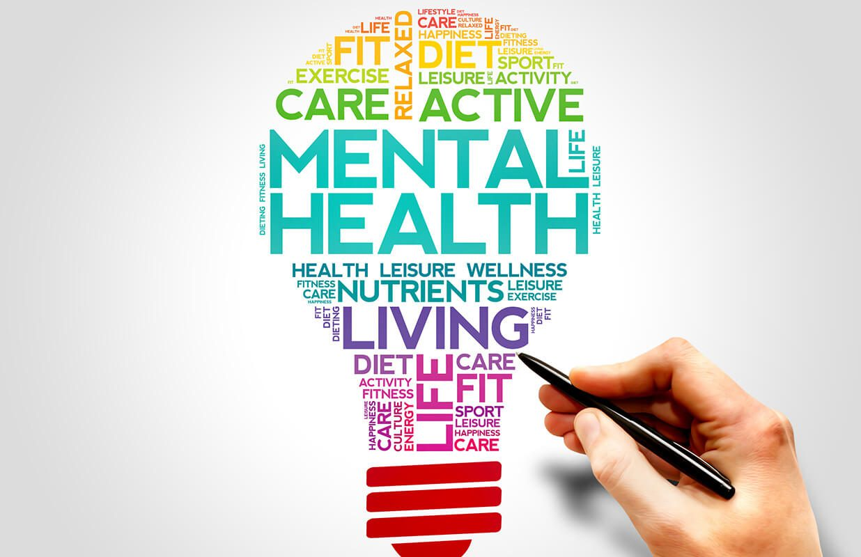
THANK YOU!
Next session: Exploring the concept of mental wellbeing in the 21st century.

