Slide 1
Hortonworks Sandbox
Startup Guide for VirtualBox

Slide 2
Basics
Download and install VirtualBox
www.virtualbox.org
Download Sandbox
www.hortonworks.com/sandbox

Slide 3
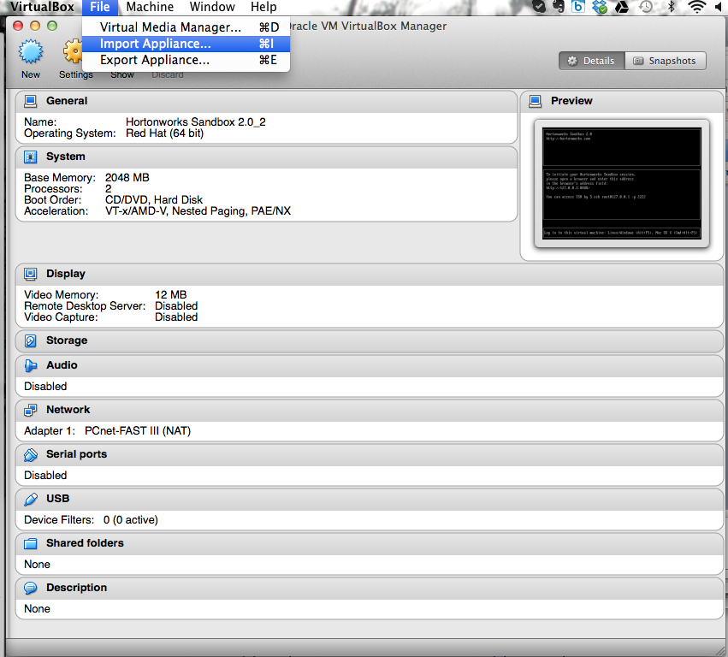
Import Sandbox VM

Slide 4
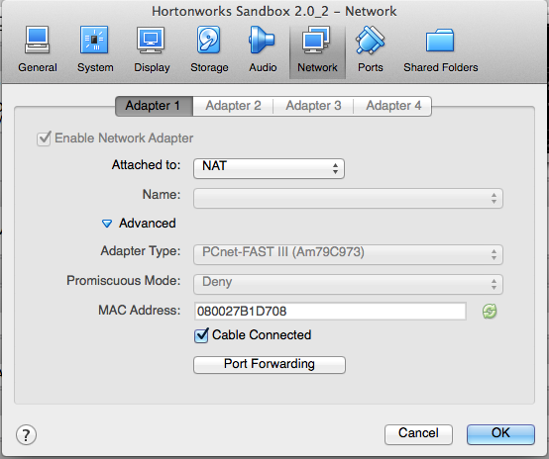
Leave default settings -- especially Networking
Note:
Only Adapter 1 is active
Set to NAT

Slide 5
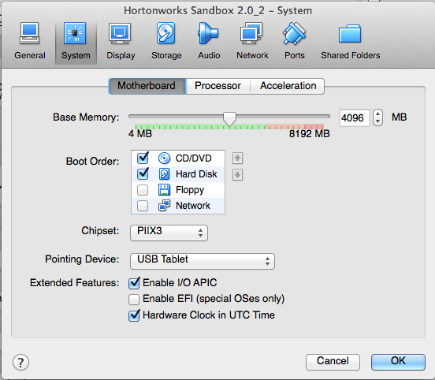
Increase Memory Allocation for Ambari and Hbase

Slide 6
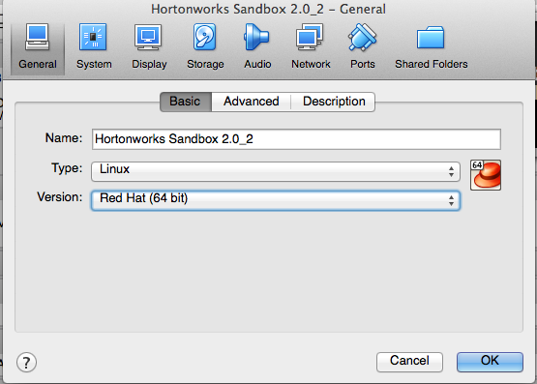
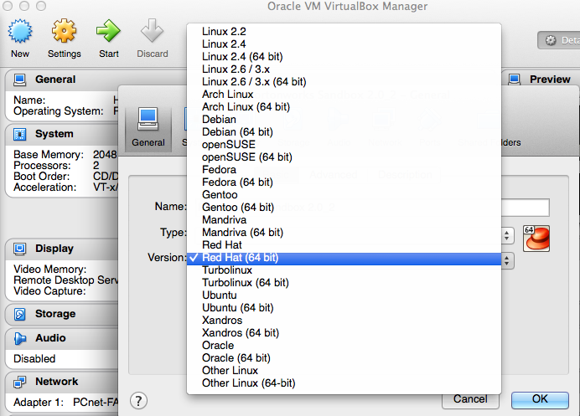
Running Linux?
If you receive the error: “The kernel requires an X86-64 CPU, but only detected i686 CPU. UNABLE TO BOOT,PLEASE USE A KERNEL APPROPRIATE FOR YOUR CPU.”
Then make sure your Version of Linux is set to the version running on your laptop.

Slide 7
Now, Start Your VirtualMachine
You are given a local web address. Use this in your browser to get to tutorials and Sandbox GUI
Want to get into the Command Line to write your own MapReduce code or install other packages? Here’s how you get to the login.
User Name: root
Password: hadoop

Slide 8
Supported Browsers
Internet Explorer 9
Chrome 25
Safari 6+
Firefox (latest stable version)
NOTE: Sandbox DOES NOT RUN on Internet Explorer 10

Slide 9
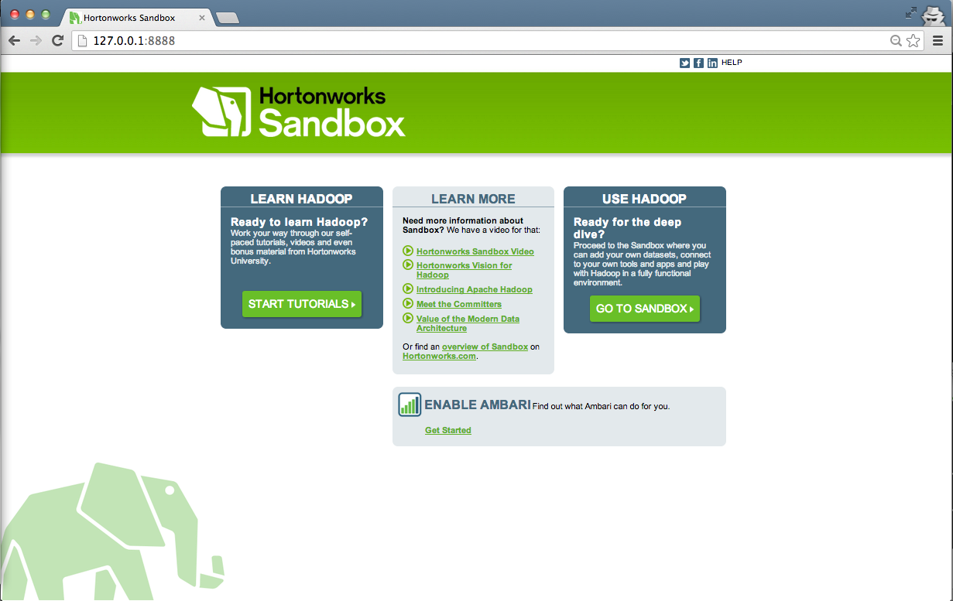
Here’s how you begin
Enter IP Address from the VirtualBox start screen. Note, your IP address may be different

Slide 10
Here’s how you begin
Click here to start tutorials
Click here to learn about Ambari
Already know what you’re doing?
Click here to get to Sandbox and HDP GUI

Slide 11
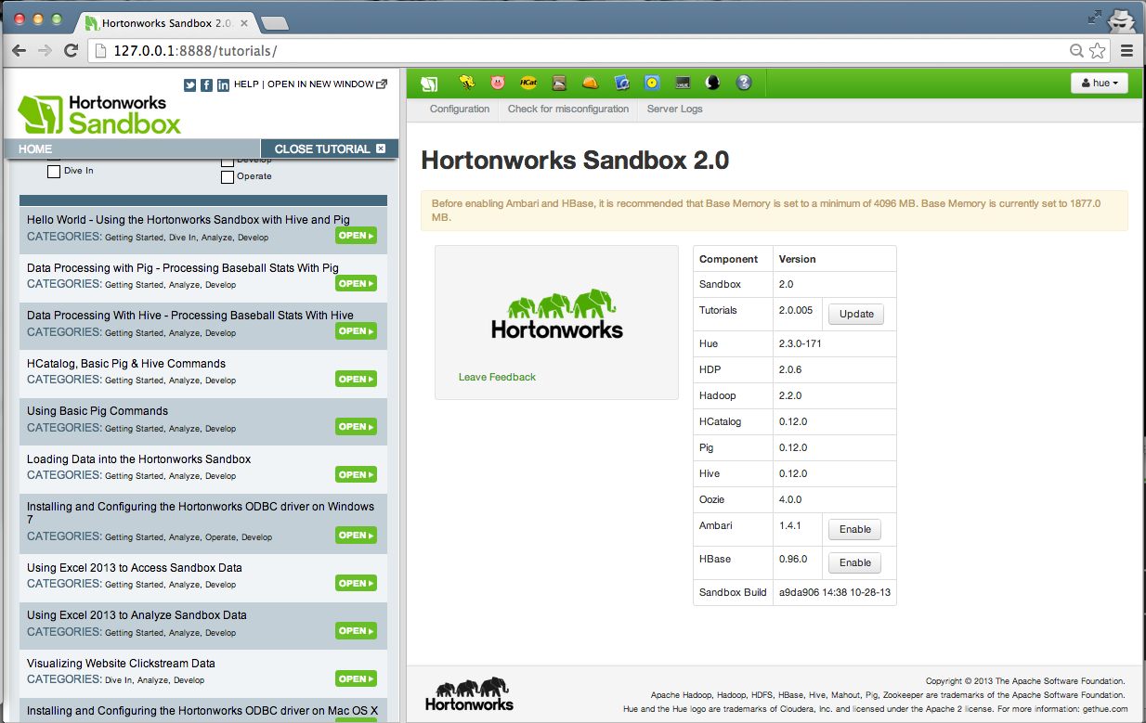
Find a tutorial
Scroll down in the left hand navigation to find a tutorial.
Click Open

Slide 12
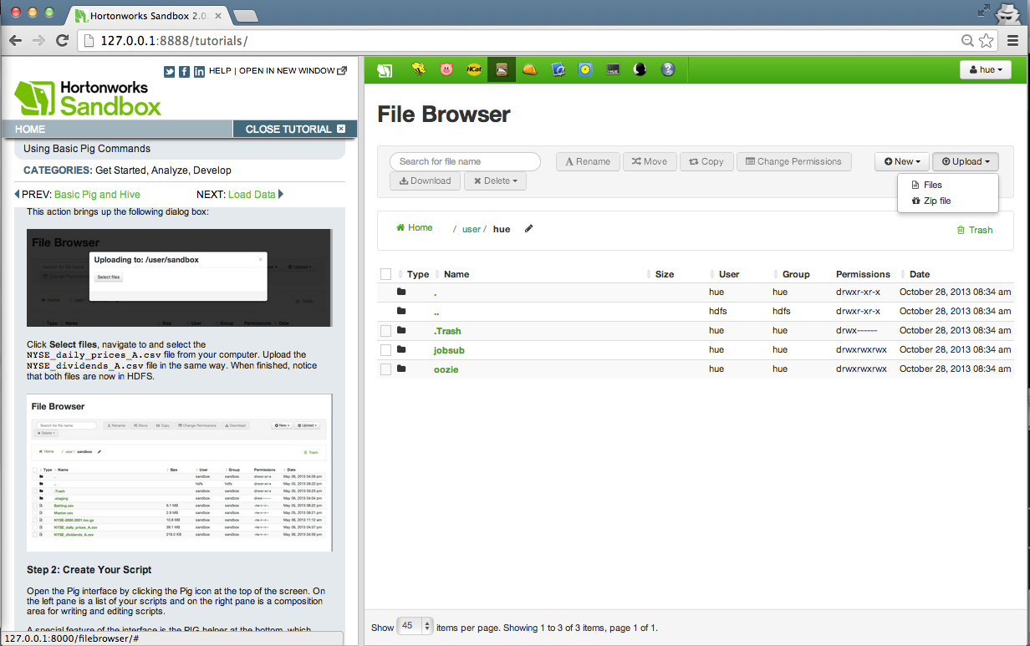
Follow along in a tutorial

Slide 13
Open tutorial in separate tab

Slide 14
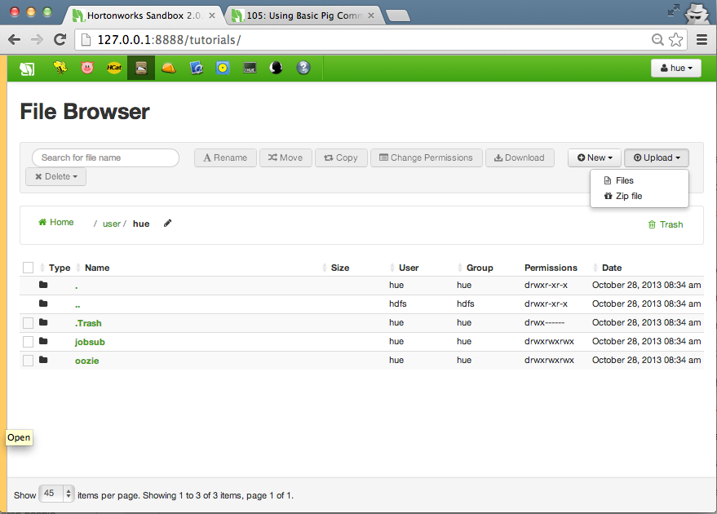
Move cursor to left window to bring tutorial window back in the same pane
Click on yellow line to bring tutorial pane back

Slide 15
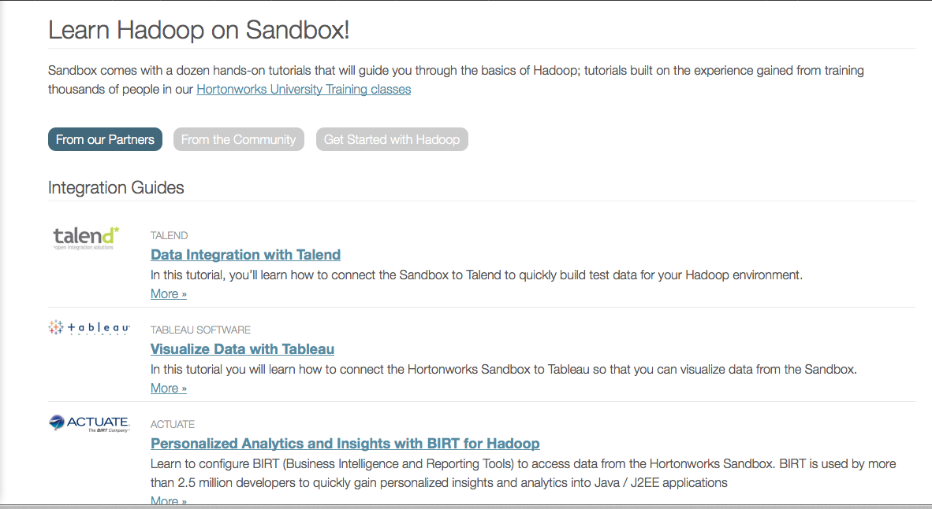
Done with the built in tutorials?
Visit our partner gallery to get hands on with tools and tutorials from our partners: http://hortonworks.com/products/hortonworks-sandbox/#tutorial_gallery

Slide 16
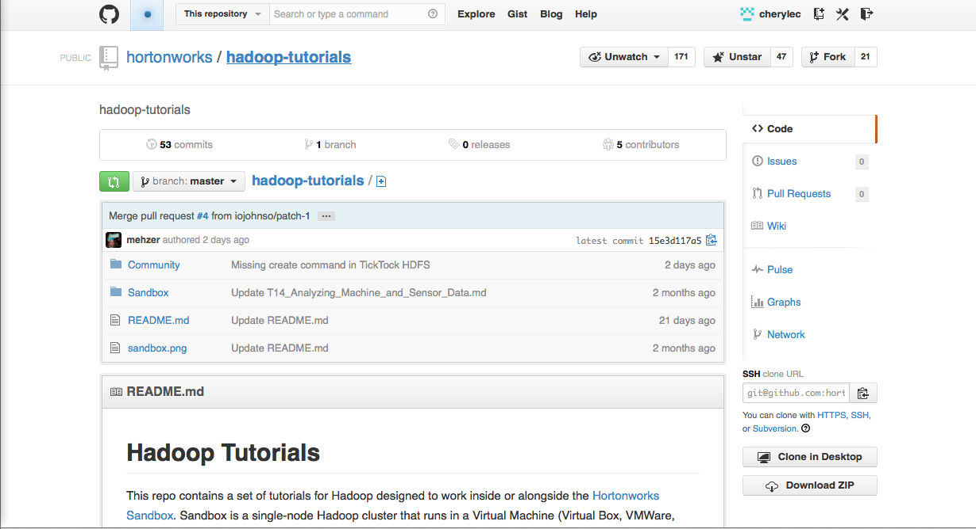
Want to add your own tutorials?
Visit our GitHub site and contribute your own tutorials: https://github.com/hortonworks/hadoop-tutorials

Slide 17
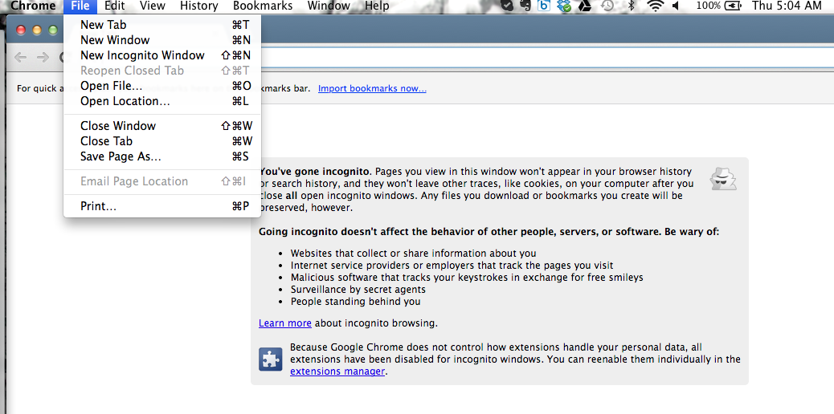
Here’s how you begin
Chrome has an “Incognito Mode”. This can help eliminate some conflicts.

Slide 18
Thanks for using the Sandbox!
Help:
Sandbox Forums are available for assistance: http://hortonworks.com/community/forums/forum/hortonworks-sandbox/
Contribute:
Want to develop and publish your own tutorial? Contribute through GitHub to:
https://github.com/hortonworks/hadoop-tutorials

