Slide 1
Finite Risk (Re)insurance
Yas Suttakulpiboon

Slide 2
Agenda
History of finite reinsurance
Functions of reinsurance
Uses of finite reinsurance
Issues in finite reinsurance
Supervisory approaches to finite reinsurance

Slide 4
Agenda
Finite reinsurance
Functions of reinsurance
Uses of finite reinsurance
Issues in finite reinsurance
Supervisory approaches to finite reinsurance

Slide 5
Definition
An entire spectrum of reinsurance arrangements that transfer limited risk relative to aggregate premiums that could be charged under the contract.
More detailed Definition in Appendix 3

Slide 6
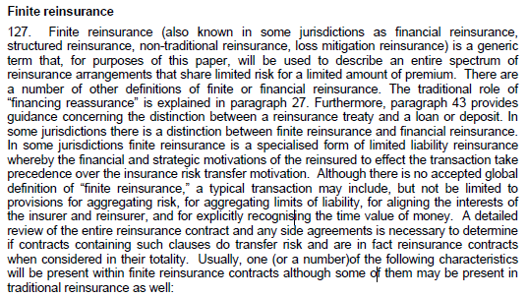

Slide 9
Characteristics of Finite Risk Reinsurance
insurance risk transfer and financing are combined
assumption of limited risk by the reinsurer (e.g., aggregate limit of liability, blended cover, sliding scale and other adjustable commissions, loss corridors and limits or caps)
transfer of volatility (e.g., multiple lines of business, multiple years of account and multiple year contract terms)
inclusion of future investment income in price of contract (recognition of time value of money with funds withheld)
potential profit sharing between parties (e.g. profit-sharing formulas, experienceaccounts)
pricing determined by ceding insurers’ results and not reinsurance pricing cycle
terms and pricing are typically determined in advance
bulk reinsurance (i.e. administration of reinsurance is done on a bulk basis rather than on a traditional seriatim policy-by-policy basis, for a block of new or in-force business).

Slide 10
Agenda
Finite reinsurance
Functions of reinsurance
Uses of finite reinsurance
Issues in finite reinsurance
Supervisory approaches to finite reinsurance

Slide 11
Functions of reinsurance
Capacity
Stability
Cat Risk protection
Financing
Expertise

Slide 12
Specific functions of life reinsurance
Mortality / Morbidity Risk Transfer
Lapse / Surrender Risk Transfer
Investment Risk Transfer
Cat Risk Transfer
Increasing Sales and Profits
Increasing reinsurer’s in-force

Slide 13
Agenda
Finite reinsurance
Functions of reinsurance
Uses of finite reinsurance
Issues in finite reinsurance
Supervisory approaches to finite reinsurance

Slide 14
Uses of finite reinsurance
to capitalize on an insurer’s above average underwriting loss experience when traditional reinsurance coverage is too expensive
to increase underwriting capacity, take larger retention in favorable underwriting environments or risks that traditional markets would not cover
to have the ability to purchase reinsurance protection when an insurer’s historic underwriting loss experience is much worse than average, making “reasonably” priced reinsurance unavailable
to provide reinsurance cover when an insurer wants to exit lines of business
to protect against potential adverse loss development, including the acquisition of new blocks of business.

Slide 15
Uses of finite reinsurance
to effect discounting of insurance liabilities in jurisdictions where discounting is not permitted and/or equalization reserves are not used
to reduce volatility (smooth) in reported earnings and enhance the financial position of the insurer over a period of time (e.g. multi-year contracts)
to provide surplus relief or capital enhancement in jurisdictions where acquisition expenses are non-deferrable
to transfer insurer’s profits to another jurisdiction or an affiliate (e.g., potentially minimizing taxes or engaging in regulatory arbitrage).

Slide 16
Types of Risk Transfer
Underwriting Risk
Realized Loss > Expected Loss
Timing Risk
Loss comes sooner than expected
Interest Rate Risk
Investment rate < Discount Rate
Credit Risk
Less pay or no pay

Slide 17
Types of Finite Risk Reinsurance Contract
Retrospective Covers (Past Underwriting Years) | Prospective Covers (Current and Future Underwriting Years)
Loss Portfolio Transfer (LPT) Adverse Development Cover (ADC) | Finite Quota Share (FQS) Spread Loss Treaty (SLT)

Slide 18
Loss Portfolio Transfer - LPT

Slide 19
Loss Portfolio Transfer - LPT

Slide 20
Adverse Development Cover - ADC

Slide 21
Finite Quota Share - FQS

Slide 22
Spread Loss Treaty - SLT

Slide 23
Spread Loss Treaty - SLT

Slide 24
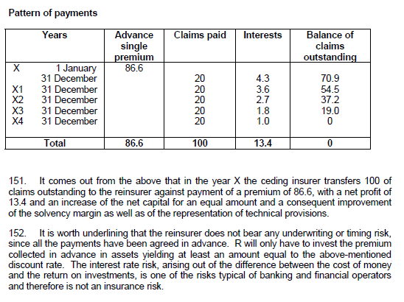
Appendix IV - Sample agreements of finite reinsurance
Time and distance policy
Notes:
These treaties cannot be taken into account for technical purposes, since there is neither a transfer of the insurance risk nor the consequent possibility of economic losses for the reinsurer.

Slide 25
Sample agreements of finite reinsurance
Non-life retrospective cover - adverse development cover
Non-life retrospective cover - loss portfolio transfer (LPT)
Non-life prospective - finite quota share
Non-life prospective – excess of loss
Non-life prospective cover- aggregate stop loss
Non-life prospective cover – multi-year stop loss

Slide 26
Agenda
Finite reinsurance
Functions of reinsurance
Uses of finite reinsurance
Issues in finite reinsurance
Supervisory approaches to finite reinsurance

Slide 27
Insurance risk transfer
Underwriting risk is the possibility that losses and expenses recoverable by the cedant from the reinsurer will exceed the consideration received by the reinsurer, thus resulting in an underwriting loss to the reinsurer
Timing risk is the risk arising from uncertainties about the timing of the receipt and payments of net cash flows from premiums, commissions, claims, and claim settlement expenses paid under a contract. The reinsurer could have a reduction in the expected investment income as a result of accelerated loss payments.

Slide 28
Insurance risk transfer: Some Jurisdictions
the extent to which actuarial liabilities have been reduced by reinsurance ceded
amounts of significant concentration of reinsurance coverage
a statement that reinsurance does not relieve the insurer of primary obligation to insured.

Slide 29
Accounting treatment of finite reinsurance: GAAP
The accounting for a reinsurance arrangement should aim for a true and fair presentation of the economic value of the transaction by insurers and reinsurers
if the finite reinsurance arrangement does not meet the criteria for significant insurance risk transfer, it should be accounted for as a loan or deposit.

Slide 30
Accounting treatment of finite reinsurance: IAS
Under IFRS 4, a reinsurance contract with only financing characteristics would not be considered an insurance contract and not be given insurance accounting treatment. Some jurisdictions require both underwriting risk and timing risk conditions to be treated as insurance.

Slide 33
Disclosure
The reporting of insurance liabilities both gross and net of reinsurance gives explicit disclosure of counterparty risk by presenting reinsurance recoverables on the insurer’s balance sheet.

Slide 34
Agenda
Finite reinsurance
Functions of reinsurance
Uses of finite reinsurance
Issues in finite reinsurance
Supervisory approaches to finite reinsurance

Slide 35
Insurance Risk Transfer
Supervisors should:
review the annual reinsurance management strategy (that has been signed off by the board of directors), which sets out a coherent reinsurance programme designed to manage and mitigate the risks assumed in the underlying policies issued by the ceding insurer
understand that the substance rather than the form of the transaction is crucial, especially if it is not clear why the ceding insurer and the reinsurer would enter into the arrangement
determine which types of risk are actually transferred and how, and why such transfer is commercially sensible for both the cedant and the reinsurer
have access to all reinsurance documentation (placement slips, cover notes, reinsurance and side agreements, and any addenda thereto) as an aid to understanding the structure of the agreements and their underlying commercial reality
have the ability to require insurers to undertake an assessment of insurance risk transfer and economic value of transactions (including the effects of any separate or side agreements or interlinked contracts, and the effects on regulatory capital), which should be available to supervisors.

Slide 36
Accounting, disclosure and information sharing
Supervisors should have the ability to verify that insurers have disclosed and accounted for any separate or side agreements or understandings that exist between the reinsurance agreement parties that would serve to reduce, offset or eliminate the reinsurer’s obligations.
Supervisors should have the power to take corrective action that could include not allowing credit for the transaction as reinsurance and requiring restatement of the financial position where material.

Slide 37
Summary
Finite reinsurance
Functions of reinsurance
Uses of finite reinsurance
Issues in finite reinsurance
Supervisory approaches to finite reinsurance

