Slide 1
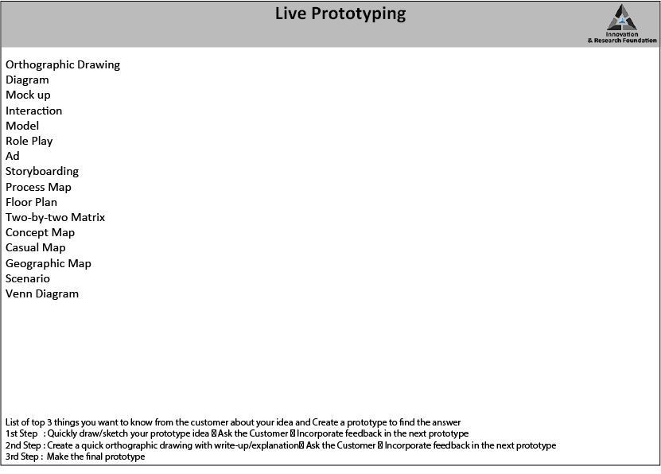
30 mins

Slide 2
Live Prototyping Today
List of top 3 things you want to know from the customer about your idea - Create a prototype to find the answer
1st Step :
Quickly draw/sketch your prototype idea Ask the Customer
Incorporate feedback in the next prototype
2nd Step :
Create a quick orthographic drawing with write-up/ explanation
Ask the Customer
Incorporate feedback in the next prototype
3rd Step :
Make the final prototype
30 mins

Slide 3
03
Express
© All rights reserved. 2019. Innovation & Research Foundation (IRF)

Slide 5
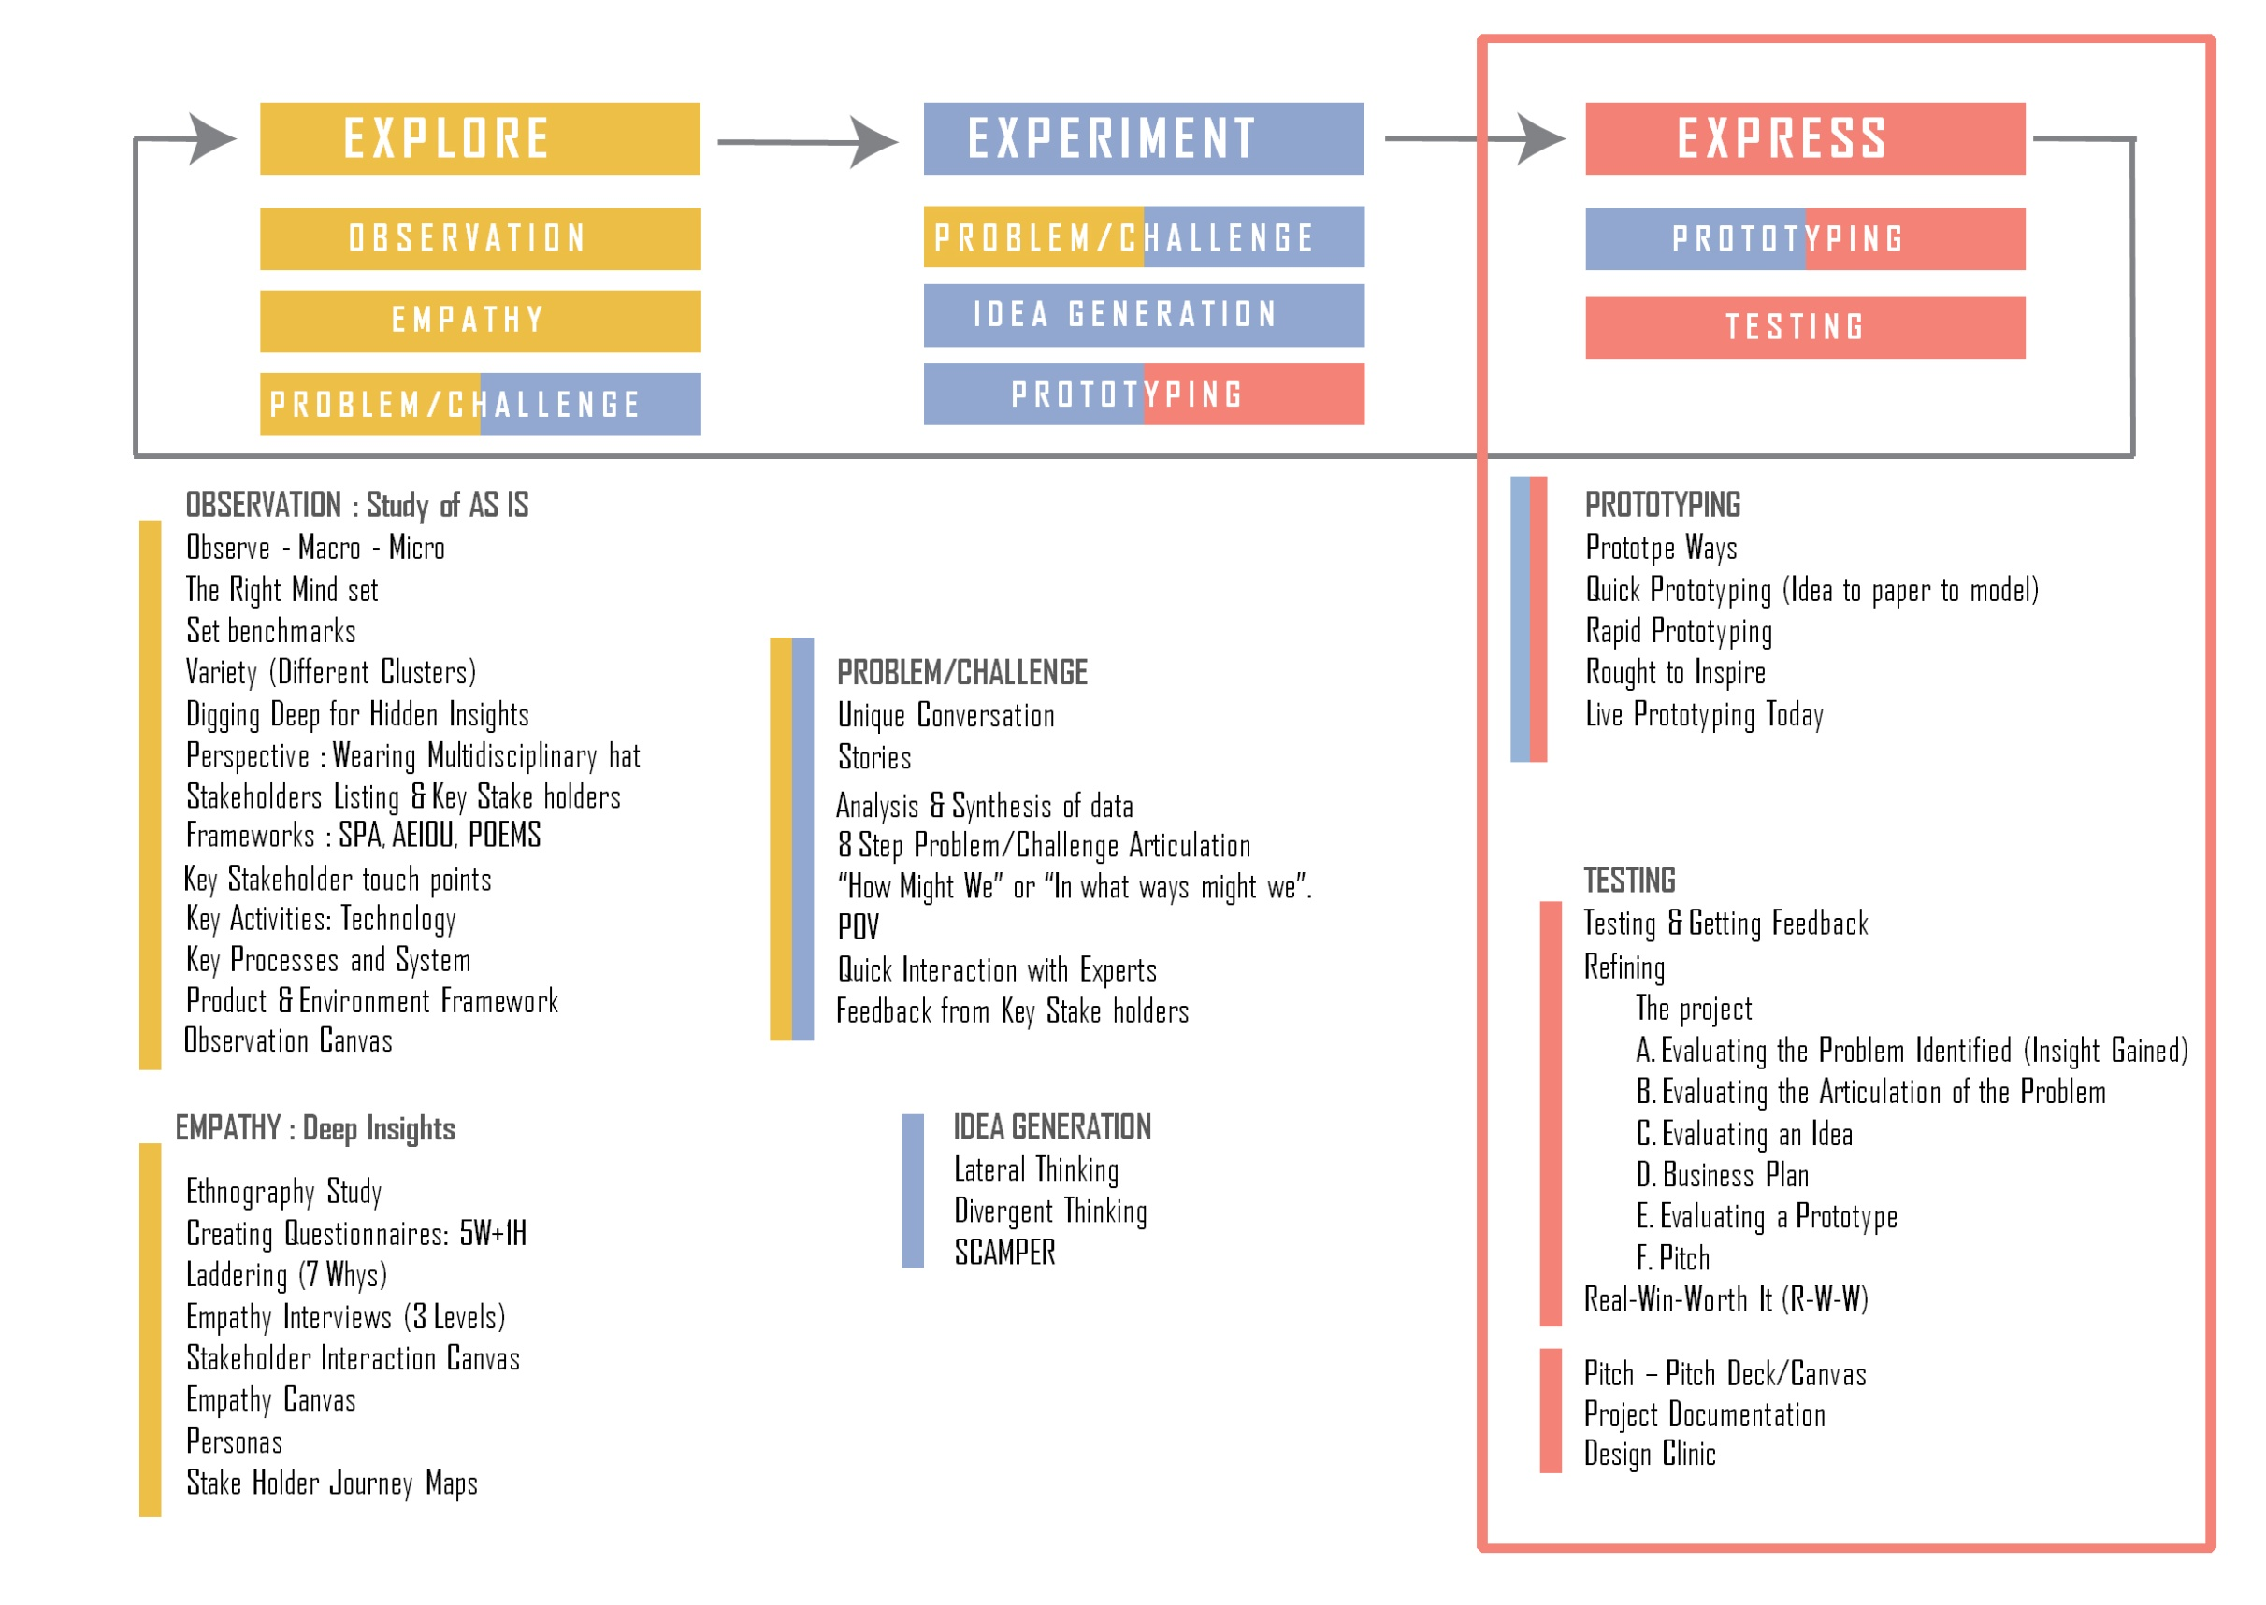

Slide 6
f. Testing

Slide 7
30 mins

Slide 8
30 mins

