Slide 1
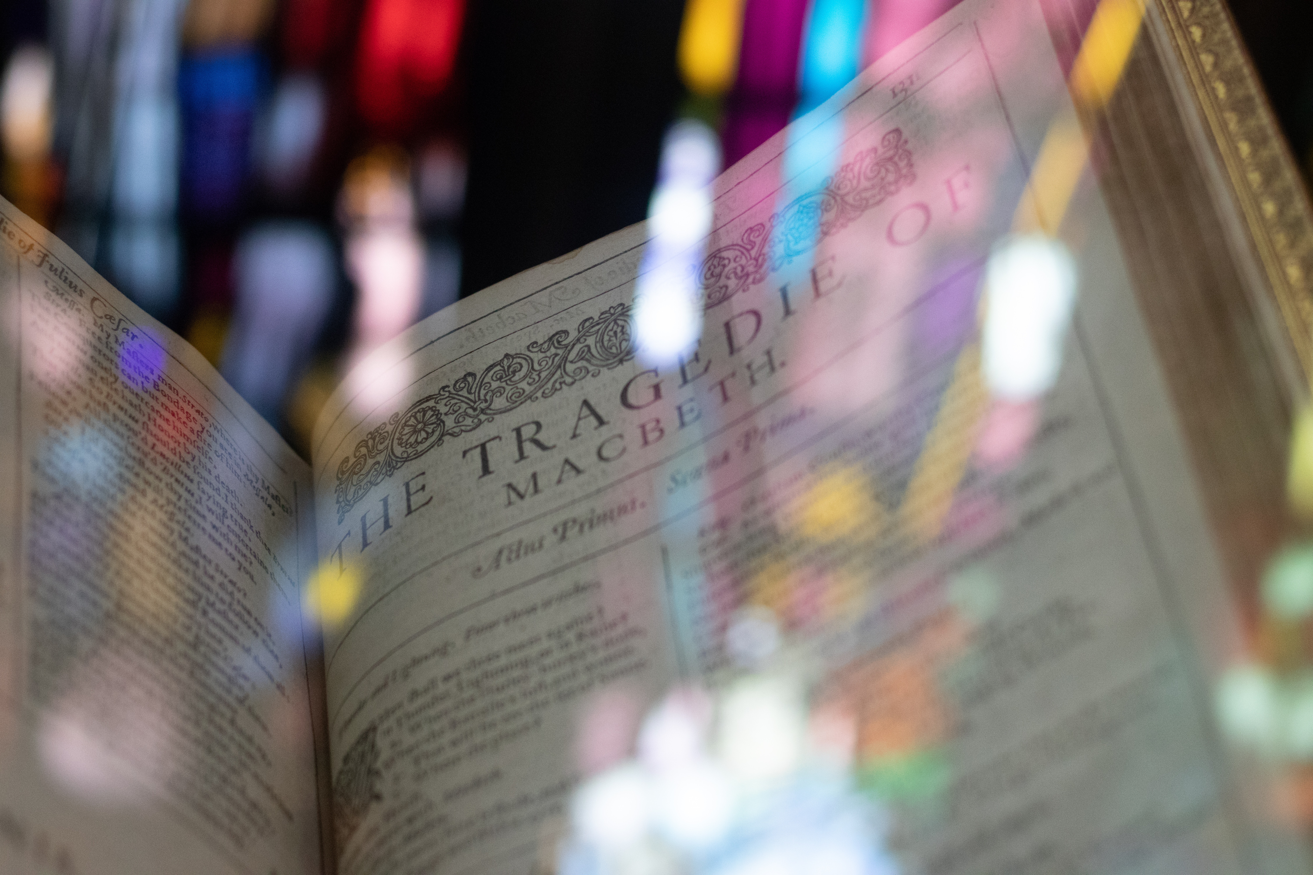
Macbeth
Narrator: Barbara Njau

Slide 2
Context

Slide 3
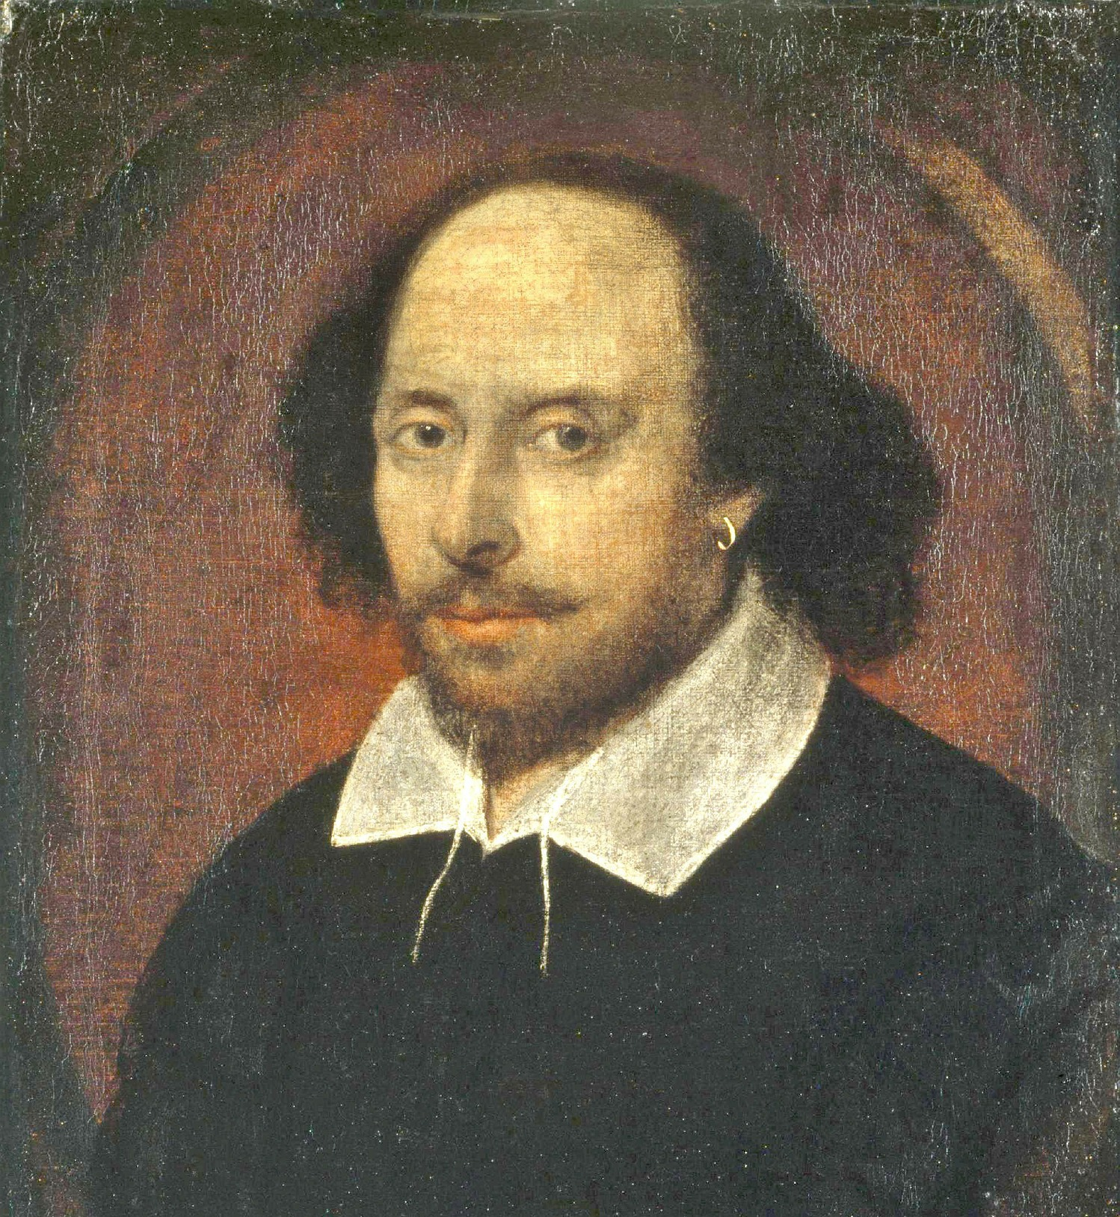
William Shakespeare
Born: Stratford-upon-Avon, 23 April 1564
Died: Stratford-upon-Avon, 23 April 1616
Parents: John and Mary Shakespeare
Married: Anne Hathaway (26) when he was 18, in 1582.
Children: Susannah, born in 1583; Hamnet and Judith (twins), born in 1585.

Slide 4
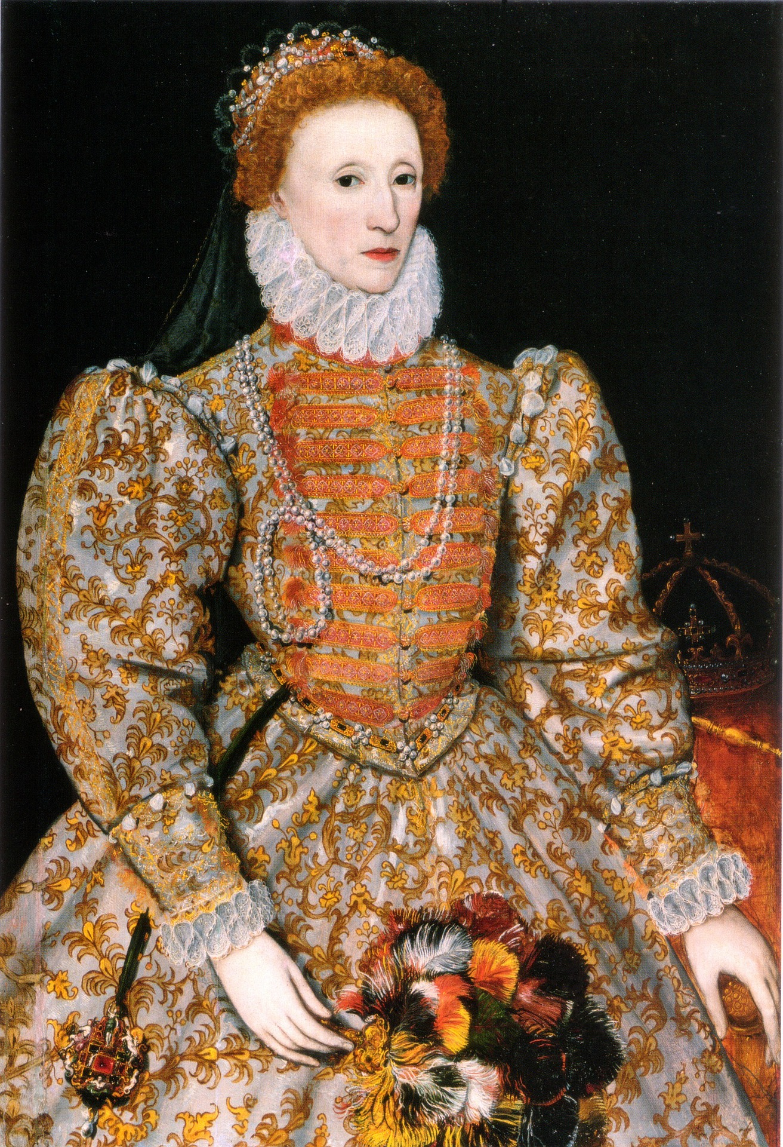
The Elizabethan Era
The Elizabethan Era is one of the most fascinating periods in the history of England.
The Elizabethan Era is named after Queen Elizabeth I and the era lasted roughly from 1558–1603.
This era is not only famous for the Virgin Queen but also for the era itself - Great Explorers, such as Sir Francis Drake and Walter Raleigh.
It was also the era of the very first Theatres in England, including Shakespeare’s own Globe Theatre.

Slide 5
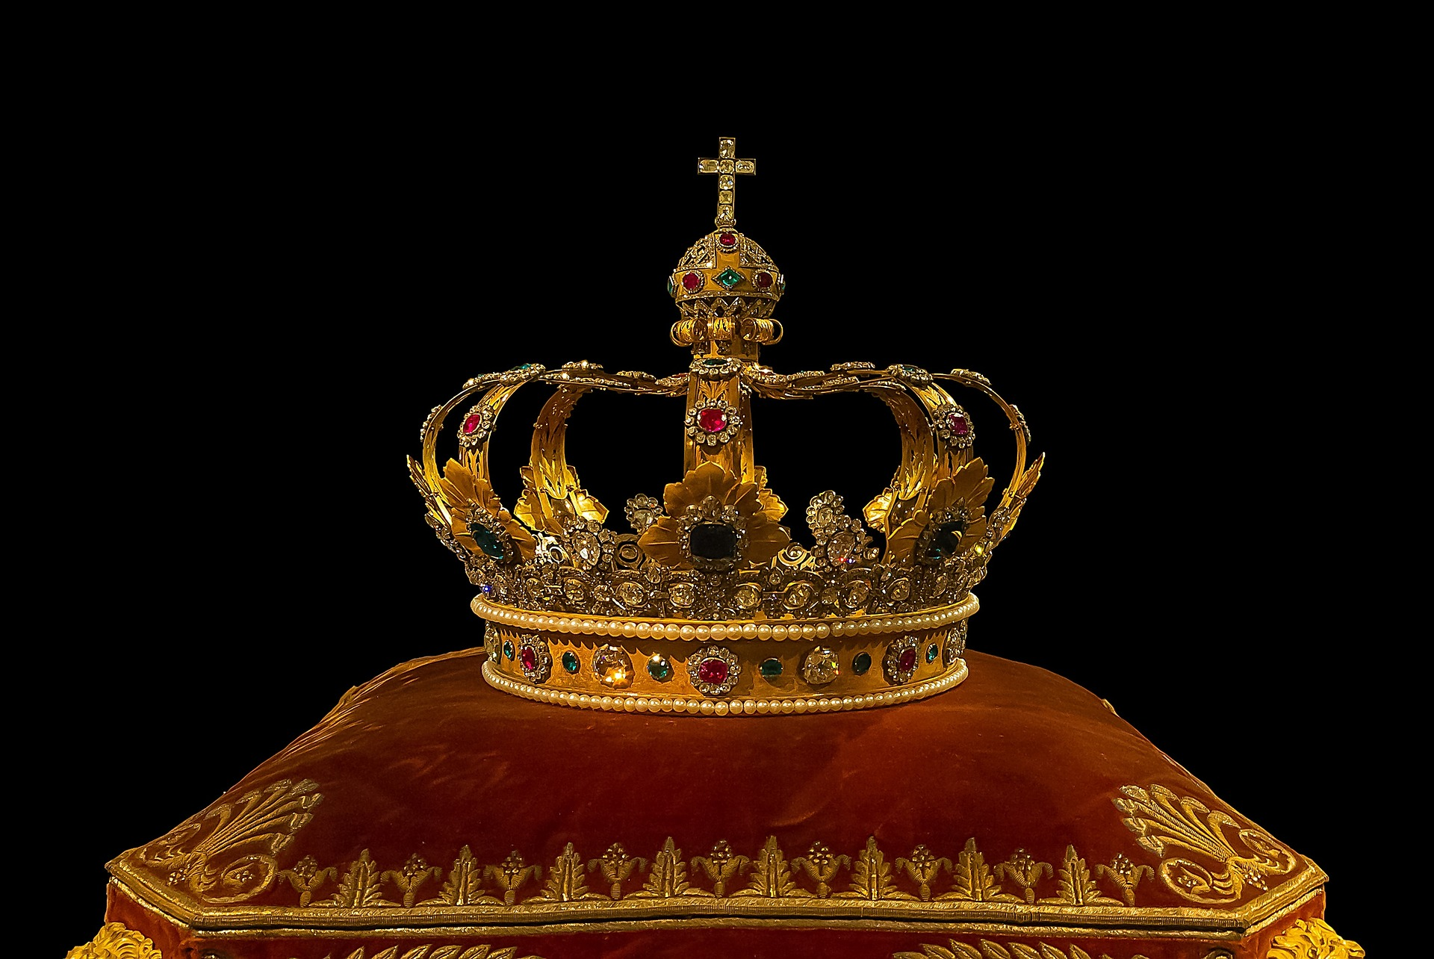
Common Elizabethan Beliefs
Superstition and the Supernatural:
Many Elizabethan people were very superstitious – they saw witches as symbols of evil and thus their appearance in plays and novels usually foreshadowed the natural order being disrupted and chaos ensuing. Witches and the supernatural were seen as evil and revealing something terrible would soon happen.
Divine Right of Kings:
The King / Queen was seen as being Divinely appointed by God to lead England. They were God’s representatives – therefore to question their rule or legitimacy was essentially questioning God’s own representative. One of the worst crimes anyone could commit was regicide – killing a monarch – as this would mean the murderer is going against the natural order that has been mandated by God and killing God’s own representative.

Slide 6
Common Elizabethan Beliefs
Elizabethan women:
Elizabethan women were classified as their husband’s property and they had very few rights. Elizabethan women were also expected to be passive and submissive, the model Elizabethan woman would be the homemaker who supported her husband. Ambition in women was looked down upon – ambitious or aggressive women ran the risk of being seen as witches, acting outside of what should be their submissive natures.
Social hierarchy and ambition:
Everyone was implicitly expected to accept and relish their social position in life. If you were born a peasant, you would live as a peasant and die as a peasant. If you were a Knight or Soldier, serving your King was what you aspired to all your life. Having ambition of rising above your social position was seen as damaging and corrosive – being too ambitious would corrode someone and make them ultimately plot evil deeds to get ahead in life, which would ultimately lead to ruin.

Slide 7
Summary

Slide 8
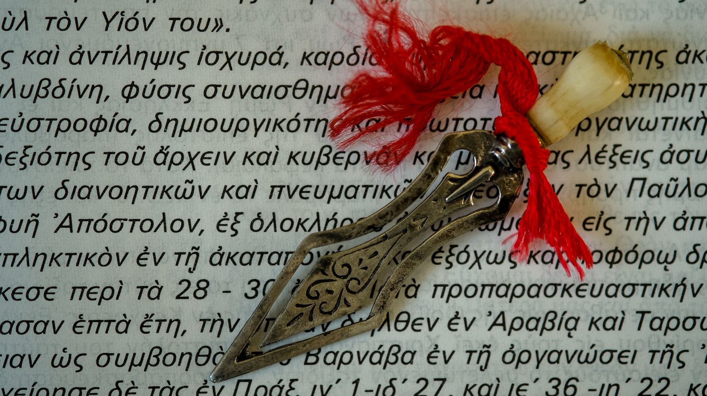
In A Nutshell
Three witches tell the Scottish general Macbeth that he will be King of Scotland.
Encouraged by his wife, Macbeth kills the King, becomes the new King, and kills more people out of paranoia.
Civil war erupts to overthrow Macbeth, resulting in more death. Ultimately Macbeth experiences his own downfall and death.

Slide 9
Act 1
On a bleak Scottish moorland, Macbeth and Banquo, two of King Duncan's generals, discover three strange women (witches).
The witches prophesy that Macbeth will be promoted twice: to Thane of Cawdor (a rank of the aristocracy bestowed by grateful kings) and King of Scotland.
Banquo's descendants will be kings, but Banquo isn't promised any kingdom himself. The generals want to hear more, but the "weird sisters" disappear.

Slide 10
Act 1
Soon afterwards, King Duncan names Macbeth Thane of Cawdor as a reward for his success in the recent battles.
The promotion seems to support the prophecy. The King then proposes to make a brief visit that night to Macbeth's castle at Inverness. Lady Macbeth receives news from her husband about the prophecy and his new title.
She vows to help him become king by whatever means are necessary.

Slide 11
Act 2
Macbeth returns to his castle, followed almost immediately by King Duncan.
The Macbeths plot together to kill Duncan and wait until everyone is asleep.
At the appointed time, Lady Macbeth gives the guards drugged wine so Macbeth can enter and kill the King.

Slide 12
Act 2
He regrets this almost immediately, but his wife reassures him.
She leaves the bloody daggers by the dead king just before Macduff, a nobleman, arrives.
When Macduff discovers the murder, Macbeth kills the drunken guards in a show of rage and retribution.
Duncan's sons, Malcolm and Donalbain, flee, fearing for their own lives; but they are, nevertheless, blamed for the murder.

Slide 13
Act 3
Macbeth becomes King of Scotland but is plagued by feelings of insecurity.
He remembers the prophecy that Banquo's descendants will inherit the throne and arranges for Banquo and his son Fleance to be killed.

Slide 14
Act 3
In the darkness, Banquo is murdered, but his son escapes the assassins.
At his state banquet that night, Macbeth sees the ghost of Banquo and worries the courtiers with his mad response.
Lady Macbeth dismisses the court and unsuccessfully tries to calm her husband.

Slide 15
Act 4
Macbeth seeks out the witches who say that he will be safe until a local wood, Birnam Wood, marches into battle against him.
He also need not fear anyone born of woman (that sounds secure, no loop-holes here).
They also prophesy that the Scottish succession will still come from Banquo's son.

Slide 16
Act 4
Macbeth embarks on a reign of terror, slaughtering many, including Macduff's family.
Macduff had gone to seek Malcolm (one of Duncan's sons who fled) at the court of the English king.
Malcolm is young and unsure of himself, but Macduff, pained with grief, persuades him to lead an army against Macbeth.

Slide 17
Act 5
Macbeth feels safe in his remote castle at Dunsinane until he is told that Birnam Wood is moving towards him. Malcolm's army is carrying branches from the forest as camouflage for their assault on Macbeth's stronghold.
Meanwhile, an overwrought and conscience-ridden Lady Macbeth walks in her sleep and tells her secrets to her doctor. She commits suicide. As the final battle commences, Macbeth hears of Lady Macbeth's suicide and mourns.

Slide 18
Act 5
In the midst of a losing battle, Macduff challenges Macbeth. Macbeth learns Macduff is the child of a caesarean birth, realises he is doomed, and submits to his enemy.
Macduff triumphs and brings the head of the traitor Macbeth to Malcolm. Malcolm declares peace and goes to Scone to be crowned king.

Slide 19
Key Characters

Slide 20
Macbeth
Macbeth is Scottish nobleman and warrior who murders the King of Scotland in order to take his throne. He has a sense of right and wrong and is torn about his decisions, but is easily influenced.
He is presented as a “tragic hero” as he is a good man at heart, however he has a fatal flaw – which is his ambition – that causes him to commit treason and kill King Duncan. Remember to note that when we first hear of Macbeth, it is through a the wounded captain’s account of his battlefield bravery.

Slide 21
Macbeth
We therefore have a really elevated view of him. However, once we see Macbeth interact with the three witches, we realise that his physical courage is joined by a consuming ambition and a tendency to self-doubt - the prediction that he will be king brings him joy, but it also creates inner turmoil.
These three attributes - bravery, ambition, and self-doubt - struggle for mastery of Macbeth throughout the play. Shakespeare uses Macbeth to show the terrible effects that ambition and guilt can have on a man who lacks strength of character.

Slide 22
Macbeth quotes
So foul and fair a day I have not seen. (Act 1, Sc 3)
Why do you dress me in borrowed robes? (Act 1, Sc 3)
Stars hide your fires, let not light see my black and deep desires. (Act 1, Sc 4)
Vaulting ambition, which o'erleaps itself / And falls on the other. (Act 1, Sc 7)
*Check out our workbook with a complete list of all relevant Macbeth quotes!*

Slide 23
Lady Macbeth
Lady Macbeth is a deeply ambitious woman who lusts for power and position.
Early in the play she seems to be the stronger and more ruthless of the two, as she urges her husband to kill Duncan and seize the crown.
After the bloodshed begins, however, Lady Macbeth falls victim to guilt and madness to an even greater degree than her husband.

Slide 24
Lady Macbeth
Her conscience affects her to such an extent that she eventually commits suicide.
Interestingly, she and Macbeth are presented as being deeply in love, and many of Lady Macbeth’s speeches imply that her influence over her husband is primarily sexual.
Their joint alienation from the world, occasioned by their partnership in crime, seems to strengthen the attachment that they feel to each another.

Slide 25
Lady Macbeth quotes
Come you spirits that tend on mortal thoughts, unsex me here. (Act 1, Sc 5)
Fill me from the crown to the toe, top-full of direst cruelty. (Act 1, Sc 5)
Stop up the access and passage to remorse… That my keen knife see not the wound it makes, nor Heaven peep through the blanket of the dark.” (Act 1, Sc 4)
Take my milk for gall. (Act 1, Sc 5)
*Check out our workbook with a complete list of all relevant Lady Macbeth quotes!*

Slide 26
King Duncan
King Duncan is a representation of orderliness. He is the epitome of God’s will being followed by his loyal representative on earth.
His language is formal and his speeches full of grace and graciousness, whether on the battlefield in Act I, Scene 2, where his talk concerns matters of honour, or when greeting his kind hostess Lady Macbeth in Act I, Scene 6.

Slide 27
King Duncan
Duncan also expresses humility when he admits his failure in spotting the previous Thane of Cawdor's treachery.
Duncan is the representative of God on earth, ruling by Divine Right, a feature of kingship strongly endorsed by King James I, for whom the play was performed in 1606.
This ‘divinity’ of the King is made clear on several occasions in the play. The importance of royal blood - the inheritance of the Divine Right to rule- is emphasised when, in the final scene, Duncan's son Malcolm takes the title of King.

Slide 28
King Duncan quotes
O valiant cousin, worthy gentleman! (Act 1, Sc 2)
My worthy Cawdor! (Act 1, Sc 3)
See, our honour'd hostess! (Act 1, Sc 5)
*Check out our workbook with a complete list of all relevant King Duncan quotes!*

Slide 29
Banquo
Banquo is a Thane who like Macbeth is known for his prowess on the battlefield.
He is also very trusting and is surprised when Macbeth betrays him.
Banquo is a noble general whose children, according to the witches’ prophecy, will inherit the Scottish throne.
Like Macbeth, Banquo thinks ambitious thoughts, but he does not translate those thoughts into action.

Slide 30
Banquo
In a sense, Banquo’s character stands as a rebuke to Macbeth, since he represents the path Macbeth chose not to take: a path in which ambition need not lead to betrayal and murder.
Appropriately, then, it is Banquo’s ghost—and not Duncan’s—that haunts Macbeth.
In addition to embodying Macbeth’s guilt for killing Banquo, the ghost also reminds Macbeth that he did not emulate Banquo’s reaction to the witches’ prophecy.

Slide 31
Banquo quotes
Why do you start, and seem to fear things that do sound so fair? (Act 1, Sc 3)
Can the devil speak true? (Act 1, Sc 3)
Look, how our partner's rapt. (Act 1, Sc 3)
The instruments of darkness tell us truths. (Act 1, Sc 3)
*Check out our workbook with a complete list of all relevant Banquo quotes!*

Slide 32
The Three Witches
Throughout the play, the three witches - referred to as the “weird sisters” by many of the characters.
They lurk like dark thoughts and unconscious temptations to evil.
In part, the mischief they cause stems from their supernatural powers, but mainly it is the result of their understanding of the weaknesses of their specific interlocutors - they play upon Macbeth’s ambition like puppeteers.

Slide 33
The Three Witches
The witches’ beards, bizarre potions, and rhymed speech make them seem slightly ridiculous, like caricatures of the supernatural. Shakespeare has them speak in rhyming couplets throughout, which separates them from the other characters, who mostly speak in blank verse.
The witches’ words seem almost comical, like malevolent nursery rhymes.
Despite the absurdity of their words, however, they are clearly the most dangerous characters in the play, being both tremendously powerful and utterly wicked.

Slide 34
The Three Witches quotes
Fair is foul, and foul is fair; Hover through the fog and filthy air. (Act 1, Sc 1)
All hail, Macbeth! hail to thee, thane of Glamis! (Act 1, Sc 3)
By the pricking of my thumbs, Something wicked this way comes. (Act 4, Sc 1)
*Check out our workbook with a complete list of all relevant quotes by the Three Witches!*

Slide 35
Macduff
Macduff is the archetype of the avenging hero, not simply out for revenge but with a good and holy purpose.
Macduff is the character who has two of the most significant roles in the play: first, he is the discoverer of Duncan’s body.
Second, the news of the callous murder of his wife and children in Act 4, Scene 3 spurs him toward his desire to take personal revenge upon the tyrannical Macbeth.
When he knocks at the gate of Macbeth's castle in Act 2, Scene 3, he is being equated with the figure of Christ, who before his final ascension into Heaven, goes down to release the souls of the damned from hell.

Slide 36
Macduff
Like Macbeth, Macduff is also shown as a human being.
When he hears of the death of his "pretty chickens," he has to hold back his emotions.
Even when (in Act 4, Scene 3) Malcolm urges him to “Dispute it like a man,” Macduff's reply “I will do so. But I must also feel it as a man” enables the audience to weigh him against Macbeth, an unfeeling man if ever there was one.
In the final combat between hero and anti-hero, this humanity is recalled once more when Macduff cries out, “I have no words; my voice is in my sword.” It is his very wordlessness that contrasts with Macbeth's empty rhetoric.

Slide 37
Macduff quotes
Is the King stirring, worthy thane? (Act 2, Sc 3)
He did command me to call timely on him: I have almost slipp'd the hour. (Act 2, Sc 3)
Most sacrilegious murder. (Act 2, Sc 3)
In nature is a tyranny; it hath been the untimely emptying of the happy throne and fall of many Kings. (Act 4, Sc 3)
*Check out our workbook with a complete list of all relevant Macduff quotes!*

Slide 38
Themes

Slide 39
Ambition
Ambition is what motivates Macbeth and Lady Macbeth to carry out their terrible deeds. Though Macbeth starts as a hero, once his ambition is out of control, he becomes a villainous murderer.
Both these characters are eventually killed because of their ambition, indicating that ambition can be a bad thing. However, other characters in the play are ambitious, but in a good way.
Malcolm is ambitious in his desire to become King, but this is a good ambition. Banquo is also ambitious for this children to become Kings, but does not act harmfully to fulfil that ambition.

Slide 40
Loyalty
Macbeth highlights that loyalty is shown through actions, not words.
Though Macbeth tells Duncan he is loyal, his actions show otherwise. Loyalty is rewarded throughout the play, such as when Macbeth is made a Thane for his loyalty to Duncan.
At the same time, Macbeth is punished for betraying Scotland and Duncan, by being killed at the end of the play.

Slide 41
Fate and Free Will
Much of the events in Macbeth seems to be left up to fate.
The Witches predict what will happen, and their prophecies all come true. However, their predictions are vague enough that characters still have free will in how they act.
Though Macbeth is told he will become king, he is not told how, and it was his own choice to murder Duncan to achieve this.

Slide 42
The Supernatural
There are a variety of supernatural forces in Macbeth.
The Witches represent the main supernatural force, and they cause chaos and disorder with their influence.
The supernatural is also used to show guilt. Macbeth sees images like the dagger and the ghost of Banquo when he feels guilty about the murders.
Lady Macbeth also thinks she sees blood once she begins to feel guilt.

