Slide 1
Project Management Skills for Business Analysts
Project Management for the Business Analyst

Slide 2
Isn’t there a Project Manager for that?

Slide 3
BAs Need to Know Project Management
Some companies don’t have Project Managers
Not always a Project Manager assigned to the project
Project Manager may need you to assist
Understand the tasks your assigned Project Manager is performing

Slide 4
Introduction to Project Management

Slide 5
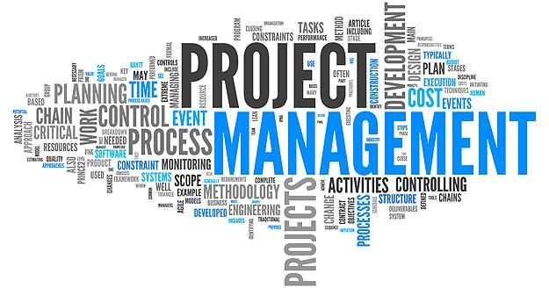
Introduction to Project Management
What is a Project?
What is Project Management?
Project Manager versus Business Analyst
Project Management Approaches

Slide 6
What is a Project?
“A temporary endeavor undertaken to create a unique product, service, or result.”
-Project Management Body Of Knowledge

Slide 7
What is a Project?
“A temporary endeavor undertaken to create a unique product, service, or result.”
-Project Management Body Of Knowledge

Slide 8
What is a Project?

Slide 9
What is a Project?
“A temporary endeavor undertaken to create a unique product, service, or result.”
-Project Management Body Of Knowledge

Slide 10
What is a Project?
“A temporary endeavor undertaken to create a unique product, service, or result.”
-Project Management Body Of Knowledge

Slide 11
What is Project Management
“The application of knowledge, skills, tools, and techniques in order to meet (…) the project requirements.”
-Project Management Body Of Knowledge

Slide 12
What Does Project Management Include?
Understand and address expectations and concerns of stakeholders
Plan for and carry out communication among stakeholders
Create a project schedule
Manage towards meeting project requirements and creating deliverables
Keep the project constraints balanced

Slide 13
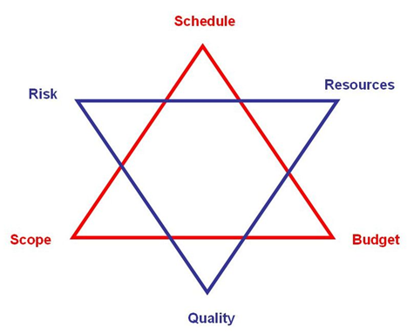

Slide 14
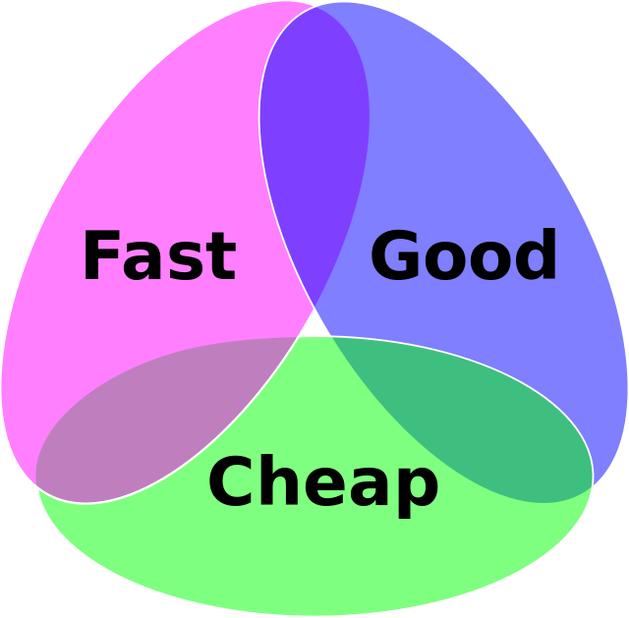

Slide 15
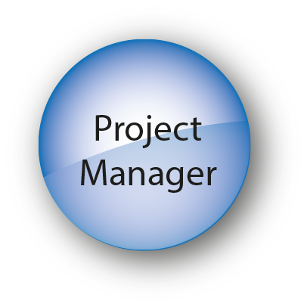
Role Comparison: PM versus BA

Slide 16
Project Management Approaches
Project Management Professional (PMP)
PRojects IN Controlled Environments (PRINCE2)

Slide 17
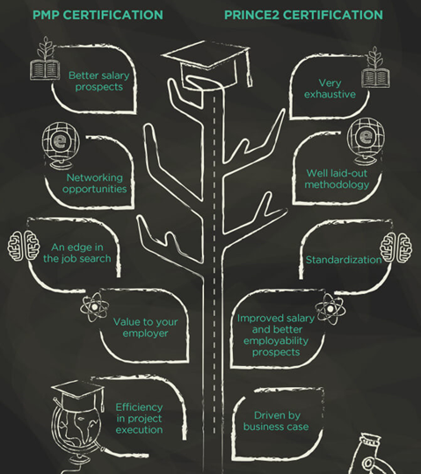
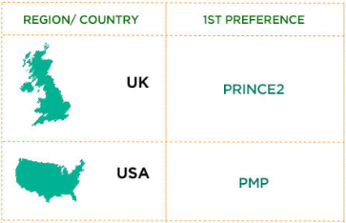
PMP vs PRINCE2

Slide 18
Approach for this Course
Project Management Institute (PMI)
Project Management Professional (PMP)

Slide 19
Project Conception and Initiation
Project Definition and Planning
Project Execution and Control
Project Close

