Slide 1
Recall Activity
Explain the principle of progressive overload and state how it can improve fitness (2 marks)
Define health (1 mark)
Using your knowledge of agility and reaction time, evaluate the importance of these components of fitness for performers in the 100m sprint. [6 marks] AO3
Exam tip
AO1: Demonstrate knowledge
AO2: Apply Knowledge
AO3: Analyse and evaluate
Set out purposes or reasons

Slide 2
Feedback
Explain the principle of progressive overload and state how it can improve fitness (2 marks)
Progressive overload means gradually increasing the work you do. For example, if you lift heavier weights, you will get stronger, therefore fitter, because the body adapts to the new workout
Define health (1mark)
A state of complete physical, mental and social well-being and not merely the absence of disease

Slide 3
Feedback
Using your knowledge of agility and reaction time, evaluate the importance of these components of fitness for performers in the 100m sprint. [6 marks] AO3
AO1 – Knowledge of agility and reaction time,
• Agility – changing direction at speed, whilst maintaining control
• Reaction time – time taken to initiate response to a stimulus
AO2 – Application to the 100m,
• 100m sprint does not need agility because it is run in a straight line and therefore changing of direction is not required
• 100m does need reaction time because runners start in a stationary position and have to react to the gun (stimulus) at the start
AO3 – Analysis/evaluation of the importance of agility and reaction time in 100m,
• Agility – any changes in direction could result in leaving a lane and being disqualified
• Agility – need to change direction is unlikely. However, athlete may change their positioning within their own lane
• Reaction time – 100m is the shortest outdoor sprint event and therefore reaction time at the start of the event is usually crucial to success
• Reaction time – is a major component impacting on overall time taken to complete the 100m sprint
• Reaction time – it is possible to win a race with a poor reaction time start
• Neither agility nor reaction time is as important as speed
Judge from available evidence; could be positive or negative

Slide 4
1.6 Training Thresholds - AQA/ Edexcel only
By the end of this video you will know the difference between aerobic and anaerobic training zones

Slide 5
Intensity
We can measure the intensity of a session by using training thresholds
This will ensure that the performer is working within their target training intensity
This is all calculated through measuring heart rate
All: To understand what Training thresholds are

Slide 6
Heart Rate
The amount of times your heart beats in a minute.
As you exercise your heart rate will increase and get faster
Maximum heart rate = 220 – age
Work out your max heart rate now
All: To understand what Training thresholds are

Slide 7
Training Thresholds
Training thresholds use max heart rate to calculate the intensity that the athlete is working at
Anaerobic training threshold 80%-90% of max heart rate
Aerobic training threshold 60%-80% of max heart rate
Some: To know the difference between aerobic and anaerobic training zones

Slide 8
Anaerobic 80%-90%
Anaerobic exercise is performed in short, fast bursts.
Sporting examples include; 100m sprint, shotput, powerlifting
Some: To know the difference between aerobic and anaerobic training zones

Slide 9
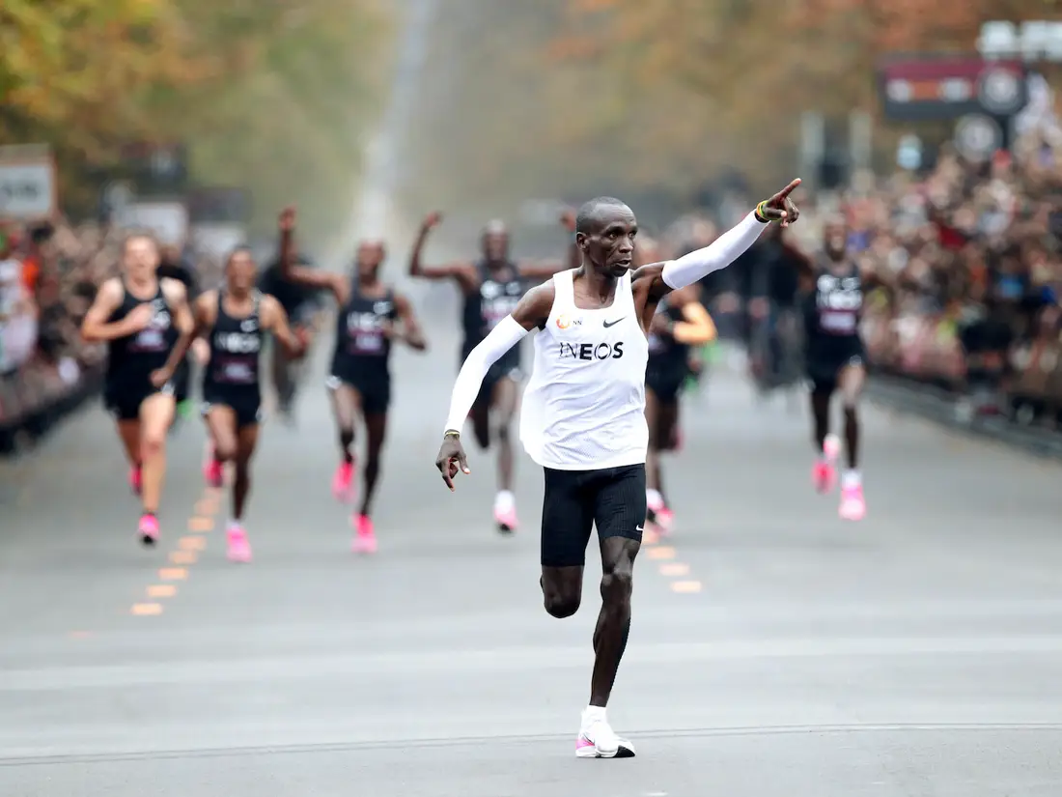
Aerobic 60%-80%
Aerobic exercise is steady and not too fast.
Aerobic training improves cardiovascular fitness.
This exercise relates more to football because you need the heart to supply your muscles with oxygen so they can work for long periods of time.
Examples are; football, marathon running, rugby, hockey
Some: To know the difference between aerobic and anaerobic training zones

Slide 10
Jane
Before exercise
Resting HR: 62
During exercis
2mins: 104
4mins: 150
6mins 159
8mins: 168
10mins: 171
12mins: 176
After exercise (recovery rate)
1min: 131
2mins 101
3mins 77
4mins: 66
5mins: 64
Calculating Training Thresholds
Jane is 20 years old and she is taking part in a 12 minute continuous training session.
She is wearing a heart rate monitor to record her heartrate during the session.
Plot the resting heart rate at 0mins, and continue to plot recorded scores across the graph, every 2 minutes – including the recovery rate.
1) What would Jane’s heart rate be if she worked her to her maximum?
220 – Age = Maximum heart rate
220 – 20 = ………
2) Calculate her aerobic training zone?
Aerobic training zone: 60% to 80% of maximum heart rate
60% of 200
60 / 100 x 200 = ……….
3) Calculate her anaerobic training zone?
Anaerobic training zone: 80%+ of maximum heart rate
80% of 200
80 / 100 x 200 = ……….
90 / 100 x 200=……….
4) Draw a line on the graph for her anaerobic training zone and a line on the graph for her aerobic training zone in a different colour
Most: To be able to calculate Training thresholds

Slide 11
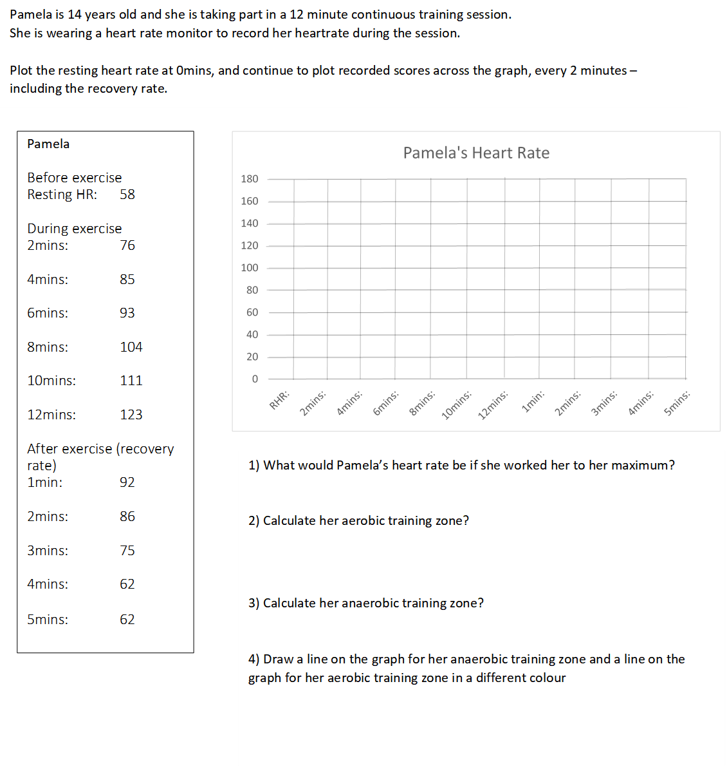
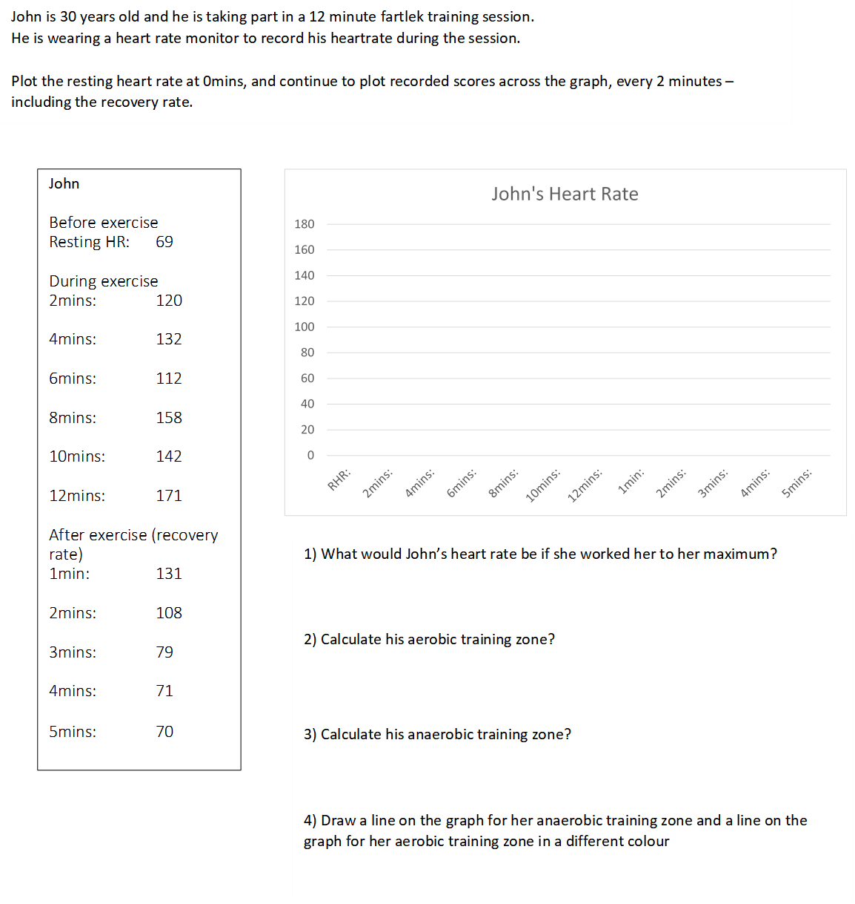
Complete the worksheets
3.16 Training Thresholds
Most: To be able to calculate Training thresholds

