Slide 1
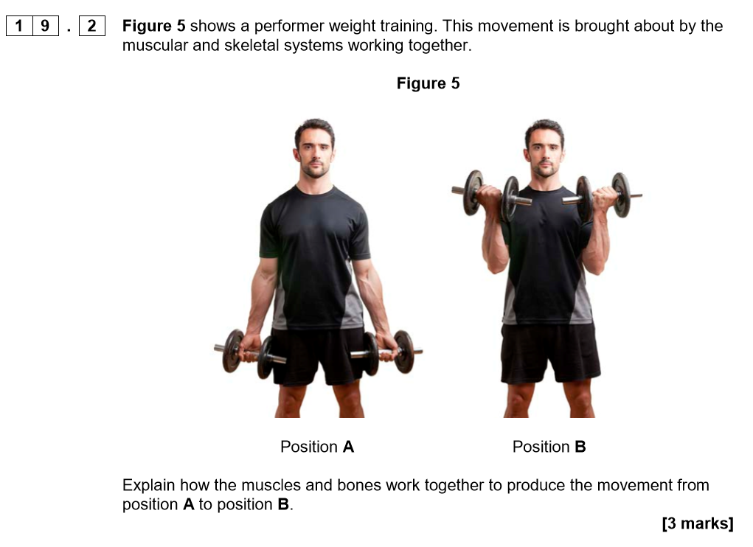
Recall Activity
Exam tip
AO1: Demonstrate knowledge
AO2: Apply Knowledge
AO3: Analyse and evaluate

Slide 4
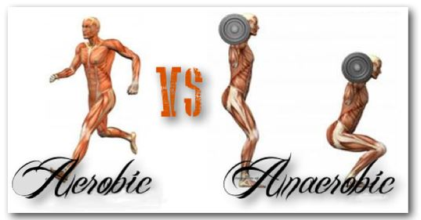
2.10 Aerobic and Anaerobic Exercise
By the end of this video you will understand the effects of aerobic and anaerobic exercise

Slide 5
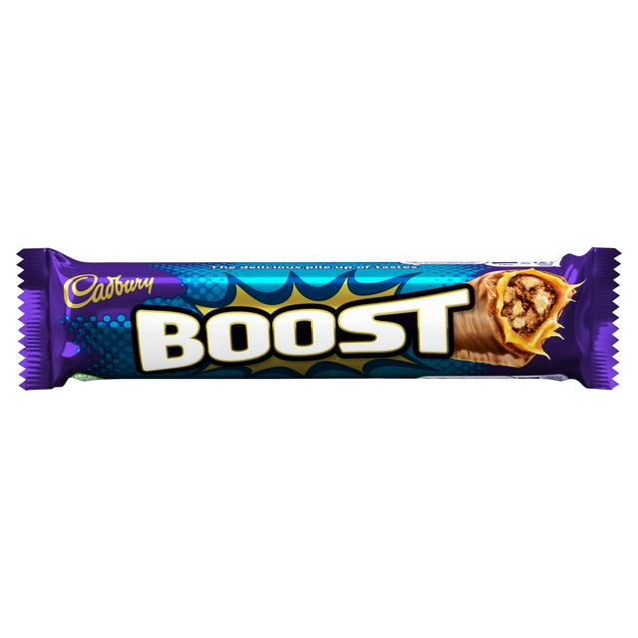
What does oxygen provide muscles with and how?
What are the aerobic and anaerobic training thresholds?
Which one is higher intensity?
What is glucose?
Carbohydrates that are eaten are converted into glucose by the body. Glucose is used by the muscles as a source of energy.
All: Understand the terms aerobic and anaerobic

Slide 6
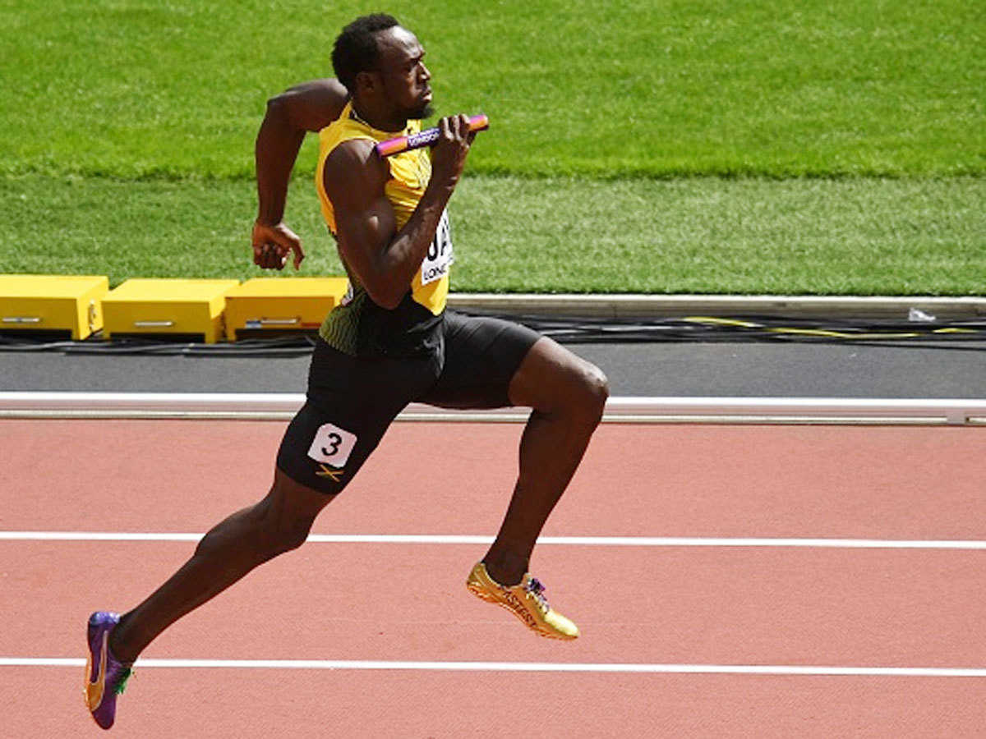
A common misunderstanding!!!
Even though it is called respiration, aerobic and anaerobic respiration has nothing to do with breathing rate!
It is a chemical reaction that transfers energy to cells and where this energy comes from
All: Understand the terms aerobic and anaerobic

Slide 7
Aerobic Respiration
Why is the aerobic training threshold for steady state exercises that are for long periods of time?
When working at a moderate intensity the body and the respiratory system will work together and be able to supply the muscles with the oxygen and energy that it demands for long periods of time
Aerobic respiration takes place in the presence of OXYGEN!
Examples of aerobic respiration: long distance runners, endurance cyclists, long distance swimmers
All: Understand the terms aerobic and anaerobic

Slide 8
Aerobic Respiration - Formula
What breathed in?
What is stored in the body to provide muscles with energy?
What does the Oxygen and glucose provide the muscles with?
What is diffused out of the alveoli in gas exchange and breathed out?
What else do you think is produced, think about what happens on your forehead when you exercise ?
Oxygen + Glucose
Energy + Carbon dioxide + Water
All: Understand the terms aerobic and anaerobic

Slide 9
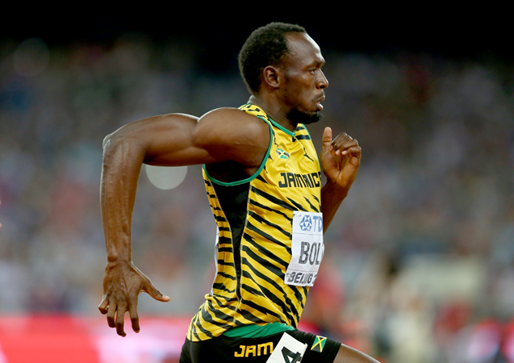
Anaerobic Respiration
At what intensity does anaerobic respiration take place?
When working at very high intensity the body cannot supply enough oxygen to the muscles because the demand for oxygen is too much
So the body uses glucose instead of oxygen
When glucose is used lactic acid is formed which causes the muscles to fatigue very quickly - anaerobic respiration must be for short periods of time
Anaerobic respiration takes place without the presence of oxygen!
All: Understand the terms aerobic and anaerobic

Slide 10
Anaerobic respiration – Formula
What is used to provide the energy?
What does the glucose provide the muscles with?
If the body respires anaerobically for a period of time the muscles start to fatigue. What causes this fatigue?
Glucose
Energy + Lactic acid
All: Understand the terms aerobic and anaerobic

Slide 11
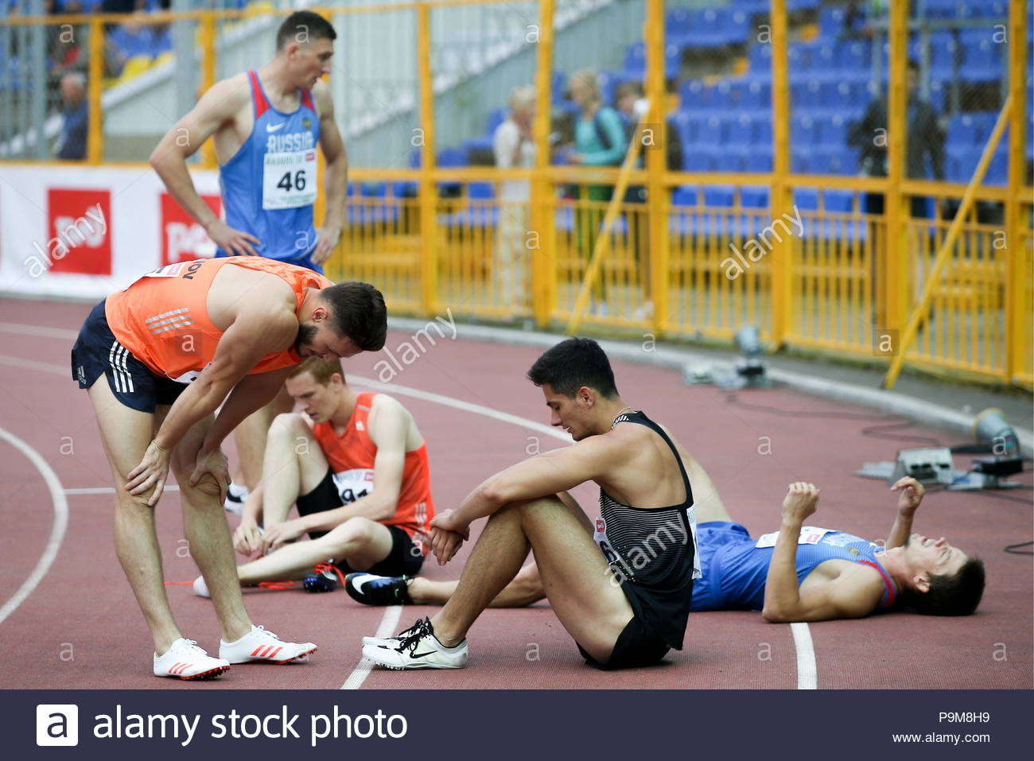
Excess Post-exercise Oxygen Consumption (EPOC)
After anaerobic activity, heavy breathing is needed to neutralize the lactic acid and replenish the oxygen.
This is called an oxygen debt.
It is repaid after exercise.
Rapid and deep breathing is needed for a short period after high intensity exercise in order to repay the debt.
.
Most: Understand the effects of aerobic and anaerobic exercise

Slide 12
Mind Map
1 mind map on Aerobic Exercise
1 mind map on Anaerobic Exercise
All: Understand the terms aerobic and anaerobic
Most: Understand the effects of aerobic and anaerobic exercise

Slide 13
Key Words
Anaerobic exercise Intensity
EPOC
Aerobic Exercise Sprinter
Long-distance runner Lactic Acid
Aerobic exercise Anaerobic exercise
Most: Understand the effects of aerobic and anaerobic exercise

Slide 14
Activity | Intensity | Time | Aerobic or Anaerobic
Consider specific parts of different sports, eg dribbling with the ball in football
Most: Understand the effects of aerobic and anaerobic exercise

Slide 15
The Recovery Process
Ensures that the body recovers from vigorous exercise
Cool down
Gradually reduce heart rate and stretch – Replenishes the muscles with oxygen, removes lactic acid and helps prevent DOMS
Manipulation of diet
Drinking water – Replenishes water lost during exercise
Carbohydrate loading – Eating high amount of carbs to maximize the amount of glucose
Protein – Gives body nutrients for growth and repair
Ice baths or massage
Prevent DOMS – Massages increase blood flow to sore area
Prevent lactic acid build up - Ice baths flush out lactic acid through vasoconstriction which forces lactic acid out of the muscles

