Slide 1
PASSION
PROJECTS
WHEN IS OK TO WORK FOR FREE?

Slide 2
PASSION
PROJECTS
WHEN IS OK TO WORK FOR FREE?
GOOD FOR BRANCHING OUT

Slide 3
PASSION
PROJECTS
WHEN IS OK TO WORK FOR FREE?
GOOD FOR BRANCHING OUT
GOOD FOR DIVERSIFYING SKILLS

Slide 4
PASSION
PROJECTS
WHEN IS OK TO WORK FOR FREE?
GOOD FOR BRANCHING OUT
GOOD FOR DIVERSIFYING SKILLS
GOOD TO GIVE BACK (SELF ACTUALIZATION)

Slide 5
PASSION
PROJECTS
HOWEVER IT IS IMPORTANT TO LEARN HOW TO SAY “NO”

Slide 6
PASSION
PROJECTS
WHEN IS IT OK TO SAY “YES”

Slide 7
PASSION
PROJECTS
WHEN IS IT OK TO SAY “YES”
1. IT FURTHERS YOUR SPECIFIC BUSINESS GOALS

Slide 8
PASSION
PROJECTS
WHEN IS IT OK TO SAY “YES”
1. IT FURTHERS YOUR SPECIFIC BUSINESS GOALS
2. AN OPPORTUNITY TO WIN AN IDEAL CLIENT –
BE CAREFUL NOT TO BE TAKEN ADVANTAGE OF – CREATE BOUNDARIES

Slide 9
PASSION
PROJECTS
WHEN IS IT OK TO SAY “YES”
1. IT FURTHERS YOUR SPECIFIC BUSINESS GOALS
2. AN OPPORTUNITY TO WIN AN IDEAL CLIENT
2. AN OPPORTUNITY TO WIN AN IDEAL CLIENT –
BE CAREFUL NOT TO BE TAKEN ADVANTAGE OF – CREATE BOUNDARIES
3. SOCIAL IMPACT WORK (SELF-ACTUALIZING)

Slide 10
PASSION
PROJECTS
WHEN JACKSON SAID “YES”

Slide 11
PASSION
PROJECTS
WHEN JACKSON SAID “YES”
LARGE P.R. CAMPAIGN +
LOTS OF PRESS COVERAGE
THE PROJECT HAD A

Slide 12
PASSION
PROJECTS
WHEN JACKSON SAID “YES”
LARGE P.R. CAMPAIGN +
LOTS OF PRESS COVERAGE
THE PROJECT HAD A
HE TOOK ADVANTAGE OF FREE P.R. – HIS VIDEO WAS SEEN ON MULTIPLE CHANNELS . THESE WERE LINKED TO HIS WEBSITE BECAUSE HE NEGOTIATED IT TO BE SO.

Slide 13
PASSION
PROJECTS
WHEN JACKSON SAID “YES”
LARGE P.R. CAMPAIGN +
LOTS OF PRESS COVERAGE
THE PROJECT HAD A
HE TOOK ADVANTAGE OF FREE P.R. – HIS VIDEO WAS SEEN ON MULTIPLE CHANNELS . THESE WERE LINKED TO HIS WEBSITE BECAUSE HE NEGOTIATED IT TO BE SO.
HE SAW THE POTENTIAL TO LICENSE MEDIA AND DID

Slide 14
PASSION
PROJECTS
WHEN JACKSON SAID “YES”
THROUGH HIS WEBSITE LINK +
NEW CONNECTIONS
THE FREE PROJECT =
0VER £20,000
NEW BUSINESS

Slide 15
PASSION
PROJECTS
LOOK FOR PROJECTS THAT
WILL GET YOU EXPOSURE

Slide 16
PASSION
PROJECTS
LOOK FOR PROJECTS THAT
WILL GET YOU EXPOSURE
PROJECTS WITH EXISTING
PR AND MARKETING

Slide 17
PASSION
PROJECTS
LOOK FOR PROJECTS THAT
WILL GET YOU EXPOSURE
PROJECTS WITH EXISTING
PR AND MARKETING
EXCHANGING YOUR SERVICES FOR
EXPOSURE

Slide 18
PASSION
PROJECTS
PICK YOUR PROJECTS WISELY
PROJECTS WITH EXISTING PR AND MARKETING
REMEMBER TO NEGOTIATE TERMS AND CONDITIONS
CUSTOM EDITS
CREDITS
WEBSITE LINKS

Slide 19
PASSION
PROJECTS
PICK YOUR PROJECTS WISELY
PROJECTS WITH EXISTING PR AND MARKETING
REMEMBER TO NEGOTIATE TERMS AND CONDITIONS
SET A DEADLINE
LIMIT COSTS OF TIME AND MONEY
ENSURE THE VIDEO IS
STILL RELEVANT

Slide 20
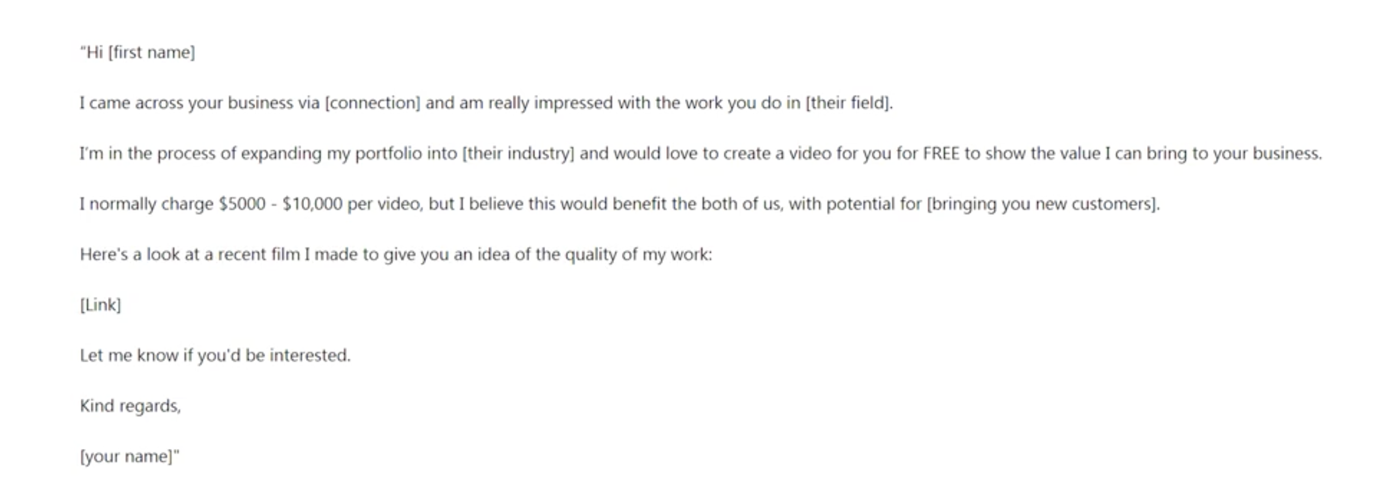
PASSION
PROJECTS
EXAMPLE OF INTRO LETTER
PROJECTS WITH EXISTING PR AND MARKETING
REMEMBER TO NEGOTIATE TERMS AND CONDITIONS
SET A DEADLINE
LIMIT COSTS OF TIME AND MONEY
ENSURE THE VIDEO IS
STILL RELEVANT

Slide 21
PASSION
PROJECTS
INTRO
1. IMPLEMENT BRAND POSITIONING

Slide 22
PASSION
PROJECTS
INTRO
1. IMPLEMENT BRAND POSITIONING
2. COMMUNICATE AS A BUSINESS PERSON WHO
UNDERSTANDS BUSINESS CONCEPTS

Slide 23
PASSION
PROJECTS
INTRO
1. IMPLEMENT BRAND POSITIONING
2. COMMUNICATE AS A BUSINESS PERSON WHO
UNDERSTANDS BUSINESS CONCEPTS
3. SET YOURSELF BOUNDARIES

Slide 24
PASSION
PROJECTS
INTRO
1. IMPLEMENT BRAND POSITIONING
2. COMMUNICATE AS A BUSINESS PERSON WHO
UNDERSTANDS BUSINESS CONCEPTS
3. SET YOURSELF BOUNDARIES
4. DON’T BE AFRAID TO SAY ”NO”

Slide 25
PASSION
PROJECTS
STARTING OUT?
YOU NEED 3 – 4 EXAMPLES OF YOUR CHOSEN NICHE

Slide 26
PASSION
PROJECTS
STARTING OUT?
YOU NEED 3 – 4 EXAMPLES OF YOUR CHOSEN NICHE
ESTABLISHED?
A PASSION PROJECTS EVERY 3 – 4 MONTHS IS A GOOD TARGET TO AIM FOR.

Slide 27
PASSION
PROJECTS
WHEN MAKING
BUSINESS DECISIONS
YOUR GOALS SHOULD
ALWAYS COME FIRST

