Slide 1
http://www.ezinfluence.com/
ez4u@ezinfluence.com
Tel: 514-933-5135
How to Sell Anything to Anyone
Elaina Zuker

Slide 2
Unique
Selling
Proposition
Define your product/service
What category is it in?
What makes it better, different from all others in the category? Unique? Only one like it?

Slide 3
WHO are your customers?
WHERE can you find them?
WHAT are their distinct characteristics, habits?
WHY do they want/need what you have? (Problem you’re fixing, pain you’re alleviating)
HOW do they make decisions (menu?)
Getting to
Know You
(Prospecting)

Slide 4
Establishing
Rapport
Know, Like, Trust
Establish common bonds
Social proof

Slide 5
Presenting
Your
Offer
Describe your product/service in “you” language
Be brief, allow for pauses, questions

Slide 6
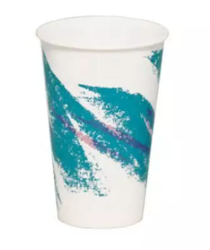
Example: Styrofoam Cup
Features
(Benefits)
Benefits
Features
White
Lightweight
Holds 8 oz
Holds hot + cold
Easy to see; goes w/every décor
Portable
Standard size
Multi-functional

Slide 7
Ask
for the
Order
Presumptive Close:
Green or Blue?
UPS or Regular Mail?

Slide 8
Yes, but ----------
Anticipate: I know you weren’t planning on getting this now, but I think you do want the……benefit, benefit, benefit
Price too high: You haven’t built enough value
Add scarcity: Offer ending soon, early bird discount, Limited quantity
Objections

Slide 9
Close again – handle objections
Re-state Benefits
Rinse and Repeat
Finish
The
Close

