Slide 1
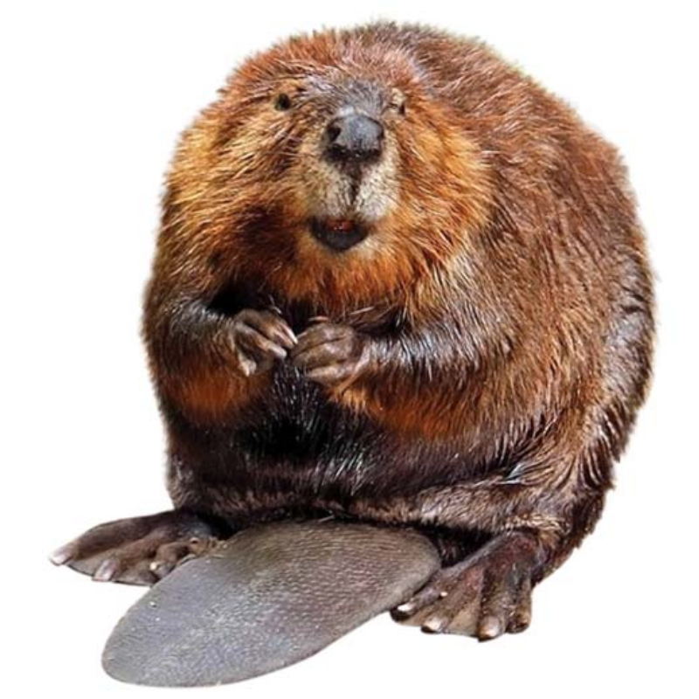
Beavers

Slide 2
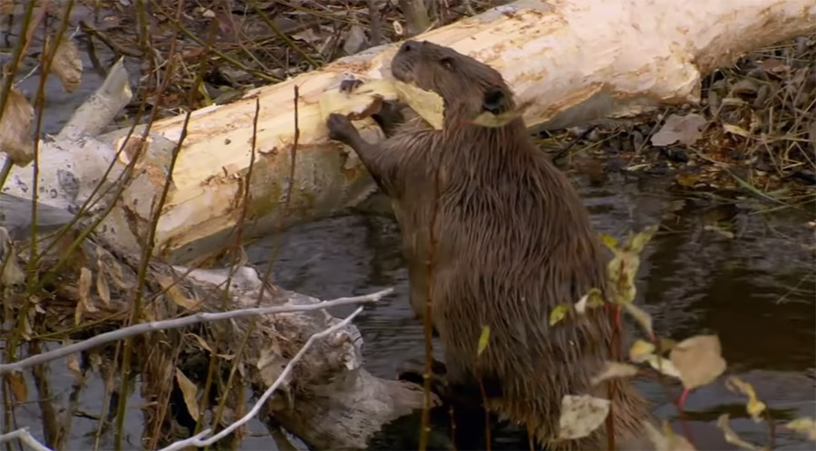
Beaver is called an animal engineer.

Slide 3
An engineer builds many things.

Slide 4
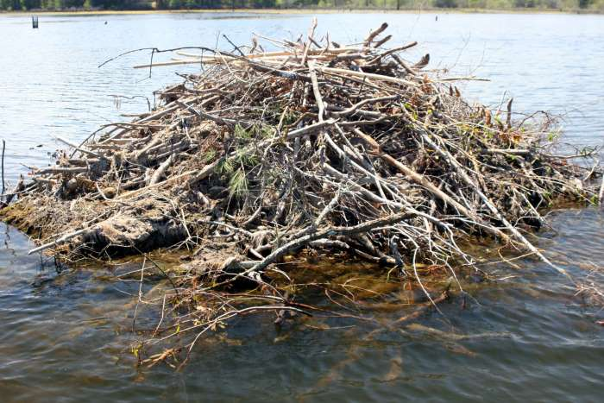
Beavers build their homes in the middle of pond.

Slide 5
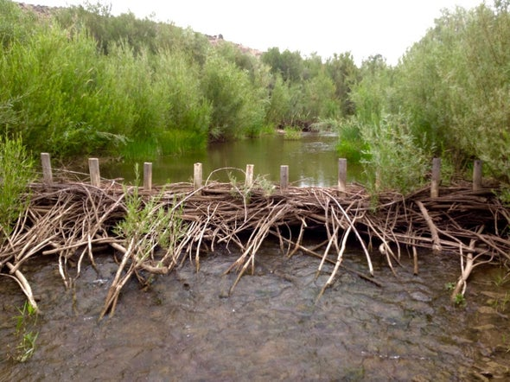
If they cannot find a pond in which to make a home, they will build a dam across a stream to make a pond.

Slide 6
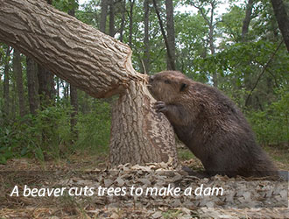

Slide 8
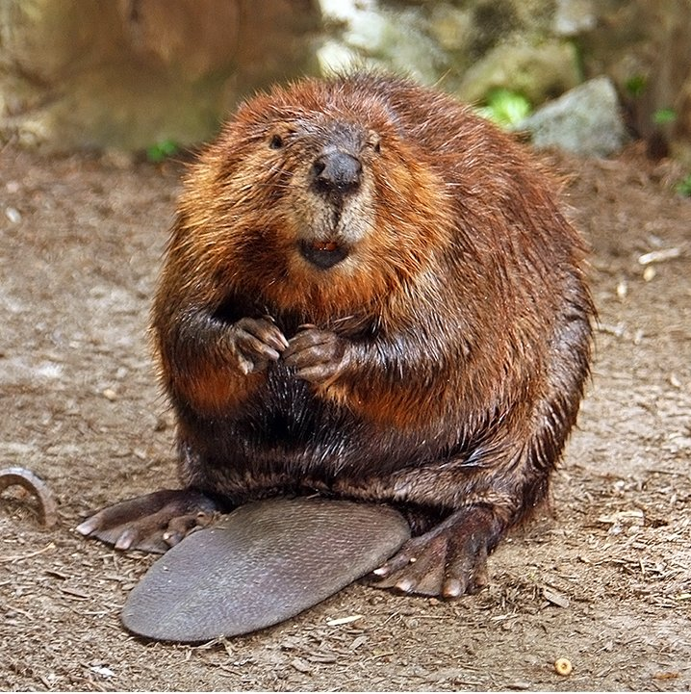
God made the beaver to be a builder of ponds, That’s why he gave the beaver’s body a special design.

Slide 9
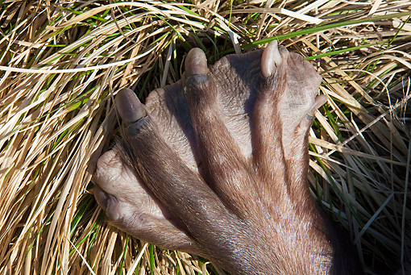
Webbed back feet of beaver

Slide 10
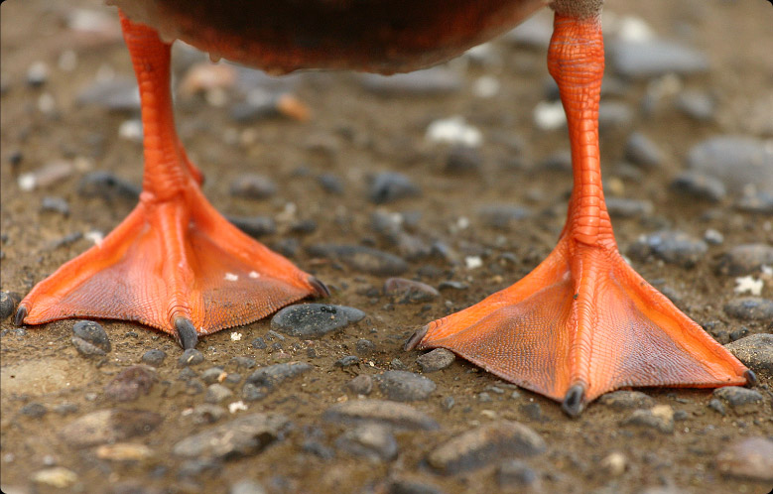
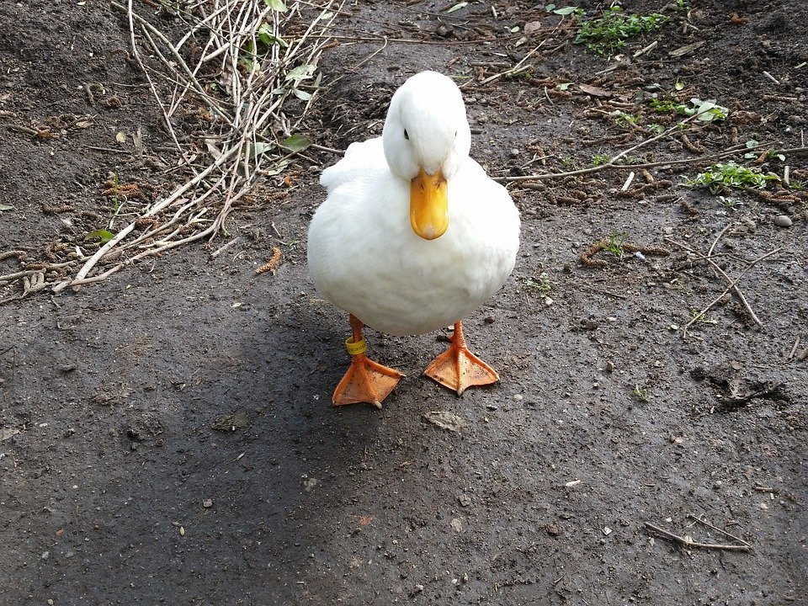

Slide 11
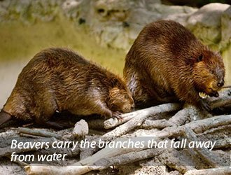
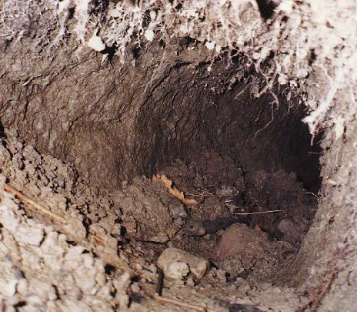
The front feet of beaver s are paws that have a sharp claws. These are used for digging mud and dragging tree branches.

Slide 12
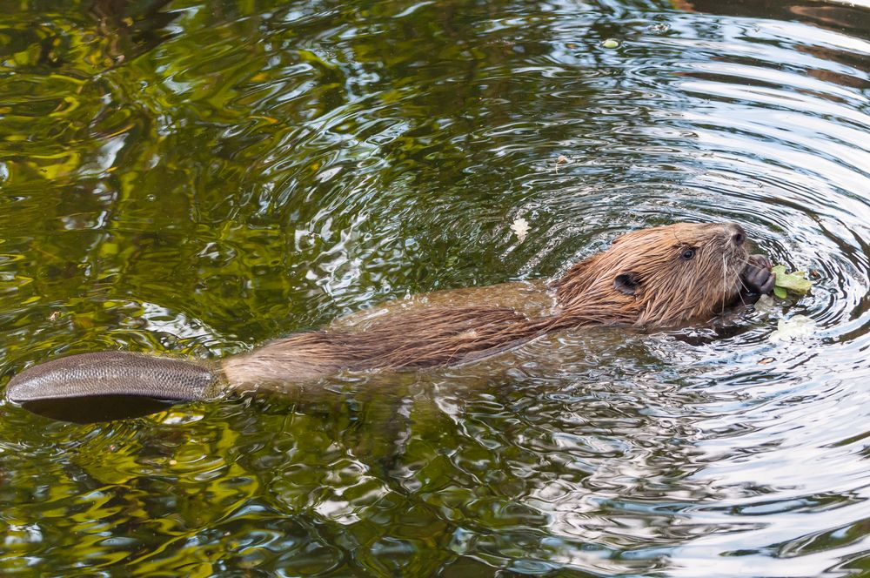
Beaver is a good swimmer.

Slide 13
How can the beaver cut down so many trees?

Slide 14
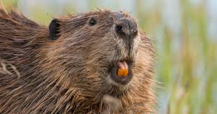
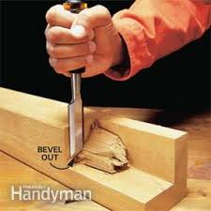
His teeth are sharp like a chisels.

Slide 15
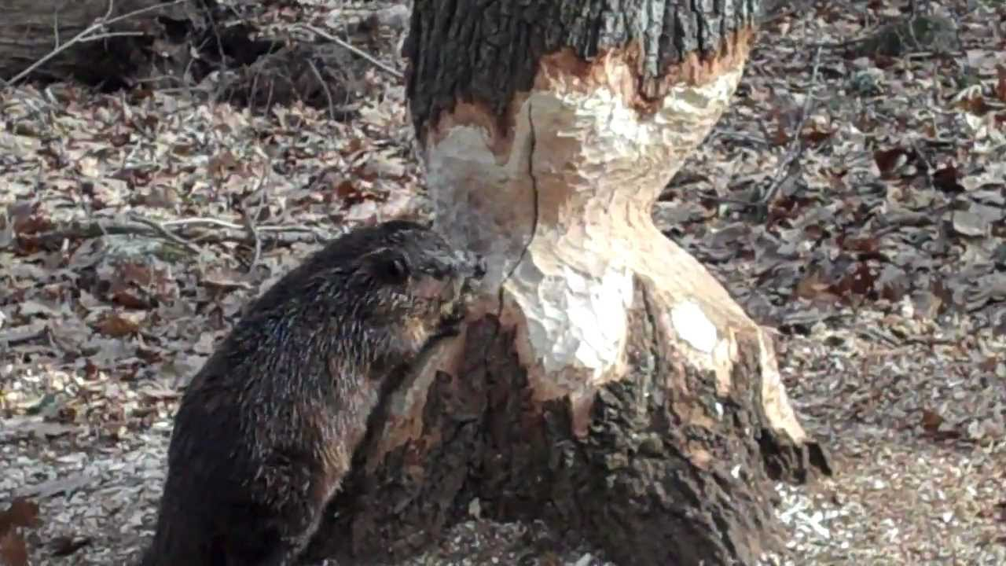

Slide 16
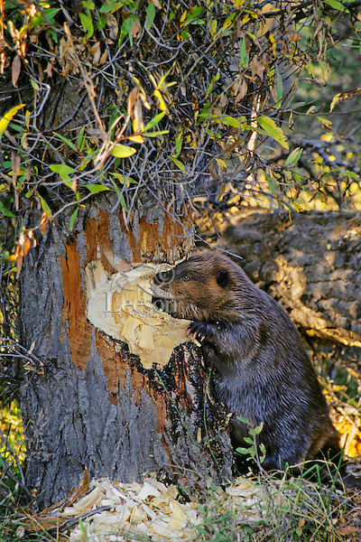
What does a beaver eat?
Beaver’s favorite food is the tree barks.

Slide 17
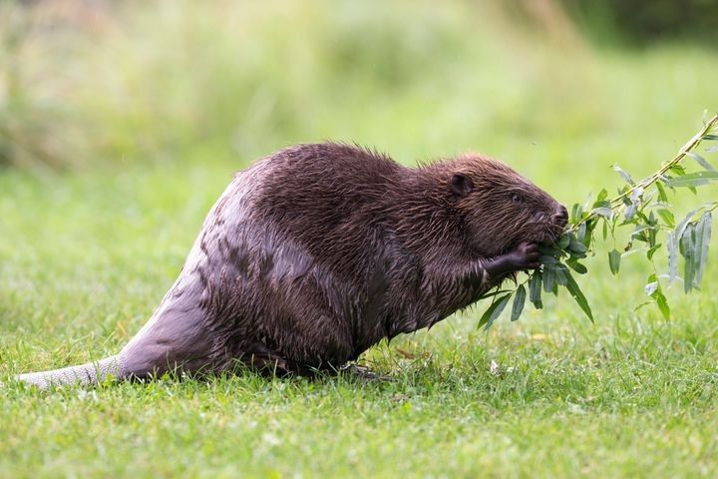
Beavers also eats berries, grass and plants.

Slide 18
Let’s Review!

Slide 19
The beaver is called
An animal destroyer
An animal explorer
An animal engineer

Slide 20
The beaver is called
An animal destroyer
An animal explorer
An animal engineer

Slide 21
Where do beavers build their homes?
Lake
Ponds or streams
sea

Slide 22
Where do beavers build their homes?
Lake
Ponds or streams
sea

Slide 23
Why God made a beaver?
To keep his creation
To be a builder of ponds
To be a helper to people

Slide 24
Why God made a beaver?
To keep his creation
To be a builder of ponds
To be a helper to people

Slide 25
What does a beaver use to cut down the trees?
his feet
his tail
his teeth

Slide 26
What does a beaver use to cut down the trees?
his feet
his tail
his teeth

Slide 27
What is a beaver’s favorite food?
fruits
tree bark
grass

Slide 28
What is a beaver’s favorite food?
fruits
tree bark
grass

