Slide 1
Weather Risk Management
Yas Suttakulpiboon

Slide 2
The Material

Slide 3
Types
Catastrophic weather event – insurance / cat bond
Non-catastrophic weather event – weather derivatives

Slide 4
Introduction to Weather Derivative

Slide 5
Hedgers vs Speculators
Players
Hedgers
Speculators
ข้อดี
return จากตราสารเหล่านี้ไม่เกี่ยวข้องกับ market / other financial returns
สามารถกระจายความเสี่ยงจากพื้นที่ที่มี low weather risk ไปยังพื้นที่ที่มี high weather risk ได้ง่าย

Slide 6
Contract
The contract period
A measurement station
A weather variable
An index
A pay-off function
Premiums

Slide 7
Index-based and Indemnity-based Weather Insurance
Index-based -> ง่าย แต่มี basis risk… basis risk จะหมดไปถ้า loss highly correlated กับ weather
Indemnity-based -> คำนวณยาก

Slide 8
Index
Temperature-based
Wind-based
Rain-based and Precipitation-based
Snow-based
Number of sunshine hours

Slide 9
Temperature-based Indices
Degree day indices
Heating degree days (HDDs)
Cooling degree days (CDDs)
Average of average temperature indices
Cumulative average temperature indices
Event indices
A general classification of indices

Slide 10
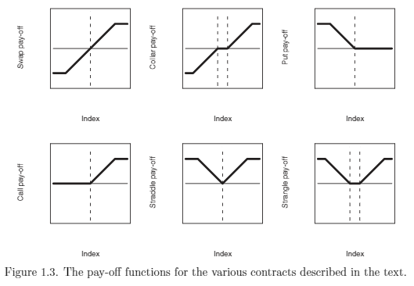
Derivative Payoffs

Slide 11
Data Cleaning and Trends

Slide 12
How to Price Weather Derivatives using Meteorological Data
Data Cleaning: filling/intra-extrapolating missing values + outliers
Identify jumps in the data due to station change
Remove trends
Check out Boissonnade et al, 2002 for detail

Slide 13
Data
Data source: National Meteorological Services (NMSs)
US data… good and cleaned
Others… expensive and often available in hard copies
Types
Synoptic
Climate
Challenges
Gaps/missing data
Jumps… caused by station changes
0.5 degree Celcius change is considered large already!
Trends / mean shifts

Slide 14
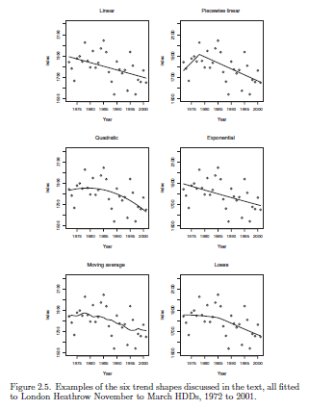

Slide 15
Pricing

Slide 16
Burn Analysis
Idea: how a contract would have performed in previous years
No distributional structure or Monte Carlo simulation required
Linear Swaps
Strike K = E[X]; X = weather index used
Add a risk loading… e.g. 20% of a standard deviation of the underlying index
Option
Average historical option payoffs = option price
Add a risk loading

Slide 17
Index Modeling: Statistical Modeling Method
Steps:
Step 1: Model the distribution of the underlying index using statistical method
Step 2: Use the payoff function and the distribution of the underlying index to compute the expected payoff… that’s the price.
Caveat: Wrong distribution choice -> Worse result than burn method!

Slide 18
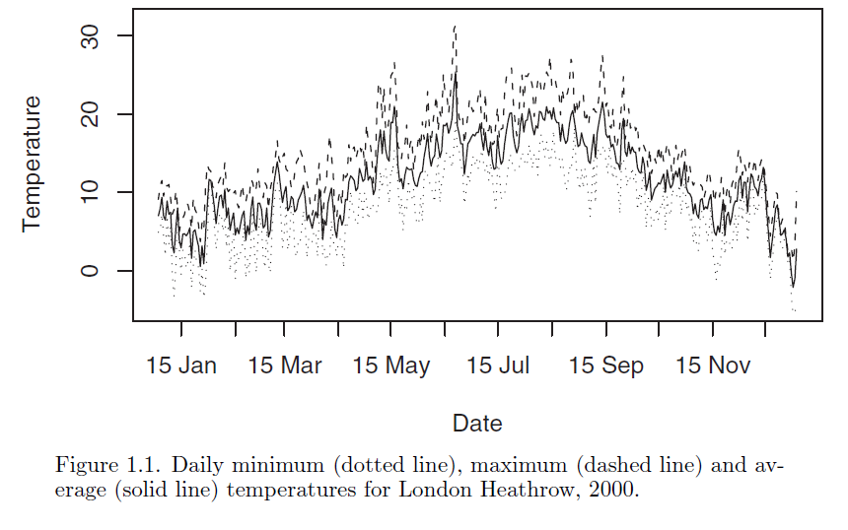

Slide 19
How to fit the index?
Discrete vs Continuous?
Parametric vs Non-parametric (kernel density approach)?
Fitting the distribution
MM or MLE
Testing the goodness of fit
Histogram, qq-plot, CDF plot
Chi-squared test, Kolmogorov-Smirnov test, Anderson-Darling test, Shapiro-Wilk test

Slide 20
A side note on Kernel Density approach…

Slide 21
Calculation of Expected Payoffs
Analytical/closed-form solution
Numerical integration
Simulation

Slide 22
Paper

Slide 24
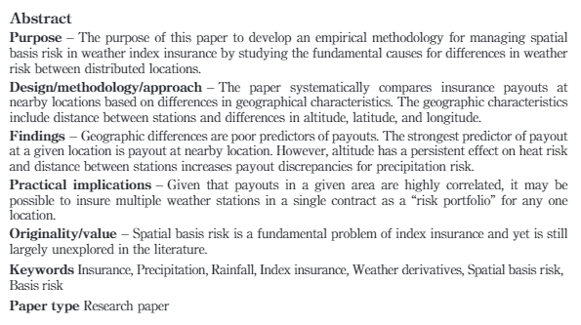
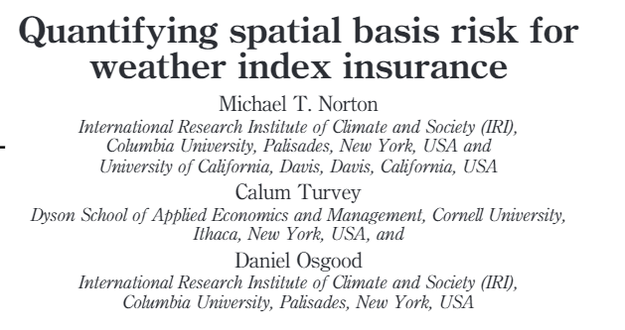

Slide 25
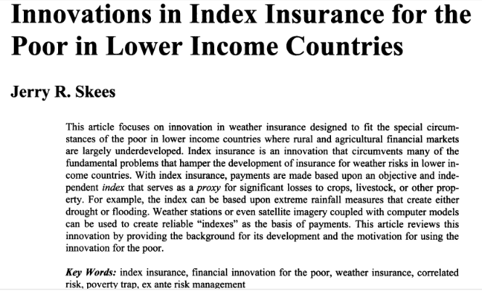

Slide 26
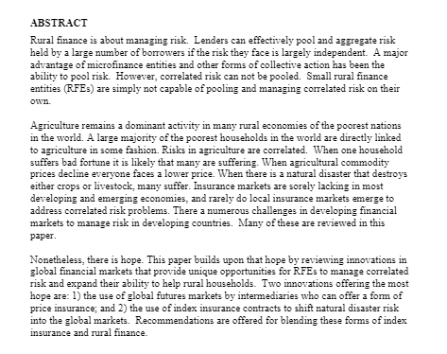

Slide 27
Conclusion

