Slide 1
Cash Out On Cannabis
Session 4

Slide 2
Trading Vs Investing
Trading is for income
Investing is for building wealth

Slide 3
Core Investing Strategy

Slide 4
When To Buy And When To Sell

Slide 5
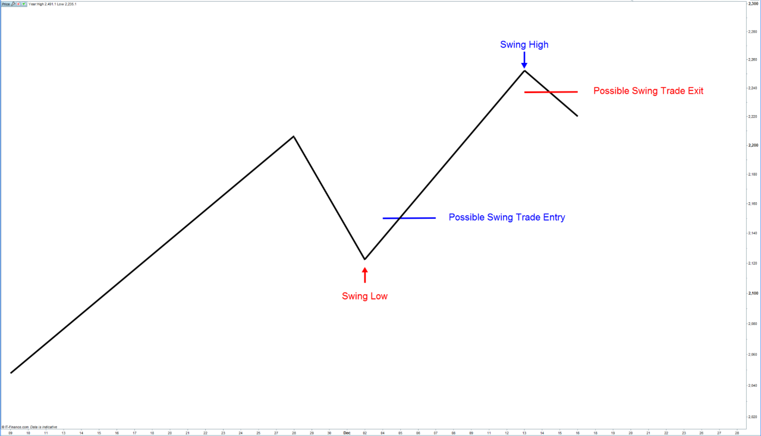
Core Investing Strategy
Swing Trading Strategy

Slide 6
Basic Chart Reading
Let’s Go To Yahoo Finance

Slide 7
Buy & Hold Funds
Let’s Look At A Fund & It’s Holdings

Slide 8
Actively Invest Or Trade Stocks

Slide 9
Buy Value Stocks When They Are Undervalued
Sell Value Stocks When They Are Overvalued

Slide 10
See You In The Next Session

