Slide 1
Part 3: Damages and Recovery in a Child Sex Abuse Case (BRAND NEW)

Slide 2
DEALING WITH THE FAMILY CASE/INDIVIDUAL
PLAN:
STATUTE OF LIMITATIONS
INTAKE/INVESTIGATION
THE CLAIM LETTER
LITIGATION
TRIAL, JUDGMENT & COLLECTION

Slide 3
STATUTE OF LIMITATIONS

Slide 5
INTAKE & INVESTIGATION: What can you do?

Slide 6
Initial Search
Google/Internet searches
NYSCEF
Grand Jury Reports
FOAIs/FOILs to local agencies
Create working timeline of perpetrator’s assignments

Slide 7
Disciplinary Rule 7-104
Communicating With One of Adverse Interest
(A) During the course of his representation of a client a lawyer shall not:
Communicate or cause another to communicate on the subject of the representation with a party he knows to be represented by a lawyer in that matter unless he has the prior consent of the lawyer representing such other party or is authorized by law to do so
Give advice to a person who is not represented by a lawyer, other than the advice to secure counsel, if the interests of such person are or have a reasonable possibility of being in conflict with the interests of his client
Non-Contact Rule as Applied in Other States
California
New Jersey
Pennsylvania

Slide 8
Niesig v. Team I, 76 N.Y.2d 363 (N.Y. 1990)
N.Y. Jud. App., Code Prof. Resp. DR 7-104(A)(1) states that during the course of the representation of a client a lawyer shall not communicate or cause another to communicate with a party the lawyer knows to be represented by a lawyer in that matter unless the lawyer has the prior consent of the lawyer representing such other party or is authorized by law to do so
N.Y. Jud. App., Code Prof. Resp. DR 7-104(A)(1) applies only to current employees, not to former employees
In determining whether corporate employees are "parties" under N.Y. Jud. App., Code Prof. Resp. DR 7-104(A)(1), the test that best balances the competing interests, and incorporates the most desirable elements of the other approaches, is one that defines "party" to include corporate employees whose acts or omissions in the matter under inquiry are binding on the corporation (in effect, the corporation's "alter egos") or imputed to the corporation for purposes of its liability, or employees implementing the advice of counsel -- all other employees may be interviewed informally

Slide 9
Snider v. Superior Court, 113 Cal. App. 4th 1187
“There was no violation of rule 2-100 as the contacted employees were not “represented parties” within the scope of that rule as
they were not “officer[s], director[s] or managing agent[s]” of the organization;
the subject matter of the communications was not an act or omission of the employees that could be binding or imputed to the organization; and
they were not employees whose statements might constitute admissions on behalf of the organization.” Id.

Slide 10
THE CLAIM LETTER & ETHICAL CONSIDERATIONS

Slide 11
Claim Letter or Litigation??
Advantage of Claim Letter
Advantage of Litigation
Quick
No digging into personal life
Avoid a lawsuit
Full discovery
Full recovery
Bankruptcy
Judgment proof

Slide 12
Claim Letter: What is the Process?
Send Letter
Give deadline to response
Initiate call
Follow-up on calls
Mediation

Slide 13
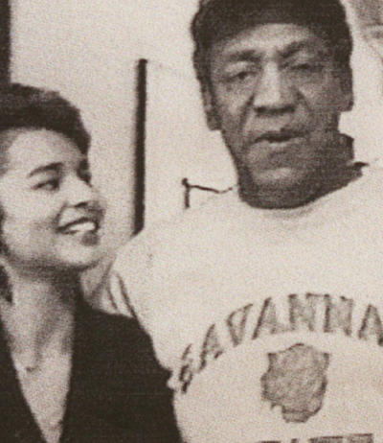
United States v. Jackson, 180 F.3d 55 (2d Cir.)
Jackson (Bill Cosby’s daughter out of wedlock) threatened to publicize her claim to be his daughter and harm his reputation and that she was prepared to go to a tabloid on his voicemail and repeated conversations with his personnel and attorneys.
Jackson indicted in 1998 on alleged violation of 18 U.S.C. § 875(d), 18 U.S.C. § 1952(a)(3), 18 U.S.C. § 371. She was convicted on all three counts.
2nd Circuit found error in the Court’s definition of the word “extort” and found error in the conspiracy charge. Remanded on technical errors

Slide 14
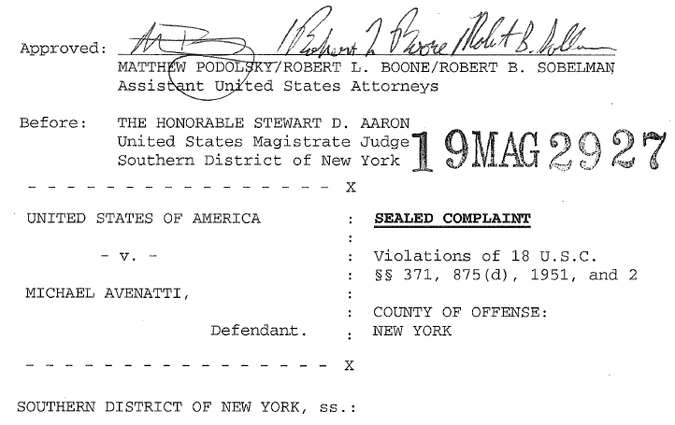
United States of America v. Michael Avenatti
Michael Avenatti used threats of economic and reputational harm to extort Nike. Avenatti threatened to hold a press conference on the eve of Nike’s quarterly earnings call and announce allegations of misconduct of employees of Nike
Avenatti said he would refrain from holding the press conference and harming Nike, only if Nike made payment. He demanded as much as $25 million
Notes:
Michael Avenatti used threats of economic and reputational harm to extort Nike
Avenatti threatened to hold a press conference on the eve of Nike’s quarterly earnings call and announce allegations of misconduct of employees of Nike
Avenatti said he would refrain from holding the press conference and harming Nike, only if Nike made payment. He demanded as much as $25 million

Slide 15
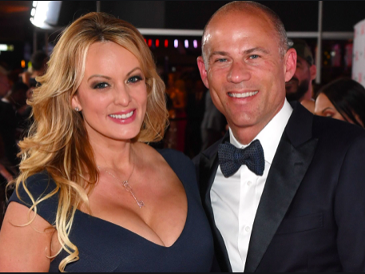
Avenatti: Guilty on ALL Counts
Jury convicted Avenatti on all counts. He faces a potential 42 years in prison for the extortion convictions
Avenatti, who was convicted on extortion and fraud charges stemming from an attempted shakedown of the athletic apparel giant in 2019, was released from Manhattan’s Metropolitan Correctional Center in April because of the coronavirus. His sentencing has been moved to October of 2020
https://www.usatoday.com/story/news/politics/2019/03/25/michael-avenatti-arrest-stormy-daniels-says-shes-not-shocked/3272212002/
Notes:
NBC NY 2/14/20 -Jury convicted Avenatti on all counts. He faces a potential 42 years in prison for the extortion convictions
Law.com 7/22/20 - Avenatti, who was convicted on extortion and fraud charges stemming from an attempted shakedown of the athletic apparel giant in 2019, was released from Manhattan’s Metropolitan Correctional Center in April because of the coronavirus. His sentencing has been moved to October of 2020
NY TIMES 3/25/19 - Geoffrey S. Berman, the United States attorney for the Southern District of New York, based in Manhattan, said at a news conference that Mr. Avenatti’s conduct amounted to a “shakedown.” “Avenatti used illegal and extortionate threats for the purpose of obtaining millions of dollars in payments from a public company,” he said. “Calling this anticipated payout a retainer or a settlement doesn’t change what it was — a shakedown. When lawyers use their law licenses as weapons, as a guise to extort payments for themselves, they are no longer acting as attorneys.”

Slide 16
TRIAL, JUDGMENT & COLLECTION

Slide 17
Trial: Important Considerations
Expert witness testimony
Default judgments
Inquests/damages
Anonymity and Sealing/Redacting

Slide 18
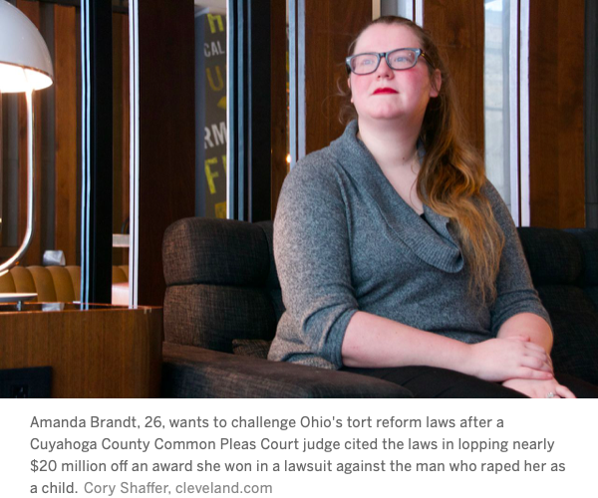
Doe v. Pompa, No. CV-18899352 (Ohio Ct. Com. Pl. Cuyahoga Cty., Nov. 20, 2019)
$134 verdict for woman who was repeatedly abused by her friend’s father
Doe, who was 11 at the time, frequently spent the night at her friend's house. During these visits, the friend's father, Roy Pompa, administered sedatives to and sexually abused Doe. Pompa was later arrested, and tapes were found showing him engaging in sexual acts with young girls, including Doe.

Slide 19
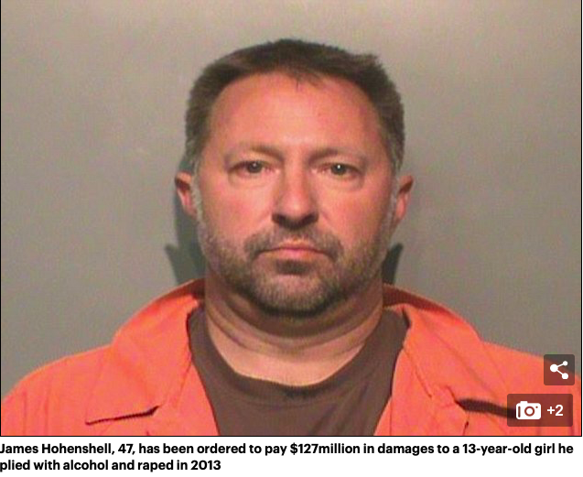
Gray v. Honenshell, 927 N.W.2d 680, 2019 WL 325015, at *10 (Iowa Ct. App. 2019)
The Iowa Court of Appeals orders father to pay $127 million in damages to 13-year-old girl he raped

Slide 20
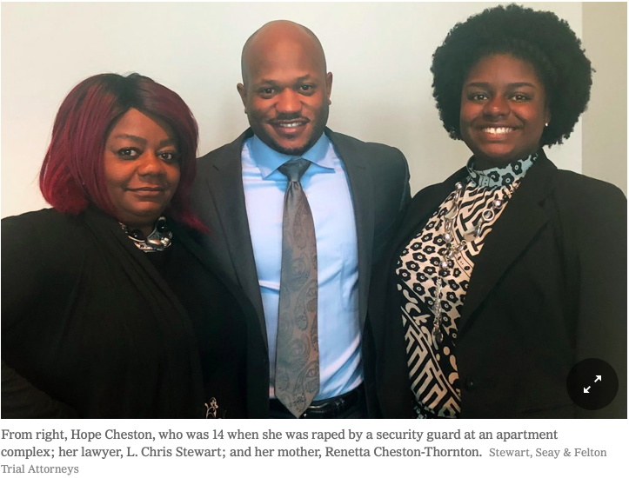
Woman Who Was Raped as a Teenager Is Awarded $1 Billion in Damages
Daniel Victor, Woman Who Was Raped as a Teenager Is Awarded $1 Billion in Damages (May 23, 2018) https://www.nytimes.com/2018/05/23/us/georgia-assault-billion-dollars.html

Slide 21
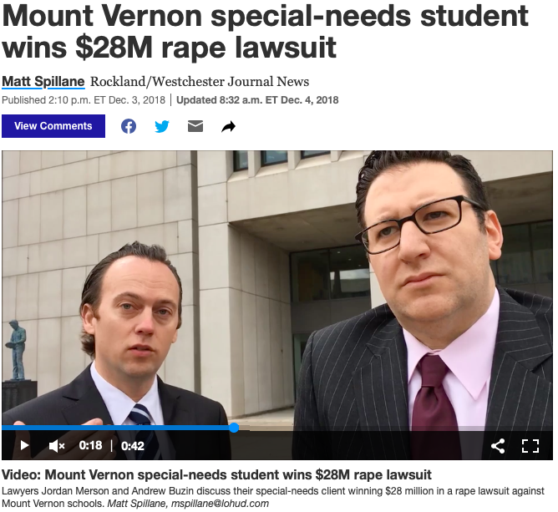
Gloria G. v. Mount Vernon, Index No.: 70026/2012

Slide 22
Collection
Money Judgments
Seizing bank accounts
Seizing real property

