Slide 1
Make Your Mark: Monoprinting & More!
With Julia Malakoff

Slide 2
Famous Artists who used Monotype:
1. Edgar Degas
2. Paul Gaugin
3. Pablo Picasso

Slide 3
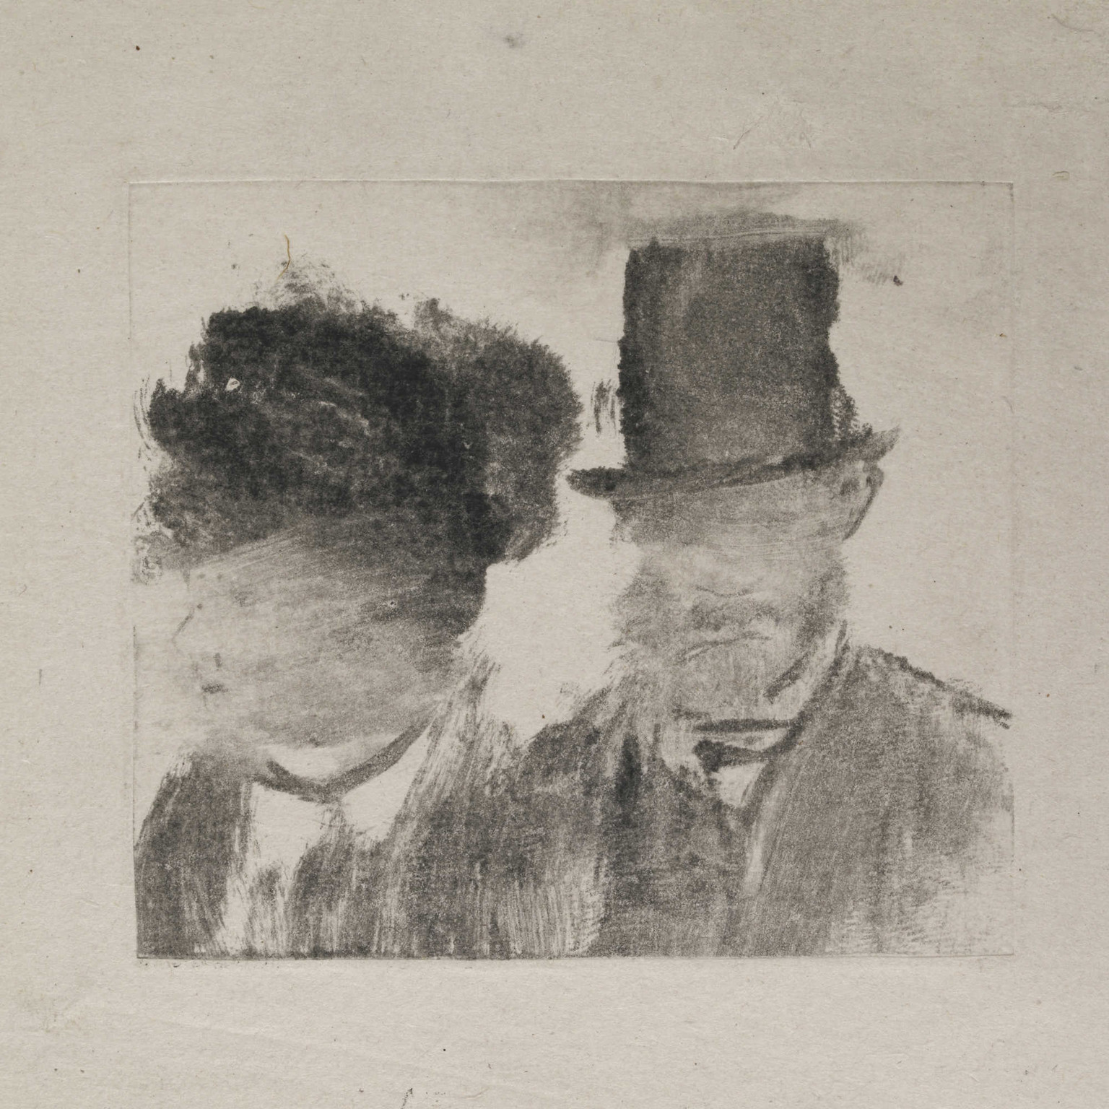
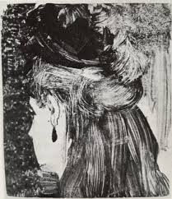
Edgar Degas: Monoprints

Slide 4
Landscape: Edgar Degas

Slide 5
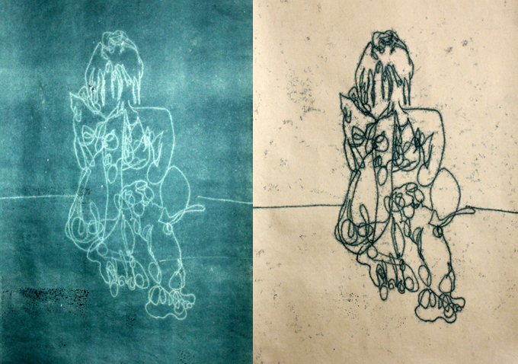
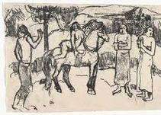
Paul Gaugin: Monoprints

Slide 6
Paul Gaugin: Tahitian Landscape

Slide 7
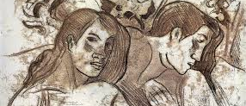
Paul Gaugin
Two heads of Marquesan women, one in profile, the other three-quarters, both to right, against a background of wooden carvings. c.1902 Verso: pencil drawing used to make the tracing Traced monotype, printed in black-brown with lighter brown areas

Slide 8
Pablo Picasso

Slide 9
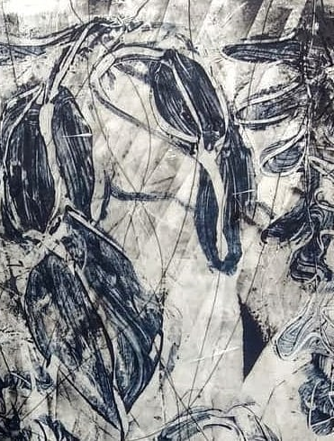
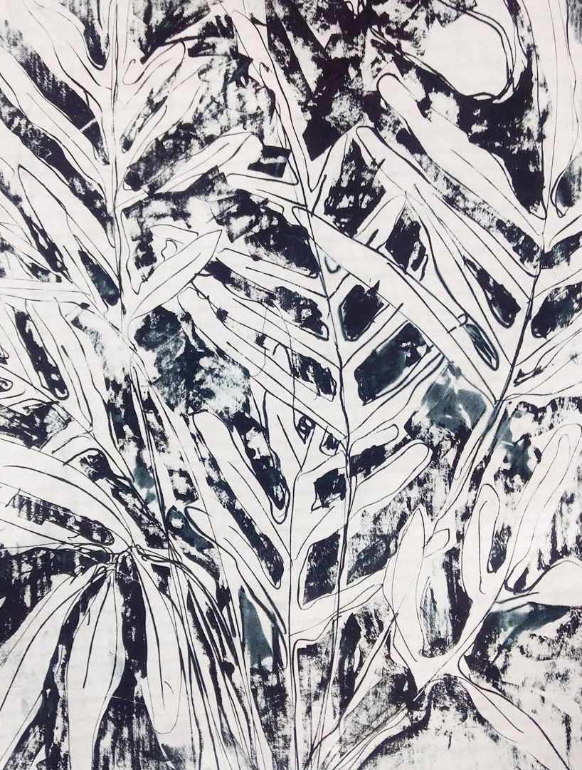
Trace by Debra Claffey Art
A detail from Indigo Ice, No. 4, before I deliver it to the Art Complex Museum for the MGNE Monotype/Monoprint show.

Slide 10
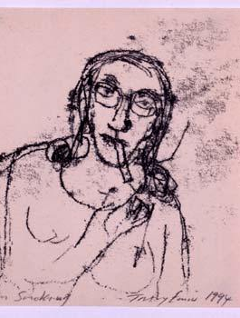
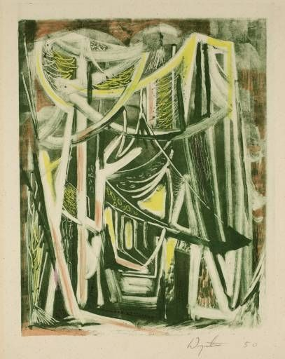
Tracey Emin - Mum Smoking
Bryan Wynter | Path Through Wood, 1950, monoprint

Slide 11
‘Seikenji Fuji’ by Utagawa Hiroshige. Photo courtesy of the Art Institute of Chicago.

Slide 12
David Fox

Slide 13
Monoprint by Linda Spadaro

