Slide 1
Probability Exam (Exam P)
สอนโดย
กีรติ จรูญพงษ์ศักดิ์ (พี่เซฟ)

Slide 2
1.

Slide 3
An urn contain 10 balls: 4 red and 6 blue. A second urn contains 16 red balls and an unknown number of blue balls. A single ball is drawn from each urn. The probability that both balls are the same color is 0.44 calculate the number of blue balls in the second urn.
2.

Slide 4
Mutually independent
Mutually exclusive

Slide 5
3.
An actuary studying the insurance preferences of automobile owners makes the following conclusion
(i) An automobile owner is twice as likely to purchase collision coverage as disability coverage.
(ii) The event that an automobile owner purchases collision coverage is independent of the event that he or she purchases disability coverage.
(iii) The probability that an automobile owner purchases both collision and disability coverages is 0.15.
Calculate the probability that an automobile owner purchases neither collision nor disability coverage.

Slide 6
4.
An insurance agent offers his clients auto insurance, homeowners insurance and renters insurance. The purchase of homeowners insurance and the purchase of renters insurance are mutually exclusive. The profile of the agent’s clients is as follows
i) 17% of the clients have none of these three products.
ii) 64% of the clients have auto insurance
iii) Twice as many of the clients have homeowners insurance as have renters insurance.
iv) 35% of the clients have two of these three products.
v) 11% of the clients have homeowners insurance, but not auto insurance.
Calculate the percentage of the agent’s clients that have both auto and renters insurance

Slide 7
Bayes Theorem / Law of total probability
A
B

Slide 8
Bayes Theorem / Law of total probability
A
B₁
B₂

Slide 9
Bayes Theorem / Law of total probability

Slide 10
5.
A health study tracked a group of persons for five years. At the beginning of the study, 20% were classified as heavy smokers, 30% as light smoker, and 50% as nonsmokers.
Results of the study showed that light smokers were twice as likely as non smokers. to die during the five-year study, but only half as likely as heavy smokers.
A randomly selected participant from the study died during the five-year period. Calculate the probability that the participant was a heavy smoker

Slide 11
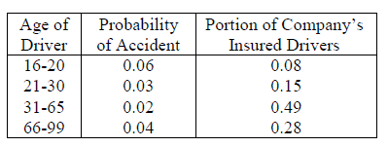
6.
An auto insurance company insures drivers of all ages. An actuary compiled the following statics on the company’s insured drivers
A randomly selected driver that the company insures has an accident. Calculate the probability that the driver was age 16-20.

Slide 12
Random variable
Discrete Random Variable
Expected
Variance

Slide 13
7.
An insurance policy pays 100 per day for up to three days of hospitalization and 50 per day for each day of hospitalization thereafter.
The number of days of hospitalization, X is a discrete random variable with probability function
Determine the expected payment for hospitalization under this policy.

Slide 14
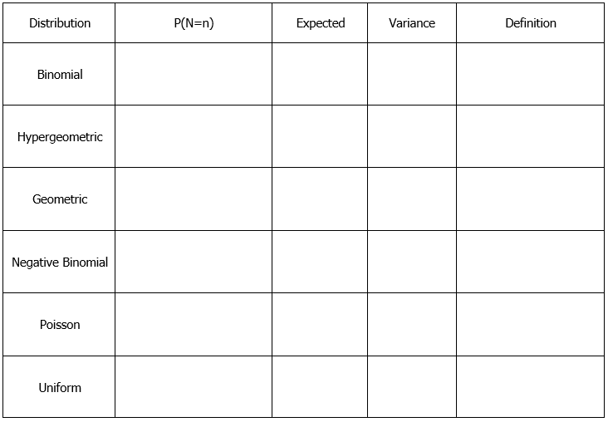
discrete distribution

Slide 15
8.
An actuary has discovered that policyholders are three times as likely to file two claims as to file four claims.
The number of claim filed has a Poisson distribution.
Calculate the variance of the number of claims filed

Slide 16
9.
A company prices its hurricane insurance using the following assumptions:
(i) In any calendar year, there can be at most one hurricane.
(ii) in any calendar year, the probability of a hurricane is 0.05
(iii) The numbers of hurricanes in different calendar years are mutually independent.
Using the company’s assumptions, calculate the probability that there are fewer than 3 hurricanes in a 20 year period.

Slide 17
10.
A company takes out an insurance policy to cover accidents that occur at its manufacturing plant. The probability that one or more accidents will occur during any given month is 0.6. The numbers of accidents that occur in different months are mutually independent. Calculate the probability that there will be at least four months in which no accidents occur before the fourth month in which at least one accident occurs.

Slide 18
11.
In a hospital ward there are 16 patients, 4 whom have AIDS. A doctor is assigned to 6 of these patients at random. What is the probability that he gets 2 of the AIDS patients?

Slide 19
12.
A company has five employees on its health insurance plan. Each year, each employee independently has an 80% probability of no hospital admissions. If an employee requires one or more hospital admissions, the number of admissions is modeled by a geometric distribution with a mean of 1.50. The numbers of hospital admissions of different employees are mutually independent.
Each hospital admission costs 20,000.
Calculate the probability that the company’s total hospital costs in a year are less than 50,000.

Slide 20
Random variable
Continuous random variable

Slide 21
13.
The lifetime of a machine part has a continuous distribution on the interval (0, 40) with probability density function f(x), where f(x) is proportional to (10 + x)⁻² on the interval.
Calculate the probability that the lifetime of the machine part is less than 6.

Slide 22
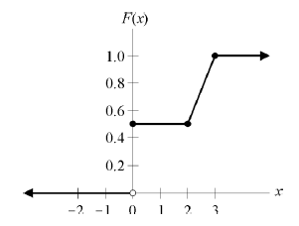
14.
The figure below shows the cumulative distribution function of a random variable, X.
Calculate E(X).

Slide 23
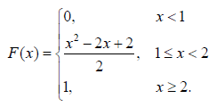
15.
A random variable X has the cumulative distribution function
Calculate the variance of X.

Slide 24
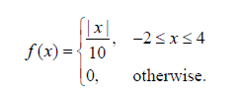
16.
Let X be a continuous random variable with density function
Calculate the expected value of X.

Slide 25
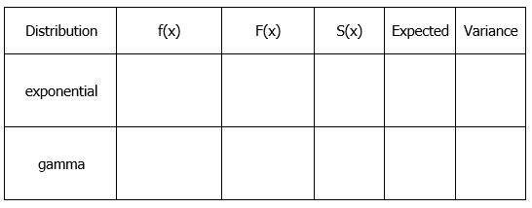
continuous distribution

Slide 26
Integrate Shortcut
1.
2.

Slide 27
17.
A device that continuously measures and records seismic activity is placed in a remote region. The time, T, to failure of this device is exponentially distributed with mean 3 years. Since the device will not be monitored during its first two years of service, the time to discovery of its failure is X = max(T, 2) Calculate E(X).

Slide 28
Percentile
ถ้า อยู่ตำแหน่ง percentile ที่ r แล้ว F( ) =
F(x)
40th percentiles = 5
100th percentiles = 10
1
70th percentiles = 10
0.7
0.5
0.4
Given that x is more than 5.
Find 50th percentiles
x
5
7.5
10

Slide 29
18.
An insurer's annual weather-related loss, X, is a random variable with density function
Calculate the difference between the 30th and 70th percentiles of X.

Slide 30
19.
An insurance company sells an auto insurance policy that covers losses incurred by a policyholder, subject to a deductible of 100. Losses incurred follow an exponential distribution with mean 300.
Calculate the 95th percentile of losses that exceed the deductible

Slide 31
Maximum / Minimum
Max
Max

Slide 32
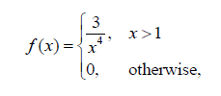
20.
Claim amounts for wind damage to insured homes are mutually independent random variables with common density function
where x is the amount of a claim in thousands.
Suppose 3 such claims will be made.
Calculate the expected value of the largest of the three claims.

