Slide 1
What is Enterprise Phishing?
CEO/Lead Instructor: Brandon Dennis, OSCE, OSCP, OSWE

Slide 2
What is Enterprise Phishing?
Cyber Crime which is designed to lure individuals into giving up sensitive information or taking an unwanted action
Phishing happens to everyone – Check Your Spam Folder!
Enterprises can get hit the worst

Slide 3
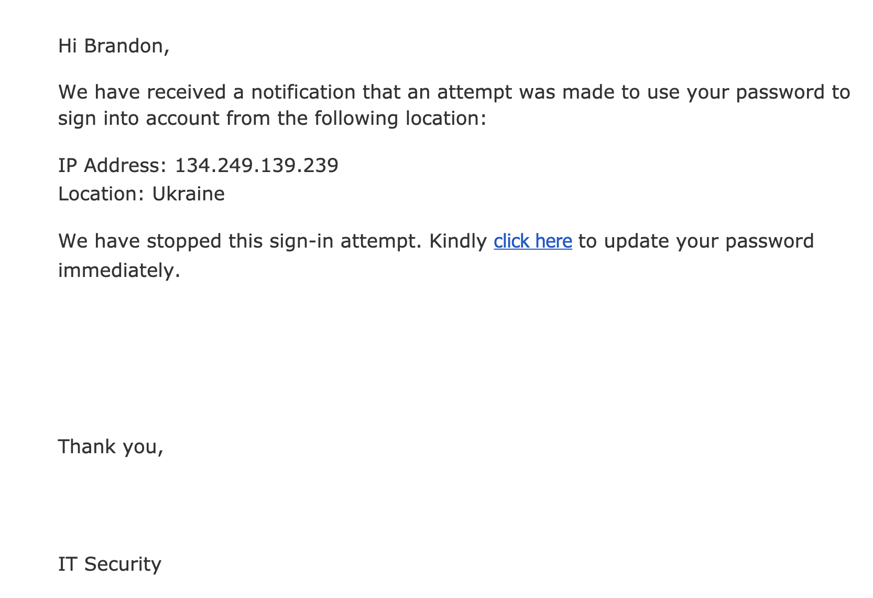
Phishing Example

Slide 4
Types of Phishing Attacks
Mass Phishing
Could be anyone
Spear Phishing
Very targeted and researched

Slide 5
Types of Phishing Payloads
Link Based
Click Here!
Malware Based
Please Review Attachment

Slide 6
Use In Red Team Operations
Quick way into the network for a foot hold
Difficult to identify the source attacker
Easily customizable attack and payloads
Plays on the human element of security

Slide 7
Some Defenses In Place
Key Word Filtering
Doman Age
Email Server Reputation
2FA
You!

