Slide 1
Elapsed Time/Schedules

Slide 2
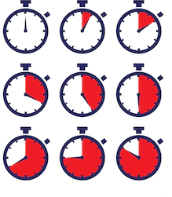
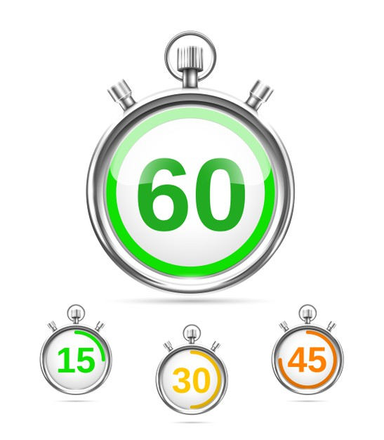
Elapsed time is the amount of time that passes from the beginning of an event/activity to the end of it.

Slide 3
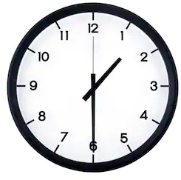
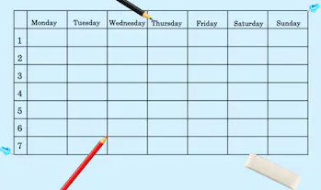
Being able to calculate elapsed time is an important skill that will also help you keep track of your own schedule.

Slide 4
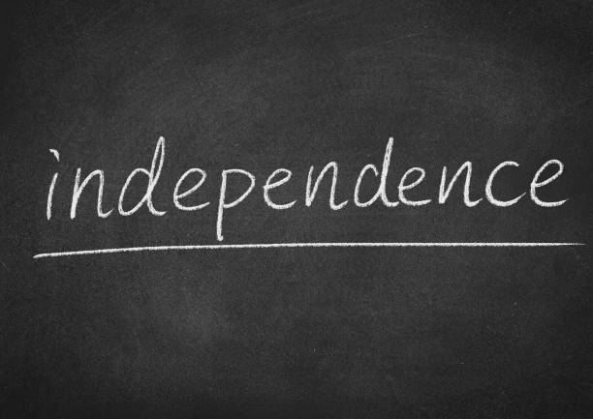
This helps you be more independent and responsible.

Slide 5
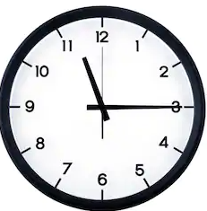
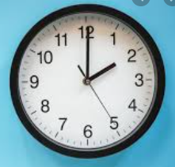
Before we start, let’s review. Does everyone know how to tell time? (Go over some examples with your class beforehand if necessary).

Slide 6
Elapsed Time & Schedules
Determine the elapsed time and fill in the schedules.

Slide 7
Corey’s hamster had to get fed every 3 hours. If the first feeding was at 8:00 a.m., what time would the next 3 feedings be?
Feedings
First Feeding | 8:00 a.m.
Second Feeding | ?
Third Feeding | ?
Fourth Feeding | ?

Slide 8
The bathrooms need to be checked every 2 hours to make sure they a clean. What time will the next checks happen?
Check #1 | 7:00 a.m.
Check #2 | ?
Check #3 | ?
Check #4 | ?
Check #5 | ?

Slide 9
Tammy was babysitting and the toddler she was watching was potty training. She needed to be taken every 30 minutes. Fill in the chart.
1st time | 3:00 p.m.
2nd time | ?
3rd time | ?
4th time | ?
5th time | ?

Slide 10
Here is a list of daily activities for Lori. Fill in the times of each activity based on the time increments if her day starts at 8:00 a.m.
Breakfast with Mom – 1 hour
Doctor’s Appointment – 45 minutes
Virtual Work Meeting – 2 ½ hours
Lunch with Sister – 1 ½ hours
Shopping – 4 hours
Dinner with a friend – 2 hours 15 minutes
Lori’s Schedule
Breakfast | 8:00 a.m.
Doctor’s Appt. | ?
Meeting | ?
Lunch | ?
Shopping | ?
Dinner | ?

Slide 11
Fill in the schedule for Paul’s afternoon and evening activities.
Paul’s Schedule
Guitar Lesson | 3:00 p.m.
Smoothies | ?
Tennis Match | ?
Dinner | ?
Go Home | ?
Guitar Lesson - 45 minutes
Smoothies with a friend – 1 hour
Tennis Match – 1 hour 15 minutes
Dinner – 2 hours

Slide 12
Fill in the schedule for Layla’s morning.
Yoga class- 1 hour
Shower & Get ready – 1 hour 15 minutes
Breakfast with friend – 1 hour 30 minutes
Meeting – 2 hours
Layla’s Morning Schedule
Yoga Class | 6:00 a.m.
Shower/Get Ready | ?
Breakfast | ?
Meeting | ?

Slide 13
Fill in Timmy’s evening schedule.
Timmy’s Schedule
Dinner | 6:00 p.m.
Movies | ?
Dessert | ?
Bowling | ?
Go home | ?
Dinner date: 2 hours
Movies: 2 hours 30 minutes
Dessert– 45 minutes
Bowling – 45 minutes

Slide 14
Let’s try a few elapsed time calculations. Try on your own and we’ll check it as a class.

Slide 15
Soccer practice starts at 4:00 p.m. and ends at 5:00 p.m. How long is soccer practice?

Slide 16
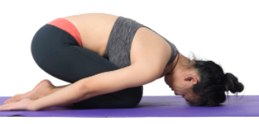
Myra’s yoga class went from 6:00 a.m. to 7:30 a.m. How long was the class?

Slide 17
Paulina went to the mall from 2:00 p.m. to 5:00 p.m. How long was she at the mall?

Slide 18
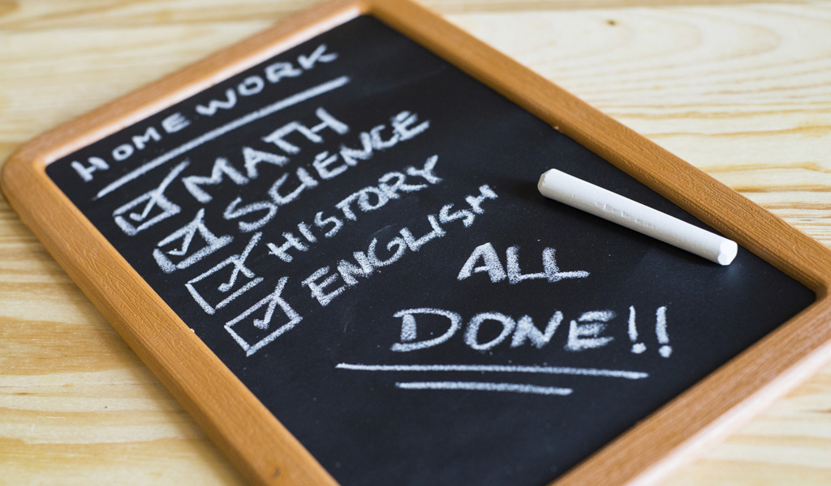
Jordy worked on his homework from 6:30 p.m. until 8:15 p.m. How long did he do his homework?

Slide 19
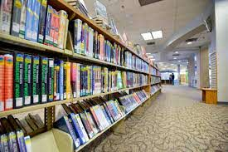
Manny had to work at the library from 9:00 a.m. to 11:45 a.m. How long was his shift?

Slide 20
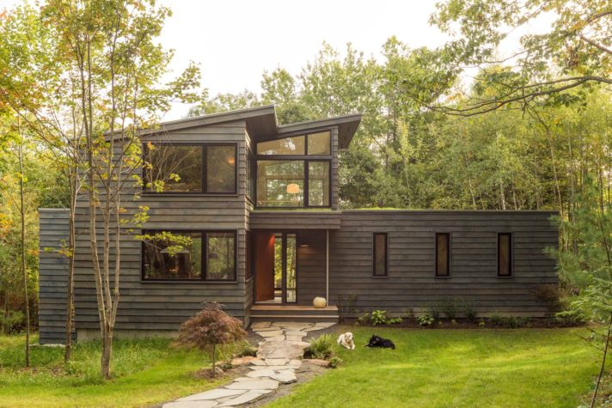
Jules was at her friends house from 1:15 p.m. until 6:30 p.m. How many hours was she there?

Slide 21
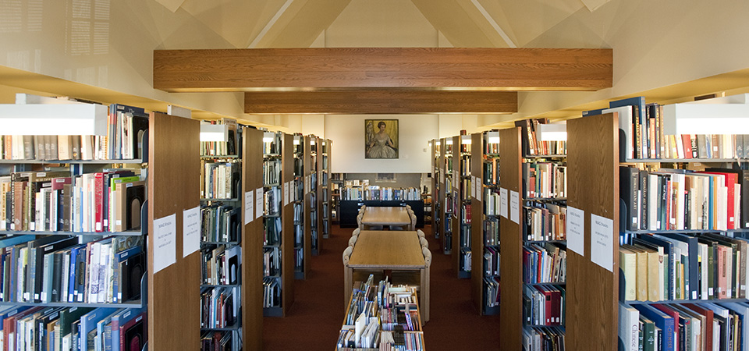
Sandra went to the library at 2:30 p.m. and left at 5:45 p.m. How long was she at the library?

Slide 22
The movie started at 7:15 p.m. and was 2 hours and 45 minutes. What time did it end?

Slide 23
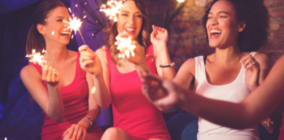
Lana’s birthday party started at 2:15 p.m. and was going to be 2 hours long. What time will the party end?

Slide 24
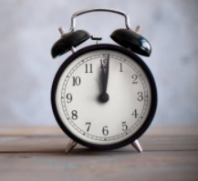
Henry left the house at 3:30 p.m. He was gone for 2 ½ hours. What time did he get back?

Slide 25
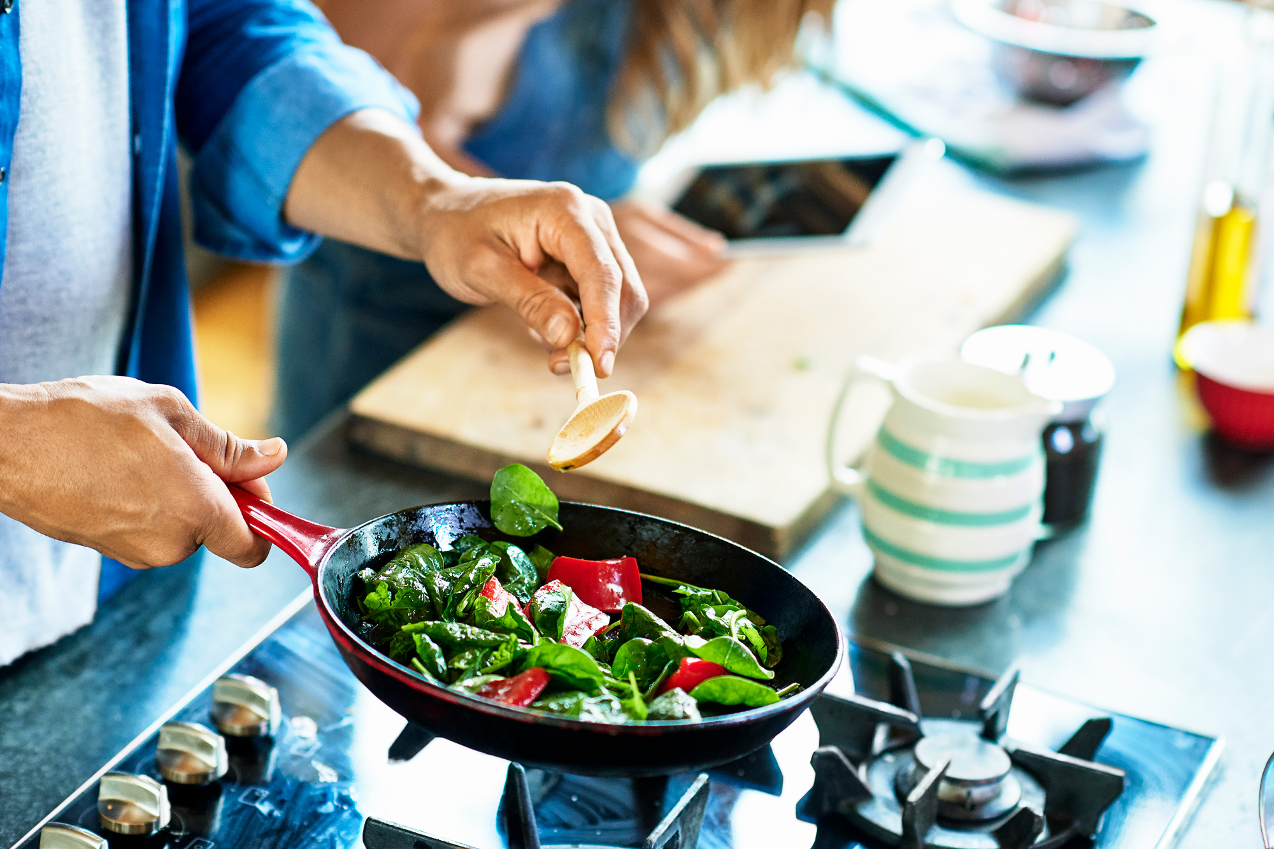
Jake taught a cooking class that lasted 2 hours 15 minutes. If it started at 7:30 p.m., what time would it end?

Slide 26
If Sam went to the theater at 8:00 p.m. and the show lasted 3 hours, what time did Sam get out?

Slide 27
Cat got to practice at 11:00 a.m. It lasted 1 hour 45 minutes. What time would Cat be done?

Slide 28
Jorge went to the park to play football with his friends at 1:45 p.m. He played for 3 hours and 15 minutes. What time did he finish playing?

Slide 29
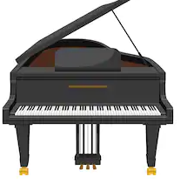
Brandon’s piano lesson was 45 minutes. If he started at 3:15 p.m., what time would be finished?

Slide 30
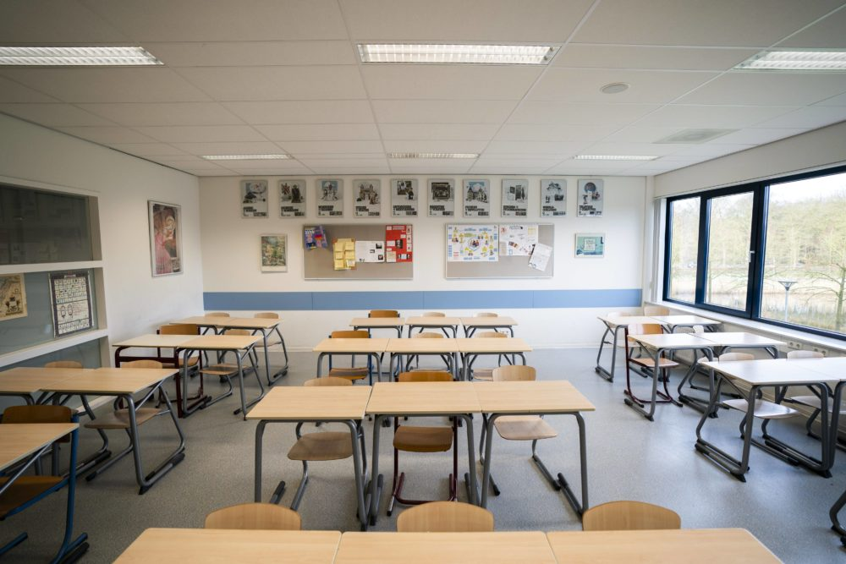
Gabby’s school day started at 7:30 a.m. She was at school for 7 hours. What time did she get out?

Slide 31
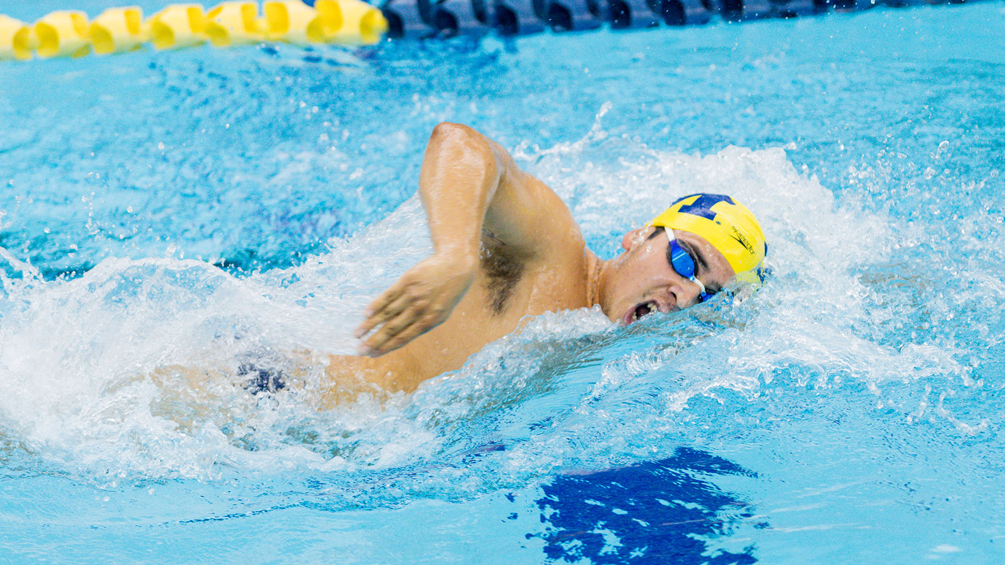
Kyle’s swim meet started at 10:00 a.m. Swim meets usually lasted 3 ½ hours. What time will he be done?

Slide 32
Review: What is elapsed time? Let’s try some on your own!

