Slide 1

Exploring the Concept of Mental Wellbeing

Slide 2
Objectives for this lesson
1. Explore what is meant by mental wellbeing
2. Discuss the link between mental health and mental wellbeing

Slide 3
Mental Health Vs. Wellbeing
While the terms mental health and mental wellbeing are often used interchangeably, wellbeing is the positive framing of our mental health—focusing on how we can build upon our strengths and increase our capacity for other qualities linked to increased levels of wellbeing.
Mental wellbeing can be described as a combination of how we feel (our emotions and life satisfaction) and how we function (relationships with others, personal control, purpose in life and independence).
It is something that affects everyone, old and young, and anyone can experience good or poor mental wellbeing.
What’s the difference?

Slide 4
Mental Wellbeing
Over time, experiencing poor mental wellbeing can contribute to the development of mental health problems such as depression or anxiety.
Experiencing factors such as those listed below can change our wellbeing levels:
Poverty
Discrimination
Violence, abuse or neglect
Peer rejection and isolation
Stressful life events
Lack of family support
Risk Factors

Slide 5
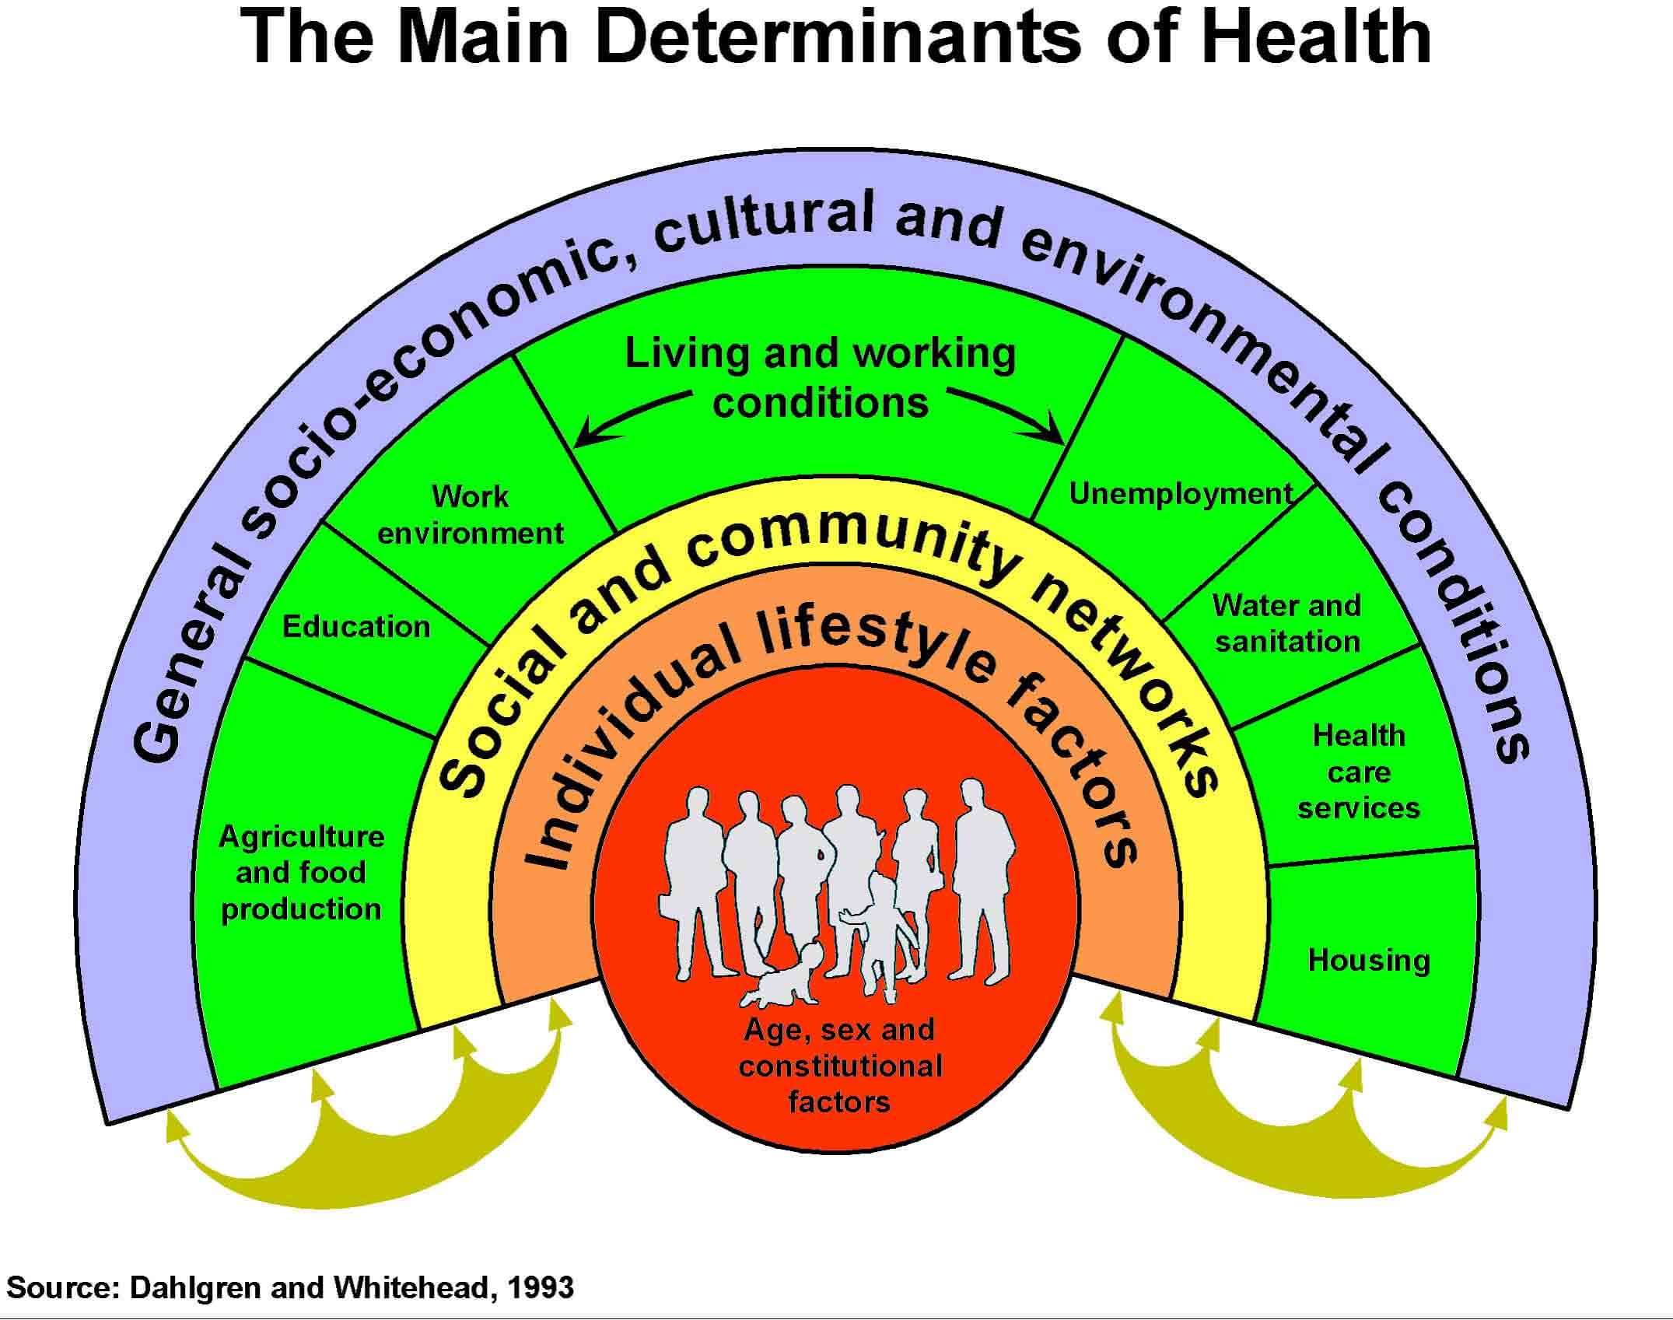
Main Determinants of Health
Dahlgren and Whitehead (1991)

Slide 6
Good Mental Health, Poor Mental Wellbeing
An individual with a diagnosed mental health condition can look after their mental health very well and be ‘flourishing’
Conversely, someone could have no diagnosable mental health condition but be ‘languishing’ with a poor level of mental wellbeing
Overall, many people who may have a diagnosed mental health condition can live rich and rewarding lives whilst others who may not have a diagnosable mental health condition can struggle with their mental wellbeing.
Is this possible?

Slide 7
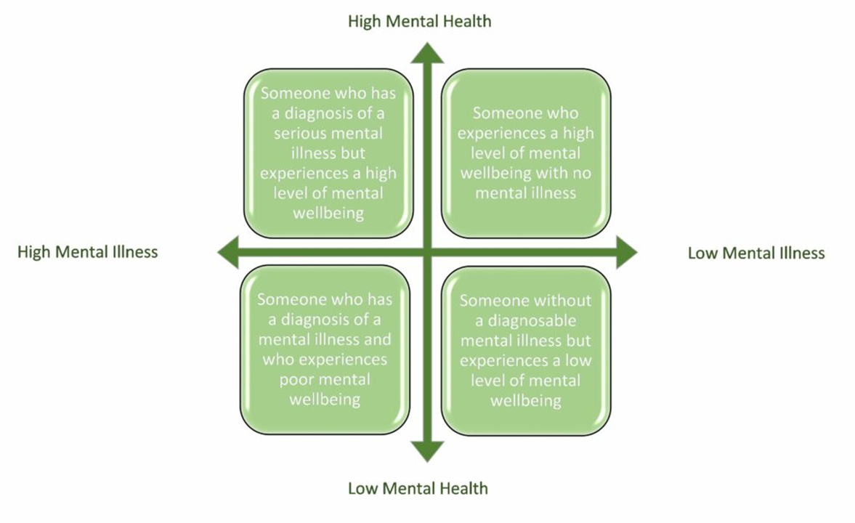
Dual Axis Model of Mental Health
20XX
What is it?
Dual continuum model illustrates that mental health is a complex state and is not merely an absence of mental illness. A person’s mental health includes; their wellbeing, their functioning as an individual, as well as their functioning in society.
The terms ‘flourishing’ and ‘languishing’ describe a person’s mental health.
Flourishing to represent an individual who is functioning optimally and implies growth, goodness and resilience.
Whilst ‘languishing’ denotes an individual who is living a life that feels empty and hollow.

Slide 8
Protective Factors
Economic security
Empowerment
Feelings of security, mastery and control
Positive interactions with others
Physical activity
Stable and supportive family environments
Healthy diet and lifestyle
For Good Mental Wellbeing

Slide 9






Summary
Mental wellbeing and mental health are terms often used interchangeably
Our mental wellbeing includes a combination of life satisfaction, our emotions and how we feel about ourselves
Positive or negative mental wellbeing can be influenced by life factors
A person with a mental health condition which is managed can experience good mental wellbeing
A person without a diagnosable mental health condition can experience poor mental wellbeing
There are protective factors which can promote good mental wellbeing such as social support

Slide 10
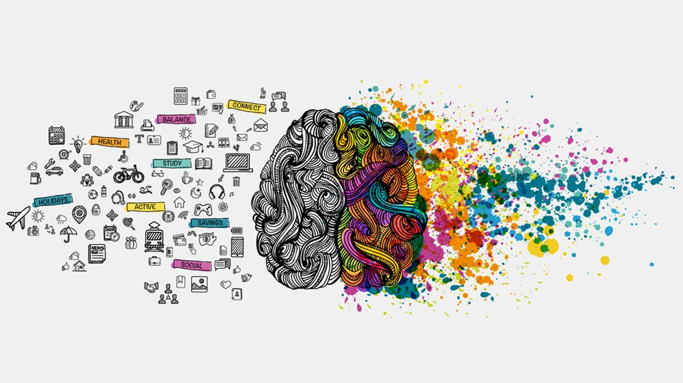
THANK YOU!
Next Session: Risk Factors of Poor Mental Health

