Slide 2
01
Business Modeling
05
Recruitment
02
06
Employed vs Self Employed
Marketing Strategy
03
07
Infrastructure Building
Understanding the Numbers
04
Pricing Structure
08
Systems and Processes

Slide 3
01
SECTION ONE
BUSINESS MODELNG

Slide 4
01
WHAT IS A BUSINESS MODEL?
CUSTOMER ACQUISITION COST
02
GROSS PROFIT
03
OVERHEAD
4
Notes:
What is business strategy?
A business strategy refers to the actions and decisions that a company takes to reach its business goals and be competitive in its industry. It defines what the business needs to do to reach its goals, which can help guide the decision-making process for hiring and resource allocation. A business strategy helps different departments work together, ensuring departmental decisions support the overall direction of the company.
Why is a business strategy important?
There are several reasons why a business strategy is important for organizations, including:
Planning: A business strategy helps you identify the key steps you will take to reach your business goals.
Strengths and weaknesses: The process of creating a business strategy allows you to identify and evaluate your company's strengths and weaknesses, creating a strategy that will capitalize on your strengths and overcome or eliminate your weaknesses.
Efficiency: A business strategy allows you to effectively allocate resources for your business activities, which automatically makes you more efficient.
Control: It gives you more control over the activities you're performing to reach your organizational goals, as you understand the path you're taking and can easily assess whether your activities are getting you close to your goals.
Competitive advantage: By identifying a clear plan for how you will reach your goals, you can focus on capitalizing on your strengths, using them as a competitive advantage that makes your company unique
Related: Understanding the Basics of Strategy Development
Here are 10 examples of great business strategies.
Cross-sell more products.
Most innovative product or service.
Grow sales from new products.
Improve customer service.
Cornering a young market.
Product differentiation.
Pricing strategies.
Technological advantage.
Improve customer retention.
Sustainability.
1. Cross-sell more products
Some organizations focus on selling more products to the same customer. This strategy works well for office supply companies and banks, as well as online retailers. By increasing the amount of product sold per customer, you can increase the average cart size. Even a small increase in cart size can have a significant impact on profitability, without having to spend money to acquire more new customers.
2. Most innovative product or service
Many companies, particularly in the technology or automotive space, are distinguishing themselves by creating the most cutting-edge products. In order to use this as your business strategy, you will need to define what "innovative" will mean for your organization or how you're innovative.
3. Grow sales from new products
Some companies like to invest in research and development in order to constantly innovate, even with your most successful products.
4. Improve customer service
This can be a good business strategy if your business has had a problem delivering quality customer service. Some companies have even built a strong reputation for having exceptional customer service. Usually, companies have a problem in one specific area, so a business strategy that's focused on improving customer service will usually focus its objectives on something like online support or a more effective call center.
5. Cornering a young market
Some large companies are buying out or merging competitors to corner a young market. This is a common strategy used by Fortune 500 companies to gain an advantage in a new or rapidly growing market. Acquiring a new company allows a larger company to compete in a market where it didn't previously have a strong presence while retaining the users of the product or service.
6. Product differentiation
This is a common business strategy, especially for business-to-consumer (B2C) businesses. They can differentiate their products by highlighting the fact that they have superior technology, features, pricing or styling.
7. Pricing strategies
When it comes to pricing, businesses can either keep their prices low to attract more customers or give their products aspirational value by pricing them beyond what most ordinary customers could afford. If companies plan to keep their prices low, they will need to sell a much higher volume of products, as the profit margins are usually very low. For companies who choose to price their products beyond the reach of ordinary customers, they are able to maintain the exclusivity of their product while retaining a large profit margin per product.
8. Technological advantage
Obtaining a technological advantage, you can often achieve better sales, improved productivity or even market domination. This can mean investing in research and development, acquiring a smaller company to gain access to their technology or even acquiring employees with unique skills that will give the company a technological advantage.
9. Improve customer retention
It's generally far easier to retain a customer than spend money to attract a new one, which is why this is a great strategy if you see opportunities for improvement in customer retention. This strategy requires you to identify key tactics and projects to retain your customers.
10. Sustainability
You could launch an entire business strategy aimed at increasing the sustainability of your business. For example, the objective could be to reduce energy costs or decrease the company's footprint by implementing a recycling program.

Slide 5
01
SALES REVENUE – “TOP LINE”
BUSINESS MODEL
02
DIRECT COSTS – “TOP LINE”
03
MARKETING AND OVERHEAD COSTS – “BOTTOM LINE”

Slide 6
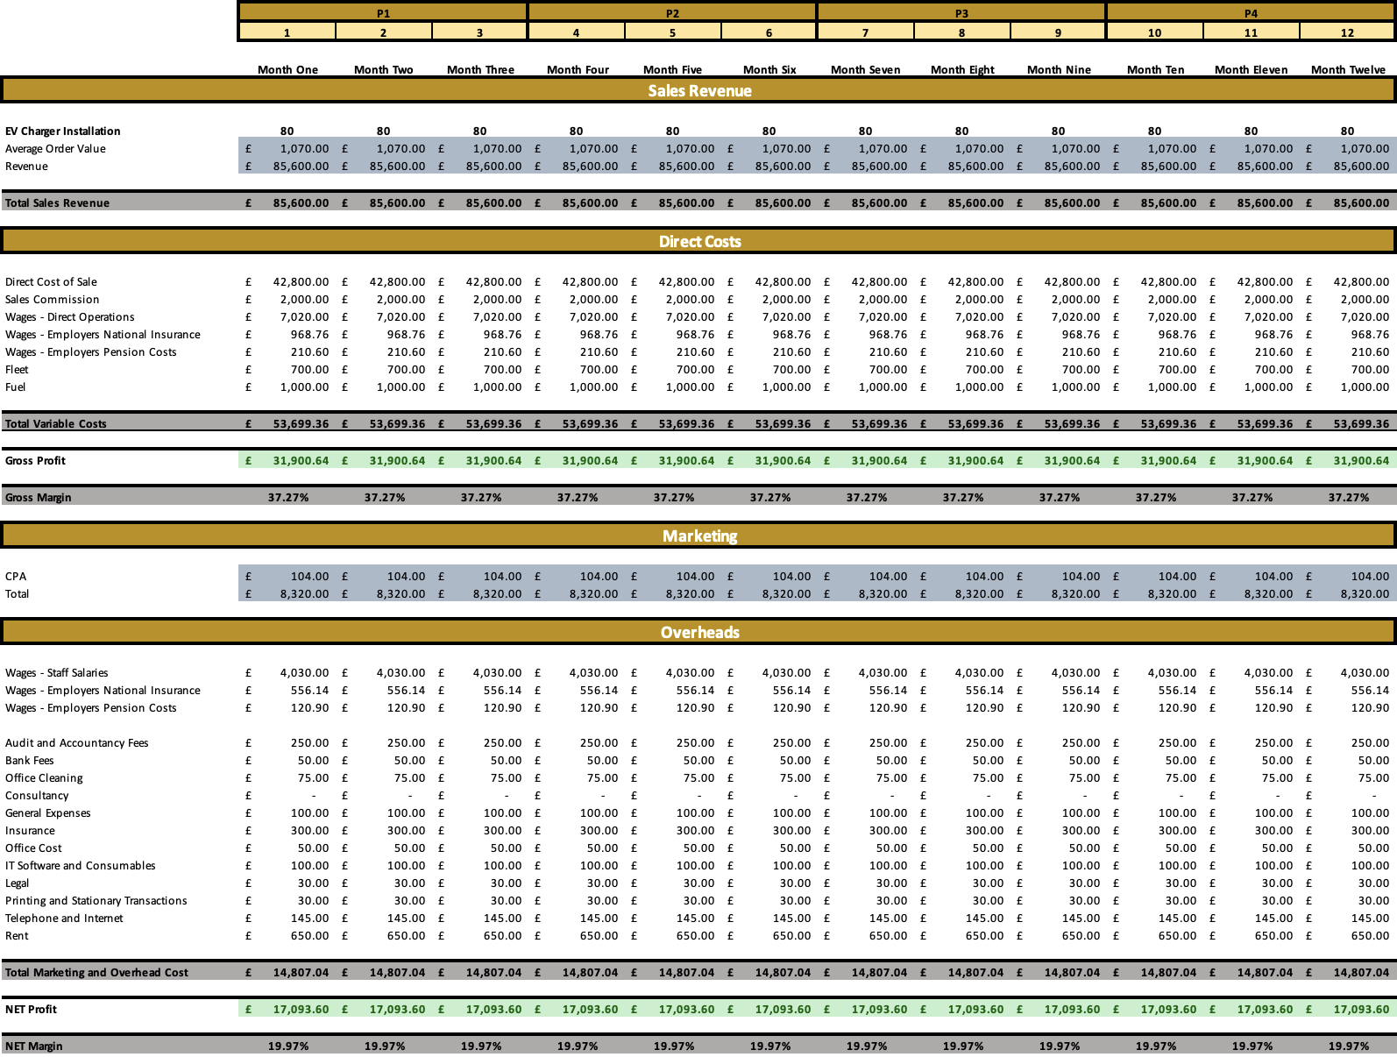

Slide 7
TOP LINE – TERMINOLOGY
Phrase | Description | Example
Units | Number of Installs | 80
Sales Revenue | Units Sold x Order Value | £85,600.00
Average Order Value | Revenue / Units Sold | £1,070.00
Direct Costs | Cost to Business Relative to Sales Activity | i.e Materials, Wages, Fleet and Fuel
Gross Profit (£) | Revenue – Direct Costs | £31,900.64
Gross Profit Margin (%) | Gross Profit (£) / Revenue | 37.27%
“NET” | Before Tax | Not Including VAT

Slide 8
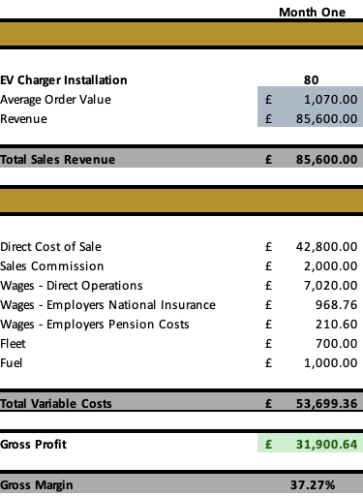
EXAMPLE
USING THE EBB TEMPLATE, THIS IS HOW THE EXAMPLE WOULD BE PLANNED OUT:

Slide 9
BOTTOM LINE – TERMINOLOGY
Term | Description | Example
Marketing CPA | Cost Per Acquisition | £104.00
Marketing Costs | Total Marketing Spend | £8,320.00
Overheads | Expenses Not Dependent on Sales | Rent, Utilities, Admin Staff
NET Profit (£) | Revenue – Total Business Expenses | £17,093.60
NET Profit Margin (%) | Net Profit (£) / Revenue | 19.97%

Slide 10
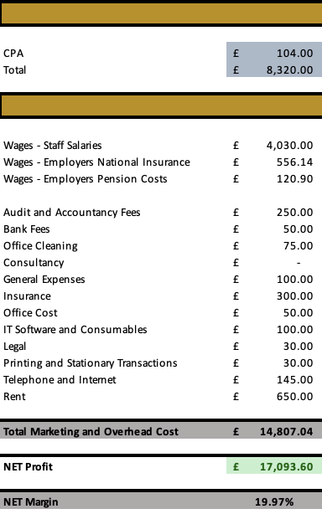
EXAMPLE
USING THE EBB TEMPLATE, THIS IS HOW THE EXAMPLE WOULD BE PLANNED OUT:

Slide 12
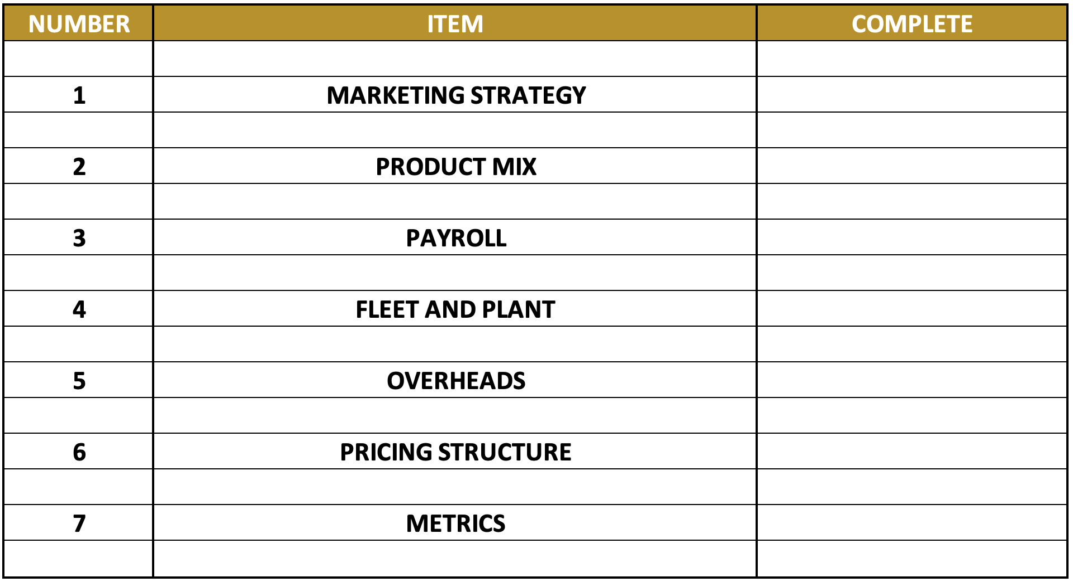
MODEL CHECK LIST

Slide 13
02
SECTION TWO
MARKETING STRATEGY

Slide 14
MARKETING STRATEGY
An overall picture of your marketing activity and spend
Make informed revenue projections based on activity

Slide 15
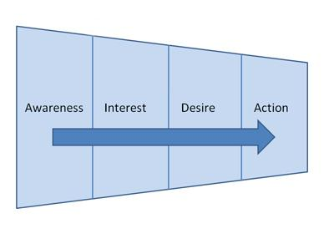
THE FUNNEL
01
UNDERSTAND THE FUNNEL
02
BUILD A STRATEGY

Slide 16
LEAD SOURCE
Lead Source | Number of Leads | Cost Per Lead
Organic | 20 | £0.00
Bark | 120 | £15.00
Napit|Leads | 80 | £50.00
Quotatis | 40 | £35.00
Leads To You | 40 | £85.00
Total | 300 | -

Slide 17
CALCULATING COST PER ACQUISITION

Slide 19
03
SECTION THREE
UNDERSTANDING THE NUMBERS

Slide 20
MEASUREMENT AND CONTROL
01
02
03
HAVE A PLAN
USE THE PLAN TO ESTABLISH KPIs
USE THEM TO ESTABLISH WHAT IS WORKING AND WHAT ISN’T

Slide 21
WHAT GETS MEASURED GETS DONE
IMPROVE YOUR PERFORMANCE BY MEASURING AND CONSTANT REVIEW
WE DO THIS BY HAVING A SET OF BUSINESS METRICS OR KPI’S TO WORK TO
21

Slide 22
METRICS

Slide 23
GO TO LIVE EXAMPLE

Slide 24
MODEL CHECK LIST

Slide 25
IDENTIFIES BREAKDOWN OF YOUR INSTALLS
01
PRODUCT MIX
IDENTIFIES PROFITABILITY OF EACH INSTALL
02
HELPS ESTABLISH YOUR TOTAL PROFIT MARGIN
03

Slide 26
IDENTIFY YOUR MIX
Product | Number | % Mix
> £1000.00 (Small Project) | 24 | 30%
£1000.00 - £1200.00 (Medium Project) | 40 | 50%
£1200.00 + (Large Project) | 16 | 20%
Total: | 40 | 100%

Slide 27
FORUMLA FOR FINDING THE %
PRODUCT UNIT / TOTAL UNITS SOLD x 100

Slide 28
EXAMPLE
24 / 80 x 100 = 30%
SMALL PROJECT

Slide 29
WEIGHTED VALUES

Slide 30
MODEL CHECK LIST

Slide 31
01
SALES STAFF
PAYROLL
02
ENGINEERS
03
ADMIN SUPPORT
31
Notes:
What is business strategy?
A business strategy refers to the actions and decisions that a company takes to reach its business goals and be competitive in its industry. It defines what the business needs to do to reach its goals, which can help guide the decision-making process for hiring and resource allocation. A business strategy helps different departments work together, ensuring departmental decisions support the overall direction of the company.
Why is a business strategy important?
There are several reasons why a business strategy is important for organizations, including:
Planning: A business strategy helps you identify the key steps you will take to reach your business goals.
Strengths and weaknesses: The process of creating a business strategy allows you to identify and evaluate your company's strengths and weaknesses, creating a strategy that will capitalize on your strengths and overcome or eliminate your weaknesses.
Efficiency: A business strategy allows you to effectively allocate resources for your business activities, which automatically makes you more efficient.
Control: It gives you more control over the activities you're performing to reach your organizational goals, as you understand the path you're taking and can easily assess whether your activities are getting you close to your goals.
Competitive advantage: By identifying a clear plan for how you will reach your goals, you can focus on capitalizing on your strengths, using them as a competitive advantage that makes your company unique
Related: Understanding the Basics of Strategy Development
Components of a business strategy
There are six key components of a business strategy. They include:
Vision and business objectives
Core values
SWOT analysis
Tactics
Resource allocation plan
Measurement
Related: Ultimate Guide to Strategic Planning
1. Vision and business objectives
The business strategy is intended to help you reach your business objectives. With a vision for the direction of the business, you can create clear instructions in the business strategy for what needs to be done and who is responsible for it.
2. Core values
The business strategy guides top-level executives as well as departments about what should and should not be done, according to the organization's core values.
3. SWOT analysis
SWOT stands for strengths, weaknesses, opportunities and threats. This analysis is included in every business strategy, as it allows the company to rely upon its strengths and use them as an advantage. It also makes the company aware of any weaknesses or threats.
4. Tactics
Many business strategies articulate the operational details for how the work should be done in order to maximize efficiency. People who are responsible for tactics understand what needs to be done, saving time and effort.
5. Resource allocation plan
A business strategy includes where you will find the required resources to complete the plan, how the resources will be allocated and who is responsible for doing so.
6. Measurement
The business strategy also includes a way to track the company's output, evaluating how it is performing in relation to the targets that were set prior to launching the strategy.
10 business strategy examples
Here are 10 examples of great business strategies.
Cross-sell more products.
Most innovative product or service.
Grow sales from new products.
Improve customer service.
Cornering a young market.
Product differentiation.
Pricing strategies.
Technological advantage.
Improve customer retention.
Sustainability.
1. Cross-sell more products
Some organizations focus on selling more products to the same customer. This strategy works well for office supply companies and banks, as well as online retailers. By increasing the amount of product sold per customer, you can increase the average cart size. Even a small increase in cart size can have a significant impact on profitability, without having to spend money to acquire more new customers.
2. Most innovative product or service
Many companies, particularly in the technology or automotive space, are distinguishing themselves by creating the most cutting-edge products. In order to use this as your business strategy, you will need to define what "innovative" will mean for your organization or how you're innovative.
3. Grow sales from new products
Some companies like to invest in research and development in order to constantly innovate, even with your most successful products.
4. Improve customer service
This can be a good business strategy if your business has had a problem delivering quality customer service. Some companies have even built a strong reputation for having exceptional customer service. Usually, companies have a problem in one specific area, so a business strategy that's focused on improving customer service will usually focus its objectives on something like online support or a more effective call center.
5. Cornering a young market
Some large companies are buying out or merging competitors to corner a young market. This is a common strategy used by Fortune 500 companies to gain an advantage in a new or rapidly growing market. Acquiring a new company allows a larger company to compete in a market where it didn't previously have a strong presence while retaining the users of the product or service.
6. Product differentiation
This is a common business strategy, especially for business-to-consumer (B2C) businesses. They can differentiate their products by highlighting the fact that they have superior technology, features, pricing or styling.
7. Pricing strategies
When it comes to pricing, businesses can either keep their prices low to attract more customers or give their products aspirational value by pricing them beyond what most ordinary customers could afford. If companies plan to keep their prices low, they will need to sell a much higher volume of products, as the profit margins are usually very low. For companies who choose to price their products beyond the reach of ordinary customers, they are able to maintain the exclusivity of their product while retaining a large profit margin per product.
8. Technological advantage
Obtaining a technological advantage, you can often achieve better sales, improved productivity or even market domination. This can mean investing in research and development, acquiring a smaller company to gain access to their technology or even acquiring employees with unique skills that will give the company a technological advantage.
9. Improve customer retention
It's generally far easier to retain a customer than spend money to attract a new one, which is why this is a great strategy if you see opportunities for improvement in customer retention. This strategy requires you to identify key tactics and projects to retain your customers.
10. Sustainability
You could launch an entire business strategy aimed at increasing the sustainability of your business. For example, the objective could be to reduce energy costs or decrease the company's footprint by implementing a recycling program.

Slide 32
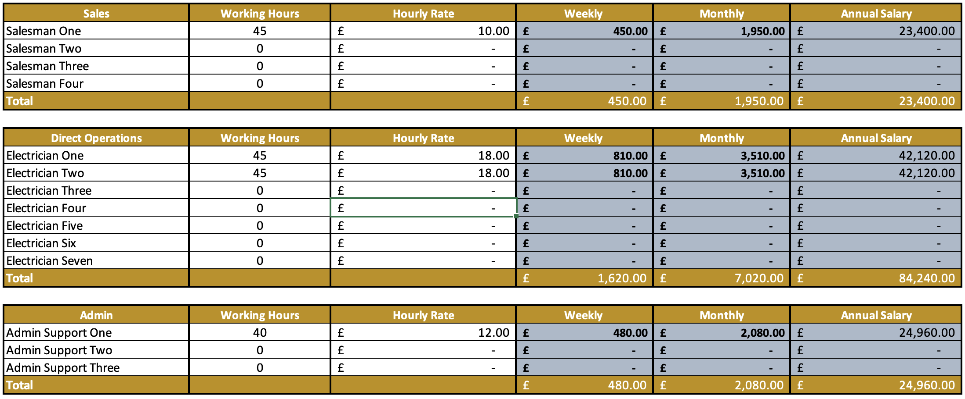
PAYROLL

Slide 33
MODEL CHECK LIST

Slide 34
FUEL AND FLEET

Slide 35
MODEL CHECK LIST

Slide 36
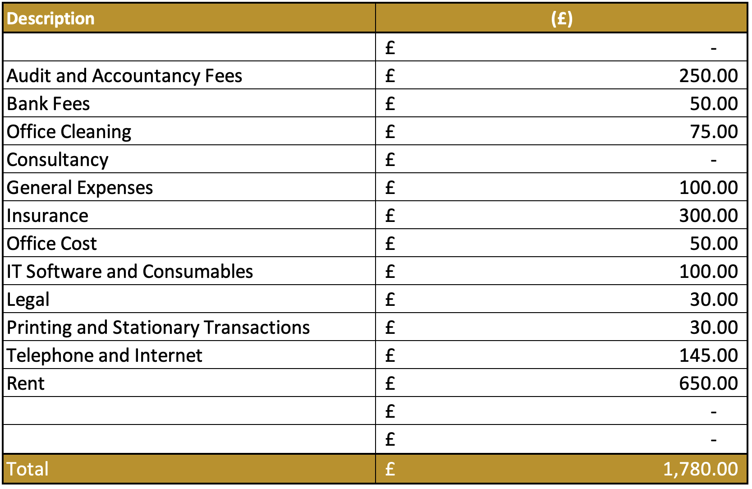
OVERHEADS

Slide 37
IMPORTANCE OF BOOKKEEPING
01
KNOWING YOUR NUMBERS
CHART OF ACCOUNTS
02
MONTHLY MANAGEMENT ACCOUNTS
03

Slide 39
METRICS

Slide 40
GO TO LIVE EXAMPLE

Slide 41
04
SECTION FOUR
PRICING STRUCTURE

Slide 42
COST
01
PRICE
02
VALUE
03

Slide 43
PRICING
UNDERSTANDING HOW TO PRICE YOUR PRODUCTS OR SERVICE
01
02
COST PER SALE
SET PROFIT TARGETS
PRICING SHOULD BE MORE CONSIDERED THAN JUST A RACE TO THE BOTTOM
Notes:
COMPETITIVE PRICE STRATEGY

Slide 44
01
BILL OF QUANTITIES
KNOWING YOUR COSTS
02
SALES COMMISSION
03
LABOUR
It's important to understand your costs before you can consider your profits.
04
REBATES
44

Slide 45
COST OF SALES EXAMPLE
Item | Cost
EV CHARGER POINT | £400.00
CABLE RUN | £50
CIRCUIT BREAKER | £5
LABOUR | £112.77
REBATE | -£50.00
Total | £517.77

Slide 46
MARGIN CALCULATION
Now we have costed our product or service, how do we find our sales price?
£ - %
COST / ( 1 - % )
46

Slide 47
CONVERT MARGIN TO DECIMAL
100% = 1
25% = 0.25
30% = 0.3
44.5% = 0.445
Notes:
COMPETITIVE PRICE STRATEGY

Slide 48
PRICING EXAMPLE
Using our cost of sale example, we will now calculate a 40% gross profit margin.
40 %
£517.77 / (1 - 0.4 ) = £862.95
48

Slide 49
DON’T CONFUSE GROSS PROFIT MARGIN WITH MARK UP
£1,000 @ 40% MARK UP =
£1,400.00
£1,000 @ 40% GROSS PROFIT =
£1,666.67

Slide 50
DON’T CONFUSE GROSS PROFIT MARGIN WITH MARK UP
MARK UP =
£724.88
GROSS PROFIT =
£862.95

Slide 51
SALES COMMISSION AT 5%
01
INCREASE YOUR GORSS MARGIN %
PERCENTAGE COSTS
02
FINAL GROSS PROFIT MARGIN %
03

Slide 53
GO TO LIVE EXAMPLE

Slide 54
05
SECTION FIVE
RECRUITMENT

Slide 55
WHAT IS RECRUITMENT?
01
02
03
CLEAR VACANCY / OUTPUT
GENERATE AWARENESS
PROCESS APPLICANTS
Notes:
Recruitment is attracting and selecting individuals into a job role. Recruiting the right individuals is crucial for organisations who need people with the right skills and capabilities to deliver their goals.
It’s a critical activity, not just for the HR team but also for line managers who are increasingly involved in the selection process. Everyone involved in recruitment must have the appropriate knowledge and skills to make effective and fair recruitment decisions. Now more than ever, organisations need to take a strategic approach to recruitment, selection and talent management.

Slide 56
THE FUNNEL
01
02
THE SAME CONCEPT
RESPECT THE PROCESS

Slide 57
01
SALES STAFF
KEY MEMBERS OF STAFF
02
INSTALLERS
03
ADMIN SUPPORT
57
Notes:
What is business strategy?
A business strategy refers to the actions and decisions that a company takes to reach its business goals and be competitive in its industry. It defines what the business needs to do to reach its goals, which can help guide the decision-making process for hiring and resource allocation. A business strategy helps different departments work together, ensuring departmental decisions support the overall direction of the company.
Why is a business strategy important?
There are several reasons why a business strategy is important for organizations, including:
Planning: A business strategy helps you identify the key steps you will take to reach your business goals.
Strengths and weaknesses: The process of creating a business strategy allows you to identify and evaluate your company's strengths and weaknesses, creating a strategy that will capitalize on your strengths and overcome or eliminate your weaknesses.
Efficiency: A business strategy allows you to effectively allocate resources for your business activities, which automatically makes you more efficient.
Control: It gives you more control over the activities you're performing to reach your organizational goals, as you understand the path you're taking and can easily assess whether your activities are getting you close to your goals.
Competitive advantage: By identifying a clear plan for how you will reach your goals, you can focus on capitalizing on your strengths, using them as a competitive advantage that makes your company unique
Related: Understanding the Basics of Strategy Development
Components of a business strategy
There are six key components of a business strategy. They include:
Vision and business objectives
Core values
SWOT analysis
Tactics
Resource allocation plan
Measurement
Related: Ultimate Guide to Strategic Planning
1. Vision and business objectives
The business strategy is intended to help you reach your business objectives. With a vision for the direction of the business, you can create clear instructions in the business strategy for what needs to be done and who is responsible for it.
2. Core values
The business strategy guides top-level executives as well as departments about what should and should not be done, according to the organization's core values.
3. SWOT analysis
SWOT stands for strengths, weaknesses, opportunities and threats. This analysis is included in every business strategy, as it allows the company to rely upon its strengths and use them as an advantage. It also makes the company aware of any weaknesses or threats.
4. Tactics
Many business strategies articulate the operational details for how the work should be done in order to maximize efficiency. People who are responsible for tactics understand what needs to be done, saving time and effort.
5. Resource allocation plan
A business strategy includes where you will find the required resources to complete the plan, how the resources will be allocated and who is responsible for doing so.
6. Measurement
The business strategy also includes a way to track the company's output, evaluating how it is performing in relation to the targets that were set prior to launching the strategy.
10 business strategy examples
Here are 10 examples of great business strategies.
Cross-sell more products.
Most innovative product or service.
Grow sales from new products.
Improve customer service.
Cornering a young market.
Product differentiation.
Pricing strategies.
Technological advantage.
Improve customer retention.
Sustainability.
1. Cross-sell more products
Some organizations focus on selling more products to the same customer. This strategy works well for office supply companies and banks, as well as online retailers. By increasing the amount of product sold per customer, you can increase the average cart size. Even a small increase in cart size can have a significant impact on profitability, without having to spend money to acquire more new customers.
2. Most innovative product or service
Many companies, particularly in the technology or automotive space, are distinguishing themselves by creating the most cutting-edge products. In order to use this as your business strategy, you will need to define what "innovative" will mean for your organization or how you're innovative.
3. Grow sales from new products
Some companies like to invest in research and development in order to constantly innovate, even with your most successful products.
4. Improve customer service
This can be a good business strategy if your business has had a problem delivering quality customer service. Some companies have even built a strong reputation for having exceptional customer service. Usually, companies have a problem in one specific area, so a business strategy that's focused on improving customer service will usually focus its objectives on something like online support or a more effective call center.
5. Cornering a young market
Some large companies are buying out or merging competitors to corner a young market. This is a common strategy used by Fortune 500 companies to gain an advantage in a new or rapidly growing market. Acquiring a new company allows a larger company to compete in a market where it didn't previously have a strong presence while retaining the users of the product or service.
6. Product differentiation
This is a common business strategy, especially for business-to-consumer (B2C) businesses. They can differentiate their products by highlighting the fact that they have superior technology, features, pricing or styling.
7. Pricing strategies
When it comes to pricing, businesses can either keep their prices low to attract more customers or give their products aspirational value by pricing them beyond what most ordinary customers could afford. If companies plan to keep their prices low, they will need to sell a much higher volume of products, as the profit margins are usually very low. For companies who choose to price their products beyond the reach of ordinary customers, they are able to maintain the exclusivity of their product while retaining a large profit margin per product.
8. Technological advantage
Obtaining a technological advantage, you can often achieve better sales, improved productivity or even market domination. This can mean investing in research and development, acquiring a smaller company to gain access to their technology or even acquiring employees with unique skills that will give the company a technological advantage.
9. Improve customer retention
It's generally far easier to retain a customer than spend money to attract a new one, which is why this is a great strategy if you see opportunities for improvement in customer retention. This strategy requires you to identify key tactics and projects to retain your customers.
10. Sustainability
You could launch an entire business strategy aimed at increasing the sustainability of your business. For example, the objective could be to reduce energy costs or decrease the company's footprint by implementing a recycling program.

Slide 58
DEFINING THE ROLE
The first stage in the recruitment process is defining the role you want to recruit for
When defining the role, you should analyse these four key areas;
The job’s purpose and what roles and responsibilities are involved
Daily, Weekly, Monthly
What KPIs that they should be accountable for.
How they fit into the organisation’s structure.
KNOW THE ROLE INSIDE OUT

Slide 59
01
JOB TITLE
02
LOCATION
03
JOB PURPOSE
JOB DESCRIPTION CHECKLIST
04
ROLES AND RESPONSBILITIES
05
QUALIFICATIONS
06
SALARY/BENEFITS
59
Notes:
A job specification should include:
The job title & position in the company, including line manager and any other members of staff reporting to them.
The location of the job
A job purpose
A list of the main duties and responsibilities
Essential & Desirable skills/qualifications
Salary and benefits
Examples of typical projects to help to illustrate the requirements

Slide 60
01
ABILITIES
02
QUALIFICATIONS
PERSON SPECIFICATION CHECKLIST
03
EXPERIENCE
04
CHARACTER TRAITS
05
ACHIEVEMENTS
60
Notes:
A person specification should include:
The technical, organisational, communicative and creative skills and abilities you expect from an ideal candidate
Any specific qualifications or education required for the role
The level of experience needed in either similar organisations or equivalent roles
The kind of personality that would fit in with your team Character traits that are likely to help them to do the job effectively
Any preferred achievements, eg volunteering

Slide 61
JOB SEARCH SITES
Job search sites are an absolute must when advertising your vacancy
They have become the first port of call for jobseekers, here are the main job search sites;
INDEED
MONSTER
REED
TOTALJOBS
GLASSDOOR
JOBSITE
61
Notes:
As soon as you have a vacancy, you should be posting it to job search sites straight away.
Many job-seekers use these as their first port of call now, so you would really be missing out if you aren’t using them. You can post your vacancy for free but in order to maximise your visibility, it is recommended to put some money behind your advert.
This ensures that you stay at the top of relevant job searches and don’t get lost in the sea of vacancies, and you are able to put as much or as little budget behind it as you want. You can also narrow the search to ensure you’re hitting the right type of candidate.
Using job search sites also enables you to track your advert, you can easily organize applications and can keep track of which candidates you might want to progress to the next stage of the process.

Slide 62
SOCIAL MEDIA
Social media has become a really good way of advertising your job vacancies.
As well as reaching more people, you are also reaching out to those who are already familiar with your business.
USE EVERYTHING YOU HAVE AT YOUR DISPOSAL
Support job posting on jobsites using social media
62
Notes:
Social media is a great way of advertising a role and has become increasingly important for those looking for work.
Facebook, Twitter, Instagram and especially LinkedIn are used by potential candidates, so make sure you post your vacancy across every channel you have a presence on.
As well as the obvious benefit of reaching more people, you may find some candidates who are already familiar with your business. These may be people who like what you do, have been a customer in the past, know who you are through word of mouth, all of which would be beneficial in terms of getting to know you and your business.

Slide 63
OUTSOURCING
IS USING A RECRUITMENT AGENCY THE RIGHT THING FOR YOU?
Get an idea of costs and weigh up whether using an agency is worth it, or whether it would be more cost-effective to handle the process yourself.
63
Notes:
Don’t rush in and use the first agency you talk to. First of all, decide whether using an agency is the right thing to do. Weigh up the benefits against the cost, is it something you could handle yourself or would the expertise of an agency make a huge difference?

Slide 64
CHOOSING THE RIGHT
AGENCY FOR YOU
The right agency will know how to find the candidates you are looking for and have a proven track record in your industry.
Make sure that the agency has a very precise brief from you in what you’re looking for.
Notes:
Remember that the agency will be the ones finding your next employee, so it’s vital that you select the right agency for you and that you can work with them.
Consider their experience and how well they know your industry.
Do they have a proven track record in your field?
Do they have a database of candidates that are already looking for work?
Do they understand the type of candidate you’re looking for?
Build a relationship with your agency so they understand your business and who would and wouldn’t fit in with you.

Slide 65
BUILD A RELATIONSHIP
Your agency will be the first impression a candidate gets of your business, make sure they know you inside out.
Notes:
You want to build a healthy relationship with your agency, they should know your business inside and out and be able to identify who would and wouldn’t fit in with it.
The last thing is you want is to be paying someone to find you the wrong candidates, so make sure you get to know your account managers and they can represent your business well to prospective employees.

Slide 66
USE THEIR KNOWLEDGE
Many recruitment companies specialise in the construction and trade industry, use their knowledge!
A good recruitment company will stay in regular contact with talents in their industry, so they should already have an idea of suitable candidates when you brief them.
Notes:
A good recruitment partner should understand your industry as well as you do and be able to offer up that knowledge in order to assist your business to get the right candidate. Don’t be afraid to let them take the lead on finding candidates and trust them to know the industry well enough to make the right call for you.

Slide 67
FILTERING AND FINDING THE RIGHT CANDIDATE
Let them do the leg work! If you have over 200 applicants for a role, going through every CV and application can be incredible time consuming.
YOU DON’T HAVE TO DO IT!
67
Notes:
If you are running your business, finding the time to look at hundreds of CV’s and job applications can be impossible, never mind filtering the right candidates to the next stage.
Outsourcing your recruitment means you don’t have to, your agency will do the hard work for you and present you with only the best candidates who are worthy of the next stage.

Slide 68
LET THEM HAVE THE
HARD CONVERSATIONS
The hiring process can be fraught with difficult conversations, sometimes ones you don’t want to have yourself.
Salary negotiations
Sensitive information
Change of circumstances
Notes:
The hiring process doesn’t always run smoothly and you may need to have some difficult and sensitive conversations. Having an agency have those conversations for you can mean you stay out of any awkward disputes that may impact your working relationship with the candidate in the future.

Slide 69
CHANGE IT UP
You don’t have to do the same thing every time you are looking to recruit. Sometimes you may have a more specalised role that requires the help of an agency, others you may be able to do yourself.
69

Slide 70
CHOOSING THE RIGHT PEOPLE FOR INTERVIEW
You’ve advertised your role, got dozens of applications and now you need to start the interview process. Make sure you are choosing the right people!
Notes:
Once you have closed your advert, the next step is reviewing the applications and choosing which candidates you would like to take to the interview process.
This is where you need to know exactly what you are looking for and review every application thoroughly, because those that you take to interview are where your next employee is. Be really clear on what you’re looking for and analyse each application based off the criteria you have set, and try not too select too many people for interview. You ideally don’t want any more than 8-10 candidates for a telephone interview.

Slide 71
SCREENING
Admin support to contact all shortlisted applicants and schedule 10 – 15 minute call with the employer.
Notes:
Once you have chosen the candidates that you’d like to interview, let them know as soon as possible that you’d like an initial interview with them. This conversation doesn’t have to go into too much detail about the role but is more a chance for you to find out more about their personality and about their experience.
It’s an opportunity for you to get an initial impression of the candidate and to see whether they can back up and elaborate on what they have put in their application/CV.
Once you have had an initial conversation, select your most favoured candidates for an in-person interview. The second interview gives you the chance to talk more specifically about the role and how the candidates would fit in, how suitable they would be and whether they are a good fit for you and your business. You want to try and interview 4-5 people in person.

Slide 72
FIRST PHASE
The first interview is often on the phone and is the quickest way to shortlist suitable candidates
Use this phase to walk them through their CV, discussing their skills and experience.
Notes:
Once you have chosen the candidates that you’d like to interview, let them know as soon as possible that you’d like an initial interview with them. This conversation doesn’t have to go into too much detail about the role but is more a chance for you to find out more about their personality and about their experience.
It’s an opportunity for you to get an initial impression of the candidate and to see whether they can back up and elaborate on what they have put in their application/CV.
Once you have had an initial conversation, select your most favoured candidates for an in-person interview. The second interview gives you the chance to talk more specifically about the role and how the candidates would fit in, how suitable they would be and whether they are a good fit for you and your business. You want to try and interview 4-5 people in person.

Slide 73
SECOND INTERVIEW
This is the final stage before hiring, so it is so vital to get this interview right.
Use this interview to ask scenario questions to gauge attitude of the individual
Notes:
Once you have had an initial conversation, select your most favoured candidates for an in-person interview. The second interview gives you the chance to talk more specifically about the role and how the candidates would fit in, how they would deal with certain scenarios, how suitable they would be and whether they are a good fit for you and your business. You want to try and interview 4-5 people in person.
This is the last time you will meet a candidate before making your decision, so here you want to be absolutely sure that you are asking the right questions and getting the right information from them.

Slide 74
WHAT TO LOOK OUT FOR DURING INTERVIEWS
- 01 -
- 02 -
PUNCTUALITY
PRESENTATION
- 03 -
- 04 -
DOES THEIR CV STACK UP?
THEIR INTEREST IN YOU
Notes:
Interviews often show up red flags in a candidate, and there are plenty of things to look out for.
Are they on time? If they can’t be on time to an interview, will they be on time for work?
Are they well presented? Have they made an effort with their appearance and how they are presenting themselves to you?
Does their CV stack up? Have they been totally truthful on their CV?
Do they show interest in you and your busines or are they just after any old job?

Slide 75
CLOSING THE DEAL
DON’T WAIT TO MAKE AN OFFER
FORMAL WRITTEN OFFER
01
02
MAKE SURE BOTH PARTIES ARE HAPPY
AGREE START DATE
03
04
Notes:
When you’ve found the right person, don’t hesitate. Make them a good offer quickly, you don’t want to wait too long and miss the boat. Offer them the best package you can, and if the money isn’t good enough then get creative – what other benefits can you give them? Finally, make sure both you and they are happy with the deal.

Slide 76
06
SECTION SIX
EMPLOYED v SELF EMPLOYED

Slide 77
WHAT’S A SUB-CONTRACTOR?
Likely to;
Be paid per job or for a specific time period
Invoice for the work they do
Be responsible for their own tax/NI
Have their own professional insurance
Work for other companies
Use their own equipment/tools

Slide 78
WHAT’S AN EMPLOYEE?
01
Has to accept the work given
03
Recognise good work
Paid hourly, weekly or annually
02
Entitled to SSP/holiday pay
04
Tax/NI paid by employer
Notes:
will be obliged to accept work offered and the employer must provide work
will be subject to more control over how they perform their work
may be subject to restrictions around working for other people during and after their employment
must work exclusively for their employer, at a location and for a time period determined by the employer
won’t be able to get someone else to do the work for them
will likely be paid by the hour, week or month, based on an annual salary or hourly rate agreed at the start of the employment.

Slide 79
BENEFITS OF USING SUB-CONTRACTORS
A specialised skill-set
Less HR admin
Can be more objective
Flexible
Good for urgent projects
Less obligations
Minimises risk of a bad hire
Notes:
A specialized skill set: Contractors can bring skills and talent to the organisation that you may not need to access on a day-to-day basis.
Less HR admin: You won’t have to organize PAYE or contribute to National Insurance for contractors as they’ll be responsible for dealing with this themselves. And as they won’t benefit from sick pay or holiday, you won’t have to manage the HR admin that comes with this.
Good for urgent or temporary work demands: If you need help fast, someone with specific skills who is ready to do the job can be a great help. They won’t need to have an induction (although you will need to cover some basics), get to know the business or undertake any training – they’ll be able to get stuck in to the work right away.
Flexibility: If you find that the contractor you’re working with doesn’t quite have the skills to meet your current need, there’s more flexibility around issuing notice and terminating the relationship. Essentially, it’s far easier to replace them with someone more suitable, than if they were an employee.
Minimise the risk of an inappropriate hire: If you’re unsure about the most appropriate hire for your current business needs, or whether there’s enough work to employ someone on a permanent basis, taking someone on as a contractor can help you to test out and better define the role you need. This will either help you to shape the role you recruit for, or you might decide to offer a permanent position to the contractor (re-issuing employment contracts, of course!)
Less obligations as an employer: You won’t be obliged to continue supplying work and paying contractors if demand in work load reduces, or if their circumstances change. For example, if they want to take maternity or shared parental leave, you wouldn’t have to keep the role open for them or make statutory payments.
Competitive advantage: Working with highly skilled specialists, who’ve had a lot of different experiences and insights from within their industry might help you to gain a competitive edge.

Slide 80
BENEFITS OF HIRING EMPLOYEES
Greater control
Builds loyalty
Availability
Consistency
Good for team morale and culture
Brand Credibility
Notes:
Set KPI’s and objectives, it’s the easiest way of tracking performance. Make sure the KPI’s are achievable and realistic, but not easy.

Slide 81
WHEN DOES A CONTRACTOR BECOME AN EMPLOYEE?
You’re defining the hours they work
They’re using your company’s equipment rather than their own
There’s no contract covering the work they’re currently carrying out
You’ve requested that they work solely for you
Notes:
Regardless of what’s written on paper, it’s the working arrangement that determines employment status and you must be careful to not use someone as a sub-contractor if they have become an employee.
There’s no contract covering the work they’re currently carrying out
There’s an expectation that you’ll keep providing them with work, and that they’ll be available to perform it
There’s no clear completion date or definitive end to the project
They’ve ended up on payroll

Slide 82
WHY DOES IT MATTER?
While it might be easy to differentiate between sub-contractors and employees as a small business working project by project, as you grow it will get more difficult and you don’t want to get caught up in disputes with HMRC down the line.
Notes:
If a contractor ends up working under terms that resemble that of an employee, they also acquire the employment rights of an employee, including a right to holiday and sick pay.
If you’ve built a strong and positive relationship with a contractor, it can be difficult to imagine that they’d ever press claims against you. But it’s not unheard of for contractors-turned-employees to try to claim back, through the courts, the pay they’ve missed out on. In such a situation you’re also likely to be liable for backdated National Insurance taxes and PAYE. Arguably, it’s a risk not worth taking.

Slide 83
FORMALITIES
PAYE Tax Bill Monthly
Employee Handbook
13.8% Employers NI
Employee Contract
Notes:
Bullying and harassment
Discipline/dismissal and grievance (this must be in writing)
Equality and diversity
Health and Safety (if you have more than five employees; in writing)
Maternity / paternity / adoption
Pay
Redundancy
Smoking, drugs and alcohol
Whistleblowing / protected disclosure
Working time and time off
Data Protection Act 2018 (1998) and General Data Protection Resolution 2018

Slide 84
07
SECTION SEVEN
INFRASTRUCTURE BUILDING

Slide 85
CREATING INFRASTRUCTURE
IDENTIFY CORE ACTIVITIES
ORGANISE EMPLOYEES AND RESOURCES
PLAN FOR GROWTH

Slide 86
01
IDENTIFY FUNCTIONS
HOW TO CREATE AN ORG CHART
02
IDENTIFY KEY ROLES
03
THINK 1 YEAR AHEAD
04
INDIVIDUAL CAN HAVE MULTIPLE ROLES

Slide 87
TYPICAL BUSINESS FUNCTIONS
- 01 -
- 02 -
SALES AND MARKETING
OPERATIONS
- 03 -
- 04 -
FINANCE
MANAGEMENT INFORMATION SYSTEMS

Slide 88
ORGANISATIONAL STRUCTURE

Slide 89
01
ESTABLISH FUNCTIONS
02
REMEMBER
IDENTIFY KEY ROLES
03
PLAN AHEAD
04
USE IT TO IDENTIFY RECRUITMENT NEEDS

Slide 90
01
LEAD GENERATION
SALES AND MARKETING
02
QUALIFICATION
03
PRICING AND SURVEYING
04
CONVERTING TO ORDER

Slide 91
01
PROJECT MANAGEMENT
02
DELIVERY
OPERATIONS
03
CUSTOMER SERVICE
04
TRAINING

Slide 92
01
DEBTORS PROCESS
02
BOOKKEEPING
FINANCE
03
FORECASTING
04
FUNDING

Slide 93
MANAGEMENT INFORMATION SYSTEMS
01
PEOPLE
02
PROCESSES
03
TECHNOLOGY
04
REPORTING

Slide 94
08
SECTION EIGHT
SYSTEMS AND PROCESSES

Slide 95
PROCESSES
Manually record processes first
Systemize to automate

Slide 96
CREATE A ROADMAP
BRAINSTORM
OUTLINE THE JOURNEY
01
02
CONSIDER THE CUSTOMER
ORGANISE INTO FUNCTIONS
03
04

Slide 97
THE CONVEYOR BELT
01
02
03
04
05
Enquiry Comes In
Qualification Call
Survey Scheduled
Follow Up Call Made
Order Placed
06
07
08
09
10
Customer Confirmation Call
Procurement
Works Scheduled
Quality Control and Follow Up
Invoice Raised and Settled

Slide 98
THE ROLE OF SOFTWARE
CREATES THE BASIS OF THE “CONVEYOR BELT”
MOVE AWAY FROM MANUAL PROCESSES
01
02
MANAGEMENT INFORMATION
DATA AND ARCHIVING
03
04

Slide 99
PILLARS OF SOFTWARE
FINANCE AND MANAGEMENT INFORMATION
LEAD AND SALES MANAGEMENT
PROJECT MANAGEMENT

Slide 100
01
START WITH OPERATIONAL DESIGN
MAKING A DECISION ON SOFTWARE
02
DISTILL REQUIREMENTS
03
Deciding on software is an important step.
IDENTIFY INDUSTRY LEADERS
04
DEMO AND SHORTLIST
100

Slide 101
01
IMPLEMENT BY PILLAR
AVOIDING STANDARD MISTAKES
02
SPLIT TEST
03
TEAM BUY IN AND TRAINING
04
MANAGE EXPECTATIONS
101

Slide 102
SOFTWARE AUTOMATIONS CHECKLIST
01
02
03
04
05
INBOUND COMMUNICATIONS
CUSTOMER SERVICE TICKETS
QC AUDITS
BACKUP AND ARCHIVE
SALES ORDER
06
07
08
09
10
INVOICING
TIMESHEETS
DEBTORS MANAGEMENT
SCHEDULE MANAGEMENT
PROCURMENT

Slide 103
RECOMMENDED SOFTWARE

