Slide 2
April 11, 2022 Men, Gender, and Trauma Supporting Men in Recovery
David Stanley, MSW, LCSW Director of Trauma Integration Services

Slide 3
Objectives:
Describe how gender messages and expectations affect male psychosocial development
Identify the challenges these messages and expectations present in the treatment of substance use disorders
Describe how the use of gender role analysis may benefit men in treatment for a substance use disorder
Notes:
There are five objectives for this module. At the end of this module participants should be able to:
Describe current rates of trauma among men in treatment for a substance use disorder or who are incarcerated
Explain how gender messages and expectations affect male psychosocial development
Identify the challenges these messages and expectations present in the treatment of substance use disorders
Describe how the use of gender role analysis may benefit men in treatment for a substance use disorder
Demonstrate at least one gender role analysis psychoeducational, experiential, and relational intervention.

Slide 4
A Trauma Informed Lens
Individual
Trauma and resiliency factors
Gender norms and expectations
Notes:
We will explore this topic with a trauma informed lens, by viewing the behavior in the context of trauma histories and coping resources as well as cultural, political and economic factors.

Slide 5
We are saturated in gender
Messages, rules, and expectations
Notes:
For most of us gender is something we usually do not give much thought to. Even though our society is saturated with messages, rules, and expectations about gender, gender identity and gender expression, we are usually not aware of them. They are not in our immediate consciousness even though they have a strong influence on our relationships to others and to ourselves. Take the example of the air around us. It is always there, but we don’t usually think of it until something draws our attention to it. We can’t really see it, but we know it is there because of its impact. So, to understand gender is to understand the air around us and the impact it has on our daily lives.

Slide 6
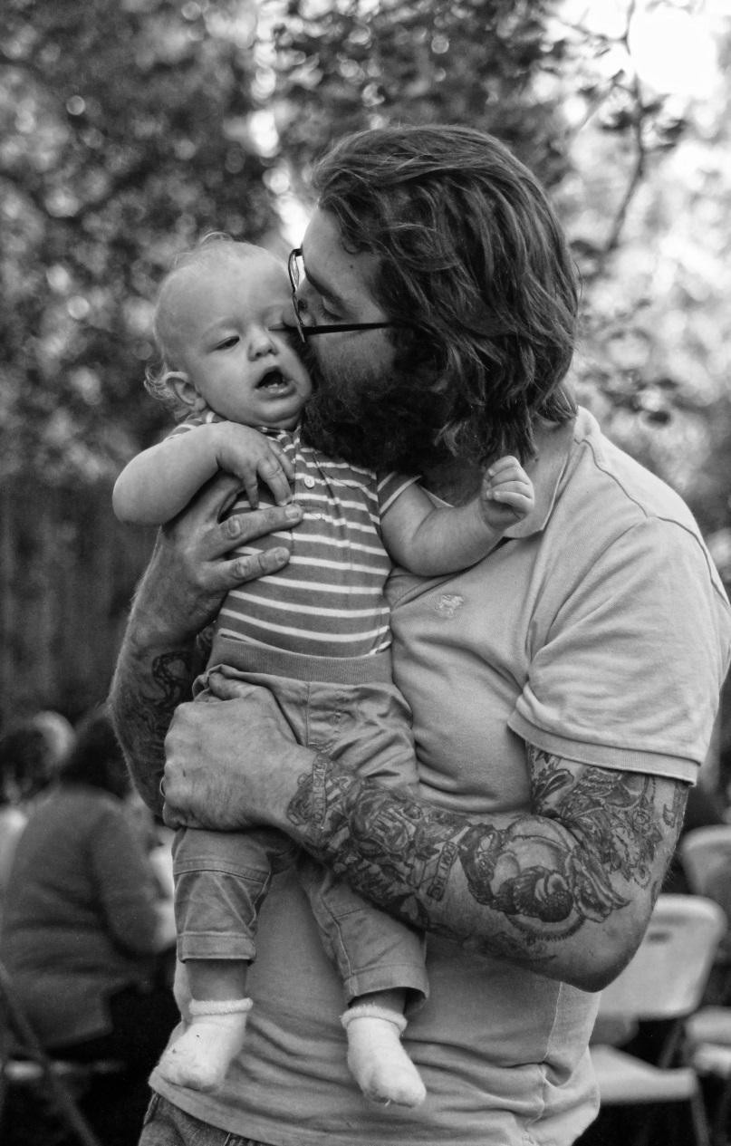
Gender Socialization
Cisgender
Boys
Girls
Notes:
So, when do boys start learning to be boys and girls to be girls? Gender socialization begins at birth. With medical technology available that can tell us the sex of the child even while in the womb, many would argue that gender socialization begins even before a baby is born. Once born, boys are usually dressed in blue and girls in pink. Each begins receiving implicit and explicit messages about gender. And as we shall see, the way adults interact with children can vary greatly according to the gender of the child.

Slide 7
Gender is fluid
“Male / Masculine”
“Female / Feminine”
At work
Taking care of daughter
Teenage
Middle-aged
Notes:
People often think of gender as binary. That is, they think of gender in black and white terms, such as male and female. What science is now beginning to tell us challenges that view. A new view of gender has emerged in which gender isn’t seen as black and white, but is viewed as existing along a spectrum or continuum. For example, none of us expresses only so-called masculine qualities or so-called female qualities. All that we are and do is a mixture of both. We all tend to move back and forth along this spectrum throughout each day and throughout our lives.

Slide 8
Why I Cringe at “Gender Reveal” Parties
Sex at birth is not gender
Gender is up to the individual
Sets unreasonable binary expectations

Slide 9
Gender Socialization
More likely to see them as "angry or distressed"
Perceive male infants as more "happy and socially engaged" when they mistakenly believe they are girls
Female: Scared
Male: Angry
(Begley, 2009; Poljac, Montagne, & Haan, 2010; Real, 1998)
Notes:
There are some differences in how caregivers interact with their children based on gender. For example, studies have shown that when baby girls are presented to adults as "boys," the adults are more likely to see them as "angry or distressed." Adults perceive male infants as more "happy and socially engaged" when they mistakenly believe they are girls. When a group of over two hundred adults was shown a video of the same baby crying, but given differing information about the baby’s sex, they described the “female” baby as scared and the “male” baby as angry.
Perhaps because of these stereotypes on average boys are spoken to less than girls, comforted less, and nurtured less.

Slide 10
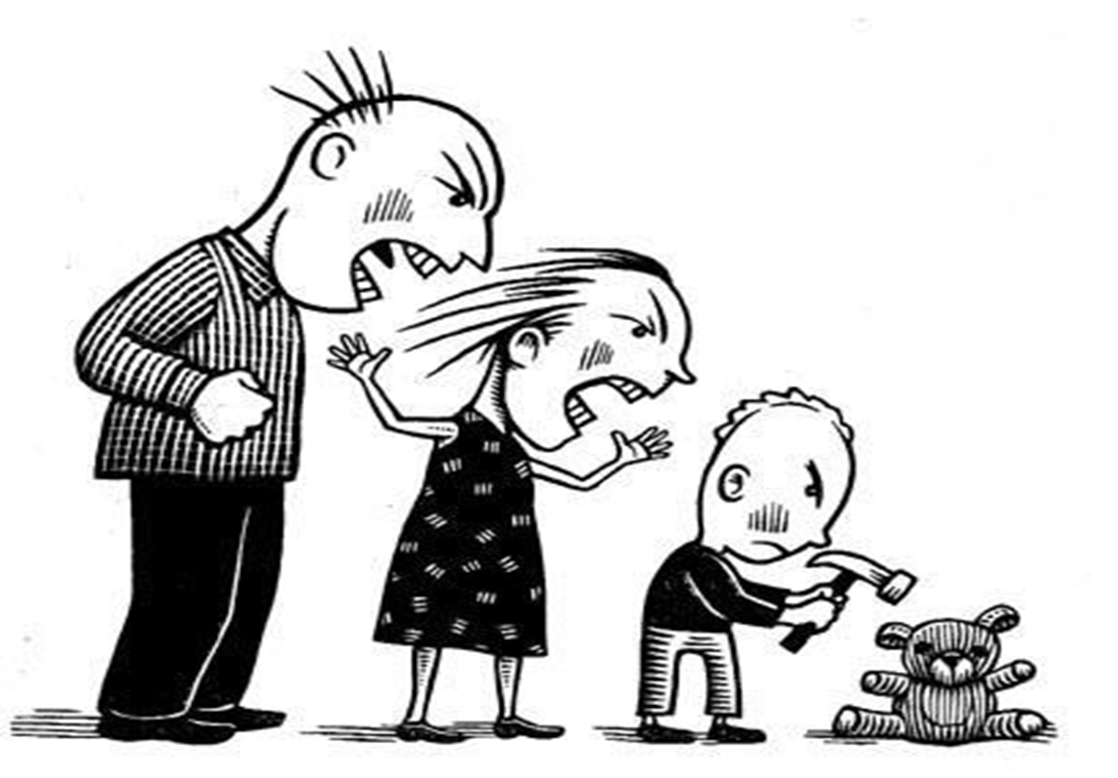
Nature or Nurture?
Weak
Vulnerable
Fear
Despair
“Don’t be a sissy!”
“Boys don’t cry!”
Shame
Anger
(Dutton, 2007)
Notes:
So how do masculine gender expectations interact with experiences of trauma?
Let’s look at the life of a young boy who is experiencing physical and emotional abuse at the hands of his primary caregivers.
He feels weak and vulnerable, fear and despair, but is not allowed to express or validate these so-called weaker emotions. Due to the conflict between what he feels and what society says he should not feel he experiences shame. If he dares to express those emotions, then he may experience shame because of what he feels and shame because of what he expressed and that expression may result in further victimization from others.
In response, and as a way to maintain safety, he transforms and denies these so-called feminine emotions. He transforms them by putting them through an emotional funnel and out of that funnel comes what is acceptable in his gendered world: anger.

Slide 11
Functions of Anger
Energize behavior
Expression
Communication
Defense
Sense of strength
Removal of aversive stimulus
Generates sense of safety
Notes:
Anger may serve several functions including energizing behavior, expression and communication, and defense. It may generate a sense of strength and potency, and lead to the removal of the aversive stimulus through aggressive behavior and posturing. In simple terms, the feelings of strength and potency he gains through expressions of anger provide him with a sense of safety. Expressing anger may also provide a sense of safety by keeping potential threats at bay.
As a result, a man may begin to externalize the causes of his inner conflict and any emotions associated with weakness and vulnerability. He may come to express only anger even though underneath that anger there may be deeper more vulnerable feelings. He can begin to resent those things in his life that are associated with weakness and vulnerability and, in many cases, treat them with aggression.

Slide 12
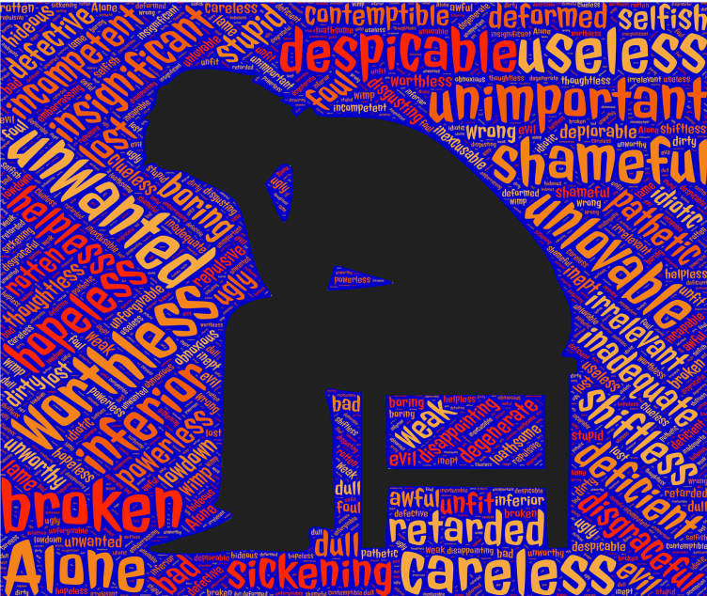
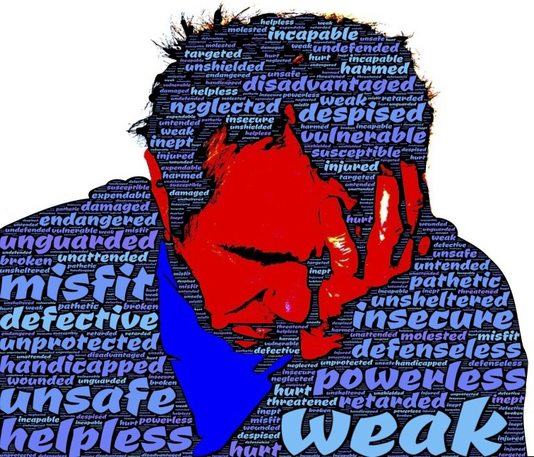
The Role and Impact of Shame
Enforcement of gender norms:
Intense emotional pain
Feeling of wanting to hide parts of oneself
Feeling that the self is bad, unworthy and deficient
Does not promote positive action or interpersonal connection
External
Internal
(Reilly, Rochlen, & Awad, 2013; Shepard & Rabinowitz, 2013)
Images source: johnhain at Pixabay.com
Notes:
As we saw in the previous example, shame plays a critical role in men’s psychosocial development. Masculine gender norms are often taught and enforced through the use of shame.
Shame has been described as a complex psychological construct that includes intense emotional pain, including the possibility of anger and rage against self and/or others; a feeling of wanting to hide; and the feeling that the self is bad, unworthy and somehow deficient (Shepard & Rabinowitz, 2013).
Shame may be considered a maladaptive, or unhelpful emotion since it does not promote positive action nor does it promote interpersonal connection.

Slide 13
Gender Norm Enforcement
I’m glad it’s not me!
Homo!
PUNCH!
Queer!
SHAME
Stepping out of gender norms and expectations is not safe.
(Carney, 2008; Shepard & Rabinowitz, 2013).
Notes:
Shame can play a powerful role in how gender norms are enforced. Both girls and boys are taught to conform to gender role norms by being shamed by their peers as well as their parents or primary caregivers when they violate them. They learn to conform to these norms through “repeated humiliations and reprimands when they behave in behavior outside these norms” (Shepard & Rabinowitz, 2013, p 452).
If, for example, a boy in school is perceived as feminine, he is labeled “queer.” If a girl decides to take a leadership role, she may be labeled “bossy”. In both cases, the mechanism through which gender norms are enforced is shame.

Slide 14
The Impact of Trauma: Thinking
Female
Feminine
Don’t
Bad
Devalue
Male
Masculine
Do
Good
Value
Notes:
Through gender expectations and relational maps men may begin to regard those parts of themselves and their world that are feminine as bad and those that are masculine as good, resulting in a tendency to devalue the feminine within himself, within others, and within the world.
We are all a mixture of masculine and feminine qualities. When we deny or devalue one gender over another, we devalue part of ourselves. We disconnect from a part of what makes us whole. When men hear or experience their inner feminine, let’s say a desire to feel emotionally intimate, to be creative, or a desire to be held and soothed, they may feel shame. Instead of validating the feelings and experiences of their inner feminine, men often deny and invalidate them.

Slide 15
Boys will be boys?
86% of all juveniles in residential juvenile detention placement
75% of student suspensions, expulsions, grade failures, special education referrals, school violence casualties, and all other assaults
(Black, et al., 2011; Covington, Griffin, & Dauer, 2011; Litz & Schlenger, 2009)
Notes:
It means seeing each individual in the context of his or her experiences while viewing substance use and other harmful behaviors as attempts to cope. We all know the familiar saying “boys will be boys.” Bullying, getting into trouble, rebelling, and breaking the law are often considered normal and desirable behaviors for young males. These gender norms, as accepted as they are, may be disrupting their development and putting them at increased risk of trauma. Consider the fact that boys represent 86% of all juveniles in detention placement. Boys also represent 75% of all student suspensions, expulsions, grade failures, special education referrals, school violence casualties, and all other assaults. When looking at this with a trauma informed lens we might ask if these behaviors, rather than be a gender norm, are actually attempts to cope with trauma.
Whether getting into trouble results from a child’s desire to be perceived as tough, as a result of risk taking, or as a result of uncontrolled anger, it can have serious implications for child development and may significantly increase the risk of experiencing trauma. Researchers found that exposure to childhood adversity increased the risk of developing Post Traumatic Stress Disorder (PTSD) later in life.

Slide 16
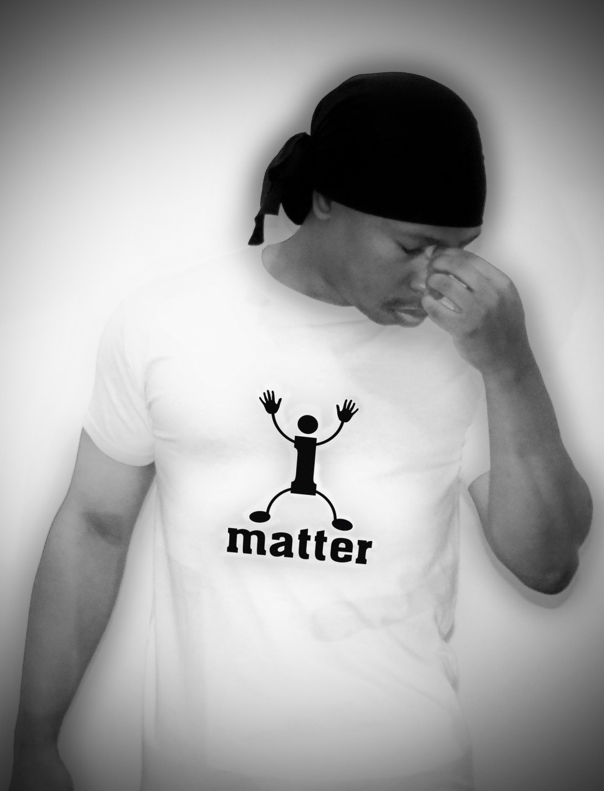
As adults
70% of suicides
76% of people living with HIV
72% victims of robbery
75% of chronically homeless
>96% of people fatally shot by police
73% of fatal drug overdoses
>2 million men in the U.S. have experienced a sexual assault or rape
(Black, et al., 2011; Litz & Schlenger, 2009)
Notes:
Now let’s shift our focus onto men in adulthood. When we shift our focus onto adult males we find some pretty startling statistics. As adults men represent 70% of suicides, 76% of people living with HIV, 72% victims of robbery , 75% of chronically homeless , >96% of people fatally shot by police, 73% of those who have died of a drug overdose and approximately 2.78 million men in the US have experienced sexual assault or rape.
Clearly trauma has had a significant impact on the lives of many men, but it has not been until recently that this impact has begun to be fully acknowledged and addressed.

Slide 17
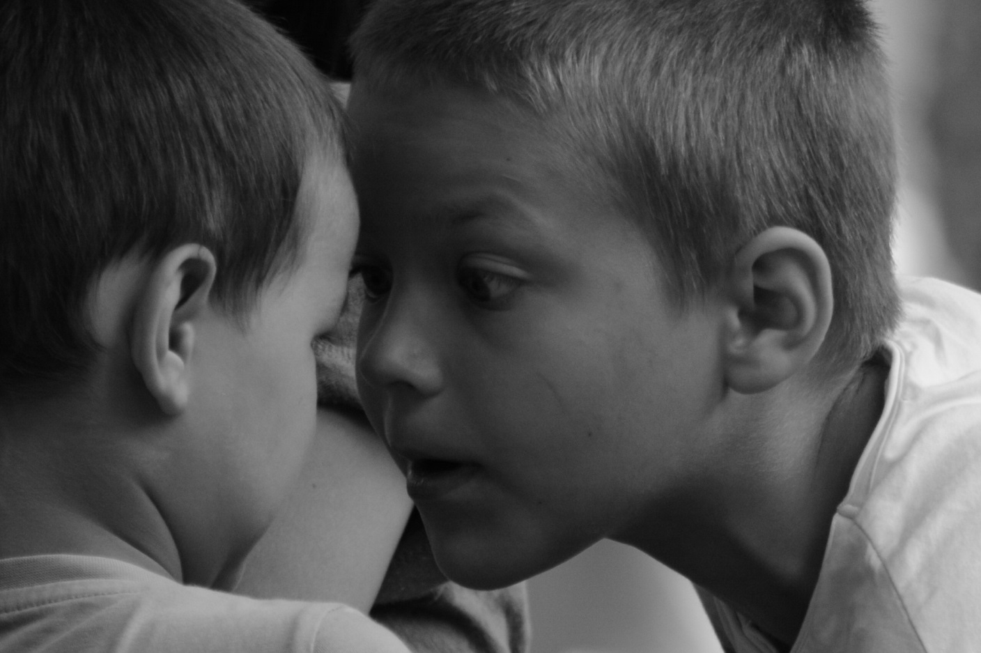
Cultural Challenges
Society often views men’s traumatic experiences as normal/normative
Rites of passage into manhood are often associated with trauma/violence
Society often denies/invalidates men’s traumatic experiences and perpetration of violence
Men often deny their own trauma out of fear of internal/external shame
(Kimmel, Hearn, & Connell, 2005)
Notes:
When seeing individuals through a trauma lens we need to consider the impact of culture on human development and the impact culture has on one’s recovery. Some cultural challenges to addressing trauma among men include the fact that society often views men’s traumatic experiences as normal or normative. Soldiers returning from war are regarded as heroes, adolescent boys that have sex at an early age are considered more manly, and men who perpetrate violence may be given more street credibility.
Rites of passage into manhood are frequently associated with trauma. Whether it is the pain of circumcision, college hazing, or gang initiations, these types of experiences and behavior are deeply engrained in our culture.
Because people associate victimhood with weakness, vulnerability, and femininity, society often denies or invalidates men’s traumatic experiences. Men who are victimized are frequently ridiculed, shamed, and at best made invisible. As a result, men tend to underreport traumatic experiences, especially sexual abuse and victimization.

Slide 18
Gender and Coping
Gender expectations affect coping skill repertoire:
Feeling Powerless – Become powerful (steroids, guns, controlling behavior, etc.)
Feeling Dead – Risk-taking, sex, violence, self-harm
Feeling Disconnected – Connect through disconnection (alcohol use, competition, jokes)
Feeling Overwhelmed – disconnect, intellectualize, suppress
(Olff, Langeland & Gersons, 2007)
Notes:
Societal gender expectations can shape the way we attempt to cope with this imbalance. These expectations tell us what coping tools are available to us based on gender norms. For example, trauma often leaves you with a sense of powerlessness. To cope a man might try to become powerful by the use of steroids, weapons, or controlling behaviors. A man who feels dead inside, disconnected from his body, might take risks, have sex, get into a fight, or engage in self harm as a way to cope. If a man feels disconnected from others he might attempt to connect through jokes, alcohol use, drug use, competition, or gang membership. If he feels overwhelmed by emotions he may cope by numbing them through the use of substances, disconnecting from them, suppressing them and intellectualizing.

Slide 19
Roles, Relationships, and Trauma
I can’t pay the rent!
Victim
Female
SHAME
I’ll pay the rent!
Rescuer/Hero
Male
You must pay the rent!
Perpetrator
Male
Anger
(DePrince & Freyd, 2002; Huh et al., 2014)
Notes:
The villain of the story is the rich and greedy male landlord who is demanding the rent from a helpless poor woman who has fallen victim to his greed. Suddenly a man jumps in to rescue her from the evil landlord by offering to pay her rent. “I’ll pay the rent”, he cries while she swoons and says, “my hero.”
Male trauma survivors may be navigating relationships with this map, but for them the idea of being a victim is bound up with shame. It is a position of vulnerability and a state in which one has little control. The opposite of these are the hero and the perpetrator. These positions hold great power and are not associated with so-called weaker emotions but strong ones. Gender norms and expectations tell a man that for him it is acceptable to be the hero or the perpetrator, but never the victim.
If he finds himself in the position of victim, he may find himself consciously or unconsciously transforming the feelings associated with this into anger at himself and others while also attempting to do something to change his position on the map by becoming either a perpetrator or hero in response.

Slide 20
Gender Norms and Recovery
Relationship, Connection, Healing
Shame
Gender norms and expectations
Notes:
In relationships male trauma survivors may find themselves confronted with repeated relational disconnections which, paradoxically, increase the desire for relational connection. Yet, because of the fear and shame associated with bringing all aspects of his experience to the relationship, that is the experience of both the masculine and feminine, a man alters himself to fit in with the expectations of others. He hides a part of himself away fearing that it may be seen by others. In this way relationships lose authenticity and mutuality, and becoming a source of disconnection.

Slide 21
Disconnection and Imbalance
Notes:
Whether one acknowledges past trauma or not, the experience of trauma may result in long-term changes within the brain-body. These changes can result in a deep sense of disconnection from oneself and others, along with disruption of emotional, biological, cognitive, spiritual, and relational balance. The experience of trauma is pervasive, affecting every part of the individual.

Slide 22
Gender Responsive Trauma Informed:
Gender Role Analysis
Stage One Trauma Interventions
Safety
Trust
Choice
Collaboration
Empowerment
(Meija, 2005; SIDCA, 2015)
22
Notes:
So, in light of what we have discussed so far, how can we better respond to the needs of men helping them to move beyond surviving to thriving, into long term recovery? By providing gender responsive trauma informed care.
Providing gender responsive trauma informed care means seeing the individual in the context of gender. It means acknowledging how society’s gender expectations affect psychosocial development. Acknowledging and challenging the role gender expectations have played in our lives may feel unsafe to many men. It challenges us to step out of our safety zone. That is why gender responsive care, including gender role analysis, should be provided in the context of trauma informed care with opportunities to learn and practice the stage one recovery skills of self awareness, self regulation and self soothing.
It is recommended that trauma recovery and substance use disorder treatment work with men begin with gender role analysis. “Gender analysis highlights the differences between and among women, men, girls and boys in terms of their relative distribution of resources, opportunities, constraints and power in a given context. Performing a gender analysis allows us to develop [treatment] that is better suited to remedy gender-based inequalities and meet the needs of different population groups” (SIDCA, 2015, p.1). It includes psychoeducational, experiential, and relational components.

Slide 23
Why men don’t report
“If it’s ok with you I’d talk about adverse life experiences, how you made it through them, and how they shaped who you are today”
Shame
Fear
Lost sense of masculinity
Shame
Fear
Lost sense of masculinity
Notes:
There may be many reasons why men don’t disclose a history of trauma or readily admit that adverse experiences have had a negative impact on them. Three of the most important and most common reasons are shame, fear, and a lost sense of masculinity. Some men may find it improper and shameful to admit being a victim. They may fear being labeled as weak as the role of the victim is associated with weakness and vulnerability. All of this together leads to a lost sense of masculinity, which can in turn create more fear and shame.
When working with male trauma survivors it is especially important to avoid asking questions such as “have you ever been the victim of trauma.” It may be more beneficial instead to talk about adverse life experiences and how these experiences influenced how they think, feel, and behave today. Focusing on survivorship versus victimhood may help alleviate some of the stigma associated with trauma while helping men to focus on the strengths they have gained from their experiences and how these have helped them to survive.

Slide 24
Central Relational Paradox
Healing takes place through relationships, but if a man cannot bring his entire self into the relationship, it will lose authenticity and thus its ability to heal and will become a source of further disconnection
(JBMTI, 2017)
Notes:
Healing takes place through relationships, but if a man cannot bring his entire self into the relationship it will lose authenticity and thus its ability to heal and will become a source of further disconnection. Leaving him desiring more connection to others, but unable to make those connections.
The poet Charles Bukowski gave us a wonderful description of this process in his poem Blue Bird. Bukowski himself was known to have a substance use disorder and a history of childhood trauma. We’ve provided a link here for those who would like to explore further.

Slide 25
Male Relational Dread
Our marriage is in trouble. We need to talk about it.
Our marriage is in trouble. I better keep my mouth shut.
(Bergman, 1995)
Notes:
It’s no secret that many men struggle with emotions and relationships. It is no wonder when you consider that most men have never really been taught the language of emotions and have spent years of their lives disconnecting from them, especially those associated with vulnerability. Due to a lack of emotional language, emotional awareness, and emotional regulation, when faced with interpersonal challenges men may freeze and become paralyzed by dread.
When faced with interpersonal challenges involving intense emotions, a man may freeze up and appear as though he is inconsiderate or disinterested in the relationship even though he may feel that his life depends on it. Stephen Bergman describes this as a process which begins with initial thoughts of the inevitability of disaster resulting from vulnerability and intimacy and ends with relational paralysis, where he either freezes or escapes the intimacy.
Although a man may move through this process when confronted with moments of intimacy with anyone, it is often most distinct when it occurs within the context of intimate relationships. It can cause miscommunication, misunderstanding, and can get in the way of mutuality, empathy, and authenticity, all of which are essential components to healthy relationships.
We will discuss these components in detail later in this module.

Slide 26
Male Relational Dread
His recovery is in trouble. We need to talk about it.
Shame
Fear
Lost sense of masculinity
My recovery is in trouble. I better keep my mouth shut.
Notes:
There may be many reasons why men don’t disclose a history of trauma or readily admit that adverse experiences have had a negative impact on them. Three of the most important and most common reasons are shame, fear, and a lost sense of masculinity. Some men may find it improper and shameful to admit being a victim. They may fear being labeled as weak as the role of the victim is associated with weakness and vulnerability. All of this together leads to a lost sense of masculinity, which can in turn create more fear and shame.
When working with male trauma survivors it is especially important to avoid asking questions such as “have you ever been the victim of trauma.” It may be more beneficial instead to talk about adverse life experiences and how these experiences influenced how they think, feel, and behave today. Focusing on survivorship versus victimhood may help alleviate some of the stigma associated with trauma while helping men to focus on the strengths they have gained from their experiences and how these have helped them to survive.

Slide 27
Emotional Safety
Be aware of the role shame has played in men’s lives
Notes:
Now, let’s talk about emotional safety. When providing emotional safety for men be aware of the role shame has played in men’s lives. Try to avoid situations in which a man is shamed, especially in front of others. Keep in mind that although society often stereotypes men as unemotional, we know that this is untrue. Men experience an array of complex emotions and it is important to respect and honor each and every one.

Slide 28
Emotional Safety
SHAME
Self Sooth
Self Regulate
Self Compassion
Notes:
You will recall from earlier in this module that the internalized shame that men may experience as a result of current gender norms may create an “emotional disposition characterized by an inability to self-soothe, emotionally regulate, and to be compassionate toward [himself] in the face of a perceived threat” (Reilly, Rochlen, & Awad, 2013, p 4). The ability to self-soothe, self-regulate, and to be compassionate towards oneself are essential components of stage one trauma recovery and are also essential skills for recovery from a substance use disorder. When working with men it is important to acknowledge the role that shame has played in their lives, and to address this shame through all three stages of recovery. Ironically, the best way to address shame is with the stage one recovery skills, especially self compassion.

Slide 29
Societal Views of Men and Compassion

Slide 30
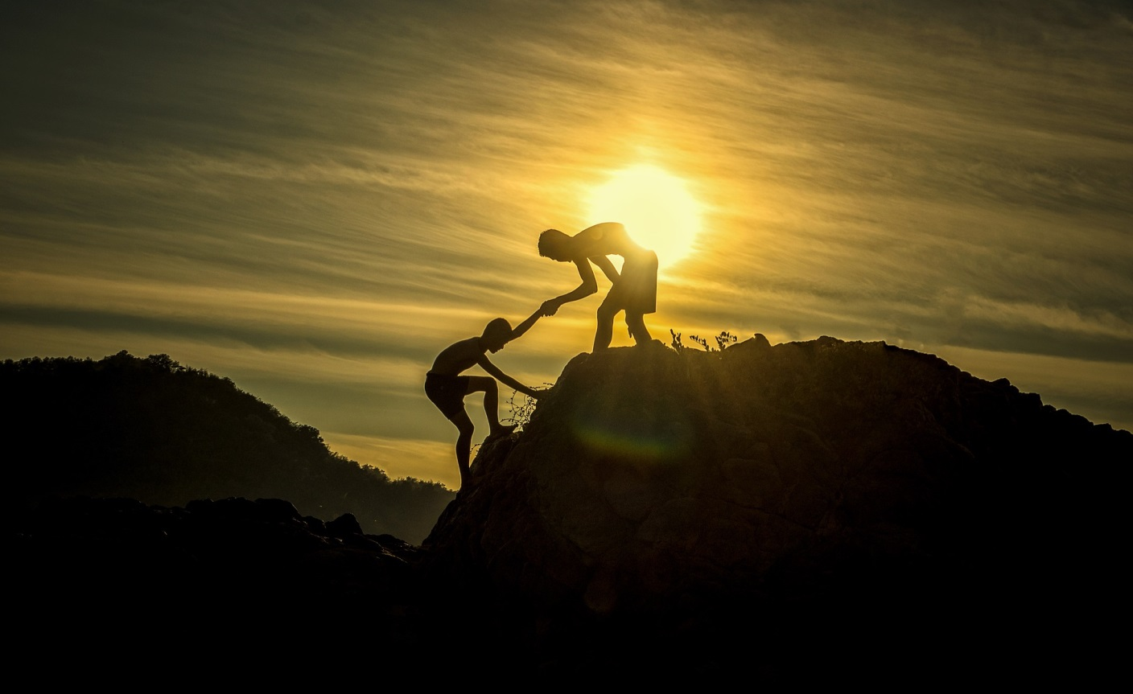
Compassion
Seeing each man in the context of his life experiences
Acknowledging the role gender has played in their lives
(Covington, Griffin, & Dauer, 2011)
Notes:
Treating men with compassion means seeing each man in the context of his life experiences and acknowledging that gender identity and gender expression develop in the context of a highly gendered culture. It means acknowledging the role gender has played in their lives.

Slide 31
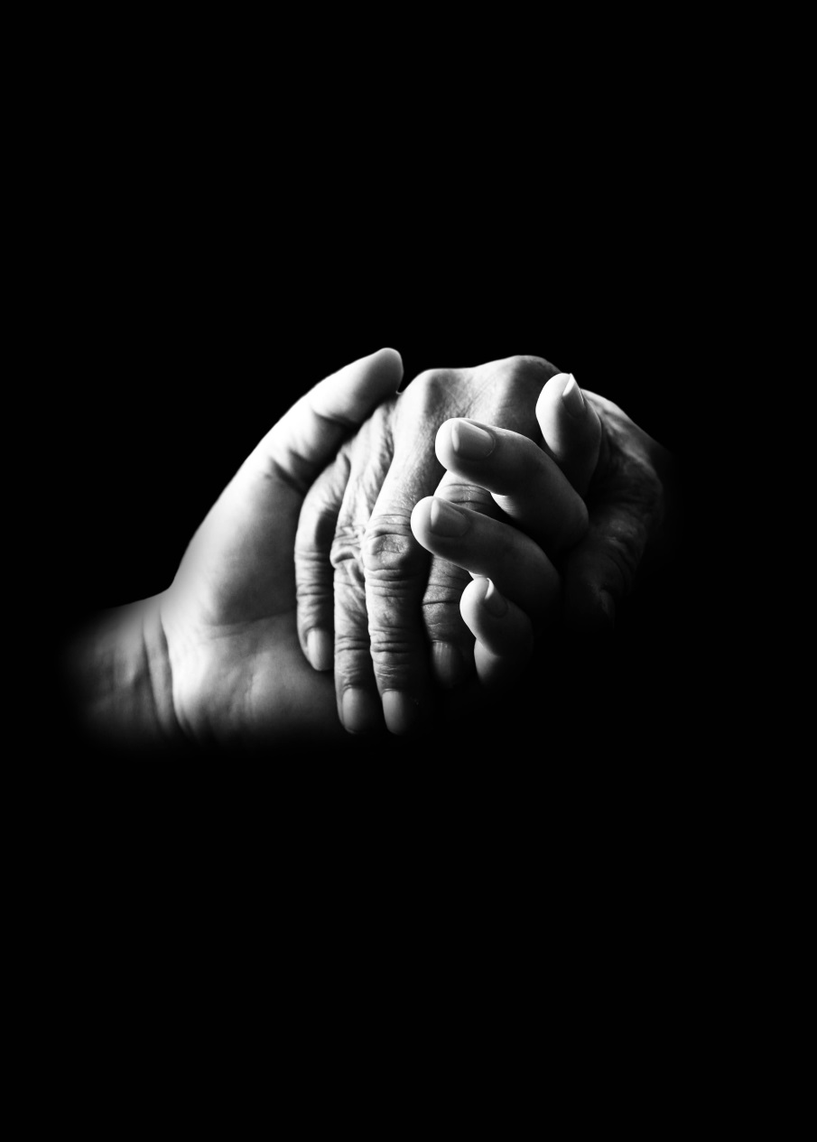
Compassion
Recognizing suffering in others
Understanding the common humanity of this suffering
Feeling emotionally connected with the person who is suffering
Tolerating difficult feelings that may arise
Acting or being motivated to act to help the person
(Herenstein & Keltner, 2006; Real, 1998; Rodriguez, Curry, & Lee, 2006; Strauss, et al., 2016; Wit, Paget, & Matthews, 1994)
Notes:
Compassion means to “feel with”. It involves five elements: recognizing suffering in others; understanding the common humanity of this suffering; feeling emotionally connected with the person who is suffering; tolerating difficult feelings that may arise; and acting or being motivated to act to help the person.

Slide 32
Mutual Responsibility
Sharing power in a collaborative way
Supporting men in making the decisions that will facilitate their recovery
Both the clinician and the client have equally important roles to play and are responsible to each other
(Covington, Griffin, & Dauer, 2011)
Notes:
Now, let’s dig a little deeper into the notion of mutual responsibility. Mutual responsibility means sharing power in a collaborative way. It means supporting men in making the decisions that will facilitate their recovery. Both the clinician and the client have equally important roles to play and are responsible to each other in enacting these roles.

Slide 33
Gender Socialization versus Treatment Expectations
Received Messages
Don’t show emotions
Don’t be weak
Don’t be a victim
Be self-reliant
Be powerful
Skills Needed for Recovery
Express your feelings
Be vulnerable
Acknowledge trauma
Rely on others
Share power equally
(Meija, 2005)
Notes:
Let me demonstrate how gender analysis works. First, let’s make a list of our society’s gender expectations for men, a list of do’s and don’ts for men. This list might include expectations that men don’t have or show emotions, that men should not be weak or victims. Men are also expected to be self-reliant and powerful. These are the messages men have been receiving all of their lives and most men have done their best to meet these expectations in the ways they know how, and many men may feel unsafe stepping out of line with these expectations.
Now let’s make a list of all of the expectations we have for men in treatment. For example, in treatment we ask men to express their feelings, make themselves vulnerable, acknowledge trauma, to rely on others and to share power equally. What we ask of men in treatment goes against the expectations they have grown up with all of their lives. Stepping out of line with these expectations may bring hope of recovery in the long run, but in the short run they can bring fear and shame.
This is the conundrum men in treatment are faced with. You're asking them to do something that feels unsafe to them, and with which they haven’t had much experience. You’re asking them to step into a place that has historically been a place of shame. Although what we expect in treatment supports long term recovery, some men may find these expectations to be a major barrier to recovery.
The goal of gender analysis is to highlight this conundrum, to bring awareness to how gender expectations can help or harm recovery (Mejia, 2005).

Slide 34
Gender Role Analysis
A systematic methodology for examining the differences in roles and norms for women and men, girls and boys; the different levels of power they hold; their differing needs, constraints, and opportunities; and the impact of these differences in their lives.
Methods:
Psychoeducational
Experiential
Relational

Slide 35
Gender Role Analysis: Psychoeducational
Goal: Facilitating awareness, developing hope
Interventions:
Acknowledging the courage it takes to enter counseling
Normalizing the situation within the larger framework of life
Considering issues of control, fear, and dependency
Identifying masculine / gender messages
Defining differences between the masculine and feminine models of the world
(Meija, 2005)
Notes:
Gender role analysis can be broken down into three areas: psychoeducational, experiential, and relational.
Let’s review each beginning with the psychoeducational. The goal of this area of gender role analysis is to facilitate awareness of how gender impacts one’s trauma risk, experience, and recovery, while developing the hope that recovery is possible.
Interventions in this area include:
Acknowledging the courage it takes to enter counseling
Normalizing the situation within the larger framework of life; that gender expectations often go against what recovery requires of us
Considering issues of control, fear, and dependency
Identifying masculine implicit and explicit messages, what do others tell me about gender and what do I tell myself?
Defining differences between the masculine and feminine models of the world

Slide 36
Gender Role Analysis: Experiential
Goal: Facilitating the experience of long-denied feelings, developing responsibility and resilience
Interventions:
Analyzing masculinity messages
Understanding the connection between beliefs about gender and problematic behaviors
Constructing a functional redefinition of masculinity
Recognizing emotional needs and accepting them as basic
(Meija, 2005)
Notes:
The second area of gender role analysis is experiential.
The goal of this area is to facilitate the experience of long-denied feelings, developing responsibility and resilience.
Interventions in this area include:
Analyzing masculinity messages, what do these messages mean for me?
Understanding the connection between beliefs about gender and problematic behaviors, how is masculinity getting in the way of safety and recovery?
Constructing a functional redefinition of masculinity, what does being a man mean to me?
And Recognizing emotional needs and accepting them as basic.

Slide 37
Gender Role Analysis: Relational
Goal: Furthering emotional connections with significant others, developing individual definitions of gender socialization and recovery
Intervention:
Develop an understanding of the need for connectedness and find healthy ways to connect
Develop an understand the influences of family of origin
(Meija, 2005)
Notes:
The third and final area of gender role analysis is relational.
The goal of this area is to further emotional connections with significant others of all genders, and to develop individual definitions of gender socialization and recovery. It is to help them create a personal sense of who they are as a man that is flexible yet strong and is able to adapt to the many challenges and rewards of relationships and recovery.
Interventions in this area include:
Develop an understanding of the need for connectedness and find healthy ways to connect
Develop an understanding of the influence of family of origin on relationships and development.

Slide 38
Stage One Trauma Interventions
Establish:
Physical safety
Emotional safety
Develop:
Self-awareness
Self regulation
Self soothing
Healthy relationships
(Barankowsky & Gentry, 2014; Herman, 1992)
Notes:
To recover and thrive an individual must first establish safety. This means establishing and maintaining both physical and emotional safety. It involves developing the skills necessary for recovery. These include self awareness, self regulation, self soothing, and healthy relationships.

Slide 39
Masculinity is not the problem:
“Acknowledging the adaptive and maladaptive aspects of masculinity and that cultivating adaptive aspects of masculinity, such as success dedication, has the potential to improve treatment outcome.” (Garcia, Finley, Lorber, & Jakpcak, 2011, p 60)
Notes:
Acknowledging the helpful and harmful aspects of masculinity and cultivating helpful aspects, such as success dedication, has the potential to improve treatment outcomes. We are not asking men to stop being men, but we are asking them to change their relationship to gender in order to achieve and sustain long term recovery.

Slide 40
How we hold it is.
Notes:
Acknowledging the harmful aspects of masculinity should always be balanced with acknowledging the helpful aspects. The point of gender analysis is not to create shame and hopelessness, but to instill clarity and hope.
Many men hold tightly to a strict view of masculinity. They’ve used these views to construct an idea of who they are and how the world operates. When I say to these men that they need to let go of some these views, it might seem unsafe since they often assume that in letting go they will lose everything. Gender role analysis doesn’t ask men to let go of masculinity completely, but it does ask them to change their relationship to it.

Slide 41
The Goals
Discover what being a man means to him
Develop stage two trauma recovery skills
Develop the skills necessary for long term recovery from a substance use disorder
Notes:
The goals of gender responsive trauma informed care within substance use disorder treatment are:
For each man to discover for himself who he is as a man and what being a man means to him. It means redefining one’s sense of manhood in light of a clearer vision of the role gender has played in our lives.
To assist each man in developing the skills needed for stage two trauma recovery. To help him move from surviving to thriving.
And to assist each man in developing the skills necessary for long term recovery from a substance use disorder.

Slide 42
Charles Bukowski: BlueBird

Slide 43
Discussion / Reflection
What does the Bluebird represent?
What is his relationship to the bluebird?
What are his fears about the bluebird?
How does cope?
How would you work with him to support his recovery?

