Slide 2
1
Consulting Mindset How To Think Like A Strategy Consultant
5
Key
Lessons
2
MECE Mind
How To Think Clearly
3
From Information To Insight
Using The Pyramid Principle To Synthesize & Structure
4
Real World Problem Solving:
Using SCQA & Issue Trees To Help Facebook Shift To Mobile
5
Storytelling & Kick-Ass Presentations
Convince CEOs to change their mind

Slide 3
Exercises
Pyramid Principle
Real World Case Study

Slide 4
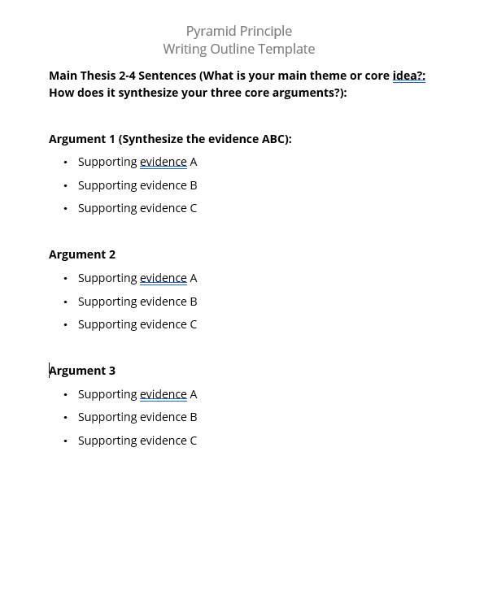
1
Persuasion: Book Review Of Impossible To Ignore How To Create Memorable Content
!!!
Bonus Content!
2
14 Hacks For Better PowerPoint Presentations
A step-by-step video
3
100+ PowerPoint Templates + Other Templates
Full deck of practical templates and consulting slides

Slide 5
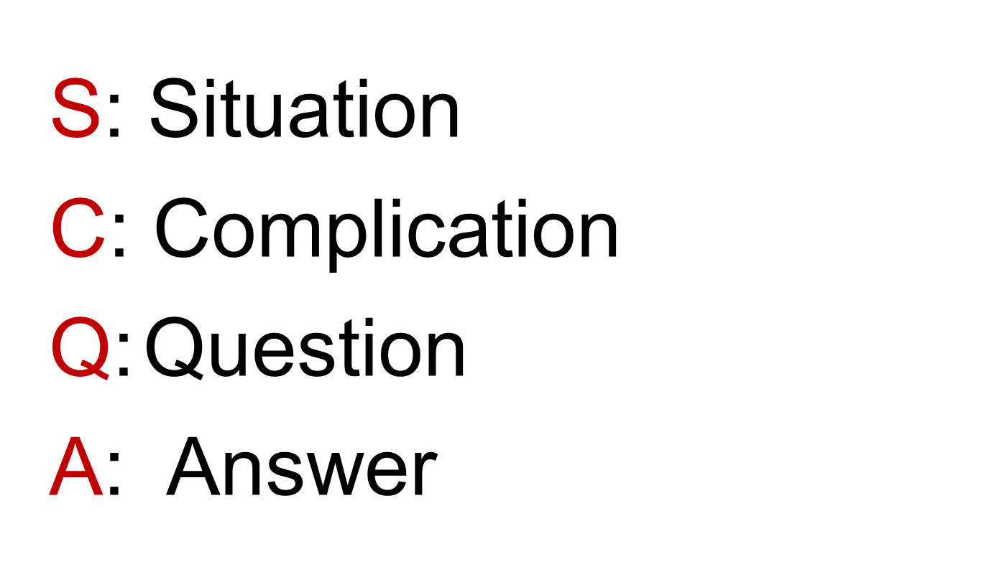
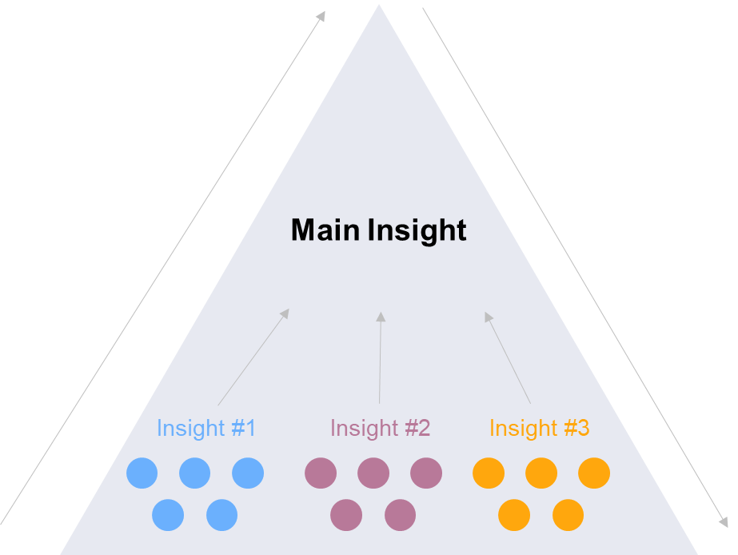
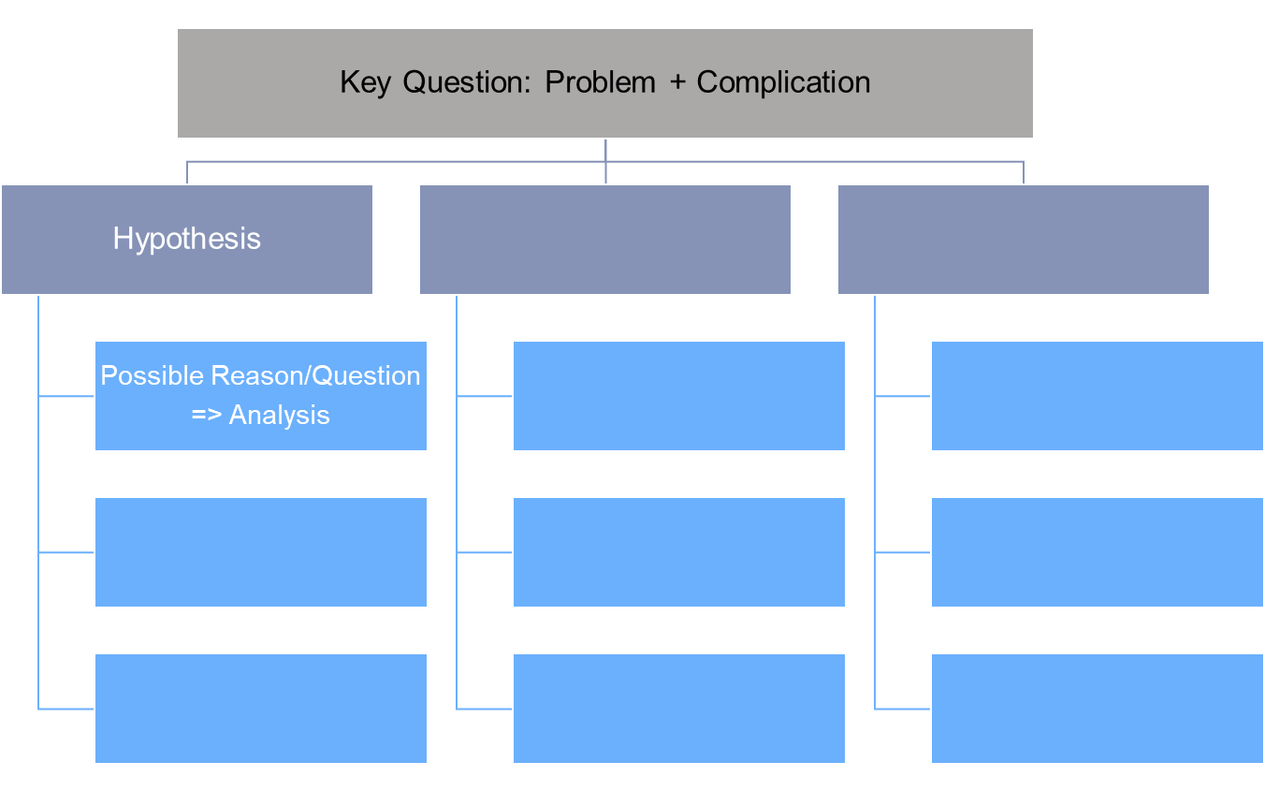
Frameworks
MECE
SCQA
Pyramid Principle
& Issue Tree
Mutually Exclusive, Collectively Exhaustive

Slide 6
Frameworks
MECE
SCQA
Pyramid Principle
& Issue Tree
Mutually Exclusive, Collectively Exhaustive
Structure Ideas
& Communication
Structure Thinking
Structure Problems

Slide 7
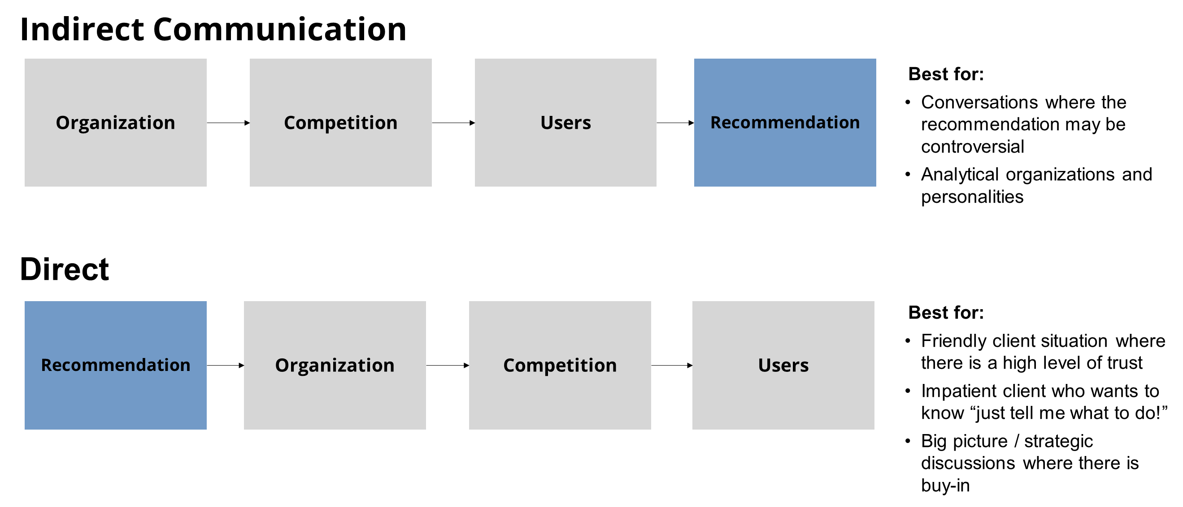
Communicate
POWERPOINT
STORY STRUCTURE
CONTENT
Communicate
Persuade & Influence
Be Memorable

