Slide 1
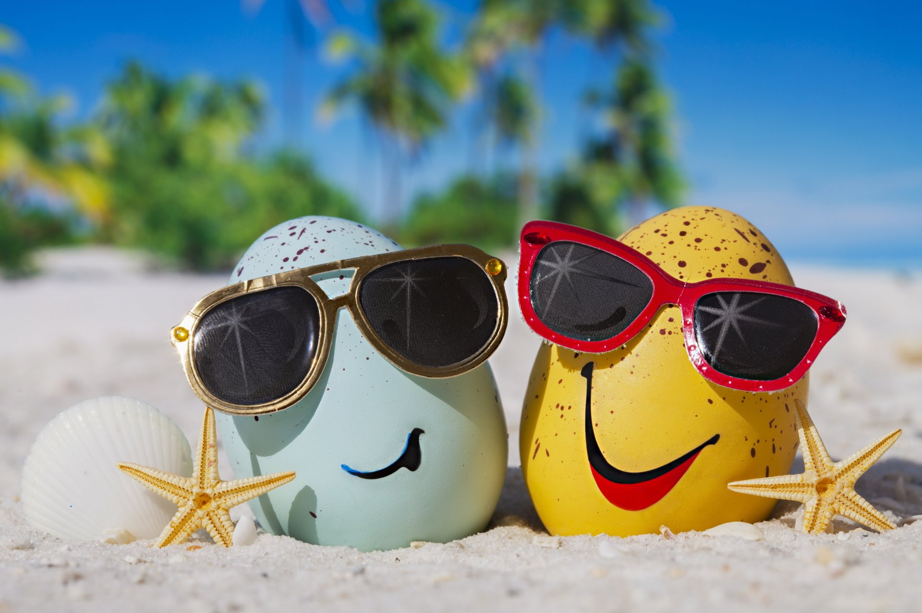
What do we wear in the Summer?

Slide 2
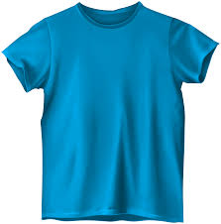
T-shirt

Slide 3
Sleeveless Shirt

Slide 4
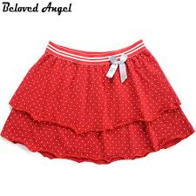
Skirt

Slide 5
Dress

Slide 6
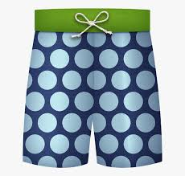
Swimsuits

Slide 7
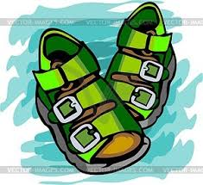
Sandals

Slide 8
Hat

Slide 9
Sunglasses

