Slide 1
System Solutions Company North America
Process Automation
PanaCIM Gen2

Slide 2
Course Overview
PanaCIM Gen2 is the new line-based manufacturing execution system which is designed and driven from the iLNB to compliment the next generation of integrated smart factory solutions (Industrial Internet of Things - IIoT).
The purpose of this training course is to provide internal members with the overview, functionality, and troubleshooting procedures that will allow them to ramp-up their skills to support the sales and engineering entities globally.
Target Audience: Panasonic team members tasked with PanaCIM Gen2 support.
Course Length: Students may work at their own pace to complete all Sections and Lectures.
Course Instructor: Process Automation – Quality Assurance Team (Tony Tang, Manager.)
Creation Date / Revision: 1-24-2019, Revision 1

Slide 3
v10.5 Training Plan Overview
Beginning 1/23/2019, the Process Automation – Quality Assurance Team, with the support of the software group, will provide multiple 2-hour blocks of training via Webex. We encourage all members who are available to attend those sessions as it will include a Q & A session following the training.
Training for v10.5 will run through the end of March 2019, however all sessions will be recorded and made available here. From the entire WebEx training session, we will break the session into digestible lectures to allow additional members to attend online as their schedule permits.
Training for subsequent versions will begin tentatively April 2019.
Please feel free to send your questions to:
Tony Tang, QA Department Manager tony.tang@us.panasonic.com
Khyati Shastri, QA Department Team Lead khyati.shastri@us.panasonic.com
James Kuhn, Training Department james.kuhn@us.Panasonic.com

Slide 4
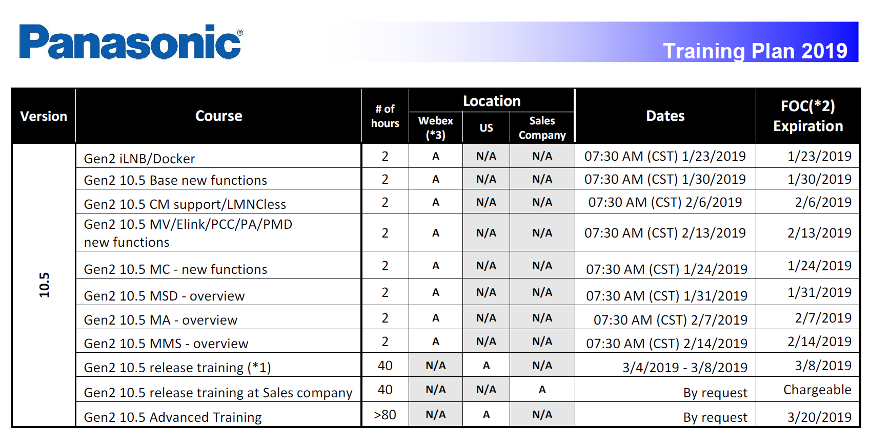
v10.5 Training Schedule
Training for v10.5 will begin on 1/23/2019 and run tentatively through 3/20/2019 (complete 2019 training plan available in the Introduction section).

Slide 5
Session 1 – Gen2 iLNB/Docker
This training session will identify and describe the basic layout of the iLNB and system functionality to include hardware and software specifications, system access, and a brief tutorial of the system interface. We will also discuss the docker, key commands, and system backups.

Slide 6
Session 2 – Gen2 10.5 MC-new functions
This training session will identify and describe the Material Control-Base (MC) module to include the system interface, system configuration, system features & functionality, and line clustering. We will also discuss receiving material and other various material options.

Slide 7
Session 3 – Gen2 Base-new functions
This training session will identify and describe the PanaCIM Base settings.

Slide 8
Session 4 – Gen2 MSD overview
This training session will identify and describe the Material Control-Moisture Sensitive Device (MSD) module.

Slide 9
Session 5 – Gen2 CM support/LMNCless
This training session will identify and describe the requirements and process of Gen2 support on Modular I machines (CM machines without using LMNC).

Slide 10
Session 6 – Gen2 MA overview
This training session will identify and describe the Material Control-Material Allocation (MA) module.

Slide 11
Session 7 – Gen2 MV/Eink/PCC/PA/PMD-new functions
This training session will identify and describe the Material Verification (MV), Enterprise Link (Elink), Production Changeover and Control (PCC), Production Analysis (PA), and Production Monitoring & Dispatch (PMD) modules.

Slide 12
Session 8 – Gen2 MMS overview
This training session will identify and describe the Material Management System (MMS) module.
.

Slide 13
Session 9 – Gen2 release training
This training session will identify and describe details on installation and release of the Gen2 system.

Slide 14
Session 10 – Gen2 advanced training
This training session will identify and describe advanced training items of the Gen2 system.

