Slide 1
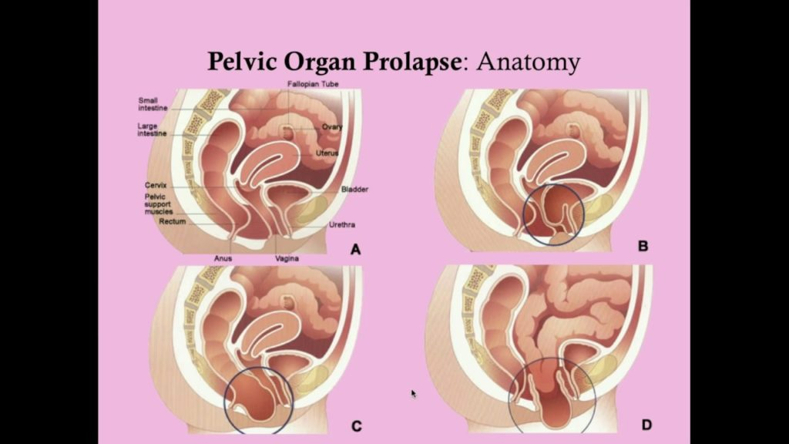
Intro of Exercise with Prolapse
Leah Bryans

Slide 2
Goal for this session
Keep it simple for you and your patient in clinic
How and why to keep them active and gaining strength while improving symptoms
This Photo by Unknown Author is licensed under CC BY-NC

Slide 3
There is no recipe/policy/protocol
Acknowledgments of all the people I have learned from to name a few….
Maggie Lawlor – Simple Strength
Helen Keeble – Women’s Health Dublin
Anthony Lo – The Physio Detective
Teresa Waser – Rx Physio
Julie Weibe
POP up lift – Haley Shevener – facebook group POP fitness
Gaynor Morgan – Pelvic Angel – facebook group Prolapse and Pessaries
Jessie Mundel

Slide 4
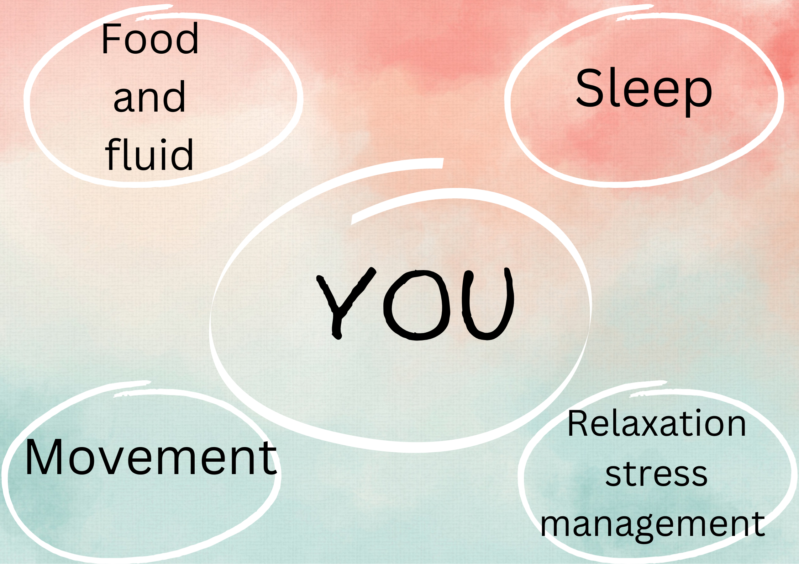

Slide 5
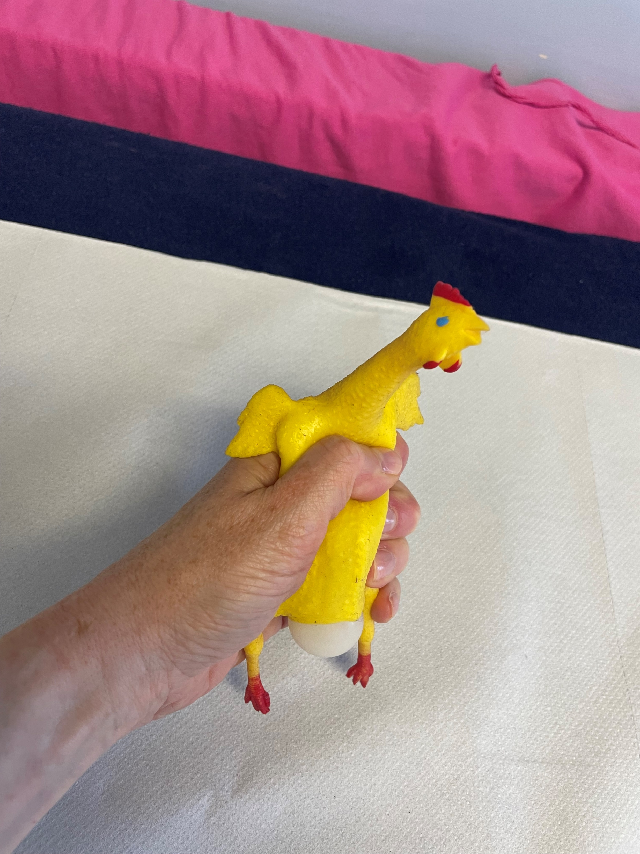
The Movement Component
Physiotherapists – experts in exercise and muscle matters
Specific Pelvic Floor Muscle Training – always! ?warm up
Not everyone can get a ‘kegel’ with a verbal instruction so
Our prior assessment is important!
Build strength to resist increases in Intra Abdominal Pressure

Slide 6
Start with some stats
75% of people opt out of fitness due to POP symptoms
5% of triathletes reported POP symptoms (2016 Yi et al)
7.8% of Cross fitters and 12.8% of runners reported POP (Forner et al 2021)
Running is a repetitive impact activity. Exploring new movement patterns and activities might improve symptoms and (re)build resilience
Physical activity can have a positive effect on the pelvic floor (Bo and Nygaard 2020)

Slide 7
What’s the point of exercise
Cardio vascular health
American College of Sports Medicine
Cardio – 150min moderate intensity or 75mins vigorous
Strength training – 2 non consecutive days
Flexibility – 2-3 times per week
Balance - 2-3 times per week
Balance and mobilty
Bone health
Fall/injury prevention
Mental health

Slide 8
Treat the individual not the condition
Meet the patient where they are at
Encourage exercise don’t avoid
What exercise do they enjoy?
What do they want to do/achieve?
How will we get there …. Reverse goal setting
The holy Trinity Of Exercise!
Strength training
Aerobic
Walking in Nature
Mobilty/ yoga / pilates

Slide 9
What do we need to consider re POP
Intra abdominal Pressure
Breathing
General mobility and flexibility
‘rigidity is the thief of shock absorption’
Impact
Ground reaction force
Load
Time under tension

Slide 10
Managing Intra Abdominal Pressure
Increases in Intra Abdominal Pressure result in something coming down/out
Urine or Prolapse
Cobb et al 2005 and Shaw et al 2014
But does it make Prolapse worse……….. ????????????
Some studies say POP-Q stage was worse after exercise but patients still asymptomatic and had no difference in their QoL…. Ali-Ross et al (2008)
Others no change

Slide 11
A place to start – ‘Exhale on effort’
Exhaling blows off some pressure
• Breath patterning had nil significant impact on
force production but did on IAP (Hagins et al, 2006)
• Breath holding/bracing, if at all, should only be
saved for max lifts?

Slide 12
The pelvic floor is dynamic and responsive
Do not tell women to hold in their tummy or their pelvic floor for the duration of their run/walk/workout
‘holding on’ isn’t functional
Do their PFMT at a specific time and try to relax and let the muscle work on its own at other times

Slide 13
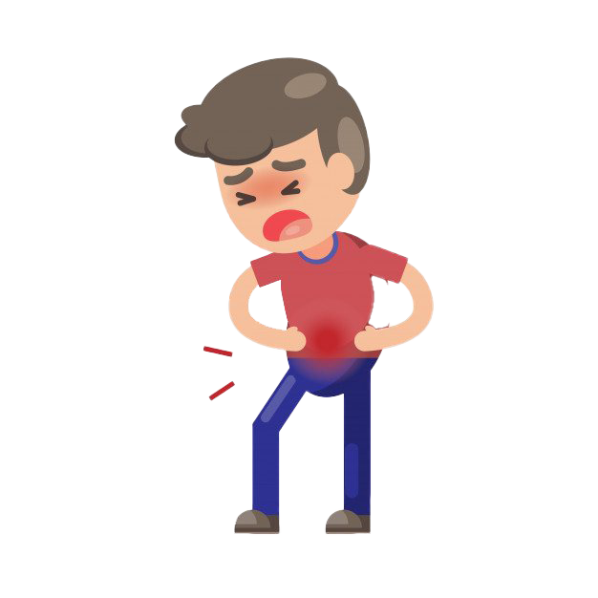
The 5Ps rule – ‘symptoms are signals’
If you feel any of the following stop and ‘do something different’
Pee
Poo
Pain
Pressure
Peaking (abdominal wall doming)
This Photo by Unknown Author is licensed under CC BY-NC

Slide 14
Figure out what causes the P
Keep work outs simple – so that you can find the culprit!
Initially simple strength training programme better than HIIT or circuits (IMO)
Avoid triggers initially
Monitor and Modify – regress/scale then progress

Slide 15
Exercises that Might increase IAP and trigger symptoms
Have a think, make a list
Group discussion
It doesn’t mean we never go here – it just might not be a good place to start with a patient with POP

Slide 16
Some of my thoughts on triggering exercises
Running (downhill)
Ski erg
Rower
Ball slams
Full press up
Shoulder press
Box jumps
Deep weighted squats
This Photo by Unknown Author is licensed under CC BY

Slide 17
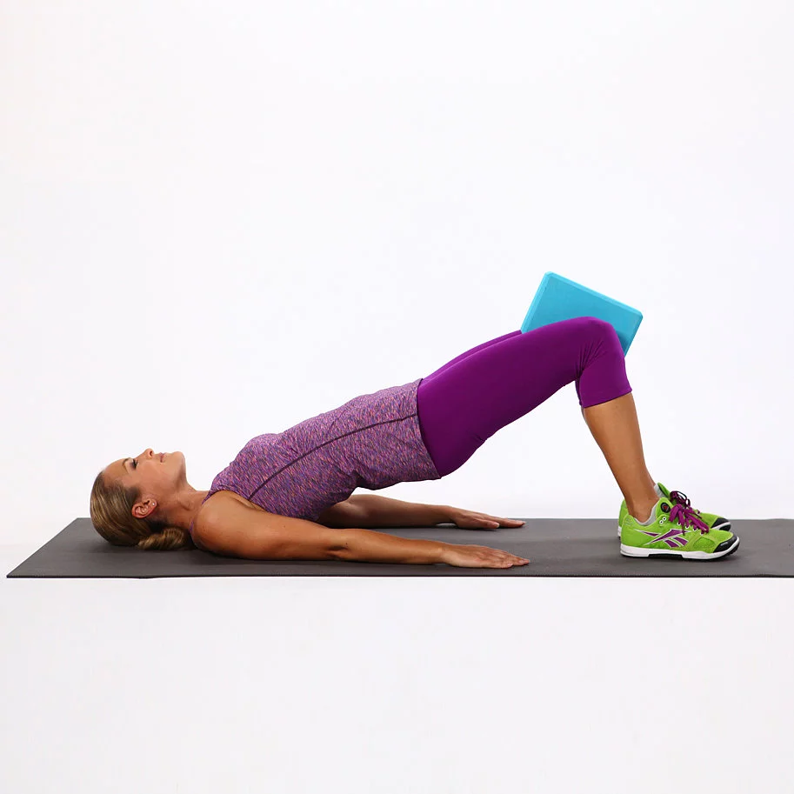
Some exercises/’things’ that are least likely to provoke POP symptoms
Have a think…..
Bridge?
Downward dog?
Consider external Support shorts/underwear
Including bras!

Slide 18
Modify/ scale don’t avoid!
Increases in IAP during less severe repeated impact may cause co- contraction of the
abdominal & PFMs thus ultimately improving their function (Kruger et al, 2005)
Helen Keeble/Anthony Lo approach
I look at it like homeopathy …. Give them a little bit of what they hate/are allergic to and they will adapt!

Slide 19
Hierarchy of load Anthony Lo/Helen Keeble
Train the pelvic floor to respond reflexively
For example if walking is the goal
Marching on the spot - record when symptoms happen (1min)
Reduce by 50% (30seconds)
Repeat x 5sets as HEP
Progress – make the steps louder, higher, do it for longer, etc
Regression – symptoms at the time reduce by 50%
Symptoms after reduce by 30%

Slide 20
Where’s the evidence
Highest IAP found with jumping and coughing when standing up
Moving from Sit to Stand has a greater change in IAP than any of the exercises in pilates
‘Roll up’ was the only other exercises that came close
Tanner et al 2015
Lorni forner et al 2019 – those who could lift heavier were less symptomatic

Slide 21
Pilates and prolapse
What exercises are (usually/often) provocative of symptoms
Roll Up +/- side twist
Double leg lowers
Heavy weight on leg series in reformer
Anything where you might notice breath holding..
But …. Really Pilates is generally ‘safe’ for prolapse and it can be a good starting point and confidence builder

Slide 22
Strength training principles
Individuality - everyone is different
Specificity - get it right!
Overload - do as many as you can do well
Progression/Periodization - make it harder when you are ready to do so
Diminishing Returns/Adaptation - rate of progress slows with time
Reversibility - use it or loose it!

Slide 23
Little recap
Breathe well
Move well
The strategy should match the task
Then add load, impact, range, reps, speed, variety

Slide 24
Do something different …. In the gym
Reduce impact – jump up, step down
Reduce range – use a box for squats, pads for dead lifts
Reduce reps
Reduce load – less weight
Think about Single leg work – more difficult with lower loads – also more functional for runners
When you find the comfort zone – no P’s…
Progress by changing one variable at a time

Slide 25
Do something different …. When running
Play around with cadence
Shorter stride length
Body position – ‘tits (or nose) over toes’
Lean in
Try interval training – walk/jog and build up
Practise on different surfaces/inclines
Breathing+++
Relax the upper body, swing your arms, allow rotation…
Also refer to return to running post partum guidelines – Grainne Donnolly et al

Slide 26
What other factors can be at play
Aside from the mechanics of prolapse, downward forces, pressure etc
Lets look at general well being
Stage in hormonal cycle
Make sure your patient is aware that progress is not linear and many other factors contribute to the sensation of prolapse without there being an anatomical change

Slide 27
Teresa Waser - TIIPPSS-FC – an evolving framework
Tension
Impact
Irritability
Position/posture
Pressure
Strategy
Then consider
Fatigue
Capacity

Slide 28
Acknowledge the world of info out there
Pelvic health landscape is changing, social media is noisy
Try not to get over whelmed
Brilliance in the basics
Treat what’s in front of you
Evidence is evolving constantly – ‘first do no harm’

Slide 29
Take home
Encourage exercise
Simplify
Specific PFEs
Manage IAP
Mobility – rigidity is the thief of shock absorption
Breath work -
Strength training x2 per week. Progress slowly
Meet the patient where they are at
Find a team!
The Mum map
Fit pros who understand PFD

Slide 30
references
Ali-Ross et al (2008) The effect of physical activity on pelvic organ prolapse. BJOG 1 16, 824-828
Bø K, Nygaard IE. Is physical activity good or bad for the female pelvic floor? A narrative review. Sports Med. 2020;50(3):471–84. https://doi.org/10.1007/s40279-019-01243-1.
Cobb et al (2005). Normal intraabdominal pressure in healthy adults. J Surg Res. 129 (2) 231-5
Forner et al (2019). Symptoms of pelvic organ prolapse in women who lift heavy weights for exercise: a cross-sectional study. International Urogynecology Journal, published online 7th Dec 2019
Forner LB, Beckman EM, Smith MD. Do women runners report more pelvic floor symptoms than women in CrossFit®? A cross- sectional survey. Int Urogynecol J. 2021;32(2):295–302. https:// doi.org/10.1007/s00192-020-04531-x.

Slide 31
references
Skaug et al 2020 Prevalence of Pelvic Floor Dysfunction, Bother and Risk Factors and Knowledge of the Pelvic Floor Muscles in Norwegian Male and Female Powerlifters and Olympic Weightlifters. Journal of Strength and Conditioning Research
Spallinger et al (2014). Relationship between intra-abdominal pressure & vaginal wall movements during valsalva in women with & without pelvic organ prolpase: technique development & early observations. Int Urogynecol J. Jul 25 (7) 873-81
Wiebe JW, LaCross J, Huang M, Nguyen A, Fridman L, Tran N, Napier C. Prevalence of Pelvic Health Symptoms Associated with Pelvic Floor Overactivity in Recreational Female Runners. Poster Presentation. American Academy of Sports Physical Therapy-American Physical Therapy Association. Combined Sections Meeting. Boston, MA. February 2024
Yi J, Tenfelde S, Tell D, Brincat C, Fitzgerald C. Triathlete risk of pelvic floor disorders, pelvic girdle pain, and female athlete triad. Female Pelvic Med Reconstr Surg. 2016;22(5):373–6. https://doi. org/10.1097/SPV.0000000000000296.

