Slide 1
The OSI Model

Slide 2
Open System Inter-Connection Model
In the late 1970s, one project was administered by the International Organization for Standardization (ISO)
OSI model was published in 1984
The concept of a seven-layer model was provided by the work of Charles Bachman at Honeywell Information Services

Slide 3
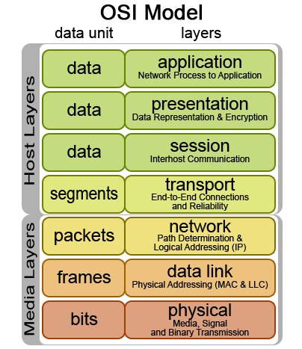
The OSI Model

