Slide 1
Matlab Master Class DAY 2
www.pantechsolutions.net

Slide 2
Day 2- Image Processing using Matlab
How to Read and Store Image, View Pixel
Types of Images (Colour,Grayscale,Binary)
Mathematical Operations in Image
Channel Separation
Colour Space Conversion
Edge Detection
Noise and Filtering
Thresholding and Image Segmentation
Histogram Equalization and contrast Enhancement
Boundary labeling and Counting
www.pantechsolutions.net

Slide 3
How to Read and Store Image
a=imread('cameraman.tif');
imshow(a);
impixelinfo;
imwrite(a,'test.png');
%Medical Image
info = dicominfo('CT-MONO2-16-ankle.dcm');
Y = dicomread(info);
figure, imshow(Y,[]);
www.pantechsolutions.net

Slide 4
Types of Images
RGB
GRAY SCALE
BINARY

Slide 5
Types of Images
a=imread('rose.png');
subplot(1,3,1);;imshow(a);
%Convert Gray Scale
b=rgb2gray(a);
subplot(1,3,2);;imshow(b);
%Convert Binary
c=im2bw(b);
subplot(1,3,3);;imshow(c);
impixelinfo;
www.pantechsolutions.net

Slide 6
Mathematical Operations in Image
Imadd
Imsubtract
Imabsdiff
immultiply

Slide 7
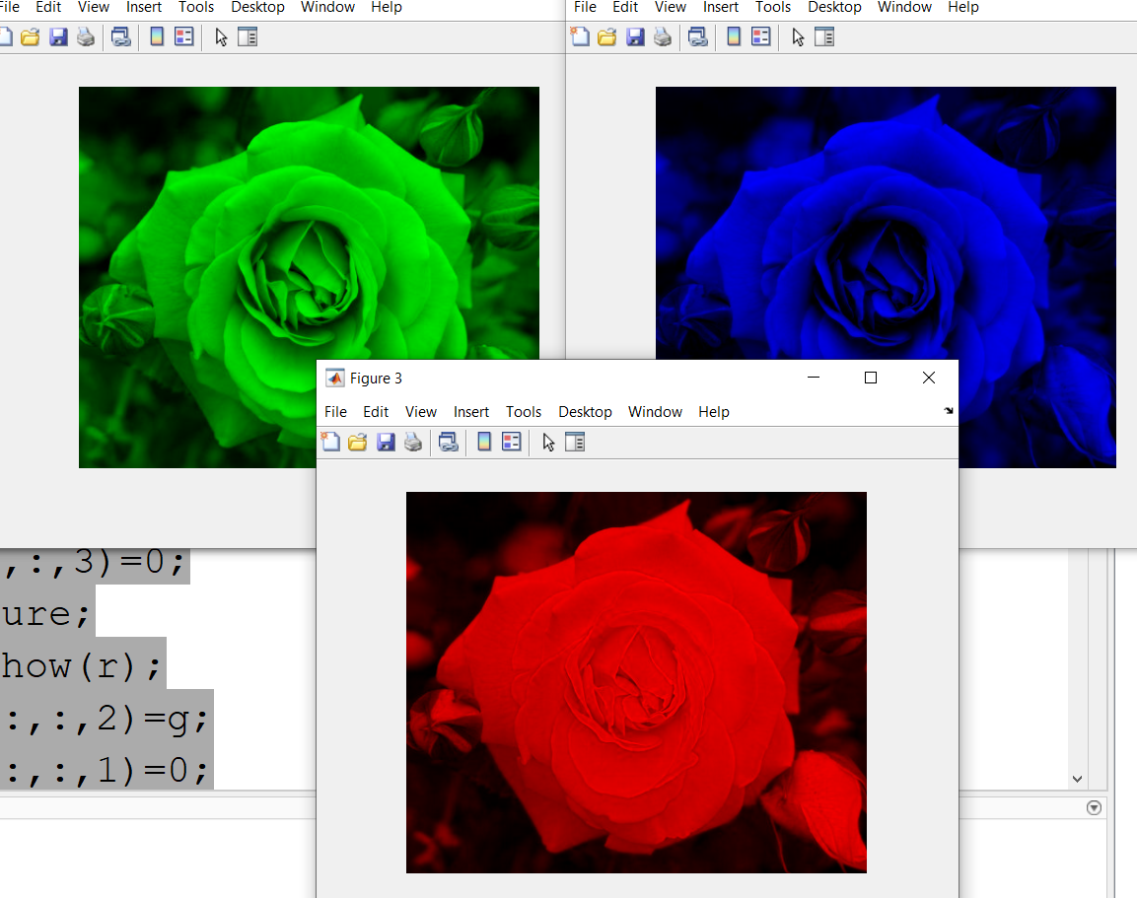
Color Channel Separation
a=imread('rose.png');
[r g b]=imsplit(a);
figure;imshow(r);
r(:,:,1)=r;
r(:,:,2)=0;
r(:,:,3)=0;
figure;
imshow(r);
gr(:,:,2)=g;
gr(:,:,1)=0;
gr(:,:,3)=0;
figure;
imshow(gr);
bl(:,:,3)=b;
bl(:,:,2)=0;
bl(:,:,1)=0;
figure;
imshow(bl);

Slide 8
Colour Space Conversion
clc;
clear;
a=imread('rose.png');
b=rgb2hsv(a);
b1=hsv2rgb(b);
c=rgb2lab(a);
c1=lab2rgb(c);
d=rgb2ycbcr(a);
d1=ycbcr2rgb(d);
e=rgb2xyz(a);
e1=xyz2rgb(e);
figure;
subplot(2,4,1);imshow(b);
subplot(2,4,2);imshow(c);
subplot(2,4,3);imshow(d);
subplot(2,4,4);imshow(e);
subplot(2,4,5);imshow(b1);
subplot(2,4,6);imshow(c1);
subplot(2,4,7);imshow(d1);
subplot(2,4,8);imshow(e1);
impixelinfo

Slide 9
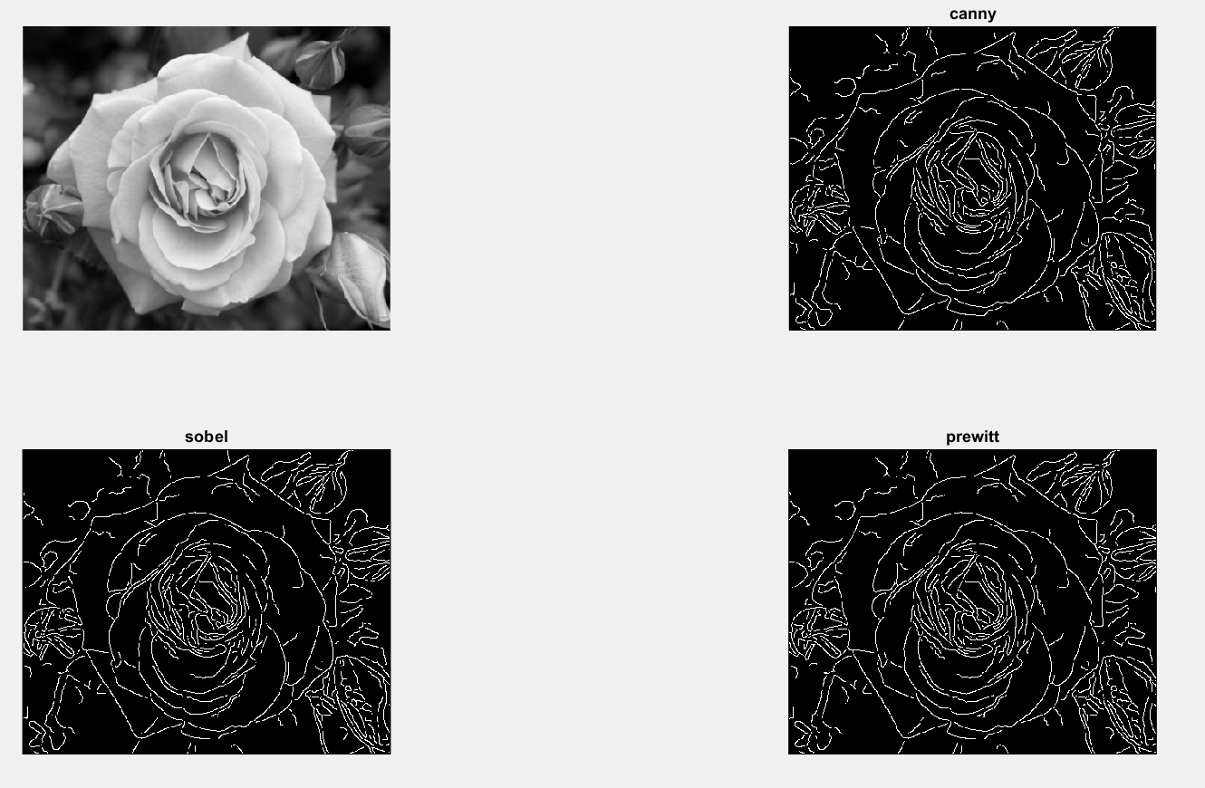
Edge Detection
clc;
clear;close all;
a=imread('rose.png');
a=rgb2gray(a);
b=edge(a,'canny');
c=edge(a,'sobel');
d=edge(a,'prewitt');
figure
subplot(2,2,1);imshow(a);
subplot(2,2,2);imshow(b);title('canny');
subplot(2,2,3);imshow(b);title('sobel');
subplot(2,2,4);imshow(b);title('prewitt');
www.pantechsolutions.net

Slide 10
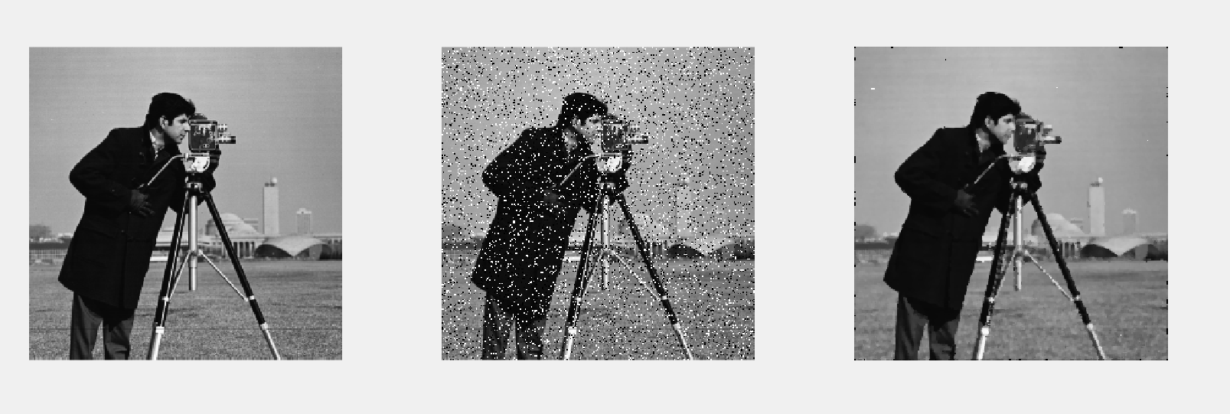
Noise and Filtering
clear;
a=imread('cameraman.tif');
J = imnoise(a,'salt & pepper', 0.12);
C=medfilt2(J,[5 5]);
subplot(1,3,1);imshow(a);
subplot(1,3,2);imshow(J);
subplot(1,3,3);imshow(C);
www.pantechsolutions.net

Slide 11
Thresholding and Image Segmentation
clear;
close all;
clc;
a=imread('coins.png');
imhist(a);
figure;
imshow(a);
b=a>100;
figure;imshow(b);
b=medfilt2(b,[5 5]);
b=uint8(b);
Inewc = a.*b;
imshow(Inewc);title('segmented coins');

Slide 12
Histogram Equalization and contrast Enhancement
a = imread('pout.tif');
b = imadjust(a);
c = histeq(a);
d = adapthisteq(a);
I=[a b c d];
imshow(I);
title("Original Image and Enhanced Images using imadjust, histeq, and adapthisteq")

Slide 13
Count the no of coins in a Image
a=imread('coins.png');
imhist(a);
figure;
imshow(a);
b=a>100;
figure;imshow(b);
b=medfilt2(b,[5 5]);
[L num]=bwlabel(b);
disp(num);
text=strcat('No of Coins=',num2str(num));
title(text);

Slide 14
Printed Certificate &Online Support System @ Rs 500(offer price)
Where you have the recorded video ,Watch at any time
Videos will be enable after live in online support system, take free preview by signing up
learn.pantechsolutions.net
Practice on your own time.
Error support –Take a screen shot and Upload on the comment box in the software, Our team will support
This version is also limited time (60 days Access only, We provide a deadline to make you learn within 30 Days) – Goal without a deadline is a dream.
(Join the 30 Days Challenge )
www.pantechsolutions.net

Slide 15
Thank You

