Slide 1
agenda
Ice-breaker
Openness to Discovery & Personas
Walk & Talk on Genius
BREAK
Share Outs
Impeccable Agreements
Notes:
Becky

Slide 2
by the end of the morning
What brings me to this work?
Who am I when I’m at my best?
Who am I when I’m at my worst?
What agreements will support us in thriving as a team?
Notes:
Becky

Slide 3
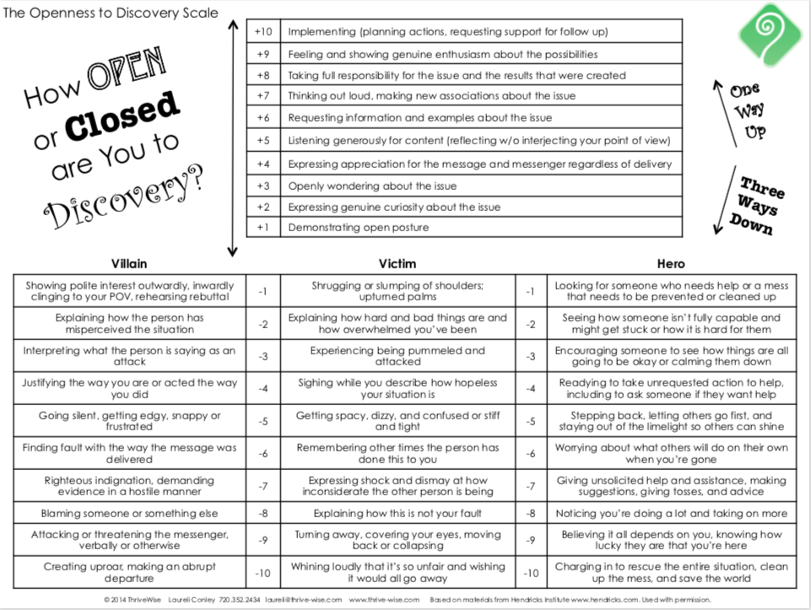
Notes:
Becky

Slide 4
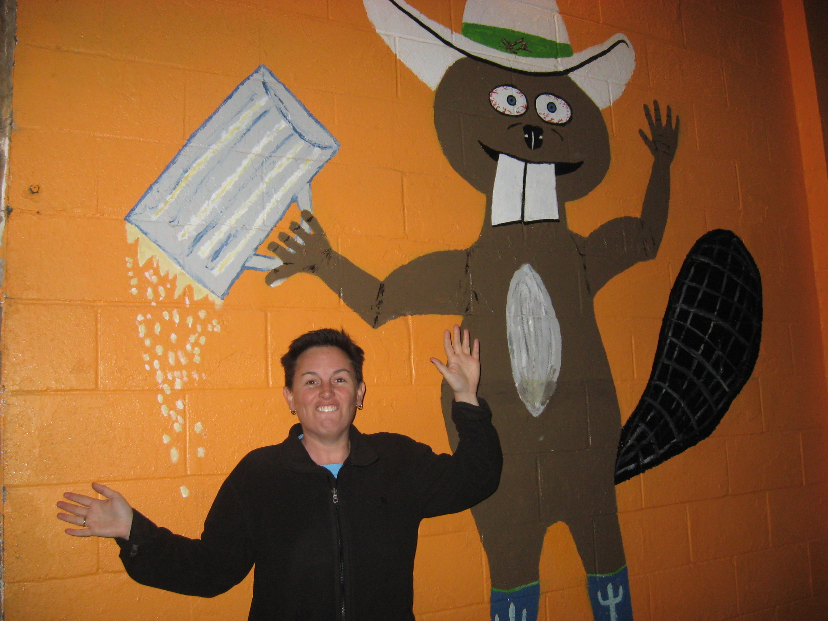
the hero: seeks temporary relief
Notes:
Seeks someone/something to blame

Slide 5
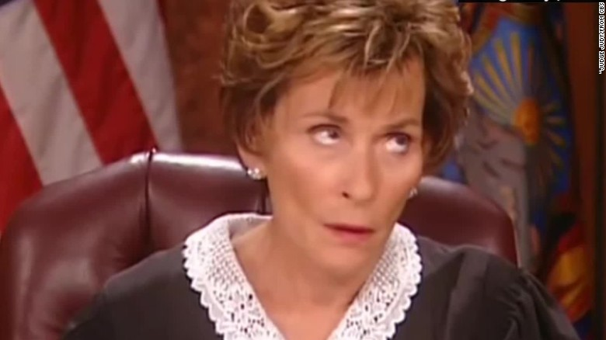
the villain: loves blame & criticism
Notes:
Seeks someone/something to blame

Slide 6
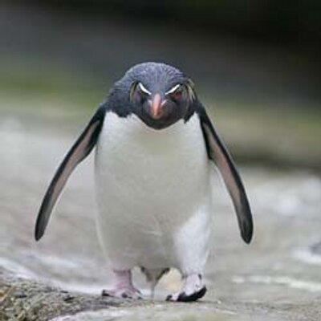
the victim: at the effect of
Notes:
Seeks someone/something to blame

Slide 7
reflection questions
Did your (-) numbers cluster around a # or a type?
What initial insights can you gather from this map?
Notes:
Becky

Slide 8
persona interview
________, what’s the most important thing to you?
________, what are you most proud of?
________, when did you make your first appearance?
________, who did you learn your style from?
________, what are you most afraid of?
________, what do you most want?
Notes:
I wasn’t ok with my boss feeling scared. It made me feel too scared so I wasted a lot of energy trying to prevent that or shut it down.

Slide 9
reflection questions
In pairs, we’re going to do persona interviews with one another; you’ll have ______ minutes total, then also time to de-brief before we pull you back to group.
Notes:
Becky

Slide 10
confession time
Who are you when you’re at your worst?
Notes:
Becky

Slide 11
genius questions
What is my unique ability?
What do I most love to do?
What produces the highest ratio of abundance/impact per time spent?
What do I do that doesn’t seem like work?
Notes:
acknowledge privilege in even asking these questions.

Slide 12
zone of excellence
What do I persist in doing that I can do better than most other people?
Unconscious commitment: doing well but playing it safe
Notes:
Popcorn out

Slide 13
zone of competence
What do I persist in doing that others can do just as well?
Unconscious commitment to sleepwalking, going through the motions, playing small
Notes:
Popcorn out

Slide 14
zone of incompetence
What do I persist in doing that others can do better?
That I do not enjoy?
That I’m no good at?
Unconscious commitment: suffering and frustration
Notes:
Why this matters

Slide 15
walk and talk
We’re going to go on break until 10:45
When we come back at 10:45, you’re going to call one another for a half hour “walk and talk” until 11:15
Choose your own adventure - you may:
Share insights from the genius calendar exercise
Do a “Genius Interview” with one another
Share stories connecting your life map and identities to what you care about now and your personas and/or genius
You’ll have 15 minutes EACH - so it’s your choice how you want to be supported and heard
Notes:
Becky

Slide 16
who calls whom?
CTE Partnerships veteran team member calls new team member/TOL–
Jessica calls Christi
Elizabeth calls Chris
Chuck calls Nicole
Notes:
Becky

Slide 17
share outs
5 minutes each - uninterrupted
Share whatever you feel called to share.
Who are you when you’re at your best?
Who are you when you’re at your worst?
What life experiences bring you to care about this work now?
How have your life experiences and identity given you proximity to the work?
What aspects of your identity or life experiences might mean you have to work harder to understand?
Notes:
Becky: which one of these will be hardest for you and what can you do to make it easier? turn and talk.

Slide 18
impeccable agreements
only say “yes” to things you genuinely want to do.
say “no” to things you don’t have a full-body yes to.
do the things you said you’d do, on time, without needing to be reminded.
if an agreement no longer works for you, proactively change it.
Notes:
Why this matters

Slide 19
changing agreements
acknowledge the original agreement
reveal what has changed for you and what you are now willing to agree to (if anything).
express regard for the other person and ask how this affects them.
request confirmation. make room for their yes or their no.
express appreciation.
Notes:
Why this matters

