Slide 1
T-SQL Programming Best Practices for Developers
Copyright © 2016 Madeira Ltd
All Rights Reserved
Full rights, including copyrights, belong exclusively to Madeira Ltd
No use of the materials, in any form, is allowed,
unless receiving a prior written permission from Madeira Ltd.

Slide 2
Local Variables
and
Parameters

Slide 3
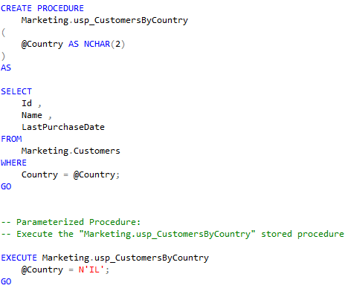
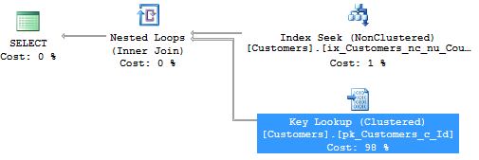

Slide 4
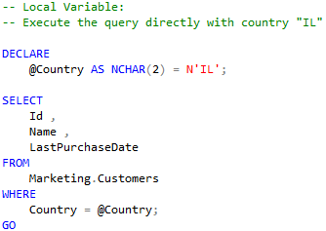
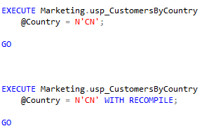
Sub-Optimal Plan
Cached Plan (for IL)
New Plan (for CN)

Slide 5
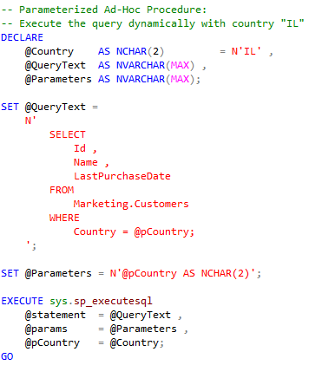

Slide 6
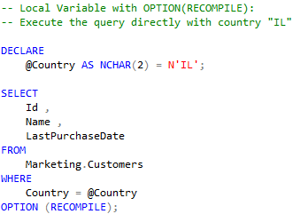
Optimal Plan (at the cost of recompilations)

Slide 7
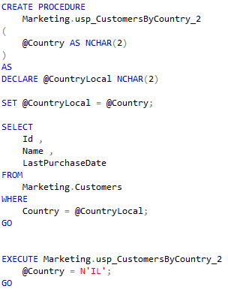
Sub-Optimal Plan

Slide 8
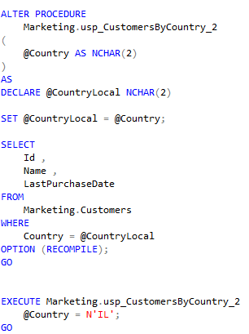
Optimal Plan (at the cost of recompilations)

Slide 9
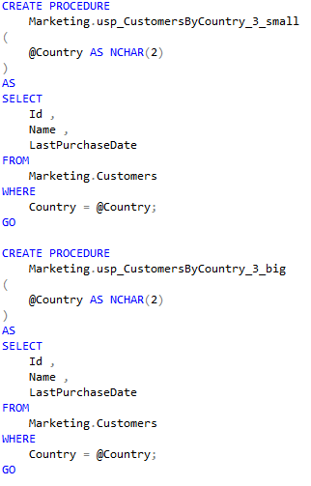

Slide 10
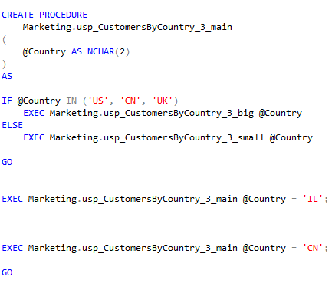
Always Optimal Plan (without cost of recompilations)

Slide 11
Summary
Parameter Sniffing
Local Variables
WITH RECOMPILE
OPTION (RECOMPILE)
Procedure “Branching” to “sub-Procedures”

