Slide 1
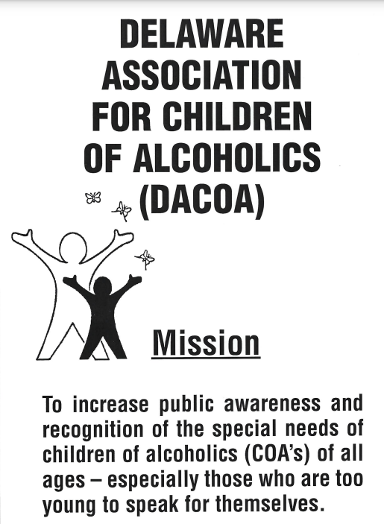
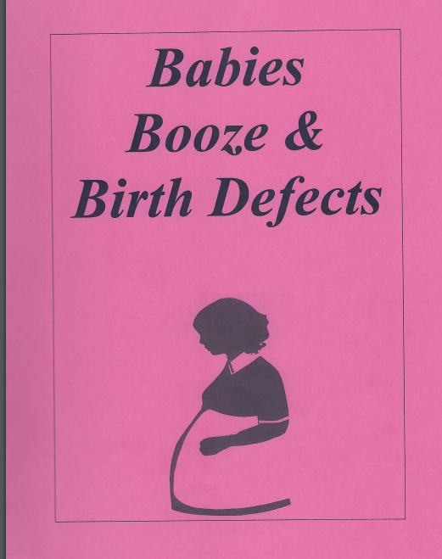
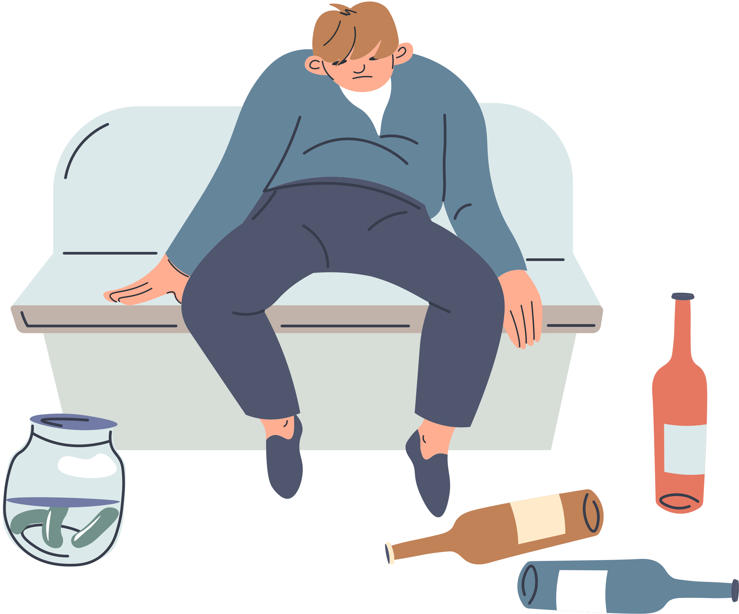
BABIES, BOOZE, & BIRTH DEFECTS

Slide 2
DACOA stands for the Delaware Association for Children of Alcoholics.
The organization is an affiliate of the National Association for Children of Alcoholics and the United Way of Delaware.
The organization does not provide treatment of any kind, but directs people to appropriate self=help and professional resources.
The Delaware Association for Children of Alcoholics' mission is to increase public awareness and recognition of the special needs of children of alcoholics (COAs) of all ages, especially those who are too young to speak for themselves.
There are 18 million alcoholics in our nation. Another 29 million, or one out of every eight, are affected by parental alcoholism. In Delaware, 85,000 adults suffer from the effects of family alcoholism. Another 27,000 to 40,000 school-age children have at least one alcoholic parent. Family alcoholism has a devastating impact: 55% of all family violence occurs in alcoholic homes. Incest is twice as likely among daughters of alcoholics. Children of alcoholics are there to four times more likely to become alcoholic than the general population. 70% of COA children develop patterns of compulsive behavior as adults, including alcoholism, drug abuse or overeating. For years, this condition was kept secret. One steadfast rule in the alcoholism, drug abuse, or overeating.
For years, this condition was kept secret. One steadfast rule in the alcoholic family is never to talk about the problem. DACOA speaks out.
Compiled and Edited by
Barbara P. Ridge, Ph.D., LCSW
Executive Director, Delaware Association for Children of Alcoholics

Slide 3
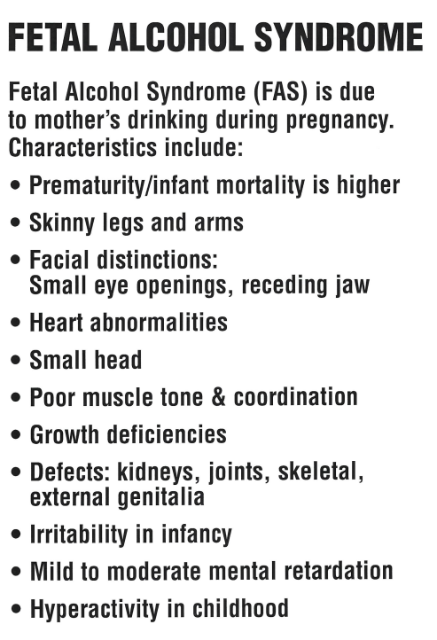
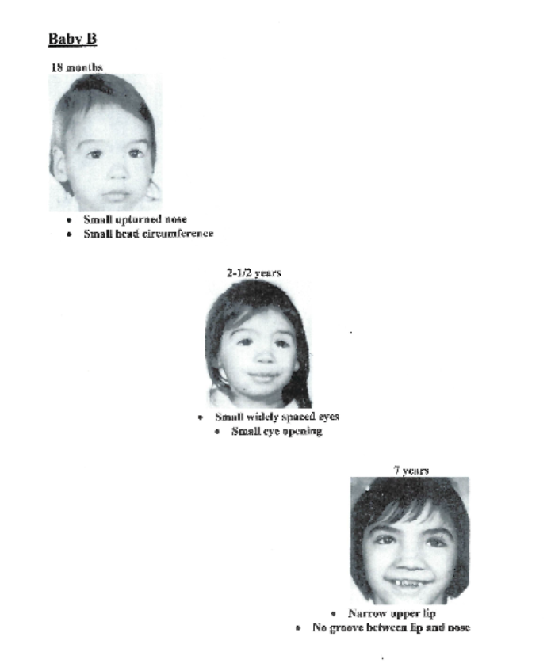

Slide 4
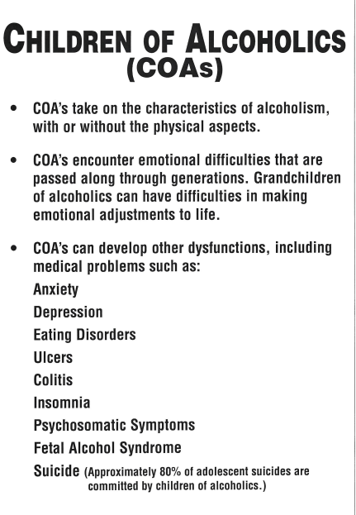


Slide 5
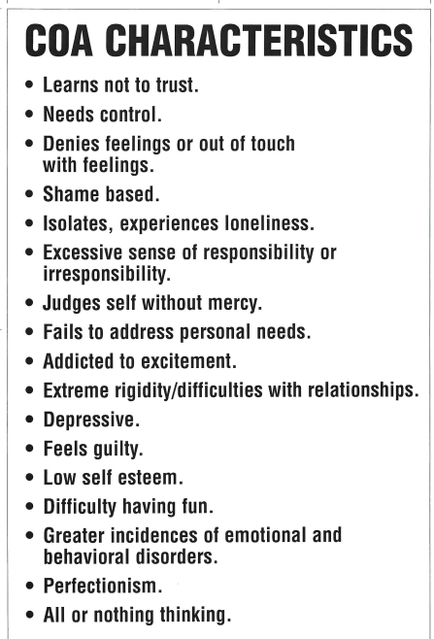
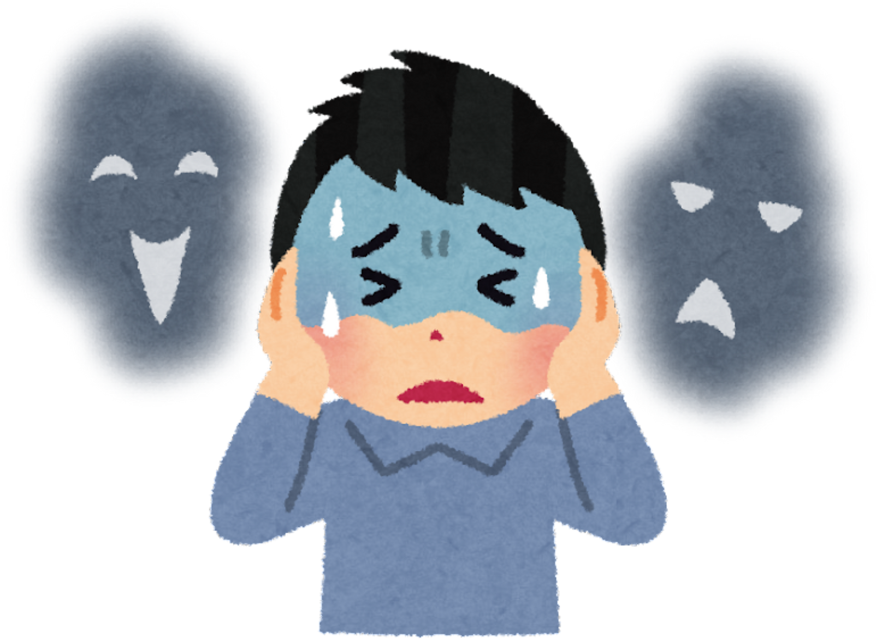

Slide 6
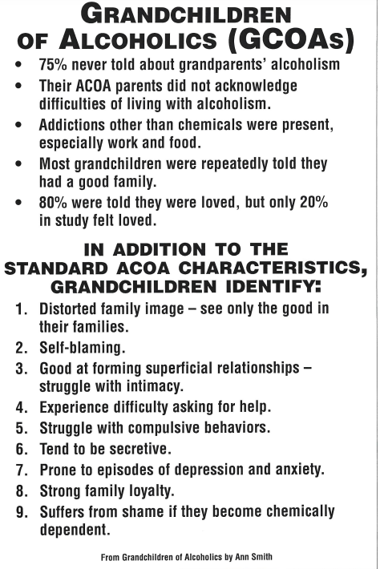


Slide 7
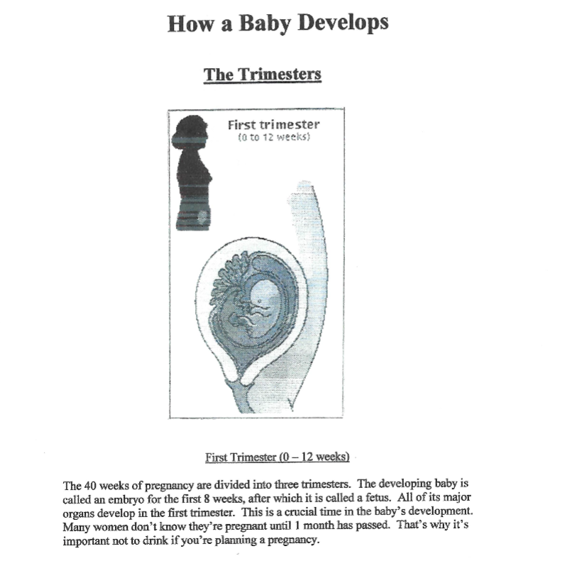
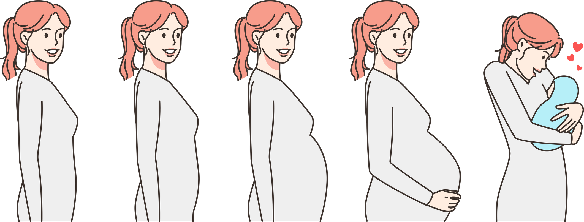
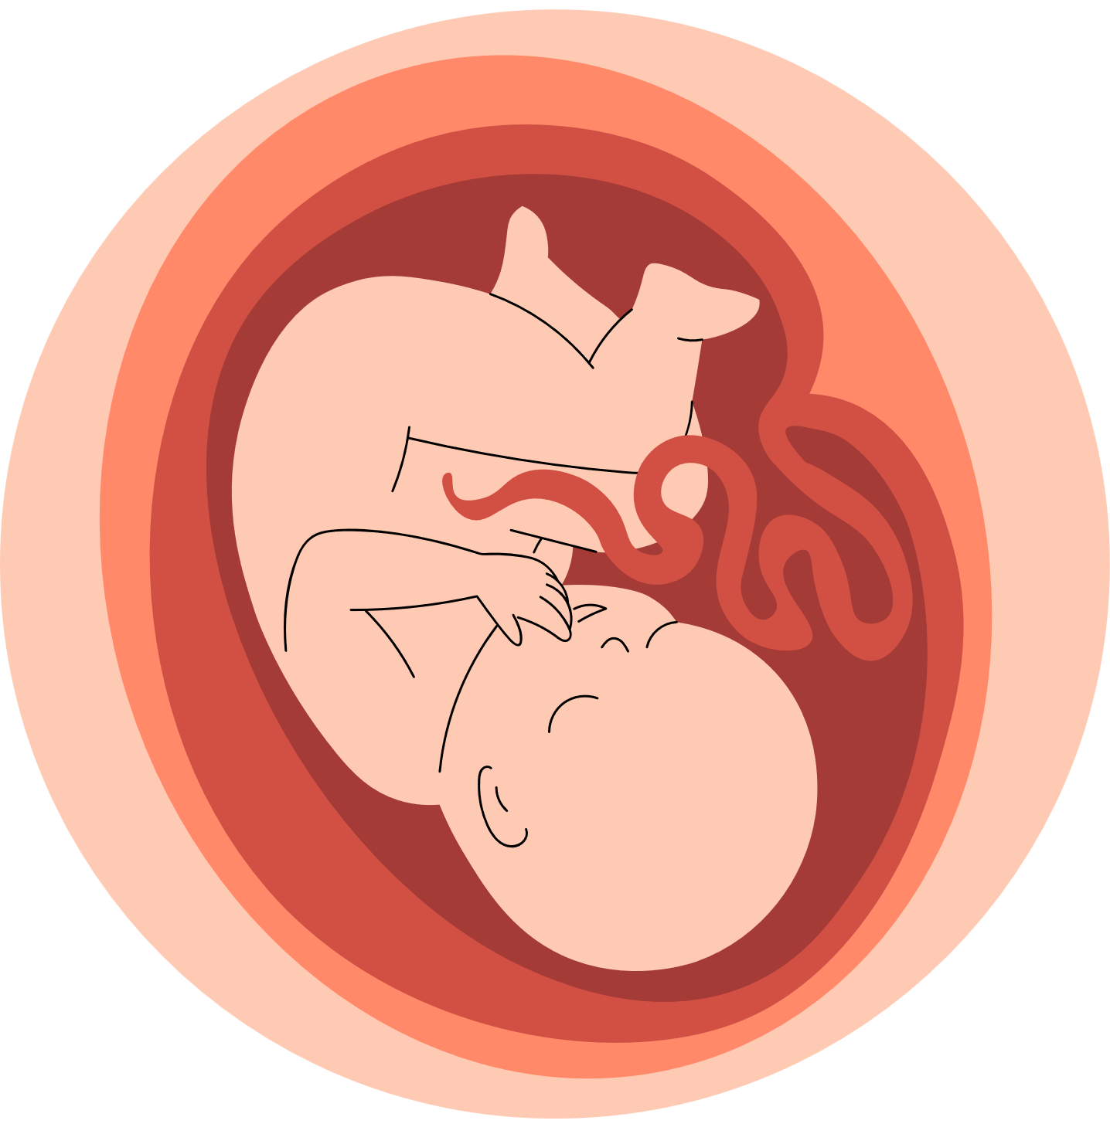

Slide 8
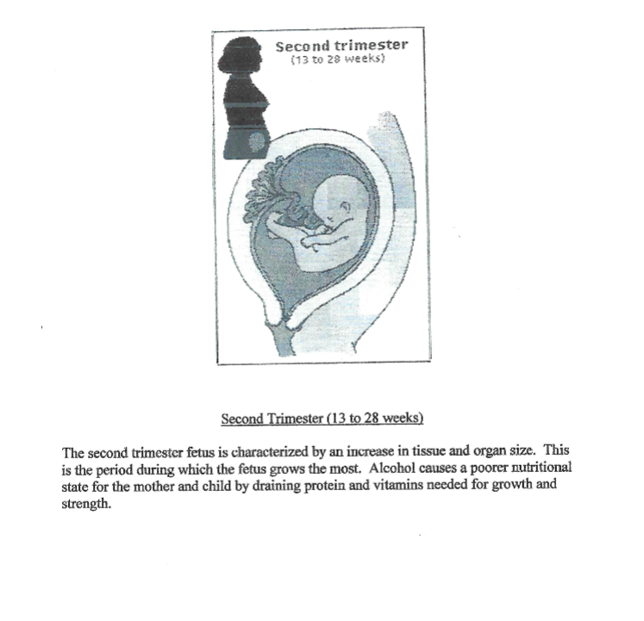

Slide 9
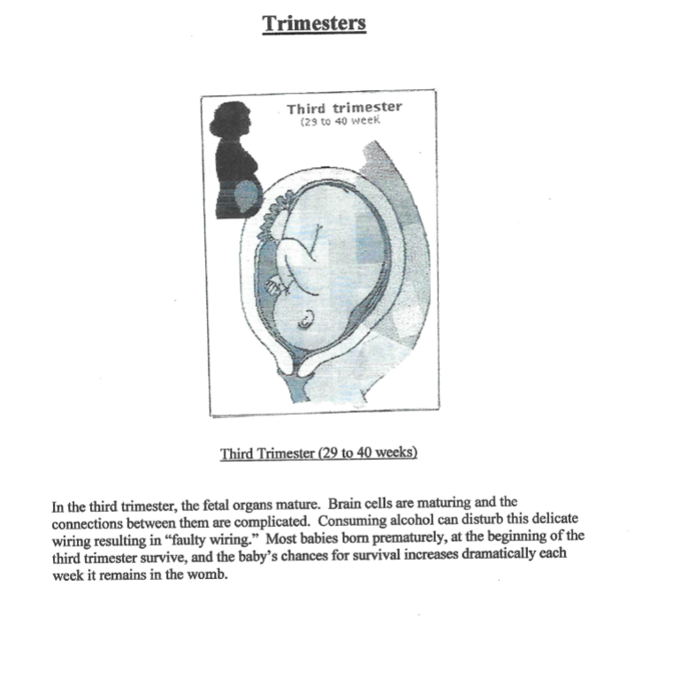


Slide 10
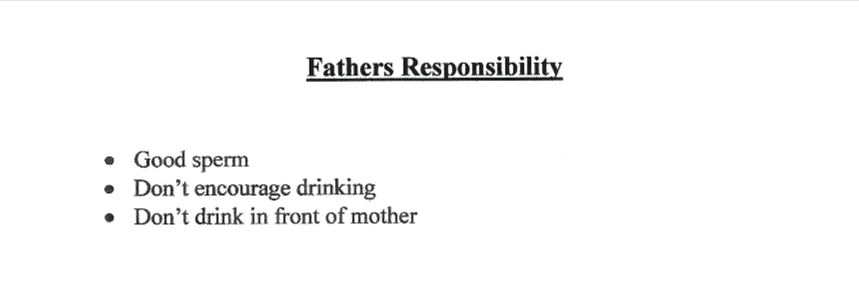


Slide 11

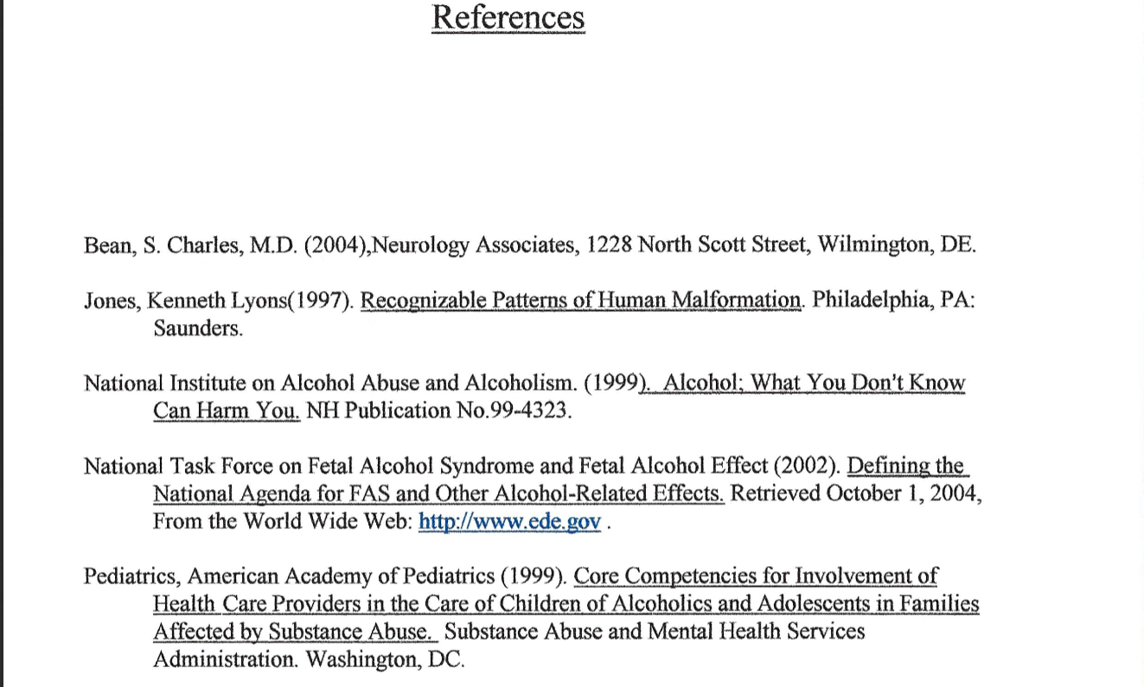
https://dacoa-online.teachable.com/

