Slide 1
Buying Lunch in the Cafeteria

Slide 2
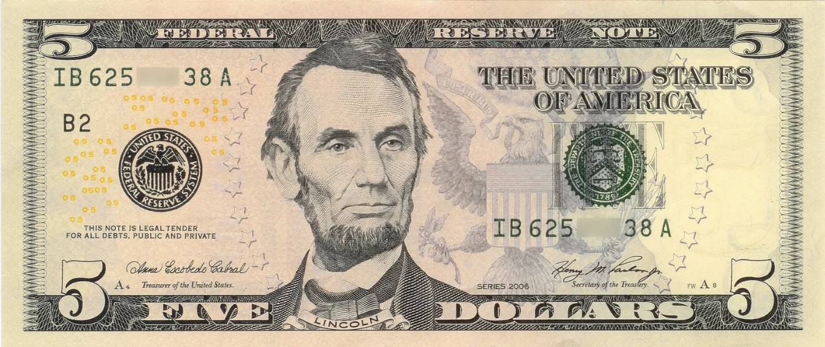
Before you leave the classroom…
#_____
Get your lunch money.
Remember your ID ##.

Slide 3
Go to the lunch line.

Slide 4
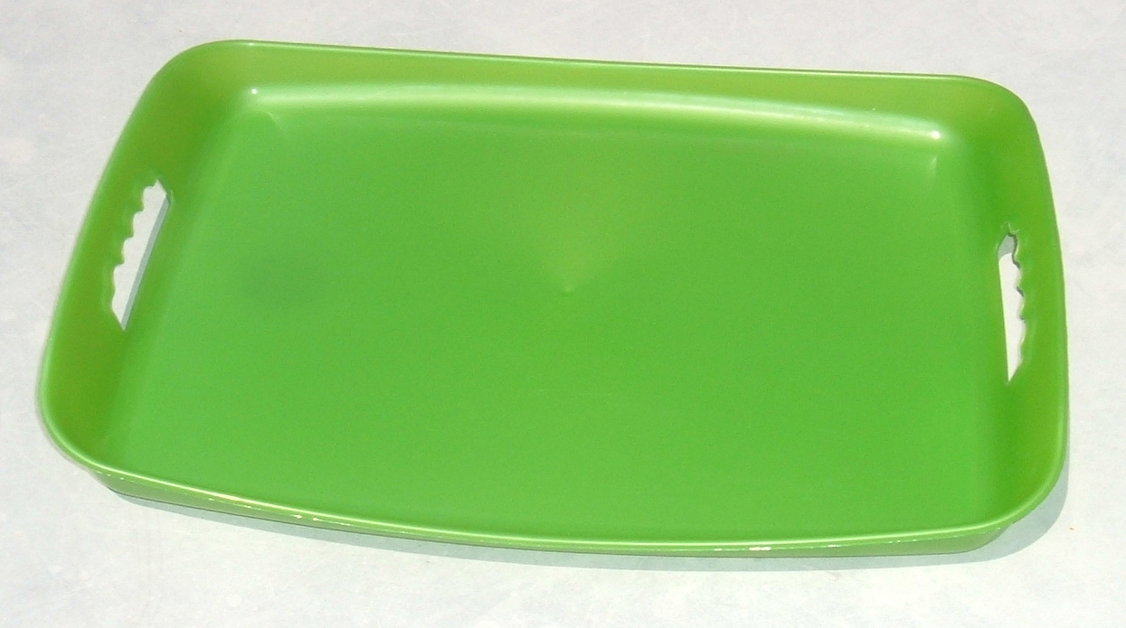
Pick up a tray.

Slide 5
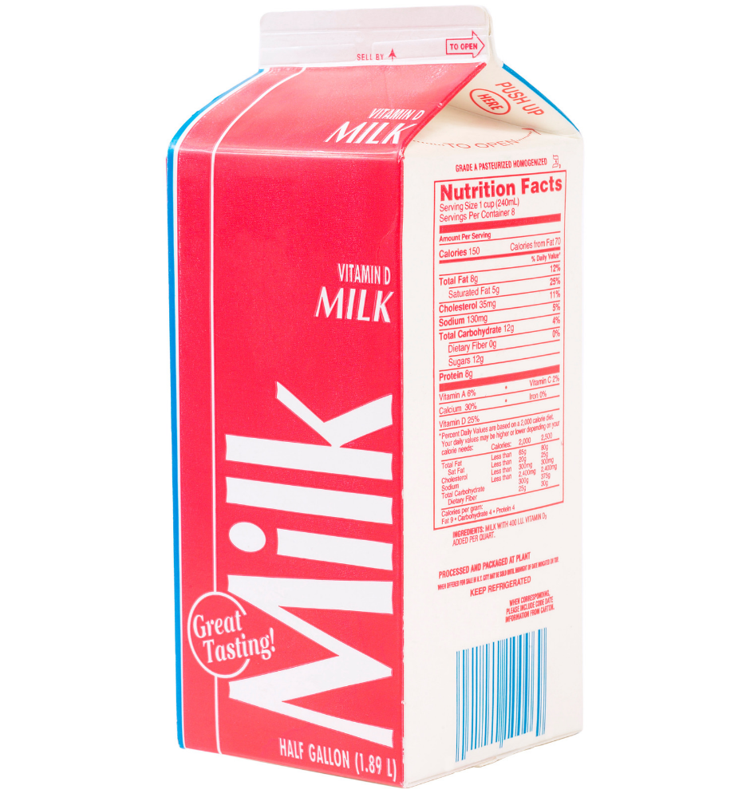
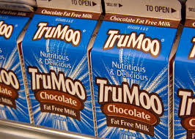
Get a milk.

Slide 6
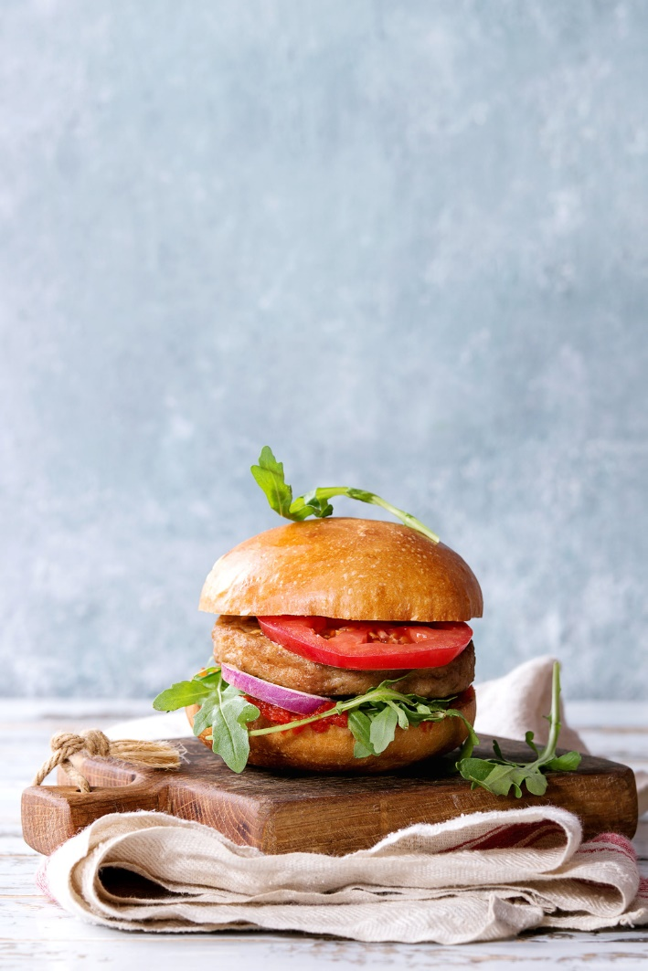
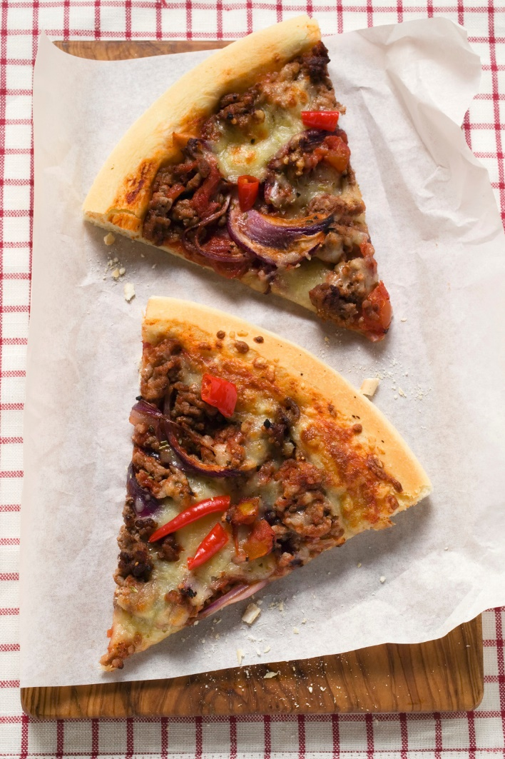
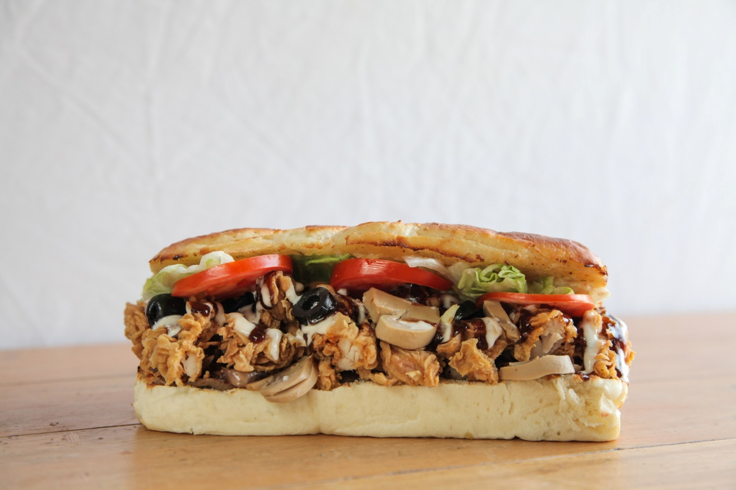
Choose an entrée.

Slide 7
Get a fruit.

Slide 8
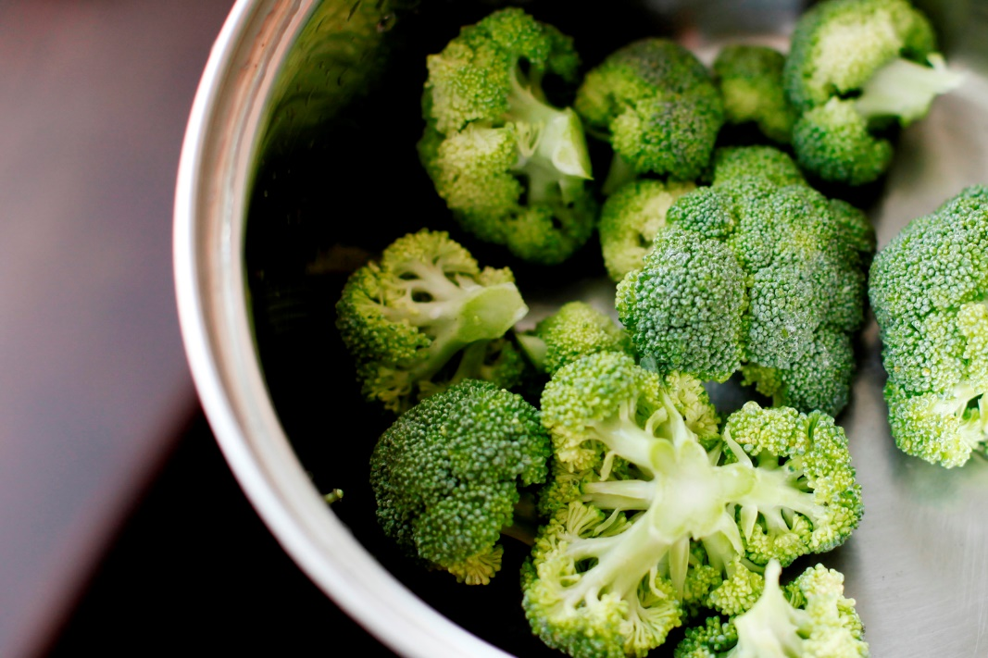
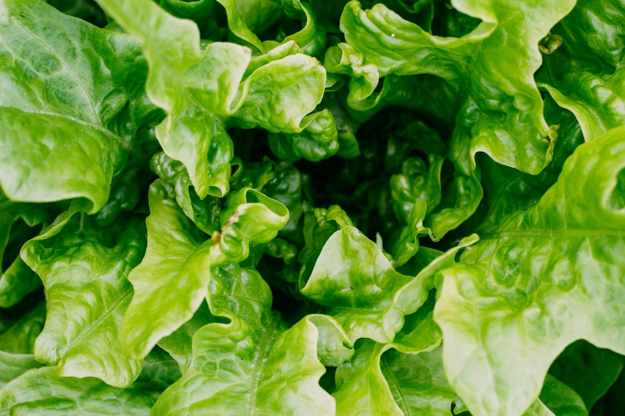
Get a vegetable.

Slide 9
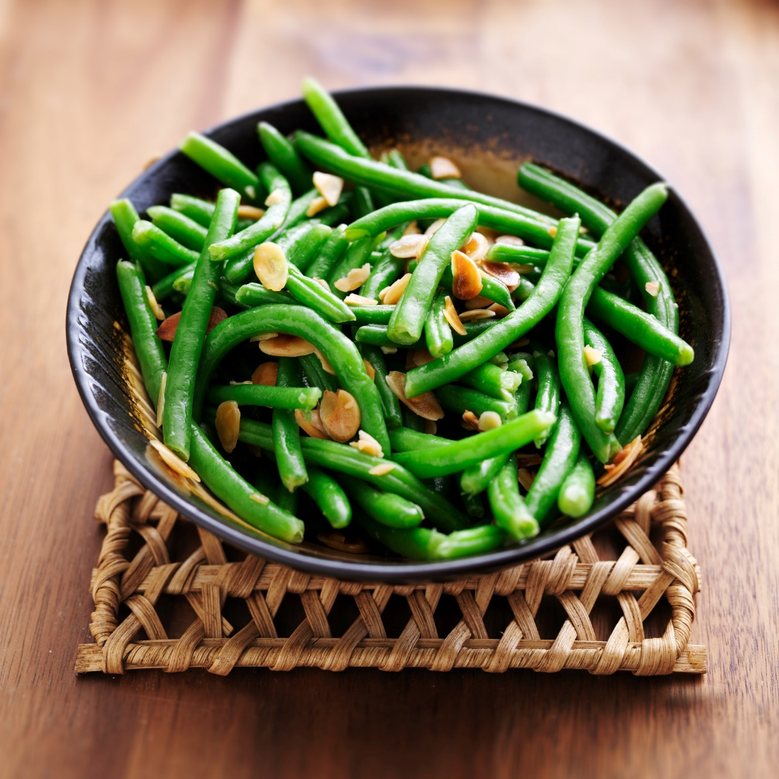
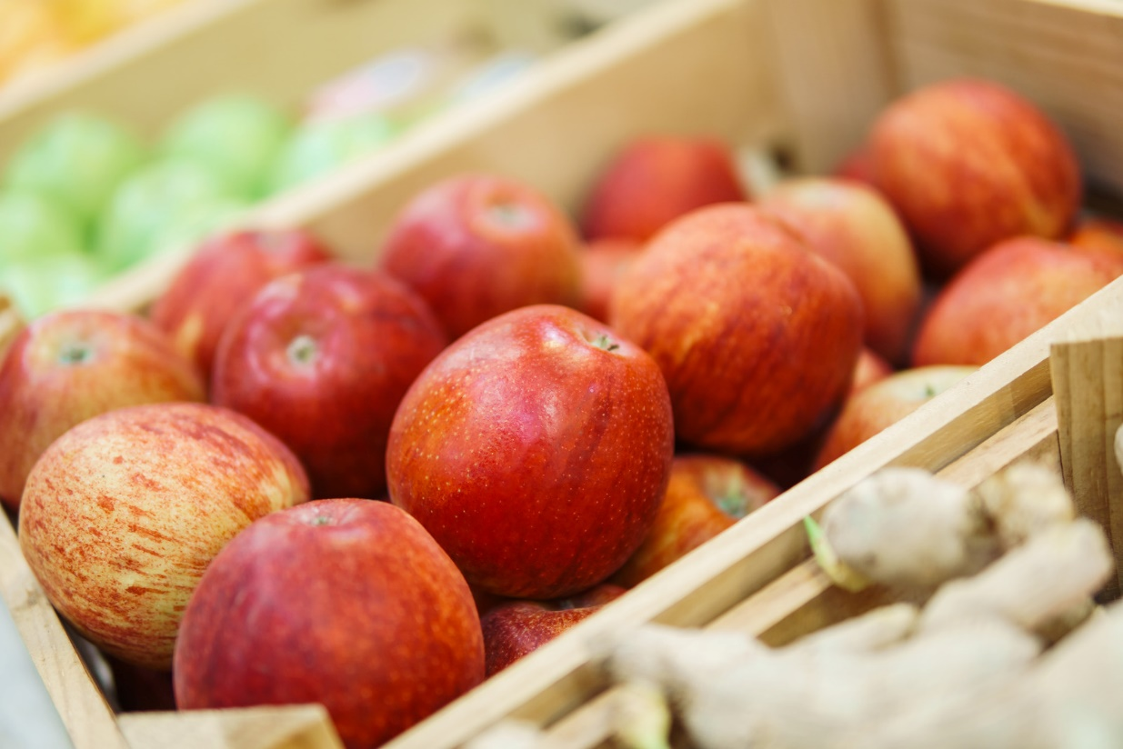
Choose another side dish.

Slide 10
Sometimes there is dessert.

Slide 11
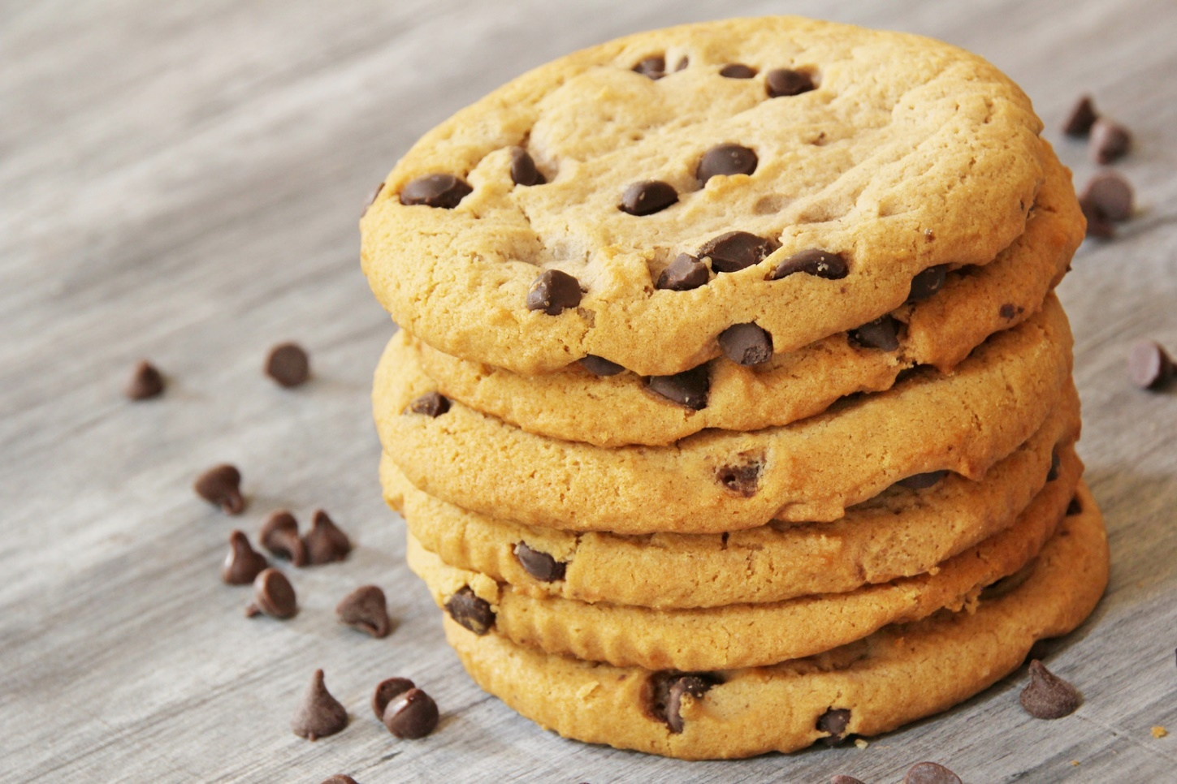
Cookies and special drinks may cost extra.

Slide 12
How many items are you allowed to get at your school?
???

Slide 13
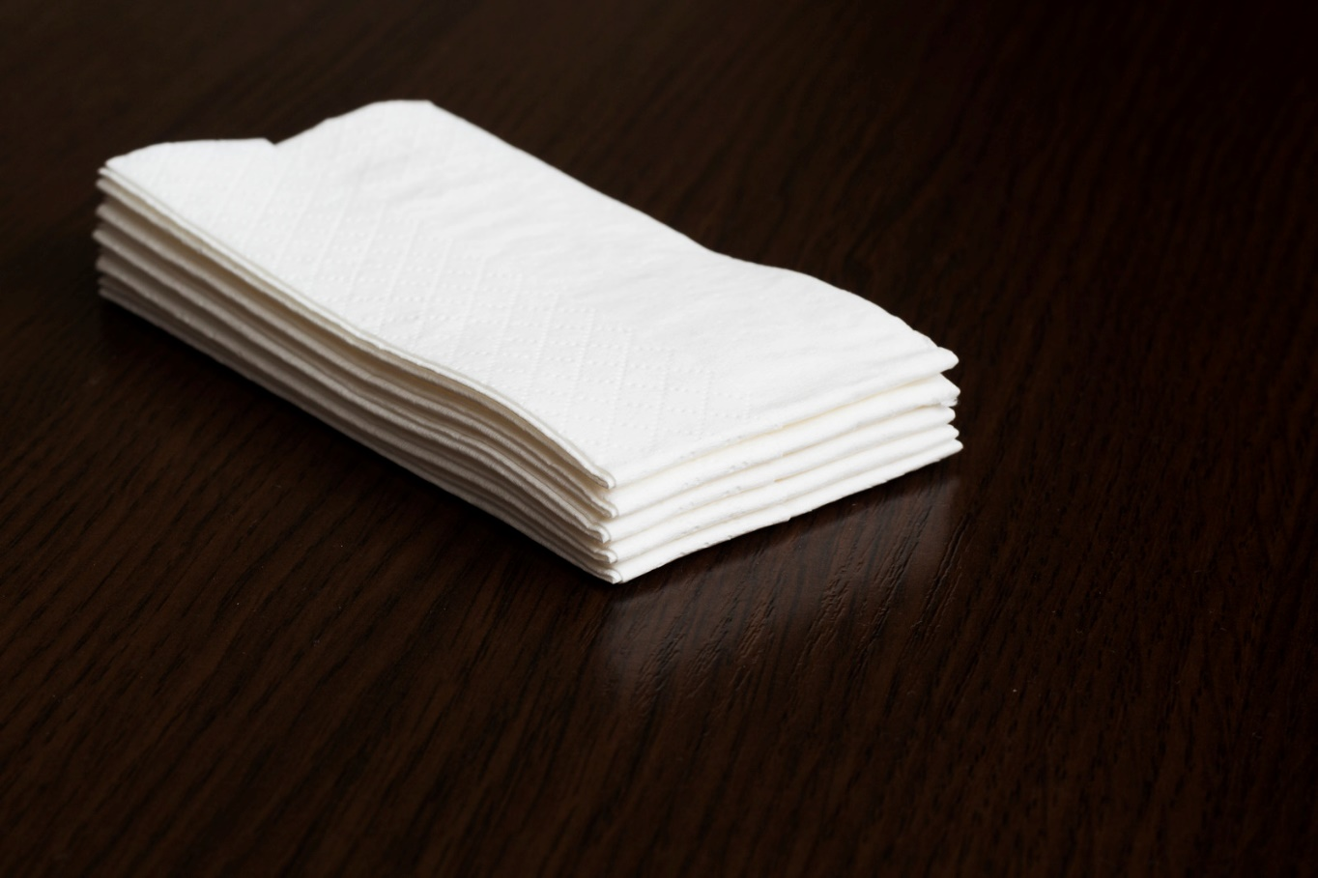
Don’t forget utensils!

Slide 14
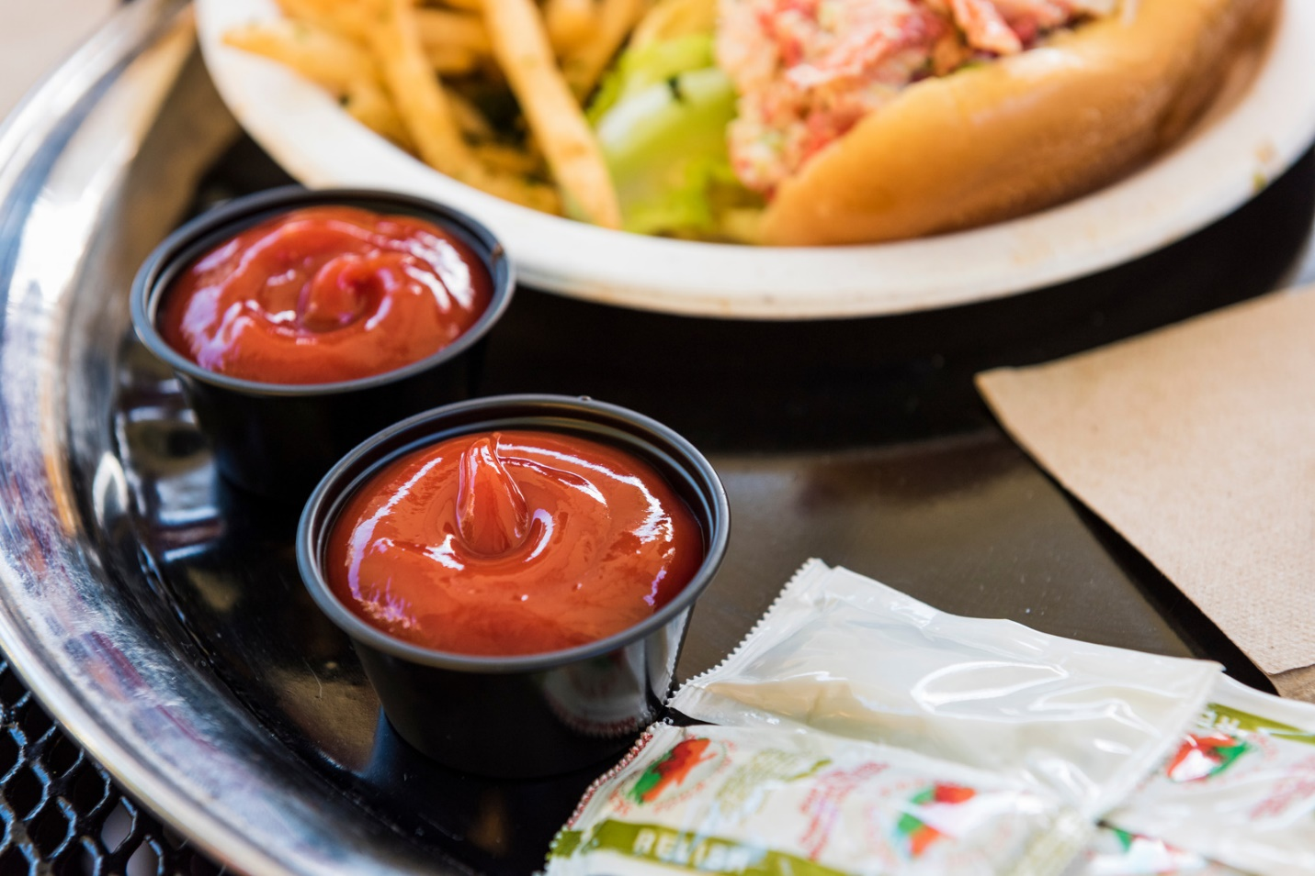
Get condiments.

Slide 15
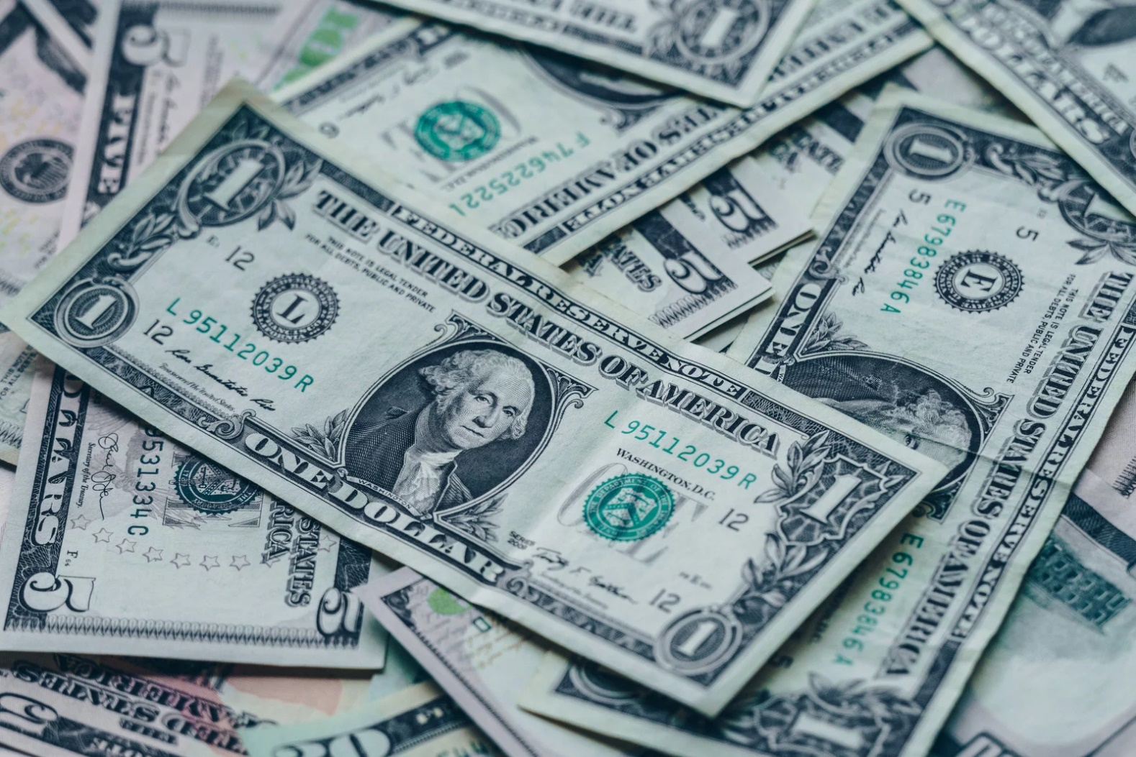
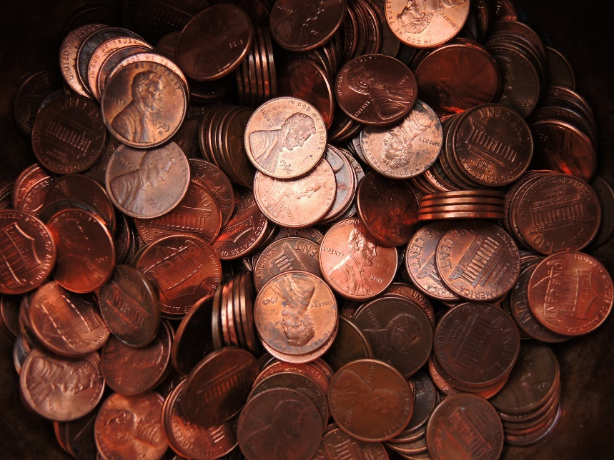
Make sure you have enough money.

Slide 16
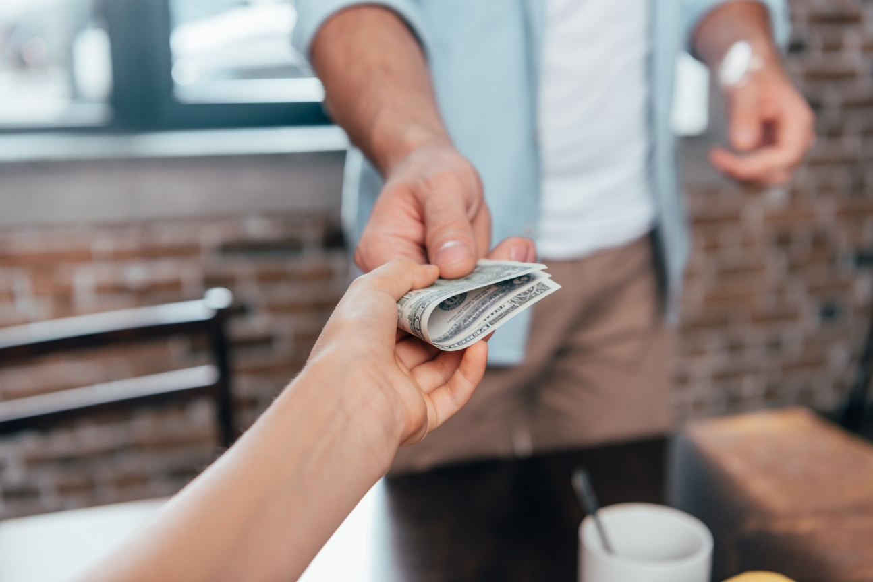
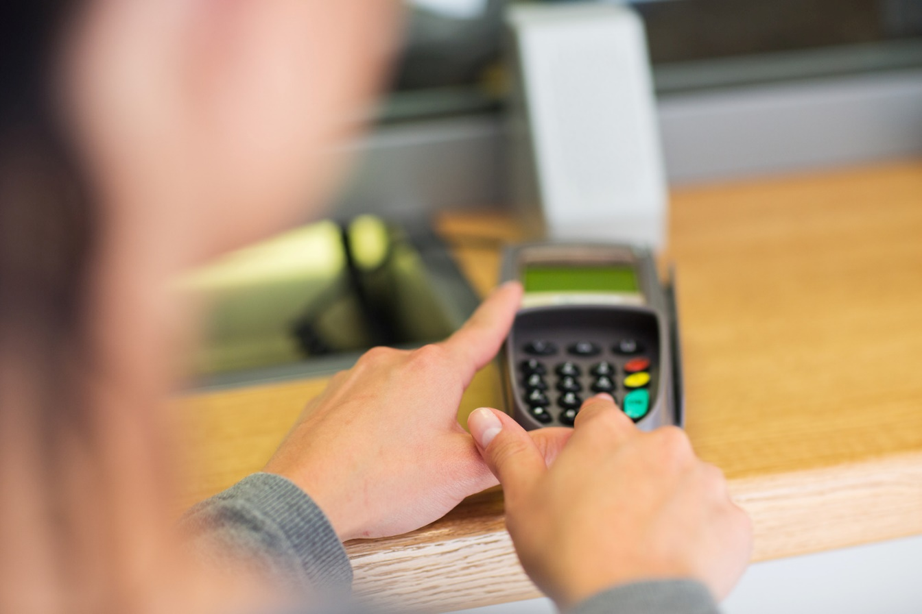
Pay for your meal with cash, or enter your number.

Slide 17
Say, “thank you!”

Slide 18
Pick up your tray and walk to your table.

Slide 19
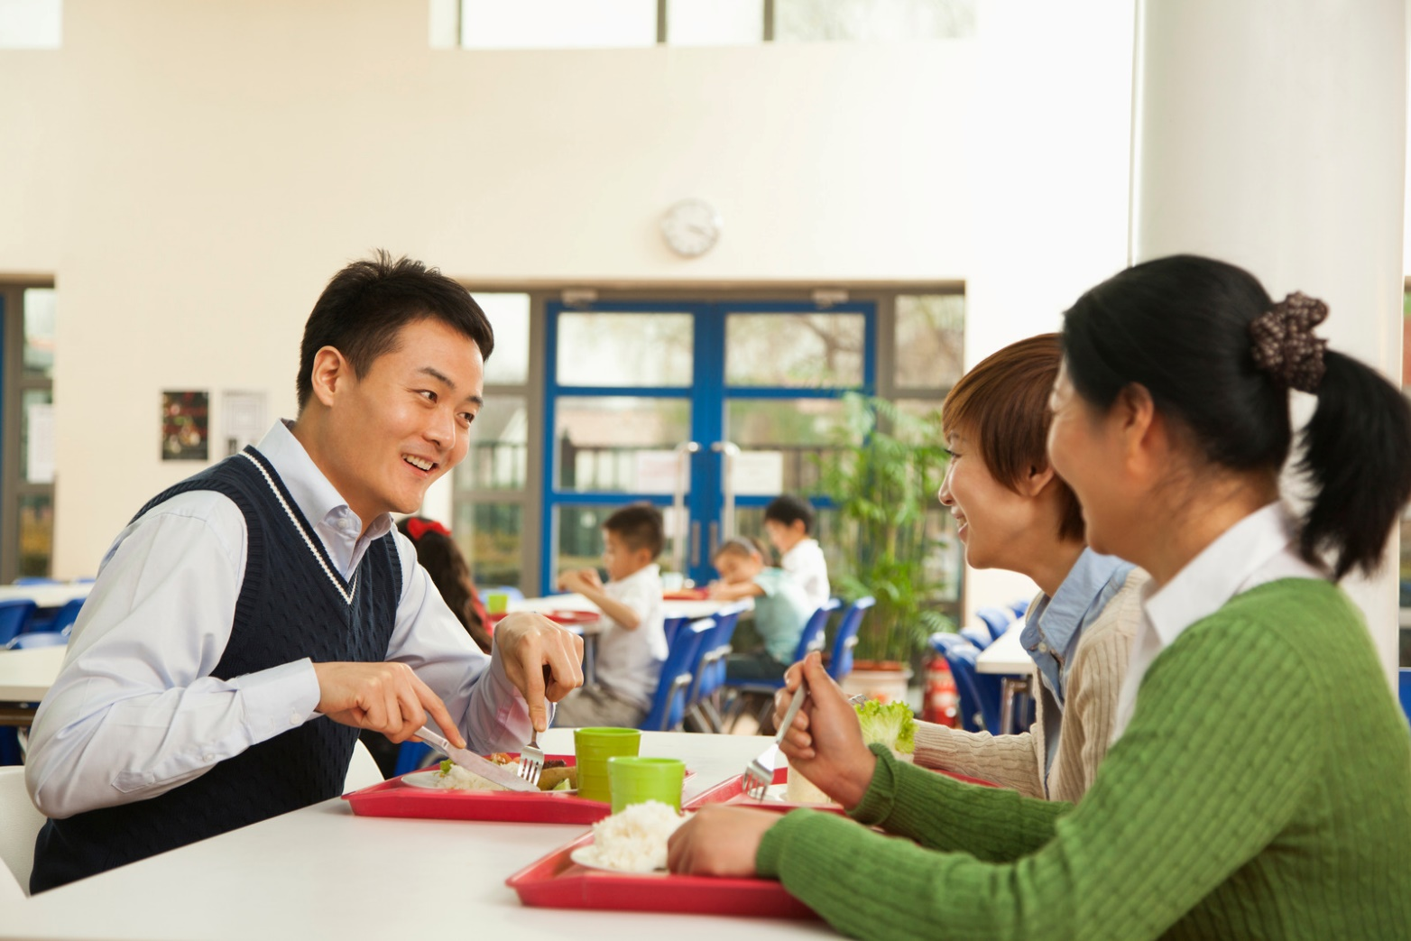
Sit down and eat!

Slide 20
Ask if you need help opening anything.

Slide 21
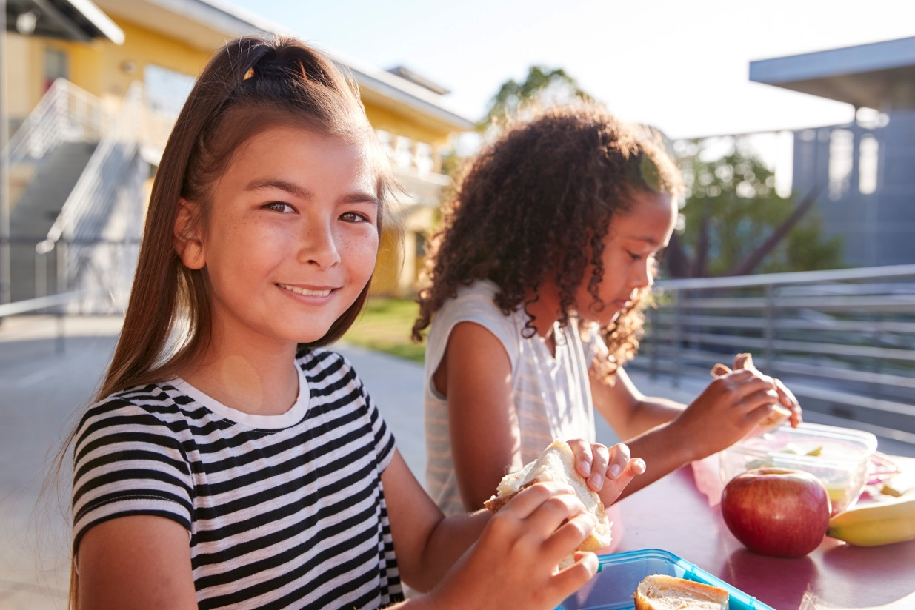
Happy Eating!!!

Slide 22
Review:
What are the steps for buying your lunch at school?
Can you name some entrées?
Can you give example of fruits & vegetables?
How many kinds of milk are there?

