Slide 1
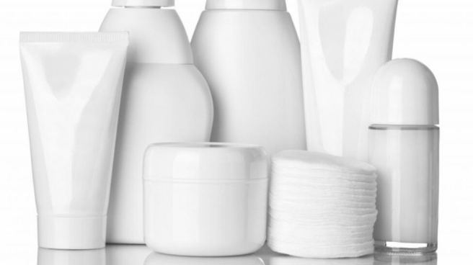
SKINCARE 101
With Dr. Gretchen Frieling

Slide 2
Layering
Hydration
Theory
Notes:
Layering hydration theory (korean)

Slide 3
THINNEST
THICKEST
Notes:
Layer products from thinnest to thickest
The more hydrated your skin is, the more absorptive potential it has
The OUTERMOST LAYER of the skin: STRATUM corneum
Can absorb up to 5-6X its weight in water
A health SC needs a water content of 10%
IDEALLY, the water content is 20-30%

Slide 4
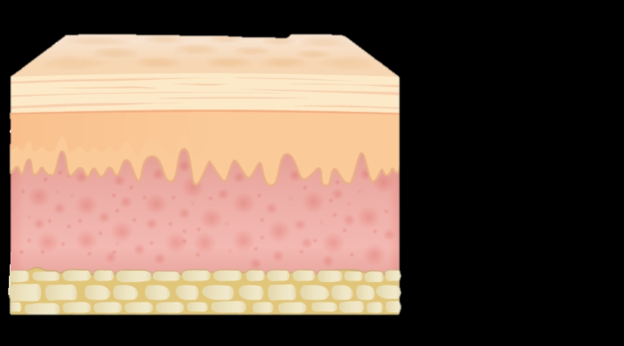
Stratum Corneum (SC)
The OUTERMOST LAYER of the skin:
- Can absorb up to 5-6X its weight in water -
- A health SC needs a water content of 10% -
- IDEALLY, the water content is 20-30% -

Slide 6
What are the essential hydrating ingredients?

Slide 7
Humectants
Emollients
Hydration
Occlusives

Slide 8
What are Humectants ?
Drive water into the skin– go down to dermal layers
Hyaluronic acid: binds up to 1000X it’s molecular weight in water
Glycerin
Honey
Panthenol
Sorbitol

Slide 9
What are emollients ?
Sit on the top of the Stratum Corneum and give the “smooth” feeling
Dimethicone
Jojoba oil
Fatty alcohols like propylene glycol
Silicones
Also occlusive
Common emollient ingredients:
Petrolatum
Lanolin
Lecithin
Cetyl alcohol
Stearic acid

Slide 10
What are occlusives?
Form a protective film/layer
Think of them as the “saran wrap” of your skin
Blocks the evaporation of water via “trans-epidermal water loss”
Dryness, flaking, itching
Blocks the entrance of allergens and irritants

Slide 11
What makes a good occlusive?
Size of the molecule
Larger molecules>>>smaller molecules
Combined with other ingredients for enhanced usability
Many are combined with humectants
Examples:
Petrolatum
Olive oil (“OL”)
Mineral oil
Beeswax
Lanolin
Argan oil *(LINOL)
Jojoba oil
Safflower oil
Tamanu oil
Notes:
Form a protective film/layer
Think of them as the “saran wrap” of your skin
Blocks the evaporation of water via “trans-epidermal water loss”
Dryness, flaking, itching
Blocks the entrance of allergens and irritants
Mineral oil and petrolatum are best- BUT they are gasoline byproducts- so their effect on the environment is controversial
Yellow- more environmentally friendly
Olive oil- great occlusive but not as moisturizing; rich in OLEIC acid which can create tiny holes in your skin and therefore damage the skins natural barrier
Argan oil- BEST OPTION- rich in linoleic acid and can help REPAIR the skins natural barrier; also has anti-inflammatory and anti-oxidant properties bc of high linoleic acid and vitamin E; BEST one comes from morocco– here is a good one

Slide 12
Now lets get to your routine…..

Slide 13
CLEANSE/EXFOLIATE
TONE
EYE CREAM
SERUMS
Brighteners
Hydrators
Vitamins
MOISTURIZE
PROTECT- SPF

Slide 14
STEP 1:
CLEANSE/EXFOLIATE
Notes:
Arguably the most important step
Removes dirt and impurities
Helps the rest of the products absorb most efficiently
Avoid cleansers with sulfates
Strip skin of essential moisturizing lipids
After cleansing, PAT your skin (no cloths)
Helps prevent transfer of bacteria
Leaving the skin slightly damp is considered one of your “hydrating” steps

Slide 15
SULFATES

Slide 16
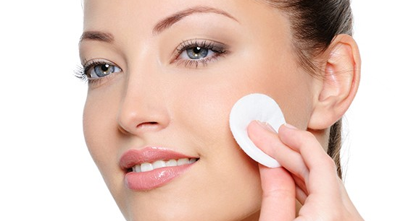
STEP 2:
TONER
Notes:
Can contain:
Acids (AHA/BHA)
Glycerin
Anti-oxidants
Anti-inflammatories
After cleansing, toners delivers mild exfoliation and hydration
Can act as a skin primer before you apply your makeup
Re-calibrates the skin’s pH (normally acidic)

Slide 17
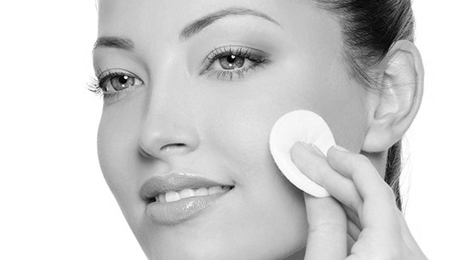
Toners can contain:
Acids (AHA/BHA)
Glycerin
Anti-oxidants
Anti-inflammatories
After cleansing, toners delivers mild exfoliation and hydration
Can act as a skin primer before you apply your makeup
Re-calibrates the skin’s pH (normally acidic)
Notes:
Historically, contained a high concentration of alcohol
Overly drying
Recommended for oily skin—can lead to excess dryness or even more oil production
Skin gets ”confused”
Modern technology
Most are alcohol FREE
No longer only for acne-prone and/or oily skin types
Mists are great

Slide 18
WHEN do I use it?
The step AFTER cleansing
This eliminates dirt, dead skin cells, and makeup
The beneficial ingredients in the toner can then reach their cellular target
Recommended to include in your morning and evening skincare routine
Use within a MINUTE after cleansing
Skin absorption is enhanced when the skin surface is DAMP
Applying active ingredients this way is much more effective
Notes:
Historically, contained a high concentration of alcohol
Overly drying
Recommended for oily skin—can lead to excess dryness or even more oil production
Skin gets ”confused”
Modern technology
Most are alcohol FREE
No longer only for acne-prone and/or oily skin types
Mists are great

Slide 19
Application
Personal preference
Dab directly on skin
Use cotton ball/pad
7 step method (Korean)
Layer a small amount of toner and pat in gently, seven times
Notes:
Historically, contained a high concentration of alcohol
Overly drying
Recommended for oily skin—can lead to excess dryness or even more oil production
Skin gets ”confused”
Modern technology
Most are alcohol FREE
No longer only for acne-prone and/or oily skin types
Mists are great

Slide 20
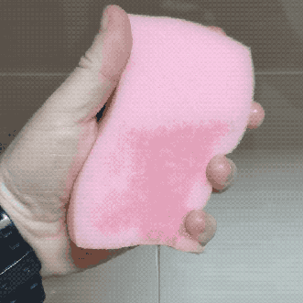
Notes:
Pic of wet sponge to dry sponge (animation)
After a toner, your skin is prepped for absorbing other products
If you put a heavy cream on a dry sponge, it isn’t ready to accept or absorb that cream

Slide 21
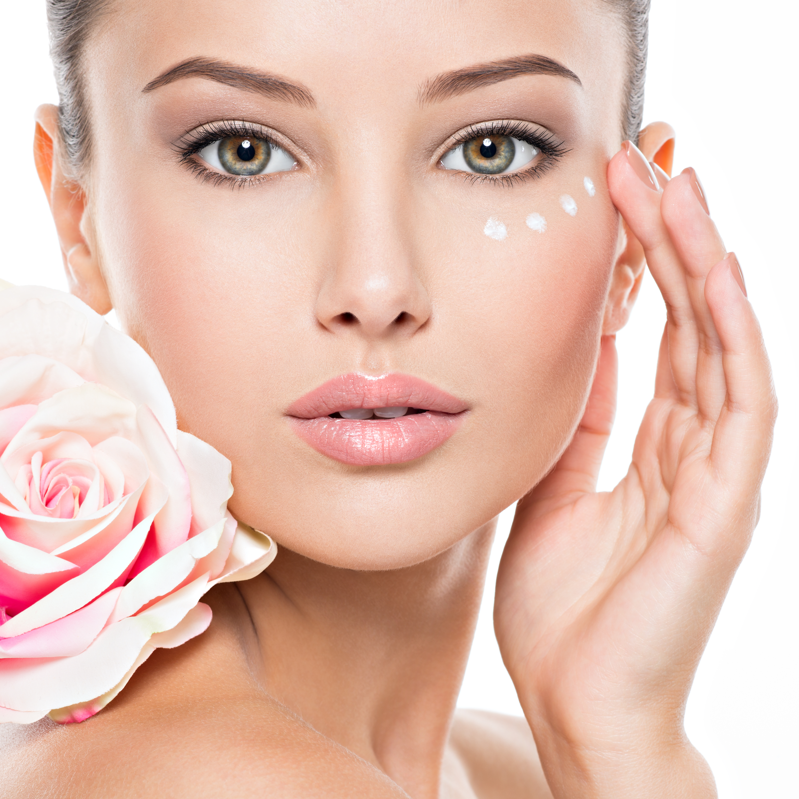
STEP 3:
EYE CREAM
Notes:
Peri-ocular skin is the thinnest, has the fewest oil glands, and starts to show the signs of aging first

Slide 22
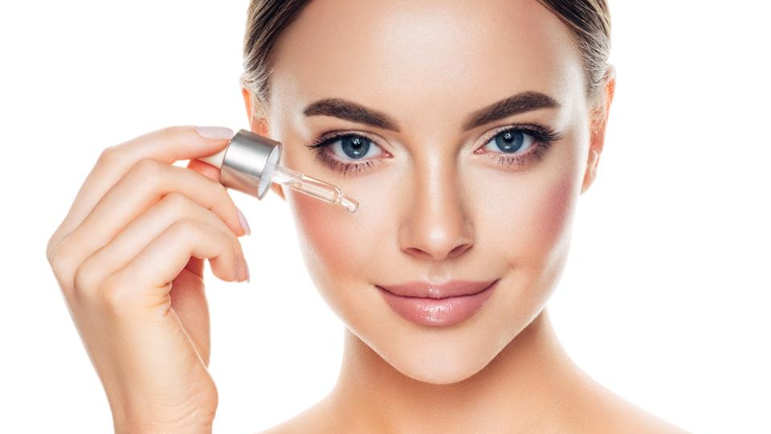
STEP 4:
SERUM

Slide 23
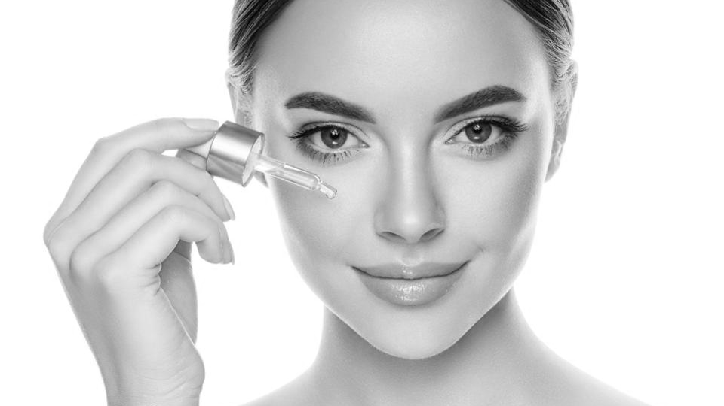
HIGHEST concentration of active ingredients
Ultra hydration
Hyaluronic acid
Fruit extracts
Squalane
Vitamin E

Slide 24
x2
Notes:
Double seruming
Thinnest to thickest
Think of textures as a delivery system
Thinner→deeper
Thicker→moisturize superficially
Brown spots, fine lines, wrinkles

Slide 25
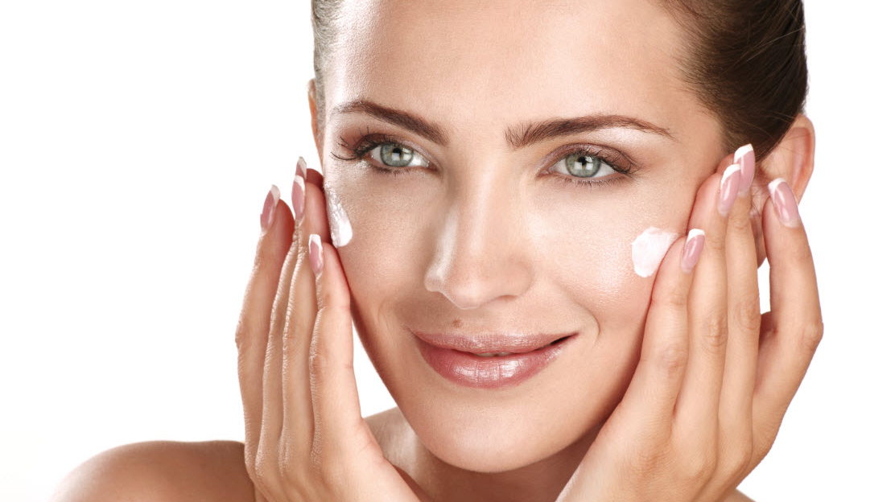
STEP 5:
Moisturize
Notes:
Hydrating and emollient properties
Nourishing
Emollients
Soften surface/dry flakes/patches
Hydrators
Lock the moisture into the skin
Barrier moisturizing creams
Protect the skins barrier
High in cholesterol, fatty acids, ceramides

Slide 26
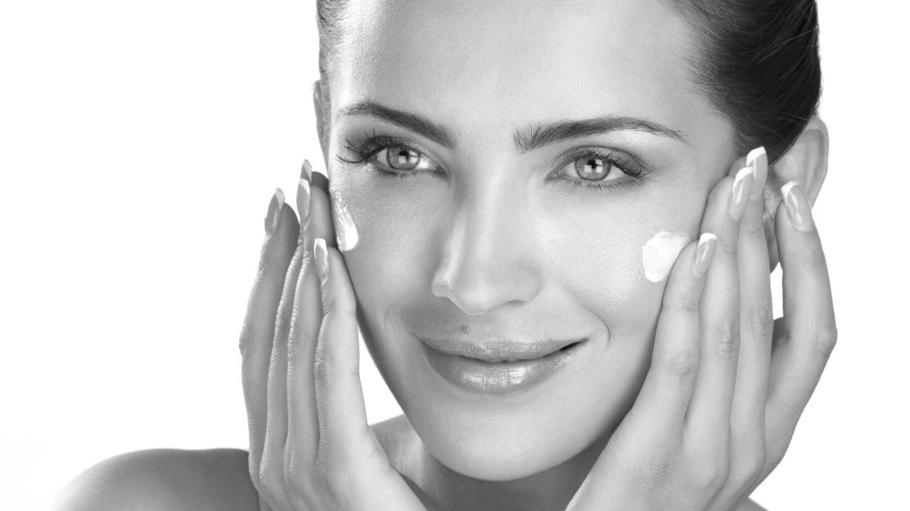
Hydrating and emollient properties
Nourishing
Emollients
Soften surface/dry flakes/patches
Hydrators
Lock the moisture into the skin
Barrier moisturizing creams
Protect the skins barrier
High in cholesterol, fatty acids, ceramides

Slide 27
WHICH COMES FIRST? MOISTURIZER OR OIL?
Notes:
MOISTURIZER FIRST
OIL SECOND
Most oils can penetrate moisturizers, but not vice versa
Most oils are occlusive and create a barrier that locks in the previously-applied ingredients
You CAN also mix them together
Some people skip oils

Slide 28
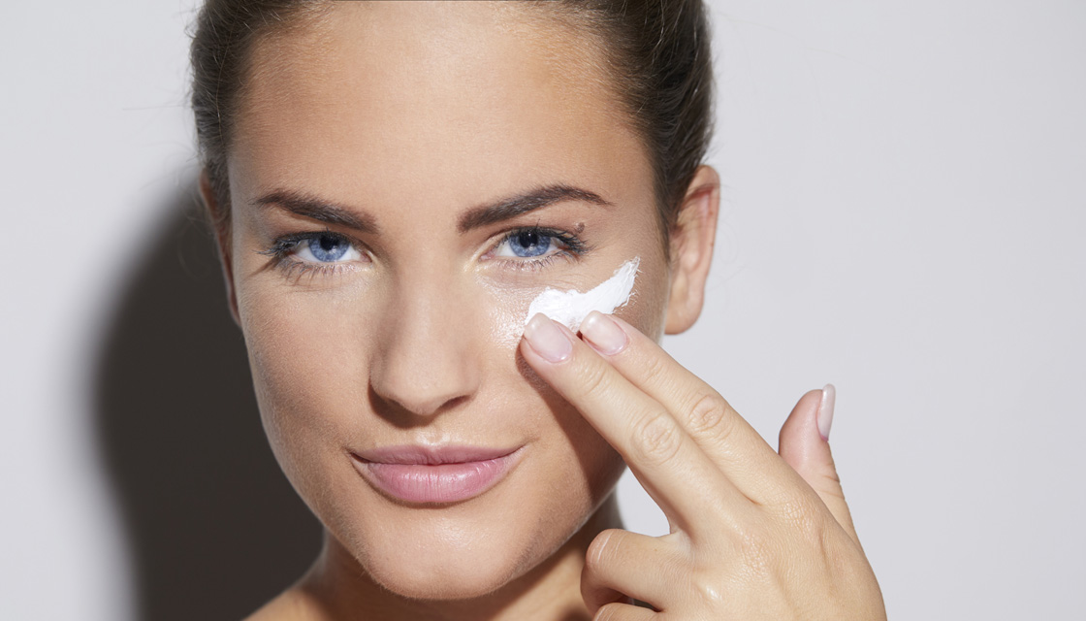
STEP 6:
SPF
Notes:
Sunscreen is always the LAST step of the routine
Do not rely on sunscreen in your moisturizer, makeup, foundation, etc.
Lends a false sense of security and not early enough protection
Use 2 SEPARATE PRODUCTS
Chemical versus physical sunscreens
Physical
Zinc and titanium oxide
Chemical
Contain oxybenzone and octinoxate- currently have received heat
There are claims that these ingredients may damage coral reefs and may cause hormonal effects.

Slide 29
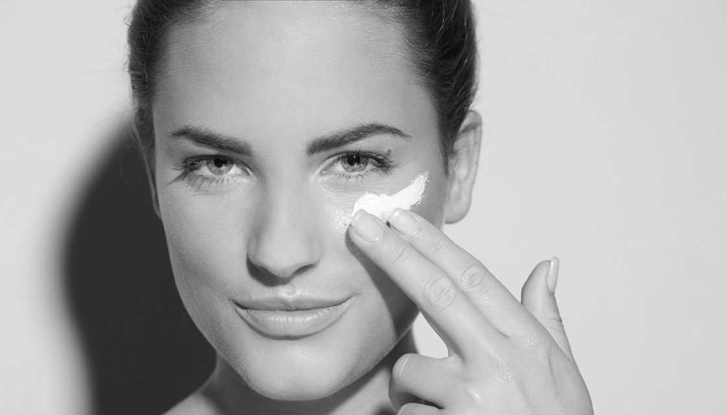
Sunscreen is always the LAST step of the routine
Do not rely on sunscreen in your moisturizer, makeup, foundation, etc.
Lends a false sense of security and not early enough protection
Use 2 SEPARATE PRODUCTS
Notes:
Sunscreen is always the LAST step of the routine
Do not rely on sunscreen in your moisturizer, makeup, foundation, etc.
Lends a false sense of security and not early enough protection
Use 2 SEPARATE PRODUCTS
Chemical versus physical sunscreens
Physical
Zinc and titanium oxide
Chemical
Contain oxybenzone and octinoxate- currently have received heat
There are claims that these ingredients may damage coral reefs and may cause hormonal effects.

Slide 30
Physical VS Chemical sunscreen
Notes:
Physical
Zinc and titanium oxide
Chemical
Contain oxybenzone and octinoxate- currently have received heat
There are claims that these ingredients may damage coral reefs and may cause hormonal effects.

Slide 31
Physical
Zinc and titanium oxide
Chemical
Contain oxybenzone and octinoxate
There are claims that these ingredients may damage coral reefs and may cause hormonal effects.
Notes:
Physical
Zinc and titanium oxide
Chemical
Contain oxybenzone and octinoxate- currently have received heat
There are claims that these ingredients may damage coral reefs and may cause hormonal effects.

Slide 32
Physical sunscreen
Works by creating a physical barrier between your skin and the sun, using mineral-based ingredients like zinc oxide and titanium dioxide
The mineral ingredients often cause have a white film, and hence, enough is not applied for the proper protection
Notes:
Physical
Zinc and titanium oxide
Chemical
Contain oxybenzone and octinoxate- currently have received heat
There are claims that these ingredients may damage coral reefs and may cause hormonal effects.

Slide 33
Chemical sunscreen
Works by triggering a chemical reaction that turns UV rays into heat, which is then dissipated from your body.
Needs to be FULLY absorbed to be effective
Notes:
Physical
Zinc and titanium oxide
Chemical
Contain oxybenzone and octinoxate- currently have received heat
There are claims that these ingredients may damage coral reefs and may cause hormonal effects.

Slide 34
“Natural” sunscreen
There is no definition for the word “natural” when it comes to skincare
Not regulated by the FDA
Notes:
Physical
Zinc and titanium oxide
Chemical
Contain oxybenzone and octinoxate- currently have received heat
There are claims that these ingredients may damage coral reefs and may cause hormonal effects.

Slide 35
Use at least SPF 15 on a daily basis, and SPF 30 or higher when outside for extended periods of time.
Look for broad spectrum and both UVA and UVB protection. UVA rays can penetrate glass, so you can still get sun damage when driving in your car or sitting next to a window.
Do not rely on SPF in your makeup, powder, or moisturizer as your sole method of protection. You can still use these products, but in conjunction with a separate sunscreen.
Choose a product that will work well for your skin type. Many patients with acne-prone skin say that they are concerned about breakouts and clogged pores. Buy a new bottle of sunscreen if your existing one is expired or has been sitting in your hot car for months. I recommend replacing sunscreens at least every six months.
Notes:
Physical
Zinc and titanium oxide
Chemical
Contain oxybenzone and octinoxate- currently have received heat
There are claims that these ingredients may damage coral reefs and may cause hormonal effects.

Slide 36
What do I do with my OILY SKIN?
You still DO need to moisturize
Hyaluronic acid
Anti-oxidant serums
Avoid thick heavy barrier creams
Avoid comedogenic ingredients
Coconut oil
Safflower oil
Isopropyl myristate
Polyethylene glycol
Red dyes
Notes:
Choose water-based and oil-free products

Slide 37
Ingredients to avoid in pregnancy/breastfeeding
Systemic retinoids
Retinol derivatives
Whitening creams (hydroquinone)
Salicylic acid
Glycolic acid
Notes:
Choose water-based and oil-free products

Slide 38
Thank you!

