Slide 1
Game Monetisation
Fundamental Strategies in use Today

Slide 2
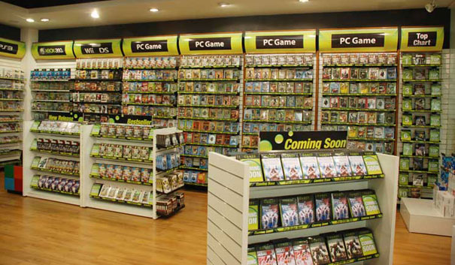
The Olden Days
Before the advent of digital distribution methods, almost all game sales were made through retail outlets
The retail model was very simple:
  Pay for game at store
  Play at home

Slide 3
Now...
Now, games are monetised in a variety of ways, whether they are indie games or not:
  Premium
  Free to play
  Freemium

Slide 4
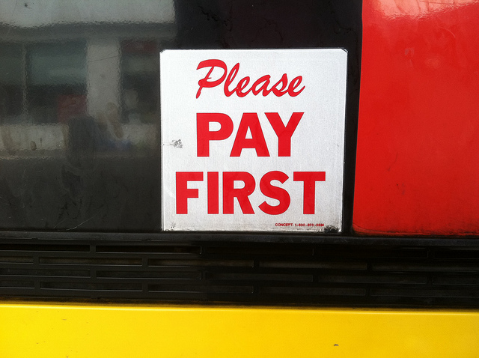
Premium
Very similar to the traditional retail model. You pay for the game, then download and play it. Simple.
Some digital distribution networks allow users to test games before paying for them, usually for a relatively short period of time.
Tends to work well for established brands, people have confidence in the product. Doesn’t usually work well for new releases from unknown indie developers. Must establish brand credibility first.

Slide 5
Free to Play
The most popular monetisation model used in the mobile (IOS, Android etc) markets presently:
  Download and play game for free. Period.
  Revenue can be generated through displaying ads in the game, and/or
  Offering in-app purchases. Sometimes also called micro-transactions.

Slide 6
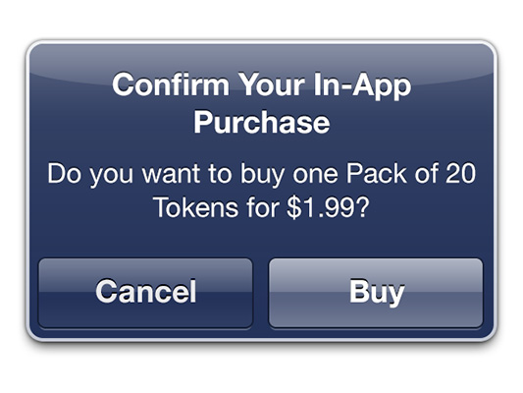
In-app purchases
To compel a player to make an in-game purchase, you must create value for the player. Value can be:
  Aesthetic: new suit, new character, shiny new vehicle, new furniture for the pad etc.
  Practical: upgrades to further progress in game. Can take many forms.
  Study Maslow’s hierarchy of needs. Your purchase should tap into 1 or more of these needs/motivations.

Slide 7
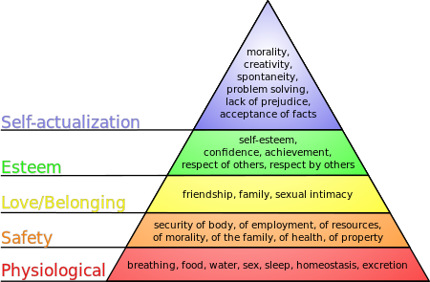
Maslows Hierarchy of Needs

Slide 8

Freemium
Freemium usually involves releasing a free and a paid version of your game.
  With the free game, we must give the player enough to captivate him, without devaluing the paid version
  The paid version should have plenty of additional content, levels and special features to motivate the player to purchase it. They must see the value versus the free version.

Slide 9

Crowdfunding
The day of the art patron returns!

Slide 10




