Slide 1
Resource 1: Video
ABC Nightline - IDEO Shopping Cart2
Observe for Design Thinking : Mindset, Culture, Space
Multidisciplinary Teams * Unique Work Culture * Unique Space design

Slide 2
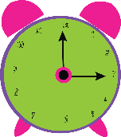
To the Field to find Problems & Possibilities
Keep in mind:
Where to look for, what to look for,
how to look for it and
how to interpret what you find.
listen carefully to understand different viewpoints.
2 hours

Slide 3
Resource 1 : Video
ABC Nightline - IDEO Shopping Cart2
Observe for Design Thinking : Mindset, Culture, Space
Ref: https://www.youtube.com/watch?v=M66ZU2PCIcM

Slide 4
Simple Product SHOPPING CART - Redesigned

Slide 5
VIDEO
Keep taking notes along with viewing the video
Stop at 2

Slide 6
- Expert on process
Process
How to innovate by using Design Thinking
Gives you a method, tools and techniques to reach to an innovation (not a common sense approach) – reason that commonsense approach can be replicated.
Can be used as many times as possible no matter what is your choice of subject
Discussion

Slide 7
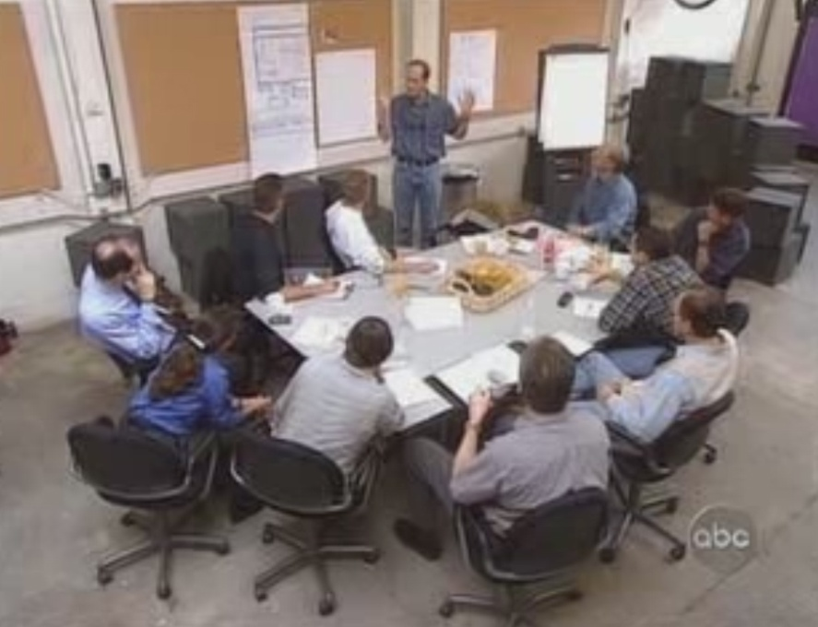
Project Leader Multi
- Project leader who is good with groups
- Members with different background in the team (Harvard MBA, Linguist, Marketing, Physiologist, Biology major)
Disciplinary Team
Design Thinking Environment
- Pull out and work from all aspects and get all perspectives
Discussion

Slide 8
- Safety
What Observations Made?
- Loss of carts
- Based on how people use
Observation made
Seat
People do not let go the cart Lead the cart to various places
In depth, talk to multiple stakeholders and real experts to get quick answers.
Stop at 5

Slide 9
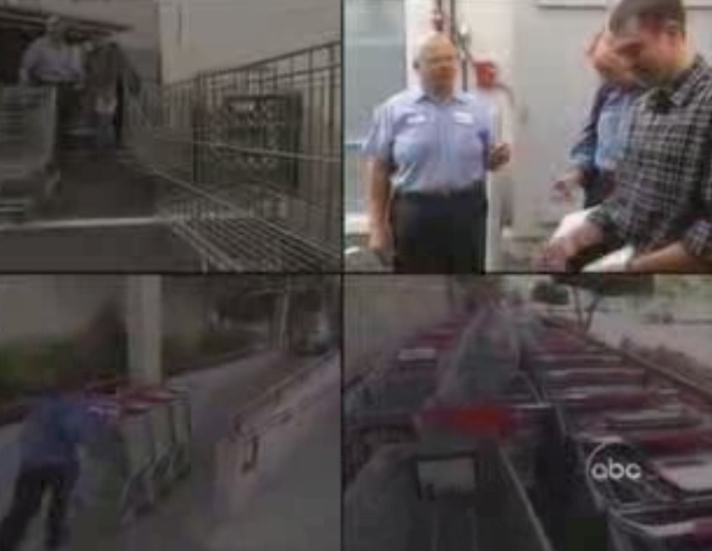
- Learn Quick instead of learning by self
Why Experts Why Research What Observation?
- To understand the user and get deeper insights from experts
- Observation is one of the easiest and best method to understand the product (tangible/intangible) better and faster
Discussion

Slide 10
Why Deadlines?
- Industry works on deadlines.
- And if deadline is not there it would go messy
Discussion

Slide 11
- All ideas excepted
Why the Bell?
- No judgment
Wild ideas
Lot of ideas
Build on others ideas
Ideas to be cool and bold
Discussion

Slide 12
Best of each idea
What kind of Ideas are put into one Prototype?
After 5

Slide 13
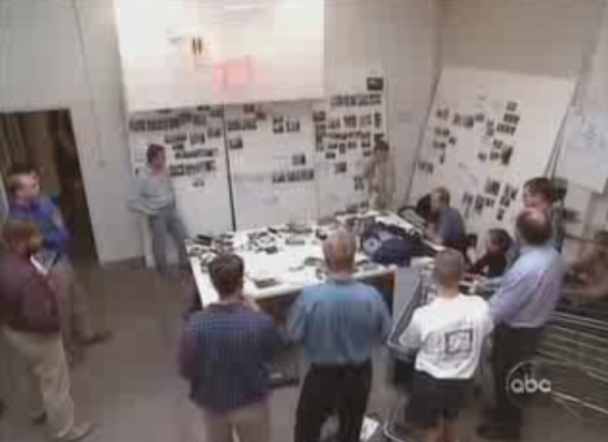
Features of the cart
- High tech
Importance of Prototyping, Building, Presenting
How ideas are presented
(Ideas can be posted on the wall/board)
- Written
- Modular
- Child safety
- Drawn
- Let shoppers talk to the super market staff remotely
- Refocus
Prototyping, building and presenting the product

Slide 14
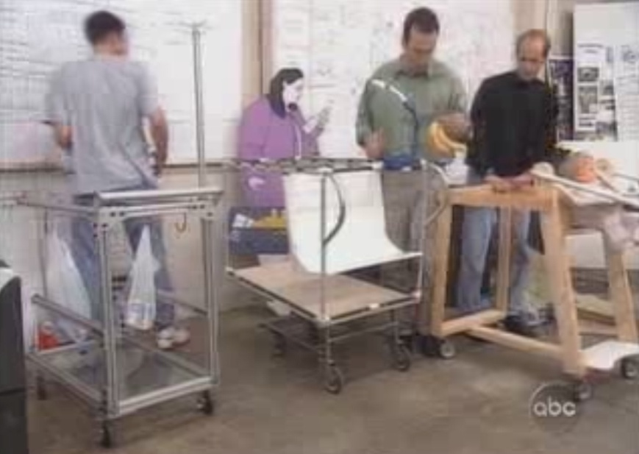
1. Building prototype and prepare for the mock-ups
Continued..
Being playful is of huge importance for being innovative
Took the best elements out of each prototype
Design the cart in a day
Fabricated in a day
Worked throughout the night
The cart is different in every way as compared to the existing cart
4. Took the cart to the real super market and saw what people had to say

Slide 15
Based upon the video you can work in your teams and come up with your clarity and understanding of the following points.
Who is a project leader
Why multi disciplinary team is necessary
What does a design thinking environment look like?
What observations made?
Why experts and why research & what observations?
Why deadlines?
Why the bell?
What kind of ideas are put into one prototype?
Importance of prototyping, building, presenting
After you go through the video kindly open the PowerPoint presentations and in your team collectively give answers and what understanding you developed while you saw the video.

Slide 16
Steps
Gather facts and knowledge
Share facts with the team (define)
Brainstorm
Build-on others ideas
Prototype & iterate

