Slide 1
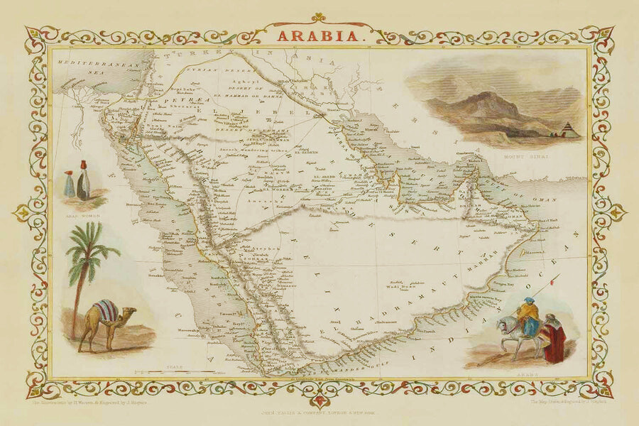
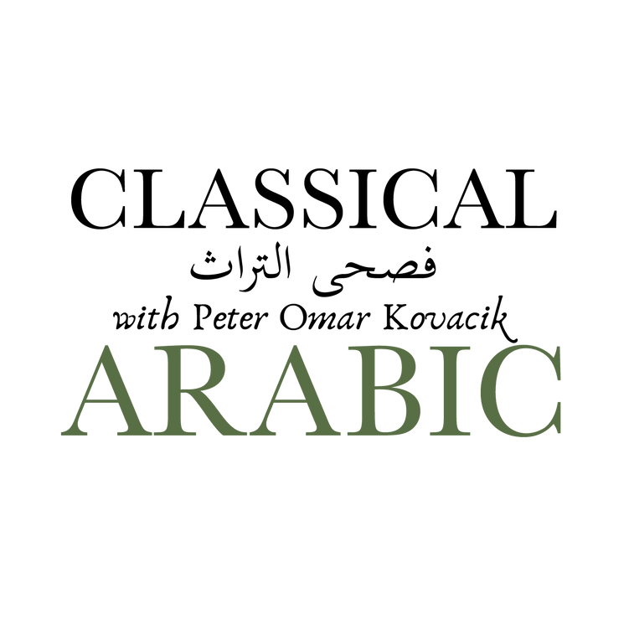
INTRODUCTION TO THE
MATN AL-AJURŪMIYYAH
By: al-Imām al-Ṣanhājī

Slide 2
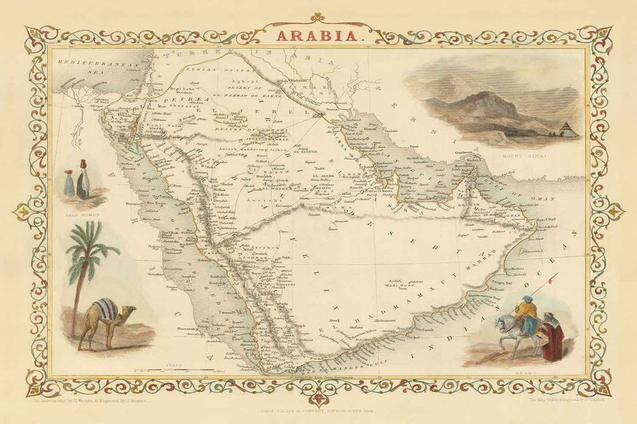
FAST FACTS
Author of the text:
al-Imām Abū ʿAbdillāh Muḥammad bin Muḥammad ibn Dāwūd al-Ṣanhājī
1
3
Ṣinhājah is the name of a tribe in the Maghrib.
Born in 672 H. (1273 C.E.)
Died on 723 H. (1323 C.E.)
2
4
Also known as: Ibn Ājurrūm

Slide 3
ABOUT THE STUDIES OF IBN ĀJURRŪM
On his way to Mecca for Ḥajj, he studied with an accomplished grammarian and scholar of tafsīr named Abu Ḥayyān al-Andalūsī. He is a grammarian and scholar who was born in Granada. He is famous for writing the tafsīr ‘al-Baḥr al-Muḥīt.’
After travelling to Mecca, he wrote Matn al-Ājurrūmiyyah.

Slide 4
The commentator al-Kafrāwī mentioned two stories about writing it:
  Ibn Ājurrūm wrote his text while facing and sitting directly in front of the Ka’ba.
  After writing it, he threw it into the sea. He made a supplication that if he was doing it sincerely for Allah, the text would not be damaged by the water, and then it was miraculously like he had asked.
He later returned to Fez where he taught and was eventually buried in 723 H. (1323 C.E.).

Slide 5
AL-ĀJURRŪMIYYAH IS A TEXT IN AL-NAḤW
Arabic grammar consists of two sciences:
  al-naḥw (Arabic syntax)
    Naḥw (syntax): phrase/sentence level grammar
  al-ṣarf (Arabic morphology)
    Ṣarf (morphology): word level grammar

Slide 6
DEFINITION OF ṢARF FROM TAṢRĪF AL-ʿIZZĪ
اعلم أنّ التصريف في اللغة التغيير و في الصناعة تحويل الأصل الواحد إلى أمثلة مختلفة لمعان مقصودة لا تحصل إلا بها

Slide 7
DEFINITION OF NAḤW FROM HIDĀYAT AL-NAḤW
النحو علم بأصول يُعرف بها أحوال أواخر الكلم الثلاث من حيث الإعراب و البناء و كيفية تركيب بعضها مع بعض

Slide 8
There are many commentaries for al-Ājurrūmiyyah including:
  Al-Tuḥfat al-Saniyyah by al-Shaykh Muḥammad Muḥyi l-Dīn ʿAbd al-Ḥamīd
  Sharḥ al-Makūdī
  Sharḥ al-Daḥlān
  Sharḥ al-Kafrāwī
  Al-Tawḍiḥāt al-Jaliyyah li-l-Shaykh Muḥammad al-Hāshimī

Slide 9
A related text is Mutammimāt al-Ajurrūmiyyah by al-ʿAllāmah al-Ḥaṭṭāb. It utilizes the text al-Ajurrūmiyyah and expends its length by approximately 5 times to make it a more expansive grammar text.
It has two main commentaries, which are:
  Al-Kawāwib al-Duriyyah
  Sharḥ al-Fawākih al-Janiyyah

Slide 10
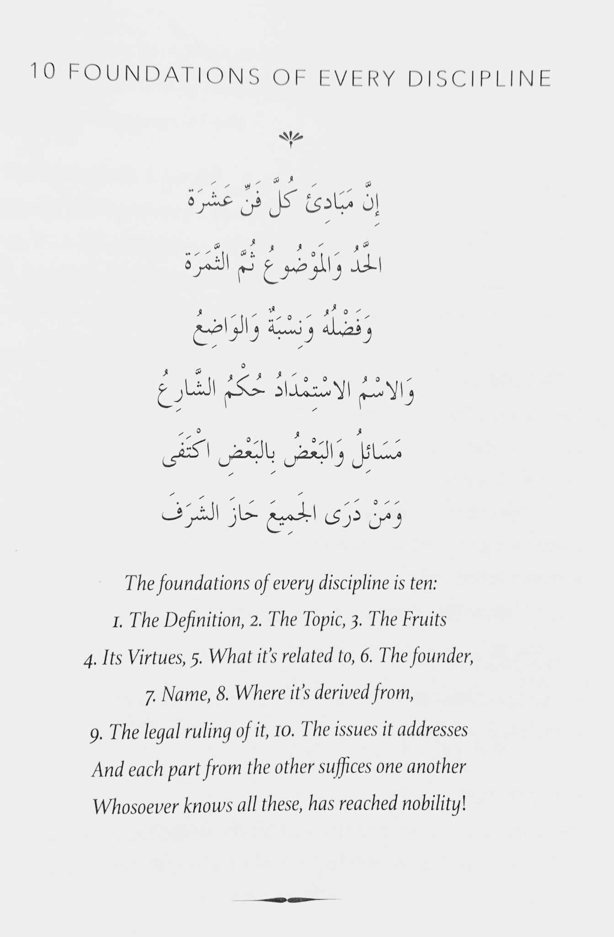

Slide 11
The foundations of every discipline is ten:
  The Definition
  The Topic
  The Fruits
  Its Virtues
  What it’s related to
6. The founder
7. Name
8. Where it’s derived from
9. The legal ruling of it
10. The issues it addresses
And each part from the other suffices one another. Whosever knows all these, has reached nobility!

