Slide 1
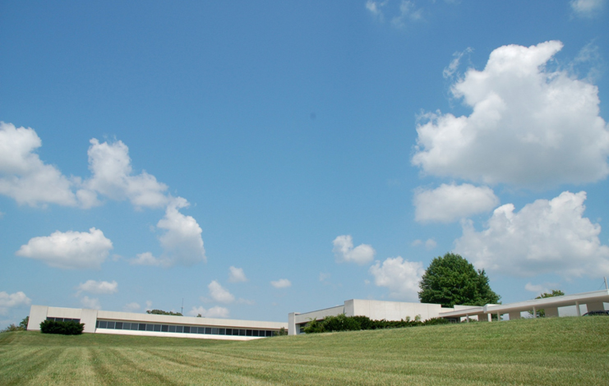

Omar Galal
Founder and Design Engineer

Slide 2
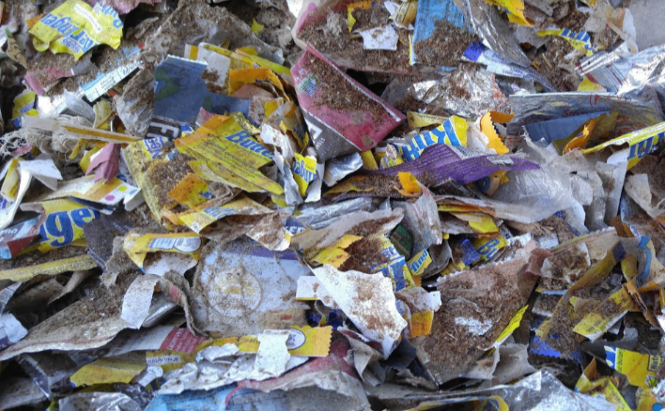
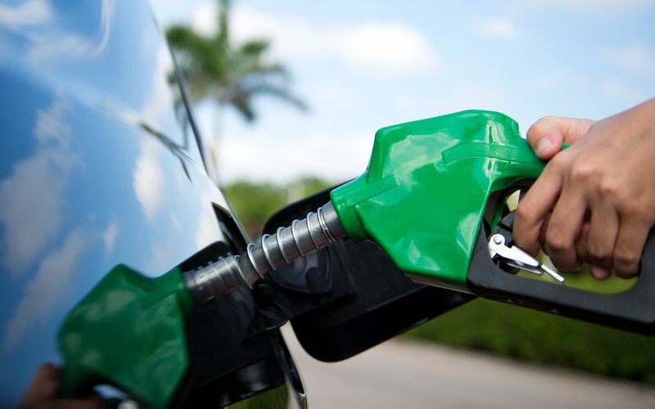
Opportunity
Reduce Landfill usage, disposal costs for industrial customers with high volume of comingled material products
Provide sustainable/alternative fuel
Decrease the use of agriculture fertilizers saving money and natural resources
Improve the health and yield of livestock
Improve Air quality

Slide 3
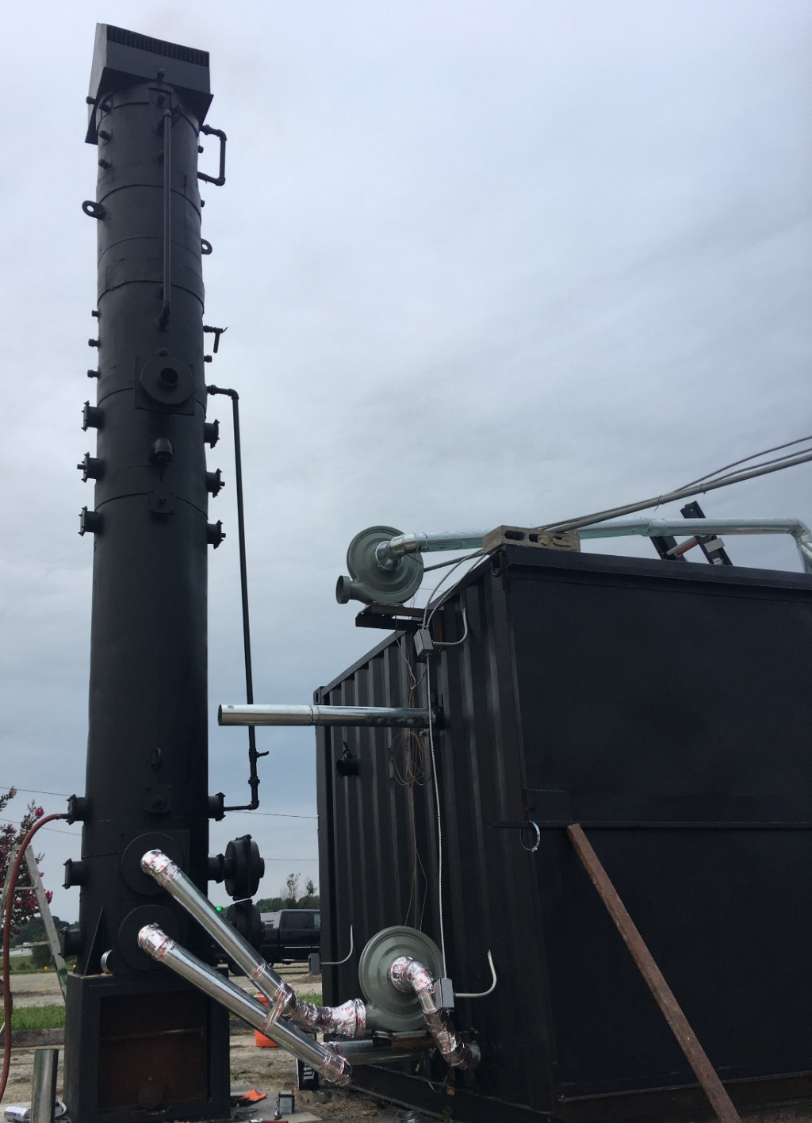
Value Proposition
We convert unwanted materials (feedstock) into a multitude of value added products
  Feedstocks: comingled scrap product, food waste, tires, comingled-plastic, paper, and organic matter
We provide a multitude of services and products

Slide 4
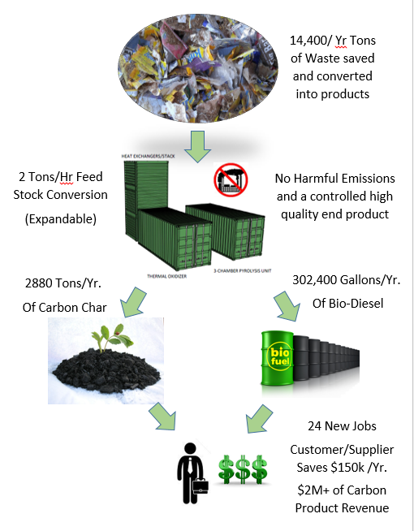
Underlying Magic
Our point of differentiation is the entire triple revenue business model using a multitude of technologies and internal IP.
Using our low cost methods of development, implementation, and existing customer base allows us to take on less debt and return more, and faster than comparable businesses.

Slide 5
Business Model
Currently Landfills provide the un-sustainable services of collecting and disposing the waste in an inefficient manner.
We have a triple revenue concept:
1. Disposal services at below market value
2. Alternative and sustainable Off-road Diesel
3. Carbon based products for produce farmers, livestock farmers, and commodity farmers

Slide 6
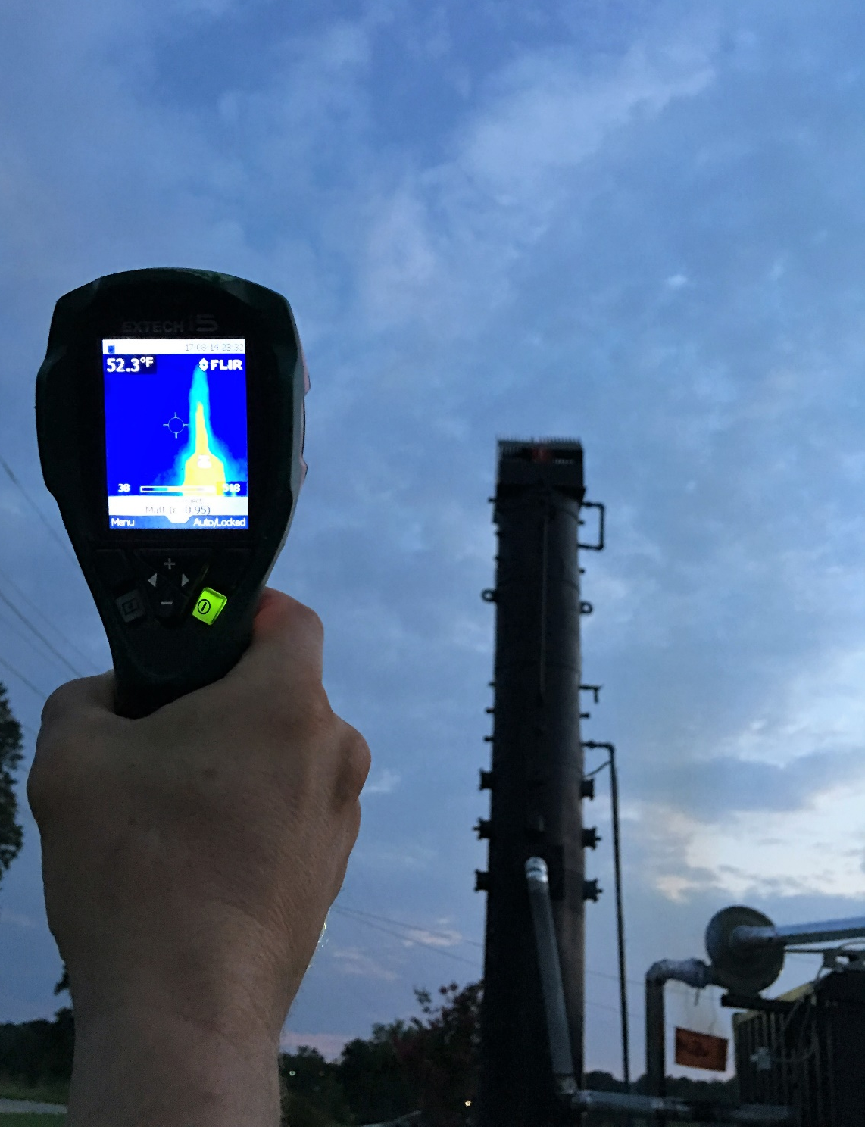
Market Plan
By utilizing existing relationships and with products and services in high demand. Cost and time to Marketing budgets will be greatly reduced
Existing similar markets as RainReserve will jumpstart Carbon sales, the major highest potential by-product

Slide 7
Competitor Analysis
Competitors include landfills, gas stations, and nascent bio-char companies.
Bio-char companies are regionalized and small scale. Many of them purchase their end product at a high market value from other industry producers. As an original source, we could supply and co-pack other “competitors” products.

Slide 8
Team
Omar Galal-Design Engineer, operator, and entrepreneur
Dave Seidel-Veteran Engineer with a background in varied applicable industries Responsible for; tech assistance, enviro regulations
Devin Dillon- “waste”/Feedstock acquisition and investor relations
Alex Giannikoulis- End product sales Director and investor relations
Kostas Gianikoulis- Marketing Director and product development strategist
Enginuity full staff and resources- engineers, scientists, logisitics

Slide 9
Projections
Year 1: $500k – 10 customers- 5 services and products
Year 2: $1.5M – 100 customers – 10 services and products
Year 3: $ 7M – 1000 customers – 15 services and products, including building similar facility for additional customers
Year 4: $20M – 1005 Customers- 20 services and products including building multiple similar facilities for additional customers

Slide 10
Current Status
1/10 scale facility is built and operational
Initial feedstock provider relationships are built
Product development for all product services is 30% complete
$250k has been raised via state grants
Potentially $500K in private investment is on the horizon.
Contracts for working relationships, funding vehicle7, and operating agreements are 90% complete
Proof of concept and MVP have been produced but are awaiting testing.
Currently raising $2.5M for 20% Equity.

Slide 11
Current Status
Phase 1: Establish Business Plan, Investors for Phase 2, and Feedstock Providers
Phase 2: Build 1/10 scale testing facility, research product development, establish proof of concept, and finalize operating agreements/contracts for working relationships
Phase 3: Raise 10 to 100 million in an initial coin offering
Phase 4: Build full scale facility and bring it to 85% operating capacity
Phase 5: Build super facility outside a major metropolitan area
Phase 6: Build multiple facilities around the Unites States and world

