Slide 1
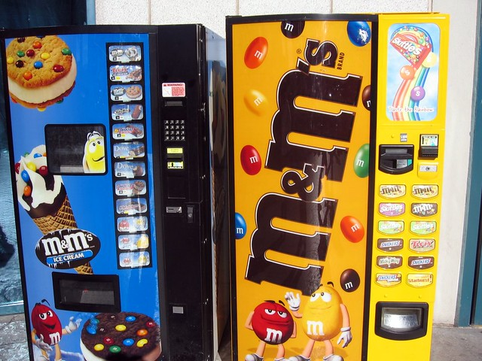
How to use a Vending Machine

Slide 2
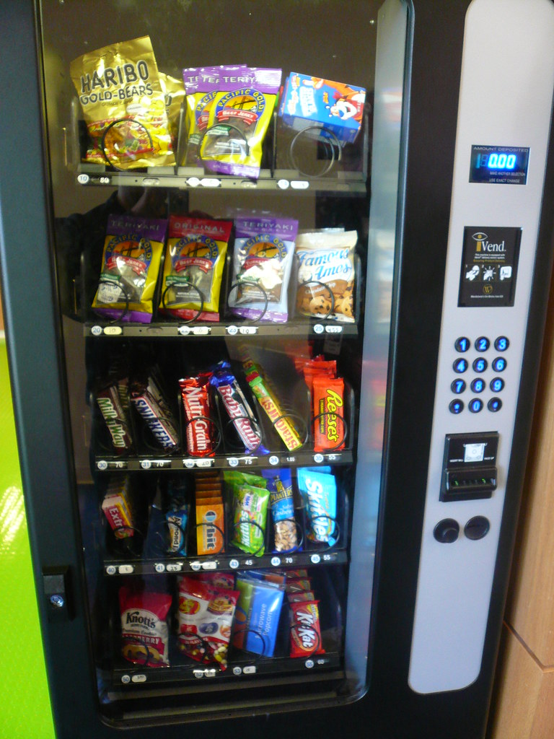
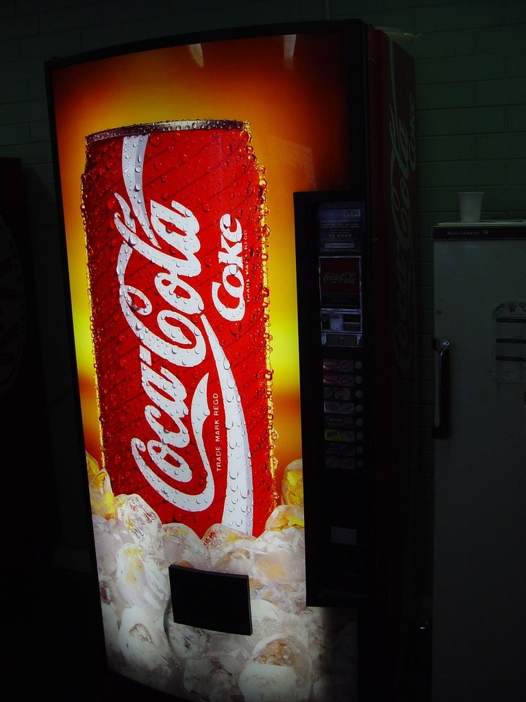
This is a vending machine. It has snacks and drinks for sale.

Slide 3
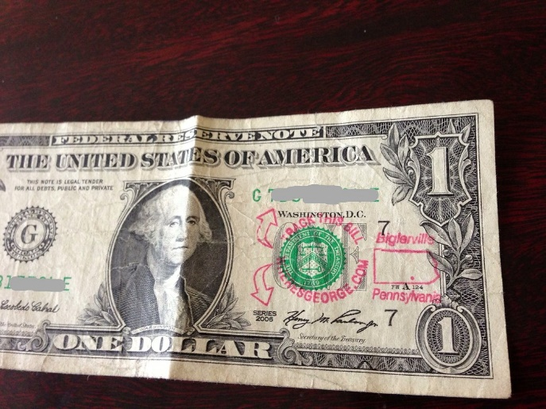
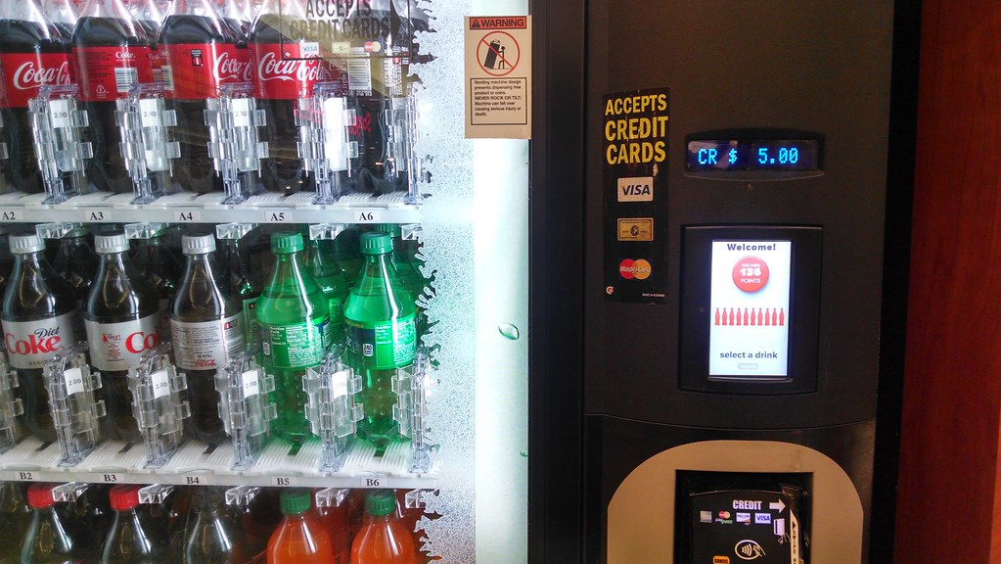
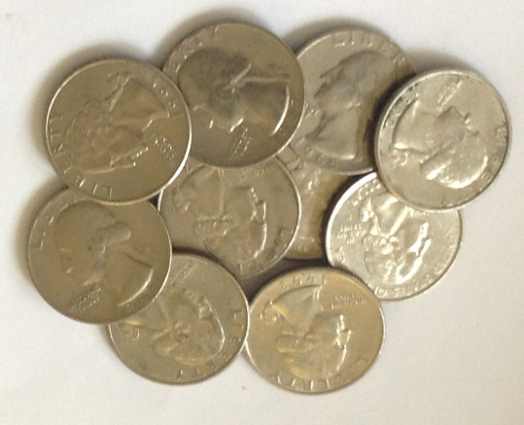
Some machines take cash and some take credit card.

Slide 4
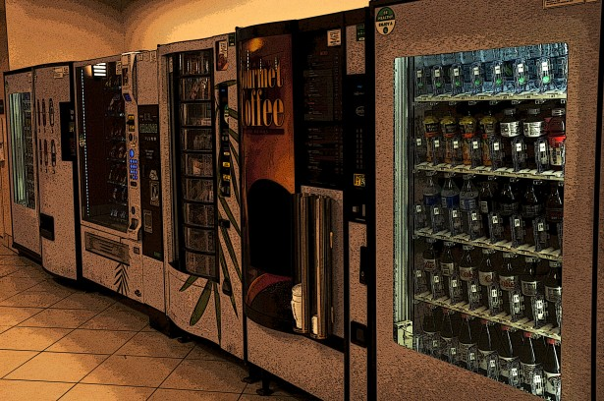
Vending machines are located in a lot of places like schools, malls, buildings, and stores.

Slide 5
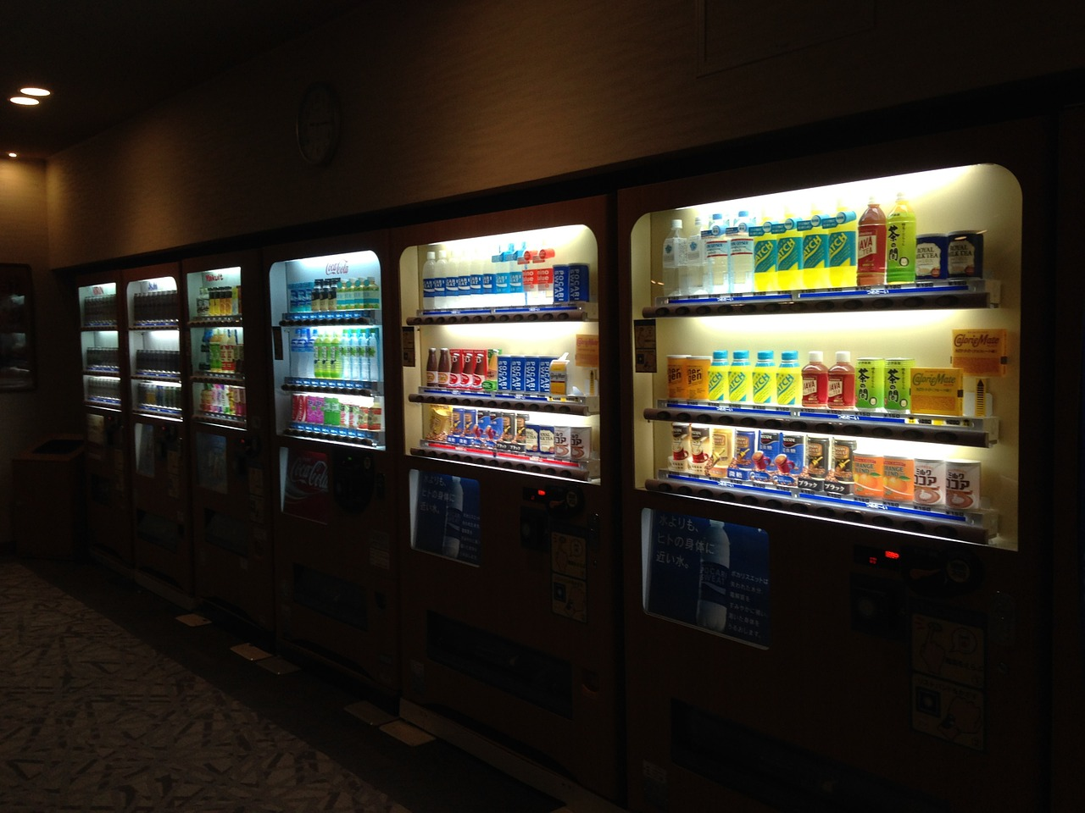
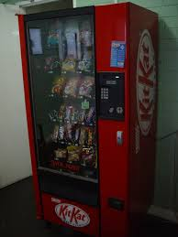
First, you look and choose what you want.

Slide 6
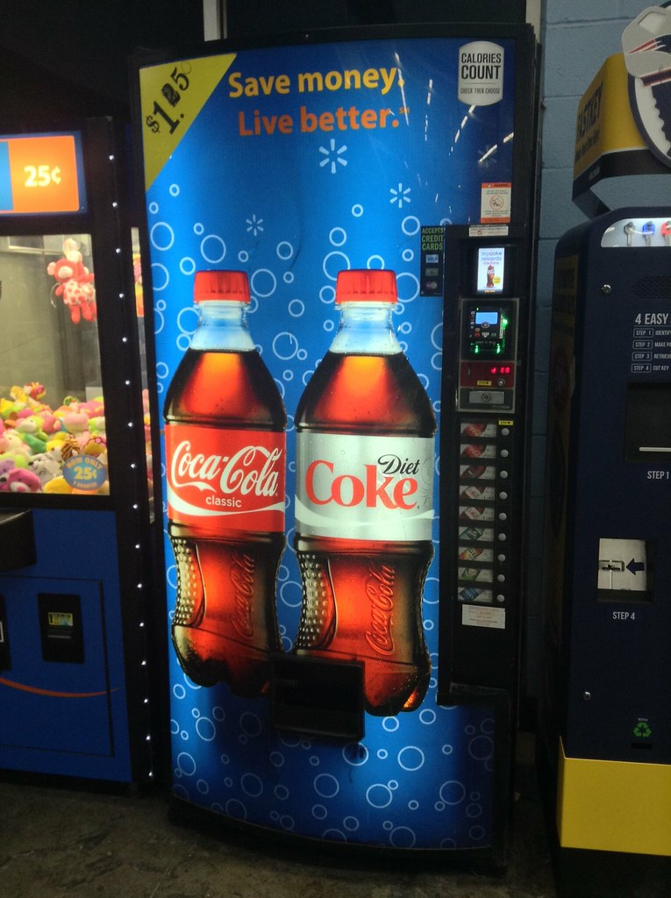
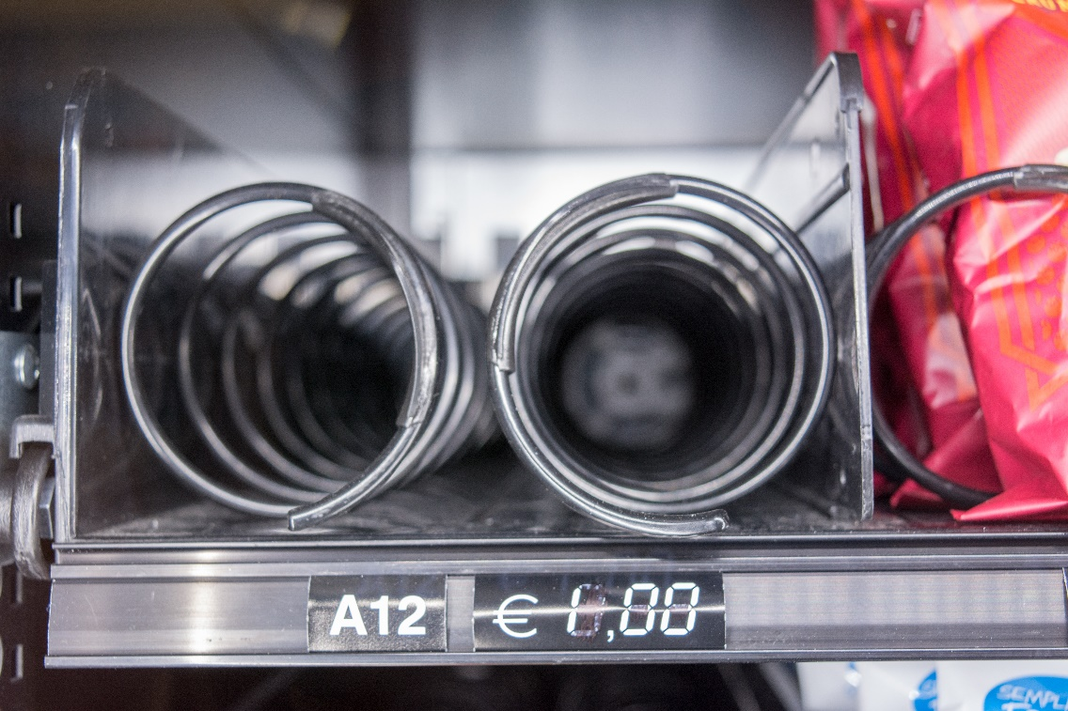
Look at the price, make sure you have enough money.

Slide 7
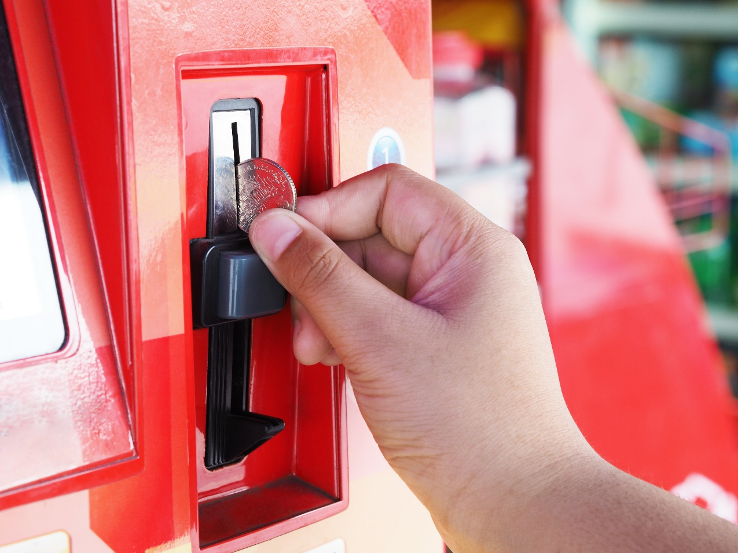
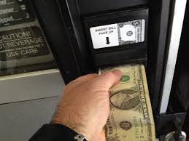
Put your dollars and coins into the appropriate slot, face up (see picture for correct direction of dollar).

Slide 8
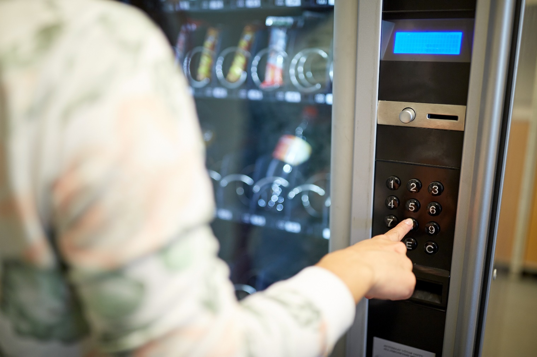
Press the letter/number of the item that you want.

Slide 9
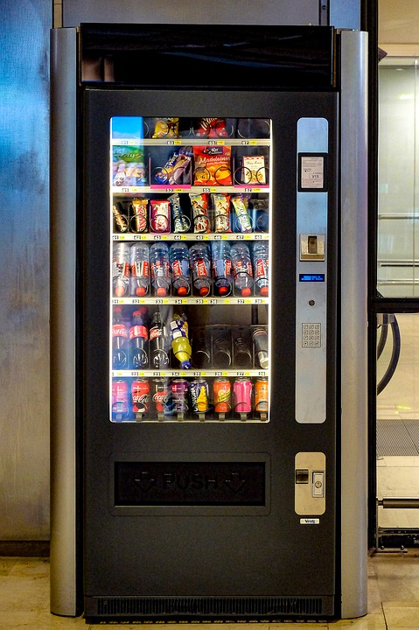
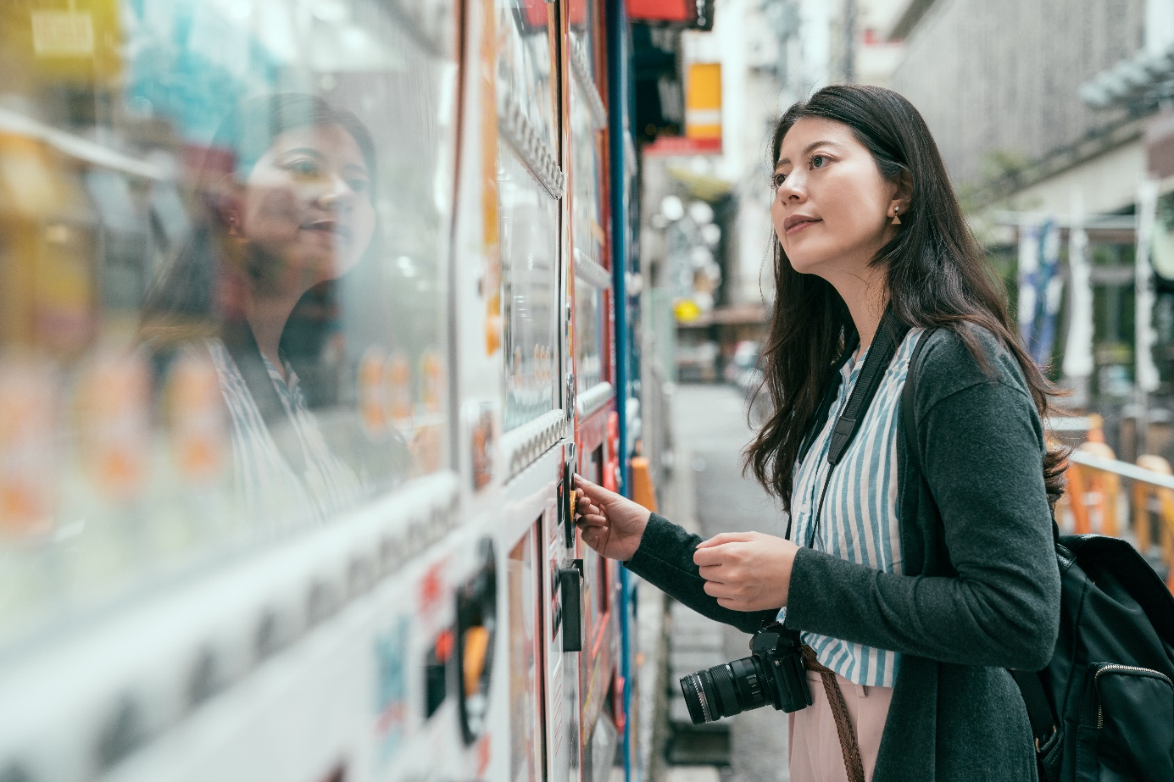
Wait for the snack to dispense and fall.

Slide 10
Put your hand into the little door and get your snack.

Slide 11
Grab any change if you get some.

Slide 12
Review: How do you use a vending machine?

