Slide 1
CULTIVATION OF OYSTER MUSHROOM
Course designed by Mr. Bipin Badoni
Entrepreneur and Influencer

Slide 2
Pleurotus
19%
Auricularia
18%
Lentinula
22%
Flammulina 11%
Volvariella
5%
Agaricus 15%
Others 10%
Royse et al. 2017

Slide 3
Why Oyster mushroom?
Bioactive compounds
Lovastatin
Antioxidants
Pleuran
D-Mannitol
Gamma-aminobutyric acid
Nutritive value
Protein-18-25 %
Carbohydrate-49-57 %
Crude fiber- 6-15%
Fat-Approx nil%

Slide 4
Species Description
25 species are commercially cultivated in different parts of the world
Species Common names
Pleurotus eryngii Kabul dhingari, King of oyster, Boletus of the steppes
Pleurotus ostreatus Oyster mushroom, tree oyster, Hiratake, Tamogitake
Pleurotus citrinopileatus oyster, golden oyster, Tamogitake, IImak
Pleurotus pulmonarius P. sajor caju, Phoenix mushroom, dhingari
Pleurotus djamor Pink oyster, Salmon oyster, strawberry oyster, flamingo,Takiiro hiratake, Tabang Ngungut

Slide 5
Pleurotus ostreatus var florida
Parameters | Values
Spawn run temp | 24˚C
Spawn run duration | 15-20 days
Spawn Run CO2 conc | 5,000- 20000ppm
Primordia formation temp | 15-22 ˚C
Fruit body devlp. temp | 18-25˚C
Relative humidity | 85-90%
Fruiting CO2 conc | <1000ppm
Light requirement | 1000-2000 lux

Slide 6
Pleurotus ostreatus
Parameters | Values
Spawn run temp | 24˚C
Spawn run duration | 15-20 days
Spawn Run CO2 | 5,000- 20000ppm
Primordia formation temp | 14-18 ˚C
Fruit body devlp. temp | 18-24˚C
Relative humidity | 85-90%
Fruiting CO2 conc | <1000ppm
Light requirement | 1000-2000 lux

Slide 7
P. pulmonarius (sajor caju)
Parameters | Values
Spawn run temp | 24-29˚C
Spawn run duration | 15 days
Spawn Run CO2 conc | > 5,000ppm
Primordia formation temp | 15-27 ˚C
Fruit body devlp. temp | 24-28˚C
Relative humidity | 90-95%
Fruiting CO2 conc | 400-800 ppm
Light requirement | 1000-2000 lux

Slide 8
Benefits of Growing Oyster
Requires temperature from 20-30̊c, which is optimum to grow indoors.
Requires basic crop waste, which is easily available.
Compost is very easy to prepare unlike compost for other mushrooms.
Does not require any sophisticated machinery.
Less labor intensive.
Tastes better.

Slide 9
4S CROP
Sterilization/ Pasterurization
Substrate
Sanitation
Spawn

Slide 10
OYSTER CULTIVATION STEPS
Preparation or procurement of spawn
Substrate preparation
1
2
4
3
Crop management
Spawning of
substrate

Slide 11
SELECTION OF SUBSTRATE
Rich in cellulose, lignin and hemicellulose .
Cellulose and lignin contents are important components for yield.
Globally 200 different wastes is available as oyster mushroom substrates.
Generally wheat bran, rice bran or wheat straw, rice straw etc.

Slide 12
METHODS OF SUBSTRATE PREPARATION
Hot water method Tunnel method
Autoclaving
Bleaching method

Slide 13
HOT WATER TREATMENT
Substrate after chopping (5-10 cm).
Straw/bran is soaked in hot water.
Paddy straw- 70˚C - 80˚C for 45 min.
Wheat straw-65˚C - 70˚C for 60 min.
Drain excessive water on perforated surface.
Maintain substrate moisture 65% before spawning.

Slide 14
HOT WATER TREATEMENT

Slide 15
OTHER WAYS OF PATEURIZATION
Bleaching powder can be used as a disinfectant in the compost preparation for Oyster
Mushroom.
Used as .05% of the total volume of water being used.
Close the lid of the tank, and keep it overnight.
Drain out the excess water, and let the wet substrate dry until it retains 70% of moisture.

Slide 16
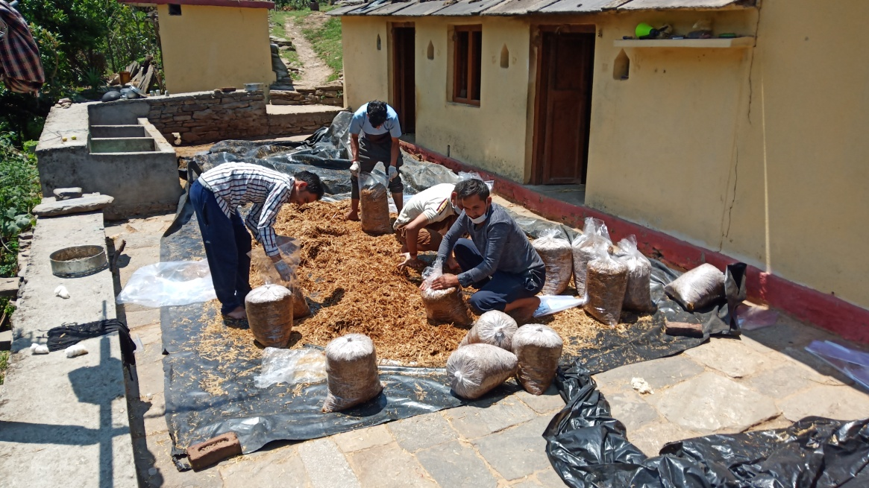
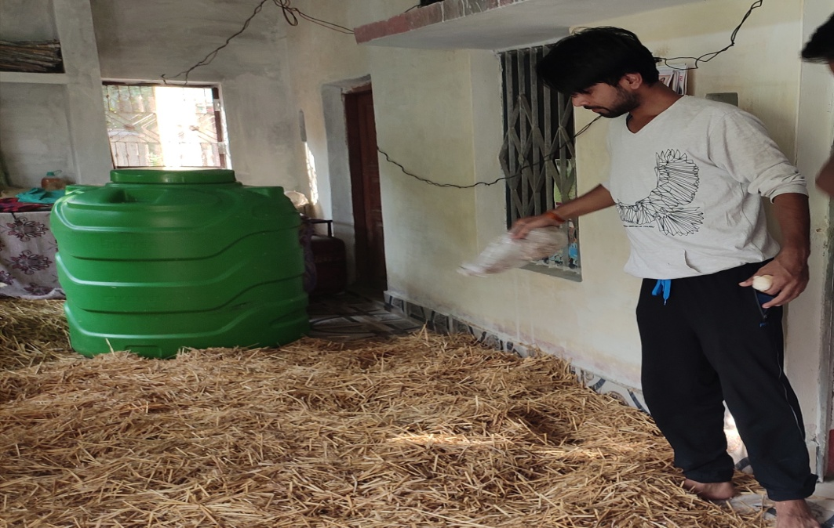
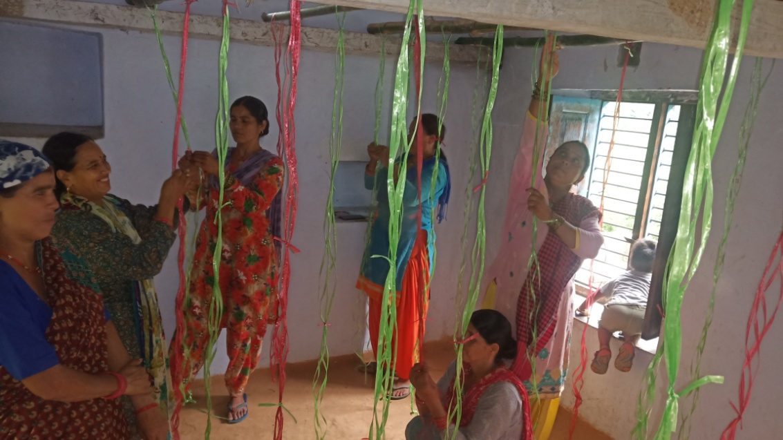

Slide 18
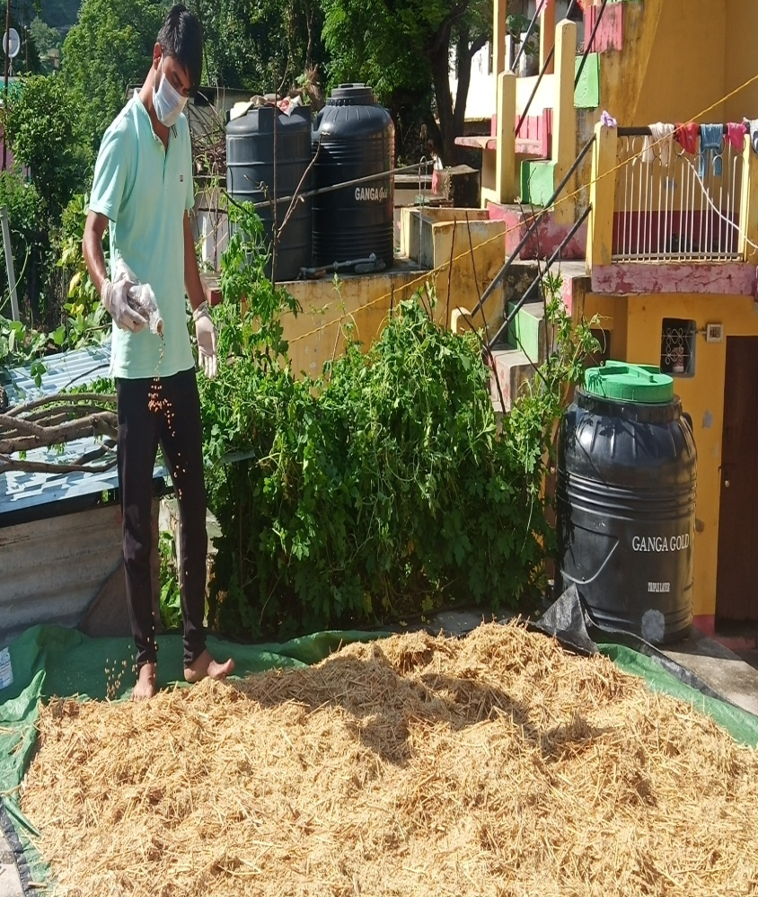
SPAWNING OF COMPOST
The spawning should be done in a pre-fumigated room (48 h with 2% formaldehyde).
The spawn should be mixed @ 10% of the dry weight.
Spawned compost can be filled in PP bags (Polypropylene bags) or trays or bottles.
10-15 small holes (0.5-1.0 cm dia) should be made on all sides especially two to four holes in the bottom for draining excess water.

Slide 19
ABOUT SPAWN
Spawn should be fresh (20-30 days) old and white in color
Spawning could be done in layers or thorough mixed spawning.
Spawn should be crushed to break the mycelium and separate the grains.

Slide 20
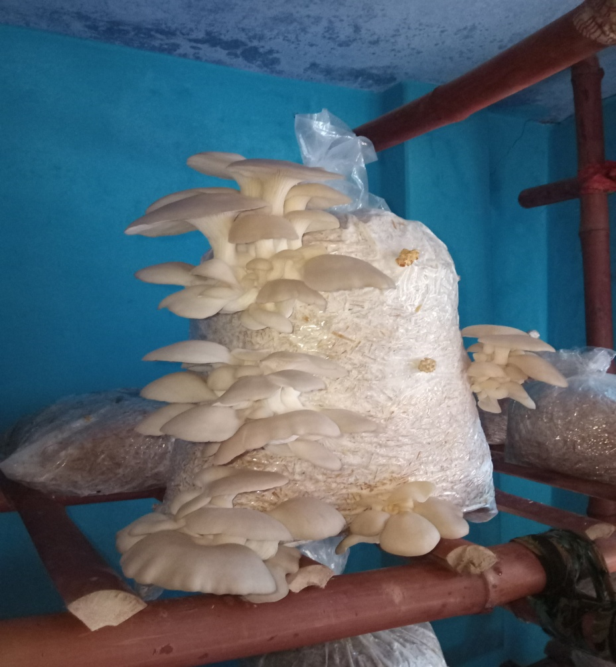
CROP MANAGEMENT
Incubation
Fruit body induction
Temperature
Relative humidity
Fresh air requirements
Light
Post Harvest Practices
Disease and pest

Slide 21
INCUBATION
Higher temperature (more than 30C) will inhibit
growth.
Mycelium can tolerate very high CO2 concentration of
1.5-2.0%
During mycelial growth the bags are not opened
No ventilation is needed.
No need for any high relative humidity
No water should be sprayed.
Incubation period lasts for 10-15 days

Slide 22
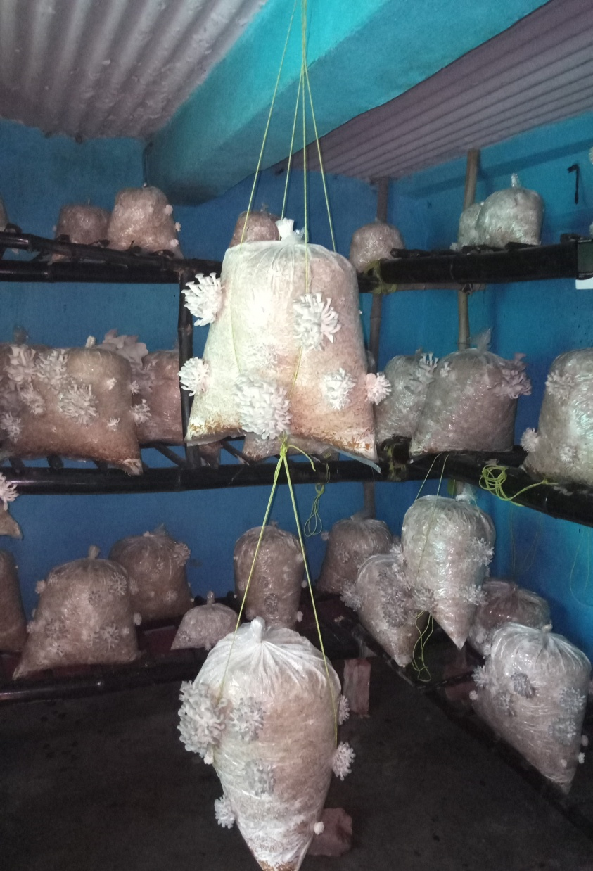
FRUIT BODY INDUCTION
Mycelium has fully colonized the substrate, it forms a thick mycelial mat and is ready for fruiting.
Contaminated bags are discarded, so as not to spread the contamination.
In case of air exchange, it should be done every for 1 hour after every two hours in a day.
Temp – 20-25̊c
Relative humidity- 70-75%

Slide 23
RELATIVE HUMIDITY
All the Pleurotus species require high relative humidity (80-90%) during fruiting.
During hot and dry weather conditions, daily 2-3 spray are recommended while in hot and humid conditions (monsoon) one light spray will be sufficient.
The requirement of water spray can be judged by touching the surface of the
substrate.
Spraying should be done with a fine nozzle to create a mist or fog
It is desirable that mushrooms are harvested before water spray.
To remove excess moisture from the cap surface exhausts fans should be operated.

Slide 24
LIGHT REQUIREMENT
Light is required to initiate fruit body formation.
For primordia formation light requirement is more than 200 lux intensity for 8-12 hour. Optimum 800 lux.
Inadequate light conditions can be judged by long stalk (stipe), small cap and poor yield.
The colour of the pileus is also influenced by the light
intensity and its duration.
Fruit bodies raised in bright light are dark brown, grey or blackish coloured.

Slide 25
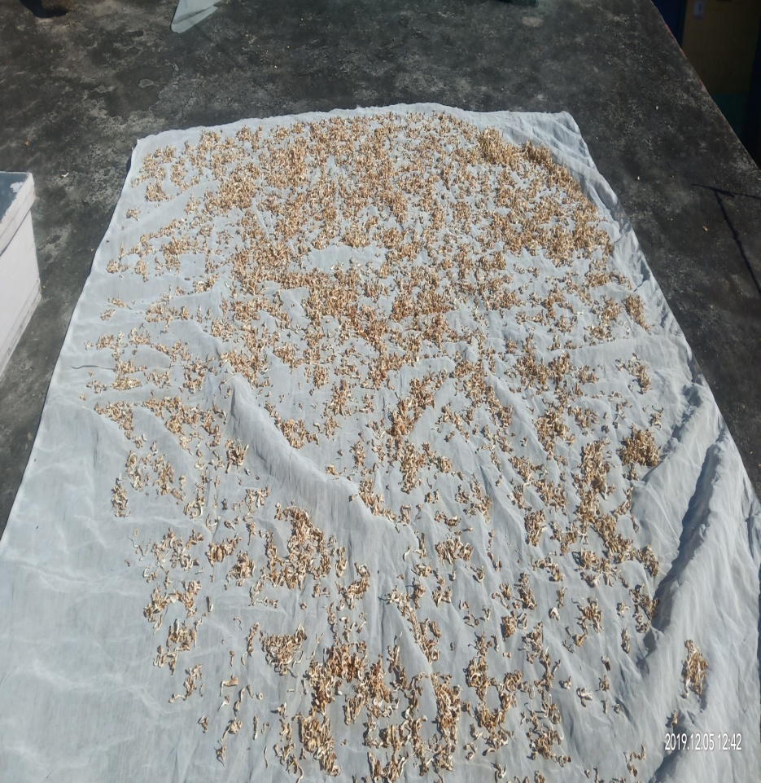
HARVESTING OF MUSHROOMS
Should be plucked in a clockwise direction.
Clean container should be used to collect the mushrooms
Proper precautions should be used to enter the mushroom area.
No knife should be used to cut the mushroom.
Dried Mushroom

Slide 26
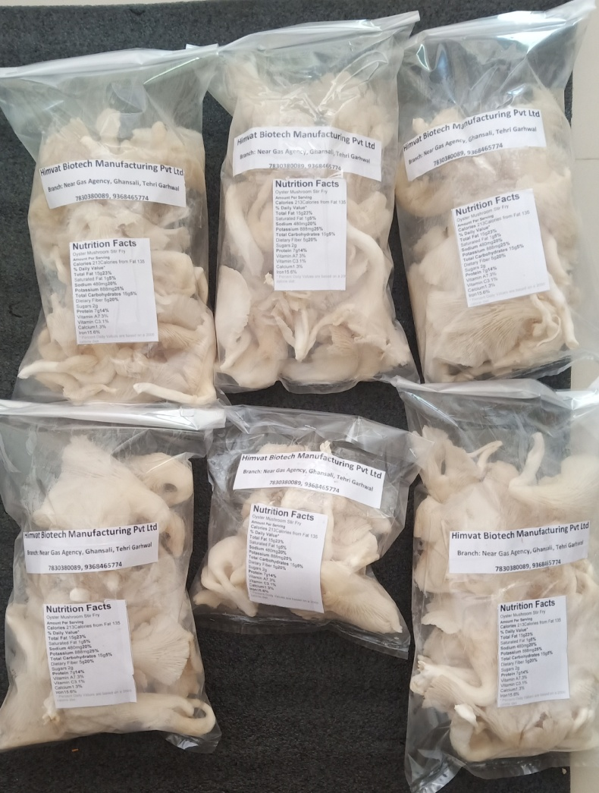
POST HARVEST PRACTICES
Mushrooms should always be harvested before water spray
In young mushrooms the edge of the cap is thick
Cap of mature mushroom as flat and inward curling starts cap margin is enrolled
It is advisable to harvest all the mushrooms at one time from a bag so that the next crop of mushrooms starts early
Stipe is kept short or almost non-existent, as it is hard and not liked by many consumers.

Slide 27
PRECAUTIONS
Spores of oyster mushroom may cause allergies.
Windows and doors should be opened minimum 2 hours before entering for harvest or spraying water.
It is desirable to have exhausts and inlet fans and should be put on after every 8 hrs so that there is no spore build up in growing rooms.

Slide 28
Mould

Slide 29
COB WEB DISEASE

Slide 30
Mushroom flies

Slide 31
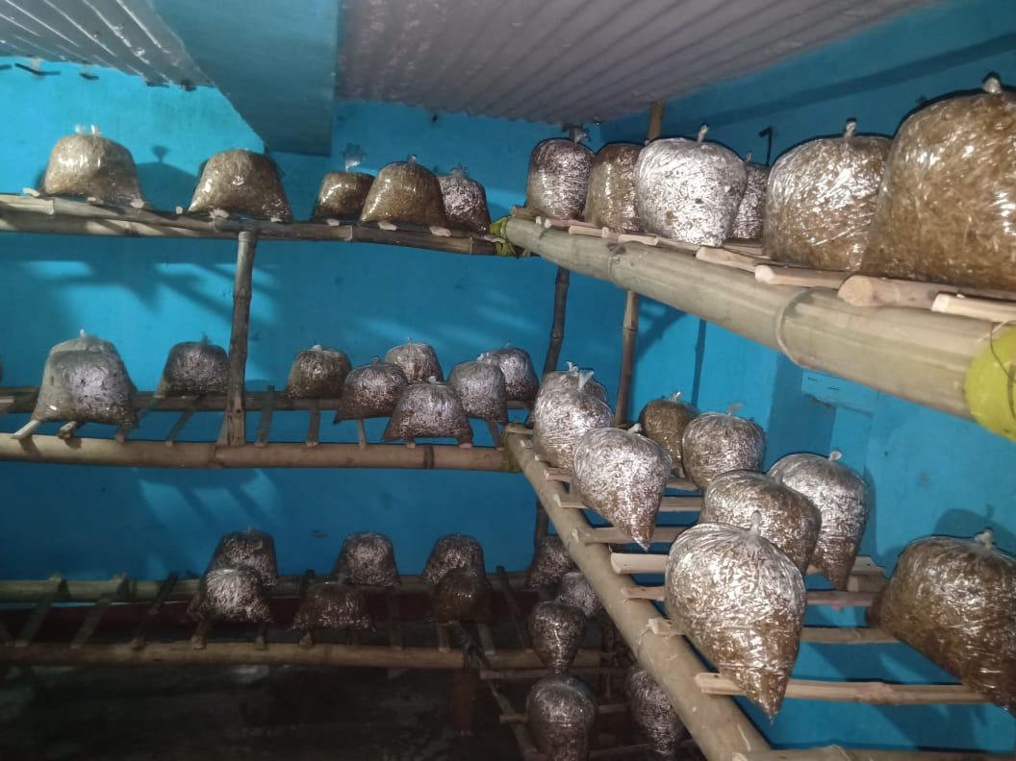
LOW COST ROOM MODEL
Structure should be of concrete platform.
The size may vary from 10X10×10 feet.
The majority of small growers are having the 2-3 rooms with variable size.
The 4-5 tier system is utilized in the cropping rooms with the hanging and
the bamboo rack system.
The humidity is controlled by manual sprayer, sprinkler and fogger system .
The model with the size of 10×10×10 feet can produce 8-12 tonnes / annum of oyster mushroom.
Durability 3-5 years.

Slide 32
Shape of growing room
Interior walls
Mold resistant.
Insulated
No abberation
If possible white paint regularly
Shape of growing room should be rectangular.
Rectangular shape improve the air flow and are easy to manage.
Floor
Cemented
Sloped to drain excessive water

Slide 33
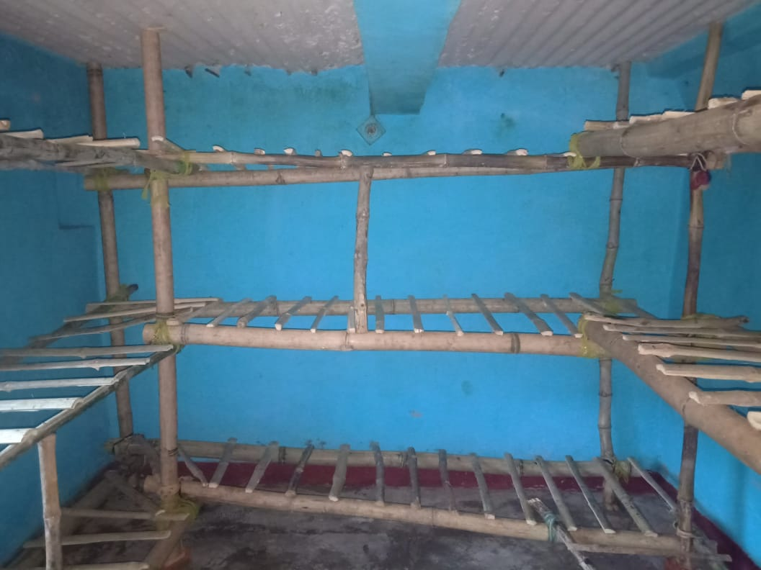
Racks setup
Racks size may vary according to bag size.
A 5 kg bag require rack of dimension 1.5m length of rack with width of 0.75m. The rack tier may vary.
The tier starts 6 inch above the ground.
Gaps are given around 1.5 feet and gap from wall is given around 1 foot for movement and proper aeration.

Slide 34
Humidifiers
BumbleBeeOrganics.farm
Sprinkler
Fogger

Slide 35
Measuring instrument
BumbleBeeOrganics.farm
Hygrometer
CO2 meter
Lux meter

Slide 36
Thank You
By:
School of BumbleBee Organics

