Slide 1
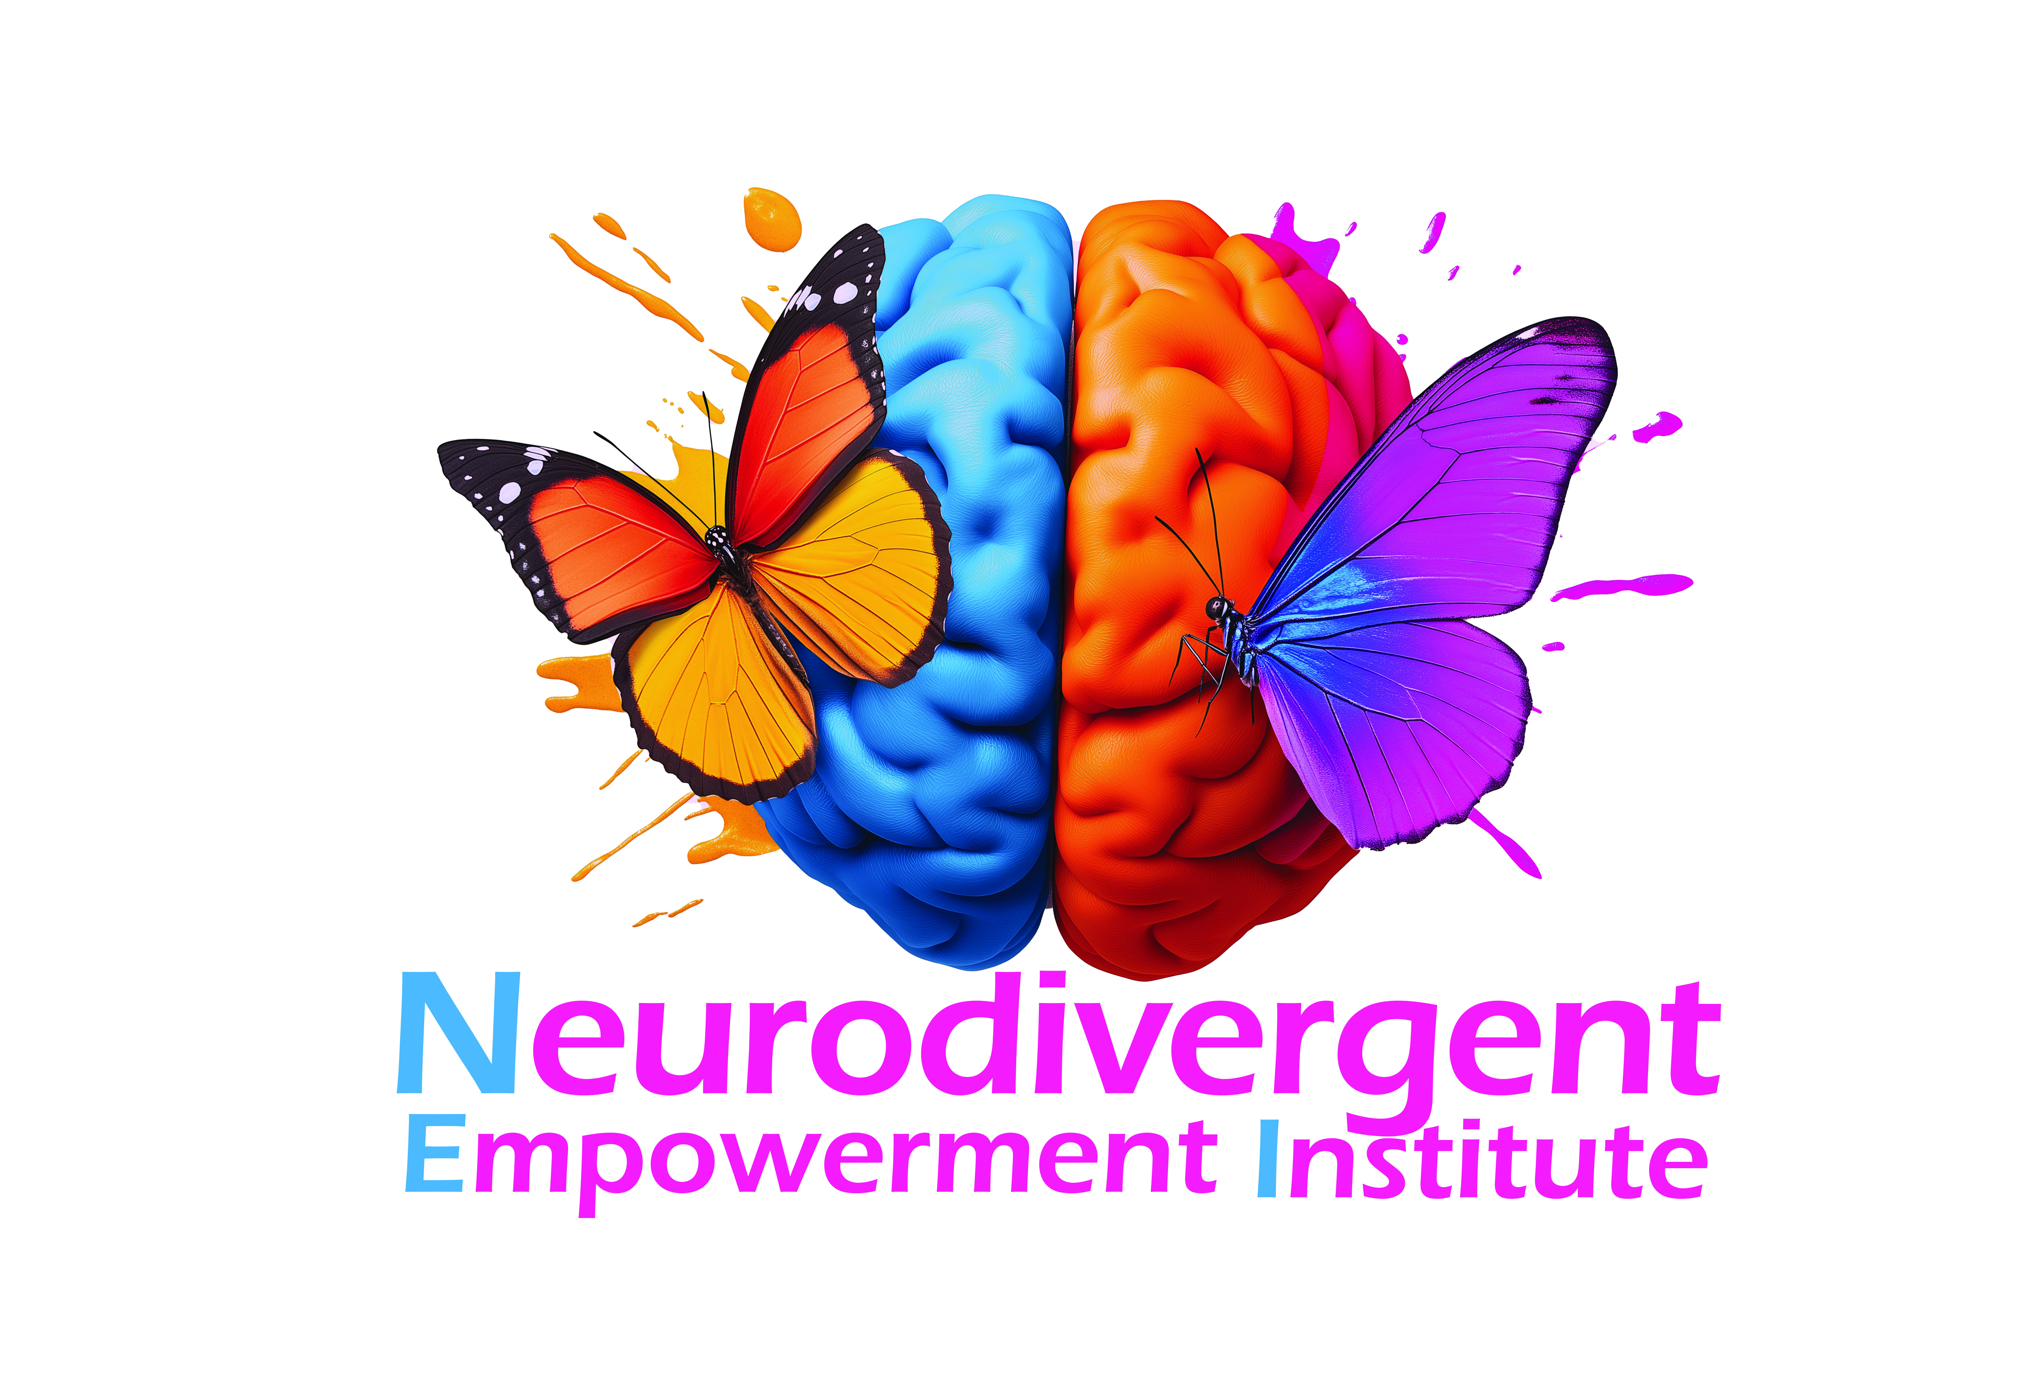
Module 1: Foundations of Neurodivergence
An Introduction to Neurodiversity, Its History, and Cultural Contexts
Notes:
Slide 1: Module 1: Foundations of Neurodivergence Welcome to Module 1: Foundations of Neurodivergence. In this module, we’ll delve into the rich and complex world of neurodiversity. Together, we’ll explore the science, history, and cultural contexts that shape our understanding of neurodivergence. Let’s begin.

Slide 2
Learning Objectives
1. Define neurodivergence and explain its diversity.
2. Identify historical and cultural influences on neurodivergent care.
Notes:
Slide 2: Learning Objectives By the end of this module, you’ll be able to:
Define neurodivergence and explain its diversity.
Identify historical and cultural influences on neurodivergent care.
Keep these goals in mind as we move through the content.

Slide 3
What is Neurodivergence?
Understanding neurodiversity as natural brain variation, not a disorder or deficit.
Notes:
What is Neurodivergence? Neurodivergence refers to the natural variation in human brain function. It’s not a disorder or deficit but rather a part of the diversity of human experiences. This perspective shifts us away from a medicalized view and towards acceptance and empowerment.
Evidence: Neurodiversity describes the idea that people experience and interact with the world around them in many different ways; there is no one "right" way of thinking, learning, and behaving, and differences are not viewed as deficits. (health.harvard.edu)
Engagement Tip: Ask participants what comes to mind when they hear the word neurodivergence.

Slide 4
Key Neurotypes
Examples: Autism, ADHD, Dyslexia, Dyspraxia, Tourette Syndrome, and more.
Notes:
Key Neurotypes Neurodivergence includes various neurotypes, such as Autism, ADHD, Dyslexia, Dyspraxia, Tourette Syndrome, and more. Each neurotype brings unique strengths and challenges. Understanding these differences helps us provide better care and support.
Evidence: Neurodiversity acknowledges that people with different neurological conditions, like autism, ADHD, dyslexia, and others, have unique strengths and ways of thinking. (diversity.social)

Slide 5
Neuroscience of Neurodivergence
Exploring brain structures, neural pathways, and cognitive processing styles.
Notes:
Neuroscience of Neurodivergence Understanding neurodivergence requires a closer look at its neuroscientific basis. Brain structures, neural pathways, and cognitive processing styles vary among neurodivergent individuals. These differences influence how people perceive and respond to the world.
Evidence: Neurodiversity is attributed to nature and nurture factors, and about a fifth of the human population is considered neurodiverse. (mdpi.com)

Slide 6
Brain Structure Differences
How different neurotypes show variation in brain connectivity and regions.
Notes:
Brain Structure Differences Research shows that neurodivergent individuals often have structural and functional differences in their brains. This may affect connectivity between brain regions, sensory processing, and emotional regulation.
Evidence: Neurodiversity is a concept and a social movement that addresses and normalizes human neurocognitive heterogeneity to promote acceptance and inclusion of neuro-minorities. (mdpi.com)
Engagement Tip: Share an example of how brain connectivity might affect sensory experiences.

Slide 7
Cognitive Processing Styles
Diverse ways of thinking, problem-solving, and perceiving the world.
Notes:
Cognitive Processing Styles Cognitive diversity is one of the hallmarks of neurodivergence. People process information, solve problems, and engage with the world in uniquely valuable ways. Recognizing these styles helps us adapt our therapeutic approaches.
Evidence: Neurodiversity honors each person's unique perspectives and experiences without judgment. (nm.org)

Slide 8
Neural Pathways and Connectivity
Differences in neural communication and sensory integration.
Notes:
Neural Pathways and Connectivity Differences in neural pathways and connectivity can explain why some individuals excel in areas like pattern recognition while struggling in others, such as executive functioning tasks. Our role is to support their strengths and address their challenges.
Evidence: Neurodiversity is attributed to nature and nurture factors, and about a fifth of the human population is considered neurodiverse. (mdpi.com)

Slide 9
Genetic and Epigenetic Factors
The role of genes and environmental influences in neurodivergence.
Notes:
Genetic and Epigenetic Factors Genetic predisposition plays a significant role in neurodivergence, but epigenetic factors—how the environment influences gene expression—also matter. This highlights the importance of creating supportive environments.
Evidence: Neurodiversity is attributed to nature and nurture factors. (mdpi.com)

Slide 10
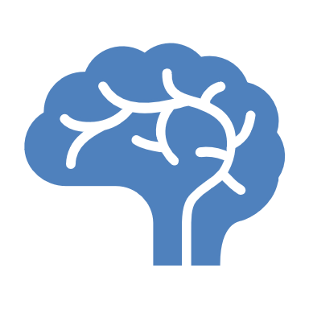
Neurotransmitters and Chemical Signaling
Impact of dopamine, serotonin, and other neurotransmitters.
Notes:
Neurotransmitters and Chemical Signaling Neurotransmitters like dopamine and serotonin play crucial roles in emotional regulation, focus, and mood. Imbalances or differences in these chemicals are often observed in neurodivergent individuals.
Evidence: Neurodiversity is attributed to nature and nurture factors. (mdpi.com)
Engagement Tip: Ask participants if they’ve seen how neurotransmitter differences affect clients in practice.

Slide 11
History of Neurodivergent Care
Key milestones in understanding and supporting neurodivergence.
Notes:
History of Neurodivergent Care Historically, neurodivergence was often misunderstood and pathologized. We’ve come a long way from institutionalization and harmful therapies to approaches centered on empowerment and respect.
Evidence: All early texts aimed at categorizing and pathologizing neurodivergent symptoms as deficiencies, seeking treatment to make neurodivergent people more 'normal'. (link.springer.com)

Slide 12
Medical Model vs. Social Model
Comparing deficit-based and strength-based approaches.
Notes:
Medical Model vs. Social Model The Medical Model views neurodivergence as something to be fixed. In contrast, the Social Model emphasizes removing barriers and creating inclusive environments. Our work aligns with the social model.
Evidence: The neurodiversity paradigm argues that diversity in neurocognition is part of humanity and that some neurodivergences generally classified as disorders are differences and disabilities that are not necessarily pathological. (en.wikipedia.org)

Slide 13
Evolution of Therapeutic Models
From behaviorism to empowerment-based therapies like EBiT.
Notes:
Evolution of Therapeutic Models
Therapeutic approaches have shifted significantly over time. Early interventions were often correction-based, aiming to make neurodivergent individuals conform to neurotypical norms. Modern approaches, such as Empowerment-Based Integrated Treatment (EBiT), focus on building on strengths, validating experiences, and fostering autonomy.
Evidence: Research supports strength-based therapeutic approaches, highlighting their effectiveness in improving well-being and self-acceptance in neurodivergent individuals (PubMed).
Engagement Tip: Ask participants to reflect on a therapeutic approach they have observed. Was it strength-based or correction-based?

Slide 14
Early Misconceptions
Historical misunderstandings and stigma surrounding neurodivergence.
Notes:
Early Misconceptions
Historically, neurodivergent traits were often misunderstood as intellectual deficiencies or moral failings. Autistic individuals were labeled as "unfeeling," while ADHD was seen as laziness. These misconceptions contributed to harmful interventions and societal stigma.
Evidence: The misconception of autism as a lack of empathy has been debunked by research showing autistic individuals often experience heightened emotional empathy (Frontiers in Psychology).
Engagement Tip: Ask participants to identify a common misconception they’ve encountered and discuss its impact on clients.

Slide 15
Advances in Research and Therapy
Current trends in neurodivergent care and therapy.
Notes:
Advances in Research and Therapy
Contemporary neurodivergent care emphasizes neuroplasticity, sensory integration, and individualized approaches. Therapies like play therapy, sensory-based interventions, and strength-focused coaching are gaining prominence.
Evidence: Recent studies show that sensory integration therapies can improve attention and self-regulation in autistic children (NCBI).
Engagement Tip: Ask participants if they’ve used sensory integration techniques in their practice.

Slide 16
Social and Cultural Considerations
How cultural attitudes shape neurodivergent experiences.
Notes:
Social and Cultural Considerations
Cultural contexts influence how neurodivergence is perceived and addressed. In some cultures, neurodivergent traits are seen as spiritual gifts, while others may stigmatize them. Effective care must be culturally informed and sensitive.
Evidence: A study on cultural views of autism revealed significant differences in acceptance and intervention approaches across global cultures (SpringerLink).
Engagement Tip: Ask participants to share cultural perspectives they’ve encountered in their work.

Slide 17
Stigma and Advocacy
Addressing stereotypes and promoting neurodivergent rights.
Notes:
Stigma and Advocacy
Stigma remains one of the biggest barriers to care for neurodivergent individuals. Advocacy efforts, including neurodiversity movements and awareness campaigns, play a crucial role in dismantling harmful stereotypes.
Evidence: Advocacy campaigns like #ActuallyAutistic have been instrumental in reshaping public perceptions of autism and empowering autistic voices (ResearchGate).
Engagement Tip: Discuss the role of advocacy in clinical settings and how therapists can be advocates.

Slide 18
Global Perspectives on Neurodivergence
How neurodivergence is perceived and supported globally.
Notes:
Global Perspectives on Neurodivergence
Support for neurodivergent individuals varies widely worldwide. Countries with inclusive education policies often report better outcomes. International collaborations are increasingly sharing best practices for neurodivergent care.
Evidence: The United Nations promotes inclusive education policies as a global standard for neurodivergent support (UNESCO).
Engagement Tip: Ask participants to share examples of effective policies or global initiatives they know about.

Slide 19
Intersectionality in Neurodivergence
Overlapping identities: race, gender, socioeconomic status.
Notes:
Intersectionality in Neurodivergence
Neurodivergent individuals often navigate overlapping identities, including race, gender, and socioeconomic status. Intersectionality highlights how these factors create unique challenges and opportunities for support.
Evidence: Research indicates that Black autistic individuals are often underdiagnosed or misdiagnosed due to systemic biases (JAMA Pediatrics).
Engagement Tip: Ask participants to discuss how intersectionality might affect therapeutic approaches.

Slide 20
Case Study: Intersectionality
Exploring real-world examples of intersectional experiences.
Notes:
Case Study: Intersectionality
Let’s consider a case study where neurodivergence intersects with race and gender identity. Reflect on how systemic barriers might have influenced diagnosis, intervention, and access to care.
Evidence: Intersectional approaches in therapy improve trust and therapeutic alliance, particularly in underserved populations (APA).
Engagement Tip: Break participants into small groups to analyze the case and share insights.

Slide 21
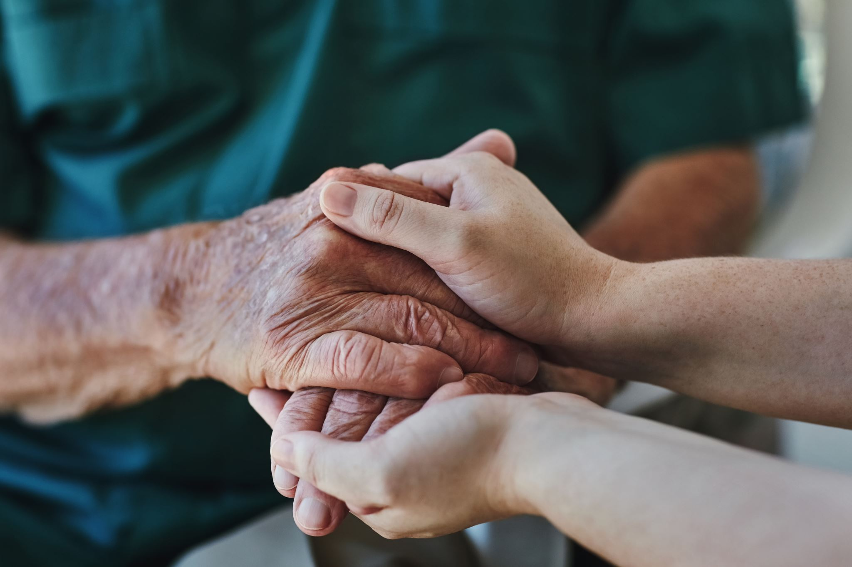
Empathy and Understanding
Fostering compassion and reducing judgment in care approaches.
Notes:
Empathy and Understanding
Empathy is central to supporting neurodivergent clients. Therapists must foster an environment of trust, openness, and acceptance to enable meaningful engagement.
Evidence: Studies show that client outcomes improve when therapists practice active listening and empathy-focused techniques (APA PsychNet).
Engagement Tip: Ask participants to share one technique they use to demonstrate empathy in sessions.

Slide 22
Empowerment-Based Integrated Treatment (EBiT)
The role of EBiT in supporting neurodivergent clients.
Notes:
Empowerment-Based Integrated Treatment (EBiT)
EBiT emphasizes Validate, Accept, Nurture as guiding principles for neurodivergent care. This approach fosters trust, resilience, and self-empowerment.
Evidence: Empowerment-focused interventions have shown higher rates of client satisfaction and improved emotional resilience (Sage Journals).
Engagement Tip: Ask participants to brainstorm ways to implement EBiT principles in their current practice.

Slide 23
Key Principles of EBiT
Validate, Accept, Nurture.
Notes:
Key Principles of EBiT
The three principles—Validate, Accept, Nurture—are the cornerstone of the EBiT model. Each principle builds trust and ensures clients feel seen, heard, and supported.
Evidence: Empathy and validation are key predictors of positive therapy outcomes (NCBI).

Slide 24
Therapeutic Alliance
Building trust and rapport with neurodivergent individuals.
Notes:
Therapeutic Alliance
Building trust and rapport with neurodivergent clients is essential. Authenticity, transparency, and consistent communication are foundational to this relationship.
Evidence: Research highlights that a strong therapeutic alliance predicts better treatment adherence and outcomes (PsycNET).
Engagement Tip: Share a brief example of how trust improved a therapeutic outcome in your practice.

Slide 25
Case Study Example
A practical application of EBiT principles in therapy.
Notes:
Case Study Example
Review a practical case study where EBiT principles were successfully implemented. Reflect on the challenges, successes, and key takeaways.
Engagement Tip: Invite participants to identify which principles they saw in action in the case.

Slide 26
Reflection Activity
Journaling: Reflect on personal biases and assumptions.
Notes:
Reflection Activity
Take a moment to journal about any biases or assumptions you’ve noticed in your work. How might these impact your therapeutic relationships?
Engagement Tip: Allow 3-5 minutes for journaling and invite volunteers to share insights.

Slide 27
Discussion Questions
1. What does neurodiversity mean to you?
2. How can you support neurodivergent clients more effectively?
Notes:
Discussion Questions
What does neurodiversity mean to you?
How can you better support neurodivergent clients?
Engagement Tip: Facilitate an open group discussion.

Slide 28
Key Takeaways
1. Neurodiversity is natural and valuable.
2. Cultural and social contexts shape neurodivergent experiences.
Notes:
Key Takeaways
Neurodiversity is natural and valuable.
Cultural and social contexts shape neurodivergent experiences.

Slide 29
Closing Thoughts
Thank you for engaging with Module 1: Foundations of Neurodivergence!
Notes:
Closing Thoughts
Thank participants for their engagement and encourage them to apply the principles from this module in their practice.

